Slide 1
Sorting
Data Structure and Algorithms

Slide 2
Outline
Sorting
Motivation
In-Place vs Non In-Place
Quadratic vs. Linearithmic
Insertion Sort
Selection Sort
Bubble Sort
Quick Sort
Merge Sort

Slide 3
Motivation
Sorting:
A process of arranging things in certain order
Motivation:
Few sample applications:
List of cities with largest populations
List of students in order of GPAs
Alphabetical list of words
Lexicographic order of dictionary
Files and folder arrangement in file explorer according to date, size, name etc.
0 | 1 | 2 | 3 | 4 | 5
8 | 20 | 15 | -5 | 7 | -55
0 | 1 | 2 | 3 | 4 | 5
-55 | -5 | 7 | 8 | 15 | 20

Slide 4
In-Place vs. Not-In-Place Sorting
In-Place:
An in-place algorithm transforms an input into output with a constant amount of extra storage space
In the context of sorting, this means that the input array converted to sorted array without using a new array. Like
Selection Sort
Bubble Sort
Insertion Sort
Heap Sort
Not-In-Place:
Just opposite of in-place, requires amount of extra space proportional to size of input, in case of sorting it will be an additional array. Like
Merge Sort

Slide 5
Stability
If list contains many equal numbers, then there can be multiple correct sorted solutions
For example if we sort the list of three words {apple, chair, king} according to word length, then two possible solutions are:
{king, chair, apple}
{king, apple, chair}
A sorting algorithm is stable if relative position of equal elements in output is equal to their relative position in input.
Stable sorted solution of above list is {king, apple, chair}

Slide 6
Time Complexity
Quadratic→ O(n²)
Selection Sort
Bubble Sort
Insertion Sort
Linearithmic → O(nlogn)
Quick Sort
Merge Sort
Heap Sort
Linear→ O(n)
Bucket Sort
Counting Sort
Radix Sort

Slide 7
Comparison vs Non Comparison Sorting
Sorting by comparing values as whole to each other. Complete data values are compared without any kind of assumptions about them.
Selection Sort
Insertion Sort
Bubble Sort
Quick Sort
Merge Sort
Heap Sort
Non-Comparison sorting sorts the numbers with partial comparison and may assume some constraints about data.
Bucket Sort
Counting Sort
Radix Sort

Slide 8
Selection Sort
Iterative and in-place
Main Idea
Selects the smallest element of the array and places it at index 0, then selects the second smallest and places it in index 1, then the third smallest in index 2, etc..
So at any time there are two partitions of list:
One that is sorted
One that is unsorted
Advantages:
Very simple
Memory efficient: in-place means swapping elements within same array
Disadvantages:
Slow: runs in quadratic O(n2) time

Slide 9
Selection Sort
0 | 1 | 2 | 3 | 4 | 5
8 | 20 | 15 | -5 | 7 | -55
0 | 1 | 2 | 3 | 4 | 5
-55 | 20 | 15 | -5 | 7 | 8
Swap
0 | 1 | 2 | 3 | 4 | 5
-55 | -5 | 15 | 20 | 7 | 8
0 | 1 | 2 | 3 | 4 | 5
-55 | -5 | 7 | 20 | 15 | 8
0 | 1 | 2 | 3 | 4 | 5
-55 | -5 | 7 | 8 | 15 | 20
0 | 1 | 2 | 3 | 4 | 5
-55 | -5 | 7 | 8 | 15 | 20
0 | 1 | 2 | 3 | 4 | 5
-55 | -5 | 7 | 8 | 15 | 20

Slide 10
Selection Sort
Algorithm: SELECTIONSORT(A[], N)
Input: an array of size N
Output: sorted array
Steps:
Let pos_min=-1;
for(count=0; count<N; count++)
//find minimum
pos_min=count //consider 1st element of remaining array minimum
for(index=count; index < N; index++)
if (A[index]<A[pos_min])
pos_min=index
End if
End loop
//swap the min with value at count
tmp=A[pos_min]
A[pos_min]=A[count]
A[count]=tmp
End loop

Slide 11
Insertion Sort
Iterative and in-place
Main Idea
Arranges items one at a time by comparing each element with every element before it and inserting it into the correct position
Advantages:
Works particularly well if the list is already partially sorted
Memory efficient: in-place
Disadvantages:
Slow: runs in quadratic O(n2) time.

Slide 12
Insertion Sort
Find 1st number that is < its previous number, means it is incorrect position, find its correct location by comparing it with numbers on left side. Shift numbers to right. Place number at founded location
0 | 1 | 2 | 3 | 4 | 5
8 | 20 | 15 | -5 | 7 | -55
0 | 1 | 2 | 3 | 4 | 5
8 | 15 | 20 | -5 | 7 | -55
0 | 1 | 2 | 3 | 4 | 5
-5 | 8 | 15 | 20 | 7 | -55
0 | 1 | 2 | 3 | 4 | 5
-5 | 7 | 8 | 15 | 20 | -55
0 | 1 | 2 | 3 | 4 | 5
-55 | -5 | 7 | 8 | 15 | 20

Slide 13
Insertion Sort
Algorithm: INSERTIONSORT(A[], N)
Input: an array of size N
Output: sorted array
Steps:
for(count=1; count<N; count++)
v=A[count]
j=count
while(A[j-1]>v and j>0) //find the correct position
A[j] = A[j-1])
j--
End While
A[j]=v //store v at correct position
End loop

Slide 14
Bubble Sort
Iterative and in-place
Main Idea
Arranges items from first element to last, comparing each pair of elements and swapping their positions if needed.
Advantages:
Very simple
Memory efficient: in-place
Disadvantages:
Slow: runs in quadratic O(n2) time.

Slide 15
Bubble Sort
First iteration
One number is placed at right position. Now we need to repeat the same process on remaining list (Orange part is sorted)
0 | 1 | 2 | 3 | 4 | 5
8 | 20 | 15 | -5 | 7 | -55
0 | 1 | 2 | 3 | 4 | 5
8 | 20 | 15 | -5 | 7 | -55
0 | 1 | 2 | 3 | 4 | 5
8 | 15 | 20 | -5 | 7 | -55
0 | 1 | 2 | 3 | 4 | 5
8 | 15 | -5 | 20 | 7 | -55
0 | 1 | 2 | 3 | 4 | 5
8 | 15 | -5 | 7 | 20 | -55
0 | 1 | 2 | 3 | 4 | 5
8 | 15 | -5 | 7 | -55 | 20

Slide 16
Bubble Sort
2nd iteration
Another number is placed at right position. Now sorted list contain two numbers.
0 | 1 | 2 | 3 | 4 | 5
8 | 15 | -5 | 7 | -55 | 20
0 | 1 | 2 | 3 | 4 | 5
8 | 15 | -5 | 7 | -55 | 20
0 | 1 | 2 | 3 | 4 | 5
8 | -5 | 15 | 7 | -55 | 20
0 | 1 | 2 | 3 | 4 | 5
8 | -5 | 7 | 15 | -55 | 20
0 | 1 | 2 | 3 | 4 | 5
8 | -5 | 7 | -55 | 15 | 20

Slide 17
Bubble Sort
3rd iteration 4th iteration
0 | 1 | 2 | 3 | 4 | 5
8 | -5 | 7 | -55 | 15 | 20
0 | 1 | 2 | 3 | 4 | 5
-5 | 7 | -55 | 8 | -15 | 20
0 | 1 | 2 | 3 | 4 | 5
-5 | 8 | 7 | -55 | 15 | 20
0 | 1 | 2 | 3 | 4 | 5
-5 | 7 | -55 | 8 | 15 | 20
0 | 1 | 2 | 3 | 4 | 5
-5 | 7 | 8 | -55 | 15 | 20
0 | 1 | 2 | 3 | 4 | 5
-5 | -55 | 7 | 8 | 15 | 20
0 | 1 | 2 | 3 | 4 | 5
-5 | 7 | -55 | 8 | -15 | 20

Slide 18
Bubble Sort
5th iteration 6th iteration
0 | 1 | 2 | 3 | 4 | 5
-5 | -55 | 7 | 8 | 15 | 20
0 | 1 | 2 | 3 | 4 | 5
-55 | -5 | 7 | 8 | 15 | 20
0 | 1 | 2 | 3 | 4 | 5
-55 | -5 | 7 | 8 | 15 | 20

Slide 19
Bubble Sort
Algorithm: BUBBLESORT(A[], N)
Input: an array of size N
Output: sorted array
Steps:
for(count=N; count>=0; count--) //Outer loop to count iteration
for(index=0; index < count; index++) //Inner loop for swaps
if (A[index]<A[index+1])
temp = A[index]
A[index] = A[index+1]
A[index+1] = temp
End if
End loop
End loop

Slide 20
Divide and Conquer
Divide-and-conquer is a general algorithm design paradigm:
Divide: divide the input data S into disjoint subsets S₁, S₂, …, S_{k}
Recur: solve the sub problems associated with S₁, S₂, …, S_{k}
Conquer: combine the solutions for S₁, S₂, …, S_{k} into a solution for S
The base case for the recursion is generally sub problems of size 0 or 1
There are certain sorting algorithms which works in this way:
Merge sort
Quick sort

Slide 21
Merge Sort
Merge sort is a sorting algorithm based on the divide-and-conquer paradigm
Like the quadratic sorts, merge sort is comparative
Merge sort is recursive and runs in O(n log n) time
Main Idea:
Divide: partition list A of size N into two halves left and right of size N/2
Recur: sort the left and right half recursively
Conquer: merge the sorted left and right halves into a sorted sequence
Advantages
Efficient, requires nlogn time
Disadvantages
Not in-place, require O(N) extra space for merging
In-Place solutions do exist but more complex

Slide 22
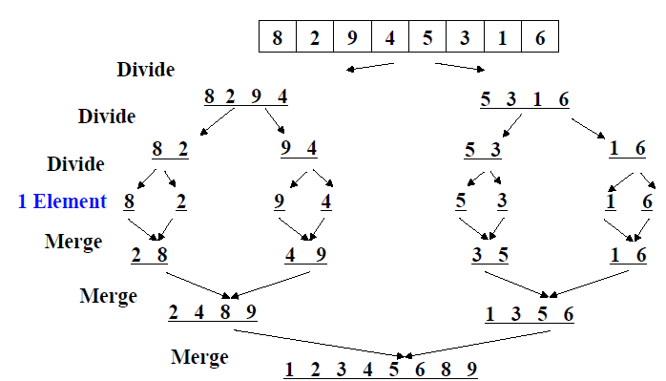
Merge Sort
If a list has 1 element or 0 elements it is sorted
If a list has more than 2 elements, split into 2 separate lists
Perform this algorithm on each of those smaller lists
Take the 2 sorted lists and merge them together

Slide 23
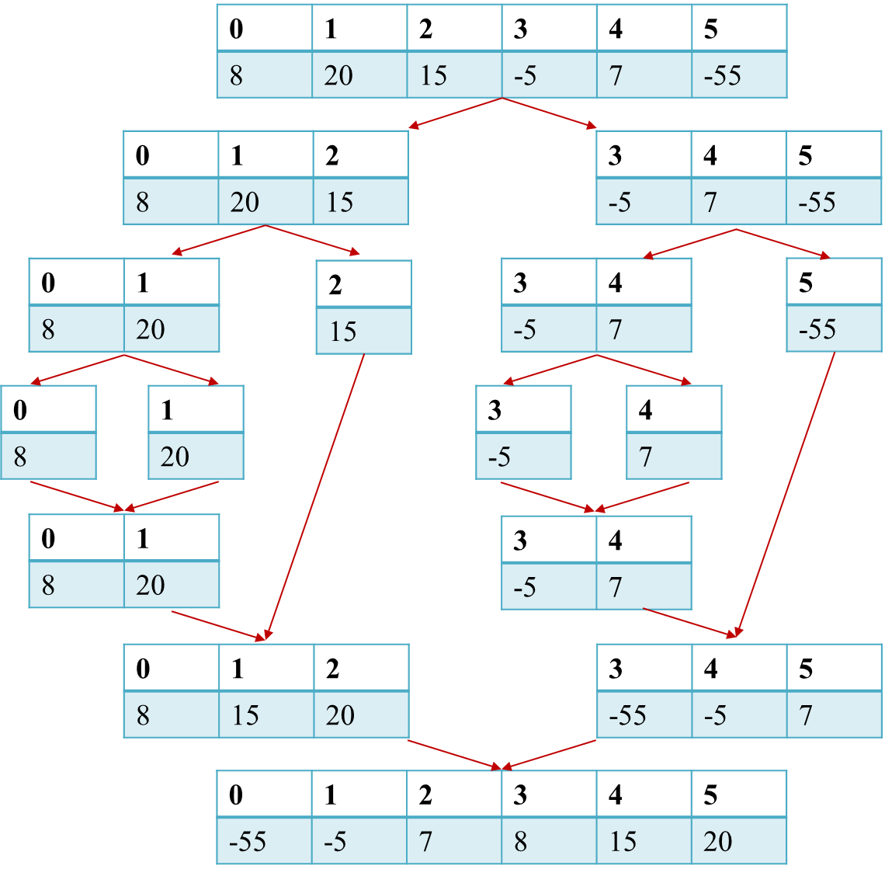

Slide 24
Merge Sort
Algorithm: MERGESORT(A[], start, end)
Steps:
If (end-start+1)<2 //if size of array is 0 or 1
return A
Else
mid=(start+end)/2
MERGESORT(A, start, mid)
MERGESORT(A,mid+1, end)
MERGE(A, start, mid,end)
End if

Slide 25
Merge Sort
MERGE(A[], start, mid, end)
n1 = mid-start+1
n2=end-mid
left[n1], right[n2]
i=start, j=mid+1
//make copy of left and right half
For i=0; i<n1; i++
left[i]=A[start+i]
End For
For j=0;j<n2;j++
right[j]=arr1[j+mid+1]
End For
i=0, j=0, k=start
While i<n1 and j<n2
if left[i]<=right[j]
A[k]=left[i]
i=i+1
Else
A[k]=right[j]
j=j+1
End if
k=k+1
End While
While i<n1 //copy rest of left half
A[k]=left[i]
k++, i++
End While
While j<n2 //copy rest of right half
A[k]=right[j]
k++, j++
End While

Slide 26
Quick Sort
Quick sort is another sorting algorithm based on the divide-and-conquer paradigm.
Divide: pick an element as pivot and partition list A into
elements less than pivot
elements greater than pivot
Recur: quicksort both divisions
Conquer: a sorted list in order of less than pivot, pivot and greater than pivot elements
Although merge sort is O(n log n), it is quite inconvenient for implementation with arrays, since we need extra space to merge.
In practice, the fastest sorting algorithm is Quicksort, which uses partitioning as its main idea.

Slide 27
Quick Sort
Let say 1st element is selected as pivot.
Get the smaller numbers
Get the larger numbers
Recursively do same process on smaller half and larger half, till size is 1.
Sorted list= smaller + Pivot + Larger
37
11
56
75
9
45
2
21
89
11
61
38
<pivot
pivot
>pivot
11
9
2
21
11
37
56
75
45
89
61
38
11
9
2
21
11
56
75
45
89
61
38
9
2
11
21
11
45
38
56
75
89
61
<pivot
pivot
>pivot
<pivot
pivot
>pivot

Slide 28
Quick Sort
37
11
56
75
9
45
2
21
89
11
61
38
11
9
2
21
11
37
56
75
45
89
61
38
11
9
2
21
11
37
56
75
45
89
61
38
9
2
11
21
11
37
45
38
56
75
89
61
9
2
11
21
11
37
45
38
56
75
89
61
2
9
11
11
21
37
38
45
56
61
75
61
2
9
11
11
21
37
38
45
56
61
75
61
2
9
11
11
21
37
38
45
56
61
75
61

Slide 29
Quick Sort
How to choose pivot?
First element or Last element
Middle element
Randomly selected element
Mid of low, mid and high index
How to do partition?
Elements that are less than pivot are shifted to left side of pivot
Elements that are greater than pivot are shifted to right side of pivot
Different variations are present.
Two commonly used algo’s are discussed here.

Slide 30
Quick Sort-1
Algorithm: QUICKSORT(A[], start, end)
Steps:
If (start>=end)//base case, arraysize is 0 or 1
return
Else
pivot_index=PARTITION(A, start, end)
QUICKSORT(A, start, pivot_index-1)
QUICKSORT(A,pivot_index+1, end)
End if
This is known as lomuto partitioning scheme.
https://en.wikipedia.org/wiki/Quicksort#Lomuto_partition_scheme
PARTITION(A[], left, right)
pivot=A[right]
//shift numbers, most tricky part
i=left; j=left
For j=left; j< right; j++ //start from left
If A[j]<=pivot //move smaller numbers to left of list
swap(A[i],A[j])
i=i+1
End If
j=j+1
End For
swap(A[i], pivot)
return i
// i is the pivot location after moving smaller and larger numbers

Slide 31
Quick Sort-1
Pivot=A[right], i=left
For j=left; j< right; j++
If (A[j] <= pivot)
Swap (A[i], A[j])
increment i
End If
End For
Swap (A[i], pivot)
return i //→pivot_index
left, i, j
right
0 | 1 | 2 | 3 | 4 | 5
8 | 20 | 15 | -5 | 7 | -55
left, i
j
right
0 | 1 | 2 | 3 | 4 | 5
8 | 20 | 15 | -5 | 7 | -55
0 | 1 | 2 | 3 | 4 | 5
-55 | 20 | 15 | -5 | 7 | 8

Slide 32
Quick Sort-1
Pivot=A[right], i=left
For j=left; j< right; j++
If (A[j] <= pivot)
Swap (A[i], A[j])
increment i
End If
End For
Swap (A[i], pivot)
return i //→pivot_index
left, i, j
right
0 | 1 | 2 | 3 | 4 | 5
-55 | 20 | 15 | -5 | 7 | 8
left, i
j
right
0 | 1 | 2 | 3 | 4 | 5
-55 | 20 | 15 | -5 | 7 | 8
left
i
j
right
0 | 1 | 2 | 3 | 4 | 5
-55 | -5 | 15 | 20 | 7 | 8
left
i
j
right
0 | 1 | 2 | 3 | 4 | 5
-55 | -5 | 7 | 20 | 15 | 8
0 | 1 | 2 | 3 | 4 | 5
-55 | -5 | 7 | 8 | 15 | 20

Slide 33
Quick Sort-1
Complete Working
0 | 1 | 2 | 3 | 4 | 5
8 | 20 | 15 | -5 | 7 | -55
Array is shown after each call to Partition method
0 | 1 | 2 | 3 | 4 | 5
-55 | 20 | 15 | -5 | 7 | 8
0 | 1 | 2 | 3 | 4 | 5
-55 | -5 | 7 | 8 | 15 | 20
0 | 1 | 2 | 3 | 4 | 5
-55 | -5 | 7 | 8 | 15 | 20
0 | 1 | 2 | 3 | 4 | 5
-55 | -5 | 7 | 8 | 15 | 20

Slide 34

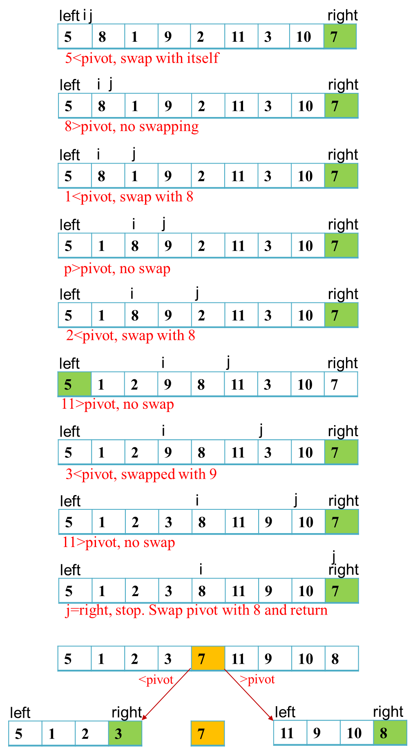
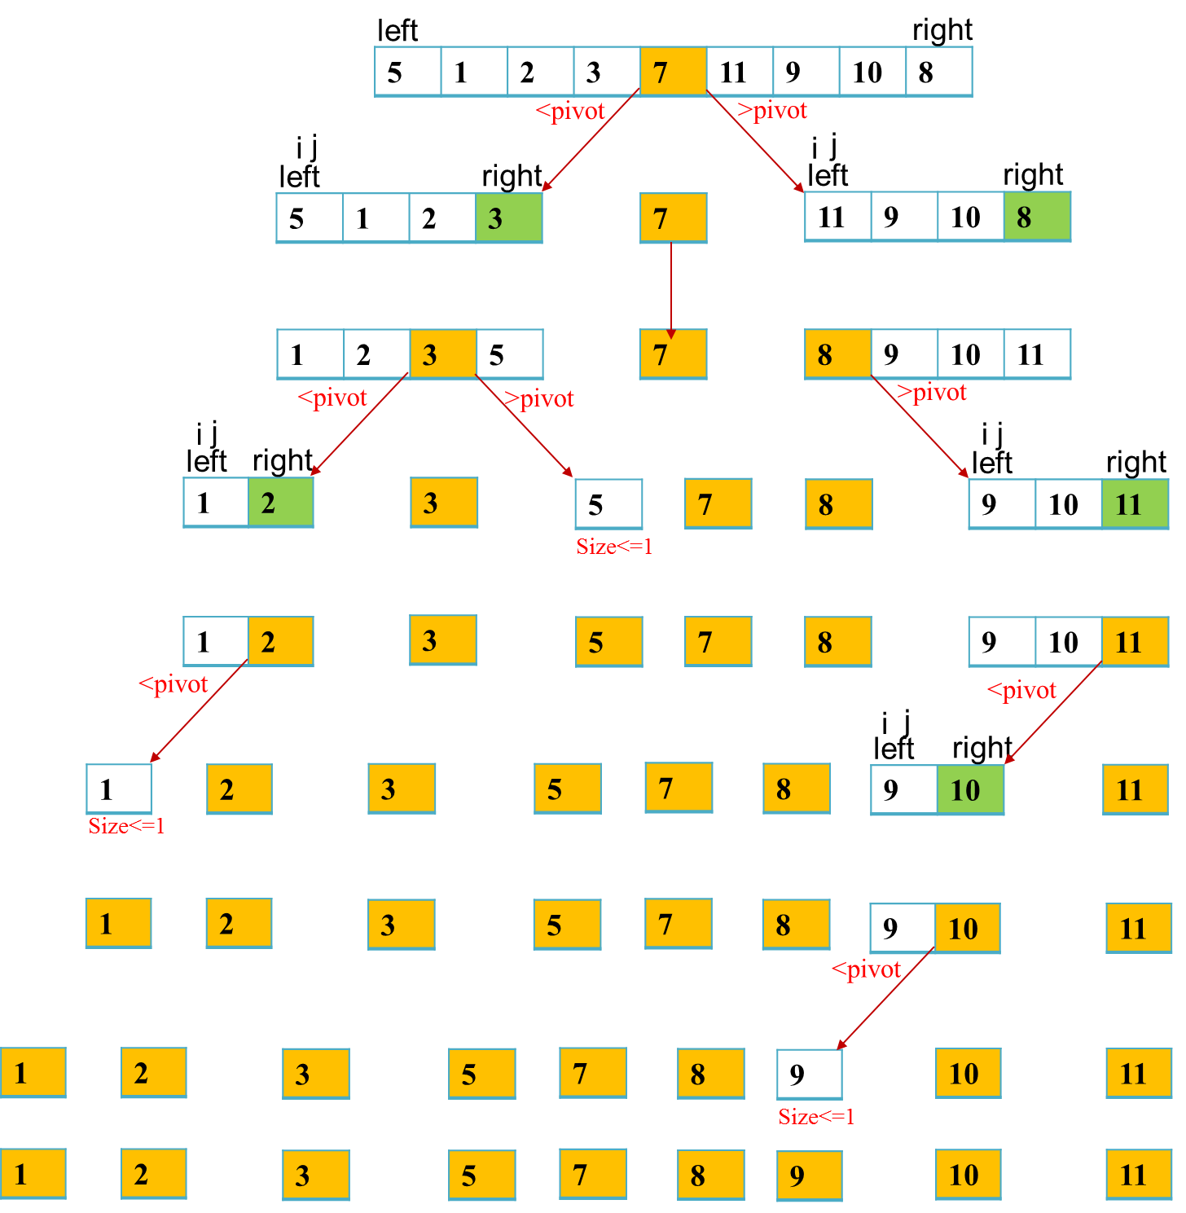
All steps for 1st call are shown in detail.
For Subsequent calls only input and final output is shown
1st call to Partition method
2 more calls to
Partition method
2 more calls to
Partition method
1 more calls to
Partition method

Slide 35
Quick Sort-2
Algorithm: QUICKSORT(A[], start, end)
Steps:
If (start>=end)//base case, arraysize is 0 or 1
return
Else
pivot_index=PARTITION(A, start, end)
QUICKSORT(A, start, pivot_index)
QUICKSORT(A,pivot_index+1, end)
End if
A variation of Hoare’s partitioning scheme.
https://en.wikipedia.org/wiki/Quicksort#Hoare_partition_scheme
PARTITION(A[], left, right)
pivot=A[left]
//shift numbers, most tricky part
i=start; j=end
while (true)
while (A[i]< pivot )
i++
while (A[j] >pivot)
j--
If i<j //swap
temp=A[i]
A[i]=A[j]
A[j]=temp
if(A[i]==A[j]) //otherwise loop will never end
i=i+1
Else
return j
End if
End While

Slide 36
Quick Sort-2
left, i
right, j
Pivot=A[left], i=left, j=right
While(true)
While(A[i]<pivot)
i=i+1
While(A[j]>pivot)
j=j-1
If(i<j)
Swap (A[i], A[j])
Else
return j//→pivot_index
0 | 1 | 2 | 3 | 4 | 5
8 | 20 | 15 | -5 | 7 | -55
left, i
right, j
0 | 1 | 2 | 3 | 4 | 5
-55 | 20 | 15 | -5 | 7 | 8
left
i
j
right
0 | 1 | 2 | 3 | 4 | 5
-55 | 8 | 15 | -5 | 7 | 20
left
i
j
right
0 | 1 | 2 | 3 | 4 | 5
-55 | 7 | 15 | -5 | 8 | 20
left
i
j
right
left
i
j
right
0 | 1 | 2 | 3 | 4 | 5
-55 | 7 | -5 | 8 | 15 | 20
0 | 1 | 2 | 3 | 4 | 5
-55 | 7 | 8 | -5 | 15 | 20

Slide 37
Quick Sort-2
Complete Working
0 | 1 | 2 | 3 | 4 | 5
8 | 20 | 15 | -5 | 7 | -55
0 | 1 | 2 | 3 | 4 | 5
-55 | 7 | -5 | 8 | 15 | 20
0 | 1 | 2 | 3 | 4 | 5
-55 | -5 | 7 | 8 | 15 | 20
0 | 1 | 2 | 3 | 4 | 5
-55 | -5 | 7 | 8 | 15 | 20
0 | 1 | 2 | 3 | 4 | 5
-55 | -5 | 7 | 8 | 15 | 20

Slide 38
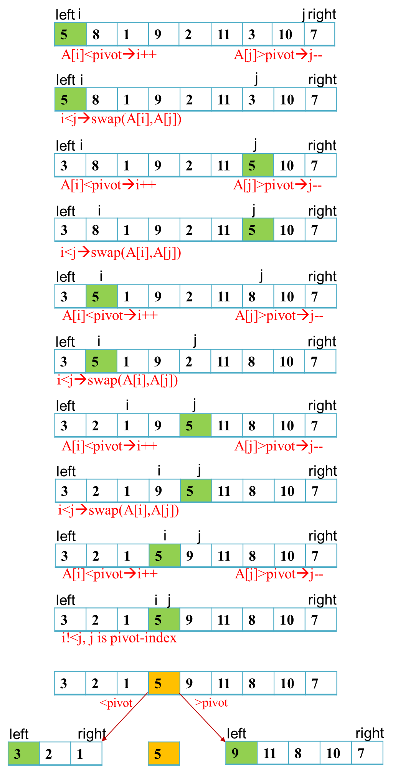
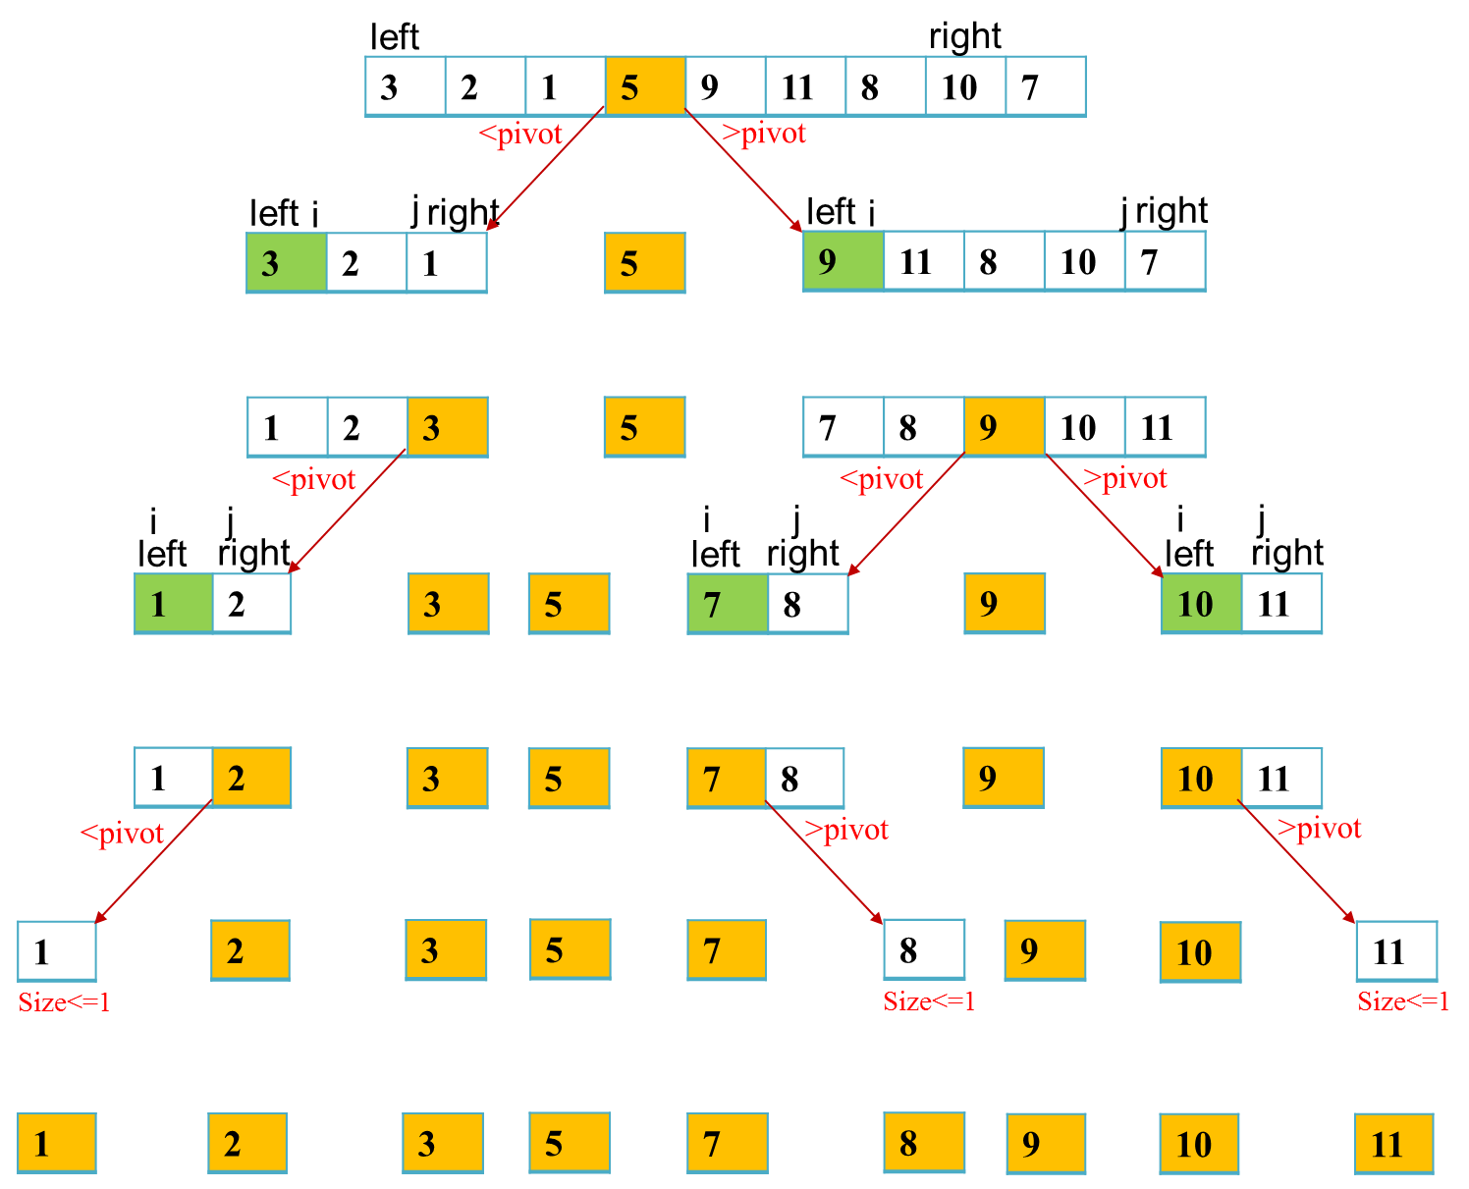
All steps for 1st call are shown in detail.
For Subsequent calls only input and final output is shown
1st call to
Partition method
2 more calls to
Partition method
3 more calls to
Partition method

Slide 39
Heap Sort
Heap sort is another recursive algorithm to sort the numbers using heap concept.
Main Idea:
Build the heap from given list of numbers
Repeatedly swap the root with last element of heap until list is sorted.
Advantages
Time efficient-O(NlogN)
In-Place
Disadvantages
Uses an additional data structure-heap

Slide 40
Heap Sort
1st step: Building Heap
Start from middle location and go to start
Assume it as parent
Find index of maximum of parent, its left and right child
If parent is not maximum
swap parent with maximum
repeat step(2) on maximum index
0 | 1 | 2 | 3 | 4 | 5 | 6 | 7 | 8
23 | 1 | 6 | 19 | 14 | 18 | 8 | 24 | 15
0 | 1 | 2 | 3 | 4 | 5 | 6 | 7 | 8
23 | 1 | 6 | 19 | 14 | 18 | 8 | 24 | 15

Slide 41
Heap Sort
Middle location=4 to 0
P=4, No left, right child
P=3, L=7, R=8
Max= 7
Swap P and Max
Now P=Max=7, no left, right child
P=2, L=5,R=6
Max=5
Swap P and Max
Now P=5, no left, right child
0 | 1 | 2 | 3 | 4 | 5 | 6 | 7 | 8
23 | 1 | 6 | 19 | 14 | 18 | 8 | 24 | 15
0 | 1 | 2 | 3 | 4 | 5 | 6 | 7 | 8
23 | 1 | 6 | 19 | 14 | 18 | 8 | 24 | 15
0 | 1 | 2 | 3 | 4 | 5 | 6 | 7 | 8
23 | 1 | 6 | 24 | 14 | 18 | 8 | 19 | 15
0 | 1 | 2 | 3 | 4 | 5 | 6 | 7 | 8
23 | 1 | 6 | 24 | 14 | 18 | 8 | 19 | 15
0 | 1 | 2 | 3 | 4 | 5 | 6 | 7 | 8
23 | 1 | 18 | 24 | 14 | 6 | 8 | 19 | 15

Slide 42
Heap Sort
P=1, L=3,R=4
Max=3
Swap P and Max
Now P=3, L=7, R=8
Max=7
Swap P and Max
Now P= 7, No left, right
P=0, L=1,R=2
Max=1
Swap P and Max
Now P= 1, L=3, R=4
Max=1=P, No need of swapping,
List is finished
0 | 1 | 2 | 3 | 4 | 5 | 6 | 7 | 8
23 | 1 | 18 | 24 | 14 | 6 | 8 | 19 | 15
0 | 1 | 2 | 3 | 4 | 5 | 6 | 7 | 8
23 | 24 | 18 | 1 | 14 | 6 | 8 | 19 | 15
0 | 1 | 2 | 3 | 4 | 5 | 6 | 7 | 8
23 | 24 | 18 | 19 | 14 | 6 | 8 | 1 | 15
0 | 1 | 2 | 3 | 4 | 5 | 6 | 7 | 8
23 | 24 | 18 | 19 | 14 | 6 | 8 | 1 | 15
0 | 1 | 2 | 3 | 4 | 5 | 6 | 7 | 8
24 | 23 | 18 | 19 | 14 | 6 | 8 | 1 | 15

Slide 43
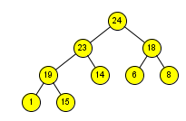
Heap Sort
Array is converted into a heap.
Now comes the 2nd part.
Swap the root with last element of heap
15 will go on top
Heap size will be reduced.
Heapify 15 to rebuild heap order.
Repeatedly do the same process, until heap size becomes 1.
0 | 1 | 2 | 3 | 4 | 5 | 6 | 7 | 8
23 | 1 | 6 | 19 | 14 | 18 | 8 | 24 | 15
0 | 1 | 2 | 3 | 4 | 5 | 6 | 7 | 8
24 | 23 | 18 | 19 | 14 | 6 | 8 | 1 | 15

Slide 44
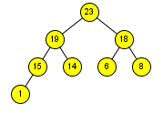
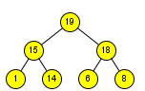
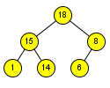
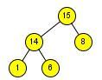
Heap Sort
Swap root with last element of heap, rebuild heap
0 | 1 | 2 | 3 | 4 | 5 | 6 | 7 | 8
23 | 19 | 18 | 15 | 14 | 6 | 8 | 1 | 24
0 | 1 | 2 | 3 | 4 | 5 | 6 | 7 | 8
19 | 15 | 18 | 1 | 14 | 6 | 8 | 23 | 24
0 | 1 | 2 | 3 | 4 | 5 | 6 | 7 | 8
18 | 15 | 8 | 1 | 14 | 6 | 19 | 23 | 24
0 | 1 | 2 | 3 | 4 | 5 | 6 | 7 | 8
15 | 14 | 8 | 1 | 6 | 18 | 19 | 23 | 24

Slide 45
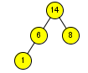



Heap Sort
0 | 1 | 2 | 3 | 4 | 5 | 6 | 7 | 8
14 | 6 | 8 | 1 | 15 | 18 | 19 | 23 | 24
0 | 1 | 2 | 3 | 4 | 5 | 6 | 7 | 8
8 | 6 | 1 | 14 | 15 | 18 | 19 | 23 | 24
0 | 1 | 2 | 3 | 4 | 5 | 6 | 7 | 8
6 | 1 | 8 | 14 | 15 | 18 | 19 | 23 | 24
0 | 1 | 2 | 3 | 4 | 5 | 6 | 7 | 8
1 | 6 | 8 | 14 | 15 | 18 | 19 | 23 | 24
0 | 1 | 2 | 3 | 4 | 5 | 6 | 7 | 8
1 | 6 | 8 | 14 | 15 | 18 | 19 | 23 | 24

Slide 46
Heap Sort
Algorithm: HEAP_SORT(A[], N)
buildMaxHeap(A,N)
For i= N-1; i>1; i--
swap(A[0], A[i])
maxHeapify(A, 0, i)
End For
Algorithm: buildMaxHeap(A[], N)
For i= N/2; i>=0; i--
maxHeapify(A, i, N)
End For
Algorithm: maxHeapify(A[], i, N)
L=2*i+1
R=2*i+2
if L<N and A[L]>A[i]
largest=L
else
largest= i
If R<N and A[R]> A[largest]
largest=R
If(largest != i)
Swap(A[i], A[largest])
maxHeapify(A, largest, N)
End If

Slide 47
Comparison
http://www.cprogramming.com/tutorial/computersciencetheory/sortcomp.html
 | Worst Case | Best Case | In-Place | Stable
Selection | O(n²) | O(n²) | Yes | No
Insertion | O(n²) | O(n²) | Yes | Yes
Bubble | O(n²) | O(n²) | Yes | Yes
Quick | O(n²) | O(n logn) | Yes | No
Merge | O(n logn) | O(n logn) | No | Yes
Heap | O(n logn) | O(n logn) | Yes | No

