Slide 1
COMPREHENSIVE FEASIBILITY REPORT
AI-Enabled Clinical Data & Rehabilitation Management Platform
Web Platform • Native Android App • AI Clinical Analytics • AI & Dynamic Scheduling • Multi-Channel WhatsApp Booking • Anomaly Detection & Security
Prepared for AL-Nafay E-Services | August 2026

Slide 2
AGENDA
What This Report Covers
01
Executive Summary
06
UI/UX Approach
02
Project Scope
07
Implementation Timeline
03
Technical Architecture
08
Cost Estimation
04
Integration Feasibility
09
Risk Assessment
05
Infrastructure & Hardware
10
Recommendations & Conclusion
Clinical Rehab Platform — Feasibility
2

Slide 3
EXECUTIVE SUMMARY
A Feasible, Phased Path to a Unified Platform
A single backend can power a responsive website, a native Android app, dual dashboards, and three synchronized booking channels — using mature, cost-effective technology on commodity infrastructure. AI analytics and scheduling are layered in as clinical data accumulates.
TECHNICAL
OPERATIONAL
ECONOMIC
SECURITY/COMPLIANCE
SCHEDULE
Feasible
Feasible
Feasible (phased)
Feasible with controls
8–10 wks MVP
Mature web, mobile, WhatsApp & AI tooling available
Needs training + phased pilot rollout
MVP-first approach controls upfront cost
Encryption, RBAC, anomaly detection built-in
Full platform in 6–7 months
Clinical Rehab Platform — Feasibility
3

Slide 4
PROJECT SCOPE
Four Functional Layers
Clinical & Operational Core
Intelligence Layer
Experience Layer
Booking & Security
• Centralized patient records & rehab plans
• AI clinical analytics & plateau-risk detection
• Patient & management dashboards
• WhatsApp chat + WhatsApp AI agent + online booking
• Longitudinal tracking of assessments & outcomes
• AI & dynamic scheduling optimization
• Responsive website + native Android app
• Real-time conflict-free synchronization
• Automated cycle reporting (daily → yearly)
• Trend-based forecasting
• Professional, English-first, multilingual-ready UI
• Encryption, RBAC & continuous anomaly detection
Clinical Rehab Platform — Feasibility
4

Slide 5
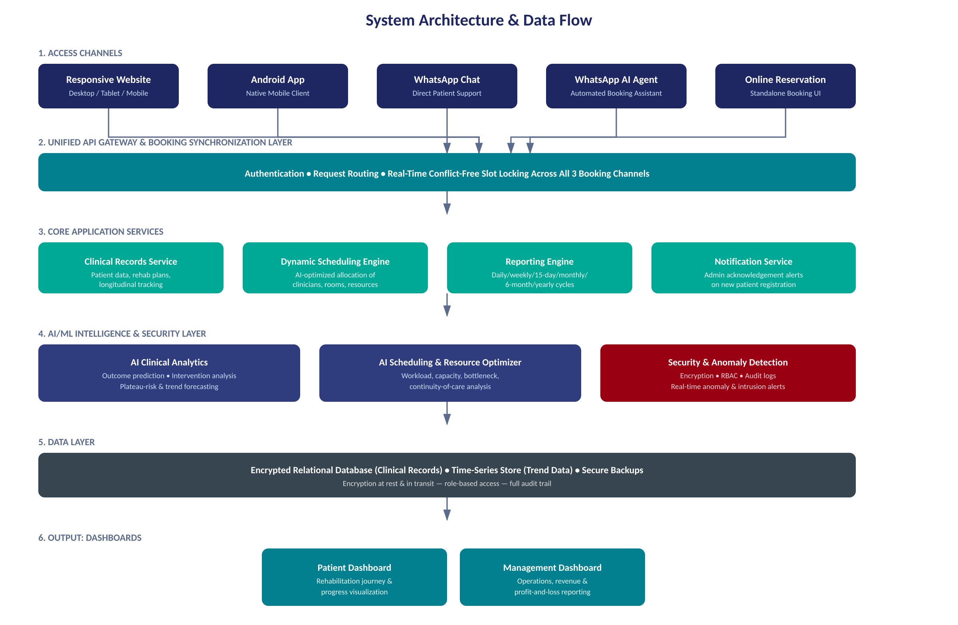
TECHNICAL ARCHITECTURE
System Architecture & Data Flow
Clinical Rehab Platform — Feasibility
5

Slide 6
PLATFORM REQUIREMENTS
Recommended Technology Stack
Layer | Recommendation | Why
Website | React / Vue.js, mobile-first responsive | One codebase adapts across desktop, tablet, phone
Android App | Flutter (shared logic with web) | Faster delivery, consistent behavior with website
Backend / API | Node.js or Python (FastAPI) | Mature, well-supported, large talent pool
Database | PostgreSQL + Redis cache | Structured clinical data + fast slot-locking
AI / ML | Python (scikit-learn, time-series libs) | Transparent models first, ML as data accumulates
Messaging | WhatsApp Business Cloud API + LLM agent | Official, compliant channel for chat + AI agent
Hosting | Managed cloud VPS (AWS/Azure/local) | Low-cost, scalable, healthcare-grade options available
Clinical Rehab Platform — Feasibility
6

Slide 7
FEATURE FEASIBILITY
Standard vs. Custom-Build Effort
Feature | Build Type | Relative Complexity
Patient records & rehab plans | Standard CRUD + forms | Low
Longitudinal tracking & cycle reports | Standard, custom report templates | Medium
Patient / management dashboards | Standard BI + custom visuals | Medium
Responsive website + Android app | Standard cross-platform build | Medium
Online reservation system | Standard booking UI | Low–Medium
WhatsApp chat + AI agent | Standard API + custom conversation design | Medium–High
Three-channel booking sync | Fully custom coordination logic | High
AI clinical analytics (prediction, plateau-risk) | Custom ML on clinic-specific data | High
AI & dynamic scheduling optimizer | Custom optimization engine | High
Anomaly detection & security layer | Standard tooling + custom rules | Medium–High
Clinical Rehab Platform — Feasibility
7

Slide 8
INTEGRATION FEASIBILITY
Keeping Three Booking Channels in Sync
WhatsApp Cloud API
Central Booking Engine
Official Meta channel for chat + AI agent; supports templated & session messaging within compliance rules.
Every channel calls the same slot-locking service — no channel books directly against its own copy of the calendar.
Real-Time Conflict Resolution
AI Scheduling Feed
First confirmed request wins; other channels are updated within seconds to prevent double-booking.
The optimizer consumes live bookings from all channels, so clinician/room allocation reflects true demand.
Clinical Rehab Platform — Feasibility
8

Slide 9
HARDWARE & INFRASTRUCTURE
Low-Cost, Healthcare-Ready Infrastructure
Component | Recommendation | Approx. Cost
Application hosting | Cloud VPS (2–4 vCPU, 4–8GB RAM to start) | Rs. 5,000–15,000/mo
Database | Managed PostgreSQL with automated backups | Included / Rs. 3,000–8,000/mo
Admin acknowledgement alert | Push notification (browser + mobile app) | Rs. 0
Optional desk alert device | ESP32 + buzzer/LED (Wi-Fi) | Rs. 3,000–6,000 one-time
Storage & backups | Encrypted object storage, versioned backups | Rs. 1,000–5,000/mo
Security monitoring | Cloud-native anomaly/intrusion detection | Rs. 5,000–15,000/mo
No specialized on-premise servers are required — the entire platform is designed to run on commodity cloud infrastructure sized to patient volume.
Clinical Rehab Platform — Feasibility
9

Slide 10
UI/UX CONSIDERATIONS
One Design System, Every Screen
Mobile-First Responsive
Consistent Cross-Platform Feel
Single design system scales from phone to desktop — no separate mobile site to maintain.
Shared components between website and Android app for a unified, professional look.
Role-Based Workflows
Accessibility First
Distinct, simplified views for patients, clinicians, and administrators — each sees only what they need.
High-contrast text, readable type sizes, and clear navigation for patients across age groups.
Clinical Rehab Platform — Feasibility
10

Slide 11
IMPLEMENTATION TIMELINE
Six-Phase Rollout
Phase 0
Phase 2
Phase 4
Discovery & Architecture
Android App + WhatsApp Chat & AI Agent
AI Analytics & AI Scheduling
2–3 wks
4–6 wks
5–8 wks
Phase 1
Phase 3
Phase 5
MVP: Records, Website, Reservation, Notifications
Dashboards & Automated Cycle Reporting
Security Hardening, UAT, Training & Go-Live
6–8 wks
3–4 wks
2–3 wks
MVP pilot-ready in 8–10 weeks • Full platform in 6–7 months
Clinical Rehab Platform — Feasibility
11

Slide 12
COST ESTIMATION
Indicative Investment (PKR)
Item | Estimated Range | Notes
Website + Android app development | 550,000 – 1,300,000 | One-time; shared codebase reduces cost
Backend, DB, dashboards & reporting | 450,000 – 1,000,000 | Includes automated cycle reporting
AI analytics & AI scheduling module | 350,000 – 1,000,000 | Phase 4; scales with model sophistication
WhatsApp API, AI agent & sync engine | 150,000 – 400,000 | Includes booking-coordination logic
Security & anomaly detection setup | 100,000 – 300,000 | One-time setup + ongoing monitoring
Cloud hosting & monitoring (annual) | 150,000 – 400,000/yr | Scales with patient volume
Maintenance & support (annual) | 10–20% of dev cost/yr | Bug fixes, updates, minor enhancements
Clinical Rehab Platform — Feasibility
12

Slide 13
RISK ASSESSMENT
Key Risks & Mitigations
Risk | Area | Mitigation
Booking-channel sync failures under load | Technical | Dedicated workstream, load testing, single source of truth
Low staff adoption | Operational | Phased pilot, hands-on training, simple UI
Patient data privacy breach | Regulatory | Encryption, RBAC, audits, anomaly detection
Poor AI predictions from thin data | Technical | Start rule-based; introduce ML after 3–6 months of data
Scope creep delaying MVP | Operational | Fixed MVP scope; AI & advanced features phased later
Clinical Rehab Platform — Feasibility
13

Slide 14
FAQ
Frequently Asked Questions
Q
Can this run on low-cost hardware?
Q
Will three booking channels confuse patients?
Yes — a modest cloud VPS and free push notifications cover the core requirement.
No — one sync engine behind all three prevents double-booking automatically.
Q
Is the system really “100% secure”?
Q
Do we need AI on day one?
Treated as a design target: encryption, RBAC, audits & anomaly detection — not an absolute guarantee.
No — MVP first, AI analytics & scheduling added once real clinical data exists.
Clinical Rehab Platform — Feasibility
14

Slide 15
RECOMMENDATIONS
How to Move Fast Without Adding Risk
1
Follow the phased roadmap — MVP first, then app, WhatsApp channels, dashboards, and AI.
2
Treat multi-channel booking sync as its own workstream with dedicated testing.
3
Start AI with transparent, rule-based models; move to ML once real data accumulates.
4
Use a WhatsApp Business Solution Provider rather than integrating with Meta directly.
5
Pilot with a single clinic before full rollout to validate workflows under real conditions.
Clinical Rehab Platform — Feasibility
15

Slide 16
CONCLUSION
Feasible, Achievable, and Ready to Start
The proposed platform is technically, operationally, and economically feasible using mature, cost-effective technology. Risk is well understood and manageable provided booking synchronization, phased AI adoption, and security-by-design are treated as first-class priorities from day one.
Recommended Next Step
Proceed to Phase 0 (Discovery & Architecture) immediately. Confirm patient volume, clinician headcount, and pilot go-live date; finalize the WhatsApp Business Solution Provider; and commission a data-protection review in parallel with early development.
Clinical Rehab Platform — Feasibility
16

