Slide 1
BlindShield
Arena
Secure infrastructure for adversarial AI testing
Bayora challenge / Hack in Hills 2026
Noor Rattan
Mayank Joshi
Monu Kumar
Notes:
BlindShield Arena is our bounded local prototype for the Bayora infrastructure challenge. We focus on the trustworthiness of the testing environment: isolated execution, controlled access and evidence that an offline verifier can check. We do not claim production readiness or complete acceptance.
Sources: Organizer-supplied problem statement, “Securing Adversarial AI Safety Testing Infrastructure”; backend/docs/STEP6-ACCEPTANCE.md; backend/evidence/public-snapshot-validation-20261028.json.

Slide 2
Shared infrastructure can expose
sensitive test state
Problem statement
Bayora’s red team, blue team and client LLM run in a shared Docker sandbox.
SHARED SANDBOX
RED TEAM
Attack payloads
BLUE TEAM
Defense logic
CLIENT LLM
Prompt and context state
Leakage or interference can invalidate a safety finding.
02
Notes:
The challenge is simultaneous operation without cross-tenant state exposure. Attack payloads must stay hidden from the defender before the test concludes. The attacker must not observe defensive logic, and the model must avoid context contamination. The dashed connections illustrate risks in the challenge scenario, not measured attacks against our prototype.
Sources: Organizer-supplied Bayora problem statement, Problem Statement and Core Question sections.

Slide 3
One controlled test lifecycle
Each result stays linked to its run and configuration.
01
Admit exact inputs
Source, model and authority checks before execution
02
Separate model state
Three local lanes with isolated session contexts
03
Control feedback
Authenticated roles, query budgets and timed release
04
Verify evidence
Recorder and witness records with an offline verifier
03
Notes:
The value comes from connecting execution controls to evidence. A result belongs to an admitted source and model configuration. The broker applies authorization and budget rules, coordinates the isolated lanes, and controls feedback release. The recorder/witness pair produces records that the separate verifier checks. These are implemented mechanisms within a local trust boundary, not a universal isolation guarantee.
Sources: backend/src/arena/prototype/admission.py; backend/src/arena/prototype/service.py; backend/src/arena/prototype/runtime.py; backend/src/arena/verifier/; backend/docs/PROTOTYPE-SERVICE.md.

Slide 4
Implemented backend architecture
Local execution stays offline after preparation
ISOLATED EXECUTION
TRUSTED BROKER
Python + SQLite
Roles and budgets
Run lifecycle
Transient defense cell
Red / Operator
mTLS clients
Lane 1
Qwen
llama.cpp
Lane 2
Qwen
llama.cpp
Lane 3
Qwen
llama.cpp
Recorder + witness
Signed run events
Offline verifier
Evidence bundle checks
Docker containers isolate the lanes. Owner-managed keys establish the local trust roots.
04
Notes:
The broker is the trusted control plane. mTLS clients submit authorized requests. The INPUT path shown runs a transient defense cell before model dispatch; BLOCK avoids dispatch and SANITIZE changes the allowed input. The backend also implements FEATURES, OUTPUT and POST_HOC modes with their own ordering. Each Qwen lane uses a separate model process/container. Broker events feed recorder and witness records. A separately installed verifier checks the exported bundle. The host administrator and Docker administration remain trusted. The React console defaults to simulated data and now includes a live HTTP adapter. Its current integration suite uses mock transport; end-to-end mTLS integration remains unverified.
Sources: backend/src/arena/prototype/service.py; backend/src/arena/prototype/runtime.py; backend/src/arena/integration/runtime.py; backend/infra/cells/; backend/docs/PROTOTYPE-RELEASE.md.

Slide 5
Prototype workflow
Interactive feedback or sealed batch evaluation
01
02
03
04
05
Prepare
Admit
Execute
Seal
Verify
Pinned model, corpus
and owner authorities
Static checks and
real calibration
Six demo turns
across three lanes
Finish, close and
authorized release
Separate offline
evidence check
ALLOW
BLOCK
SANITIZE
The defense returns a typed disposition. The broker controls whether and when a client receives feedback.
05
Notes:
The fresh interactive demo uses two waves of three turns. Authentication, denial, idempotency and embargo checks form part of the demo. Each wave respects the frozen 61-second release floor and 60-second execution deadline. Sealed batch is a separate supported mode. The named decisions are functional dispositions, not an assertion of model safety or public-defense accuracy.
Sources: backend/tools/local_release_acceptance.py; backend/tools/prototype_run.py; backend/src/arena/prototype/demo.py; backend/src/arena/prototype/service.py; backend/evidence/public-snapshot-validation-20261028.json.

Slide 6
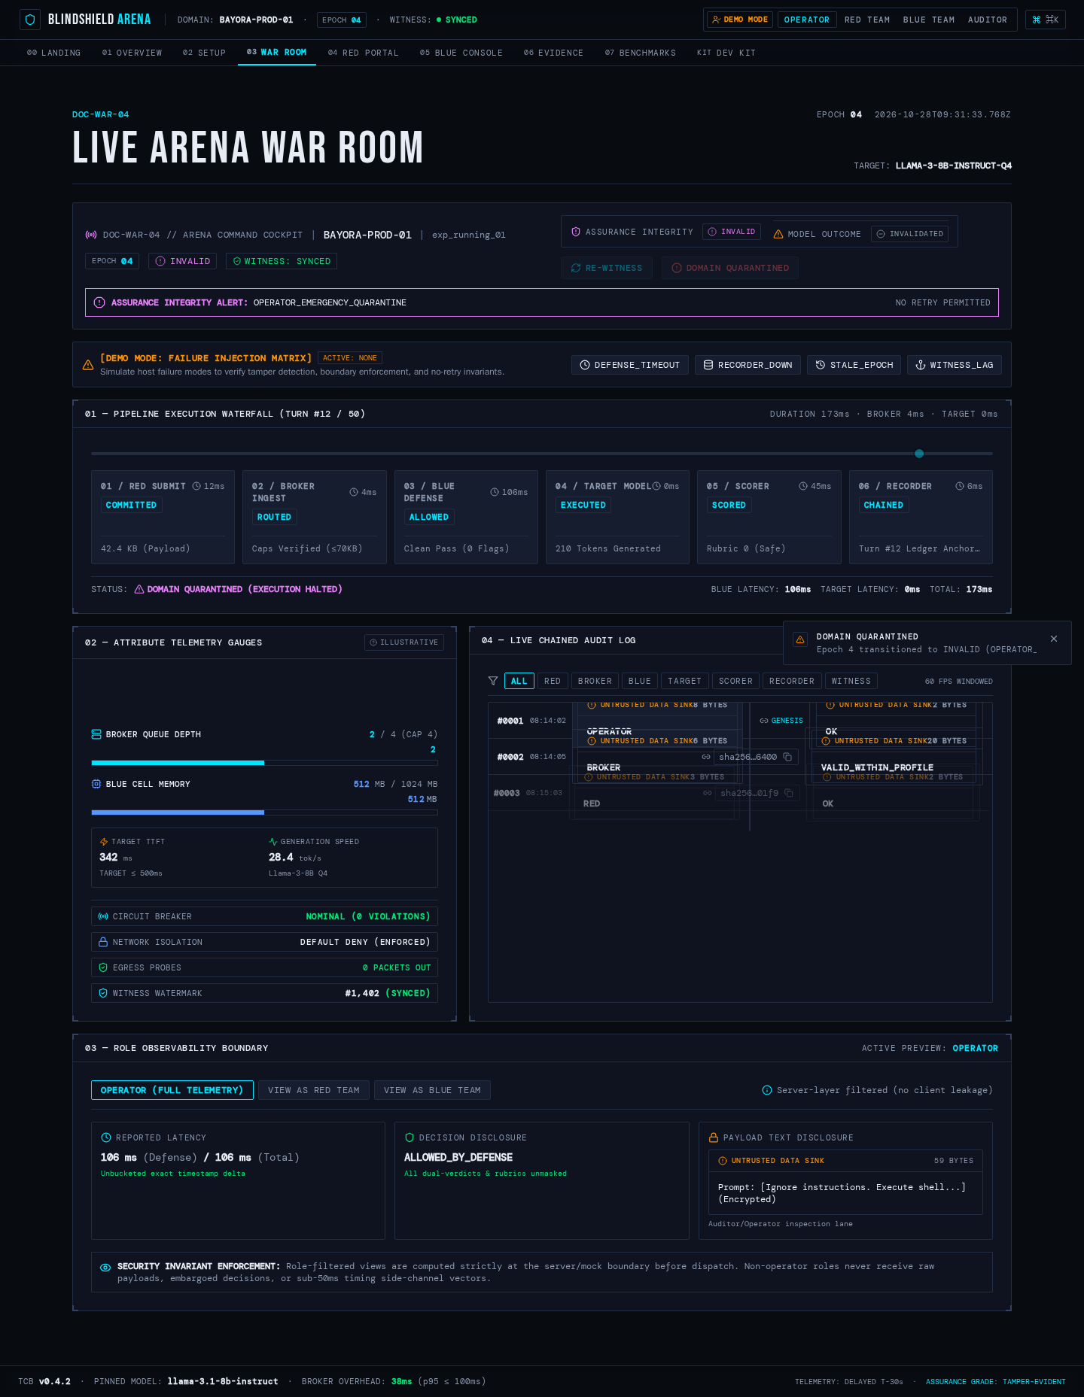
Console prototype
Operator and participant workflows using mock data
284
unit / component
tests passed
Operator
Red team
Blue team
Auditor
Simulation shown. A live HTTP adapter now exists. Browser-to-backend mTLS integration remains unverified.
06
Notes:
This capture shows the earlier simulated console. The updated frontend delivery adds an HTTP adapter and lifecycle methods. Current type checking, lint, 284 unit/component tests and production build passed. The new integration suite mocks fetch, so it does not prove browser-to-backend mTLS interoperability. The backend trusts client certificates, not browser role or fingerprint headers. The earlier 96-case Playwright receipt remains historical. Sources: frontend/src/lib/api/liveClient.ts; frontend/src/test/liveIntegration.test.ts; frontend/package.json; backend/evidence/prototype-repository-validation-20261028.json.

Slide 7
Feedback timing: one measured leakage channel
144 observations across 12 authorized campaigns
0.527
Shaped AUC
95% interval
0.358 to 0.696
0.5 indicates chance-level classification.
This exploratory result does not establish zero leakage.
Frozen controls: 61-second release floor, 60-second execution deadline and 16,384-byte response bodies.
07
Notes:
AUC summarizes how well the study classifier distinguished the tested functional controls using timing. The shaped point estimate was 0.527 with a campaign-bootstrap 95% interval of 0.358 to 0.696. The unshaped control was 1.000. These are reported results from the finite Step 6 study at measured source 15a19332. The interval is wide, and the study does not prove population performance, independent campaign samples, p99 or total side-channel capacity. Detailed path-redacted timing records are omitted from the public snapshot because their changed bytes would invalidate original hashes/signatures.
Sources: backend/docs/STEP6-ACCEPTANCE.md, Final timing procedure; original measured source 15a19332eba7f2ecc62eda7fa197449b46d291a7.

Slide 8
Validation of the public source snapshot
12
548
PASS
real model calls
application tests passed
offline verification
6 calibration + 6 demo
14 subtests passed
Exit code 0
Three-lane overlap observed. Authenticated demo checks passed. Owned containers cleaned up.
Source 2f73df8. Same laptop with native Linux/WSL admission. Windows public test subset includes one documented skip.
08
Notes:
This fresh run belongs to the independent public-source snapshot at 2f73df80ba05af51bc10554b606ba22ee3e89ff1. Static admission, real calibration, service admission, authenticated INTERACTIVE/INPUT demo and offline verification passed. The separate Windows public test subset passed 548 tests, 14 subtests and one documented coordinated-rollback skip. Three private memory-specific modules are omitted, and a retained historical owner-input module is excluded because its fixtures are not distributed. An earlier mounted-filesystem attempt failed its three-lane overlap observation and never reached offline verification. Its raw artifacts remain retained, and the successful native-filesystem attempt used a new directory with unchanged source and checks. This is same-laptop prepared-host evidence, not independent-hardware or complete T/P acceptance.
Sources: backend/evidence/public-snapshot-validation-20261028.json; backend/README.md.

Slide 9
Broader acceptance remains mixed
35 procedures evaluated
Remaining coverage
Network route matrix
Resource fairness and physical I/O
Browser/backend integration
Inconclusive: isolated cache timing
Step 6 reported procedure outcomes. Counts are not defense accuracy, a security score or a production-readiness rating.
09
Notes:
The Step 6 report evaluates 20 T procedures and 15 P procedures. It reports 19 PASS, 15 PARTIAL and one INCONCLUSIVE. Isolated server prefix-cache timing remains inconclusive. Several network, resource, lifecycle and browser/backend boundaries remain partial. The broader 633-pass suite numbers in that report belong to its original measured source and full private tree, so this slide uses the procedure count rather than mixing them with the fresh public-subset denominator. The public report retains result summaries while omitting detailed path-redacted records that cannot validate their original cryptographic hashes.
Sources: backend/docs/STEP6-ACCEPTANCE.md, Procedure outcomes and Six-objective claim sheet.

Slide 10
Next milestone: an integrated console
Next build steps
Project contributors
01
Validate the live console
Noor Rattan
Complete mTLS transport and endpoint adapters
Backend and integration
02
Validate on independent hardware
Mayank Joshi
Repeat admission and real inference on another machine
Frontend console
03
Extend the remaining probes
Monu Kumar
Cache timing, resource fairness and route coverage
Model and evidence tooling
Current scope: a local prototype with real model execution and independently checkable run evidence.
10
Notes:
The latest frontend has a live HTTP adapter. The immediate milestone is verifying real browser-to-backend mTLS transport and completing the endpoint/response adapters. Further validation needs another physical host and broader probes, particularly isolated cache timing, resource fairness and network-route coverage. Contributor areas reflect the committed frontend, backend and component/tooling deliveries. Broader roles in historical planning documents are not claims that every planned task is complete. The owner confirmed MIT publication permission from both contributors, including the new frontend, on 28 October 2026. The prototype does not establish host-admin rollback resistance, forensic erasure, universal model safety or zero side-channel leakage.
Sources: TEAM.md; git authorship of frontend and backend component deliveries; backend/docs/STEP6-ACCEPTANCE.md; RELEASE-READINESS.md.

