Slide 1

Project Title - Seasonal Agriculture Performance Analysis
Student Name: NOOR SANIYA
College name: TKR College of Engineering and Technology
AICTE STU ID : STU68938cda2efeb1754500314

Slide 2

PROBLEM STATEMENT
Agricultural activities are influenced by seasonal variations in environmental conditions, farming practices, resource availability and market conditions. As a result, agricultural performance may differ from one season to another. However, raw agricultural data does not clearly explain how agricultural performance changes across seasons or what patterns can be observed in different seasonal conditions. The problem is to analyze the given agricultural dataset and investigate seasonal differences in agricultural performance by identifying meaningful patterns, trends, relationships and variations within the available data.

Slide 3
Project Description
Seasonal Agriculture Performance Analysis is a data analytics project that studies agricultural performance across different crops and seasons. The project analyses factors such as crop yield, production, profitability, rainfall, irrigation, water efficiency, and disease/pest risk. Using data cleaning, statistical analysis, visualization, and correlation analysis, the project identifies patterns in crop performance and provides insights to support better crop selection, seasonal planning, irrigation, and resource management.

Slide 4

WHO ARE THE END USERS?
Farmers – Support crop selection, seasonal planning, and irrigation decisions.
Agricultural Departments – Analyse crop performance and seasonal agricultural trends.
Agricultural Researchers – Study factors influencing crop yield and profitability.
Agribusinesses – Identify profitable crops and support business planning.
Resource Managers – Improve water and other resource management.

Slide 5

Technology Used
Python
Pandas
NumPy
Matplotlib
Seaborn
Google Colab

Slide 6
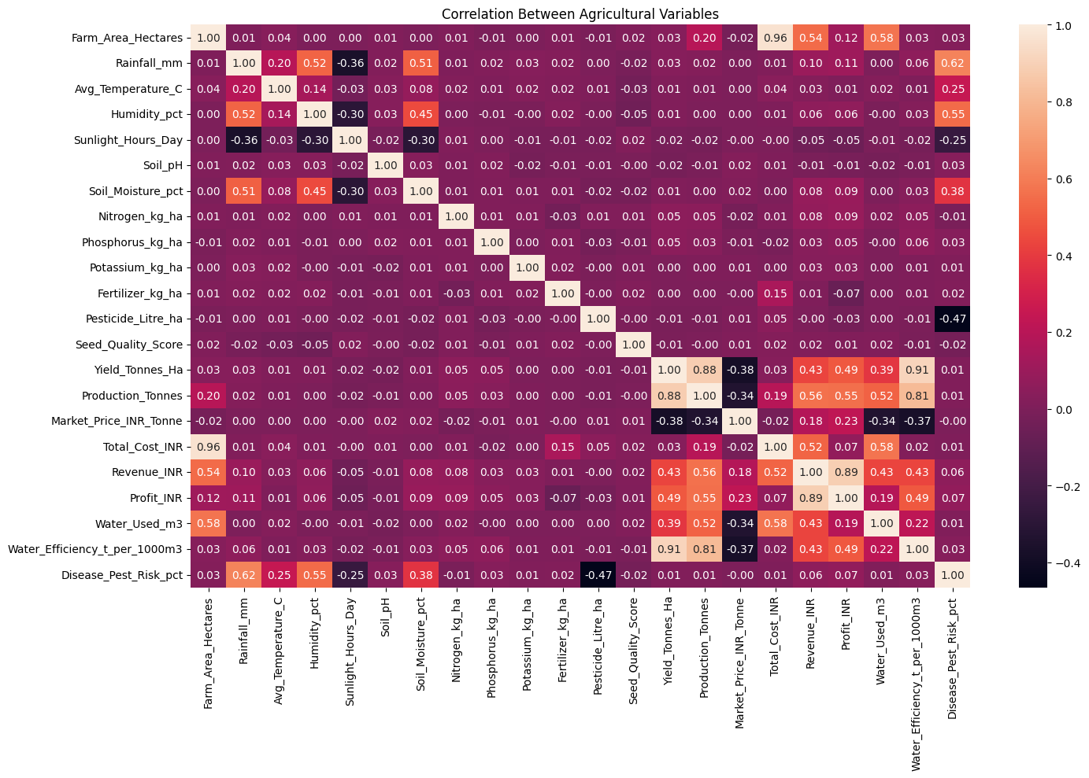
RESULTS
The heatmap shows the relationships between the major agricultural variables. Strong positive relationships can be observed between yield and water efficiency, production and yield, and revenue and profit.

Slide 7
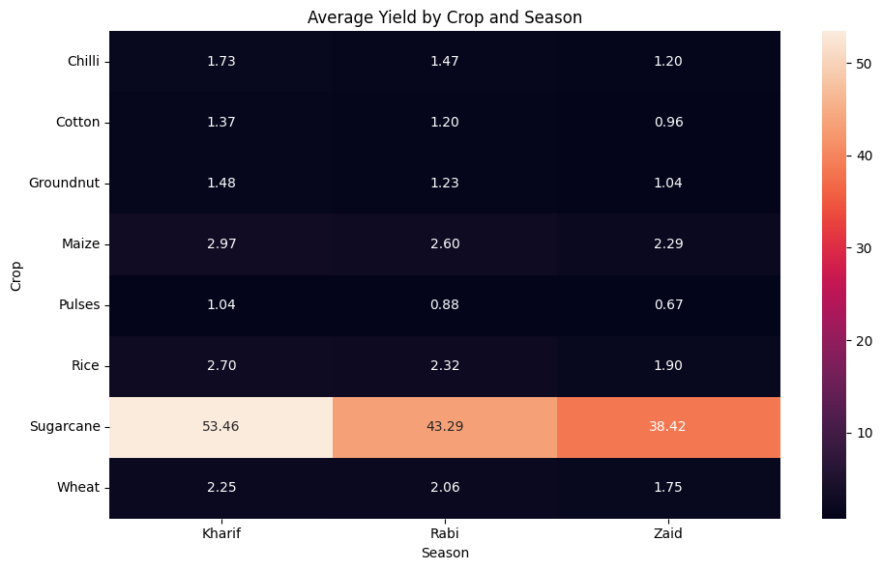
RESULTS
[Add screen shots of your code ]
This heatmap compares the average yield of different crops across Kharif, Rabi, and Zaid seasons. It highlights the crop-season combinations with higher and lower productivity.

Slide 8
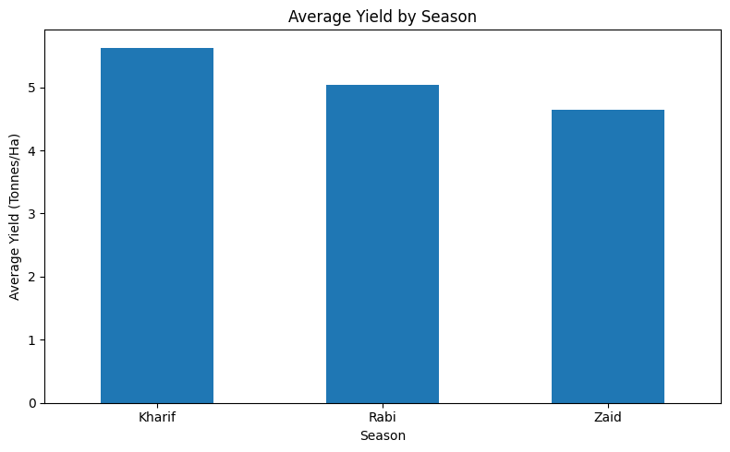
RESULTS
[Add screen shots of your code ]
The chart compares crop yield across different agricultural seasons. Kharif has the highest average yield at 5.63 tonnes/ha, followed by Rabi and Zaid.

Slide 9
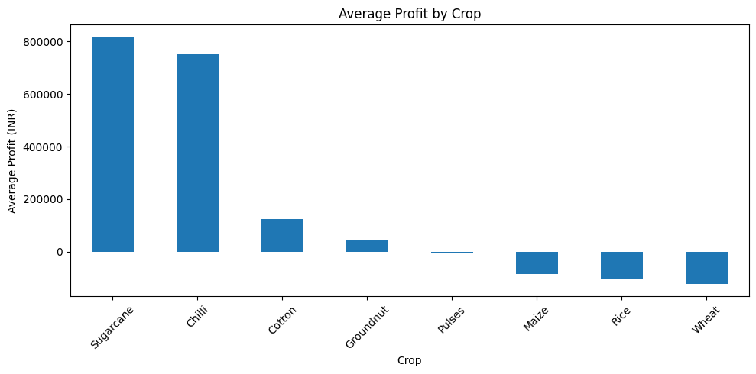
RESULTS
[Add screen shots of your code ]
This chart compares the average profit generated by different crops. Sugarcane and Chilli show relatively higher profitability compared with the other crops.

Slide 10
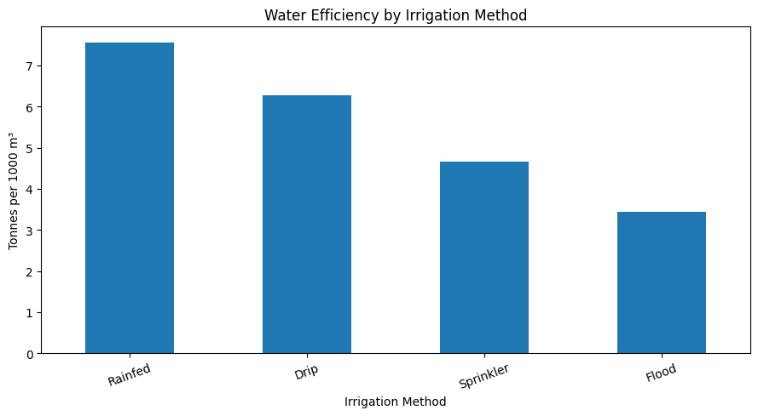
RESULTS
[Add screen shots of your code ]
This chart compares the average crop yield across different irrigation methods. It helps identify which irrigation practices are associated with better crop productivity.

Slide 11
Future scope
Predictive Analysis – Develop machine learning models to predict crop yield and profitability.
Real-Time Data Integration – Incorporate live weather, rainfall, soil, and market-price data.
Smart Recommendations – Develop systems that recommend suitable crops, seasons, and irrigation methods.
Interactive Dashboard – Build a user-friendly dashboard for monitoring agricultural performance.
Advanced Risk Analysis – Improve prediction and management of disease and pest risks.

Slide 12
GitHub Link
https://github.com/NoorSaniya321/SeasonalAgriculturePerformanceAnalysis-

Slide 13
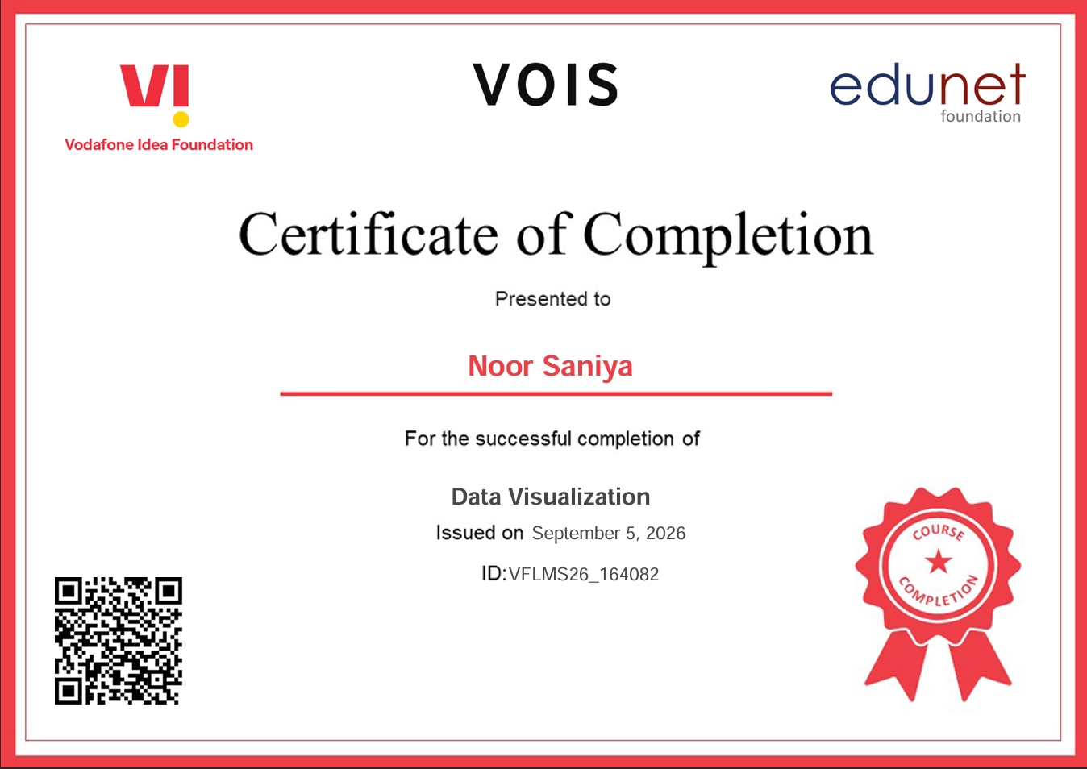
VOIS Course completion certificate - Course name- Data Visualization

Slide 14
Thank you
Thank you to VOIS and EDUNET for providing me with this valuable internship opportunity and hands-on learning experience. This internship helped me strengthen my skills in data analytics and real-world problem solving.
.
.

