Slide 1
Sahyog (Aims to empower deaf and mute people through gesture recognition technology)

Slide 2
Contents
Problem Statement
Objective
How to achieve?
What are gestures
Types of gestures
What is gesture recognition
Types of gesture recognition
Architecture Diagram
How it works
Screen-shots
Areas where we can use
Future scope

Slide 3
Problem Statement
In our society where we have number of differently abled (impaired hearing and vocally impaired) people who have faced lots of problems in their day to day lives either it’s as common as opening a bank account or to get a railway ticket. It’s very difficult for those people to express their feelings, thoughts and ideas.
As per 2011 Census, there are approx. 15 lacs differently abled people in India.
As we have large scale of these type of people in our community we should take steps to be able to communicate with them to share knowledge ,thoughts ,ideas and even feelings.

Slide 4
Objective
To create a program ‘Sahyog’ to help differently abled (deaf and mute) people of India.
To understand the sign language better and convert it into text.

Slide 5
How to achieve?
To get the desired results (convert gestures into text or speech), it’s very important to understand what the gestures are and how gesture recognition technology works.

Slide 6
What are gestures?
Gestures are an important aspect of human interaction, both interpersonally and in the context of machine interface.
Gesture is a form of non-verbal communication in which visible bodily actions communicate particular messages, either in place of speech or text.
Gestures include movement of hands, face or other parts of body.

Slide 7
Types of Gestures
Gesticulation
Spontaneous movements of hands and arms that accompany speech.
Language like gesture
Gesticulation that is integrated into spoken utterance, replacing a particular spoken word or phrase.
Sign languages
Linguistic system, such as American sign language, which is well defined.
Emblems
Familiar gesture like V for victory and thumbs up etc.

Slide 8
What is gesture recognition
Human computer interaction
Gesture provides a way for computers to understand human body language
Deals with the goal of interpreting human gestures via mathematical algorithms
Enables humans to interface with the machine and interact naturally without any mechanical devices.

Slide 9
How gesture technology works

Slide 10
Types of gesture recognition
Sign language recognition
Facial gesture recognition

Slide 11
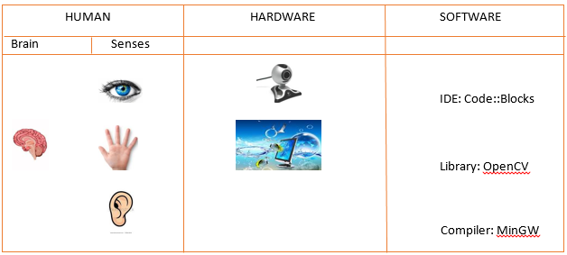
Architecture Diagram

Slide 12
Sahyog
Code::Blocks
OpenCV
MinGW

Slide 13
How it works
Capture the image through camera and converts RGB source image to Grayscale image.
Set ROI (region of interest) using cvSetImageROI function.
Smooth the grayscale image using cvSmooth function.
Threshold the smoothed image by using cvThreshold function.
At last we find contours using contour detection, convex hull of palm region, convexity defects.

Slide 14
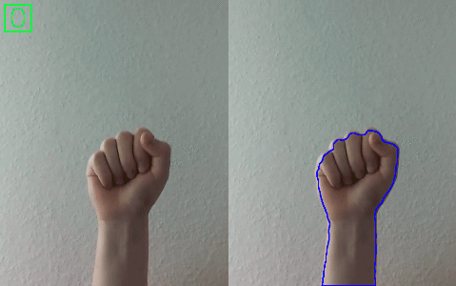
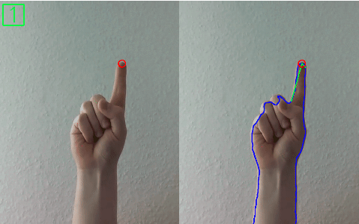
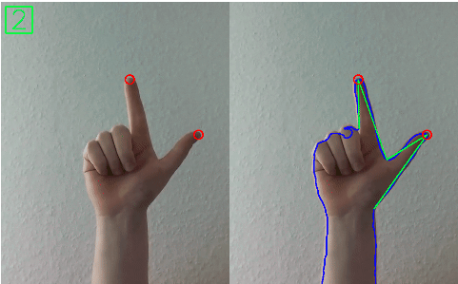
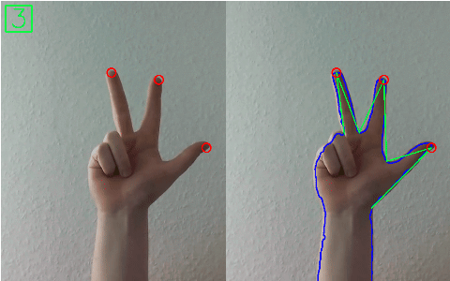
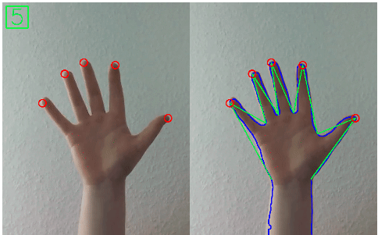
Few hand gestures

Slide 15
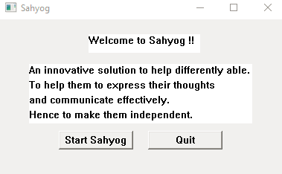
Welcome to Sahyog – Screen-shots

Slide 16
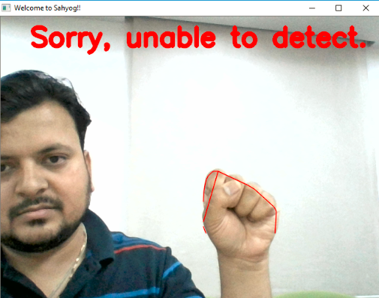
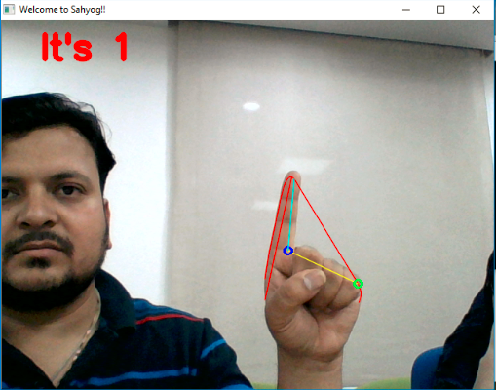
Detect gestures!

Slide 17
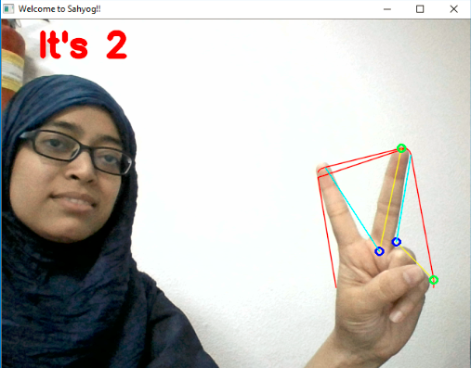
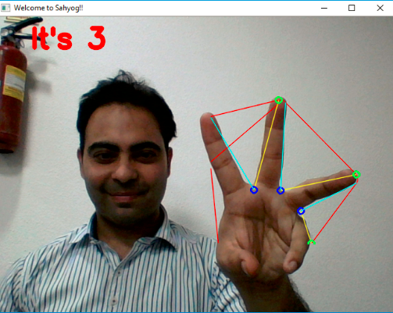
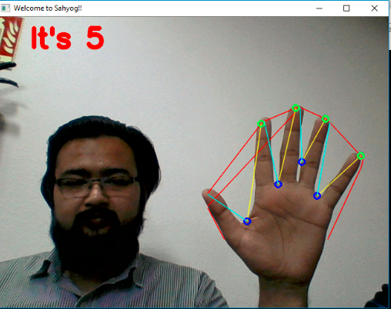

Slide 18
Areas where we can use
Banks
Railways
Airports
Other government offices

Slide 19
Future Scope
Add face recognition capability to the program
Enhance the recognition capability of various conditions
Achieving more accuracy
Identifying multiple number of gestures
Applying gesture recognition for accessing internet applications
Add ‘text to speech’ conversion to save time of reading the converted text

Slide 20
Thank you!

