Slide 1
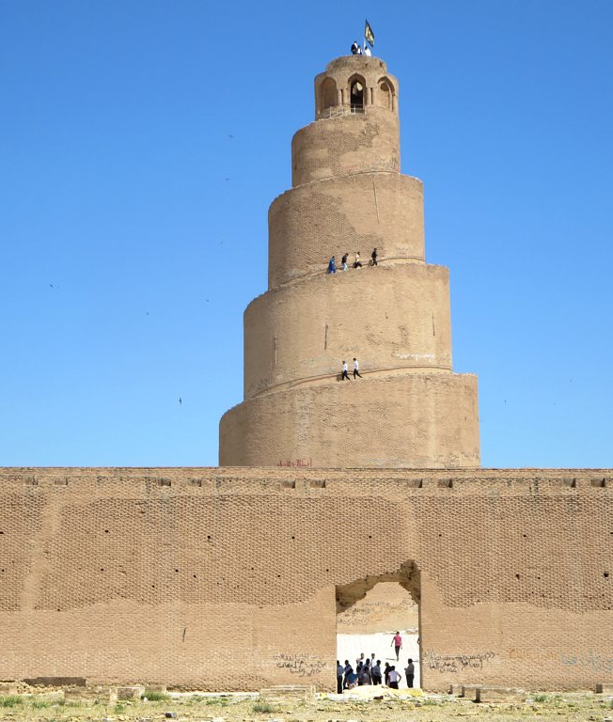
My bachelor thesis proposal
IRAQ,
OIL & THE
BUDGET
IRAQ,
OIL & THE
BUDGET
Iraq Economic Observatory
I want to understand the economy
and build a tool that helps me explore it.
Nooruldeen Al Sammarraie
ASE · Economic Informatics in English
Notes:
I wanted to bring together the parts of my degree that interest me most: programming, statistics and economics. Iraq matters to me personally, and I want to understand its oil dependence through evidence I can actually check. I have started a working Python application. I would like to discuss whether its research question and computational contribution are suitable for my bachelor thesis. My proposed academic title is: Iraq’s Oil Dependence and Economic Outlook: A Python Application for Monthly Fiscal Analysis and Scenario Testing.
SOURCES
ASE INFO_EN, 2023 cohort, year 3
https://planinvatamant.ase.ro/Plan.aspx?id=7107&lang=en
Photograph: David Stanley, 2016-04-05
https://commons.wikimedia.org/wiki/File:Malwiya_Minaret_(30553349415).jpg
CC BY 2.0: https://creativecommons.org/licenses/by/2.0/
No pixel edits. Displayed with a proportional crop to a portrait frame.

Slide 2
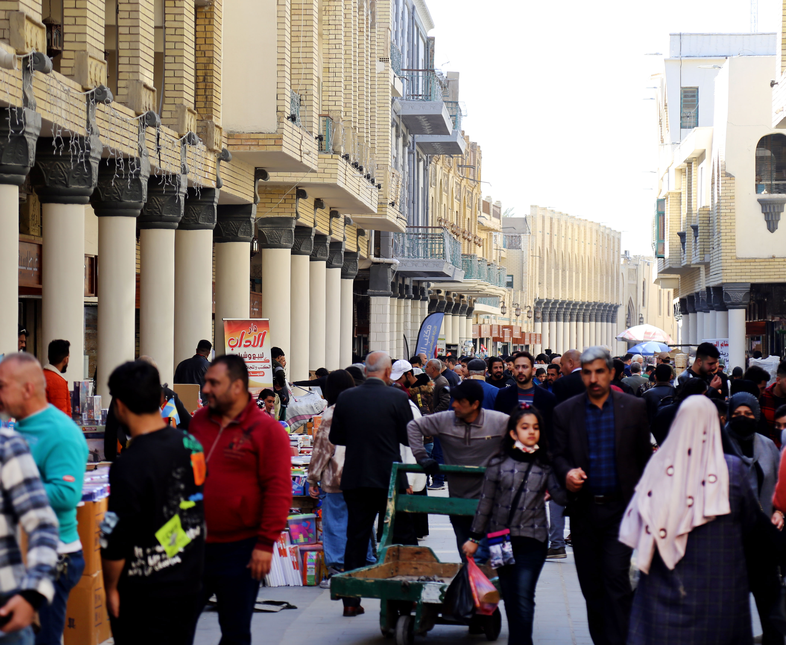
Why this matters to me
I grew up in Iraq.
I want to understand
what the numbers
can actually tell me.
Programming lets me build the tool.
Statistics helps me question the results.
A project I want to keep developing
02
Notes:
Iraq is a place I know personally, so this question gives me a reason to keep learning. I am interested in why a country with oil income can still face budget pressure and difficulties building a more diverse economy. I want the research to challenge my assumptions. I also want to prepare for a master’s in statistics or applied data analysis through methods I can understand and reuse. This photograph gives a sense of place. I do not infer employment status or economic performance from the people shown.
SOURCES
Photograph: Safa Daneshvar, 2022-02-15
https://commons.wikimedia.org/wiki/File:001126-AlMutanabbi-Baghdad-IMG_8168-2.jpg
CC BY-SA 4.0: https://creativecommons.org/licenses/by-sa/4.0/
No pixel edits; displayed with proportional crop or fit where stated. Any adapted photo remains CC BY-SA 4.0.

Slide 3
What happens when oil income changes?
I use Python to connect the data, test the relationships
and calculate what different assumptions would mean.
Oil prices
and export volume
Public
revenue
Spending
and budget balance
How exposed is Iraq’s budget,
and what does that mean for its economic outlook?
My Python workflow checks the inputs, runs the analysis and exports the results so I can trace each conclusion.
03
Notes:
One of my main questions is how changes in oil income relate to Iraq’s public revenue and fiscal balance. Prices alone do not determine income: export quantities, exchange rates and non-oil receipts matter as well. Spending commitments can make revenue shocks difficult to absorb. The arrows describe the mechanisms I want to investigate, not a causal estimate I have already identified. I will use real income and manufacturing as development context, while keeping the core model narrow enough for the available observations.
SOURCES
Central Bank of Iraq, monthly statistical workbook, direct download
https://cbi.iq/static/uploads/up/file-179015939752236.xlsx
World Bank monthly commodity prices, October 2026 snapshot
https://thedocs.worldbank.org/en/doc/74e8be41ceb20fa0da750cda2f6b9e4e-0050012026/related/CMO-Historical-Data-Monthly.xlsx
IMF WEO April 2026 complete workbook
https://data.imf.org/-/media/iData/External-Storage/Documents/2F78EE59F79143A7921E5E203D3AAA80/en/WEOApr2026all.xlsx
Downloaded WDI oil-rents API, 12 countries
https://api.worldbank.org/v2/country/IRQ;DZA;IRN;SAU;KWT;OMN;ARE;QAT;AZE;KAZ;NGA;AGO/indicator/NY.GDP.PETR.RT.ZS?source=2&format=json&date=1960:2025&per_page=20000&footnote=y

Slide 4
I have annual history and a monthly fiscal core
What I can study | Verified window | Source
Annual development context | 2003–2025 | World Bank WDI
Monthly revenue, spending and balance | Jan. 2016–June 2026 | CBI archived tables
Monthly oil and mineral revenue | Jan. 2016–Dec. 2025 | CBI archived tables
Separate fiscal outlook | 2026–2031, annual projections | IMF April 2026 WEO
126 fiscal months
120 oil-category months
The study still begins in 2003. I have also extracted older months from 2008, with coverage and revision checks still needed.
04
Notes:
My study keeps the annual development history from 2003. I have expanded its econometric core to 126 consecutive monthly budget records, January 2016 to June 2026, extracted from ten CBI annual bulletins and the current workbook. The monthly oil-and-mineral revenue category has 120 records through December 2025. The published accounts are cumulative within the year. January equals its reported total; later increments are differences from the preceding month. These can contain revisions. I also prepared 222 archived monthly accounts from January 2008, but keep earlier coverage and revision issues separate from the continuous modelling core. The 2014 footnote changes coverage and the 2015 table contains a large reversal. Older 2004 to 2007 layouts require a separate extraction adapter. WDI development indicators remain annual through 2025 and oil rents end in 2021. IMF 2026 to 2031 values remain separate annual projections. I never repeat annual observations to manufacture monthly data. Checked on 12 October 2026.
SOURCES
Central Bank of Iraq, archived annual bulletins with monthly budget tables
https://cbi.iq/page/142
Central Bank of Iraq, monthly statistical workbook, direct download
https://cbi.iq/static/uploads/up/file-179015939752236.xlsx
Downloaded WDI oil-rents API, 12 countries
https://api.worldbank.org/v2/country/IRQ;DZA;IRN;SAU;KWT;OMN;ARE;QAT;AZE;KAZ;NGA;AGO/indicator/NY.GDP.PETR.RT.ZS?source=2&format=json&date=1960:2025&per_page=20000&footnote=y
IMF WEO April 2026 complete workbook
https://data.imf.org/-/media/iData/External-Storage/Documents/2F78EE59F79143A7921E5E203D3AAA80/en/WEOApr2026all.xlsx

Slide 5
The budget moved from surplus to deficit
2022
2025
+44.74
−17.04
CBI recorded budget execution, 2004–2025. Balance = revenue less expenditure. Figures are preliminary and revisable.
05
Notes:
I calculated these balances from the CBI annual table and converted million Iraqi dinars to trillion Iraqi dinars. The 2022 balance is positive 44.737855 trillion, followed by deficits in 2023, 2024 and 2025. The 2025 deficit is 17.042689 trillion. There are both surpluses and deficits across the history, so I cannot say the balance has deteriorated every year. I want to investigate the changes in revenue and expenditure behind this pattern. CBI execution totals and IMF fiscal balances have different source coverage and vintages and stay separate in my application.
SOURCES
Central Bank of Iraq, monthly statistical workbook, direct download
https://cbi.iq/static/uploads/up/file-179015939752236.xlsx
Central Bank of Iraq, Economic Report 2024
https://cbi.iq/static/uploads/up/file-176709256118155.pdf

Slide 6
I can track oil-related revenue each month
120
oil-category
months available
2025: 87.3% of reported revenue came from oil and mineral resources
Chart: monthly increments, 2024–2025. Published accounting adjustments can affect a month. This does not identify a causal effect.
06
Notes:
This chart displays 24 genuine monthly increments in 2024 and 2025. The broader oil-and-mineral category has 120 monthly records for 2016 to 2025. I extracted it separately from total public revenue, rather than assuming an oil share. Its 2025 total is 108412262 million IQD against total revenue of 124185236 million IQD, a share of 87.2988 percent. The category includes mineral resources and differs from oil rents and SOMO export sales. Monthly differences can include accounting adjustments. October 2019 has a negative oil-category increment, which I preserve and flag. My small lagged monthly regression has 124 rows and an oil-price coefficient interval spanning zero. I want to review its timing, controls and diagnostics before making stronger claims.
SOURCES
Central Bank of Iraq, archived annual bulletins with monthly budget tables
https://cbi.iq/page/142
Central Bank of Iraq, monthly statistical workbook, direct download
https://cbi.iq/static/uploads/up/file-179015939752236.xlsx
World Bank monthly commodity prices, October 2026 snapshot
https://thedocs.worldbank.org/en/doc/74e8be41ceb20fa0da750cda2f6b9e4e-0050012026/related/CMO-Historical-Data-Monthly.xlsx

Slide 7
I also want to look beyond the budget
Real GDP per person
Manufacturing share
Why has Iraq followed a different development path from the UAE, Saudi Arabia and Bahrain?
Where did public spending go, and how much supported investment?
I want to compare the evidence and spending reports. These Iraqi trends alone cannot explain the differences.
07
Notes:
I want to understand why Iraq’s development path differs from those of the UAE, Saudi Arabia and Bahrain, and whether spending supported a more diverse economy. I have checked WDI downloads for all four countries. Real GDP per person runs through 2025 for Iraq, Saudi Arabia and Bahrain, and through 2024 for the UAE. Manufacturing runs through 2025 for Iraq and Saudi Arabia, through 2024 for the UAE, and from 2006 through 2025 for Bahrain. Oil rents end in 2021 for all four. I would align the years and examine published public-spending reports, including wages, pensions and investment, where comparable definitions exist. My current budget module contains aggregate totals. I have not yet implemented that spending breakdown or added the UAE and Bahrain to the interface. The World Bank public expenditure review gives me a credible starting point for this extension. I would agree a limited comparison with my coordinator. Countries differ in population, institutions and conflict history, so their trends cannot identify a causal effect of oil. These two Iraqi graphs are development context, not proof of why the countries differ.
SOURCES
World Bank Indicators API documentation
https://datahelpdesk.worldbank.org/knowledgebase/articles/889392-about-the-indicators-api-documentation
Downloaded WDI oil-rents API, 12 countries
https://api.worldbank.org/v2/country/IRQ;DZA;IRN;SAU;KWT;OMN;ARE;QAT;AZE;KAZ;NGA;AGO/indicator/NY.GDP.PETR.RT.ZS?source=2&format=json&date=1960:2025&per_page=20000&footnote=y
World Bank, Iraq public expenditure review (2021)
https://documents1.worldbank.org/curated/en/568141622306648034/pdf/Iraq-HD-PER-Final.pdf

Slide 8
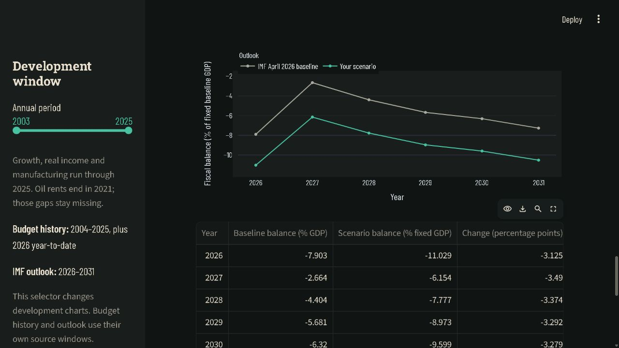
My Python application turns inputs into results
I change the price or spending assumptions, then compare the budget paths and export the numbers.
My working fiscal module. Actual prototype screenshot, October 2026. Python calculates the scenario behind this view.
08
Notes:
I have started a working Python application with real downloaded data and saved source snapshots. Its views cover Iraq over time, country comparisons, the statistical workbench, budget scenarios and source quality. Python loads and validates the observations, runs the algorithms and calculates the scenario. Streamlit and Plotly display the controls, graph and table. I can change the inputs without manually rebuilding the analysis, and export the numerical results. This screenshot shows my actual fiscal module with a ten-percent price-fall scenario. The development selector runs through 2025 and the separate IMF outlook reaches 2031. The scenario assumptions are detailed on slide 13. I still need to refine the software, understand each module thoroughly and complete the thesis evaluation.
SOURCES
World Bank Indicators API documentation
https://datahelpdesk.worldbank.org/knowledgebase/articles/889392-about-the-indicators-api-documentation
Central Bank of Iraq, monthly statistical workbook, direct download
https://cbi.iq/static/uploads/up/file-179015939752236.xlsx
IMF WEO April 2026 complete workbook
https://data.imf.org/-/media/iData/External-Storage/Documents/2F78EE59F79143A7921E5E203D3AAA80/en/WEOApr2026all.xlsx

Slide 9
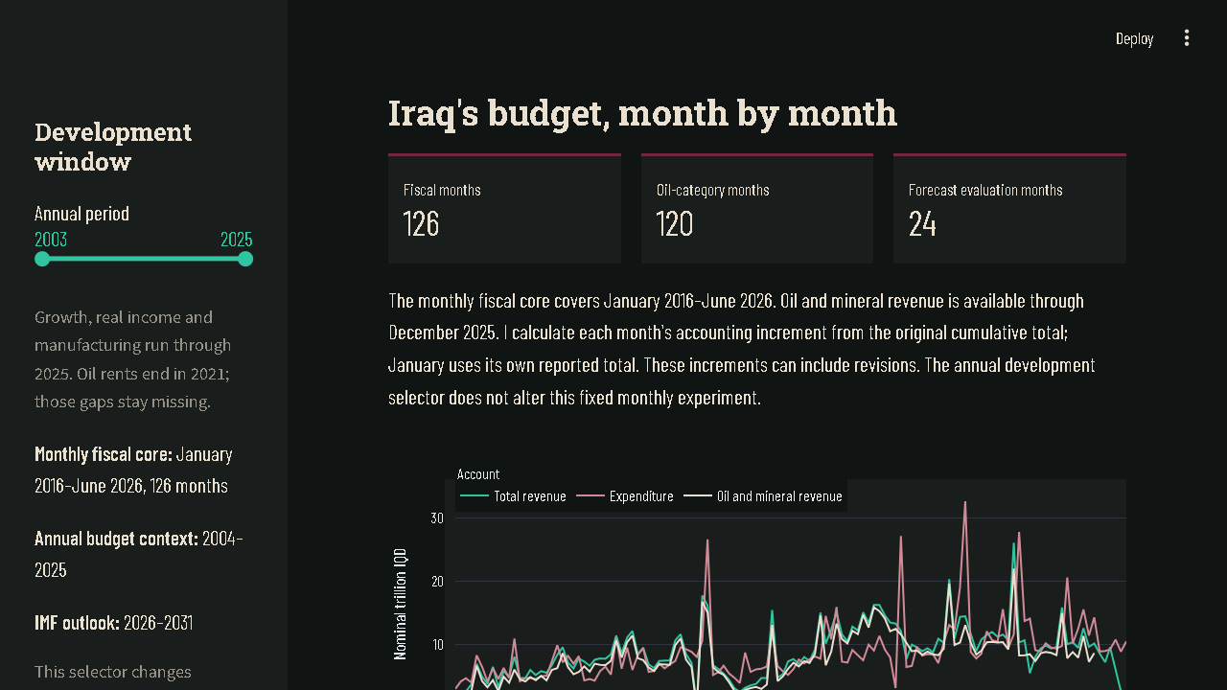
My monthly fiscal view is already working
I can inspect each month
I keep the original totals
and show how I derive
each monthly increment.
I can test the forecasts
I compare models, inspect their uncertainty and export the results.
Actual application view, 12 October 2026. Annual economic history still starts in 2003 in its own view.
09
Notes:
This screenshot shows my actual new monthly Streamlit view, captured from the running application on 12 October 2026. It displays 126 fiscal months, 120 oil-category months and 24 evaluation targets. I added cumulative conversion checks, source and grain validation, monthly forecast experiments, diagnostics and exports. The application now has six views. Its annual development selector remains 2003 to 2025 and does not change the fixed monthly experiment. I intend to review the navigation and performance with Professor Uscatu if he agrees to supervise.
SOURCES
Central Bank of Iraq, archived annual bulletins with monthly budget tables
https://cbi.iq/page/142
Central Bank of Iraq, monthly statistical workbook, direct download
https://cbi.iq/static/uploads/up/file-179015939752236.xlsx
English Software Development for Data Analysis syllabus, 2025–26
https://fisadisciplina.ase.ro/Default.aspx?IDD=91695&IDF=7&IDL=EN
English Software Quality and Testing syllabus, 2025–26
https://fisadisciplina.ase.ro/Default.aspx?IDD=91708&IDF=7&IDL=EN

Slide 10
I can explain how the comparisons work
What my Python program compares
Oil rents
Real income per person
Manufacturing share
I can change the weights
and inspect each contribution.
I would ask Professor Uscatu to help me improve the algorithm, and Professor Davidescu to help me interpret the data.
2003–2007 baseline, equal weights, 12 selected countries.
Lower distance means greater measured similarity. This is descriptive.
10
Notes:
I implemented this country-ranking algorithm in Python. It uses baseline averages for 2003 to 2007, requiring at least three complete years per country. I standardize oil rents, log real income and manufacturing, calculate weighted squared distances and show how each feature contributes. The results here use equal weights within twelve deliberately selected countries. Angola, Azerbaijan and Kuwait have the smallest distances in the saved output. This is descriptive similarity and cannot turn those countries into causal controls. The calculation costs O(Kd), followed by O(K log K) sorting. I would ask Professor Uscatu to help me review the algorithm, data structures and implementation. I would ask Professor Davidescu to help me understand whether the variables, normalization and interpretation are appropriate. These are requests for guidance and do not assume their agreement.
SOURCES
Downloaded WDI oil-rents API, 12 countries
https://api.worldbank.org/v2/country/IRQ;DZA;IRN;SAU;KWT;OMN;ARE;QAT;AZE;KAZ;NGA;AGO/indicator/NY.GDP.PETR.RT.ZS?source=2&format=json&date=1960:2025&per_page=20000&footnote=y
English Programming Techniques and Algorithms syllabus, 2023–24
https://fisadisciplina.ase.ro/Default.aspx?IDD=91638&IDF=7&IDL=EN
ASE official Davidescu CV, August 2023
https://doctorat.ase.ro/wp-content/uploads/MSD/CSE/CV-Davidescu-EN-31.08.2023.pdf

Slide 11
The software is part of the research
I import the source files, check their units and missing values, and store the observations.
Python then runs the comparisons, forecast tests and scenarios. The interface lets me
change inputs, inspect the results and export the evidence without repeating the data preparation.
Data and
source snapshots
Validation
Structured
storage
Analysis
Interface
and exports
URLs and hashes
Units, keys and gaps
SQLite for WDI
CSV fiscal snapshots
Peer distances
Forecasts and scenarios
Charts and tables
CSV and reports
33 passing tests
I check data integrity, timing and accounting identities.
Python, pandas, statsmodels, SQLite, Plotly and Streamlit. I still need to integrate the fiscal tables into the relational store.
11
Notes:
The current pipeline retains downloaded source snapshots, checks their hashes, validates units and duplicate keys, and prepares tidy observations. WDI data persist in a relational SQLite schema, while the fiscal module currently reads validated CSV snapshots. Moving the fiscal observations and experiment settings into the same structured store is still part of my development plan. The analysis modules implement peer ranking, annual-change exploration, forecast backtests and explicit accounting scenarios. Thirty-three tests passed on 12 October 2026. Monthly checks include January resets, absent months, accounting reconstruction, forecast timing and source flags. They cover problems such as duplicate records, future leakage, stale cached inputs and the zero-shock accounting identity. I want guidance on module design, database integration and a defensible evaluation of the software.
SOURCES
English Programming Techniques and Algorithms syllabus, 2023–24
https://fisadisciplina.ase.ro/Default.aspx?IDD=91638&IDF=7&IDL=EN
English Software Development for Data Analysis syllabus, 2025–26
https://fisadisciplina.ase.ro/Default.aspx?IDD=91695&IDF=7&IDL=EN
English Software Quality and Testing syllabus, 2025–26
https://fisadisciplina.ase.ro/Default.aspx?IDD=91708&IDF=7&IDL=EN

Slide 12
Monthly forecasts I have tested
Method | MAE, trillion IQD
AR(1) | 2.815
ARIMA(1,1,1) | 2.956
Last month | 3.155
SARIMA(1,0,0)(0,1,1)[12] | 3.528
Same month last year | 3.669
24 test months
July 2024–June 2026
Monthly revenue in IQD
126 historical months
AR(1) has the lowest MAE. ARIMA has the lowest RMSE.
I still need to review the diagnostics before choosing a model.
I can reuse the monthly analysis for other countries after checking comparable variables, units and source coverage.
12
Notes:
I have replaced the 22-observation annual forecast as the econometric core with monthly total revenue, measured in nominal trillion IQD. All five fixed methods forecast the same 24 one-month-ahead targets, July 2024 to June 2026. The first training window has 102 months and grows one month at a time. Last-month MAE is 3.1553, same-month-last-year 3.6688, AR(1) 2.8151, ARIMA(1,1,1) 2.9565, and SARIMA(1,0,0)(0,1,1)[12] 3.5277. ARIMA has the smallest RMSE, 4.4183, against AR(1) 4.5512. AR(1) still has a 12-lag residual Ljung-Box p-value of 0.040; ARIMA has 0.230 in that check. Level ADF and KPSS evidence differs. I therefore want guidance on breaks, transformations and residual checks before selecting a final model. Conditional intervals are visible in the application and can cross zero; I do not clip them. Tests use revised data and fixed teaching specifications, so this is exploratory comparison rather than a locked final validation exercise. Annual GDP and development indicators retain their own frequency. The older annual model remains a supporting baseline.
SOURCES
Central Bank of Iraq, archived annual bulletins with monthly budget tables
https://cbi.iq/page/142
Central Bank of Iraq, monthly statistical workbook, direct download
https://cbi.iq/static/uploads/up/file-179015939752236.xlsx
World Bank monthly commodity prices, October 2026 snapshot
https://thedocs.worldbank.org/en/doc/74e8be41ceb20fa0da750cda2f6b9e4e-0050012026/related/CMO-Historical-Data-Monthly.xlsx
English Software Quality and Testing syllabus, 2025–26
https://fisadisciplina.ase.ro/Default.aspx?IDD=91708&IDF=7&IDL=EN

Slide 13
What if oil prices fall by 10%?
I can change an assumption and recalculate every year at once. This helps me compare
possible pressures quickly and save the exact inputs behind each result.
2026: −7.90% to −11.03%
I assume 90% of revenue responds to the price shock. Spending, volumes, other revenue, GDP and FX stay fixed. This scenario has no probability.
13
Notes:
The implemented scenario engine lets me change an oil-price proxy, export volumes, non-oil revenue and spending independently. Here I use a ten-percent price fall and an assumed ninety-percent sensitive revenue share. The IMF April 2026 revenue and expenditure projections form the baseline. GDP and exchange rates stay fixed, and I do not model macroeconomic feedback. The 2026 balance therefore changes from negative 7.9035 to negative 11.0287 percent of fixed baseline GDP, a reduction of 3.1253 percentage points. The ninety-percent share is a scenario assumption, not an oil-revenue estimate extracted from WEO. This calculation answers what follows from those assumptions. It is neither an IMF forecast nor a prediction with an estimated probability. I want to review the assumed share and sensitivity ranges before interpreting it further.
SOURCES
IMF WEO April 2026 complete workbook
https://data.imf.org/-/media/iData/External-Storage/Documents/2F78EE59F79143A7921E5E203D3AAA80/en/WEOApr2026all.xlsx
IMF WEO April 2026 documentation
https://data.imf.org/-/media/iData/External-Storage/Documents/4AA1F4D0624C46E98F95988F1F83E770/en/April-2026-WEO-Database-Appendix.pdf

Slide 14
What I have ready, and what comes next
WORKING NOW
I STILL NEED TO COMPLETE
Annual history and monthly fiscal pipeline
Reviewed diagnostics and sensitivity
Country ranking and contribution checks
Fiscal database and experiment records
Monthly forecast tests and fiscal scenarios
Usability checks and clearer reports
Source checks, exports and 33 tests
The written thesis and my final defence
I would refine the scope and next steps with your advice.
12–16 active weeks for the core
Defence: July 2027
14
Notes:
I have enough working material to make the proposal concrete, but I still need academic review of the model diagnostics and sensitivity, a stronger fiscal database adapter, saved experiment settings, usability checks and the written explanation. I estimate twelve to sixteen active weeks for core development, with approximately 215 to 285 focused hours for the full project including learning, writing and revision. These are planning estimates, and I am aiming to defend in July 2027. I would adjust the scope and next steps according to your advice if you agree to guide the project. I am open to a narrower question or a different method if that makes the thesis more defensible.
SOURCES
ASE bachelor graduation regulation, Senate decision 8, February 2026
https://senat.ase.ro/wp-content/uploads/2026/20260204/Hot.Senat%20nr.%208%20din%2004.02.2026_Mod.Reg.finalizare%20studii%20licenta.pdf

Slide 15
The guidance I would like from you
Professor Uscatu
Professor Davidescu
Would you consider coordinating
my bachelor thesis?
Would you be willing to advise me
on the statistical methodology?
I would like your help with the design
and algorithms, making the application
run smoothly, and deciding what to
build and test next.
I want to understand what I am doing
with the data. I would value your help
choosing the methods, checking their
assumptions and interpreting the results.
I would agree the scope and consultation arrangements with you. Any formal additional role requires ASE confirmation.
15
Notes:
I am bringing the software and algorithmic part to Professor Uscatu because it connects to his verified Programming Techniques and Algorithms teaching in my first-year English programme and to his later algorithm teaching. I want to design the application well and be able to explain the data structures, ranking calculation and tests. I am asking whether he would consider acting as my formal coordinator. Professor Davidescu’s econometrics and forecasting expertise would help me choose a question the data can support, assess the diagnostics and explain uncertainty. I would like focused methodological consultation if she is willing. I do not assume either professor has agreed, or that ASE automatically allows two internal formal coordinators.
SOURCES
English Programming Techniques and Algorithms syllabus, 2023–24
https://fisadisciplina.ase.ro/Default.aspx?IDD=91638&IDF=7&IDL=EN
English Evolutive Programming and Genetic Algorithms syllabus, 2024–25
https://fisadisciplina.ase.ro/Default.aspx?IDD=91667&IDF=7&IDL=EN
ASE official Davidescu CV, August 2023
https://doctorat.ase.ro/wp-content/uploads/MSD/CSE/CV-Davidescu-EN-31.08.2023.pdf
Davidescu, Apostu and Paul, Entropy, 2021
https://www.mdpi.com/1099-4300/23/3/325
ASE bachelor graduation regulation, Senate decision 8, February 2026
https://senat.ase.ro/wp-content/uploads/2026/20260204/Hot.Senat%20nr.%208%20din%2004.02.2026_Mod.Reg.finalizare%20studii%20licenta.pdf

Slide 16
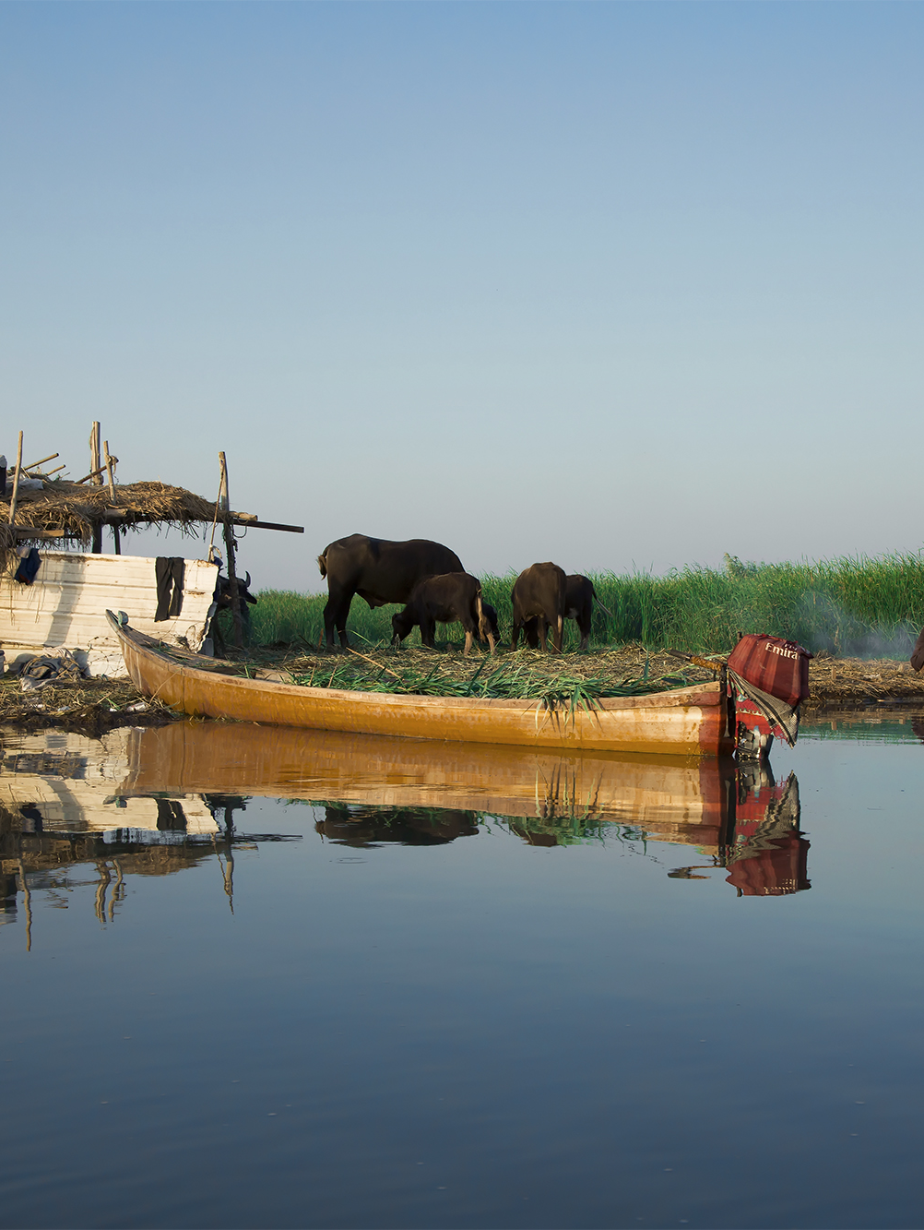
Could we develop
this into my
bachelor thesis?
I would like to agree the question,
the software contribution,
and the methods I should build on.
Proposed academic title
Iraq’s Oil Dependence and Economic Outlook: A Python Application for Monthly Fiscal Analysis and Scenario Testing
Notes:
My intention is to understand an economic problem I care about and finish with software that I can explain and defend. I have checked the sources, started the implementation and tested some preliminary ideas. I would appreciate your assessment of whether this is a suitable bachelor-thesis direction, what the minimum contribution should be and what I need to change before formally registering it. I am open to narrowing the question. The photo is a sense-of-place illustration, not evidence for an agricultural or water-economics model.
SOURCES
Photograph: Taisir Mahdi, 2016-09-18
https://commons.wikimedia.org/wiki/File:The_marshes_of_Iraq.jpg
CC BY-SA 4.0: https://creativecommons.org/licenses/by-sa/4.0/
No pixel edits; displayed with proportional crop or fit where stated. Any adapted photo remains CC BY-SA 4.0.

Slide 17
Sources I used for this proposal
World Bank WDI: annual development context
Central Bank of Iraq: archived monthly tables
Central Bank of Iraq: current monthly workbook
World Bank: historical commodity prices
IMF WEO: April 2026 data and definitions
Iraq photographs
Cover: David Stanley (2016), CC BY 2.0. App photo: MohammadHuzam (2017).
Al Mutanabbi: Safa Daneshvar (2022). Marshes: Taisir Mahdi (2016).
Other photos: CC BY-SA 4.0. Proportional crops for this presentation.
17
Notes:
I have linked the official sources behind the data. Full source definitions and download provenance are in my research package. I checked the monthly archive and prototype on 12 October 2026. Other source vintages retain their recorded dates.
PHOTO CREDITS
David Stanley, 2016-04-05
https://commons.wikimedia.org/wiki/File:Malwiya_Minaret_(30553349415).jpg
CC BY 2.0: https://creativecommons.org/licenses/by/2.0/
No pixel edits. Displayed with a proportional crop to a portrait frame.
Safa Daneshvar, 2022-02-15
https://commons.wikimedia.org/wiki/File:001126-AlMutanabbi-Baghdad-IMG_8168-2.jpg
CC BY-SA 4.0: https://creativecommons.org/licenses/by-sa/4.0/
No pixel edits; displayed with proportional crop or fit where stated. Any adapted photo remains CC BY-SA 4.0.
Taisir Mahdi, 2016-09-18
https://commons.wikimedia.org/wiki/File:The_marshes_of_Iraq.jpg
CC BY-SA 4.0: https://creativecommons.org/licenses/by-sa/4.0/
No pixel edits; displayed with proportional crop or fit where stated. Any adapted photo remains CC BY-SA 4.0.
MohammadHuzam, 2017-12-29
https://commons.wikimedia.org/wiki/File:Tigris_river_in_Baghdad.png
CC BY-SA 4.0: https://creativecommons.org/licenses/by-sa/4.0/
No pixel edits; displayed with proportional crop or fit where stated. Any adapted photo remains CC BY-SA 4.0.
The Samarra cover photograph is CC BY 2.0. Adaptations of the other photographs remain CC BY-SA 4.0. The photos imply no endorsement. I used no Deadlock game artwork or site copy. The presentation layout is original.
SOURCES
World Bank WDI data catalogue and CC BY 4.0 license
https://datacatalog.worldbank.org/search/dataset/0037712/world-development-indicators
Central Bank of Iraq, archived annual bulletins with monthly budget tables
https://cbi.iq/page/142
Central Bank of Iraq, monthly statistical workbook, direct download
https://cbi.iq/static/uploads/up/file-179015939752236.xlsx
World Bank monthly commodity prices, October 2026 snapshot
https://thedocs.worldbank.org/en/doc/74e8be41ceb20fa0da750cda2f6b9e4e-0050012026/related/CMO-Historical-Data-Monthly.xlsx
IMF WEO April 2026 complete workbook
https://data.imf.org/-/media/iData/External-Storage/Documents/2F78EE59F79143A7921E5E203D3AAA80/en/WEOApr2026all.xlsx

Slide 18
The limits I need to keep visible
Data or method | How I handle it
Original budget rows | I derive increments from cumulative accounts.
Older archived months | I review coverage and revisions before expanding the core.
126 monthly core records | I test baselines and inspect seasonality and breaks.
Annual GDP and oil rents | I keep their frequency and leave missing values unfilled.
Forecasts and scenarios | I separate fitted intervals from assumed shocks.
I keep the October 2019 oil-category adjustment visible.
I want to understand where my results are uncertain.
18
Notes:
The main thesis retains annual economic context from 2003 and adds a monthly fiscal modelling core from 2016 to June 2026. Original monthly records are cumulative. Differencing them creates accounting increments that can reflect revisions. I retain a flagged October 2019 oil-category reversal and a sensitivity around it. Earlier archival monthly data exist, but 2014 changes coverage and 2015 has a large accounting reversal; I keep those outside the current forecasting core. The monthly core has 126 observations but not 126 independent observations. Annual GDP and oil rents remain annual; I neither repeat them twelve times nor manufacture monthly GDP denominators. Monthly targets use nominal IQD. IMF projections retain their annual vintage and never enter historical monthly training. Forecast intervals depend on the fitted model and the scenario calculator retains its own explicit assumptions.
SOURCES
Central Bank of Iraq, archived annual bulletins with monthly budget tables
https://cbi.iq/page/142
Central Bank of Iraq, monthly statistical workbook, direct download
https://cbi.iq/static/uploads/up/file-179015939752236.xlsx
Downloaded WDI oil-rents API, 12 countries
https://api.worldbank.org/v2/country/IRQ;DZA;IRN;SAU;KWT;OMN;ARE;QAT;AZE;KAZ;NGA;AGO/indicator/NY.GDP.PETR.RT.ZS?source=2&format=json&date=1960:2025&per_page=20000&footnote=y
IMF WEO April 2026 documentation
https://data.imf.org/-/media/iData/External-Storage/Documents/4AA1F4D0624C46E98F95988F1F83E770/en/April-2026-WEO-Database-Appendix.pdf

Slide 19
Thank you for
considering my proposal.
I would be grateful for your kind consideration and your feedback
on the topic, the research approach and what I should improve next.
I would like to develop this thesis with your guidance.
I am open to refining the question, methods and scope together.
Could we discuss whether this is a suitable direction?
19
Notes:
Thank you for taking the time to consider my proposal. I would be grateful for your input on the topic, the data, the methods and what I should improve next. I would like to develop this thesis with Professor Uscatu’s supervision and, if possible, Professor Davidescu’s methodological guidance. I am open to refining the question, methods and scope together. These are requests, and I would agree the arrangements with you before registering the topic.
SOURCES

