Slide 1


SHIFTING shadows:
THE INTERPLAY OF CORRUPTION, PROTESTS AND EMIGRATION
A study by
Al Sammarraie Nooruldeen
Litescu David Adrian
Gagiu Casandra

Slide 2

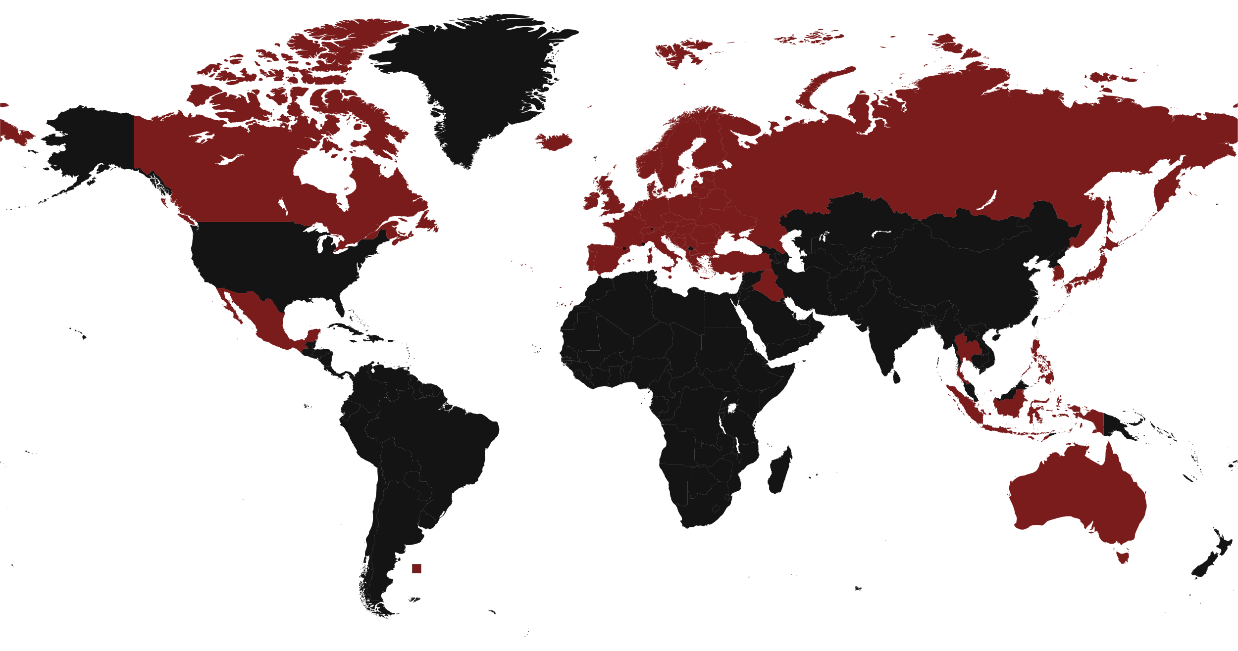
Introduction
The Study
This is a study that dives deep into Corruption and how it leads to Protests which might end up in Emigration
The Significance
It’s important for us to understand the process in which people try to resolve larger issues in their society such as political, economic and social issues within the whole country in which they reside, this study dives into the 2 most frequent choices when unsatisfied with the government
The Sample

Slide 3
Understanding the variables
Corruption
It is when figures of authority in the system such as the government are misusing their powers with ill intentions such as thievery, which leads displeasured citizens who will start
Protests
After being frustrated with a corrupted system, the people will start protesting using their power their voice, but since protests sometimes go under the radar and their failure sometimes leads to
Emigration
The “holy grail”, as some call it, the last resort a person can take when all else fails, moving to a more stable and reliable destination that meets the requirements and needs of life better.

Slide 4
LITERATURE REVIEW
(2024). Exit or Voice? Corruption Perceptions and Emigration
  This study shows how the higher the perceived corruption the less likely people are to protest.
  Shows how people choose emigration as their most effective answer to the high level of corruption.
  And dives deep into what countries these people choose as their destination.
(2024). Corruption as a Push and Pull Factor of Migration Flows
  Corruption is a push factor for migration.
(2019). Emigration and Collective Action
  Emigration option weakens protests.
  It is a solution for some but an issue for the rest.
(2020 ). Voice after Exit? Bulgarian Civic Activists between Protest and Emigration
  Shows how in some countries emigration did not weaken protests such as Bulgaria.
  As they always hope to return to their native land if it gets better, and if there is a chance of reparations they will join in the action.
(2022). Voting with Their Feet: Emigration in the Aftermath of Kazakhstan’s Bloody January
  Shows how after a very big protest went wrong most people flee the country after losing hope in change.

Slide 5


Trustworthy INFORMATION
We have trustworthy sources for our data, for both the literature review and the sample data sets are chosen carefully with consideration to creditability. You will find all the sources at the end in the bibliography if you would like to look through.
We have used the credible known application RStudio for doing the calculations all across the whole project.

Slide 6
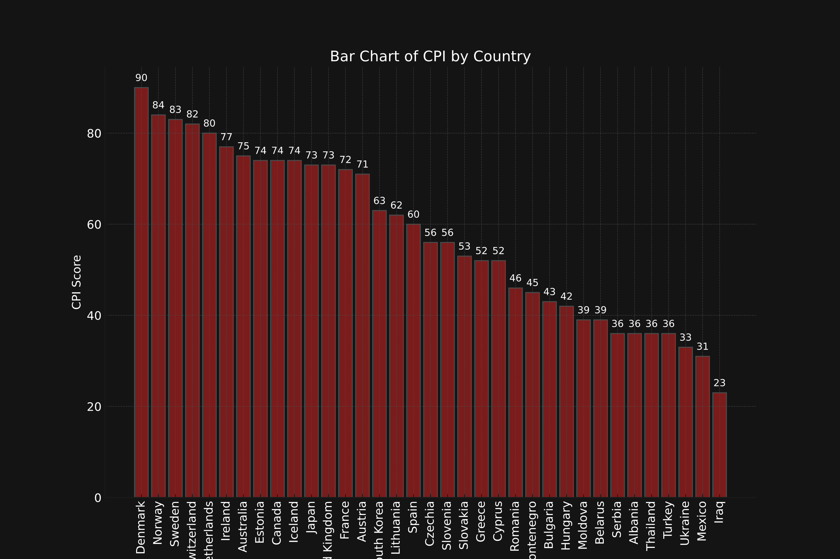
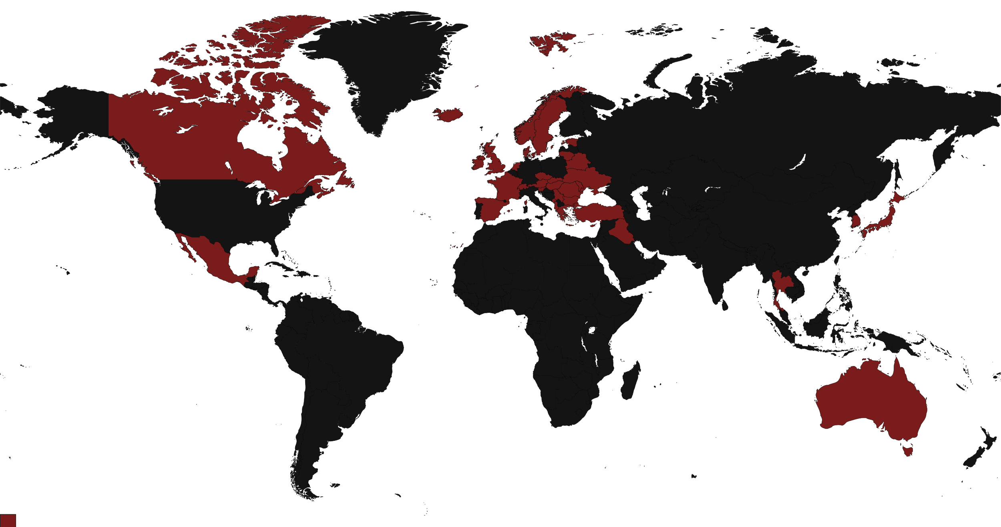
Country CPI
Variables | CPI
Mean | 57.74
Median | 56.00
Mode | 36.00
Std. Deviation | 18.62
Standard Error | 3.14
Variance | 346.96
The Chosen Sample

Slide 7
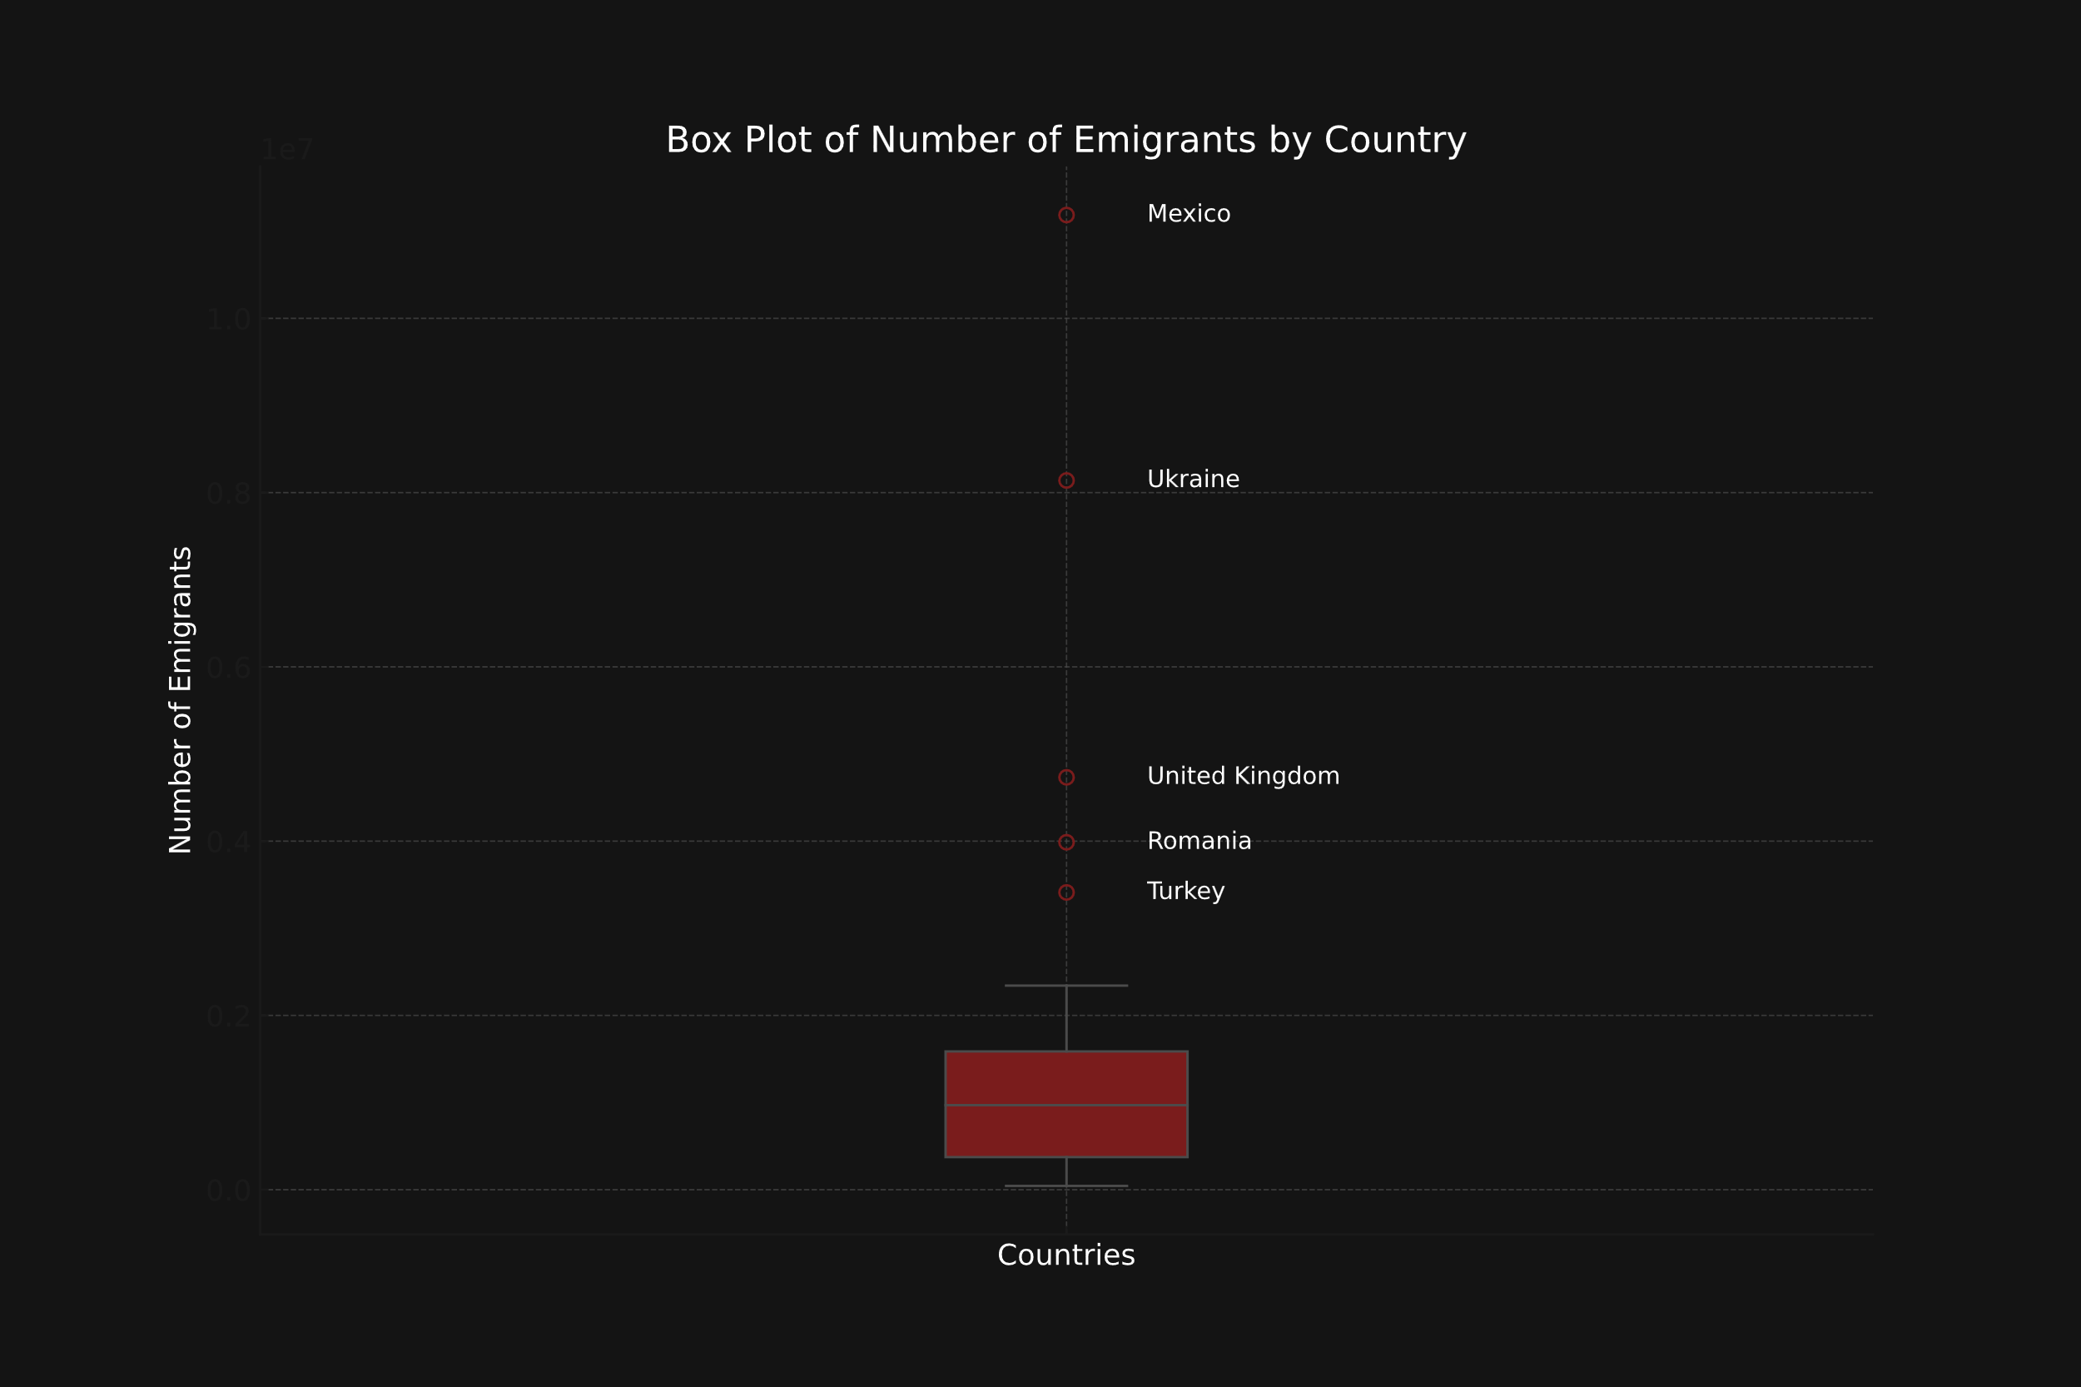
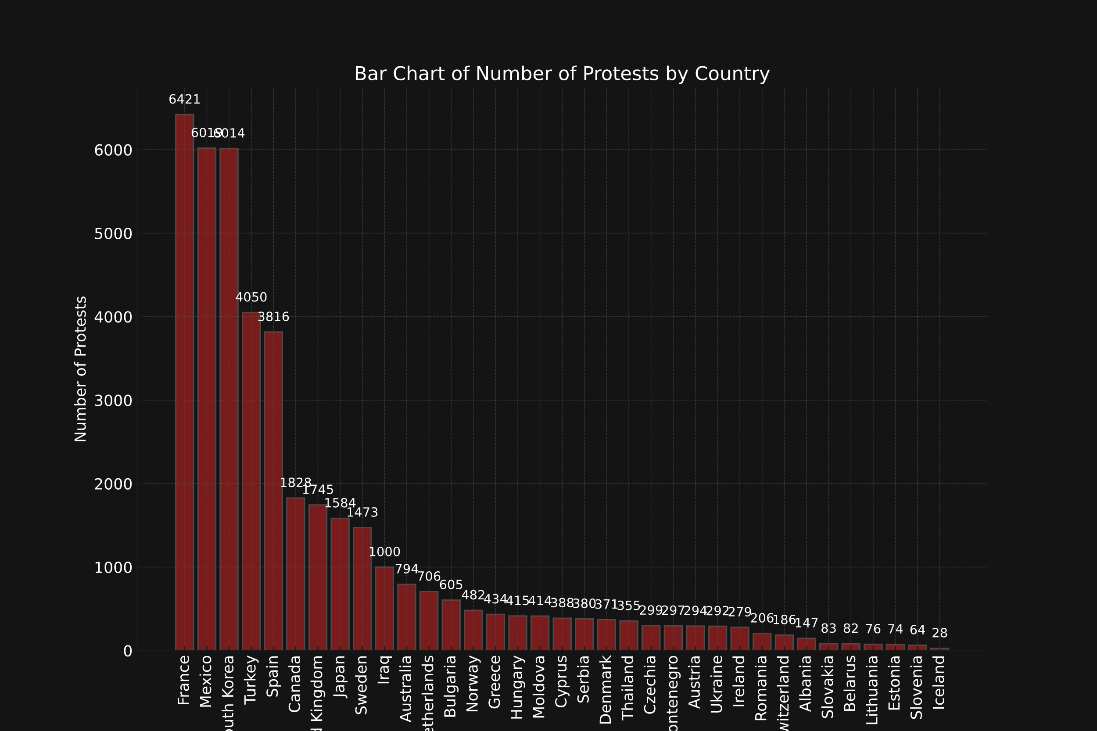
Emigrants
Protests
Variables | Emigrants
Mean | 1638499.74
Median | 970403.00
Mode | 43251.00
Std. Deviation | 2312929.90
Standard Error | 390956.51
Variance | 5349644767626.43
Variables | No of Protests
Mean | 1191.45
Median | 388.00
Mode | 28.00
Std. Deviation | 1801.50
Standard Error | 304.50
Variance | 3245409.96

Slide 8

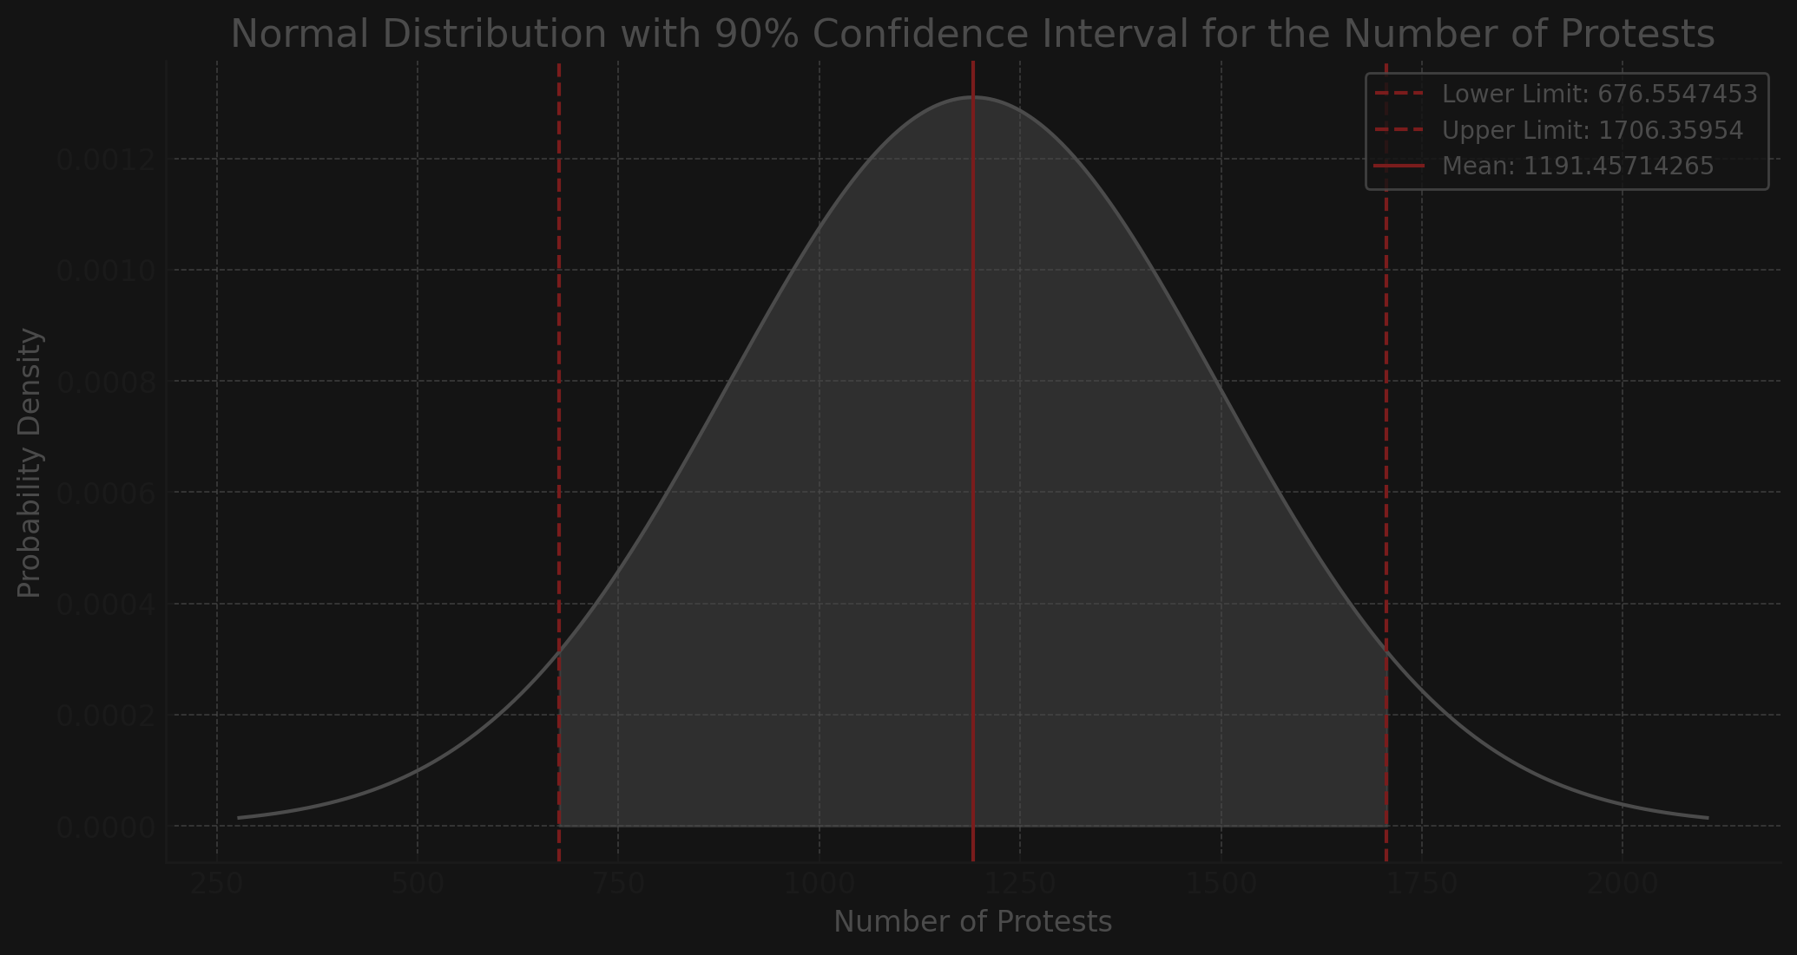
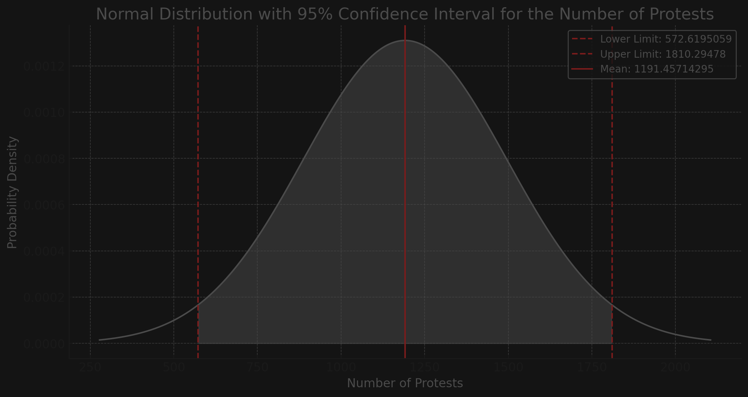
Confidence Levels
Interpretation: We are 90% confident that the protests mean score is between 676.5547453 and 1706.35954.
Interpretation: We are 95% confident that the protests mean score is between 572.6195059 and 1810.29478.
Protests

Slide 9

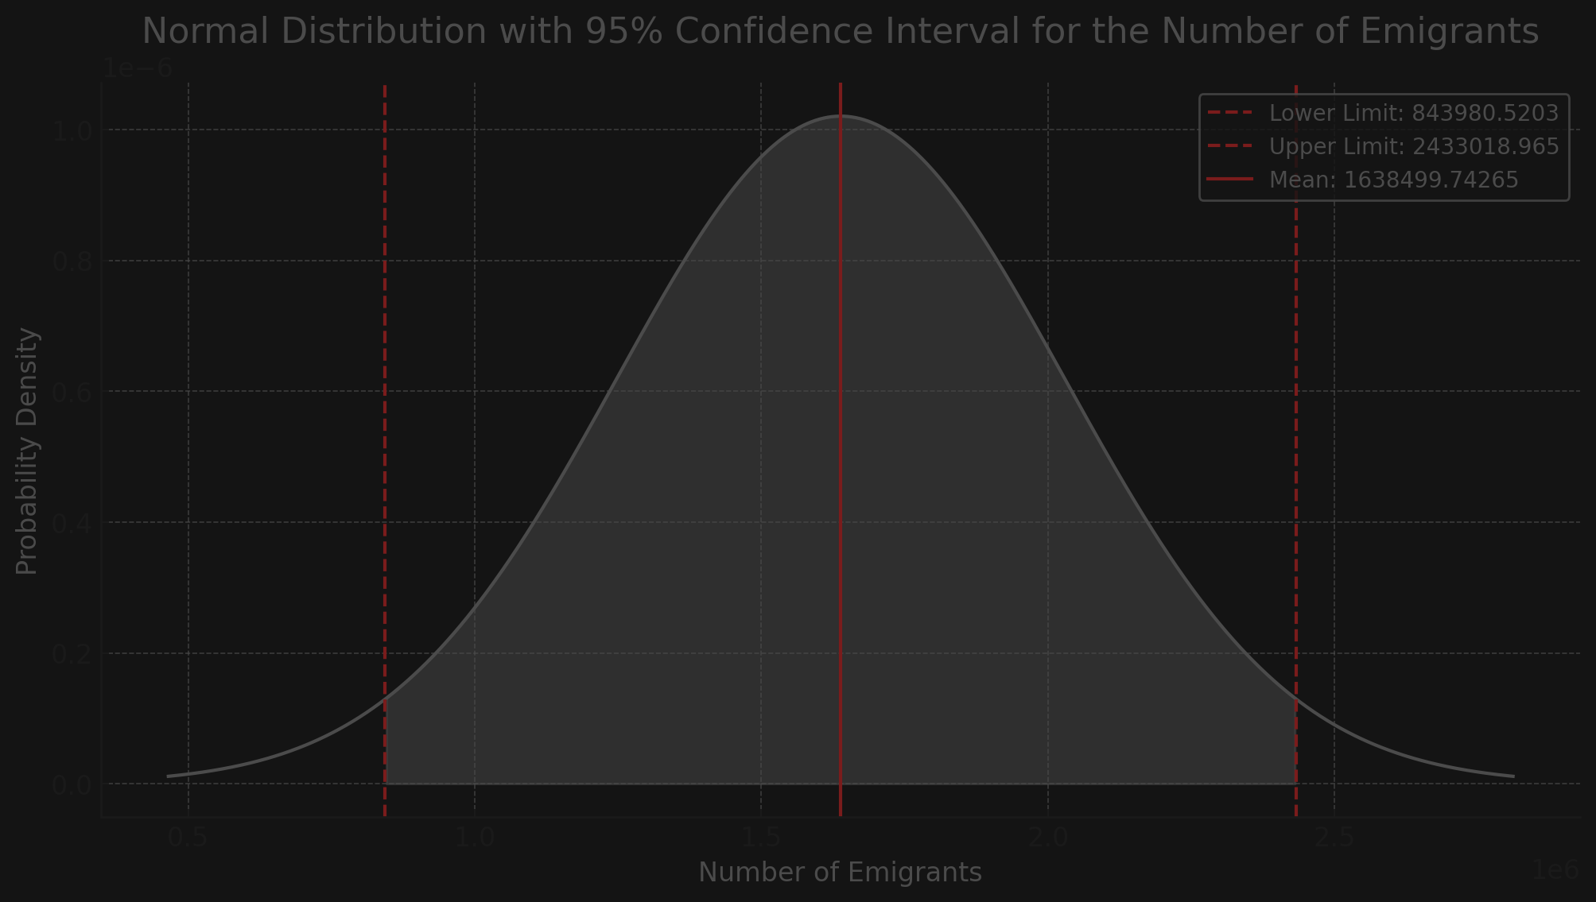
Emigrants
Confidence Levels
Interpretation: We are 90% confident that the population mean score is between 977421.896 and 2299577.59
Interpretation: We are 95% confident that the population mean score is between 843980.5203 and 2433018.965.

Slide 10
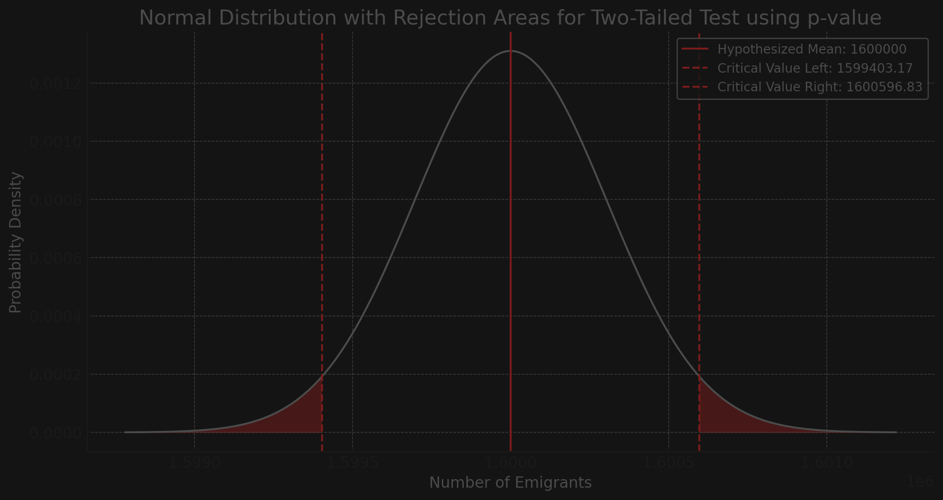
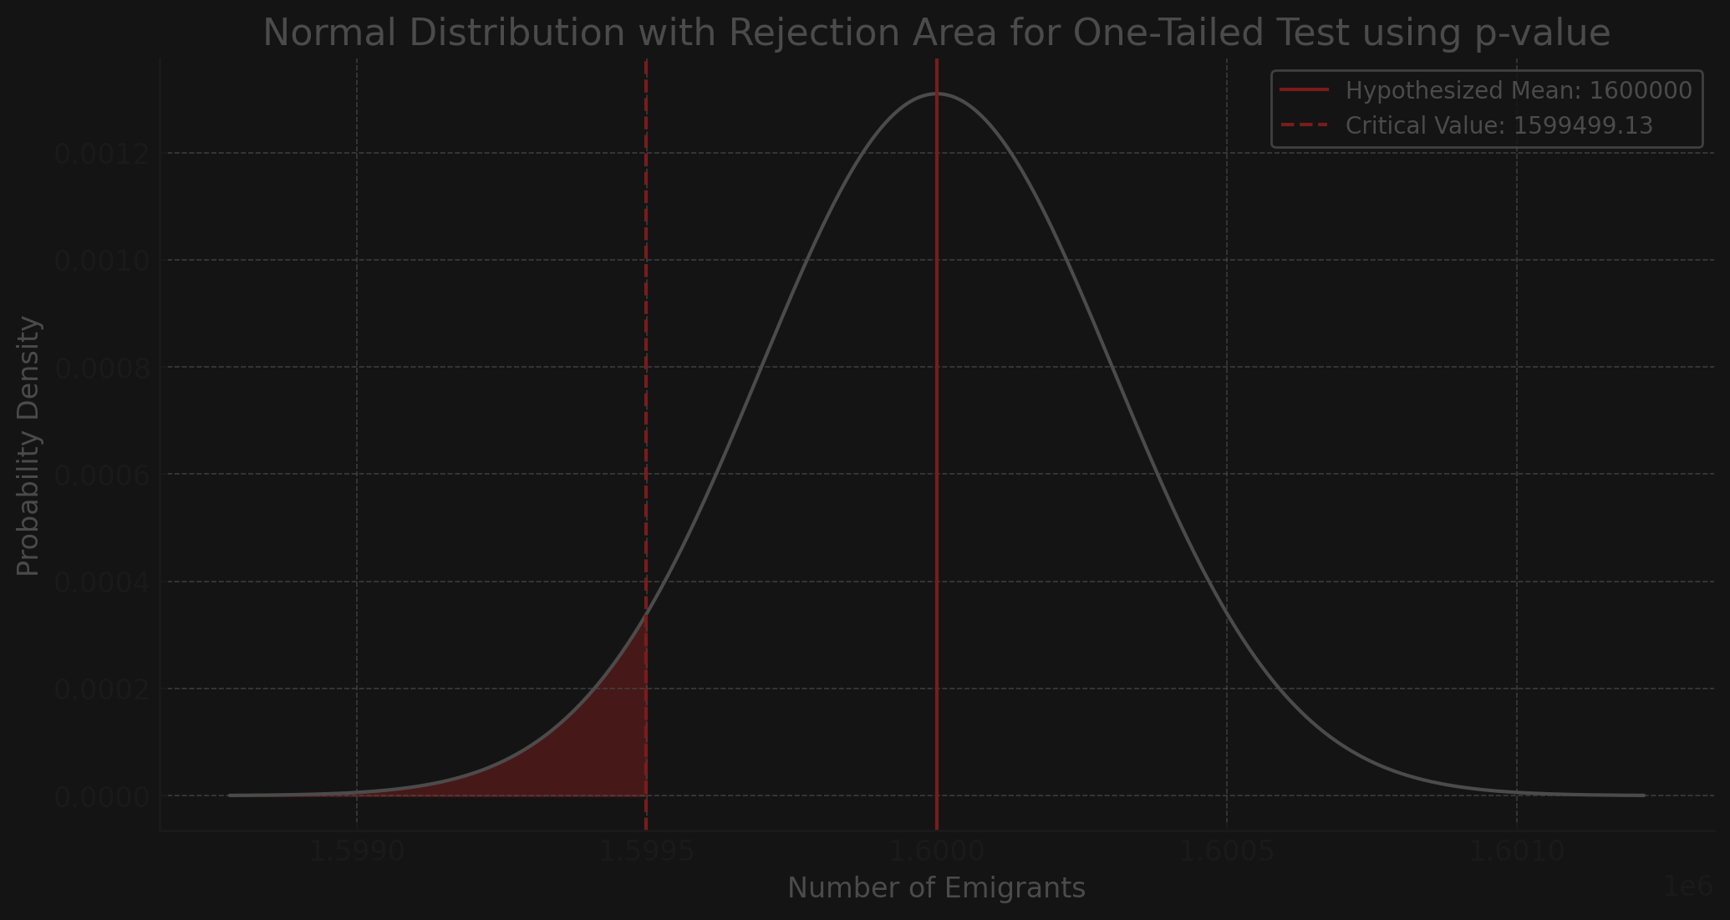
Emigrants
Hypothesis Testing
Based on the two-tailed test, there is not enough evidence to suggest that the average number of emigrants is not
around 1,600,000. So, we accept the null hypothesis, stating that the average number of emigrants is around 1,600,000.
The p-value 0.9291803777 is greater than or equal to alpha ( 0.05 ). Fail to reject the Null Hypothesis (H0).
Using the p-value for the lower-tailed test we fail to reject the null hypothesis because there is not enough evidence to suggest that the average number of emigrants is not less or equal to 1,600,000, thus accepting it.
The p-value 0.5356724961 is greater than or equal to alpha ( 0.05 ). Fail to reject the Null Hypothesis (H0).

Slide 11

ANOVA
Analysis of Variance (ANOVA) for Number of Protests by Subregion
Overall Mean: 1172.8
Source | Df | Sum Sq | Mean Sq | F value | Pr(>F)
Between Groups | 9 | 30951703.13 | 3439078.126 | 1.173262471 | 0.3378953183
Within Groups | 40 | 117248380.9 | 2931209.522
The F value of 1.17 indicates that the variation between subregions means is not much greater than the variation within subregions.
This is further supported by the p-value of 0.33, which is greater than the typical significance level of 0.05, which indicates that the observed differences in means are not statistically significant.
Therefore, we fail to reject the null hypothesis, suggesting that the subregions do not significantly differ in terms of the average number of protests.

Slide 12
Simple Linear Regression
 | Estimate | Std. Error | t value | Pr(>|t|)
(Intercept) | 498.07918 | 1056.43023 | 0.47147 | 0.64096
CPI | 10.01097 | 17.75810 | 0.56374 | 0.57742
Residual standard error | 1781.59 on 28 degrees of freedom
Multiple R-squared | 0.01122276
Adjusted R-squared | -0.02409071
F-statistic | 0.317804 on 1 and 28 DF
p-value | 0.577418
 | Estimate | Std. Error | t value | Pr(>|t|)
Intercept | 3863901.39 | 1336249.99 | 2.89160 | 0.0073318
CPI | -38661.77 | 22461.74 | -1.72123 | 0.0962428
Residual standard error | 2253484 on 28 degrees of freedom
Multiple R-squared | 0.09568391
Adjusted R-squared | 0.06338691
F-statistic | 2.962625 on 1 and 28 DF
p-value | 0.09624278

Slide 13
Simple Linear Regression
 | Estimate | Std. Error | t value | Pr(>|t|)
Intercept | 836643.6646 | 407945.7335 | 2.05087 | 0.04974344
No. Protests | 788.0171 | 200.7451 | 3.92546 | 0.00051299
Residual standard error | 1903191 on 28 degrees of freedom
Multiple R-squared | 0.3549762
Adjusted R-squared | 0.3319396
F-statistic | 15.40925 on 1 and 28 DF
p-value | 0.0005129884
R-Squared: The variation in the number of emigrants is explained in proportion of 35% by the independent variable, number of protests.
F-statistic: The F-statistic is relatively high, suggesting that the model with number of protests as the predictor explains
a substantially larger proportion of the variance in the number of emigrants.
.
Intercept: The expected value of the dependent variable, number of emigrants is approximately 836,643 when the independent variable is 0.
Number of protests: For each one-unit increase in the number of protests, the number of emigrants increases by approximately 788. Since the p-value is lower than 0.05, the effect of the number of protests on the number of emigrants is statistically significant.
p-value: This p-value is substantially below the 0.05 threshold, suggesting that the model as a whole is statistically significant

Slide 14
Multiple Linear Regression
 | Estimate | Std. Error | t value | Pr(>|t|)
(Intercept) | 4247892.77052 | 1206327.04243 | 3.52134 | 0.00099678
CPI | 61550.01315 | 23728.82730 | -2.59389 | 0.01276117
No protests | 1557.62935 | 560.16042 | 2.78068 | 0.00789303
Edu. lvl H | 1033864.77244 | 793454.83480 | 1.30299 | 0.19920596
Int. term | -17.69372 | 9.31532 | -1.89942 | 0.06393013
Residual standard error | 1937503 on 45 degrees of freedom
Multiple R-squared | 0.4672492,
Adjusted R-squared | 0.4198935
F-statistic | 9.866814 on 4 and 45 DF,
p-value | 0.000008090689
Adjusted R-Squared: It indicates that approximately 42.0% of the variability in the number of emigrants can be explained by the model, accounting for the number of predictors
CPI: For each one-unit increase in the CPI, the number of emigrants decreases by approximately 61,550, Caeteris Paribus. Since the p-value is less than 0.05, this effect is statistically significant.
Number of protests: For each additional protest, the number of emigrants increases by approximately 1,558, Caeteris Paribus. This effect is also statistically significant, as indicated by the p-value being
less than 0.05.
Education level - high: Countries with a high education level have approximately 1,033,865 more emigrants compared to countries with a low education level, Caeteris Paribus. However, this effect is not statistically significant, as the p-value is greater than 0.05.
Intercept: The expected value of the dependent variable number of emigrants is 4,247,892.77 when the other variables are 0. Since the P value is less than 0.05 it’s statistically significant.
Interaction Term: For each additional unit increase in the product of CPI and the number of protests, the number of emigrants decreases by approximately 18. This effect is close to being statistically significant, with a p-value just above the 0.05 threshold (p-value = 0.064).

Slide 15
CONCLUSIONS
How do levels of corruption impact emigration patterns across different countries?
Higher levels of corruption often lead to increased emigration as individuals seek better governance and economic opportunities elsewhere.
Are there correlations between protest activities and perceptions of corruption within specific regions?
There is a strong correlation between protest activities and high perceptions of corruption, with protests frequently occurring in regions where citizens perceive corruption as rampant.
Do countries with higher protests have higher amounts of emigrants?
Countries experiencing higher levels of protests often see higher emigration rates, as political instability and dissatisfaction drive people to leave.

Slide 16
BIBLIOGRAPHICAL REFERENCES
​Datasets/Data
​Corruption Perceptions Index From https://www.transparency.org/en/cpi/2022 Year 2022
​Emigration From https://ourworldindata.org/migration Year 2020
​Protests From https://acleddata.com/ Year 2022
​Population From https://database.earth/population/by-country/2022 Year 2022
Literature Review
​​Exit or Voice? Corruption Perceptions and Emigration
​Published: 09 May 2023, Volume 59, pages 138–175, (2024)
​Corruption as a push and pull factor of migration flows: evidence from European countries Published: 18 December 2023, Volume 51, pages 263–281, (2024)
​Emigration and Collective Action
​Published: October 2019, Volume 81, Number 4
​Voice after Exit? Bulgarian Civic Activists between Protest and Emigration Published 1 May, 2020 Volume 35, Issue 1
​Voting with Their Feet: Emigration in the Aftermath of Kazakhstan’s Bloody January Published February 09, 2022

Slide 17


Thanks!
Yours truly-
Al Sammarraie Nooruldeen
Litescu David Adrian
Gagiu Casandra
Scientific Leaders:
DAVIDESCU N ADRIANA-ANAMARIA
AGAFITEI M MARINA-DIANA
Year of Support: 2024

