Slide 1
Jframe
setVisible();
setDefaultCloseOperation();
setSize();
setLocation();
setBounds();
setIconImage();
setTitle();
setBackground();
setResizable();
Noor_Mustafa_Rajpar

Slide 2
Jframe
JFrame frame = new JFrame();
//Note Jframe visibility by Default false
frame.setVisible(true);
frame.setDefaultCloseOperation(JFrame.EXIT_ON_CLOSE);
After Clicling on exit our program will become Terminate:

Slide 3
Jframe
frame.setSize(400,400);
frame.setLocation(100,150);
Or instead of Using Both Two Function we can also use
frame.setBounds(100,150,400,400);// but inside this perameters first we have to find the location
First Left And then top
And then width and then height

Slide 4
Jframe
frame.setTitle("JFRAME_PROGRAM");
For set The Icon inside the JFRame First We Will Create the ImageIcon then iside that we will pass the image in its perameters and the we will add it into JFRame.
Step1:
1: ImageIcon icon = new ImageIcon("p1.jpg");
2:frame.setIconImage(icon.getImage());

Slide 5
Jframe
Backround change:
BackGround we can change through Jframe ContentPane;
frame.getContentPane();// ContentPane is Like a Container type
So We will store it into the Container object
Container c = frame.getContentPane();
Note: Container Is Not The Class OF JAVA Swing.
It is The class OF Java AWT package;
frame.setResizable(false); // its by default is true.

Slide 6
Jlabel:
JLabel:
setText();
setFont();
How to use Image in Jlabel.
How To use both Image and Text in Jlabel.

Slide 7
Jlabel:
JLabel:
JLabel l1 = new JLabel("UserName");
or
l1.setText(“ Password ”);
c.add(l1);
Note: Jframe By default layout is Flow that’s why it shows the Label inside the
Center:
So For that we will use
c.setLayout(null);
So our Location will not visible : so for that we have to set Locations as well as the the size
L1.setBounds(100,150,200,250);

Slide 8
Jlabel:
Jlabel FontSize:
We have to use FontClass:
Font fn = new Font("Arial",Font.ITALIC,30);
l1.setFont(fn);

Slide 9
Jlabel:
Add image in Jlabel
ImageIcon icon1 = new ImageIcon("p1.jpg");
JLabel l2 = new JLabel(icon1);
l2.setBounds(150,100,300,100);// or
l2.setBounds(250,200,icon1.getIconWidth(),icon1.getIconHeight());
c.add(l2);

Slide 10
JTextField
setText();
setFont();
setBackground();
setForeground();
setEditable();

Slide 11
JTextField
JTextField f1 = new JTextField();
f1.setBounds(100,150,100,30);
c.add(f1);
f1.setEditable(false);

Slide 12
JPasswordField.
setechoChar();
How to Hide/Show Password

Slide 13
JPasswordField.
setechoChar();
How to Hide/Show Password

Slide 14
JPasswordField.
JPasswordField f = new JPasswordField();
f.setBounds(100, 150,100,25);
f.setText("Noor@@!!@");
c.add(f);

Slide 15
JPasswordField.
f.setEchoChar(‘ * ‘); it will show the start in password field
For showing the passward
f.setEchoChar((char)0);

Slide 16
JButton
f.setEchoChar(‘ * ‘); it will show the start in password field
For showing the passward
f.setEchoChar((char)0);

Slide 17
JButton
JButton btn = new JButton("Click_ME");
btn.setBounds(150,100,100,30);
c.add(btn);

Slide 18
JButton
Font fn = new Font("Arial",Font.ITALIC,25);
btn.setFont(fn);

Slide 19
JButton
Text_Dinamically Change:
btn.setText("MyButon");
Color_Change;
btn.setForeground(Color.RED);
Btn.setBackground (Color.YELLOW);

Slide 20
JButton
CURSOR.
Cursor cur = new Cursor(Cursor.HAND_CURSOR);
btn.setCursor(cur);
Cursor cur = new Cursor(Cursor.CROSSHAIR_CURSOR);
Cursor cur = new Cursor(Cursor.WAIT_CURSOR);

Slide 21
JButton
Button_Disable OR Enable
Btn.setEnabled(false);
Btn.setEnabled(true);
Btn.setVisible(true);
Btn.setVisible(false);

Slide 22
JButton
AddImage In Jbutton:
ImageIcon icon = new ImageIcon("p1.jpg");
JButton btn = new JButton(icon);
For Button width and hight which will become image width and hight
btn.setBounds(150,100,icon.getIconWidth(),icon.getIconHeight());

Slide 23
Jbutton Events
Action Listener
Void actionPerformed();
addActionListener();

Slide 24
Jbutton Events
import javax.swing.*;
import java.awt.*;
import java.awt.event.*;
class Myframe extends JFrame implements ActionListener {
Container c;
JButton btn;
Myframe(){
c=this.getContentPane();
c.setLayout(null);
btn = new JButton("Click_Me");
btn.setBounds(100,100,100,50);
c.add(btn);
btn.addActionListener(this);
}
public void actionPerformed(ActionEvent e)
{
c.setBackground(Color.red);
}
}
public class ActionDemo {
public static void main (String args[]){
Myframe f = new Myframe();
f.setTitle("Action_Demo");
f.setBounds(100,100,700,500);
f.setVisible(true);
f.setDefaultCloseOperation(JFrame.EXIT_ON_CLOSE);
}
}

Slide 25
Jbutton Events
Multiple button events
Handling
getSource(); // Important

Slide 26
Jbutton Events
Event handling using
Anonymous inner class: Very Important
Anonymous inner class: Very Important
Inside this we don’t implement the seprate class we just pass the definition of that class inside the
addActionListenerMethod;

Slide 27
Jbutton Events
Event handling using
Anonymous inner class: Very Important
This is How We can implement the Anonymous Inner Class :
Btn.addActionListener(new ActionListener(){
Public void actionPerformed(ActionEvent e){
c.setBackground(Color.RED);
}
});

Slide 28
LoginForm
Create The Login Form using The javax Objects and when we submit it will show in the commandpromt

Slide 29
JTextArea
How To Create JtextArea
setText(String)
setFont(Font)
setEditable(Boolean)
setLinewrap(Boolean)

Slide 30
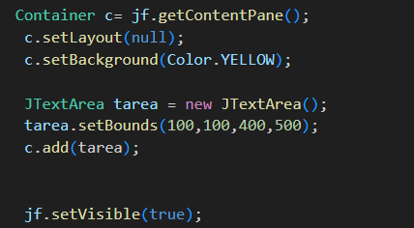
JTextArea

Slide 31
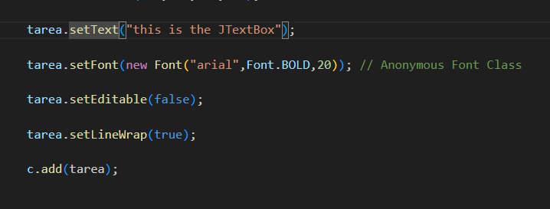
JTextArea

Slide 32
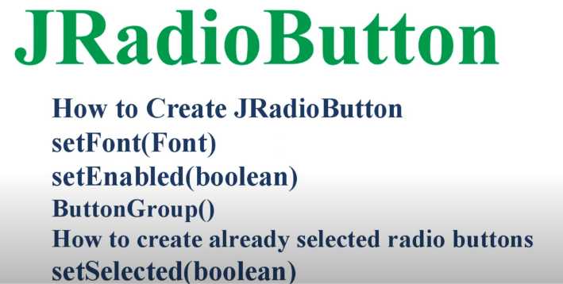
JRadioButton

Slide 33
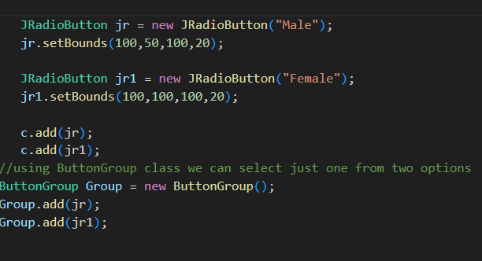
JRadioButton

Slide 34
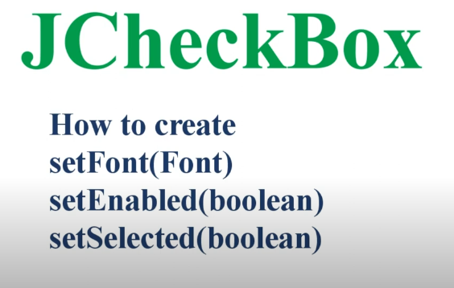
JCheckBox

Slide 35
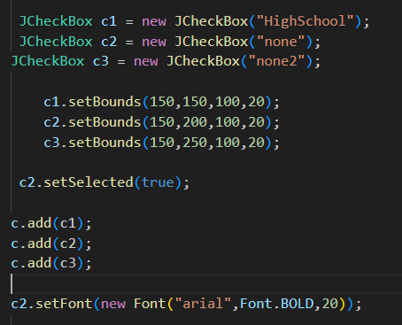
JCheckBox

Slide 36
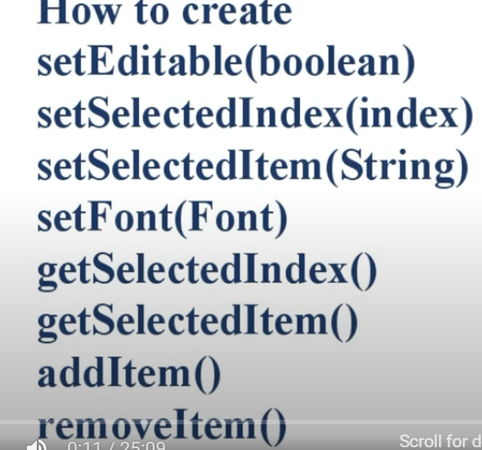
JComboBox

Slide 37
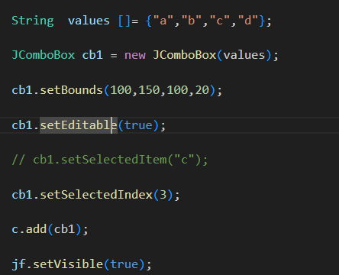
JComboBox

Slide 38
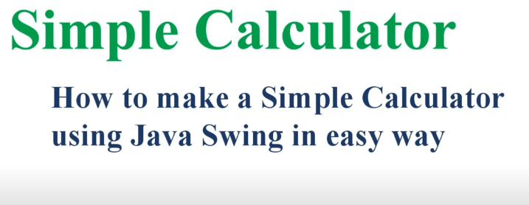
SimPle Calculator

Slide 39
Registration Form

Slide 40
JDBC
MySQL J /Connector jarfile
JDBC Connection !
Insert Program
Update and Delete Program

Slide 41
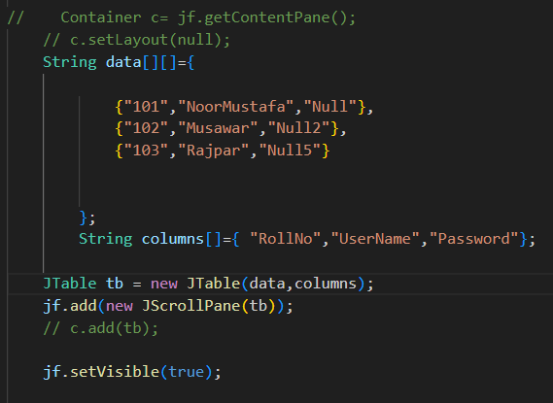
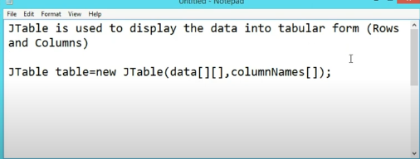
Jtable : Note There is No Need For the Container class.This Pattren for Creating table when we want to show this fix data.
For update dlete etc we have to use another pattern name Jtable(tableModel);

Slide 42
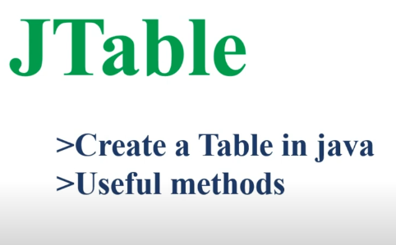
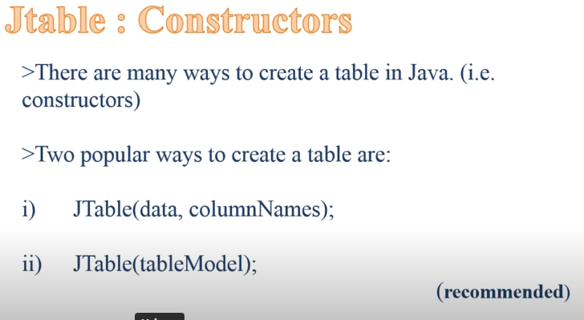
Recommended pattern

Slide 43
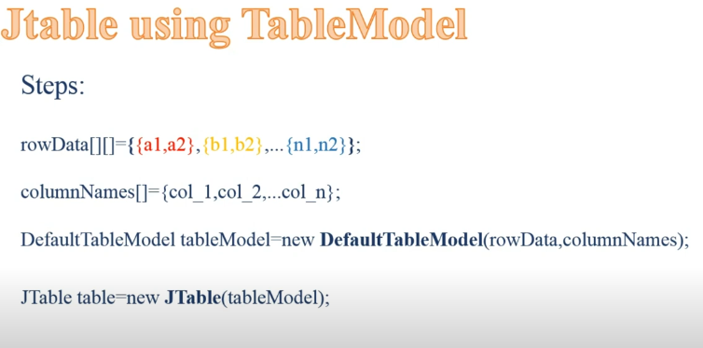
Program:

Slide 44
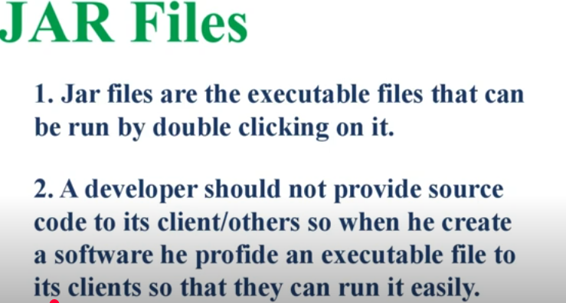
JarFile

Slide 45
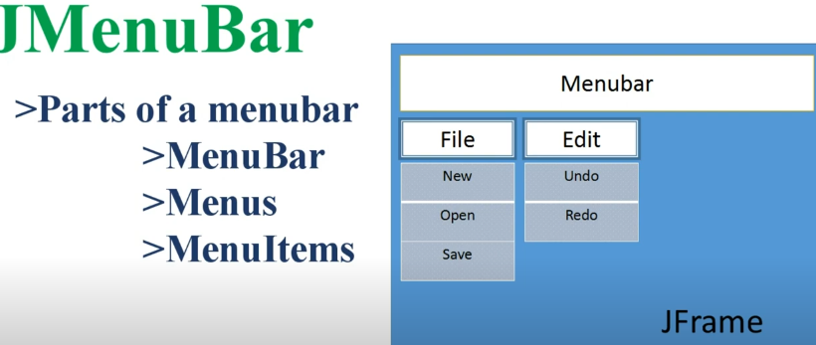
JMenuBar

Slide 46
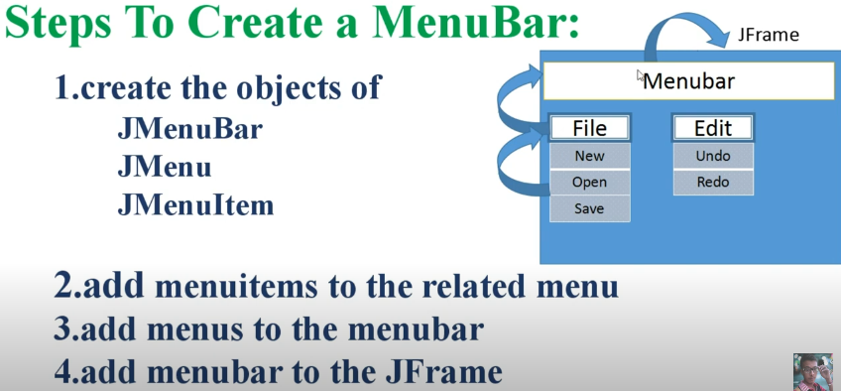
JMenuBar

