Slide 1
Introduction to PL/SQL
PL/SQL stands for Procedural Language extension to Structured Query Language. It is a proprietary extension created by Oracle Corporation for the Oracle Database.
While standard SQL is a non-procedural language—meaning you tell the database what data you want, but not how to fetch it step-by-step—PL/SQL combines SQL with the procedural features of programming languages (like loops, conditions, variables, and error handling

Slide 2
Why Do We Need PL/SQL?
1: Procedural Capabilities: Standard SQL cannot handle decision-making (IF-ELSE) or iteration (WHILE, FOR loops) on its own. PL/SQL brings full programming logic into the database.
2: Performance (Reduced Network Traffic): Instead of sending multiple individual SQL queries from an application to the database one by one, you can group them into a single PL/SQL block and send it to the database server in one trip, reducing network latency.

Slide 3
PL/SQL is strictly exclusive to Oracle Database.
PL/SQL is strictly exclusive to Oracle Database. You cannot use actual PL/SQL in MySQL or PostgreSQL
PL/SQL (Procedural Language/SQL) was specifically designed and developed by Oracle Corporation for its database system, Oracle Database.
No other database system, such as MySQL or Microsoft SQL Server, can execute actual PL/SQL code using Oracle's native PL/SQL engine.

Slide 4
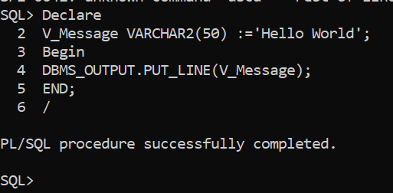
1: Oracle Databases Uses PL/SQL
Name: Procedural Language/Structured Query Language (Oracle's proprietary language).
Syntax Style: Uses DECLARE, BEGIN, EXCEPTION, END;, and ends blocks with a slash (/). Anonymous PL/SQL Block

Slide 5
2. MySQL - Uses MySQL Stored Routines / Procedural SQL
MySQL uses its own procedural extension called MySQL Stored Routines
Stored Routines" is the umbrella term in MySQL. It includes both Stored Procedures and Stored Functions. They share similar logic with Oracle's PL/SQL, but the engine and syntax belong purely to MySQL
Syntax Style: Uses DELIMITER, BEGIN, END, and requires semicolons inside the block. It does not use DECLARE the exact same way Oracle does, and printing is done via SELECT rather than a built-in package

Slide 6
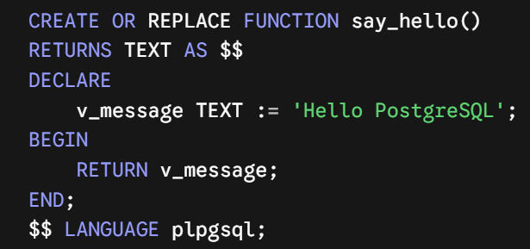
3. PostgreSQL (Managed via pgAdmin) Uses PL/pgSQL
Name: Procedural Language/PostgreSQL Structured Query Language.
Syntax Style: Very similar conceptually to Oracle's PL/SQL (which inspired it), but uses dollar-quoting ($$) instead of DELIMITER, and
requires you to specify LANGUAGE plpgsql.

Slide 7
PL/SQL Block Structure
Basic Anatomy of a PL/SQL Block
The DECLARE section (Variables & Constants)
The BEGIN section (Executable statements)
The EXCEPTION section (Error handling)
The END; terminator

Slide 8
Variables and Data Types
1: Scalar Data Types (VARCHAR2, NUMBER, DATE, BOOLEAN)
2: Anchor Declarations (%TYPE and %ROWTYPE)
Anchor Declarations in Oracle PL/SQL are a way to link (or anchor) a variable's data type directly to a database column or an entire table row.
Instead of manually typing out data types and sizes, you let PL/SQL dynamically borrow them from the database structure.
1. %TYPE (For a single column)
Use %TYPE when you need a variable to store data for just one specific column.

Slide 9
Variables and Data Types
Without Anchor (Hardcoded):
v_salary NUMBER(8,2);
Anchor Declarations in Oracle PL/SQL are a way to link (or anchor) a variable's data type directly to a database column or an entire table row.
Problem: If the database administrator later increases the salary column size in the database, your code will crash with a value error unless you manually update it.
v_sal employees.salary%TYPE;

Slide 10
Variables and Data Types
2. %ROWTYPE (For an entire row)
Use %ROWTYPE when you want to fetch and hold an entire row (all columns) from a table without declaring individual variables for every column.
With Anchor (%ROWTYPE):
v_emp_row employees%ROWTYPE;
Meaning: "Create a single record structure that automatically mirrors all columns (id, name, email, salary, etc.) of the employees table."

Slide 11
Key Benefits
Automatic Synchronization: If table columns are modified, added, or resized in the database, your PL/SQL code adapts automatically without requiring code edits.
Cleaner Code: Replaces dozens of individual variable declarations with a single %ROWTYPE declaration.
Prevents Errors: Eliminates data type mismatch bugs during database queries.

Slide 12
Introduction to Stored Procedures
Overview
A Stored Procedure is a core relational database concept rather than a feature tied exclusively to Oracle's PL/SQL. It refers to a pre-compiled, reusable group of SQL statements and procedural logic—such as conditional statements, loops, and variables—stored directly inside the database server. While Oracle uses the term PL/SQL to implement stored procedures, virtually all major Relational Database Management System (RDBMS) platforms support this concept using their own procedural extensions, including PostgreSQL (PL/pgSQL), Microsoft SQL Server (T-SQL), and MySQL.

Slide 13
Introduction to Stored Procedures
Overview
A Stored Procedures is The Set of statement inside it we can write multiple Queries. In which through we can apply DML and DDL Operations
It Provides Code Re-usibility and Performance Improvement And Security Purposes.
Procedures are Used For Actions for Performing large Actions.
Like changes in database in Multiple Tables.
While Functions is used for the Calculations and It return a value . While procedure does not return any Value.

Slide 14
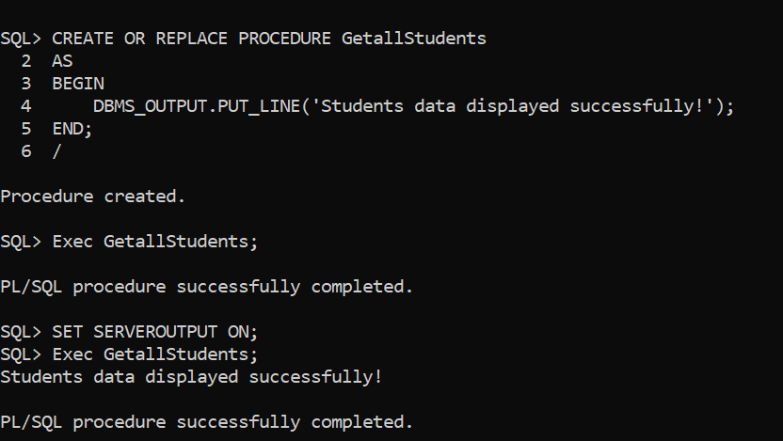
Basic Syntax !

Slide 15
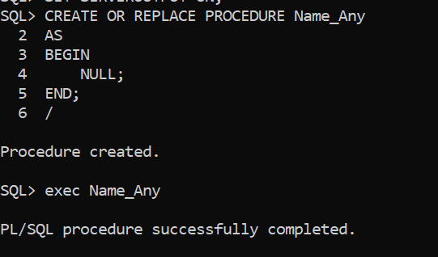
Basic Syntax !

Slide 16
Stored Procedures
Understanding Stored Procedure Parameters
Stored procedures can accept parameters to make them dynamic. There are typically three types of parameters.
IN: Passes a value into the procedure (default).
OUT: Passes a value out of the procedure back to the caller.
INOUT: Does both—takes an input value and modifies it to return a value.

Slide 17
Stored Procedures
Example 1: A Simple Stored Procedure (No Parameters)

Slide 18
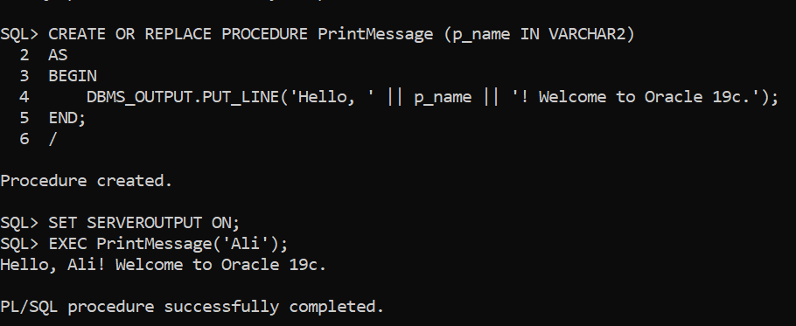
Stored Procedures
Example2: A Stored Procedure with IN parameters.

Slide 19
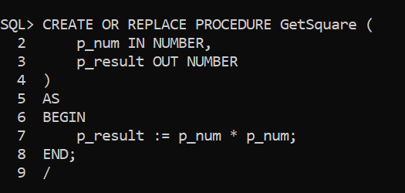
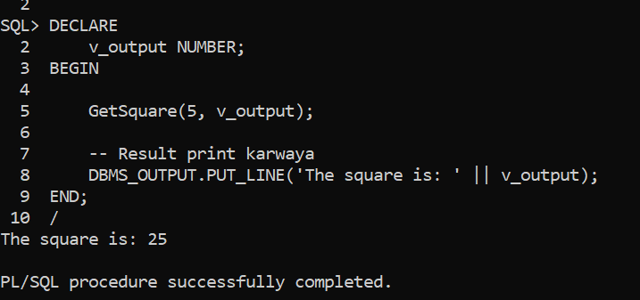
Stored Procedures
Example2: A Stored Procedure with OUT parameters.

Slide 20
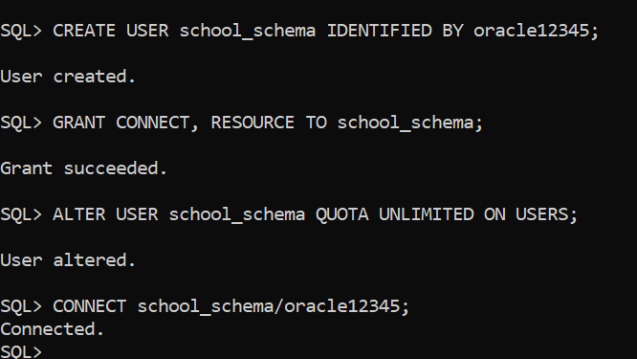
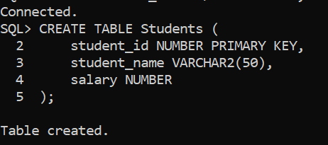
Stored Procedures
Example3: A Stored Procedure with INOUT parameters.

Slide 21
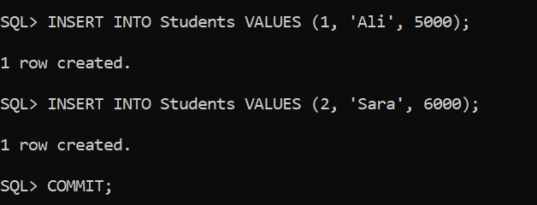
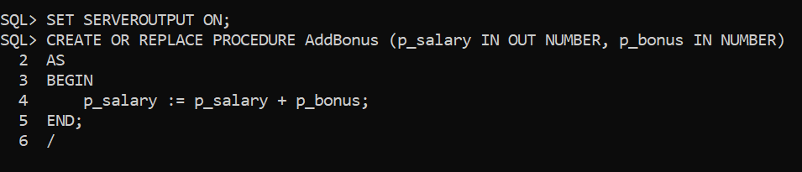
Stored Procedures
Example3: A Stored Procedure with INOUT parameters.

Slide 22
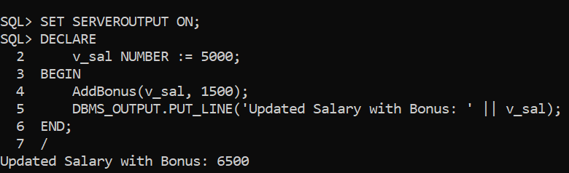
Stored Procedures
Example3: A Stored Procedure with INOUT parameters.

Slide 23
Functions In PLSQL
Function: is a Block of code That Perform a Given Task and return value.
Types of Functions:
1: Scalar Function :
2: Table Function :

Slide 24
1: Scalar Function :
In Oracle PL/SQL, a scalar function (commonly referred to as a stored function) is a database subprogram that performs a specific set of calculations or logic and returns a single, atomic value (such as a number, string, date, or boolean) to the calling environment.
Key Characteristics of Scalar Functions
Single Value Return: Unlike table functions that return an entire result set (rows and columns), a scalar function always returns exactly one value per execution
Reusability: Once created and stored in the database, it can be called repeatedly across multiple applications, queries, and blocks.
Parameter Support: They can accept zero or more input parameters (IN), and optionally output parameters (OUT or IN OUT, though IN is most common for functions used in SQL).

Slide 25
2:Table Function
In Oracle PL/SQL, a Table Function is a user-defined function that returns a collection of rows (a dataset) rather than a single scalar value.
Returns multiple rows and columns, acting as a virtual table that can be queried, joined, or filtered using standard SQL operations

Slide 26
How Table Functions Work?
To create and use a table function in Oracle, you typically need three things:
1:An Object Type: Defines the structure of a single row (columns and data types).
2:A Collection Type: Defines a table structure that holds multiple instances of that object type.
3:The Table Function (with PIPELINED): A function that uses the PIPE ROW command to stream rows back to the calling query one by one, saving memory and improving performance.

Slide 27
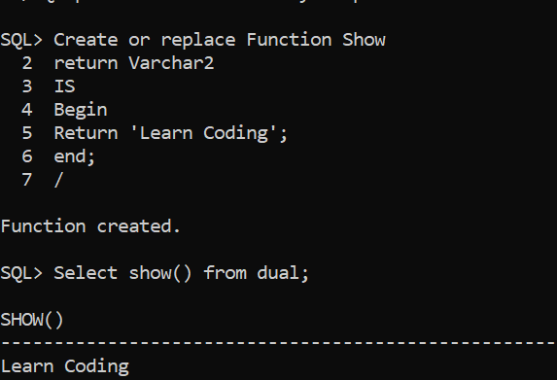
Example: Function Without parameters

Slide 28
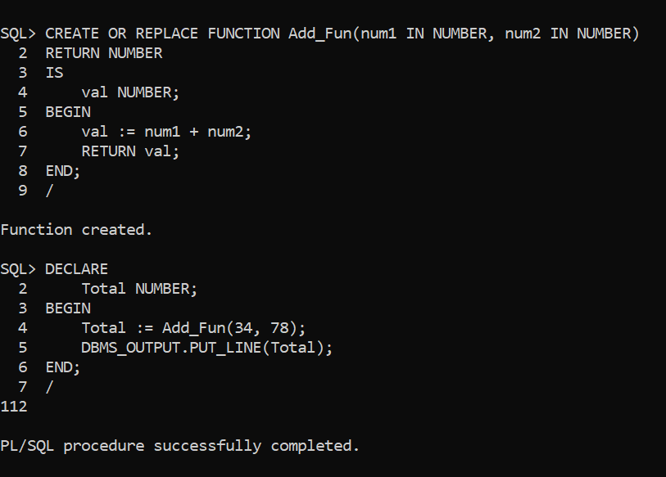
Example: Function With parameters

Slide 29
Triggers
Triggers : It is a Procedure that starts Automatically if Specific Changes Occur to the DBMS.
It has three parts:
Trigger Event : The action that causes the trigger to fire (e.g., INSERT, UPDATE, or DELETE operations on a table).
Condition :A specific criteria that must be met for the trigger action to execute (e.g., WHEN (NEW.salary > 10000)).
Trigger Action:The PL/SQL block (BEGIN ... END;) containing the actual code to be executed when the event occurs.

Slide 30
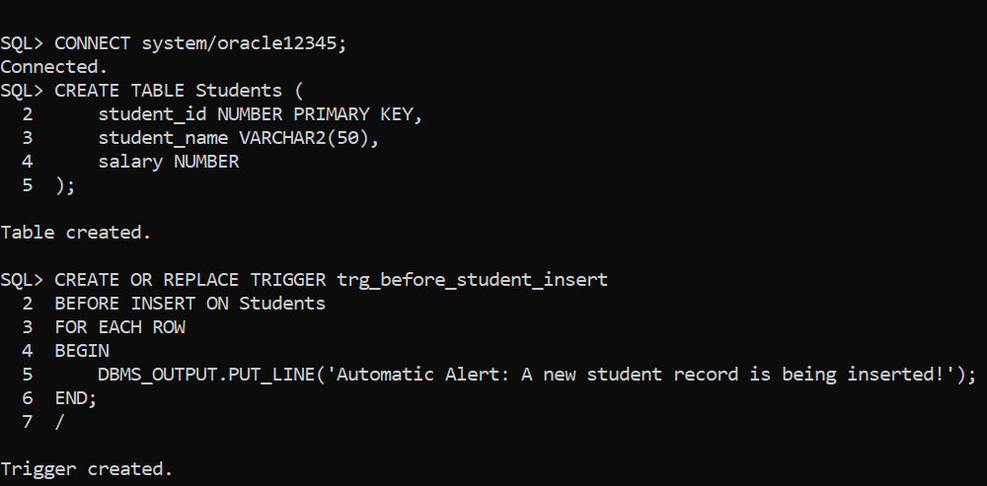
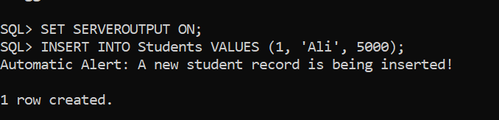
Triggers
Example1:

Slide 31
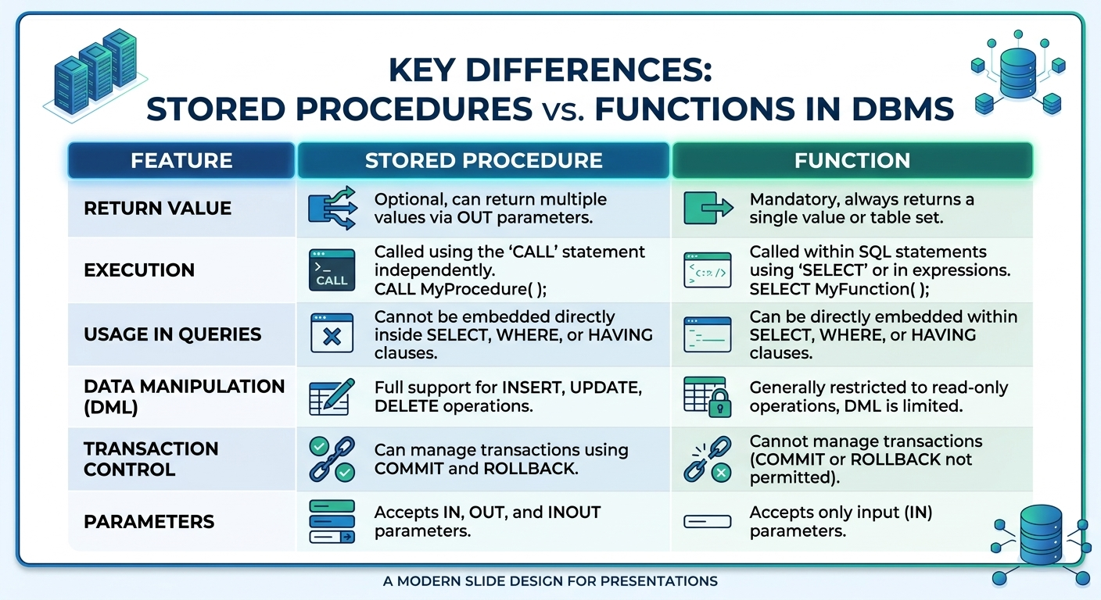
Stored Procedures VS Functions
In database management systems, both Stored Procedures and Functions are reusable blocks of code, but their working mechanisms and use cases are quite different from each other.
Key Differences

Slide 32
Control Structures in DBMS
Control Structures in database management systems (DBMS) allow you to add programming logic—such as decision-making (conditions) and loops (iteration)—inside your stored procedures and functions.
Main Types of Control Structures
1--Conditional Statements:
IF-THEN-ELSE
CASE Statement
2--Loops:
WHILE Loop
REPEAT Loop
LOOP

Slide 33
Cursor !
A Cursor holds multiple rows returned by a sql Statement .
A Cursor in PL/SQL is a memory area (or a pointer to a memory area) that Oracle Database uses to process SQL statements and manage the rows returned by those statements.
2--A cursor is a mechanism that allows PL/SQL to retrieve and process the records returned by a SQL query, one row at a time.:
For example, suppose we have an EMPLOYEES table containing 100 employees. If we execute a SELECT statement to retrieve all employees, a cursor allows us to access and process those records individually.

Slide 34
Why Do We Need Cursors?
Example : SELECT * FROM employees;
This query retrieves all records from the employees table.
But suppose we want to:
Retrieve employee records one by one.
Display each employee's name and salary.
Calculate a bonus for every employee.
Perform different operations based on employee information.

Slide 35
For these tasks, we can use a cursor in PL/SQL.
How Does a Cursor Work?
A cursor generally follows four important steps:
But suppose we want to:
1 : DECLARE
Define the cursor and specify the SQL query.
2 : OPEN
Execute the query and establish the result set.
3: FETCH
Retrieve records from the result set one at a time.
4: Close
Release the cursor resources.

Slide 36
Practical Example of Cursor in PL/SQL
Suppose we have an employees table.
Employees Table
Employee_ID | Employee_Name | Salary
101 | Ali | 30000
102 | Ahmed | 40000
103 | Sara | 50000
104 | Noor | 60000
Our requirement is to retrieve and display every employee's name and salary individually.

Slide 37
Example 1:
In notepad

Slide 38
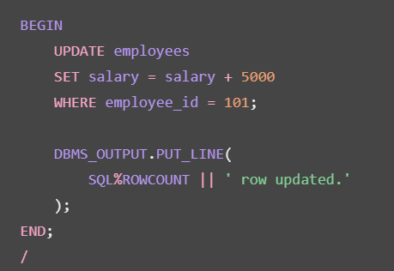
Types of Cursors in PL/SQL
Oracle PL/SQL mainly provides two types of cursors.
1 :Implicit Cursor
An implicit cursor is automatically created and managed by Oracle whenever a SQL statement is executed.
%ROWCOUNT | Returns the number of rows fetched so far.

Slide 39
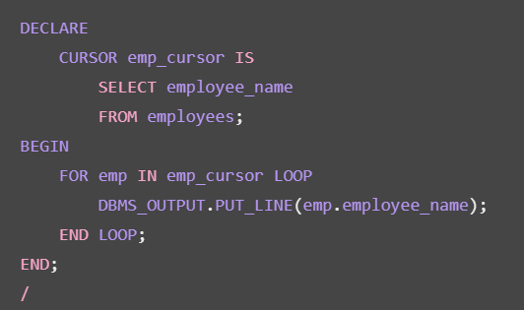
Types of Cursors in PL/SQL
Oracle PL/SQL mainly provides two types of cursors.
2: Explicit Cursor
An explicit cursor is declared and managed by the programmer when a query returns multiple rows that need to be processed individually.

Slide 40
Why Do We Need a Cursor If We Can Use the WHERE Clause?
Normally, we can retrieve specific records from a table using a SELECT statement with a WHERE condition.
For example, suppose we want to retrieve employees whose salaries are greater than 40,000.
SELECT name, salary
FROM employees
WHERE salary > 40000;

Slide 41
Why Do We Need a Cursor If We Can Use the WHERE Clause?
If we can already retrieve and filter records using the SELECT statement and WHERE clause, why do we need a Cursor in PL/SQL?
SELECT: Retrieves data from a database table.
WHERE: Filters records based on specified conditions.
CURSOR: Provides a mechanism to access and process the rows returned by a SQL query individually, one row at a time, within PL/SQL.
Note:A cursor is not a replacement for the SELECT statement or WHERE clause. Instead, it provides a mechanism to manage and process the result set returned by a SQL query.
Also, Oracle automatically uses implicit cursors for SQL statements. Explicit cursors allow programmers to control the fetching and processing of multiple records.

