Slide 1
Introduction to DBMS:
DBMS Architecture-Centralized, Client Server and Distributed Database, Database Design-Normal Forms, Data Modeling using ER and extended ER, The Relational model and Relational DBMS: integrity constraints, Basic SQL, Relational algebra, Relational calculus, Case study: Oracle/DB2/MS-SQL

Slide 2
Centralized DBMS
a) Merge everything into single system including- Hardware, DBMS software, application programs, and user interface processing software.
b) User can still connect by a remote terminal - but all processing is done at centralized site.

Slide 3
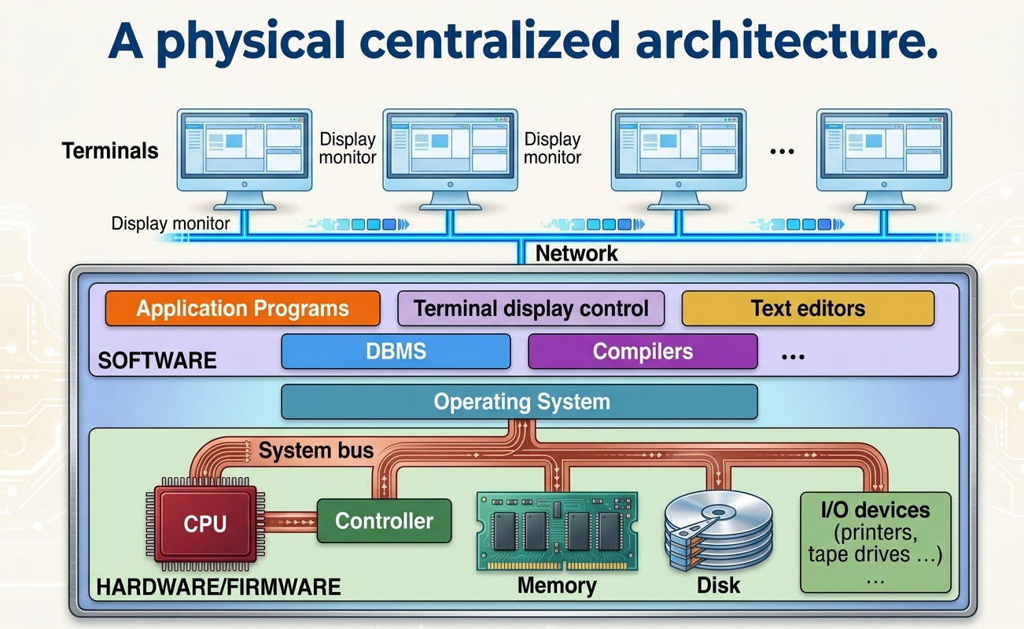

Slide 4
2-Tier Client-Server Architecture
Specialized Servers With Specialized Functions.
Print Server
File Server
DBMS Server
WEB Server
Email Server
Clients are able to access the Specialized Servers as needed .

Slide 5
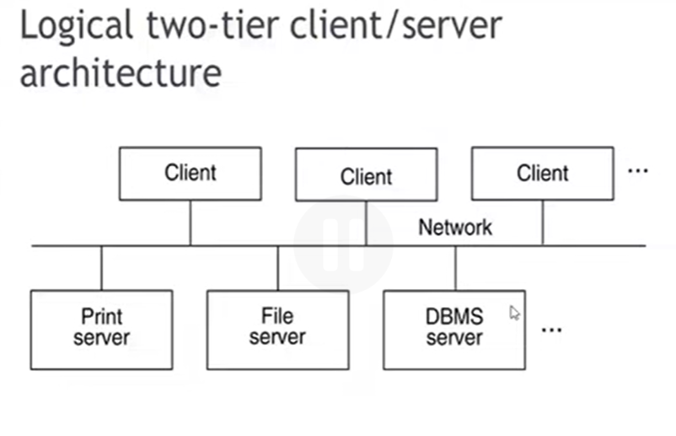

Slide 6
Advanced Querying Basics
When we move beyond basic SQL (like simple SELECT and WHERE queries)Advanced Querying is used to filter, analyze, and combine complex and heavy data
Its main components are as follows
1. Joins
2. Subqueries
3. GROUP BY And HAVING Clause
4.Aggregate Functions

Slide 7
Constraints
In Database Management Systems (DBMS), constraints are the rules enforced on the data columns of a table. They are used to limit the type of data that can go into a table to ensure the accuracy, reliability, and integrity of the data in the database
Common Types of SQL Constraints
NOT NULL : Ensures that a column cannot have a NULL (empty) value.
UNIQUE : Ensures that all values in a column are distinct and different from each other.
PRIMARY KEY : A combination of NOT NULL and UNIQUE. Uniquely identifies each row in a table.
FOREIGN KEY : Uniquely identifies a row/record in another table, establishing a relationship between two tables.

Slide 8
Over View Of SQL
Database : A Database is an Organized Collection of interrelated data .
DBMS : In Order to manage databases , we need Database Management Systems .
Database Users
DBMS
Database

Slide 9
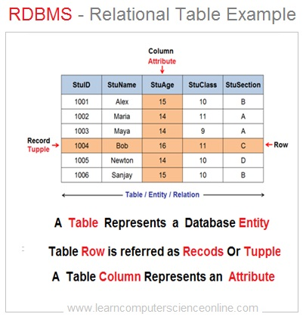
RDBMS
RDBMS : A Relational database uses Relations or Two –Dimensional tables to Store Data .
Such A database can be accessed and modified by executing Structured Query Language (SQL).
RDBMS: Soon became very popular, especially for their ease of flexibility in structure

Slide 10
SQL
SQL(Structured Query Language ) : Most Commercial Database Management Systems Support A Query Language , SQL , Which is most influential Commercially marketed product.
SQL is non Procedural Language : You specify what information you require , rather than how to get it .
In other words SQL does not require you to specify the access methods to the data .
The SQL language , Originally Called SEQUEL (Structured English Query Language) was developed by IBM. Which was latter named as SQL.

Slide 11
SQL
Language Components
SQL is divided into distinct sublanguages or language components based on the specific type of task you want to perform.
database architects categorize it into five primary components.
1:DDL (Data Definition Language)
What it does: DDL is used to define, modify, or delete the structure (schema) of the database, such as tables, indexes, views, and schemas. Ex : Create ,Alter , drop

Slide 12
SQL
Language Components
1. DML (Data Manipulation Language)
DML is used for managing the actual data stored inside the database tables. It allows you to add, modify, or remove record rows.
Ex: Insert , Update and Delete
2. DQL (Data Query Language)
DQL is specifically focused on retrieving data from the database. (In many textbooks, SELECT is grouped under DML, but in advanced architectures, it is treated as its own distinct category because it doesn't change data states.
Ex : SELECT Command

Slide 13
SQL
Language Components
4. DCL (Data Control Language)
DCL handles security, access control, and permissions. It dictates which database users can view, alter, or query specific tables and schemas.
Primary Commands:
GRANT: Gives specific privileges to a user.
REVOKE: Takes back previously granted privileges.
5.TCL (Transaction Control Language)
Primary Commands:
COMMIT: Saves all changes made during the current transaction permanently.
ROLLBACK: Undoes changes made during the current transaction if an error occurs.

Slide 14
SQL *Plus
SQL *Plus : IS An Oracle Tool That Recognizes and Submits SQL And PL/SQL (Procedural Language/Structured Query Language)
Statements to the Server Execution.
SQL*Plus is a command-line interface (CLI) tool provided by Oracle Corporation that allows users to interact with an Oracle Database
How To install –SQL *plus

Slide 15
Relational Algebra
Relational Algebra is a procedural query language used to query and manipulate data in a relational database management system (RDBMS).
To practice and implement relational algebra, we use various tools, software, and programming methods. Since it is a theoretical model, these main tools are used to make it practical.
How it works: It takes one or more relations (tables) as input, applies specific mathematical operations to them, and produces a brand-new relation as output.
Role in Databases: It serves as the theoretical and mathematical foundation for database query languages like SQL. When you write an SQL query, the database management system often translates it into relational algebra internally to optimize and execute it efficiently.

Slide 16
Relational Algebra
Who Introduced It?
Relational algebra was introduced by Edgar F. (Ted) Codd (an English computer scientist working at IBM) in 1970.
He proposed it in his seminal research paper titled "A Relational Model of Data for Large Shared Data Banks.
Because of this groundbreaking work, Dr. E.F. Codd is universally recognized as the father of the relational database model.

Slide 17
Relational Algebra
Why Is It Called "Relational Algebra?
The name is derived from combining two distinct mathematical concepts:
1 : Relational.
In database theory, a relation is the formal, mathematical term for a table (which consists of rows/tuples and columns/attributes). Because the language operates entirely on these relational tables, it is called relational.
2: Algebra (from Mathematical Operations):
In traditional algebra, you take numbers or variables(Like x and y)and apply operators (like +,-,X, ÷) to produce a new number.
Similarly, relational algebra consists of a set of formal operators that take relations (tables) as input and apply specific rules to produce a new relation.

Slide 18
Relational Algebra
Core Operations in Relational Algebra
Relational algebra operators are divided into primary categories:
Unary Operations (operate on a single table):
1--Selection (σ): Filters specific rows (tuples) that satisfy a given condition (acts like a horizontal filter)
1. Input Table:
Employees
EmpID | Name | Department | Salary
101 | Ali | IT | 50000
102 | Sara | HR | 45000
103 | Ahmed | IT | 60000
104 | John | Finance | 40000

Slide 19
Relational Algebra
Suppose we want to find all employees who work in the IT department.
σDepartment=‘IT’(Employes)
3. Output Table
The selection operation acts as a horizontal filter, keeping only the rows that match the condition (Department=‘IT’)
EmpID | Name | Department | Salary
101 | Ali | IT | 50000
103 | Ahmed | IT | 60000

Slide 20
Relational Algebra
Projection(π) Selects specific columns (attributes) and discards the rest (acts like a vertical filter).
Example:
Input Table: Employees
EmpID | Name | Department | Salary
101 | Ali | IT | 50000
102 | Sara | HR | 45000
103 | Ahmed | IT | 60000
104 | John | Finance | 40000

Slide 21
Relational Algebra
Relational Algebra Expression
Suppose we only want to see the Name and Salary of all employees, and we don't need their EmpID or Department.
Write The Operation Like this
πName,Salary (Employees)
Output Table
The projection operation acts as a vertical filter, keeping only the specified columns and discarding the rest:
Name | Salary
Ali | 50000
Sara | 45000
Ahmed | 60000
John | 40000

Slide 22
Relational Algebra
Binary Operations (operate on two tables):
1: Union (U): Combines rows from two compatible tables while removing duplicates.
Input Tables:
(Note: For a Union operation to work, both tables must be union-compatible, meaning they must have the exact same columns and data types).

Slide 23
Relational Algebra
Table 1: A_Table
RollNo | Name
101 | Ali
102 | Sara
Table 2: B_Table
RollNo | Name
102 | Sara
103 | Ahmed

Slide 24
Relational Algebra
Relational Algebra Expression
A_Table U B_Table
Output Table
The union operation merges all rows from both tables and automatically discards duplicate rows (such as "Sara" who appeared in both tables)
RollNo | Name
101 | Ali
102 | Sara
103 | Ahmed

Slide 25
Relational Algebra
2: Cartesian Product (X): Combines every row of one table with every row of another table.
The Cartesian Product (represented by X) combines every row of the first table with every row of the second table. If Table A has “n” rows and Table B has “m” rows, their Cartesian product will have
n X m rows.
Input Tables:
Table 1: Student (2 rows)
ID | Name
1 | Ali
2 | Sara

Slide 26
Relational Algebra
Table 2: Department (2 rows)
DeptCode | DeptName
D1 | CS
D2 | IT
Relational Algebra Expression
Student X Department

Slide 27
Relational Algebra
. Output Table:
Since Table Student has 2 rows and Table Department has 2 rows, the output will contain 2 X 2 = 4 rows, pairing each student with every department:
Student.ID | Student.Name | Department.DeptCode | Department.DeptName
1 | Ali | D1 | CS
1 | Ali | D2 | IT
2 | Sara | D1 | CS
2 | Sara | D2 | IT

Slide 28
Tools To Implement Relational Algebra
1 :Relational Database Management Systems (RDBMS) via SQL
SQL (Structured Query Language) is actually a practical implementation of Relational Algebra
Tools: MySQL, PostgreSQL, SQLite, aur SQL Server.
How It Works ?
How it works: When you write an SQL query (like SELECT * FROM students WHERE marks > 80), the database's Query Optimizer converts that SQL query into internal Relational Algebra expressions and executes it.

Slide 29
Tools To Implement Relational Algebra
2 : Python (Pandas Library)
What it is: Python's Pandas library is used for data manipulation, and its operations directly match Relational Algebra:
Selection (σ): For filtering rows (df[df['marks'] > 80])
Projection (π): For selecting columns (df[['name', 'marks']])

Slide 30
Normalization
It is the Process of Organizing data in database . By spiliting large messy tables into smaller One .
It is a systematic approach of organizing data in a relational database to minimize data redundancy (duplication) and prevent data anomalies (errors during data operations).
Why Do We Need Normalization?
If data is heavily duplicated, it leads to three major anomalies:
Insertion Anomaly !
Update Anomaly !
Deletion Anomaly !

Slide 31
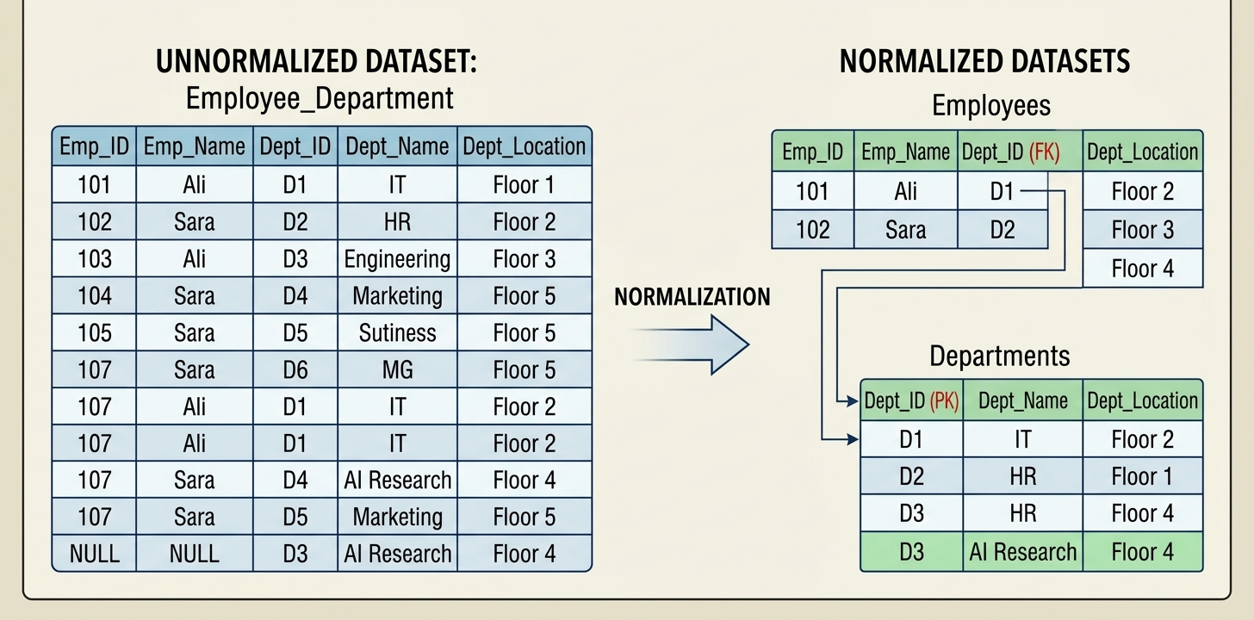
Normalization
Insertion Anomaly : You cannot insert certain data without adding dummy or unrelated data point .
Example: You cannot add a new course to a table unless at least one student is enrolled in it.

Slide 32
Normalization
Update Anomaly: Occurs when a duplicate piece of data is updated in one row or table but not everywhere else it appears, leading to data inconsistency and conflicting information.
Example: If a student changes their address, but the change is only updated in one row out of five where their record appears.

Slide 33
Normalization
Deletion Anomaly: Occurs when deleting a specific piece of data unintentionally results in the loss of other, unrelated information stored in the same row.
Example: Deleting the last student enrolled in a course accidentally erases all records and details about that course from the database.
1. The Unnormalized Table (Course_Enrollments)
Student_ID | Student_Name | Course_ID | Course_Name | Department | Course_Fee
101 | Sara | CS-101 | Intro to DB | Computer Science | $500
102 | Usman | CS-101 | Intro to DB | Computer Science | $500
103 | Ali | CS-401 | Machine Learning | AI Dept | $800

Slide 34
Normalization
1. The Unnormalized Table (Course_Enrollments)
Suppose a university stores student enrollments and course details in one combined table. Currently, Advanced Machine Learning (CS-401) has only one student enrolled (Ali):
Suppose Ali decides to drop out or cancel his registration for CS-401.
The administrator executes a standard DELETE operation to remove Ali's enrollment record:
The Problem (Unintended Loss of Data)
Because Ali was the only student in CS-401, deleting his row completely wiped out:
The fact that the course CS-401 (Machine Learning) even exists at the university.
The department offering it (AI Dept).
The fee structure ($800).

Slide 35
Normalization
Database normalization is divided into 5 primary forms:
First Normal Form (1NF)
Second Normal Form (2NF)
Third Normal Form (3NF):
Boyce-Codd Normal Form (BCNF):
Fourth Normal Form (4NF):
Fifth Normal Form (5NF):

Slide 36
Normalization
First Normal Form (1NF)
Rule1:
Each Column Should Contain Atomic Values .
Entries Like X,Y and W,X Violate this Rule.
column1 | column2
A | X, Y
B | W, X
C | Y
D | Z

Slide 37
Normalization
First Normal Form (1NF)
Rule2:
A Column Should Contain Values that are of the same type.
Do not Inter-Mix Different Types of values in any column.
Example!
DOB | Name
20-10-89 | A
13-2-92 | SK
16-11-65 | SA
R | 8-9-88

Slide 38
Normalization
First Normal Form (1NF)
Rule3:
Each Column Should have a Unique Name .
Each names Should leads to Confusion at the time of Data retrieval .
Do not Inter-Mix Different Types of values in any column.
Example!
DOB | Name | Name

Slide 39
Normalization
First Normal Form (1NF)
Rule4:
Order in Which Data is Saved Does not matter !
Using SQL Query , You can Easily fetch data in any order from a table.
Example!
Roll_no
3
4
1
2

Slide 40
Normalization
First Normal Form (1NF)
rollno | name | subject
101 | Akon | OS, CN
103 | CKON | Java
102 | BKON | C, C++
roll no | name | subject
101 | Akon | OS
101 | Akon | CN
103 | CKON | Java
102 | BKON | C
102 | BKon | C++
So Now Our Table is in 1NF

Slide 41
2_NF
For A table to be in the second Normal form .it must Follows 2 Conditions.
1 : It should be in first Normal Form.
2 : It should not have any partial Dependencies in the Table.
What is a Dependency (Functional Dependency)?
That means one column completely depends on another column.
Example: In a student table, if you know the roll no, you instantly know the student's name (e.g., Roll No 101 always belongs to Akon). We write this as:
Roll_No → Name
Means Roll No determines name . That means name is depend on Roll no

Slide 42
2_NF
What is a Partial Dependency?
A partial dependency happens when a table has a composite primary key (a primary key made of two or more columns combined), and a non-key column depends on only a part of that primary key instead of the whole thing.
Example Using Student Table (roll no, name, subject)
Roll No | Name | Subject
101 | Akon | OS
101 | Akon | CN
103 | CKON | Java

Slide 43
2_NF
What is a Partial Dependency?
The Primary Key: Because one student can take multiple subjects (like Roll No 101 taking both OS and CN), a single roll no cannot uniquely identify a row. Therefore, the Primary Key is a combination of both columns.
So Primary key = (Roll no , Subject )
Roll No | Name | Subject
101 | Akon | OS
101 | Akon | CN
103 | CKON | Java

Slide 44
2_NF
The Dependency Problem:
Does name depend on both roll no and subject? No.
name depends only on the roll no. Whether Roll No 101 takes OS or CN, the name remains Akon.
Because name depends on just a part of the primary key (roll no), this creates a partial dependency.
Roll no → name

Slide 45
2_NF
Why 2NF Forbids It & How to Fix It ?
Second Normal Form (2NF) states that a table must be in 1NF and have no partial dependencies (every non-key attribute must depend on the entire primary key, not just a part of it).
Partial dependencies cause data redundancy and update anomalies (ex, repeating "Akon" multiple times for every subject they take)
To satisfy 2NF, we split the table into two separate tables to eliminate the partial dependency:
Table 1 (Students):
Table 2 (Enrollments):
Primary Key: roll no
Columns: roll no, name
Primary Key: (roll no, subject)
Columns: roll no, subject

Slide 46
3_NF
For a Table to be in 3 Normal Form.
1 : It Should be in 2_NF
2 :And It Should Not Have The Transitive Dependency
What Is Transitive Dependency ? That means Indirect Dependency.
When a non-key column depends on another non-key column (And That non key column depends on the primary key), it is called Transitive Dependency.
StudentID, CourseID, And CourseFee
CourseID Depend on StudentID and CourseFee Depend On Course ID
3NF states that a non-key column should not have such a dependency on another non-key column.

Slide 47
3_NF
Remove Transitive Dependency !
To eliminate this transitive dependency, we split the table into two parts
Table 1 (Students): StudentID , CourseID
Table 2 (Courses): CourseID, CourseFee
Now, this table is in Third Normal Form (3NF) because the indirect (transitive) dependency has been eliminated

Slide 48
3.5_NF OR BCNF
Boyce-Codd Normal form
Table Should Satisfy Two Conditions
It Should be in 3rd NF
For any dependency A → B , A should be a superkey
which means:
For, A→B
If A is a Non-prime and B is a Prime attribute
Not In 3rd NF We discussed that :
When Non-Prime Attribute depend on Non Prime Attribute .
Then it Is known as Transitive Dependency!

Slide 49
3.5_NF OR BCNF
But What if .
Non-Prime Attribute Depend on Prime Attribute ?
BCNF Does Not Allow This !
Example !
st-id | subj | prof
101 | java | p.java
101 | c++ | p.cpp
102 | java | p.java22
103 | c# | p.chash
104 | java | p.java
"However, in this table, if there is a dependency where the Professor (prof) determines the Subject (subj) (i.e.(prof)→(Subj), then prof is not a superkey here, yet it is determining subj. Due to this indirect or improper dependency, BCNF rejects and does not allow such table structures

Slide 50
3.5_NF OR BCNF
Solution ! Decompose The Table !
Table 1: Professor And Subject’s Table.
And Here professor will become a Primary key !
prof | subj
p.java | java
p.cpp | c++
p.java22 | java
p.chash | c#

Slide 51
3.5_NF OR BCNF
Solution ! Decompose The Table !
2. Table 2: Student And Professor’s Table
st-id | prof
101 | p.java
101 | p.cpp
102 | p.java22
103 | p.chash
104 | p.java

Slide 52
4_NF
It Should be In BCNF
It should not have Multi-Valued Dependency
What is a Multi-valued Dependency? When multiple values of other columns start appearing in the same table due to a single column (for example, StudentID) which are independent of each other, it is called a Multi-valued Dependency. This means that data starts repeating in the same row
Suppose we have student data containing these columns: StudentID, Hobby, and Skill.
A student (101) can have hobbies such as Cricket and Football.
The same student's skills can be Java and Python. Here, Hobby and Skill have no direct relation with each other.

Slide 53
4_NF
Example !
StudentID | Hobby | Skill
101 | Cricket | Java
101 | Cricket | Python
101 | Football | Java
101 | Football | Python
Here, there is no direct relationship between Hobby and Skill, but data gets repeated in the table like this:

Slide 54
4_NF
Solution !
Table1:Student Hobby
StudentID | Hobby
101 | Cricket
101 | Football
Table 2 (Student-Skill):
StudentID | Skill
101 | Java
101 | Python

