Slide 1
Introduction to PL/SQL
PL/SQL stands for Procedural Language extension to Structured Query Language. It is a proprietary extension created by Oracle Corporation for the Oracle Database.
While standard SQL is a non-procedural language—meaning you tell the database what data you want, but not how to fetch it step-by-step—PL/SQL combines SQL with the procedural features of programming languages (like loops, conditions, variables, and error handling

Slide 2
Why Do We Need PL/SQL?
1: Procedural Capabilities: Standard SQL cannot handle decision-making (IF-ELSE) or iteration (WHILE, FOR loops) on its own. PL/SQL brings full programming logic into the database.
2: Performance (Reduced Network Traffic): Instead of sending multiple individual SQL queries from an application to the database one by one, you can group them into a single PL/SQL block and send it to the database server in one trip, reducing network latency.

Slide 3
PL/SQL is strictly exclusive to Oracle Database.
PL/SQL is strictly exclusive to Oracle Database. You cannot use actual PL/SQL in MySQL or PostgreSQL
PL/SQL (Procedural Language/SQL) was specifically designed and developed by Oracle Corporation for its database system, Oracle Database.
No other database system, such as MySQL or Microsoft SQL Server, can execute actual PL/SQL code using Oracle's native PL/SQL engine.

Slide 4
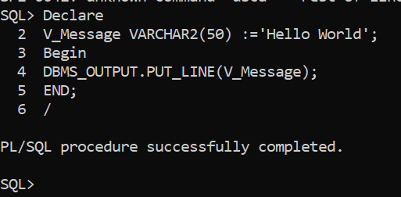
1: Oracle Databases Uses PL/SQL
Name: Procedural Language/Structured Query Language (Oracle's proprietary language).
Syntax Style: Uses DECLARE, BEGIN, EXCEPTION, END;, and ends blocks with a slash (/). Anonymous PL/SQL Block

Slide 5
2. MySQL - Uses MySQL Stored Routines / Procedural SQL
MySQL uses its own procedural extension called MySQL Stored Routines
Stored Routines" is the umbrella term in MySQL. It includes both Stored Procedures and Stored Functions. They share similar logic with Oracle's PL/SQL, but the engine and syntax belong purely to MySQL
Syntax Style: Uses DELIMITER, BEGIN, END, and requires semicolons inside the block. It does not use DECLARE the exact same way Oracle does, and printing is done via SELECT rather than a built-in package

Slide 6
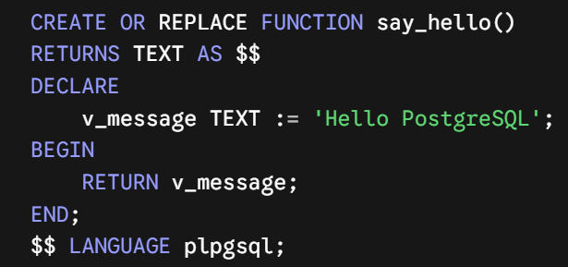
3. PostgreSQL (Managed via pgAdmin) Uses PL/pgSQL
Name: Procedural Language/PostgreSQL Structured Query Language.
Syntax Style: Very similar conceptually to Oracle's PL/SQL (which inspired it), but uses dollar-quoting ($$) instead of DELIMITER, and
requires you to specify LANGUAGE plpgsql.

Slide 7
PL/SQL Block Structure
Basic Anatomy of a PL/SQL Block
The DECLARE section (Variables & Constants)
The BEGIN section (Executable statements)
The EXCEPTION section (Error handling)
The END; terminator

Slide 8
Variables and Data Types
Scalar Data Types (VARCHAR2, NUMBER, DATE, BOOLEAN)
Anchor Declarations (%TYPE and %ROWTYPE)
Variable Initialization and Assignment (:=)

Slide 9
Introduction to Stored Procedures
Overview
A Stored Procedure is a core relational database concept rather than a feature tied exclusively to Oracle's PL/SQL. It refers to a pre-compiled, reusable group of SQL statements and procedural logic—such as conditional statements, loops, and variables—stored directly inside the database server. While Oracle uses the term PL/SQL to implement stored procedures, virtually all major Relational Database Management System (RDBMS) platforms support this concept using their own procedural extensions, including PostgreSQL (PL/pgSQL), Microsoft SQL Server (T-SQL), and MySQL.

Slide 10
Introduction to Stored Procedures
Overview
A Stored Procedures is The Set of statement inside it we can write multiple Queries. In which through we can apply DML and DDL Operations
It Provides Code Re-usibility and Performance Improvement And Security Purposes.
Procedures are Used For Actions for Performing large Actions.
Like changes in database in Multiple Tables.
While Functions is used for the Calculations and It return a value.While procedure does not return any Value.

Slide 11
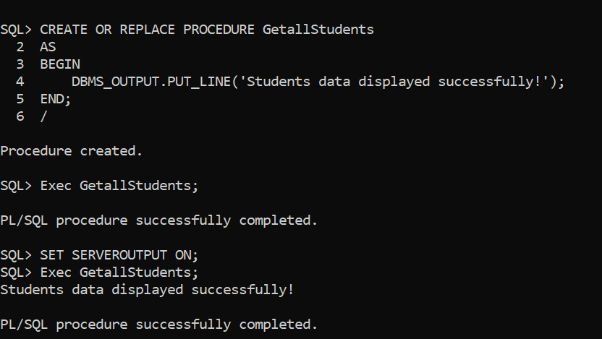
Basic Syntax !

Slide 12
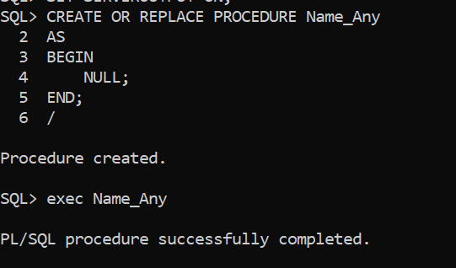
Basic Syntax !

Slide 13
Stored Procedures
Understanding Stored Procedure Parameters
Stored procedures can accept parameters to make them dynamic. There are typically three types of parameters.
IN: Passes a value into the procedure (default).
OUT: Passes a value out of the procedure back to the caller.
INOUT: Does both—takes an input value and modifies it to return a value.

Slide 14
Stored Procedures
Example 1: A Simple Stored Procedure (No Parameters)

Slide 15
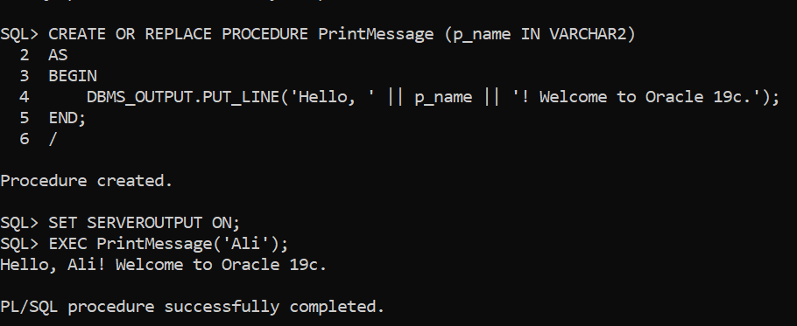
Stored Procedures
Example2: A Stored Procedure with IN parameters.

Slide 16
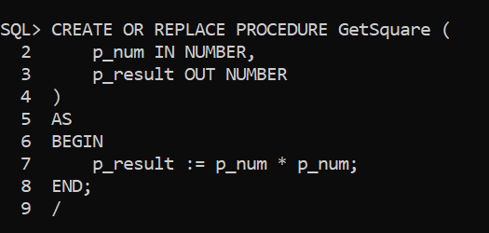
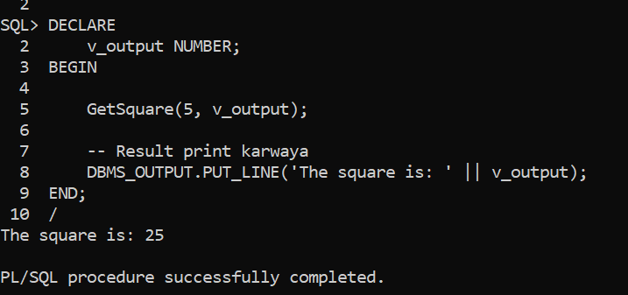
Stored Procedures
Example2: A Stored Procedure with OUT parameters.

Slide 17
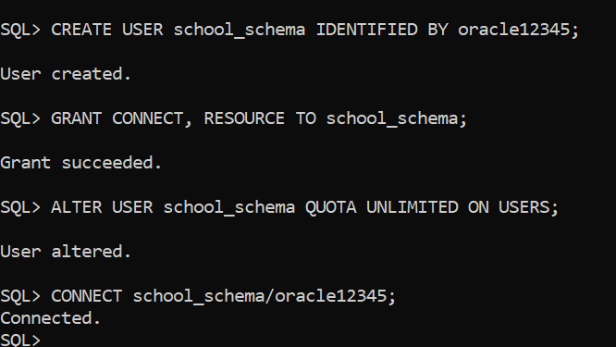
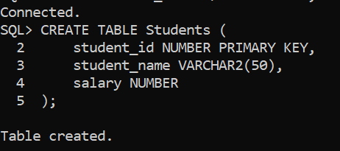
Stored Procedures
Example3: A Stored Procedure with INOUT parameters.

Slide 18
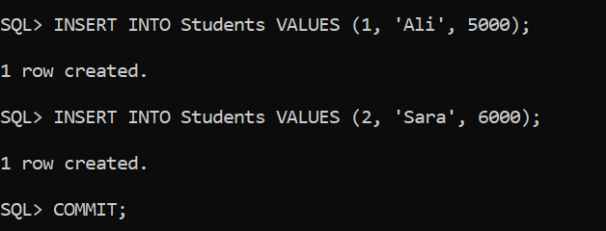
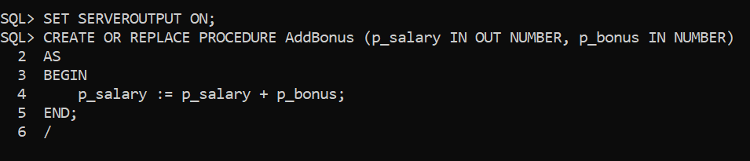
Stored Procedures
Example3: A Stored Procedure with INOUT parameters.

Slide 19
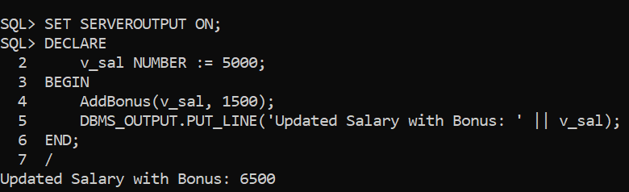
Stored Procedures
Example3: A Stored Procedure with INOUT parameters.

Slide 20
Functions In PLSQL
Function: is a Block of code That Perform a Given Task and return value.
Types of Functions:
1: Scalar Function :
2: Table Function :

Slide 21
1: Scalar Function :
In Oracle PL/SQL, a scalar function (commonly referred to as a stored function) is a database subprogram that performs a specific set of calculations or logic and returns a single, atomic value (such as a number, string, date, or boolean) to the calling environment.
Key Characteristics of Scalar Functions
Single Value Return: Unlike table functions that return an entire result set (rows and columns), a scalar function always returns exactly one value per execution
Reusability: Once created and stored in the database, it can be called repeatedly across multiple applications, queries, and blocks.
Parameter Support: They can accept zero or more input parameters (IN), and optionally output parameters (OUT or IN OUT, though IN is most common for functions used in SQL).

Slide 22
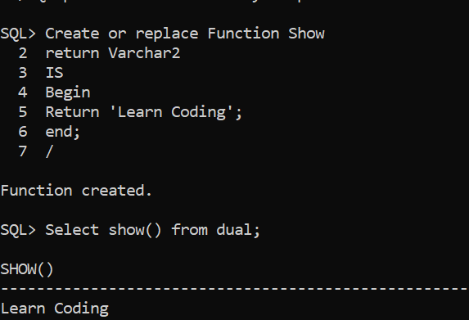
Stored Procedures
Example: Function Without parameters

Slide 23
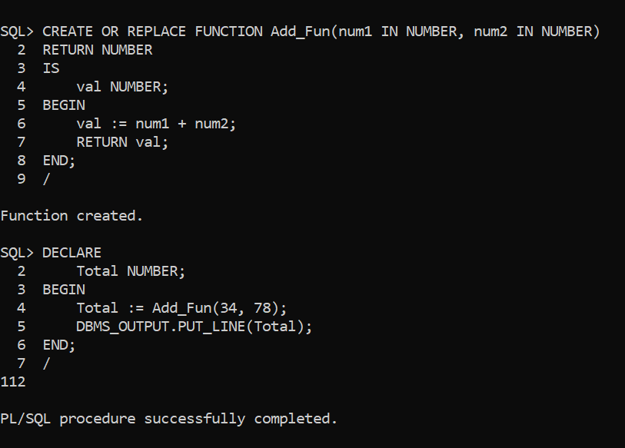
Stored Procedures
Example: Function With parameters

Slide 24
Triggers
Triggers : It is a Procedure that starts Automatically if Specific Changes Occur to the DBMS.
It has three parts:
Trigger Event : The action that causes the trigger to fire (e.g., INSERT, UPDATE, or DELETE operations on a table).
Condition :A specific criteria that must be met for the trigger action to execute (e.g., WHEN (NEW.salary > 10000)).
Trigger Action:The PL/SQL block (BEGIN ... END;) containing the actual code to be executed when the event occurs.

Slide 25
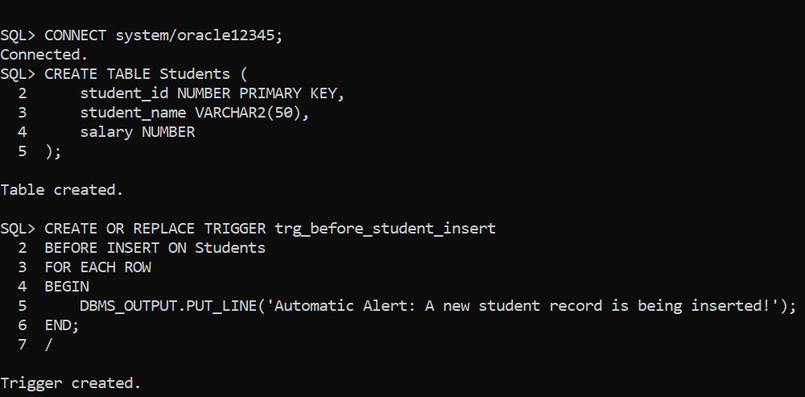
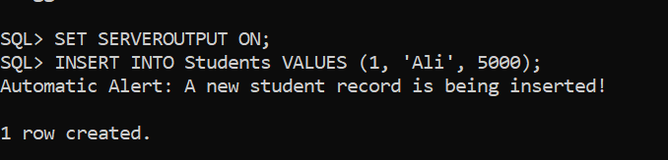
Triggers
Syntax

Slide 26
Cursor
A cursor in PL/SQL is a pointer to a memory area (context area) allocated by the database server to process and manage SQL statements. When an SQL query returns multiple rows, the database creates a working area called a cursor to hold those rows so your program can process them one by one
Types of Cursors
In PL/SQL, cursors are divided into two main types:
1. Implicit Cursors
What they are: These are created automatically by Oracle whenever an SQL statement (like INSERT, UPDATE, DELETE, or a SELECT ... INTO query that returns a single row) is executed and no explicit cursor has been declared.
How it works: You don't need to write code to open, fetch, or close implicit cursors. Oracle handles them behind the scenes.
Attributes: You can use cursor attributes (like SQL%ROWCOUNT, SQL%FOUND, SQL%NOTFOUND) to check the status of the most recent DML or query operation.

Slide 27
Cursor
2. Explicit Cursors
What they are: These are user-defined cursors created by the programmer for queries that return multiple rows.
How it works: You must explicitly manage them through four steps:
DECLARE: Define the cursor with a SQL query.
OPEN: Allocate memory by opening the cursor.
FETCH: Retrieve rows from the cursor one by one into variables.
CLOSE: Release the memory area when finished.

Slide 28
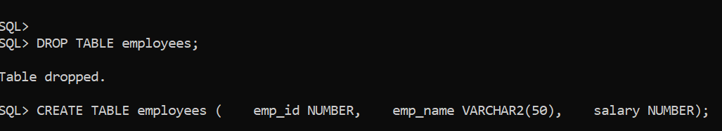
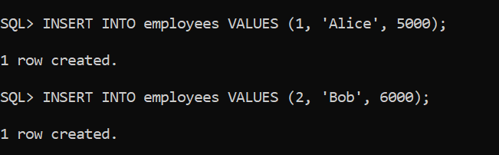
Example1:

Slide 29
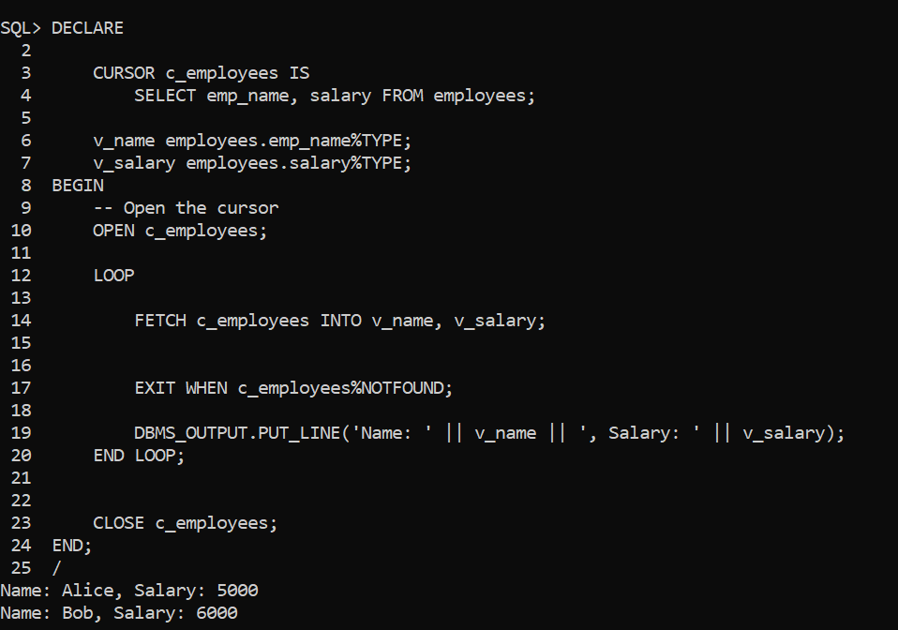
Example1:

Slide 30
Control Structures in DBMS
Control Structures in database management systems (DBMS) allow you to add programming logic—such as decision-making (conditions) and loops (iteration)—inside your stored procedures and functions.
Main Types of Control Structures
1--Conditional Statements:
IF-THEN-ELSE
CASE Statement
2--Loops:
WHILE Loop
REPEAT Loop
LOOP

