Slide 1
Support Vector Machine (SVM)
Designed by:
Nooruddin Noonari

Slide 2
Intro to Support Vector Machine
SVM or Support Vector Machine is a linear model for classification and regression problems.
It can solve linear and non-linear problems and work well for many practical problems.
The idea of SVM is simple: The algorithm creates a line or a hyperplane which separates the data into classes.
SVM helps to find a separating line(or hyperplane) between data of two classes.
SVM is an algorithm that takes the data as an input and outputs a line that separates those classes if possible.
Designed by: Nooruddin Noonari

Slide 3
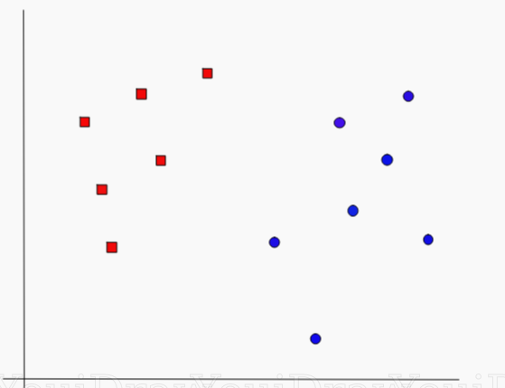
Example
Lets begin with a problem. Suppose you have a dataset as shown below and you need to classify the red rectangles from the blue ellipses(let’s say positives from the negatives). So your task is to find an ideal line that separates this dataset in two classes (say red and blue).
Designed by: Nooruddin Noonari

Slide 4
Solution
We have two candidates here, the green colored line and the yellow colored line. Which line according to you best separates the data?
Designed by: Nooruddin Noonari

Slide 5
Generalization in machine learning
In machine learning, generalization is a definition to demonstrate how well is a trained model to classify or forecast unseen data. Training a generalized machine learning model means, in general, it works for all subset of unseen data. An example is when we train a model to classify between dogs and cats. If the model is provided with dogs images dataset with only two breeds, it may obtain a good performance. But, it possibly gets a low classification score when it is tested by other breeds of dogs as well. This issue can result to classify an actual dog image as a cat from the unseen dataset. Therefore, data diversity is very important factor in order to make a good prediction. In the sample above, the model may obtain 85% performance score when it is tested by only two dog breeds and gains 70% if trained by all breeds. However, the first possibly gets a very low score (e.g. 45%) if it is evaluated by an unseen dataset with all breed dogs. This for the latter can be unchanged given than it has been trained by high data diversity including all possible breeds.
Designed by: Nooruddin Noonari

Slide 6
Data Diversity
The diversity in machine learning tries to decrease the redundancy in the training data, the learned model as well as the inference and provide more information for machine learning process.
It can improve the performance of the model and has played an important role in machine learning process.
Designed by: Nooruddin Noonari

Slide 7
Data Diversity
It should be taken into account that data diversity is not the only point to care in order to have a generalized model. It can be resulted by nature of a machine learning algorithm, or by poor hyper-parameter configuration. In this post we explain all determinant factors. There are some methods (regularization) to apply during model training to ensure about generalization. But before, we explain bias and variance as well as underfitting and overfitting.
Designed by: Nooruddin Noonari

Slide 8
Variance and bias (overfitting and underfitting)
Variance and bias are two important terms in machine learning.
Variance means the variety of predictions values made by a machine learning model (target function).
Bias means the distance of the predictions from the actual (true) target values.
A high-biased model means its prediction values (average) are far from the actual values.
Also, high-variance prediction means the prediction values are highly varied.
Designed by: Nooruddin Noonari

Slide 9
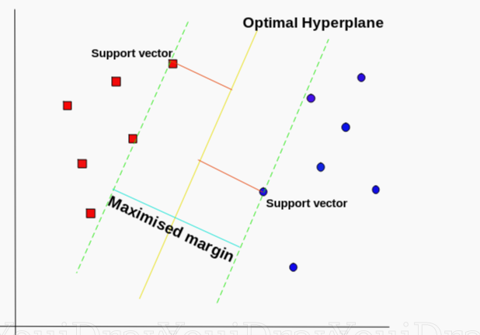
SVM’s way to find the best line
According to the SVM algorithm we find the points closest to the line from both the classes. These points are called support vectors.
Now, we compute the distance between the line and the support vectors. This distance is called the margin.
Our goal is to maximize the margin. The hyperplane for which the margin is maximum is the optimal hyperplane.
Designed by: Nooruddin Noonari

Slide 10
SVM’s way to find the best line
According to the SVM algorithm we find the points closest to the line from both the classes. These points are called support vectors.
Now, we compute the distance between the line and the support vectors. This distance is called the margin.
Our goal is to maximize the margin. The hyperplane for which the margin is maximum is the optimal hyperplane.
Designed by: Nooruddin Noonari

Slide 11
Thus SVM tries to make a decision boundary in such a way that the separation between the two classes(that street) is as wide as possible.
Designed by: Nooruddin Noonari

Slide 12
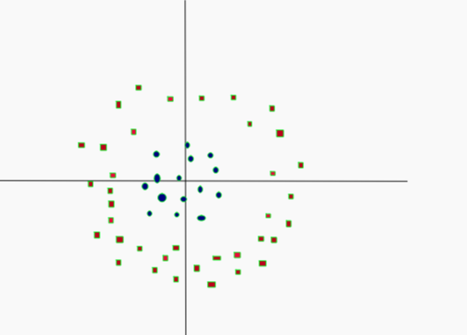
SVM in Non Linearly
Simple, ain’t it? Let’s consider a bit complex dataset, which is not linearly separable.
Designed by: Nooruddin Noonari

Slide 13
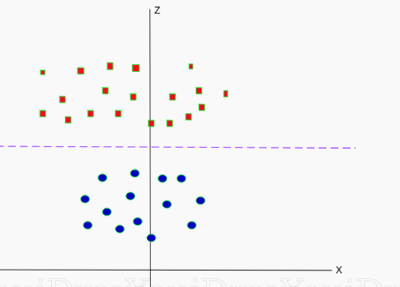
This data can be converted to linearly separable data in higher dimension. Lets add one more dimension and call it z-axis. Let the co-ordinates on z-axis be governed by the constraint,
z = x²+y²
So, basically z co-ordinate is the square of distance of the point from origin. Let’s plot the data on z-axis.
Designed by: Nooruddin Noonari

Slide 14
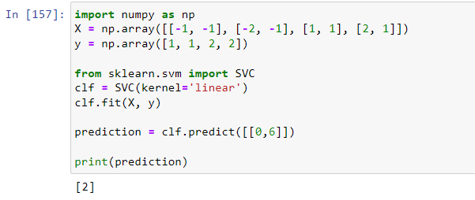
HYPERPLANE
A hyperplane in an n-dimensional Euclidean space is a flat, n-1 dimensional subset of that space that divides the space into two disconnected parts.
Designed by: Nooruddin Noonari

Slide 15
Kernel in SVM
A kernel is a function used in SVM for helping to solve problems.
They provide shortcuts to avoid complex calculations.
The amazing thing about kernel is that we can go to higher dimensions and perform smooth calculations with the help of it.
We can go up to an infinite number of dimensions using kernels.

Slide 16
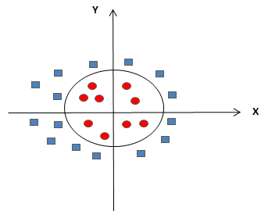
Non Linear

Slide 17
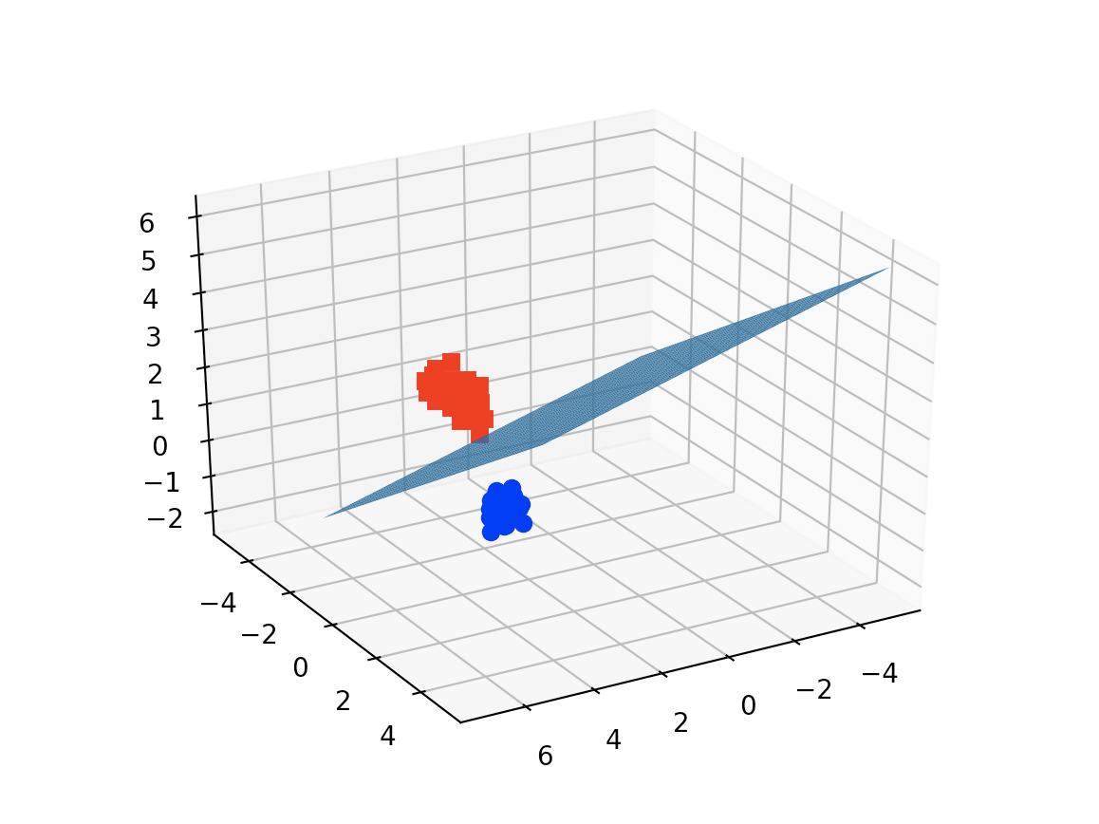
3D Non Linear

Slide 18

Linear

Slide 19
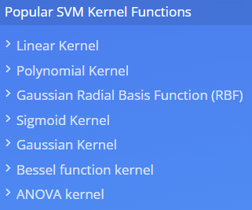
Kernel in SVM
Designed by: Nooruddin Noonari

Slide 20
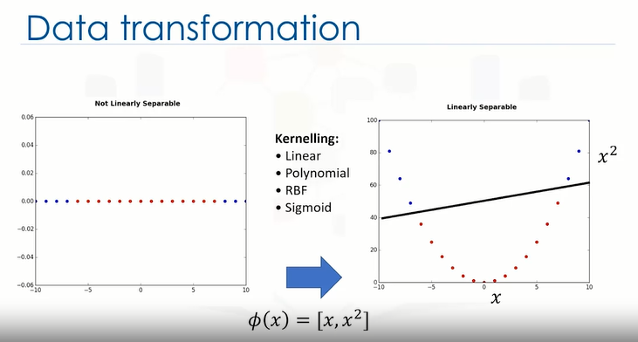
Designed by: Nooruddin Noonari

Slide 21
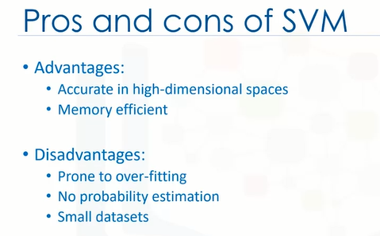
Designed by: Nooruddin Noonari

Slide 22
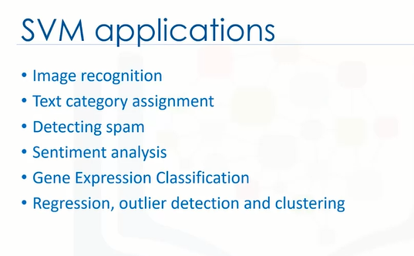
Designed by: Nooruddin Noonari

Slide 23
Designed by: Nooruddin Noonari

Slide 24
Designed by: Nooruddin Noonari

Slide 25
Designed by: Nooruddin Noonari

Slide 26
