Slide 1
METAVERSE?
NOOR-UL-HUDA

Slide 2
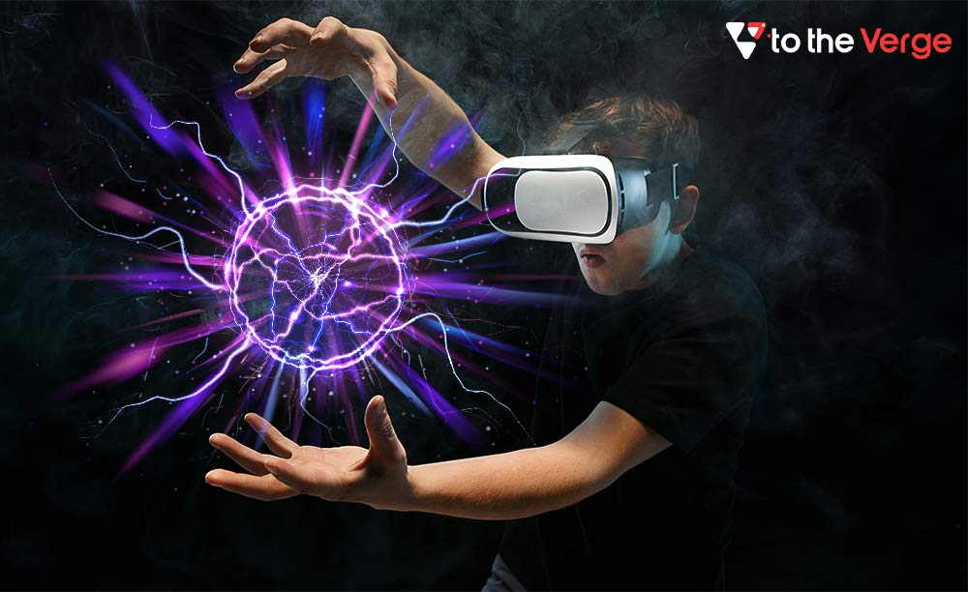
WHAT IS METAVERSE?
The term ‘metaverse’ is the combination of the worlds ‘meta’ and ‘universe.’
Meta in the term means “beyond” and verse refers to the “universe.”
The metaverse is a concept of a persistent, online, 3D universe that combines multiple different virtual spaces.

Slide 3
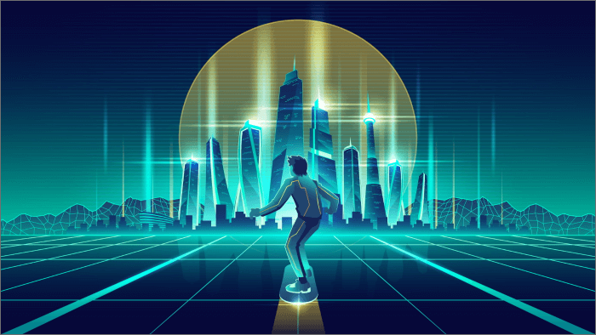
Combination of augmented,virtual and mixed reality can be Metaverse.
The internet will eventually evolve into the metaverse.

Slide 4
BLOCKCHAIN
Block chain is a public digital ledger that record transaction is called block chain.
It is duplicated or distributed across a P2P network of computer system.
It able to record information that is difficult or impossible to change,hack, or cheat the system.

Slide 5
CRYPTOCURRENCY
Cryptocurrency is a digital payment system that doesn't rely on banks to verify transactions. It’s a peer-to-peer system that can enable anyone anywhere to send and receive payments.

Slide 6
METAVERSE AND CRYPTOCURRENCY
Blockchain-based cryptocurrencies can open up possibilities of commerce in the metaverse. Cryptocurrencies promise instant and direct peer-to-peer transactions over the internet at zero cost.

