Slide 1
Introduction to Data Analytics and Statistical Analysis
Pizza Sales

Slide 2
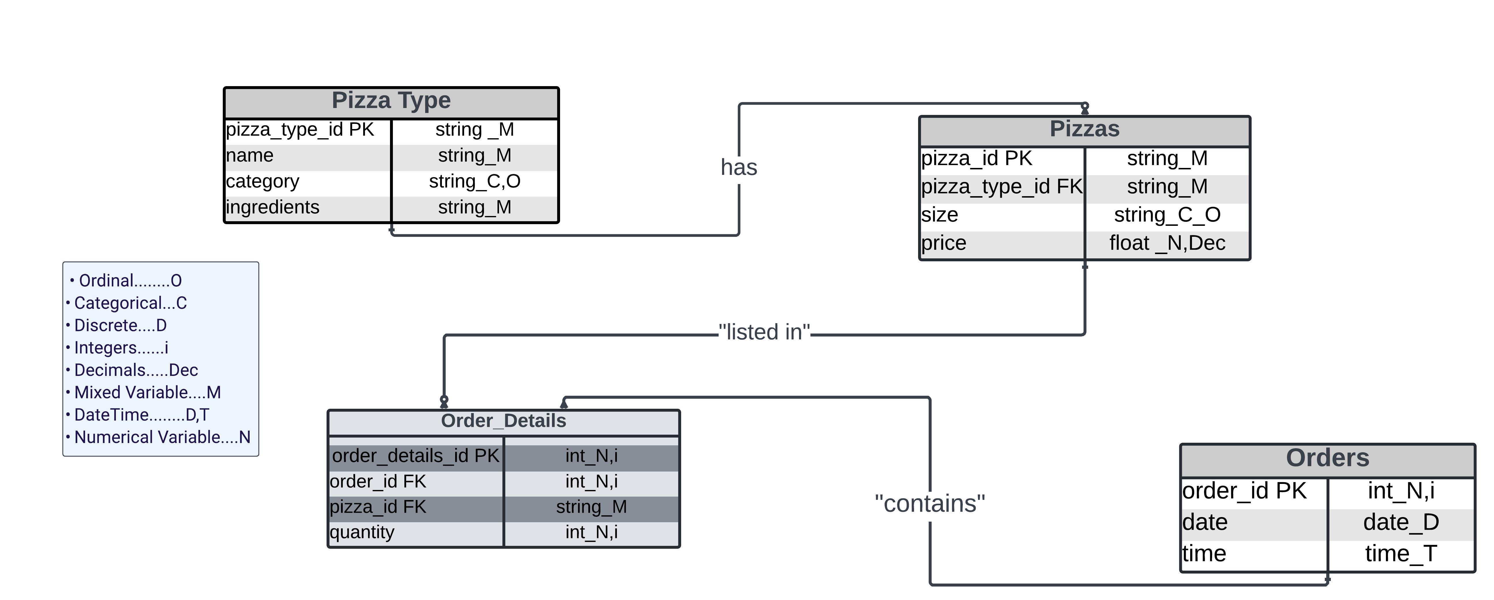
Data types
Objective:
Created an ER diagram from the Pizza Sales Table by categorizing data types and building relationships between the tables

Slide 3
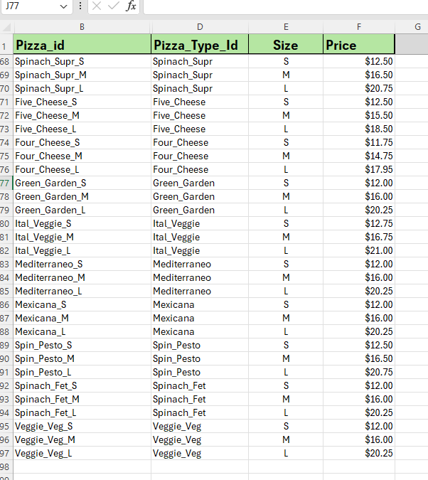
Data clean up
The following Steps were taken to clean the Data:
• Freeze the top rows in the table and highlight the column.
• Use proper function in Pizza_type_id and Pizza_id.
• Fix the alignment in the fields, i.e., Category, Size, Quantity.
• Format the fields based on numbers and currency.

Slide 4
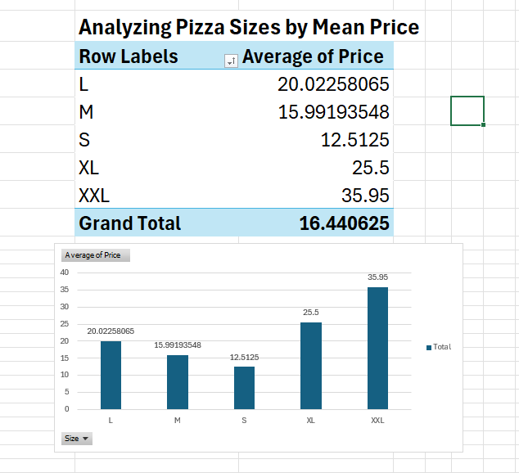
Central tendency and distribution
Objective: to analyze the average
price of pizza based on its Size
Based on the findings,
It’s clear how prices increase with the
pizza sizes. XXL size are significantly
more expensive than others.

Slide 5
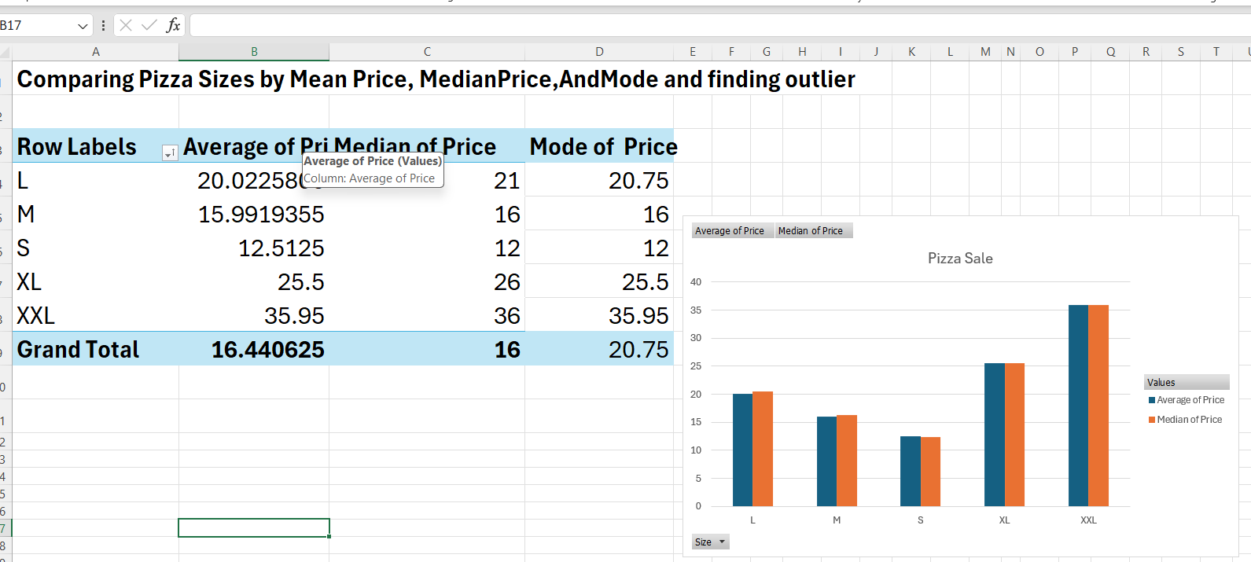
Finding outlier
The price increase from XL to XXL is not consistent. By comparing the mean with the mode and median,
it indicates there might be an outlier.

Slide 6
Hypothesis Testing Testing the Impact of Day of the Week on Pizza Sales
Null Hypothesis (H0): There is no difference in the average number of pizzas sold on weekdays and weekends
Alternate Hypothesis (H1): There is a difference in the average number of pizzas sold on weekdays and weekends.
Weekday Sales:
Number of observations: 15568
Mean sales: 1.0188 pizzas per order
Variance: 0.0195
Weekend Sales:
Number of observations: 5782
Mean sales: 1.01971 pizzas per order
Variance: 0.021

Slide 7
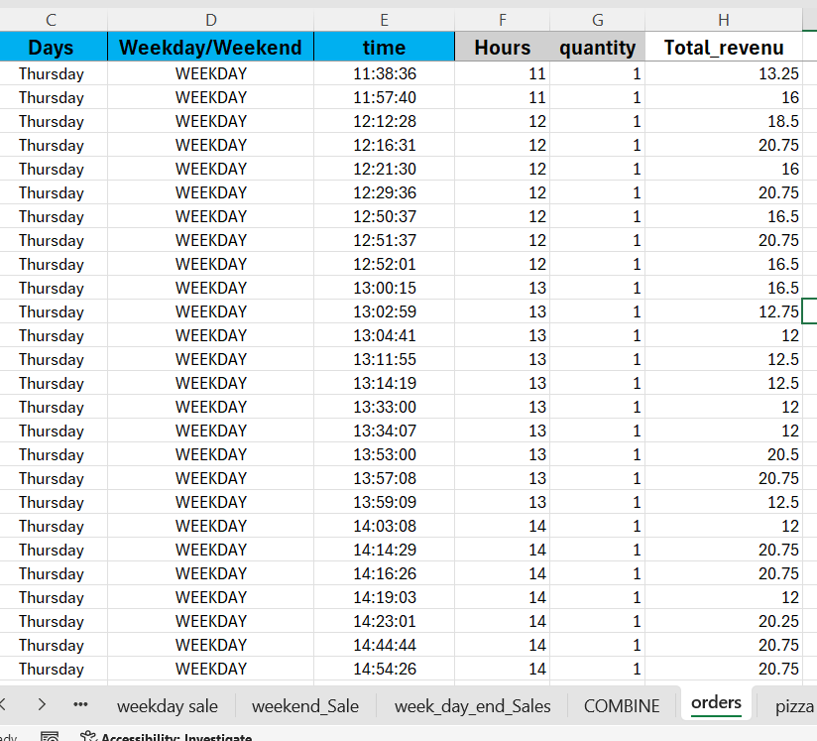

Slide 8
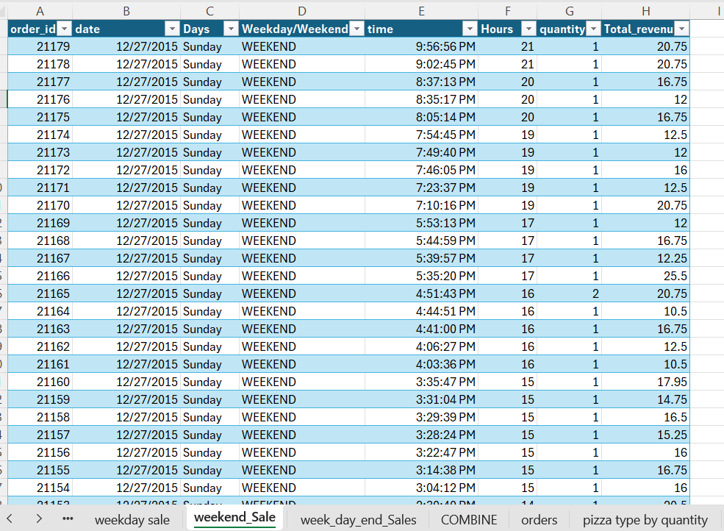
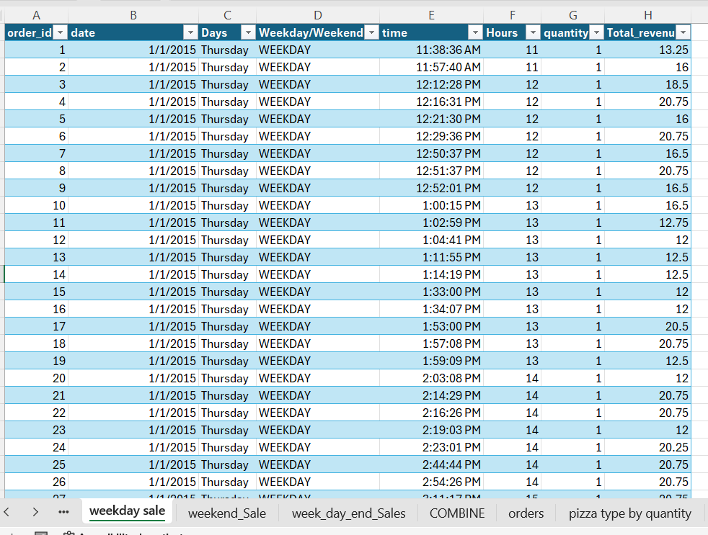
Weekend and weekday Data

Slide 9
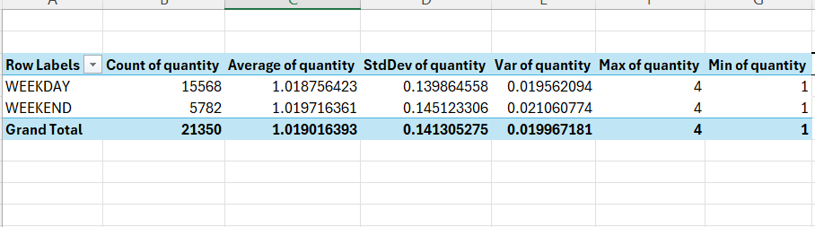

Slide 10
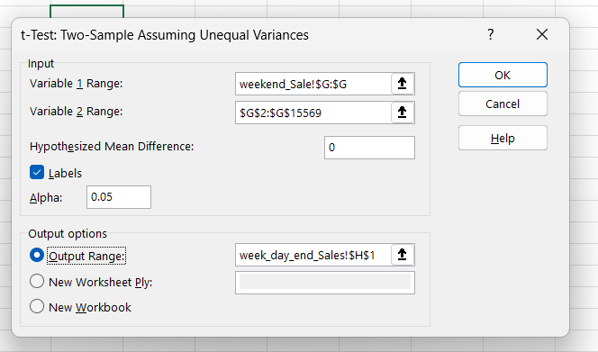

Slide 11
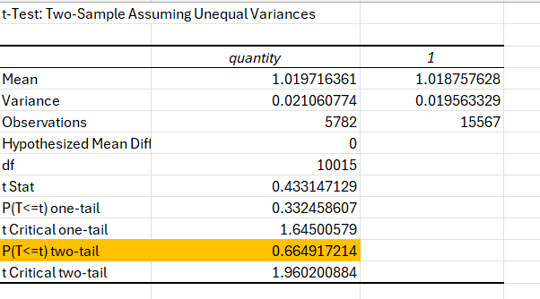

Slide 12
Decision:
P-Value
P(T<=t) two-tail: 0.6649
Since 0.6649 > 0.05, fail to reject the null hypothesis.
t-Statistic
Since 0.4331 < 1.9602, fail to reject the null hypothesis.
Based on the t-test results, there is no statistically significant difference in the average number of pizzas sold on weekdays compared to weekends.
Both the p-value and t-statistic support the null hypothesis, indicating that sales patterns are consistent across weekdays and weekends.

