Slide 1
CSS3

Slide 2
CSS3
CSS3 is the latest version of CSS. CSS3 supports responsive web design, all kinds of transitions, transformations, and animations and provides box-sizing tools that enable the user to adjust the size of any element without changing the dimensions or padding of the element.

Slide 3
Responsive Web design
Responsive Web design is the approach that allows websites and pages to render (or display) on all devices and screen sizes by automatically adapting to the screen, whether it’s a desktop, laptop, tablet, or smartphone.
Responsive web design works through CSS, using various settings to serve different style properties depending on the screen size, orientation, resolution, color capability, and other characteristics of the user’s device.
It is a combination of flexible grids, flex boxes, flexible images, and media queries.

Slide 4
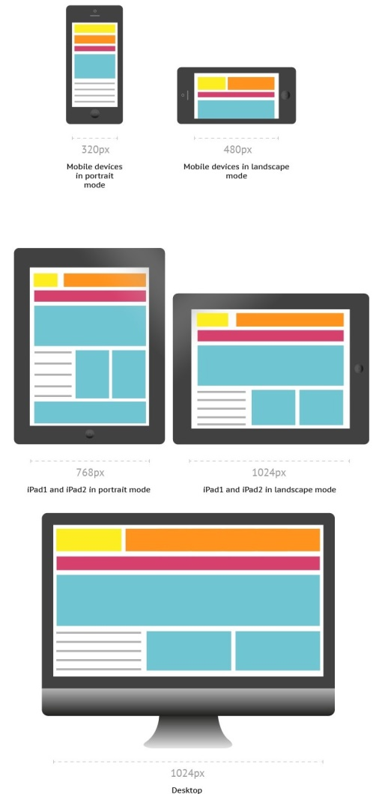
Responsive Web design

Slide 5
Media Queries
Media queries allow you to customize the presentation of your web pages for a specific range of devices like mobile phones, tablets, desktops, etc. without any change in markups.
It composed of a media type and expressions that check for the conditions of particular media features.
It is a logical expression that is either true or false.

Slide 6

Media Queries - Syntax
A media query consists of an optional media type and any number of media feature expressions.
Multiple queries are often combined in various ways by using logical operators.
Media queries are case-insensitive.
A media query is true if the media sort of the media query matches the media sort of the device and every one expression within the media query are true.
It uses the @media rule to incorporate a block of CSS properties as long as a particular condition is true.
Queries involving unknown media types are always false.

Slide 7
Media Queries - Syntax
Media Types - It describes the category of a device.
all - used for all media type devices
print - used for printers
screen - used primarily for screens like computer screens, tablets, smart-phones, etc.
speech - used for screenreaders that "reads" the page aloud
Media features - It describe specific characteristics of the user agent, output device, or environment. Some of the media features are grid, height, width, hover, max-aspect-ratio, max-color,max-color-index, max-height,etc.
Logical Operators - It used to compose a media query . Logical Operators used in media queries are not, and, and only.

Slide 8
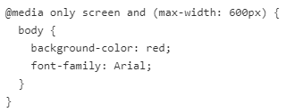
Media Queries - Example
It changes the background color of the <body> element to "red" and the font style to "Arial" when the browser window is 600px wide or less.

