Slide 1
project-9 AIR QUALITY ANALYSIS AND PREDICTION IN TAMILNADU
PHASE-4
Development Part 2

Slide 2
TEAM MEMBERS
NOORUL MAJHAR M - NM:D83DB97A3E090868AAA41DF07113B191
MOHAMED NOORISHA BILALY- D0D3C8B155E15C1B78442CA6E4FB8B11
MOHAMED WASIM AKRAM- 6B8681356287BCA97984350B34292F21
NAJIMULLA- 1B3E04461E6CA0B9EB94707EFA50D694

Slide 3
INTRODUCTION:
Air pollution is one of the greatest environmental risk to health. By reducing air pollution levels, countriescan reduce the burden of disease from stroke, heart disease, lung cancer, and both chronic and acute respiratory diseases, including asthma. Here we are studied about the air quality analysis methods in Tamil Nadu.
Dataset contains in features:
Stn_code : Station code. A code is given to each station that recorded the data.
◆ Sampling_date: The date when the data was recorded.
◆ State: It represents the states whose air quality data is measured.
◆ Location: It represents the city whose air quality data is measured.
◆ Agency: Name of the agency that measured the data.

Slide 4
DATA EXPLORATION:
◆ Let us get some insights about the data — the number of entries in each column, the type of entry in each column.
◆ It represents the type of area where the data was recorded like industrial, residential, etc.
◆ Let us see how many types of area.
◆ NO, because the agency’s name has nothing to do with how much polluted the state is. Similarly, stn_code is also unnecessary.
◆ It is given in the data description that date.
CODE:
◆ # Rows with missing “types”
◆ null_data = tn[tn.isnull().any(axis=1)]
◆ null_data.head(20)

Slide 5
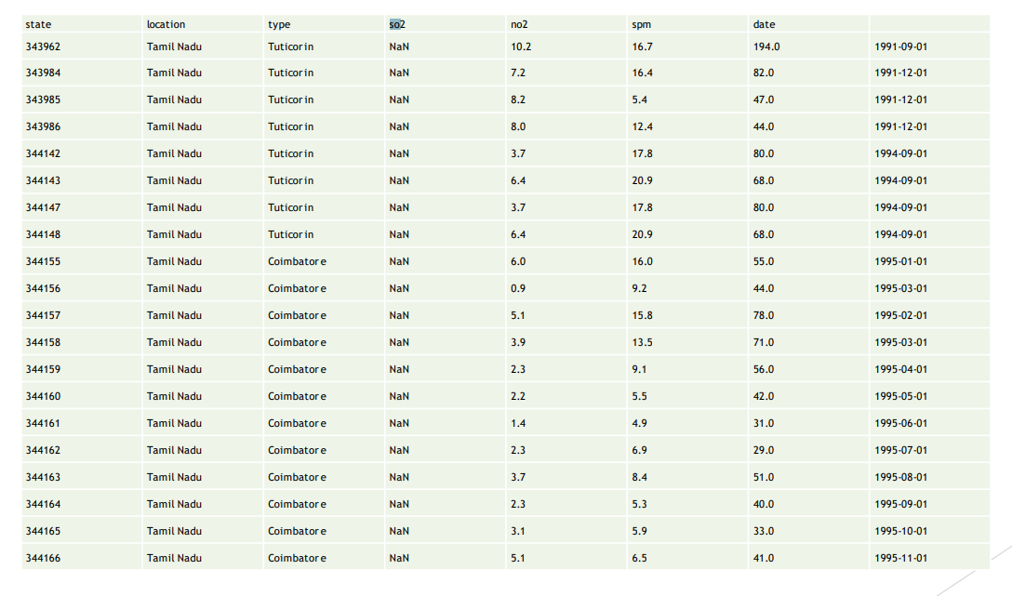
OUTPUT:

Slide 6
DATA VISUALIZATION:
Code: data visualization “
Input:
datacount =sns.countplot(x ="location",data = tn); datacount.set_xticklabels(datacount.get_xticklabels(), rotation=90);

Slide 7
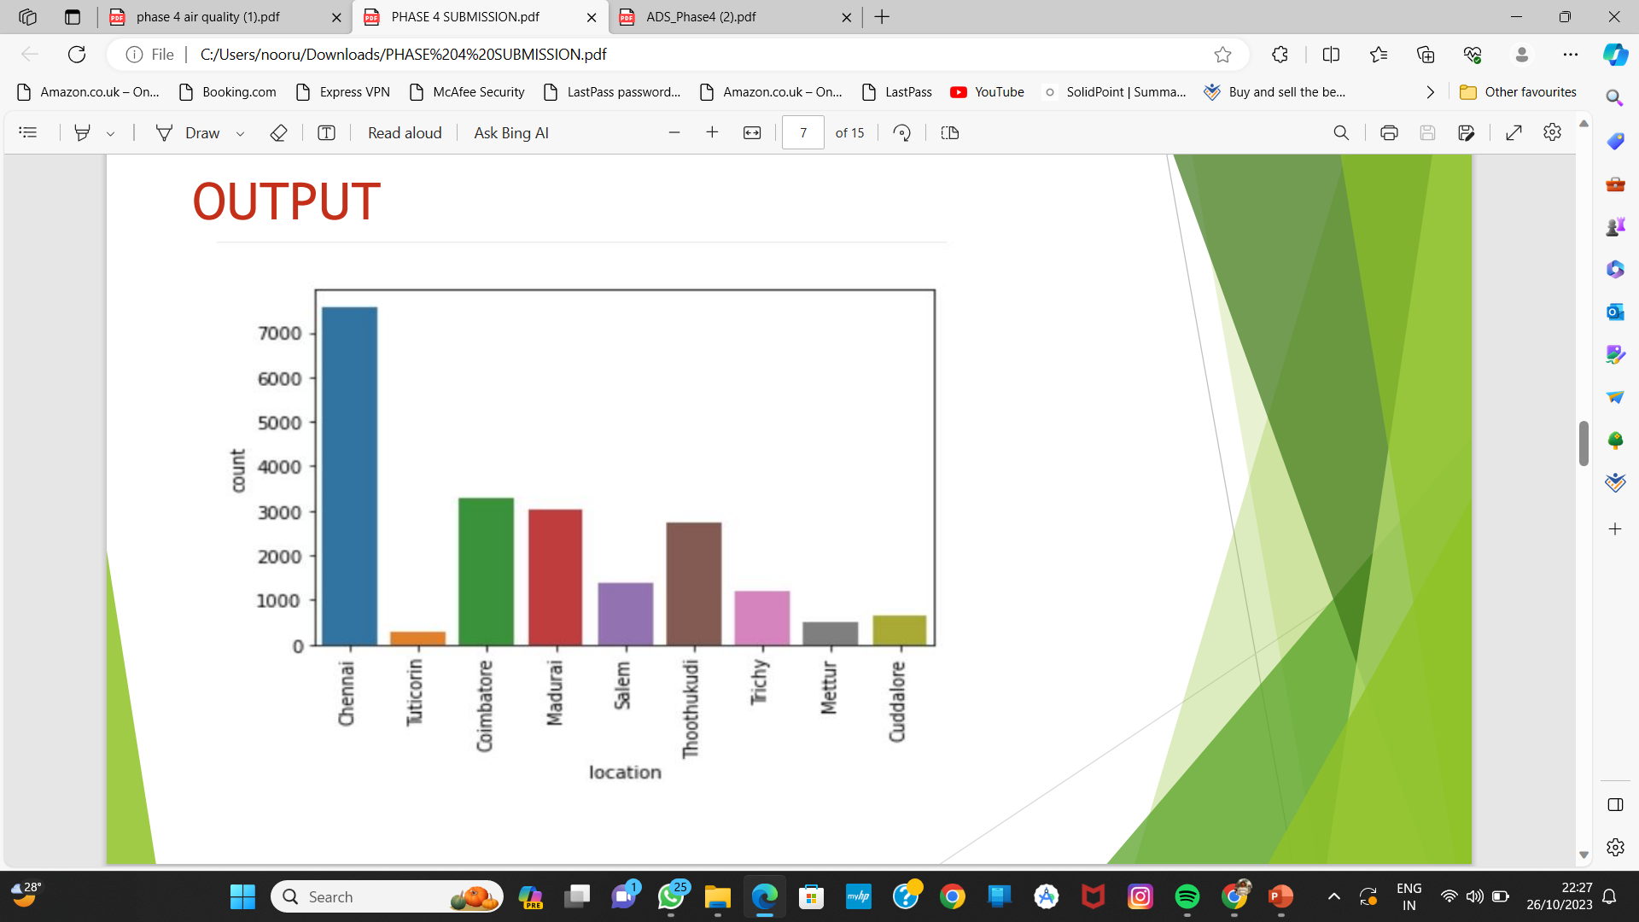
OUTPUT:

Slide 8
CALCULATE IN AIR QUALITY:
◆ The AQI is calculated by converting measured pollutant concentrations to a uniform index which is based on the health effects associated with a pollutant.
◆ The health benchmarks used for calculating the AQI are pollutant specific and are established by the EPA through the National Ambient Air Quality Standards.
◆ There are several ways to test indoor air quality, including the following: Purchase an indoor air quality monitor. High-quality monitors will test for particulate matter, chemical pollutants, humidity, carbon monoxide and even formaldehyde.

Slide 9
INPUT:
◆ #Function to calculate so2 individual pollutant index(si)
◆ def calculate_si(so2):
◆ si=0
◆ if (so2<=40):
◆ si= so2*(50/40)
◆ if (so2>40 and so2<=80):
◆ si= 50+(so2-40)*(50/40)
◆ if (so2>80 and so2<=380):
◆ si= 100+(so2-80)*(100/300)
◆ if (so2>380 and so2<=800):
◆ si= 200+(so2-380)*(100/800)
◆ if (so2>800 and so2<=1600):

Slide 10
◆ si= 300+(so2-800)*(100/800)
◆ if (so2>1600):
◆ si= 400+(so2-1600)*(100/800)
◆ return si
◆ data[‘si’]=data[‘so2’].apply(calculate_si)
◆ df= data[[‘so2’,’si’]]
◆ df.head()

Slide 11
OUTPUT:
◆ So2 si
◆ 0 4.8 6.000
◆ 1 3.1 3.875
◆ 2 6.2 7.750
◆ 3 6.3 7.875
◆ 4 4.7 5.875

Slide 12
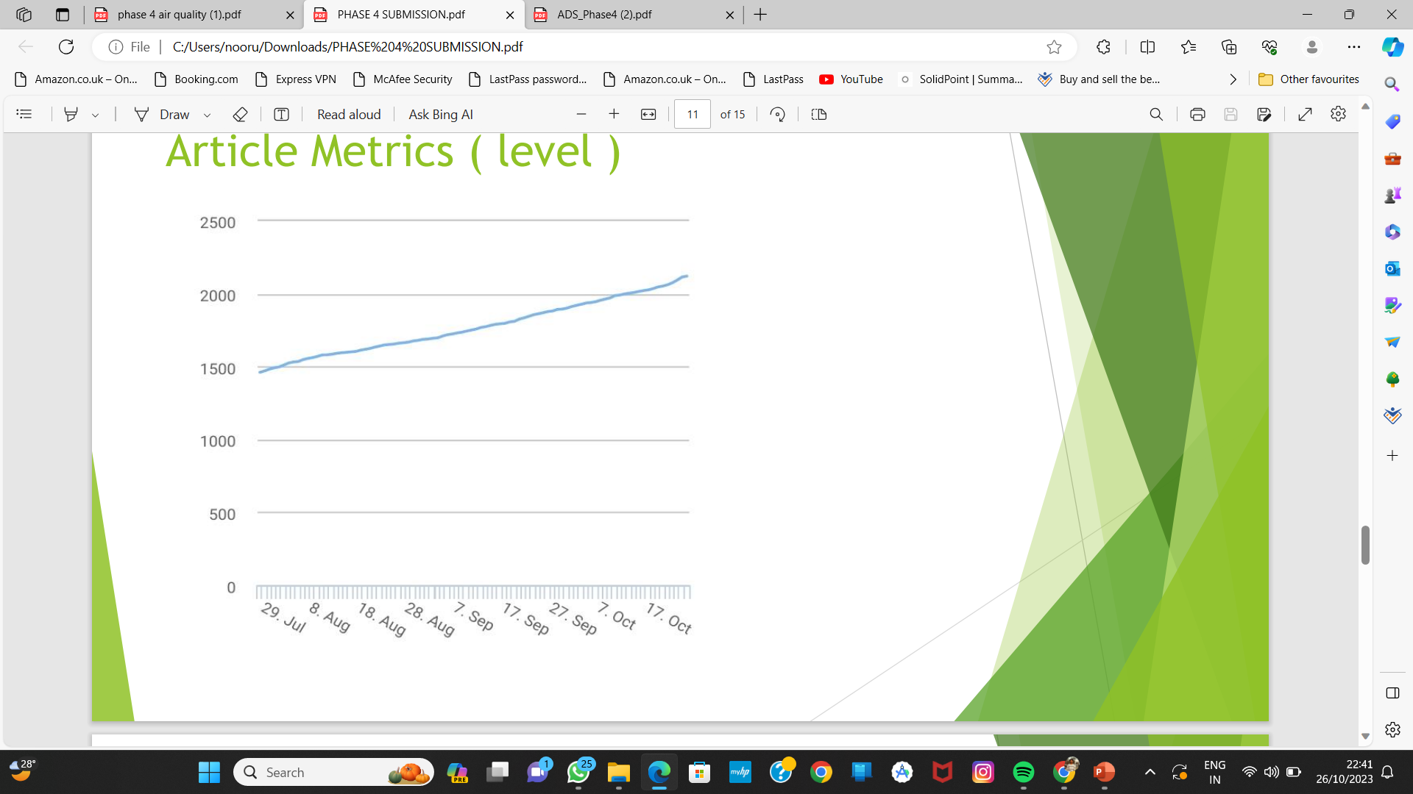
Article Metrics ( level )

Slide 13
DISTRICT LEVEL PREDICTION:
INPUT :
CODE  maxso2 = loc.sort_values(by='so2',ascending=False)
maxso2.loc[:,['so2']].head(10).plot(kind='bar'); # Based on average values

Slide 14
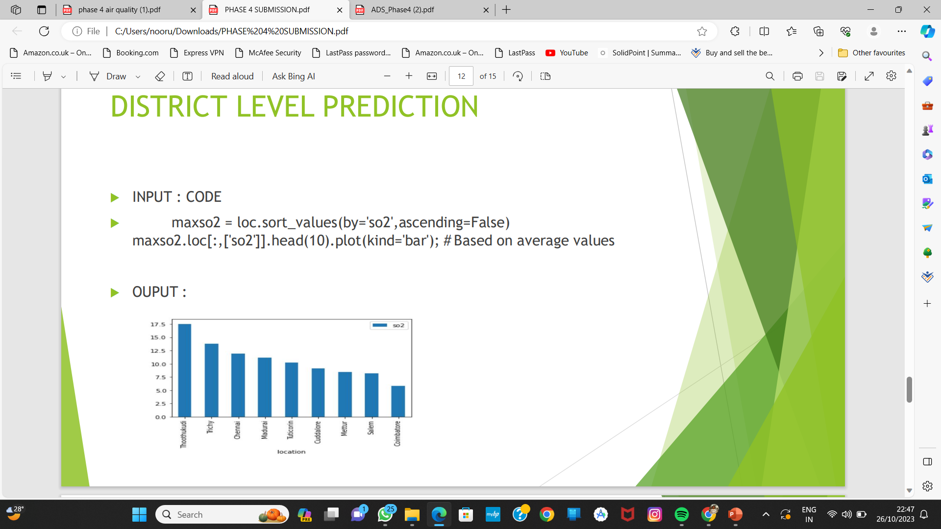
OUPUT:

Slide 15
Air quality visualization:
◆ The graphical display of data – helps us understand the distribution of air pollutants in the atmosphere. This is hard to do just by looking at a modern air monitor equipment with its digital display.
◆ By combining real-time monitoring data with python programming, one can easily visualize air monitoring data. Interactive graphs can be created which makes it easier to check air quality, and increasingly diverse colors can visually highlight the air quality level. Visualization of data has a resilient expression (more images and more insightful) than the original data table, which is favorable for further analysis of data.

Slide 16
◆ In this article, I will share examples of data visualization that have helped Devic Earth to convey more clearly the message on air quality.

Slide 17
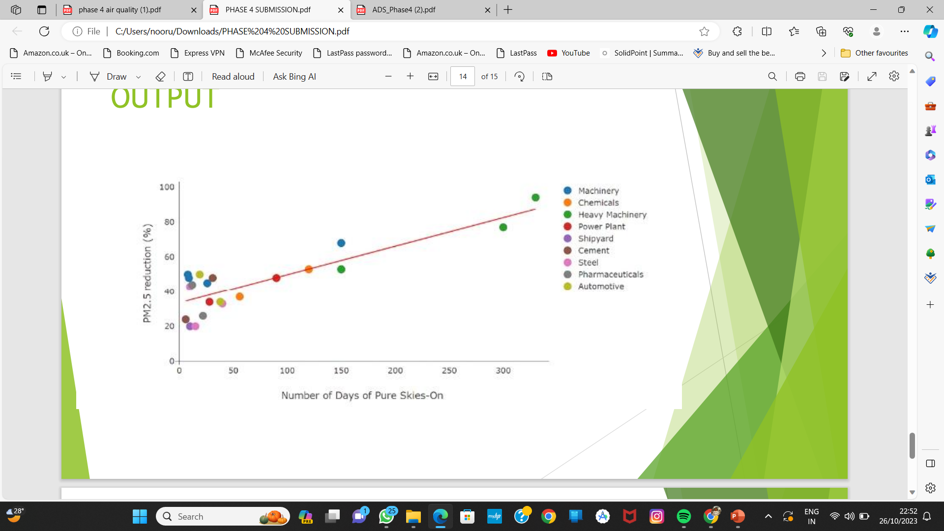
OUTPUT:

Slide 18
THANK YOU BY NOORUL MAJHAR M

