Slide 1
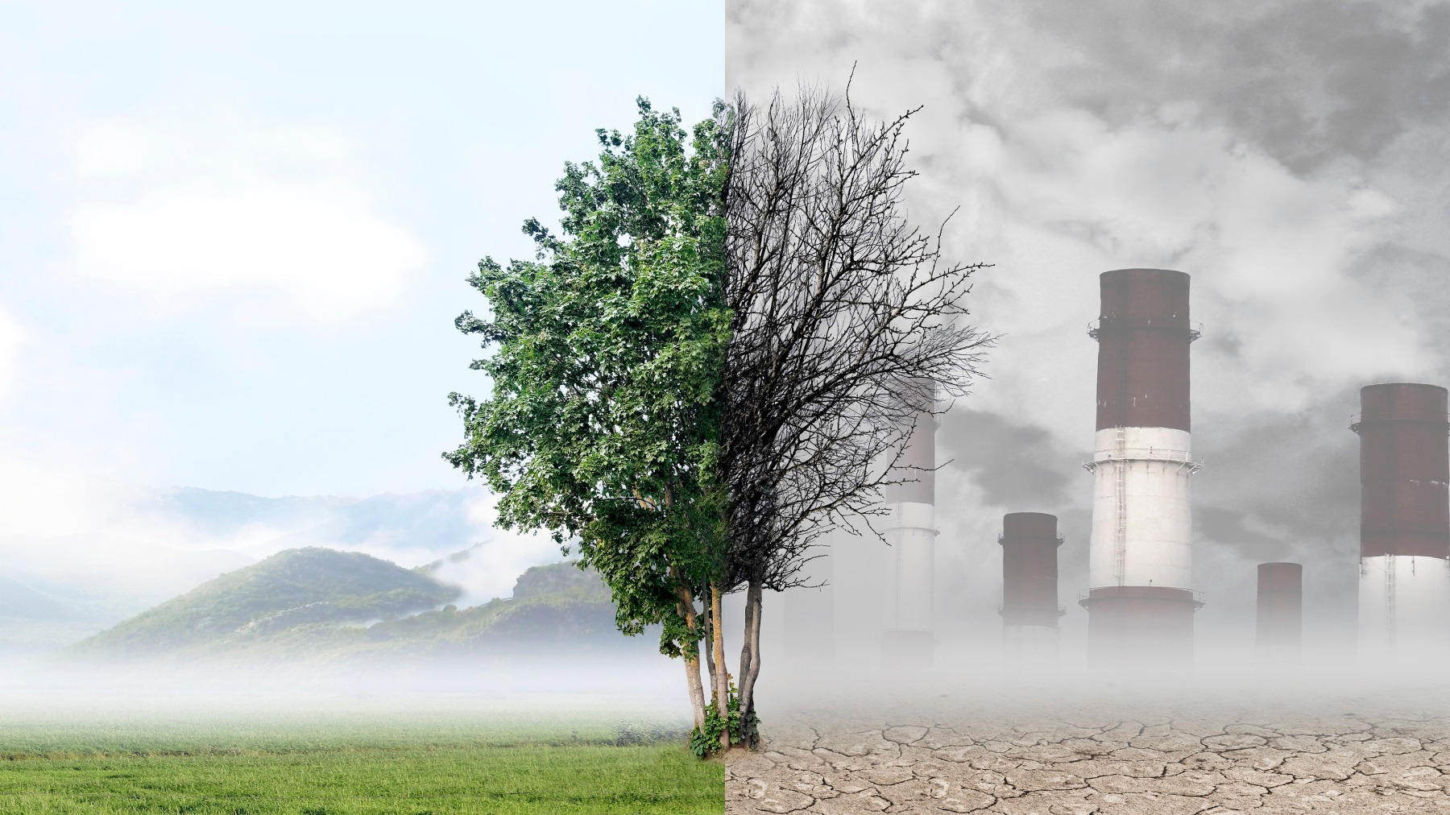
--------------------------
PROJECT-9
AIR QUALITY ANALYSIS AND PREDICTION IN TAMILNADU
PHASE-2
INNOVATION
By
NOORUL MAJHAR M
NM:D83DB97A3E090868AAA41DF07113B191

Slide 2
INTRODUCTION
Air quality analysis and prediction are crucial components of environmental science and public health management. These fields focus on monitoring, assessing, and forecasting the quality of the air we breathe, with the ultimate goal of improving air quality and minimizing its adverse effects on human health and the environment.
Air quality analysis involves the collection and examination of data related to various pollutants present in the Earth's atmosphere, such as particulate matter (PM2.5 and PM10), ground-level ozone (O3), nitrogen dioxide (NO2), sulfur dioxide (SO2), carbon monoxide (CO), and volatile organic compounds (VOCs). Monitoring stations, satellite technology, and specialized instruments continuously measure these pollutants to generate real-time data.

Slide 3
ABOUT DATASET
Where did we get the dataset?
Kaggle:
we got our ‘Air quality analysis and
prediction in Tamil Nadu’ dataset
from Kaggle. www.kaggle.com/data.
Kaggle is a popular platform for sharing
datasets and hosting data science competitions.
Details:
The dataset contains all details about the
quality of air in Tamil Nadu which is for
predicting the quality of Air.
Where the air contains S02,NO2,etc., which helps us to analyze the Air quality in various cities of Tamil Nadu.

Slide 4
DETAILS OF LIBRARIES USED AND WAY TO DOWNLOAD:
Pandas (Data Manipulation):
Pandas is a fundamental library for data manipulation and analysis, offering data structures like Data Frames and Series.
Installation:
Use the following command to install Pandas: pip install pandas
NumPy (Numerical Computing):
NumPy is essential for numerical operations, providing support for arrays and matrices.
Installation:
Install NumPy with the following command: pip install numpy

Slide 5
Matplotlib (Data Visualization):
Matplotlib is a widely used library for creating static and interactive data visualizations.
Installation:
Use this command to install Matplotlib:
pip install matplotlib
Seaborn (Statistical Data Visualization):
Seaborn is built on top of Matplotlib and simplifies the creation of informative statistical graphics.
Installation:
Install Seaborn with pip: pip install seaborn.
Scikit-learn (Machine Learning):
Scikit-learn is a powerful library for machine learning and data mining tasks.
Installation:
Use this command to install Scikit-learn: pip install scikit-learn

Slide 6
HOW TO TRAIN AND TEST:
Training and testing a dataset is a fundamental step in building and evaluating machine learning models. The process involves dividing your dataset into two parts: one for training the model and the other for testing the model's performance. Here are the general steps to train and test a dataset:
Data Splitting:
Start by splitting your dataset into two subsets: a training set and a testing set.
The common practice is to allocate a larger portion of the data for training, often around 70-80% of the dataset, and the remaining portion for testing.
Data Preprocessing:
Before training or testing, preprocess the data. This may involve tasks such as data cleaning, feature selection, handling missing values, and scaling or normalizing features to ensure the data is in a suitable format for the machine learning algorithm.
Select a Machine Learning Algorithm.
Choose an appropriate machine learning algorithm based on your problem's characteristics. Common algorithms include regression, classification, clustering, and more specialized models for specific tasks

Slide 7
Training the Model:
Use the training data to fit the chosen machine learning model. This involves feeding the algorithm with features (input variables) and their corresponding labels (output or target variable).
The model will learn patterns and relationships in the training data.
Model Evaluation:
Once the model is trained, use the testing set to evaluate its performance. The model has not seen this data during training, making it a suitable benchmark for assessing generalization.
Common evaluation metrics include accuracy, precision, recall, F1-score, mean squared error (MSE), etc., depending on the type of problem (classification, regression, etc.).
Tuning and Validation (Optional):
If the model's performance is unsatisfactory, you can fine-tune hyperparameters or explore different algorithms. Cross-validation techniques can help optimize the model further.
Make Predictions (Inference):
After achieving a satisfactory model, you can use it to make predictions on new, unseen data.
Monitoring and Maintenance:
Continuously monitor your model's performance in the real world and update it as necessary to adapt to changing data distributions or requirements

Slide 8
METRICS USED FOR ACCURACY CHECK:
Metrics used for the analysis and prediction of a dataset depend on the type of problem you are addressing—whether it's a classification problem, regression problem, clustering problem, or any other specific task. Here are some commonly used metrics for different types of data analysis and prediction tasks:
Classification Metrics (for binary or multi-class classification problems):
Accuracy: Measures the proportion of correctly classified instances. It's suitable when classes are balanced.
Precision: Measures the ratio of true positives to the total predicted positive instances. Useful when minimizing false positives is essential.
Recall (Sensitivity or True Positive Rate): Measures the ratio of true positives to the total actual positive instances. It's useful when you want to capture all relevant positive instances.
F1-Score: The harmonic mean of precision and recall. It provides a balanced measure of a model's performance, especially when classes are imbalanced.

Slide 9
Mean Absolute Error (MAE): Measures the average absolute difference between predicted and actual values.
Mean Squared Error (MSE): Measures the average squared difference between predicted and actual values. It gives more weight to larger errors.
Root Mean Squared Error (RMSE): The square root of MSE, providing a more interpretable measure.
R-squared (R²) Score: Measures the proportion of variance in the dependent variable explained by the independent variables. A higher R² indicates a better fit.

Slide 10
CONTENT
ABSTRACT
AIR ANALYSIS CODES
AIR PREDICTION ARCHITECTURE
AIR QUALITY MONITORING STATION [AQMS]
ANALYSIS AND PREDICTION OF AIR QUALITY GRAPH

Slide 11
ABSTRACT
AIR POLLUTION LEVEL
The prediction model is validated and evaluated by statistical calculations, and then it was found that it performed well in the prediction of PM2.5.
The quality of air in Alandur, Chennai is polluted by Particulate Matter (PM2.5) over the years. Reports prove that particulates affect the health of humans and environment.
PREDICTION WORK
Air quality monitoring data are used to check the concentration with the ambient air quality standards provided by the government. The purpose of prediction is to develop effective emission control strategies and also helps to find the contribution of each source causing pollution.

Slide 12
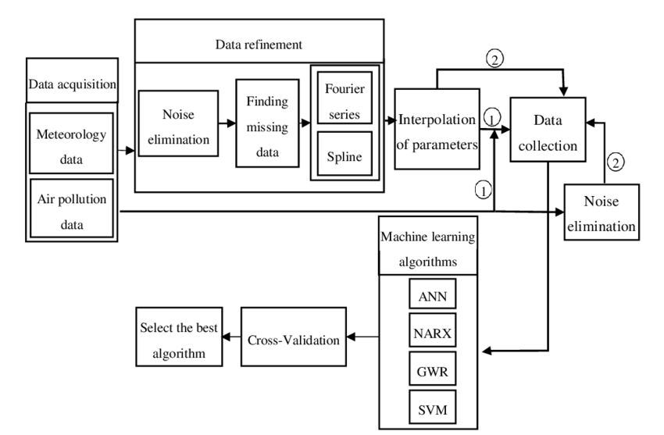
AIR PREDICTION ARCHITECTURE
BLOCK DIAGRAM

Slide 13
AIR ANALYSIS CODES
import matplotlib.pyplot as plt
from matplotlib.animation import FuncAnimation
import random
# Generate some sample air quality data (replace with your own data)
timestamps = range(1, 11)
pm25_values = [random.randint(0, 50) for _ in timestamps]
# Initialize the plot
fig, ax = plt.subplots()
ax.set_xlim(1, 10)
ax.set_ylim(0, 50)
line, = ax.plot([], [], lw=2)
# Function to update the animation at each time step
def animate(i):
line.set_data(timestamps[:i], pm25_values[:i])
return line,
# Create the animation

Slide 14
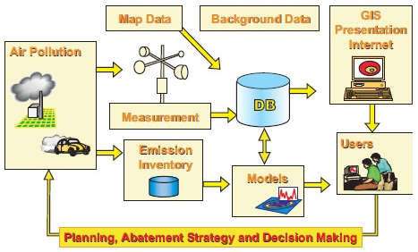
AIR QUALITY MONITORING STATION [AQMS]

Slide 15
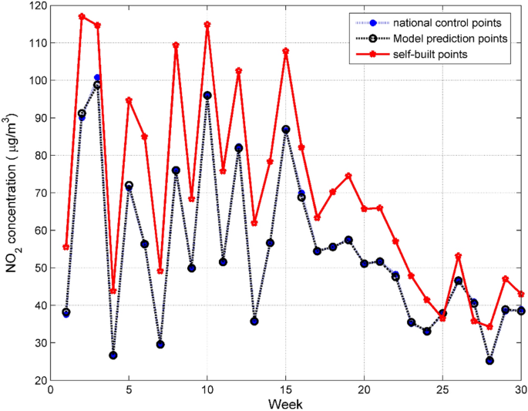
ANALYSIS AND PREDICTION OF AIR QUALITY
GRAPH

Slide 16
THANK YOU
By
NOORUL MAJHAR M
NM:D83DB97A3E090868AAA41DF07113B191

