Slide 1
Covid 19 – School Closure Government Response
Maroon Team - Final Project
Noor Yasin - Data Engineer/BI Developer
Luis Valderrama - Project Manager/BI Developer
Notes:
Good evening everyone. We are Maroon Team and we are looking forward to presenting our final project named COVID 19 – School Closure Government Response.
Our group is comprised of Noor Yasin as our Data Engineer and myself Luis Valderrama as the Project Manager.

Slide 2

introduction
The purpose of this analysis is to correlate the number of the deaths and confirmed Covid-19 cases to the government response to school closure either fully or partially
Notes:
Our objective for this project is to analyze the Government Response to the Covid19 pandemic, narrowing it down to the school closures and to see how the number of deaths and confirmed covid cases correlate to the school closures.

Slide 3
AGENDA
Data Source
Data Processing
Power BI Dashboards
Drawing Insight
Notes:
We will walk you through the process of selecting the dataset, data processing, developing the visuals in Power BI and drawing relevant insights from the data.
Without further due, I would like to introduce Noor. She will be discussing the Data Source and Processing.
Noor. I will stop sharing and yield the floor to you.
Thanks Luis! Hello all! So we are going to cover four sections in this presentation and I am going to talk about the data source and data processing sections. So, let’s get started!

Slide 4
Data Source
For the data sources of the final project, we used the following two datasets:
1- Bing Covid-19 Dataset
It includes confirmed, death, and recovered cases from all regions, updated daily as of May 2020.
2- Government Response Tracker
It includes several different common policy responses governments have taken, records these policies on a scale to reflect the extent of government action, and aggregates these scores into a suite of policy indices.
0 - no measures
1 - Recommend closing
2 - Require closing (only some levels or categories, for example, just high school, or just public schools)
3 - Require closing all level
Notes:
We will start by talking about the datasets that we have selected. We’ve selected two datasets for this project. The first one is BingCOVID 19 which provides data about the count of confirmed cases, deaths, recovered cases for the duration between 2020 and 2023. It is a large dataset with more than 4.6 million rows.
We’ve also used another dataset that shows the government response during COVID pandemic in order to reduce the number of COVID cases and corresponding deaths.
There are many measures taken by governments to respond to the pandemic, including closing school, closing workplaces, preventing group events and so on. But we will focus in this project on the school closures and its impact on the number of covid confirmed cases and deaths. The school closure took place in phases according the measure type mentioned in the dataset. So, Measure 0 means no school closure, measure 1 means that the government recommended closing schools but didn’t enforce it. Measure 2 means that schools were requested to close partially and finally, measure 3 means that schools were requested to fully close and students had to attend remotely.

Slide 5
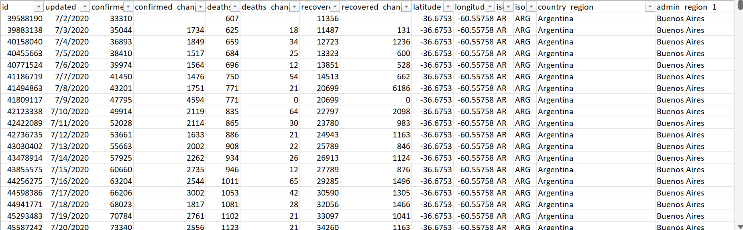
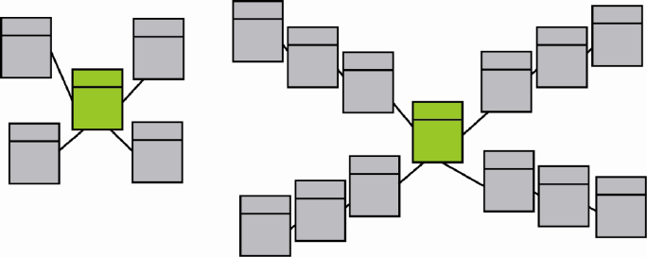
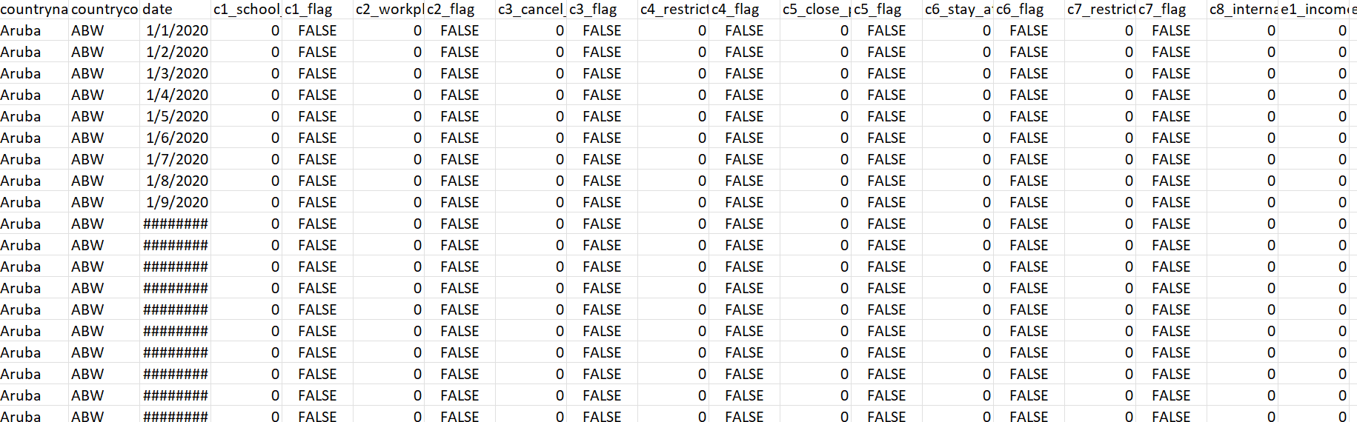
Data source
Challenges we had while selecting the data source:
Finding the right dataset that we can correlate to Bing Covid-19
Designing the data model (Choosing STAR or SnowFlake Schema)
Notes:
While choosing the second datasource, we have encountered some challenges that we will talk about over here
1- Our initial approach for the second dataset was to use stock market in order to find a relation between COVID 19 pandemic and stock prices changes. However, we weren’t able to provide meaningful information from the stock dataset, so we’ve decided to chose another dataset which was the Covid 19 government response tracker.
2- Also, we’ve come through few challenges with modelling the data and designing the data warehouse. The first challenge was to come up with fact and dim tables and building cross relationships between them in order to answer the business related question. The second challenge we’ve had was to decide which hierarchy to use either SnowFlake or STAR schema

Slide 6
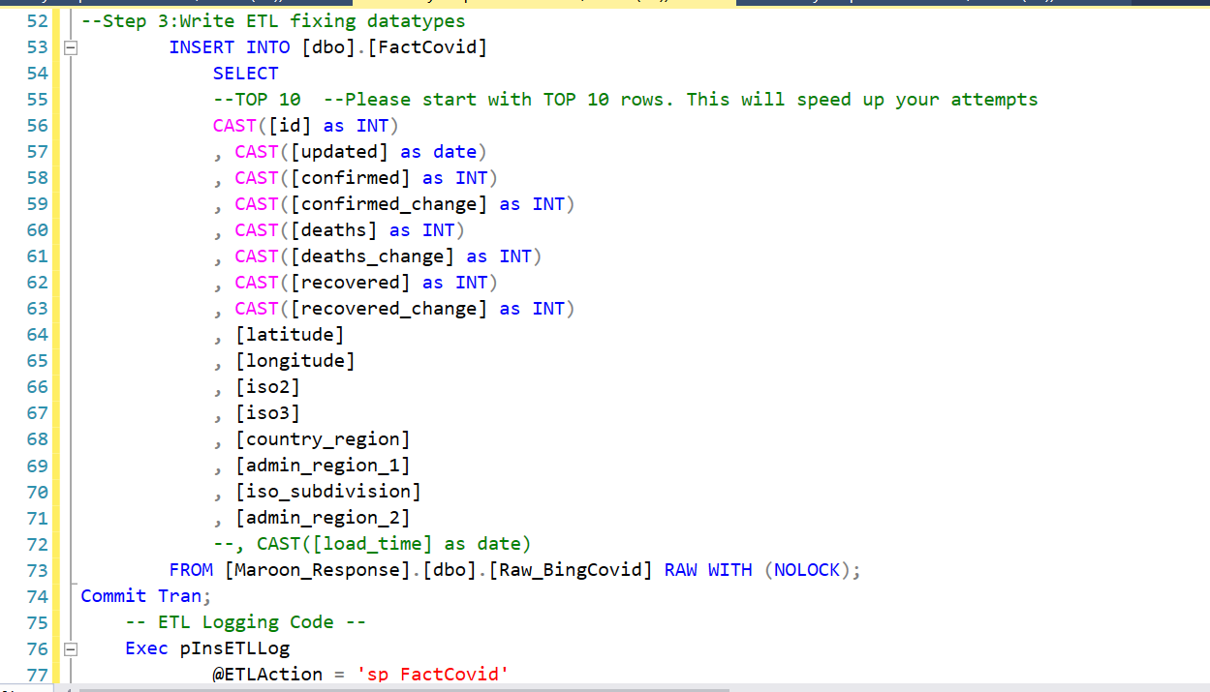
Data source
Challenges we had while selecting the data source:
Changing the types of the data in the two datasets so that we can connect them together and create measures.
Notes:
With the datatypes of the columns, we needed to convert many columns from nvarchar into int so we can calculate the data and come up with measures especially on the bing covid-19 confirmed cases column, deaths column.
For the second dataset which was the government response tracker, we had to convert the datatype of school closure column from float to int

Slide 7
AGENDA
Data Source
Data Processing
Power BI Dashboards
Drawing Insight
Notes:
we have covered the section where we talked about the datasource. Now we will move to the data processing section

Slide 8

DATA Processing
This section covers:
Data flow diagram.
Data import into SQL Management Studio.
Creating stored procedures.
Creating extraction layers/reporting views.
Extracting a backup file.
Notes:
In this section, we will talk about the following topics:
1- Data flow diagram
2- Data import into SQL Management Studio.
3- Creating stored procedures.
4- Creating extraction layers/reporting views.
5- Extracting a backup file.

Slide 9
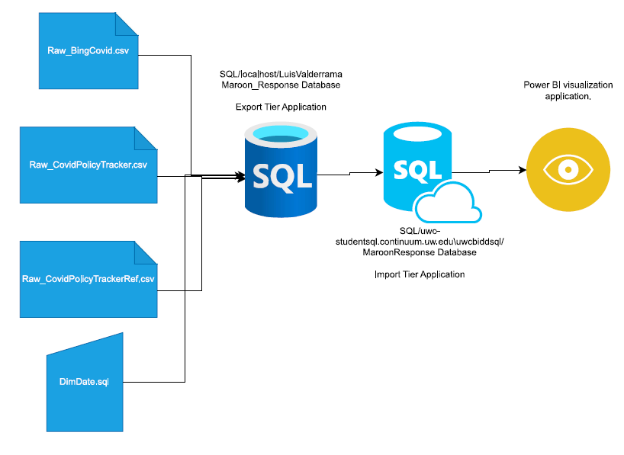
DATA Processing
Data Flow Diagram for Maroon_Response:
Import the dataset as flat files into SQL. These will become the raw data.
Create Stored Procedures to perform ETL.
Create Extraction Layers as reporting views.
Extract the data out of the views and into Power BI for visualization (covered in the next section).
Notes:
This diagram shows the steps that we have done to import the covid19 reponse tracker and bing covid 19 datasets into SQL Server local instance all the way to the class server then to Powerbi.
Both Datasets were in flat file format (CSV) and we imported each CSV file into the local instance and then we exported the database to the class server where we created the ETL stored procedures, and views. Finally, we extracted the views into power bi
Moreover, we’ve created another raw file for the definitions of the school closure indicators and imported that into dim table through a stored procedure
In a nutshell, this slide shows the end to end data flow from the csv flat files to the dashboards in powerbi.

Slide 10
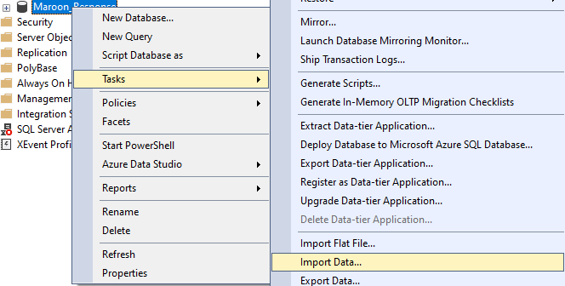
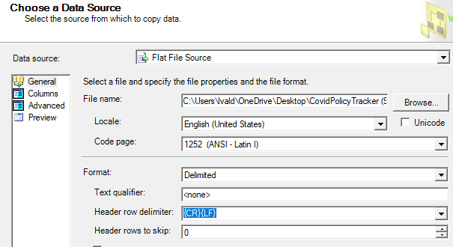
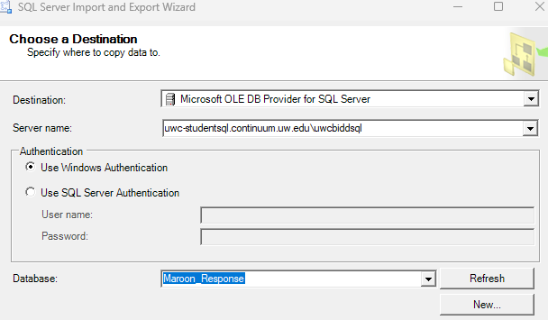
Data processing
Data Import Steps:
Connect to the local host
Create Maroon_Response database.
Click Task/Import Data.
Select Flat File Source/browse the bing_covid-19.csv file.
Examine the columns, locale, and code page.
Select MS OLE DB Provider for SQL Server as destination.
Click Next/finish.
We do the same for GovernmentResponseTracker.csv file.
Notes:
These are the steps that we did to import the database into the class server.
1- First, we connected to the local host using MS SQL Server
2- Then, we’ve created the Maroon_Response database.
3- Then, we right clicked on the database, then we selected Task, then Import Data.
4- After that, we’ve selected the flat file location and browsed to the bing_covid-19.csv file
5- Then we examined the columns, locale, and code page.
6- After that, we selected the destination as MS OLE DB SQL Server.
7- Then we clicked on Next/finish.
So Once this process was completed, we did the same process for the GovernmentResponseTracker.csv file

Slide 11
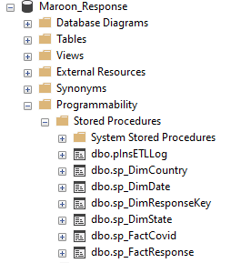
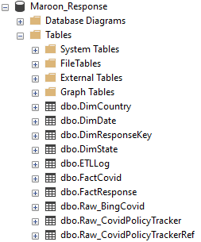
Data processing
Stored Procedures | Purpose
dbo.pnlsETLLog | Creates and admin table for logging ETL metadata
dbo.sp_DimCountry | Creates DimCountry Table Fills the table with country data from FactCovid table
dbo.sp_DimDate | Creates DimDate table
dbo.sp_DimResponseKey | Creates DimResponseKey table Fills the table with data from ReponseKey dataset which a supplemental data source
dbo.DimState | Creates DimState Fills the table with state data from FactResponse table
dbo.sp_FactCovid | Creates FactCovid table Fills the table with data from Raw_BingCovid dataset
dbo.sp_FactResponse | Creates FactResponse table Fills the table with data from Raw_CovidPolicyTracker dataset
Notes:
We are showing here the ETL stored procedures to create dim and fact tables and fill/transform the data from the raw data into these new dim/fact tables
The first procedure we created is for the the ETL Logs where it shows the status of the ETL processes whether if it went successful or if it failed
Then the DimCountry procedure which creates DimCountry table and fills the table with country data from FactCovid table
After that we created the DimDate procedure which creates the dim date table and fills the data for dates, weeks, months, and years.
Then we created the DimResponseKey procedure which creates the ResponseKey dim table and fills it with the definitions of the school closure indicators from the raw file.
We also created the DimState procedure which creates DimState table and fills it with state data from the FactResponse table
After that we created the FactCovid procedure which creates the FactCovid table and fills it with data from Raw_BingCovid dataset
And lastly, we created the FactResponse procedure that creates FactResponse table and Fills it with data from raw government response tracker flat file.

Slide 12
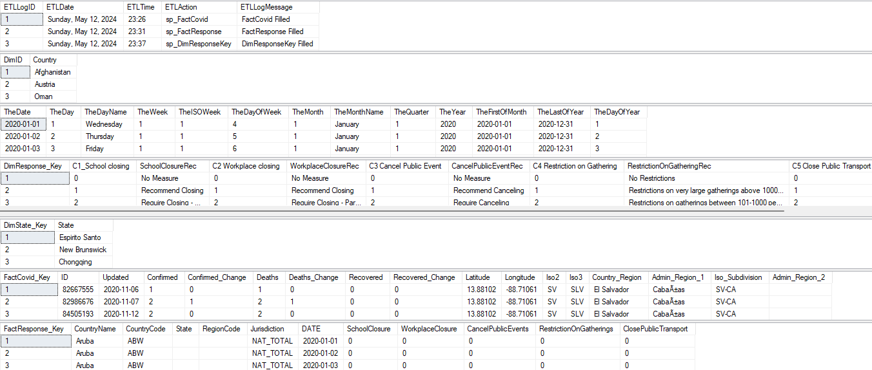
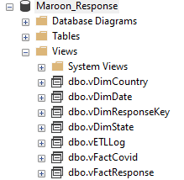
Data processing
Report Views that will later be connected to Power BI. The data displayed from the views is sampled for accuracy.
Notes:
Here is a snap shots after executing the stored procedures where it shows that the dim/fact tables and views have been successfully filled from the raw tables

Slide 13
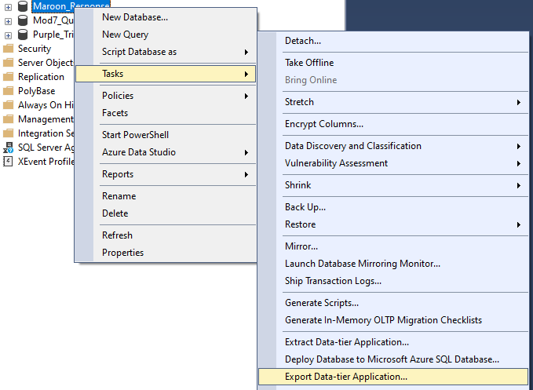
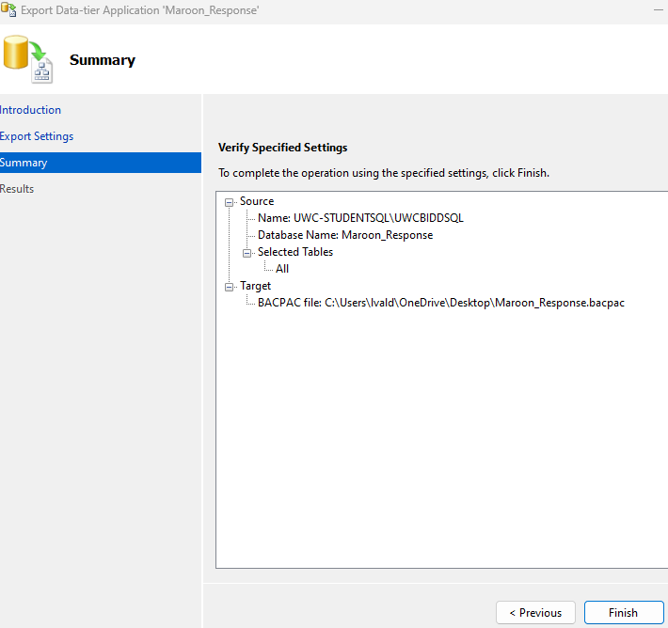
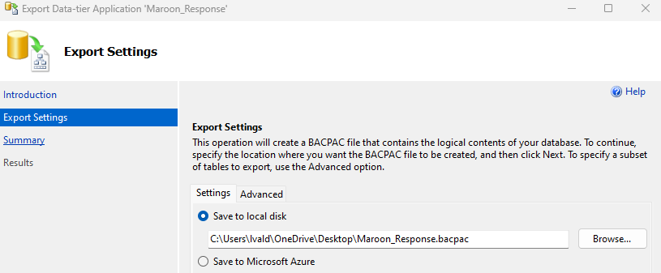
DATA PROCESSING
Extracting Backup Steps:
Drop Sprocs and views.
Click Task/Export Data-tier-Application.
Select destination.
Click Next/finish.
Notes:
This slide show the process of extracting the back up file from the local instance in order to import it into the class server
First thing, we drop the Sprocs and views, as they might cause errors during the import process.
Then we right clicked on the Maroon_Response Database on the local host and selected Task/Export Data-tier-Application.
After that we’ve select the destination folder where we will save the backup file.
Finally we clicked on Next/finish.

Slide 14
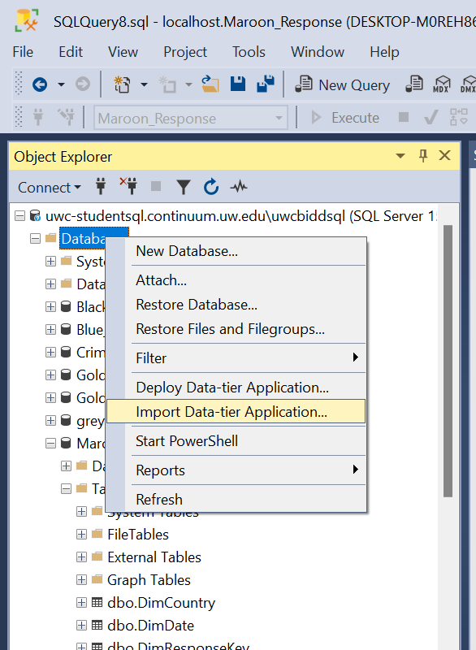
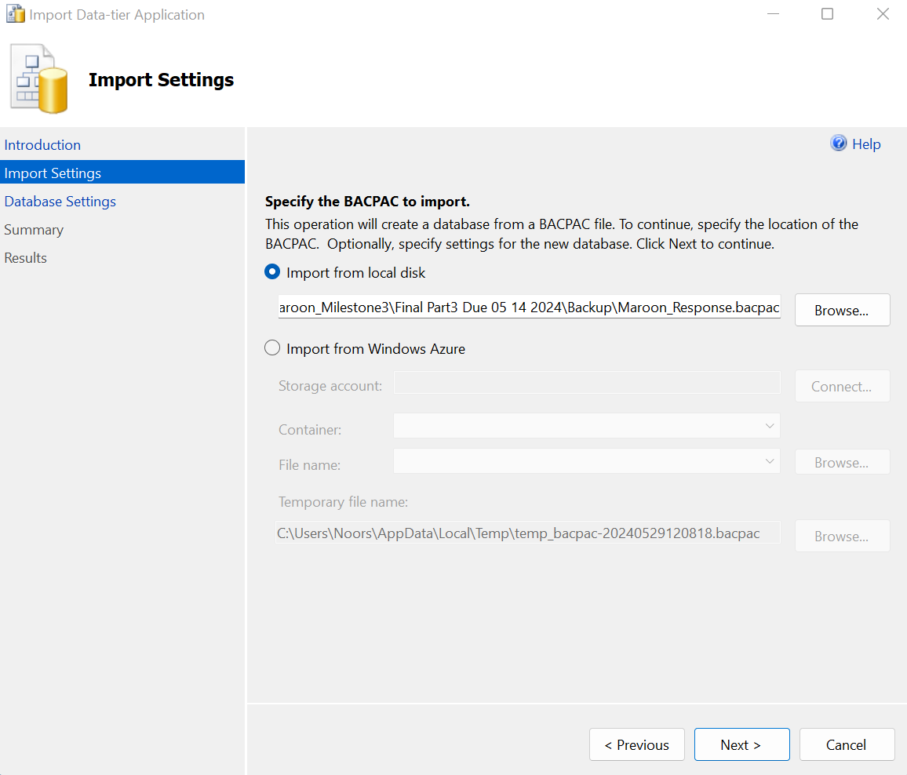
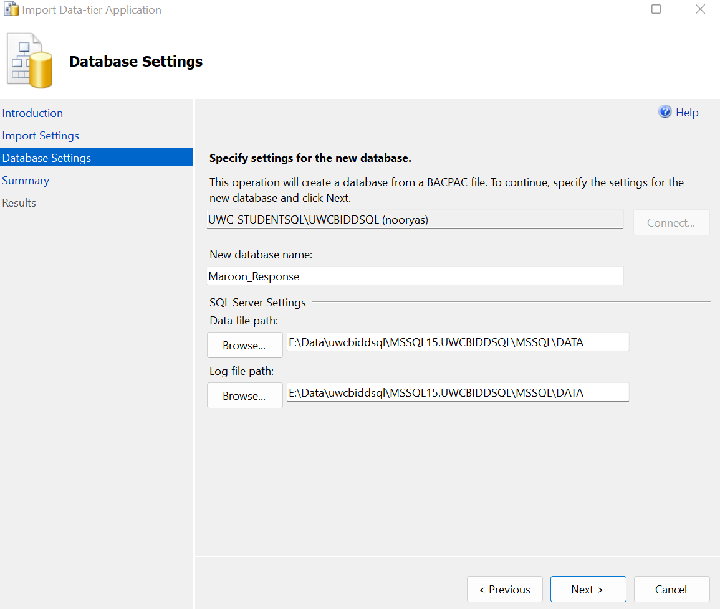
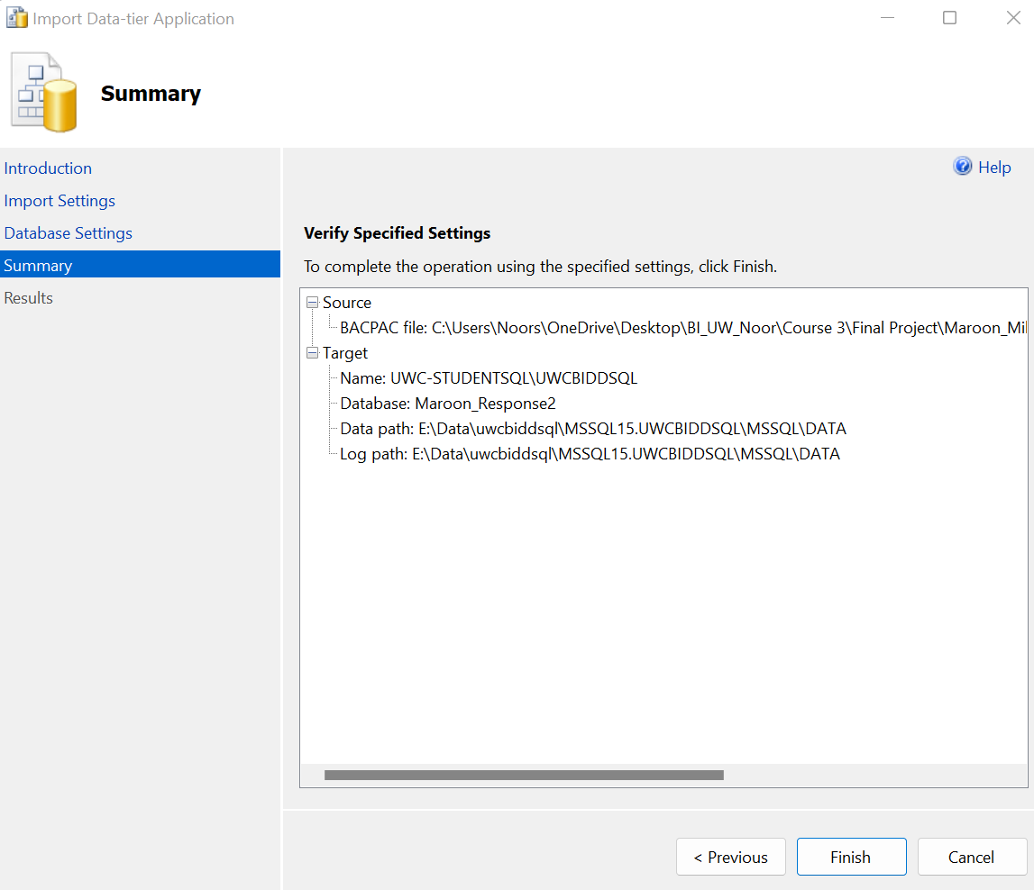
DATA PROCESSING
Importing Data-tier-Application Backup Steps:
Login to the destination server (Class Server).
Right Click on Database and import Data-tier-Application.
Choose backup file location
Select new database name.
Click finish.
Notes:
This is the last slide in this section where we’ll cover importing the backup file into the class server.
First thing, we login to the destination server (which is the Class Server).
Then we right Click on the database folder at the top and select import Data-tier-Application.
And then we choose the backup file location
And then we type in the database name (Maroon Response).
And then we click on finish.
Once the import is completed, we re-execute the stored procedures and re-create the views.

Slide 15
AGENDA
Data Source
Data Processing
Power BI Dashboards
Drawing Insight
Notes:
The next section covers the powerbi dashboards. I will handover back to Luis to go through this section. Thank you!
Thank you, Noor.
Following the agenda, I will be covering the Power BI Dashboard and Drawing Insights
In this section we examine
1. data import process
2. data modeling
3. dashboard design.
We leveraged the homeworks created for this class and used them as inspiration for this final project dashboard.

Slide 16
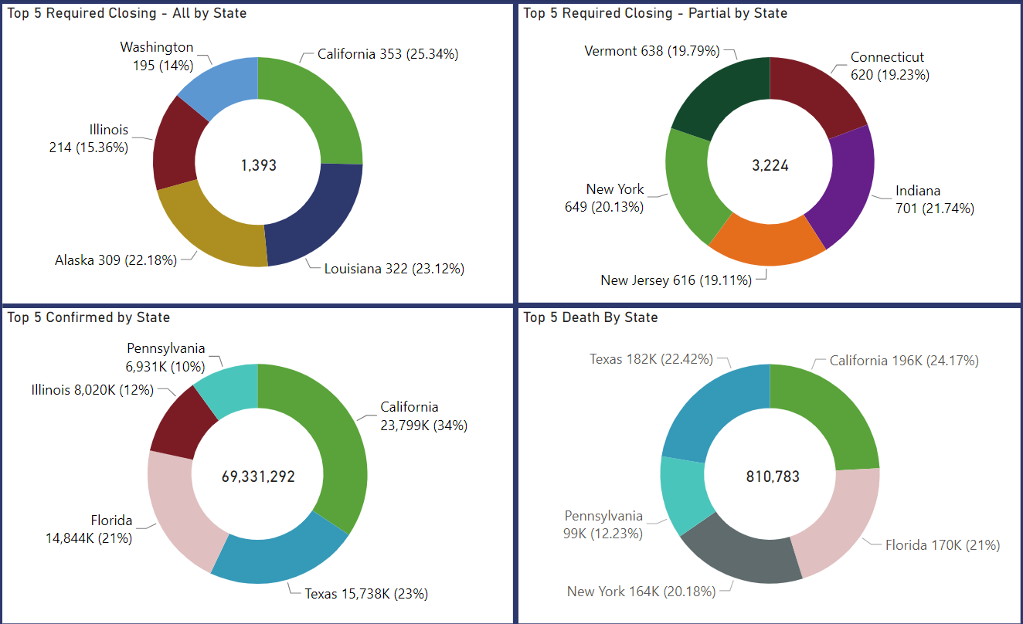
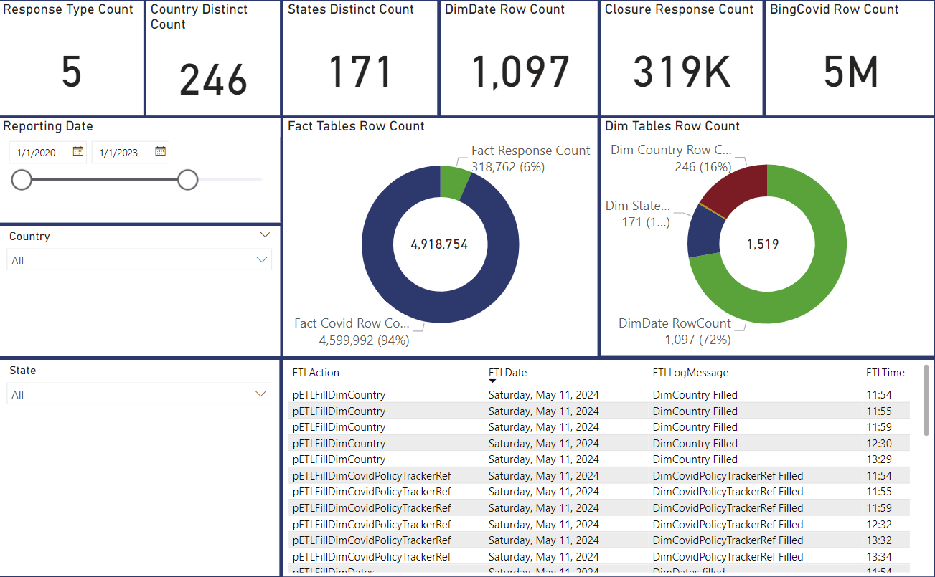
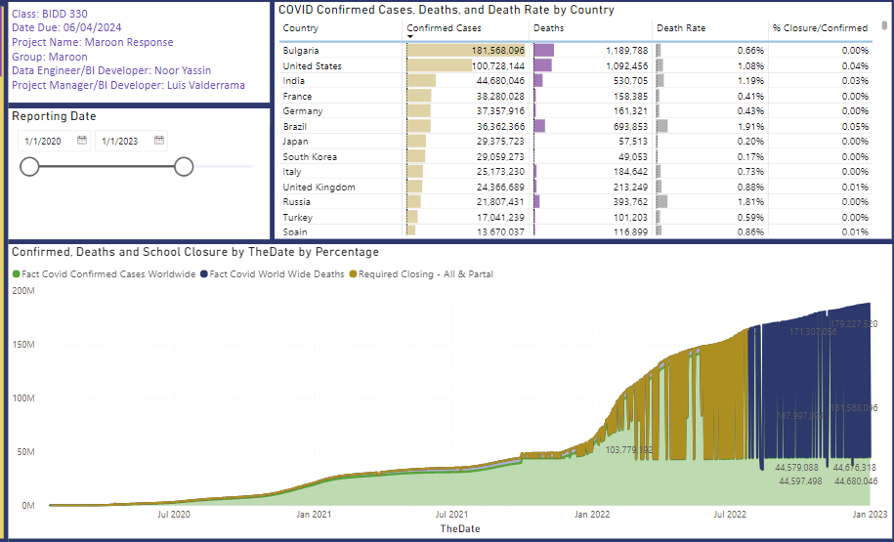
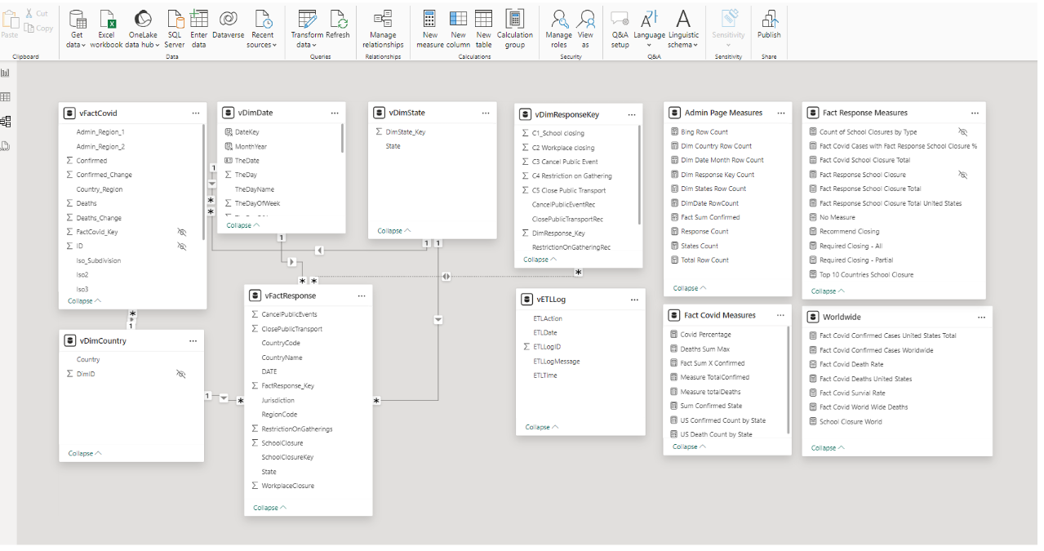
Power bi dashboard
This section covers:
Data import.
Data Model.
Dashboard design.

Slide 17

Power bi dashboard
Why we chose Power BI:
Ease of use
Data handling performance
Integration
Community, Support, Popularity
Notes:
We chose Power BI because
The application is user-friendly and suitable to prioritize performance without technical complexities.
Power BI is well-suited for organizations using Microsoft technologies, making it a widely-used visualization tool.
Power BI integrates easily with other Microsoft products and is the most popular BI tool, followed closely by Tableau.
The application is well-suited for the data we are using in this project.

Slide 18
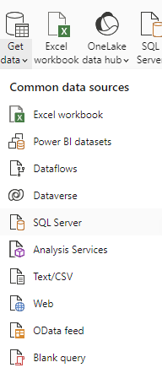
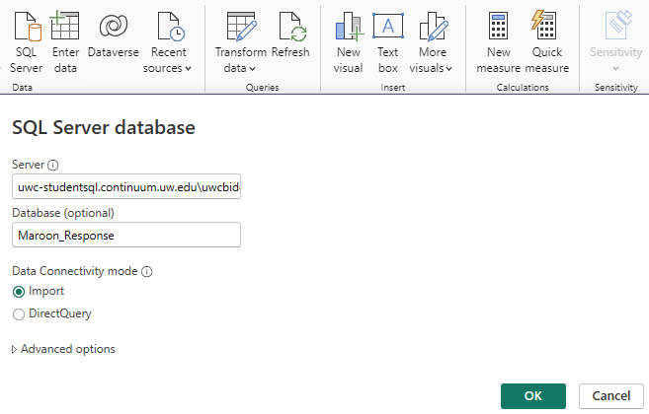
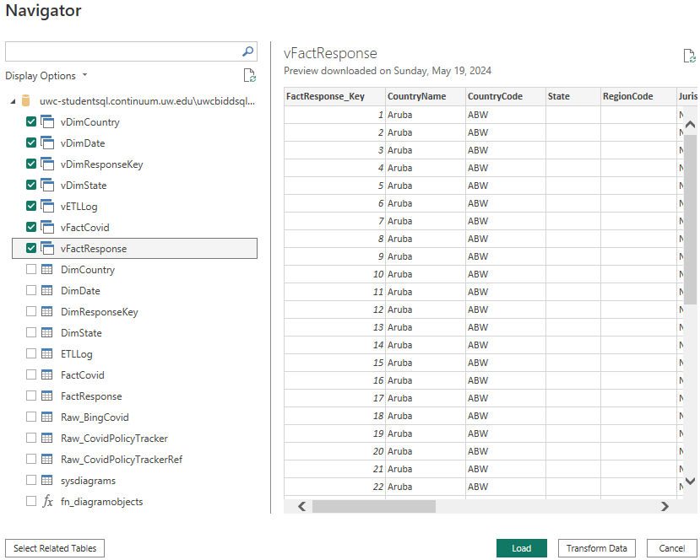
Power bi dashboard
Data Import:
Select Get Data from the menu
Select SQL Server
Enter the class server and DB info
Select the reporting views
We chose to bypass transformation. Instead, we loaded the data and performed transformation as needed at a later time
Notes:
To get the data into Power BI:
First, from Get Data at the top menu we chose SQL server, entered the class server and database names. Selected the report-views that were previously created and loaded the data.

Slide 19
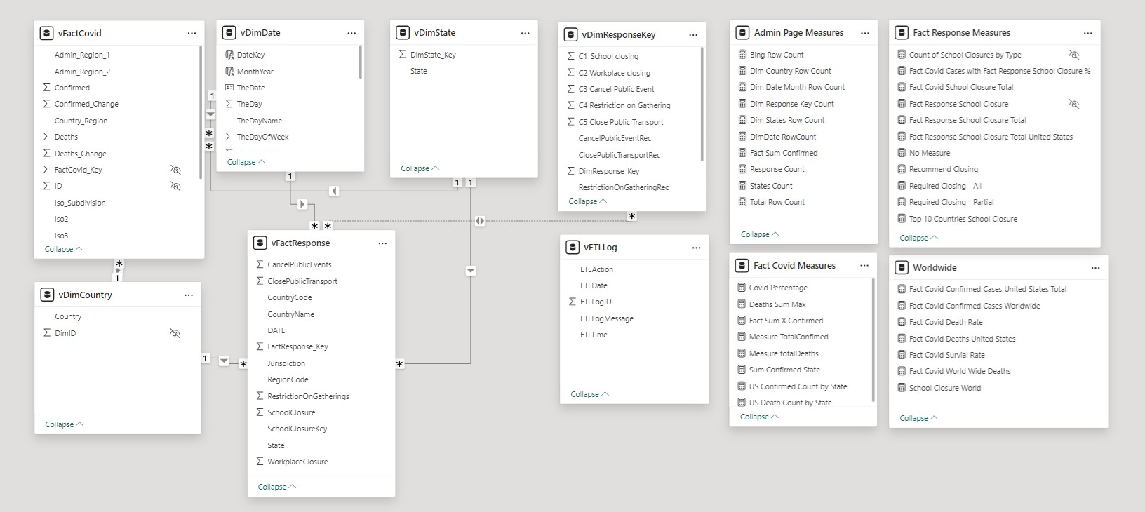
POWER BI Dashboard
Data Model consists of four-dimension tables connected to fact tables one-to-many, four measures tables, and two fact tables:
Notes:
After the data import process we end up with 4 dimension tables, 2 fact tables, 1 ETL Log Table. And, note that we added 4 measure tables as the project developed. Here you can see the final Data Model.

Slide 20
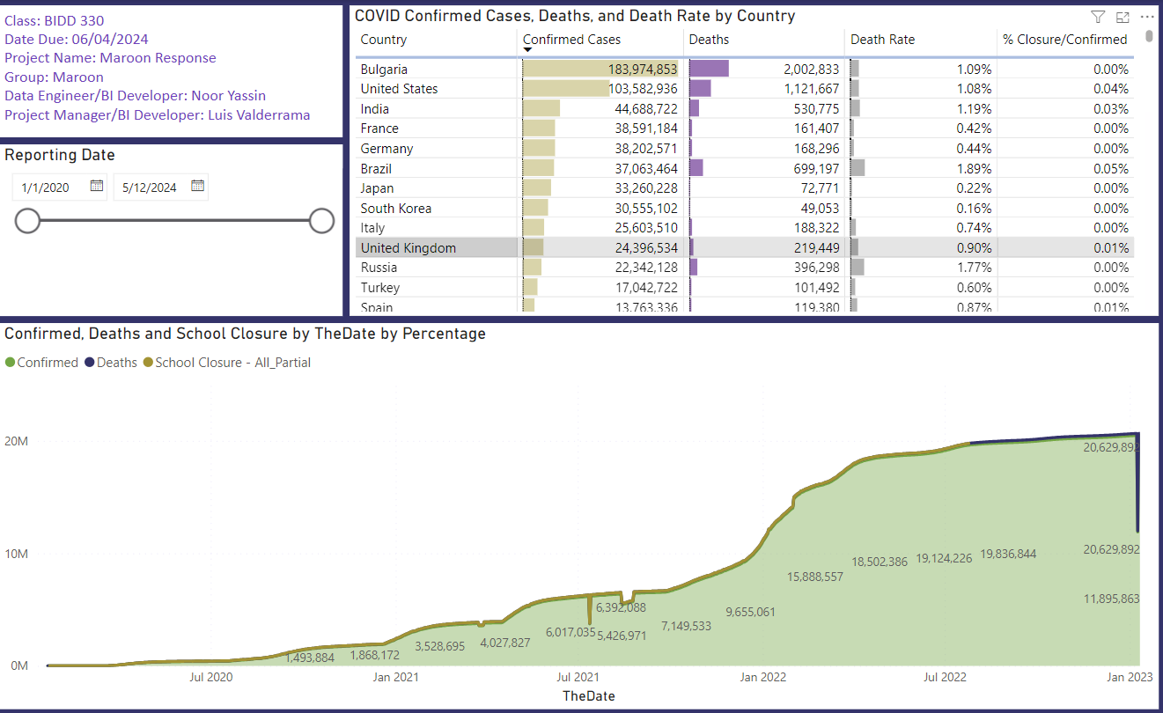
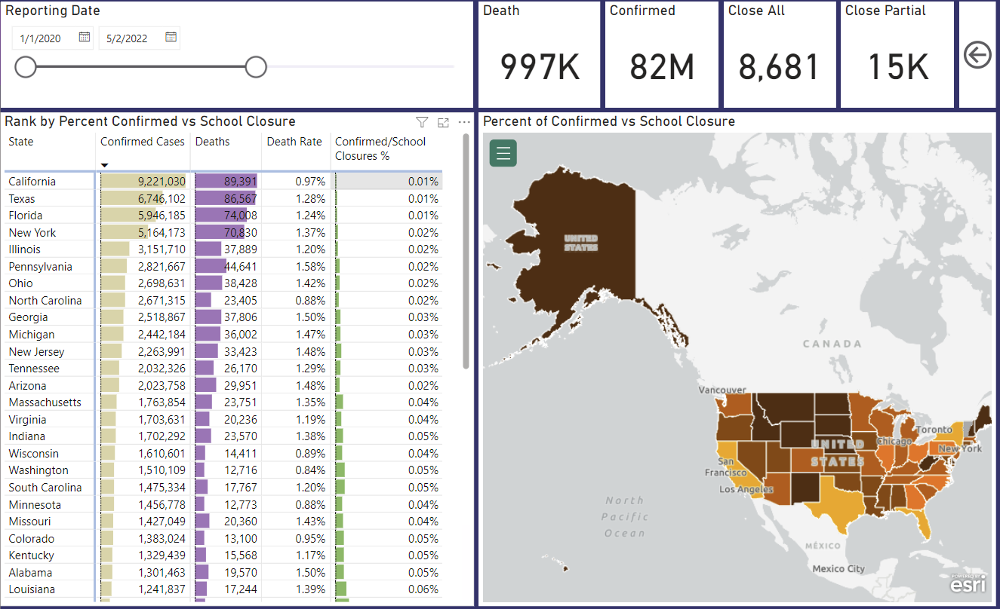
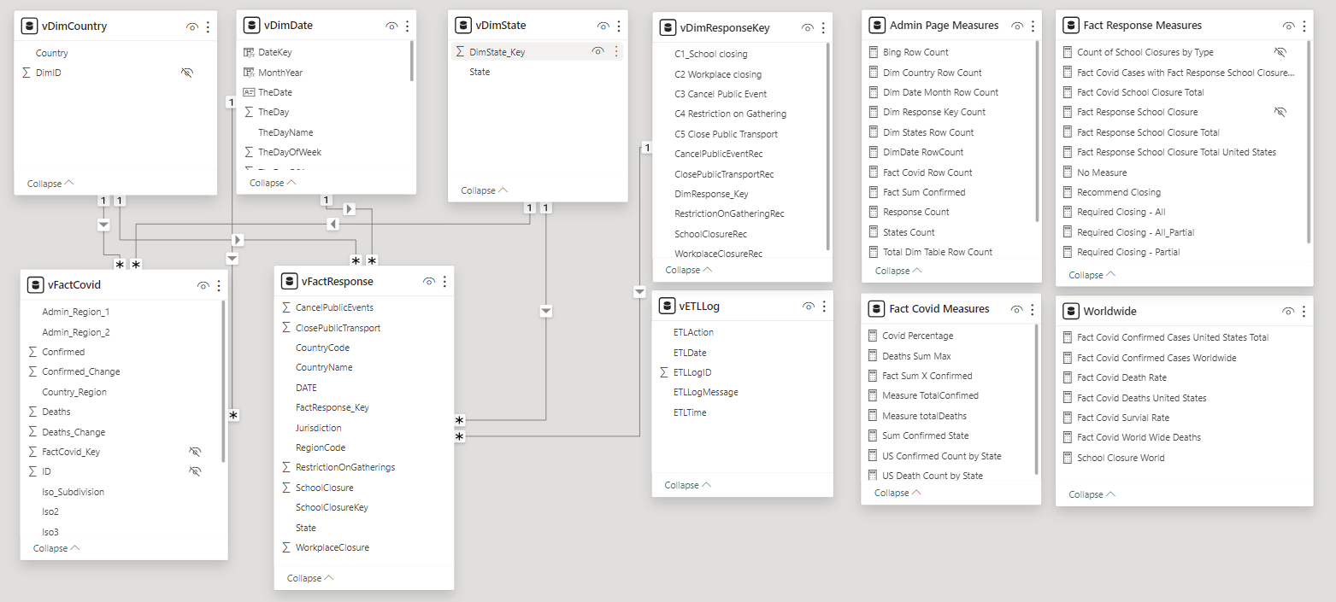
POWER BI Dashboard
Dashboard Design:
In this project we utilized components such as
Visuals
Stacked Area Chart
Donut Chart
Map
Card
Table
Matrix
Dynamic Filters
Sync Date Sliders
Bookmarks
Drill Through Features
Notes:
The visuals that we employed include
Stacked Area Charts and Donut charts which are great for revealing trends, composition and visualizing proportions and changes
Maps for geographical display
Cards for snapshot metrics and single number insights
And Tables
Other features employed in this dashboard include Dynamic Filters, Sync Date Sliders, Bookmarks, and Drill Through.

Slide 21
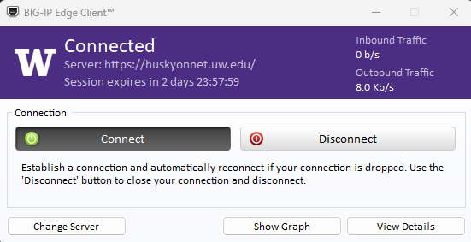

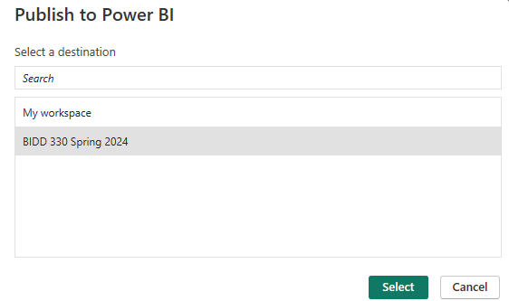

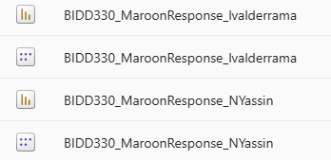
Publishing The Report
Connect to huskyonnet.uw.edu
Publish the Report to BIDD 330 Spring 2024
Report Link
Notes:
Publishing the report
Once the report is completed and validated we then published the dashboard report by
Connecting to the class server
Clicking Publish from Home in the top menu
Choosing BIDD 330 Spring 2024 as the destination
And publish
At this point, the report is opened for the users to access and utilize the report as needed.

Slide 22
AGENDA
Data Source
Data Processing
Power BI Dashboards
Drawing Insight

Slide 23
Drawing insights
This section covers:
School closures classifications
Covid19 Pandemic Dates
Interesting observations of the data
Drill Through

Slide 24
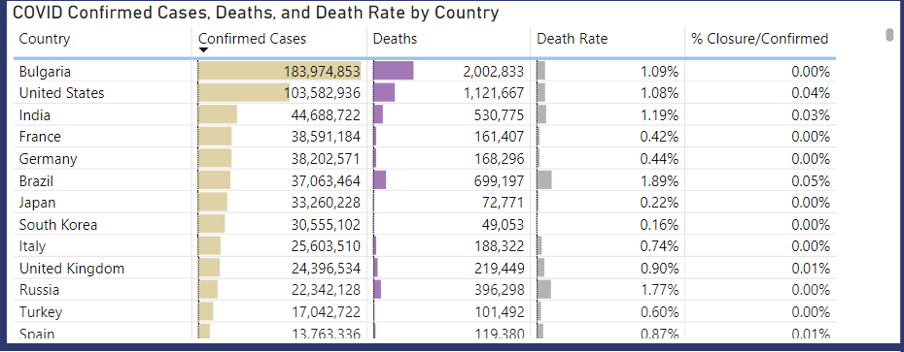
Drawing insights
School Closures
The Table shows countries sorted by confirmed cases in descending order.
Noting that the US had the highest rate of school closures compared to other countries
Bulgaria is the country with the highest confirmed cases and deaths had in fact the lowest percentage of deaths to school close
South Korea had the lowest (of the top 10) death rates during the Covid19 years. However, note that the % Covid Death to School Closure ratio is less than half of the United States
Notes:
School Closures
What we found interesting in this visual is the fact that it depicts one of the KPIs we created named % of Closure to Confirmed Cases, that is seen at the far right of this table noting that:
Bulgaria shows the highest number of confirmed covid cases and deaths, and also had the lowest % of school closures to confirmed cases.
Followed by the US which has the second highest numbers of confirmed cases and deaths. However, the US had a higher % of School Closure to Confirmed cases ratio of this top ten group
To contrasts, Brazil had the highest death rate. However not necessarily the highest number of deaths as it stayed under 700K. Brazil also has the highest % of School Closure to Confirmed Cases ratio of this group
To further the contrast, countries like France, Germany, Japan, South Korea, and perhaps others that have relatively 0 reported school closures and yet have lower death rates, confirmed cases and number of deaths.

Slide 25
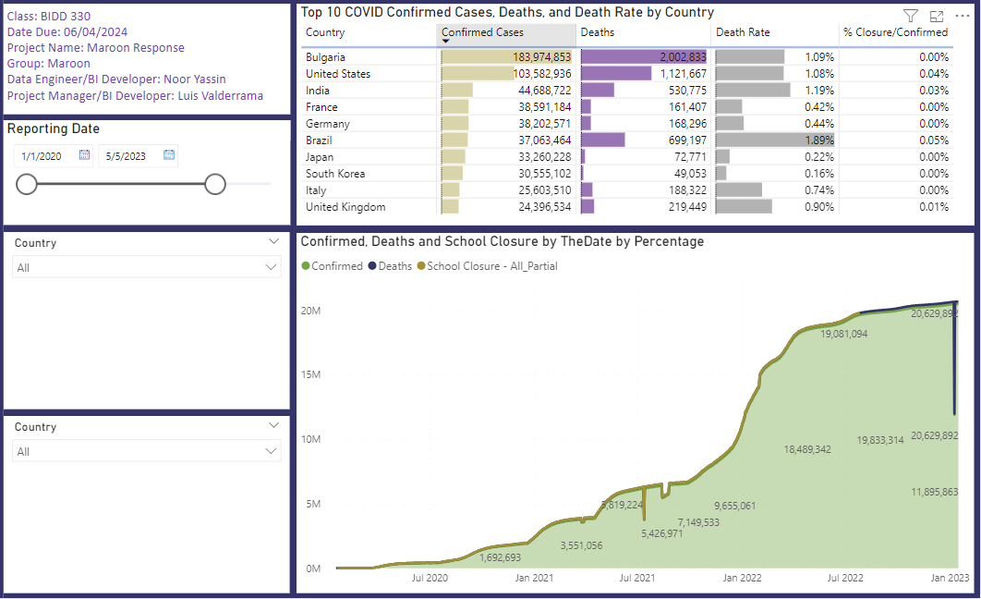
Drawing insights
School Closures – Cont.
The visuals illustrates the stacked area chart of school closures, confirmed cases, and deaths worldwide.
Looking at the graph, there is no visible correlation between schools closures and COVID confirmed cases/ related deaths.
Notes:
This is a complete view of the page which includes the stacked area chart which can be dynamically filtered by country, state, and the user can select a date range.

Slide 26
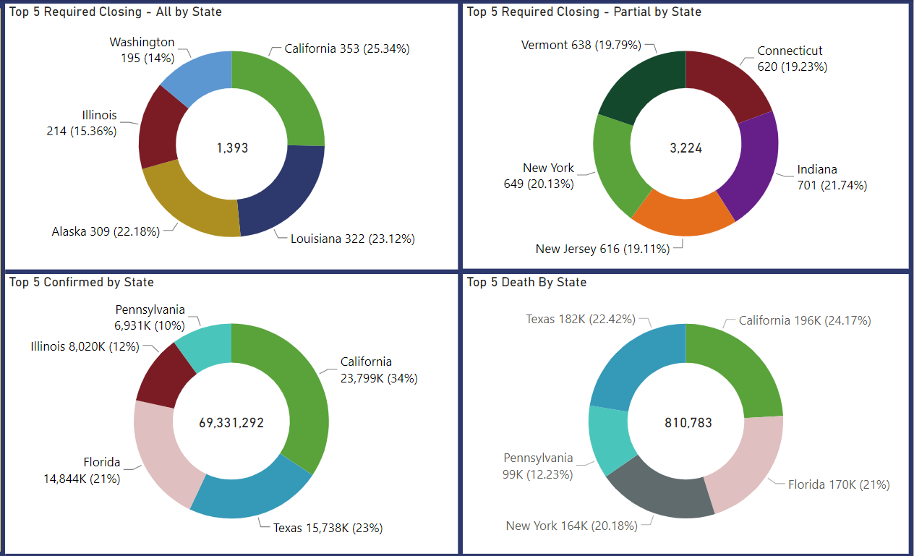
Drawing insights
Top 5 Page
The information presented in these for visuals are exclusive to the United States segmented by Top 5 states based on closure classification
California is a the top of the list with the highest number of school closing – all.
Indiana is at the top of the list with the highest number of school closing – partial.
California is at the top of the list with the highest number of COVID confirmed cases.
California is at the top of the list with the highest number of deaths due to COVID.
Notes:
Top 5 is based on US data only.
Interesting observation from looking at these visuals is that only California, Illinois, and New York out of the 10 states shown in the Top 5 states with school closure (for all or partial) are also shown in at least one of the bottom charts.
Suggesting that:
30% of the states with some form of required school closures also had high confirmed cases and deaths
While
70% of the states with some form of required school closures were not the top 5 states with high confirmed cases and deaths

Slide 27
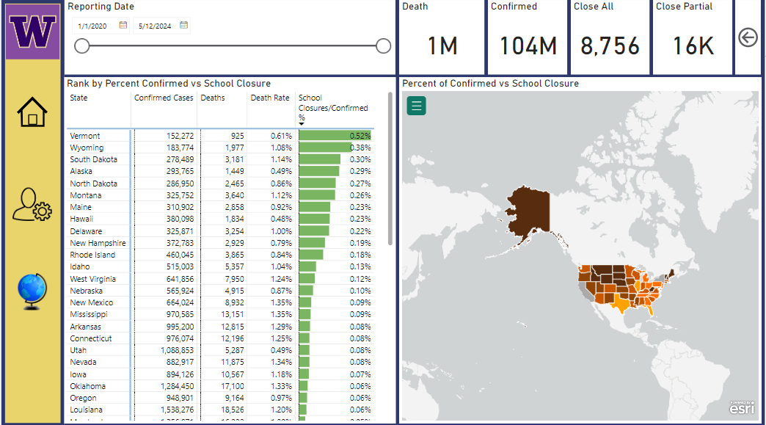
Drawing insights
Drill Through Page
The visuals shown in this slide were created solely for the purpose of drill through from the first page of the dashboard report.
This page allows the user to view the data available for each state such as deaths, confirmed cases, death rate, and the percentage of school closures per confirmed cases.
Notes:
Drill through:
The Rank table is sorted by % of School Closures to Confirmed Cases ratio in descending order placing Vermont at the top with the highest ratio in the country while California which is not shown on this image was placed at the bottom of the list. As a reminder, California had the highest number of confirmed cases and deaths. But not necessarily the highest death rate.
It is important to take into consideration the population size of these states as that can skew the results.

Slide 28
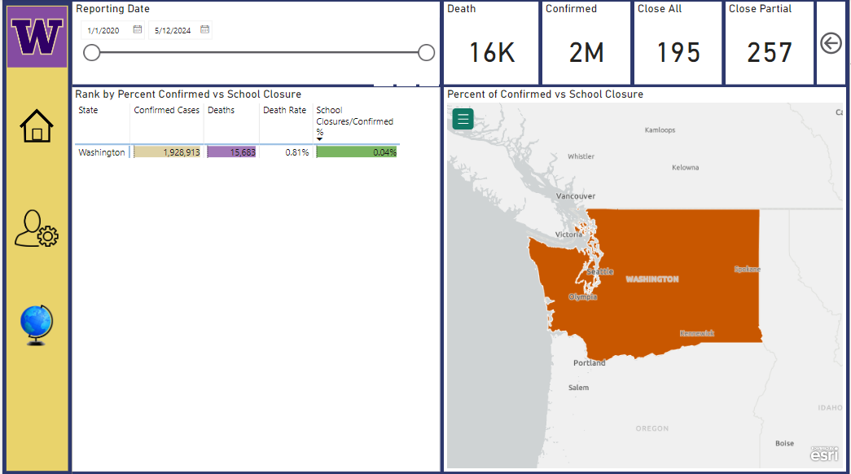
Drawing insights
Drill Through Page Continued
This is an example of a drill through down to the state of Washington.
Notes:
The drill through page has the ability to focus on one state at a time to see high level values as shown here where Washington State had: 16K deaths, 2 million cases, completely closed 195 schools, and partially closed 257 schools.

Slide 29
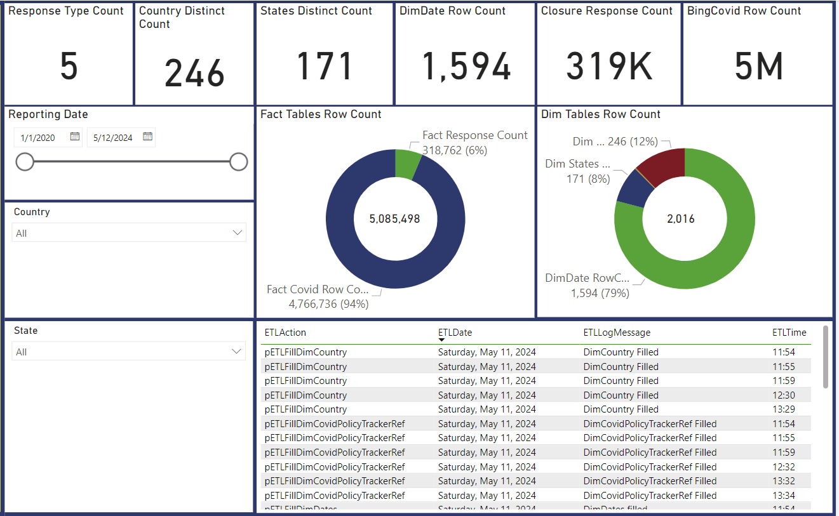
Drawing insights
Admin Page
This page provides the user with information relevant to the administration of the report such as:
ETL Log information
Dim tables row count
Fact tables row count
Notes:
Admin Page
This is probably one of my favorite pages as I can relate to it due to my work tasks. It helps the report administrator keep track of when the data was loaded as it pulls information from our vETLLog. it shows count of rows for Dim and Fact Tables separately and other relevant counts that makes it easier to validate.

Slide 30
conclusion
Can we conclude that closing schools during the pandemic materially contributed to lower covid cases or deaths?
Notes:
I’d like to close this presentation with the question.
Can we conclude that closing schools during the pandemic materially contributed to lower covid cases or deaths? I think that would be a good topic for discussion.
In my opinion there needs to be more analysis to have a better conclusion. For example,
the table presented earlier suggests that there a other countries such as France, Germany, Japan, South Korea and perhaps others that have relatively 0 reported school closures and yet have lower death rates, confirmed cases and number of deaths.
In the United States, only 3 out of the top 10 states with some form of required school closing also had the highest number of covid cases and deaths.
The good news is that the dashboard is not limited. The way we modeled the data, the dashboard can be expanded in future releases and include other datapoints already in the database. For example, some of the other datapoints that would be interesting to explore include: Workplace, public gathering and travel-transportation restrictions, stay at home requirements, among others.

Slide 31
Questions and Answers
Notes:
This concludes our presentation. Thank you all for you participation. We would like to open the floor for questions.

