Slide 1
Ingress-nginx and SSL

Slide 2
Ingress-nginx files download
URL Followed- https://kubernetes.github.io/ingress-nginx/deploy/
1.
Go To AWS section of above url
Copy-Paste this link
kubectl apply -f https://raw.githubusercontent.com/kubernetes/ingress-nginx/controller-v0.47.0/deploy/static/provider/aws/deploy.yaml
2.
TLS TERMINATION IN AWS LOAD BALANCER (ELB)
Download deploy-tls-termination.yaml
wget https://raw.githubusercontent.com/kubernetes/ingress-nginx/controller-v0.47.0/deploy/static/provider/aws/deploy-tls-termination.yaml

Slide 3
Edit deploy-tls-termination.yaml
Edit the file and change:
VPC CIDR in use for the Kubernetes cluster:
proxy-real-ip-cidr: XXX.XXX.XXX/XX
AWS Certificate Manager (ACM) ID
arn:aws:acm:us-west-2:XXXXXXXX:certificate/XXXXXX-XXXXXXX-XXXXXXX-XXXXXXXX
1. Go to VPC in AWS and get CIDR and edit yaml file ---->deploy-tls-termination.yaml
For AWS Certificate Manager
1.Go To Certificate Manager Service
2.Click Request A certificate
3.Select Request a public certificate
4.Click Request A certificate
5.Add wildcard domain name Like(*.digitalcloudplatform.com)
6.Click Next
7.Select DNS Validation-->Review-->Confirm and Request-->

Slide 4
8. Expand Domain Section-->Click Create Record in Route 53--->Continue
9. Wait till it get issued
10. Copy ARN from there and paste it in deploy-tls-termination.yaml
ARN arn:aws:acm:eu-west-1:936422292136:certificate/976184e0-3a6c-4d4b-9fc1-503b8e941a2c
After changing CIDR and ACM use this command in deploy-tls-termination
kubectl apply -f deploy-tls-termination.yaml
This will do all setup (namespaces, services, deployment)
kubectl get all -n ingress-nginx
You will get a network load balancer in services

Slide 5
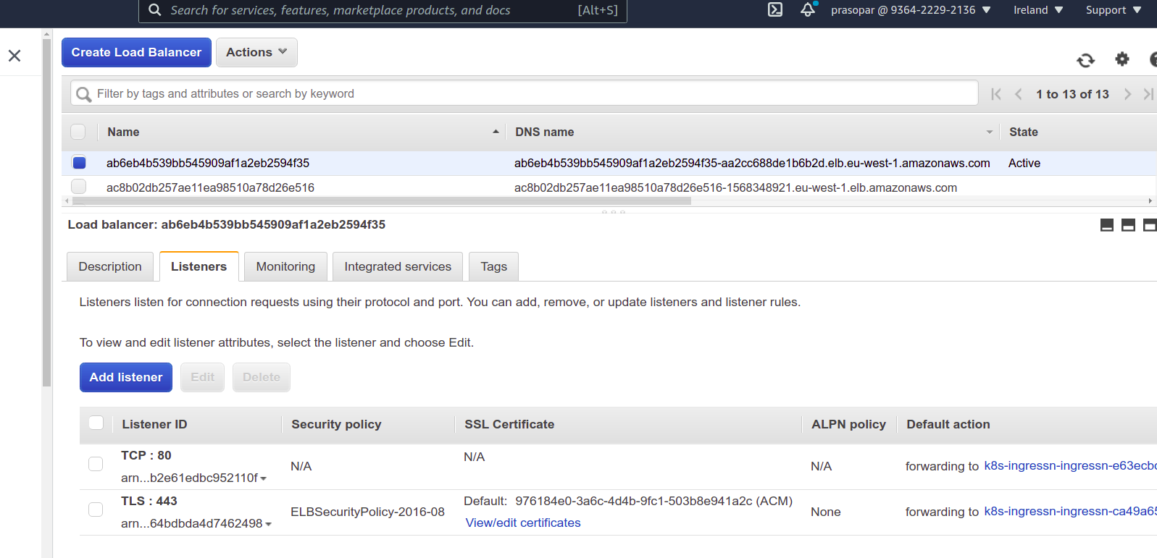
Edit Load Balancer configuration

Slide 6
Edit Listener configuration
Go to Load Balancer in AWS --->Select the one which is created and wait till it comes in active state-->Click Listeners
Select the listener which is associated with 443
If it is TLS:443 like above picture then everything is good
If it is TCP:443 then
1. Click on that TCP:443 Listener-->Delete it
2.Click Add Listener
3. Select Protocol TLS: 443
4. Keep ALPN policy as None
5.Default action-->Forward to (Select one target group) (Go Back to target group section in AWS and check which of the target group associated with this load balancer has at least 1 healthy instance)
6.Security Policy -->Pick ELBSecurityPolicy-2016-08
7.Default SSL certificate-->From ACM (recommended)-->SSL certificate which you craeted above will be in dropdown
8. Click Add LIstener

Slide 7
Attach load balancer to your domain
1. Goto Route53 services
2. Click HostedZones
3. Goto your Domain-->Create Record
4. Write Record Name or use wildcard * in place of Record Name
5.Toggle Alias
6.Choose endpoint-->Alias to Network Load Balancer
7.Choose Region
8.Choose Load Balancer --->Create Record

