Slide 1
Kubernetes
Ofc-Deployment

Slide 2
Kubernetes
kubernetes Deployment---------
Ecr role login fail
attach all ecr roles to that ec2 to do ecr login
aws ecr get-login-password --region us-east-2 | docker login --username AWS --password-stdin 123598687.dkr.ecr.us-east-2.amazonaws.com
Jenkins command for deployment
cd /home/git/Deployments/deploydcporder/
sudo rm -rf Dockerfile order-0.1.0-SNAPSHOT.jar
sudo aws s3 cp s3://dcptemp/abcd/order-0.1.0-SNAPSHOT.jar .
sudo aws s3 cp s3://dcptemp/abcd/Dockerfile .
sudo docker rmi -f dcpecomorder 123598687.dkr.ecr.eu-west-1.amazonaws.com/dcpecomorder
sudo docker build -t dcpecomorder .
sudo docker tag dcpecomorder123598687.dkr.ecr.eu-west-1.amazonaws.com/dcpecomorder
sudo docker push 123598687.dkr.ecr.eu-west-1.amazonaws.com/dcpecomorder
kubectl scale deployment dcpecomorder --replicas=0 -n dcpecomorder
kubectl scale deployment dcpecomorder --replicas=1 -n dcpecomorder
--------------------Kubernetes copy from pod to local-------------------------------------------
kubectl cp <pod-id>:<path> <destination-path> -n <namespace>
(kubectl exec jenkins-5fcbc67695-m8gmd -it -- cat /tmp/workspace.tar.gz) > /home/git/tempworkspace
kubectl cp jenkins-5fcbc67695-m8gmd:/var/jenkins_home/workspace.zip ./workspace.zip

Slide 3
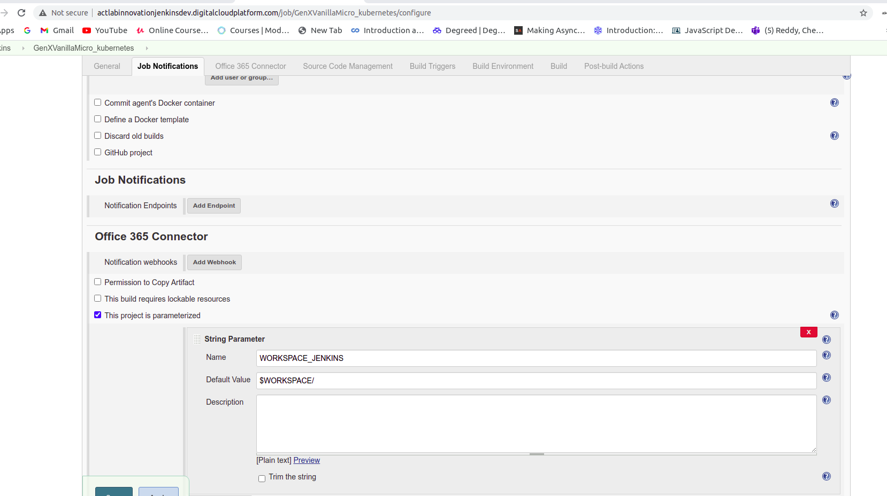
Jenkins Template

Slide 4
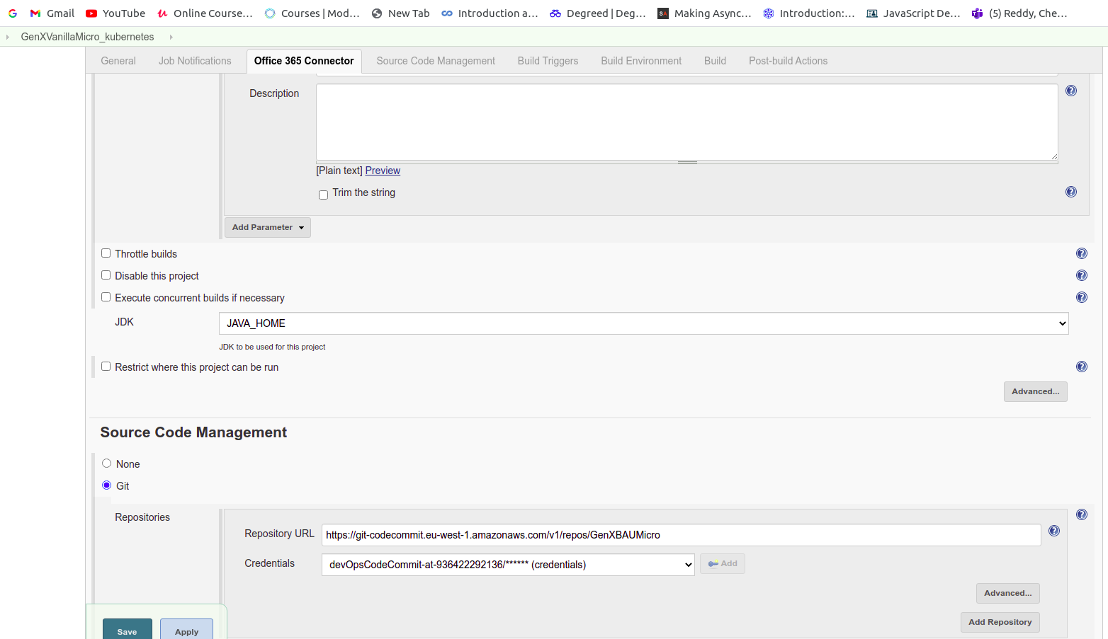

Slide 5
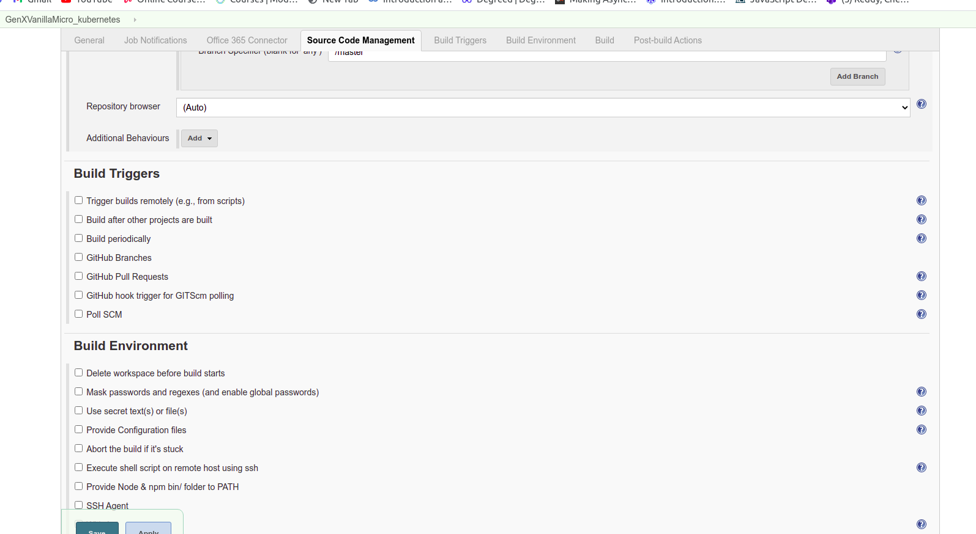

Slide 6
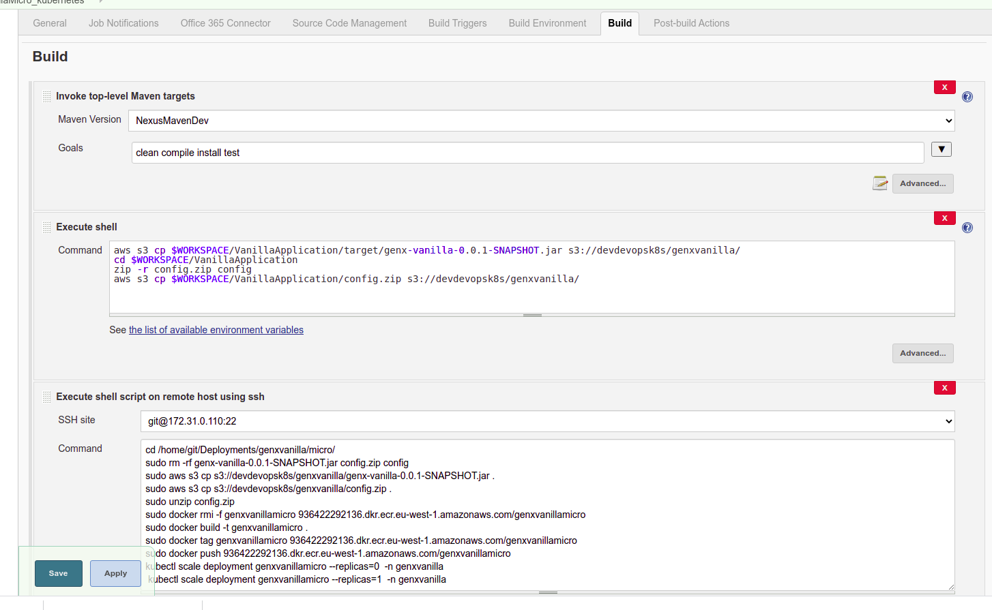

Slide 7
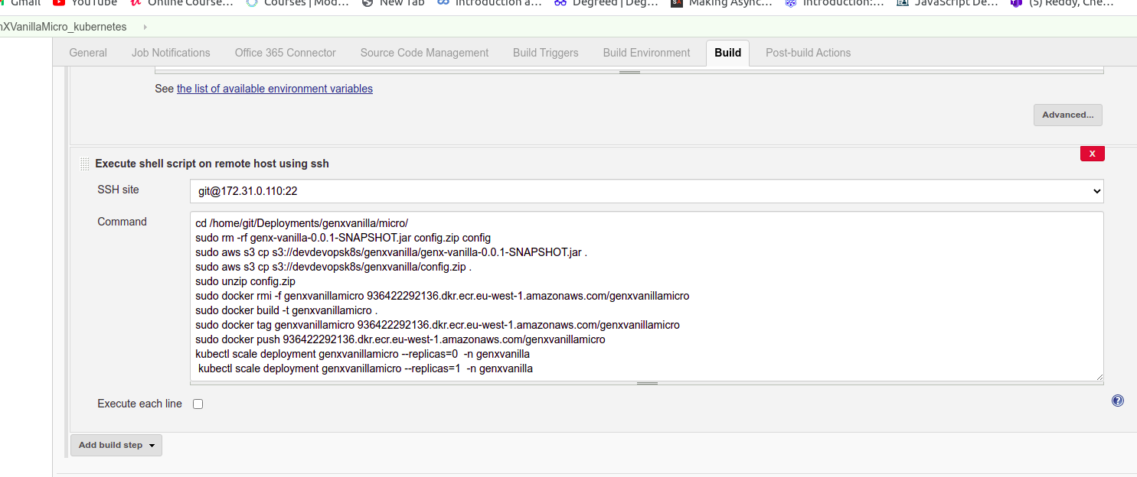

Slide 8
Deploy steps
In Deploy steps word file in this folder only

Slide 9
exservice
:~/appservices/dcpecomorder$ cat exservice-dcpecomorder.yaml
apiVersion: v1
kind: Service
metadata:
name: dcpecomorderc
namespace: ingress-nginx
spec:
type: ExternalName
externalName: dcpecomorderc.dcpecomorder.svc.cluster.local
ports:
- port: 8088

Slide 10
INgress
~/appservices/dcpecomorder$ cat ingress-resourcesdcpecomorder.yaml
apiVersion: extensions/v1beta1
kind: Ingress
metadata:
name: ingress-resourcesdcpecomorder
namespace: ingress-nginx
annotations:
nginx.ingress.kubernetes.io/rewrite-target: /$2
nginx.ingress.kubernetes.io/ssl-redirect: "false"
spec:
rules:
- host: dev.digitalcloudplatform.com
http:
paths:
- path: /dcpecomorder(/|$)(.*)
backend:
serviceName: dcpecomorderc
servicePort: 8088

