Slide 1
Kubernetes microservice Deployment

Slide 2
posts.zip is the microservice deployed in this case

Slide 3
Deployment yaml
apiVersion: apps/v1
kind: Deployment
metadata:
name: posts
labels:
app: posts
namespace: posts-namespace
spec:
selector:
matchLabels:
app: posts
template:
metadata:
labels:
app: posts
spec:
containers:
- name: posts
image: 1130998543451417.dkr.ecr.us-east-2.amazonaws.com/posts:latest
ports:
- containerPort: 4000

Slide 4
Dockerfile
FROM node:alpine
WORKDIR /app
COPY package.json ./
RUN npm install
COPY ./ ./
CMD ["npm", "start"]

Slide 5
Service.yaml
apiVersion: v1
kind: Service
metadata:
name: service-posts-port80-clusterip
labels:
app: posts
namespace: posts-namespace
spec:
type: ClusterIP
ports:
- name: ui
port: 80
targetPort: 4000
protocol: TCP
selector:
app: posts

Slide 6
Ingress Setup
Youtube link :- https://www.youtube.com/watch?v=7B6E_xLufew
Helm
helm repo add ingress-nginx https://kubernetes.github.io/ingress-nginx
Install NGINX ingress
$ helm repo update
$ helm install ingress-nginx/ingress-nginx --generate-name
Build golang app
$ docker build -t app:v0.1.0 -f Dockerfile .
$ docker tag app:v0.1.0 <your-account-id>.dkr.ecr.us-east-1.amazonaws.com/app:v0.1.0
$ aws ecr get-login-password --region us-east-1 | docker login --username AWS --password-stdin <your-account-id>.dkr.ecr.us-east-1.amazonaws.com
$ docker push <your-account-id>.dkr.ecr.us-east-1.amazonaws.com/app:v0.1.0
Deploy our app to kubernetes
$ kubectl apply -f deployment.yaml
$ kubectl apply -f service.yaml
$ kubectl get endpoints
$ kubectl apply -f ingress.yaml

Slide 7
Ingress file
---
apiVersion: networking.k8s.io/v1beta1
kind: Ingress
metadata:
annotations:
kubernetes.io/ingress.class: nginx
name: posts-ingress
namespace: posts-namespace
spec:
rules:
-
host: posts.noosarp.click
http:
paths:
-
backend:
serviceName: service-posts-port80-clusterip
servicePort: 80
path: /

Slide 8
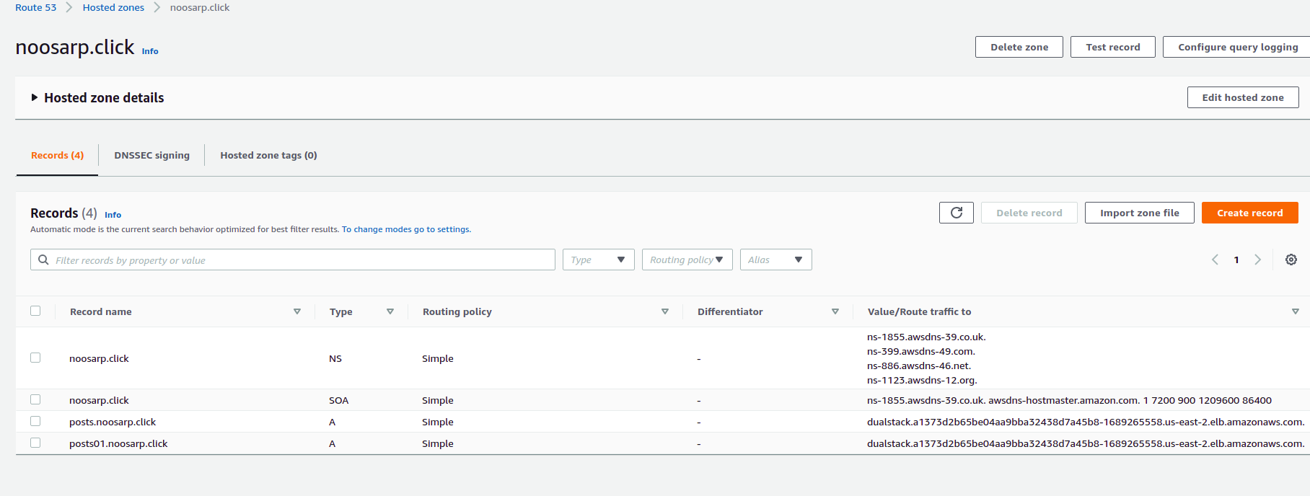
Create record for your domain name

Slide 9
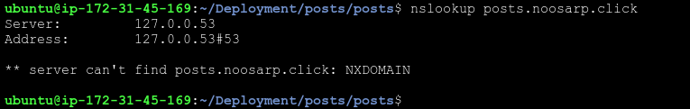
Command to check if link working
Command:- nslookup posts.noosarp.click
Output should be like
ubuntu@ip-172-31-45-169:~/Deployment/posts$ nslookup posts.noosarp.click
Server: 127.0.0.53
Address: 127.0.0.53#53
Non-authoritative answer:
Name: posts.noosarp.click
Address: 18.223.47.159
Name: posts.noosarp.click
Address: 3.129.139.74
It takes time after record is created and ingress is applied til then it will show this error

Slide 10
Useful Ingress commands
kubectl get ingress -n posts-namespace
Output
No resources found in posts01-nmamespace namespace.
ubuntu@ip-172-31-45-169:~/Deployment/posts$ kubectl get ingress -n posts01-namespace
Warning: extensions/v1beta1 Ingress is deprecated in v1.14+, unavailable in v1.22+; use networking.k8s.io/v1 Ingress
NAME CLASS HOSTS ADDRESS PORTS AGE
posts01-ingress <none> posts01.noosarp.click a1373d2b65be04aa9bba32438d7a45b8-1689265558.us-east-2.elb.amazonaws.com 80 100m

Slide 11
Useful kubernetes command
Kubectl get pods -n namespace
kubectl describe pods -n namespace
kubectl logs podname -n namespace
kubectl get svc -n namespace
kubectl describe svc -n namespace
kubectl edit svc -n namespace
kubectl get endpoints
kubectl delete ns namespace
kubect exec -it podname /bin/bash -n namespace

