Slide 1
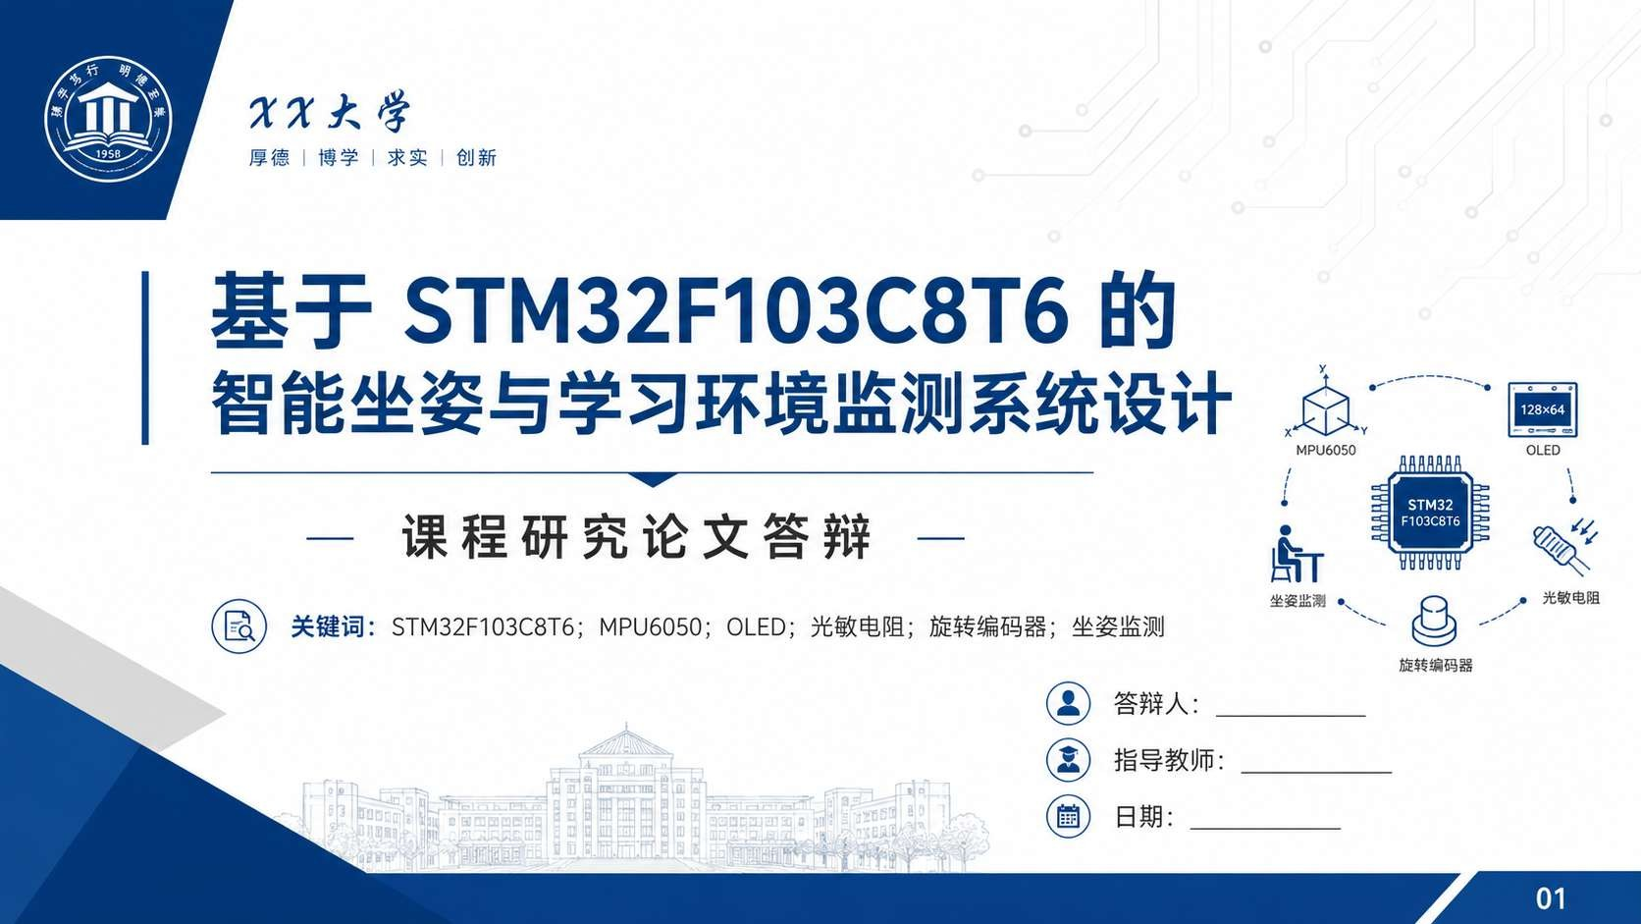





宋佳骏
马利
2026/5/15

Slide 2
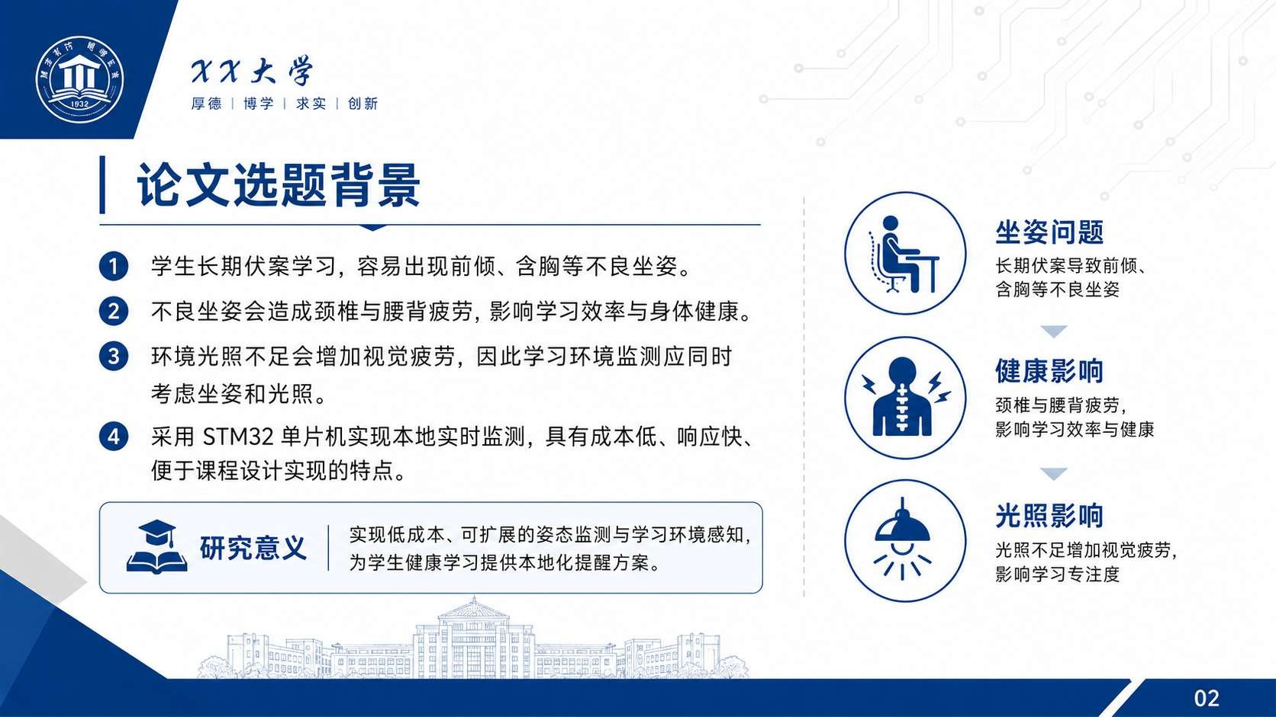


Slide 3
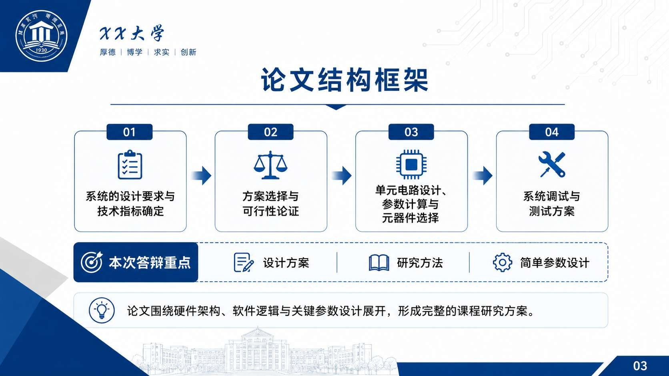


Slide 4

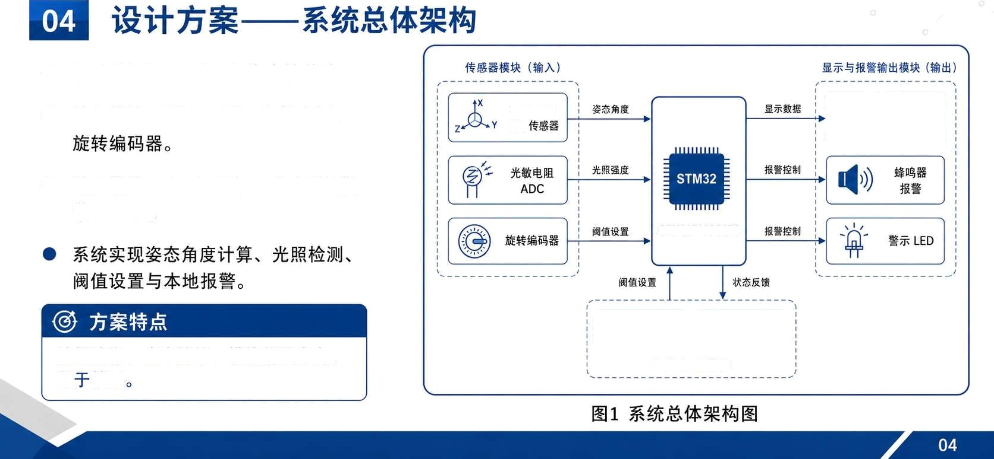




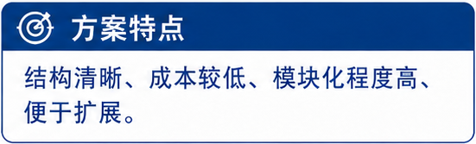



STM32F103C8T6 1ț ß
0
MPU60S0
STM32F103C8T6

Slide 5
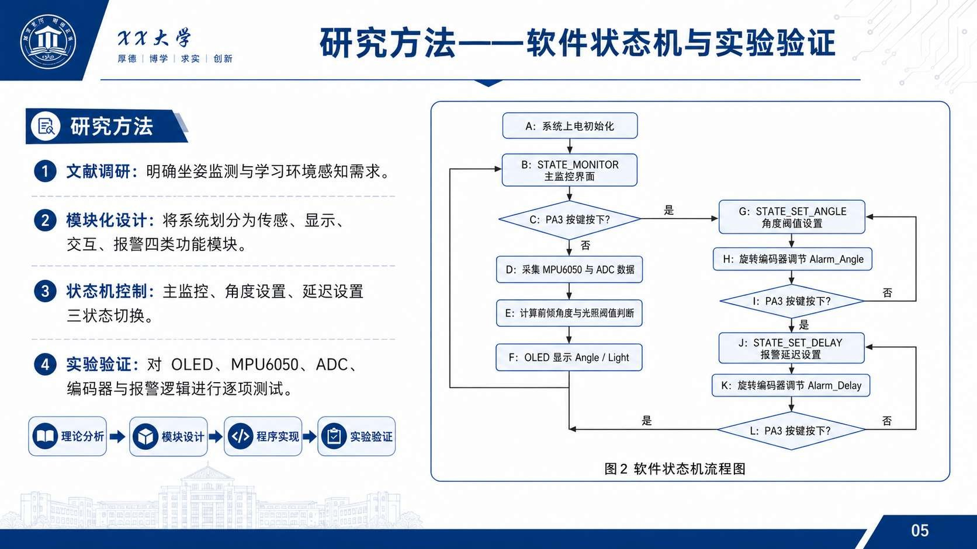

Slide 6

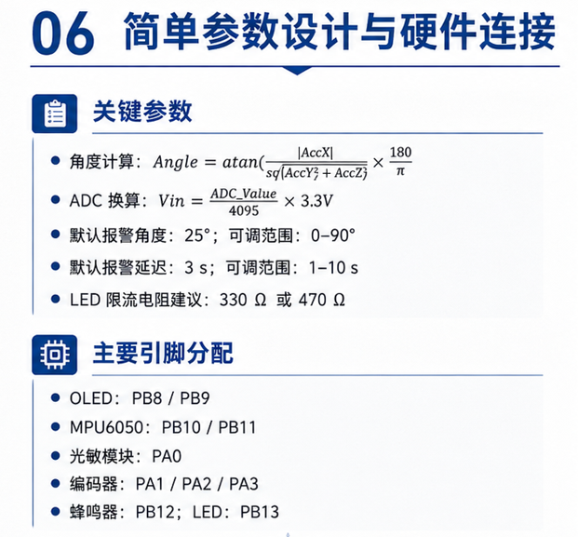
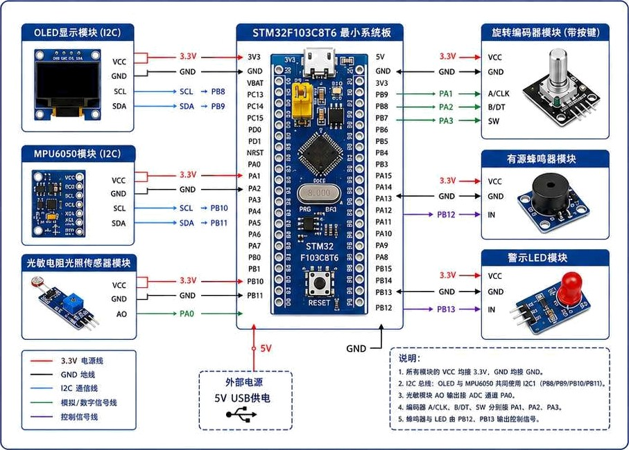




04 «»i«:†—'«/s»
ÆOWÆEIE: 2s: %ÆÆ|B: 0-90’
OLED : PB8 / PB9
NPU6050: PB10 / PB11
V&& : PA0
@Tiggg' PA1 / PA2 / PA3
ÆM&: PB12; LED: PB13

Slide 7
