Slide 1
Indoor Positioning System
Lucas Wassénius
Oscar Johansson

Slide 2
Poll
- Anchor
2. Poll Ack.
- Tag
3. Final
4. Range Report

Slide 3
- Anchor
- Tag
Poll

Slide 4
Distance
- Anchor
Distance
- Tag
Distance
Distance
Distance
Distance

Slide 5
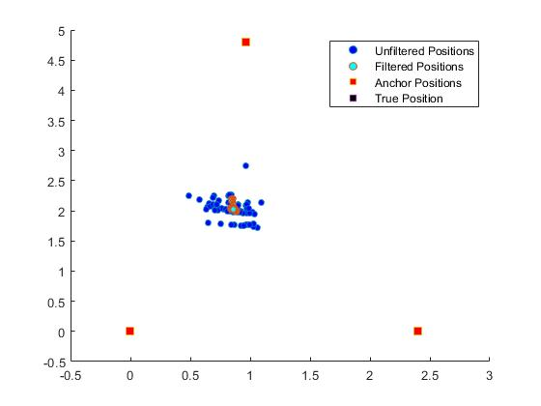

Slide 6
In Progress
Optimization of sampling frequency
Filter Parameter Selection
Next Step
Add Tag Node/
Find Orientation
Additional/Change Filter

