Slide 1
Brute Force Backtracking Branch & Bound
Dr. Krishna Gopal Dhal
Assistant Professor of Computer Science
Midnapore College (Autonomous)

Slide 2
Brute-force
Brute-force search or exhaustive search, also known as generate and test, is a very general problem-solving technique and algorithmic paradigm that consists of systematically enumerating all possible candidates for the solution and checking whether each candidate satisfies the problem's statement.

Slide 3
Brute-force
While a brute-force search is simple to implement.
Always find a solution if it exists.
Its cost is proportional to the number of candidate solutions – which in many practical problems tends to grow very quickly as the size of the problem increases.
Therefore, brute-force search is typically used when the problem size is limited, or when there are problem-specific heuristics that can be used to reduce the set of candidate solutions to a manageable size.
The method is also used when the simplicity of implementation is more important than speed.

Slide 4
0-1 Knapsack problem: brute-force approach
Since there are n items, there are 2^{n} possible combinations of items.
We go through all combinations and find the one with maximum value and with total weight less or equal to W
Running time will be O(2^{n})

Slide 5
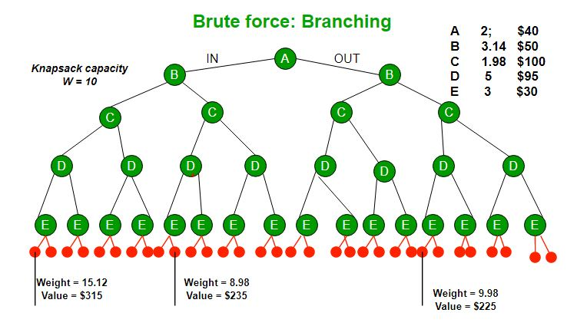

Slide 6
Backtracking
Backtracking is a general algorithm for finding all (or some) solutions to some computational problems, notably constraint satisfaction problems, that incrementally builds candidates to the solutions, and abandons a candidate ("backtracks") as soon as it determines that the candidate cannot possibly be completed to a valid solution.
Backtracking is often much faster than brute force enumeration of all complete candidates, since it can eliminate many candidates with a single test.

Slide 7
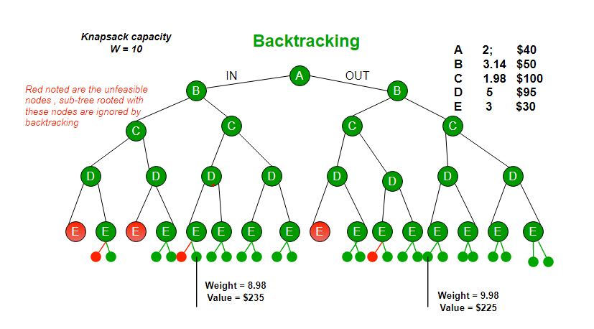
We can use Backtracking to optimize the Brute Force solution. If we reach a point where a solution no longer is feasible, there is no need to continue exploring.

Slide 8
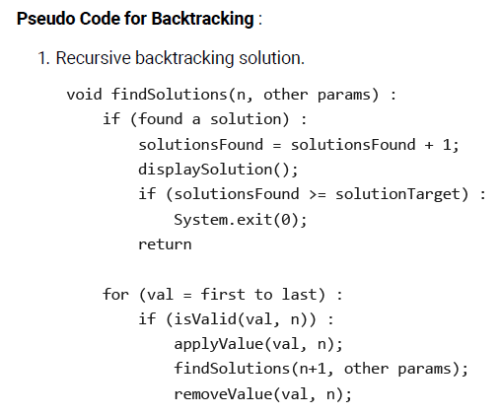

Slide 9
Branch and Bound Algorithm
Branch and bound is an algorithm design paradigm which is generally used for solving combinatorial optimization problems.
Combinatorial optimization is a topic that consists of finding an optimal object from a finite set of objects.
These problems are typically exponential in terms of time complexity and may require exploring all possible permutations in worst case.
The Branch and Bound Algorithm technique solves these problems relatively quickly.

Slide 10
Branch and Bound Algorithm
The backtracking based solution works better than brute force by ignoring infeasible solutions.
We can do better (than backtracking) if we know a bound on best possible solution subtree rooted with every node.
If the best in subtree is worse than current best, we can simply ignore this node and its subtrees.
So we compute bound (best solution) for every node and compare the bound with current best solution before exploring the node.
Limitation:
Branch and bound is very useful technique for searching a solution but in worst case, we need to fully calculate the entire tree. At best, we only need to fully calculate one path through the tree and prune the rest of it.

Slide 11
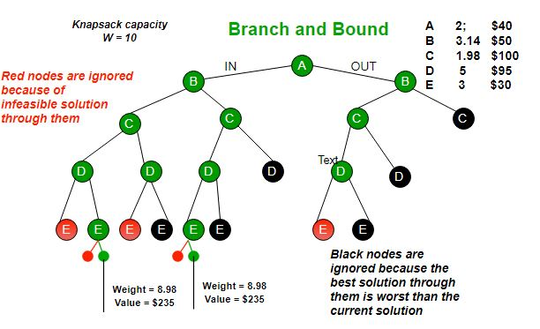

Slide 12
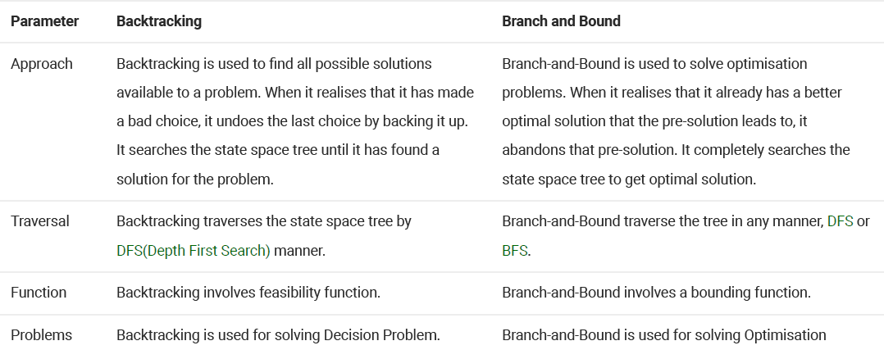
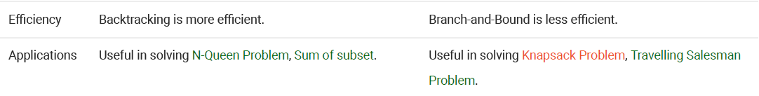
problem

