Slide 1
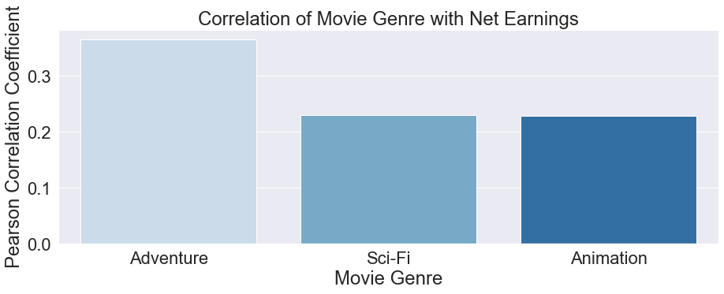
Results
Genres
Moderate influence on success
Best bet is an adventure movie
Can combine multiple genres

Slide 2
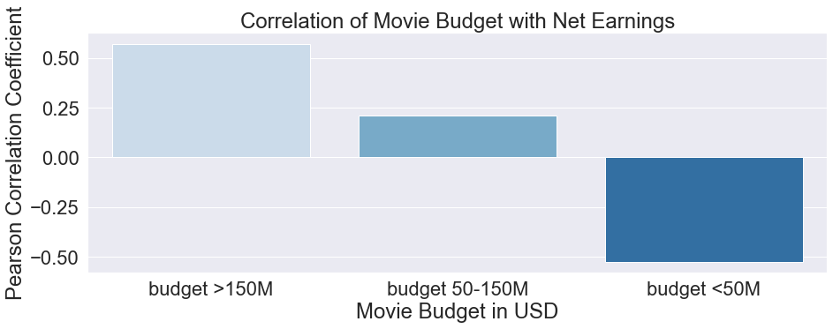
Big Budget = Big Earnings

Slide 3
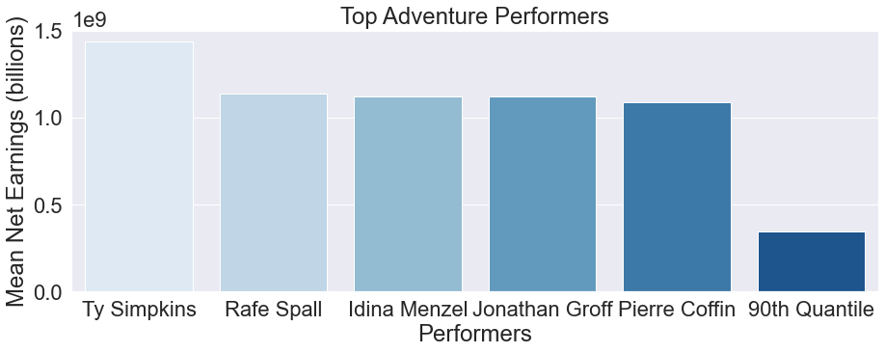
How valuable are the top performers?
Some performers were in movies that earned far more than their peers
Results may not be useful due to small sample size
Further research needed

Slide 4

Conclusions
The best performing genres, Adventure and Action, match Activision Blizzard’s top franchises: Warcraft, Call of Duty, and Starcraft
A big budget maximizes the chances of big returns
Top performers are an uncertain bet
Future Improvements
Utilize larger database & modeling to examine earning potential resulting from top performers
Examine what elements of production budgets are tied to success
Look at the value of movies to promote sales of games, toys, etc

