Slide 1
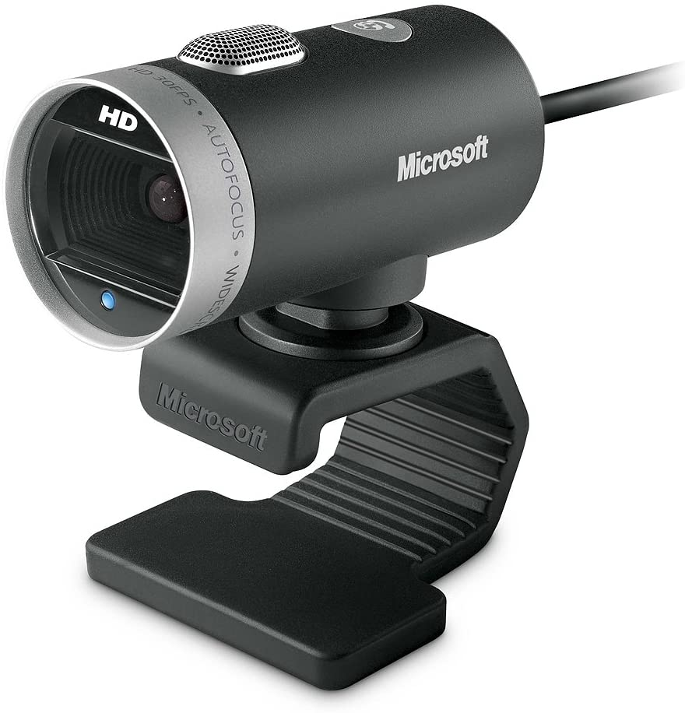

Microsoft Makes a Movie
By
Richard Hinds & Will Norton

Slide 2
Summary
Descriptive analysis of recent movie data uncovered movie production criteria to optimize net earnings. We recommend:
Producing an Adventure movie
Producing a big budget movie (>$150 million)
Selecting talent from our curated list

Slide 3

Outline
Business Problem
Results
Methods
Conclusions

Slide 4

Business Problem
Which franchise can maximize net earnings?
Notes:
Recent ATVI acquisition brings 6 stellar franchise ripe for movie making

Slide 5
Methods
Selected IMDB and Movie Budgets databases for analysis
Analyzed movies released over a decade (2012-2021)
Identified characteristics that maximized net earnings

Slide 6
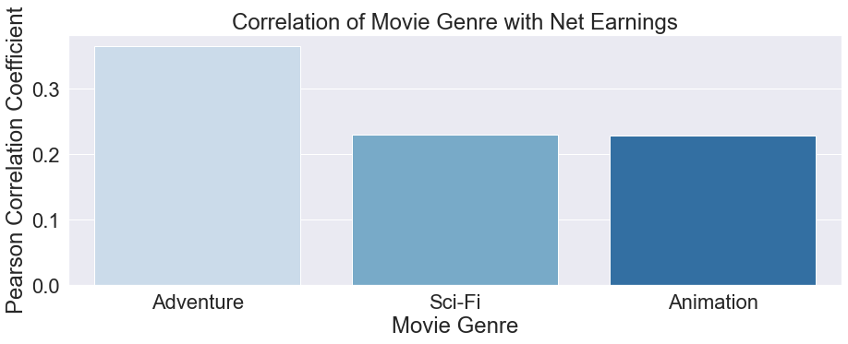
Results
Adventure movies dominate
Notes:
Consider combining top genres to maximize earnings

Slide 7
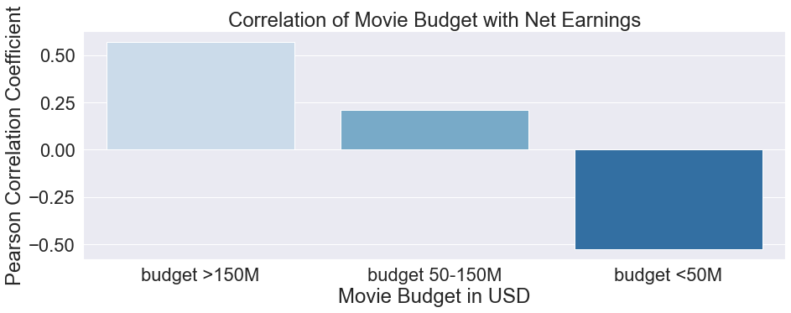
Results
Big Budget = Big Earnings

Slide 8
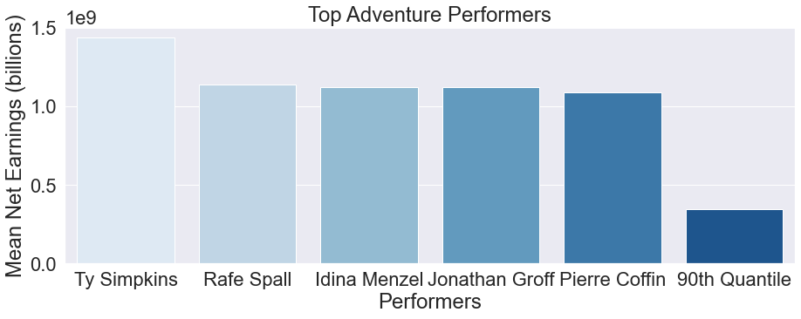
Results
Top talent performs top of chart

Slide 9

Conclusions
Best performing genres map to Activision Blizzard’s top franchises: Warcraft, Starcraft, and Candy Crush
Big budget maximizes big returns
Call Ty Simpkins agent now
Future Improvements
Correlate movie rating with net earnings
Integrate contribution of merchandise to net earnings analysis

Slide 10
Thank you
Richard Hinds
Github: RH 3421
Will Norton
Github: Noptov

Slide 11
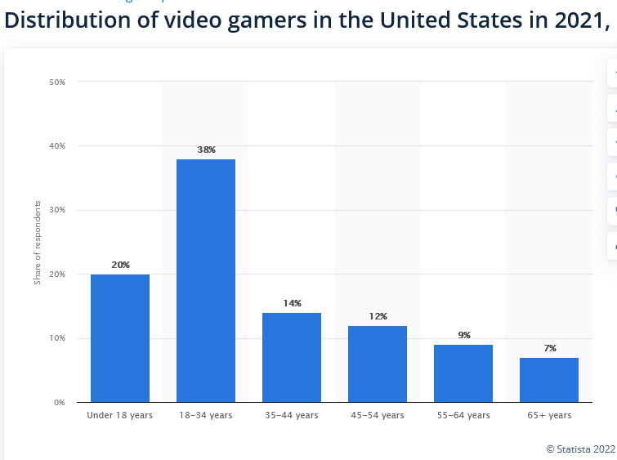
Appendix
Demographics of video gamers
https://www.statista.com/statistics/189582/age-of-us-video-game-players/

