Slide 1
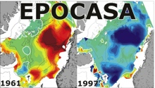

Norwegian Earth System Model (NorESM) preparing for CMIP6
Introduction What defines NorESM? NorESM2 plans for CMIP6
Ingo Bethke (ingo.bethke@bjerknes.uib.no) with contributions from
Mats Bentsen, Francois Counillon, Alf Grini, Trond Iversen, Noel Keenlyside,
Alf Kirkevåg, Pierre Rampal, Jörg Schwinger, Jerry Tjiputra and others
Notes:
- thanks to the organisers
- NorESM different research focus from TaiESM: not many specific details that are transferable

Slide 2
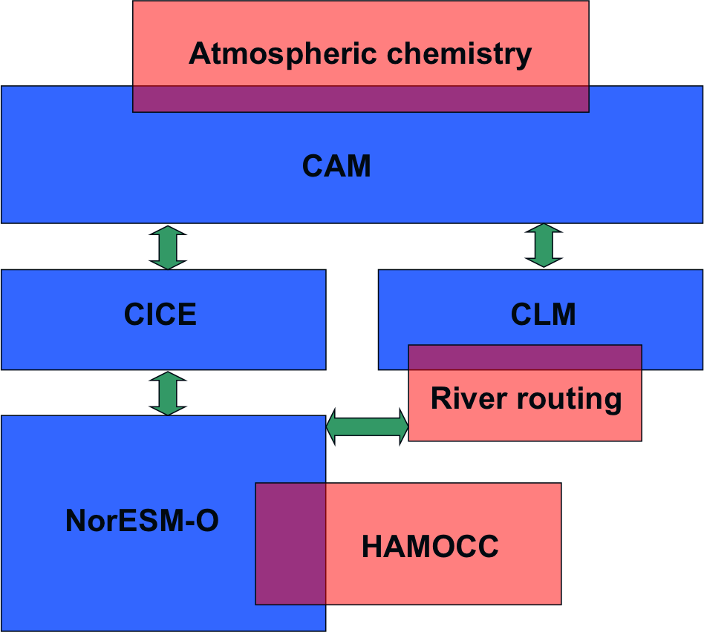
Norwegian Earth System Model
Introduction What defines NorESM? NorESM2 plans for CMIP6
Variant of CESM with key modifications
Aerosol life cycle and cloud interaction from Oslo (CAM-OSLO)
Isopycnic coordinate ocean model (NorESM-O) based on MICOM
Hamburg Ocean Carbon Cycle biogeochemistry model (HAMOCC) adapted to isopycnic coordinates
Ensemble Kalman-filter assimilation adapted to isopycnic coordinates
NorESM1-M (Bentsen et al. 2012, Iversen et al. 2012)
CAM4-Oslo (1.9x2.5, L26)
NorESM-O (1deg gx1-grid, L53)
CLM4, CICE4, CPL7 as in CCSM4
NorESM1-ME (Tjiputra et al. 2012)
based on CESM1 and includes HAMOCC
otherwise same as NorESM1-M
CMIP5
Courtesy: Mats Bentsen
Components in blue communicate
through a coupling component.
Components in red are subroutines
of blue components.
Notes:
separate NorESM1-M and NorESM1-ME
“representation of aerosols and their interaction with clouds”

Slide 3
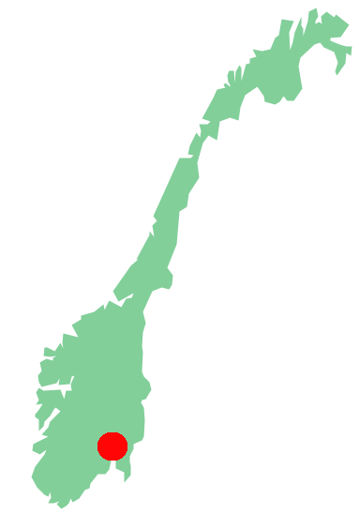
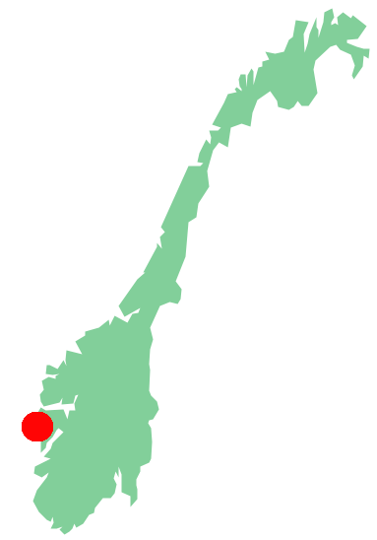
Development history
Introduction What defines NorESM? NorESM2 plans for CMIP6
CAM5-Oslo
(in progress)
CAM4-Oslo
(Kirkevåg et al. 2013)
CAM3-Oslo
(Seland et al. 2008)
CCM3-Oslo
(Iversen & Seland 2002, Kirkevåg & Iversen 2002)
ECMWF-offline aerosol
(Seland & Iversen 1999)
NorESM2 based on CESM2 (in progr.)
NorESM1-ME based on CESM1 (Tjiputra et al. 2012)
NorESM1-M based on CCSM4 (Bentsen et al. 2012)
NorESM2-O/OC
(in progress)
NorESM-O (Bentsen 2012)
MICOM/HAMOCC/LPJ coupled to ARPEGE/IFS (BCM-C, Tjiputra 2010)
MICOM coupled to ARPEGE/IFS (Bergen climate model - BCM, Furevik et al. 2003)
CMIP6
CMIP5
CMIP5
CMIP3
aerosol-cloud processes
development in Oslo
ocean physics, dynamics and biogeochemistry in Bergen
Norwegian Climate Prediction Model (NorCPM) = NorESM + EnKF assimilation
(Counillon et al. 2015, Wang et al. 2015)
CMIP6 DCPP
assimilation in Bergen
Notes:
- show Bergen and Oslo

Slide 4
Why have a Norwegian ESM?
Introduction What defines NorESM? NorESM2 plans for CMIP6
Merits
stimulates activity and collaboration on national level
fosters local expertise that is key to inform stake-holders and public
allows optimisation for regions and processes of national interest
provides infrastructure for assessing the importance and utility of new process knowledge in regional and global context
provides infrastructure for integrating new process knowledge
strengthens international visibility and attracts international scientists
makes your institute attractive partner in international projects
Challenges
demanding to maintain a state-of-the-art system
have to ensure uniqueness of model system to justify its development
proprietary issues need to be clarified: branding/naming of model, giving appropriate credit to parent model (CESM genology – Knutti et al. 2013)
should feed developments back into parent model (two-way exchange) but this requires harmonization of source code + enough manpower

Slide 5
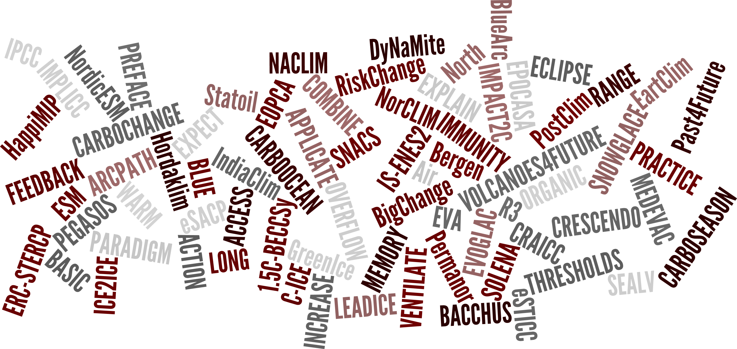
Why have a Norwegian ESM?
Introduction What defines NorESM? NorESM2 plans for CMIP6
over 50 NorESM users and growing
model used in 39 national projects with total budget of 50 mill USD
model used in 26 international projects with total budget of 130 mill USD
CMIP5 output from NorESM1 used in ~500 peer-reviewed publications

Slide 6
What defines NorESM?

Slide 7
CAM-Oslo
Introduction What defines NorESM? NorESM2 plans for CMIP6
What
schemes for aerosol chemistry, aerosol physics and interaction with clouds that are developed in Oslo
alternative to modal aerosol module (MAM) in CAM5
Key features
chemical comp.: dust, sea salt, black carbon, sulphate, organic matter, H2O
20 aerosol mixtures + precursors SO2 and DMS = 22 active tracers
4 size modes: nucleation, Aitken, accumulation, coarse
calculates log-normal size distributions with changing median and log-std
uses tabulated optical properties (e.g. single scattering, asymmetry factor, extinction coefficient) that are pre-calculated for a wide range of input values
direct and indirect aerosol effects (no indirect effects in standard CAM4)

Slide 8
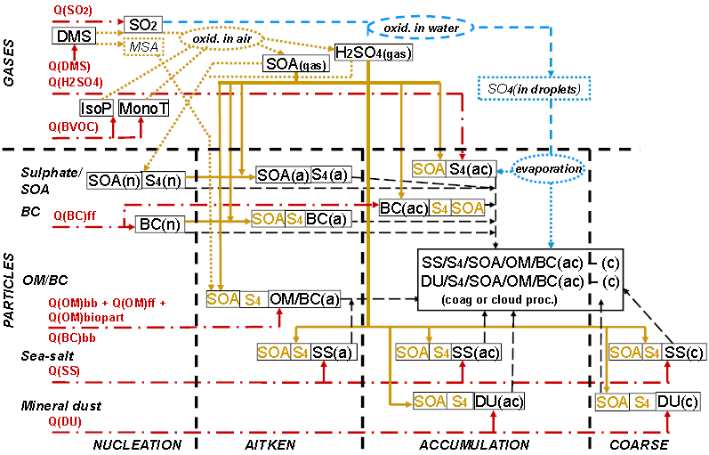
CAM-Oslo
Introduction What defines NorESM? NorESM2 plans for CMIP6
Comprehensive description of aerosol life cycles and cloud interactions
Kirkevåg et al. 2013, GMD

Slide 9
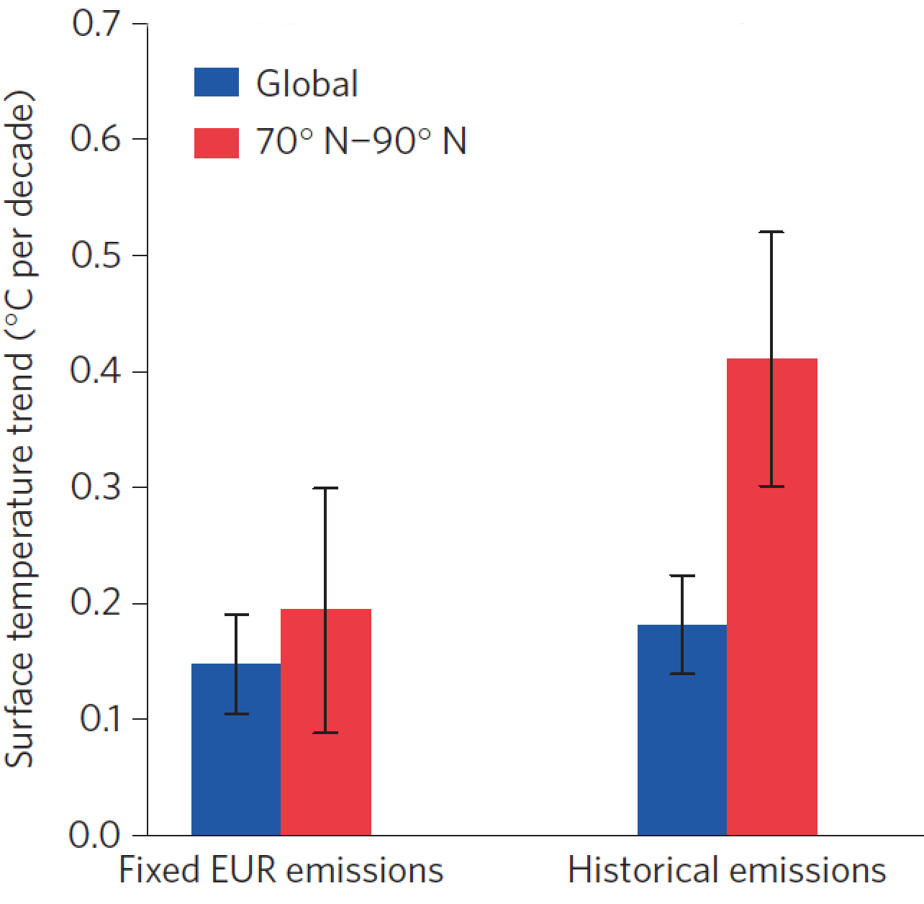
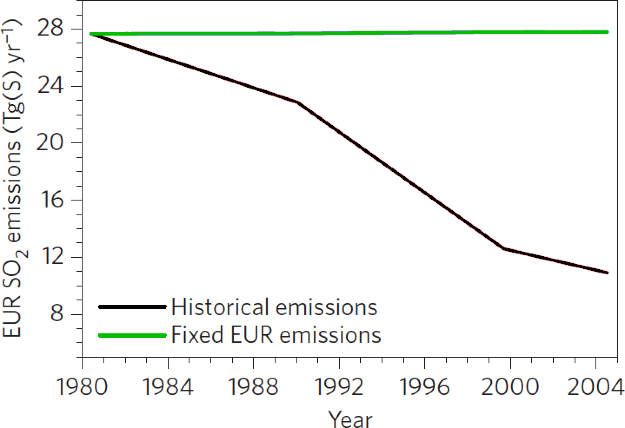
CAM-Oslo
Introduction What defines NorESM? NorESM2 plans for CMIP6
Research focus – aerosol and cloud processes in high-latitude regions
new
fixed EUR
historical
Navarro et al. 2016, Nature Geoscience
using an updated version of NorESM1-M
fixed EUR
historical
Recent reduction in European SO2 emissions contributed to Arctic amplification of global warming
Notes:
Todo
-change colors of left panel

Slide 10
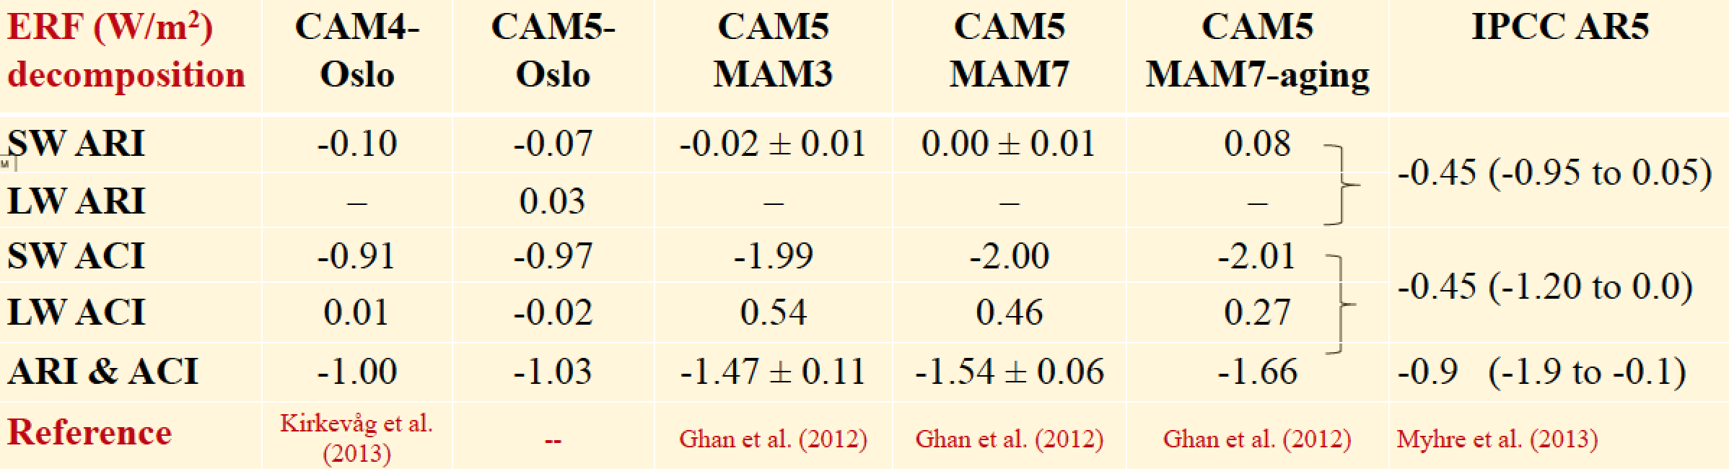
CAM-Oslo
Introduction What defines NorESM? NorESM2 plans for CMIP6
Research focus – climate sensitivity to anthropogenic aerosol emissions
Effective radiative forcing (present day – pre-industrial aerosol emissions)
new
ARI=direct effect ACI=indirect effects
Courtesy: Alf Kirkevåg
Total EFR ~50% higher in CAM-MAM than in CAM-OSLO

Slide 11
CAM-Oslo
Introduction What defines NorESM? NorESM2 plans for CMIP6
NorESM2 CMIP6 developments
new sea spray emission parametrization (Salter et al. 2015)
explicit particle formation from biogenic precursors (Makkonen et al. 2014)
interactive DMS and marine primary organic matter (will show results later)
interactive aerosol – ice nucleation (based on Wang et al. 2014)
Nitrate aerosols under development for use in AerChemMIP

Slide 12
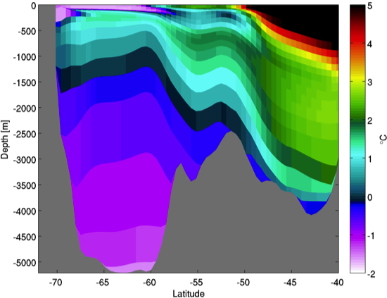
NorESM ocean component (NorESM-O)
Introduction What defines NorESM? NorESM2 plans for CMIP6
What
based on the Miami Isopycnic Coordinate Ocean Model (MICOM)
further developed at the Bjerknes Centre in Bergen
earlier version used as ocean component of the Bergen Climate Model (BCM)
Key features
natural representation of motion (overflows, thermohaline circulation, potential vorticity) as water tends to follow surfaces of constant density
spurious diapycnal mixing is minimized -> (nearly) closed energy budget
accurate conservation and transformation of water mass and tracer properties
Research focus
water mass transformation and exchanges in the North Atlantic and Arctic
climate variability and trends on decadal-to-centennial time scales
ocean heat uptake and vertical redistribution -> climate sensitivity & sea level
ice sheet – ocean interactions
Meridional T section through Southern Ocean
Notes:
Caveat: parametrized eddy meso-scale mixing turned off;

Slide 13
NorESM ocean component (NorESM-O) – dynamical core
Introduction What defines NorESM? NorESM2 plans for CMIP6
Mass conserving formulation (non-Boussinesq).
Leap-frog and forward-backward time-stepping for the baroclinic and barotropic mode, respectively.
Arakawa C-grid horizontal discretization.
Momentum equations formulated in vector invariant form and solved with a potential vorticity/enstrophy conserving scheme (Sadourny, 1975).
Layer thickness and tracer advection by incremental remapping (Dukowicz and Baumgardner, 2000).
Accurate vertical integration of the in situ density in the evaluation of the pressure gradient force.
computationally efficient
good conservation of properties
leap-frog replaced in future
Notes:
Caveat: parametrized eddy meso-scale mixing turned off;

Slide 14
NorESM ocean component (NorESM-O) – physics
Introduction What defines NorESM? NorESM2 plans for CMIP6
Surface bulk mixed layer
The depth (detrainment/entrainment) is estimated with a Kraus-Turner type turbulent kinetic energy TKE model (Oberhuber, 1993).
Extended with a parameterization of restratification by submesoscale eddies (Fox-Kemper et al., 2008).
Eddy mixing
The parameterization of thickness (Gent and McWilliams (GM), 1990) and isopycnal eddy diffusivities follows the diagnostic version of the eddy closure of Eden and Greatbatch (2008).
The eddy diffusivities are reduced when the grid resolves the first baroclinic Rossby radius.
Diapycnal mixing
Background diffusivity is vertically constant but with a latitude dependence following Gregg et al. (2003).
Shear driven mixing follows Large et al. (1994) but with increased maximum allowable mixing near the ocean bottom to provide sufficient mixing downstream of overflows.
Mixing driven by energy extracted from the mean flow by bottom drag.
Tidally driven mixing according to Simmons et al. (2004).
Notes:
Caveat: parametrized eddy meso-scale mixing turned off;

Slide 15
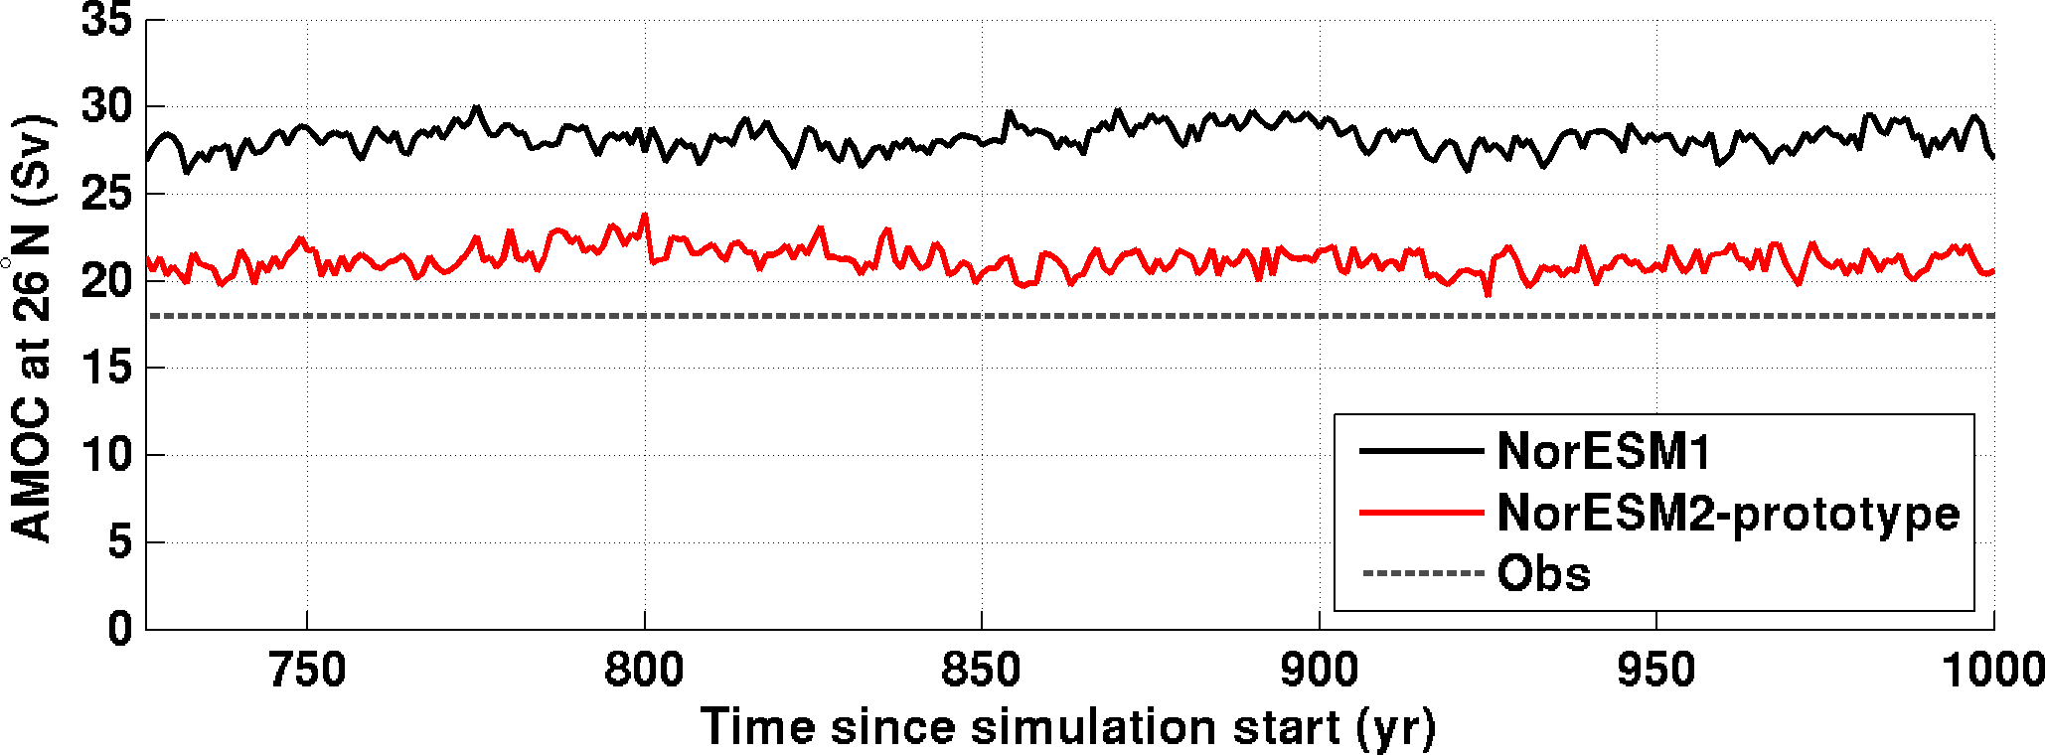
NorESM ocean component (NorESM-O)
Introduction What defines NorESM? NorESM2 plans for CMIP6
new
Atlantic meriodional overturning circulation much improved
Problem
positive bias in subtropical surface salinities (mirrored by negative bias at intermediate levels)
increased salt advection to subpolar North Atlantic
increased dense water formation leading to intensification of AMOC
Solution – revised implementation of GM eddy mixing
old formulation: layer interface smoothing, only active below mixed layer
new formulation: true Gent-McWilliams implementation, extending to surface
Notes:
Caveat: parametrized eddy meso-scale mixing turned off;

Slide 16
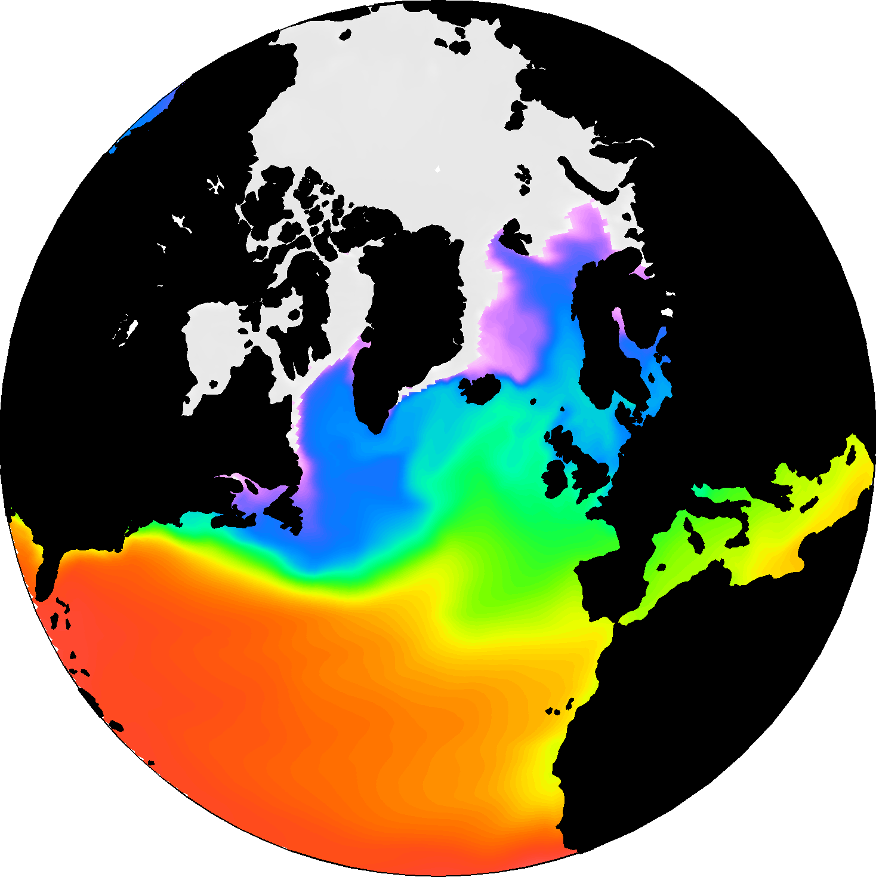
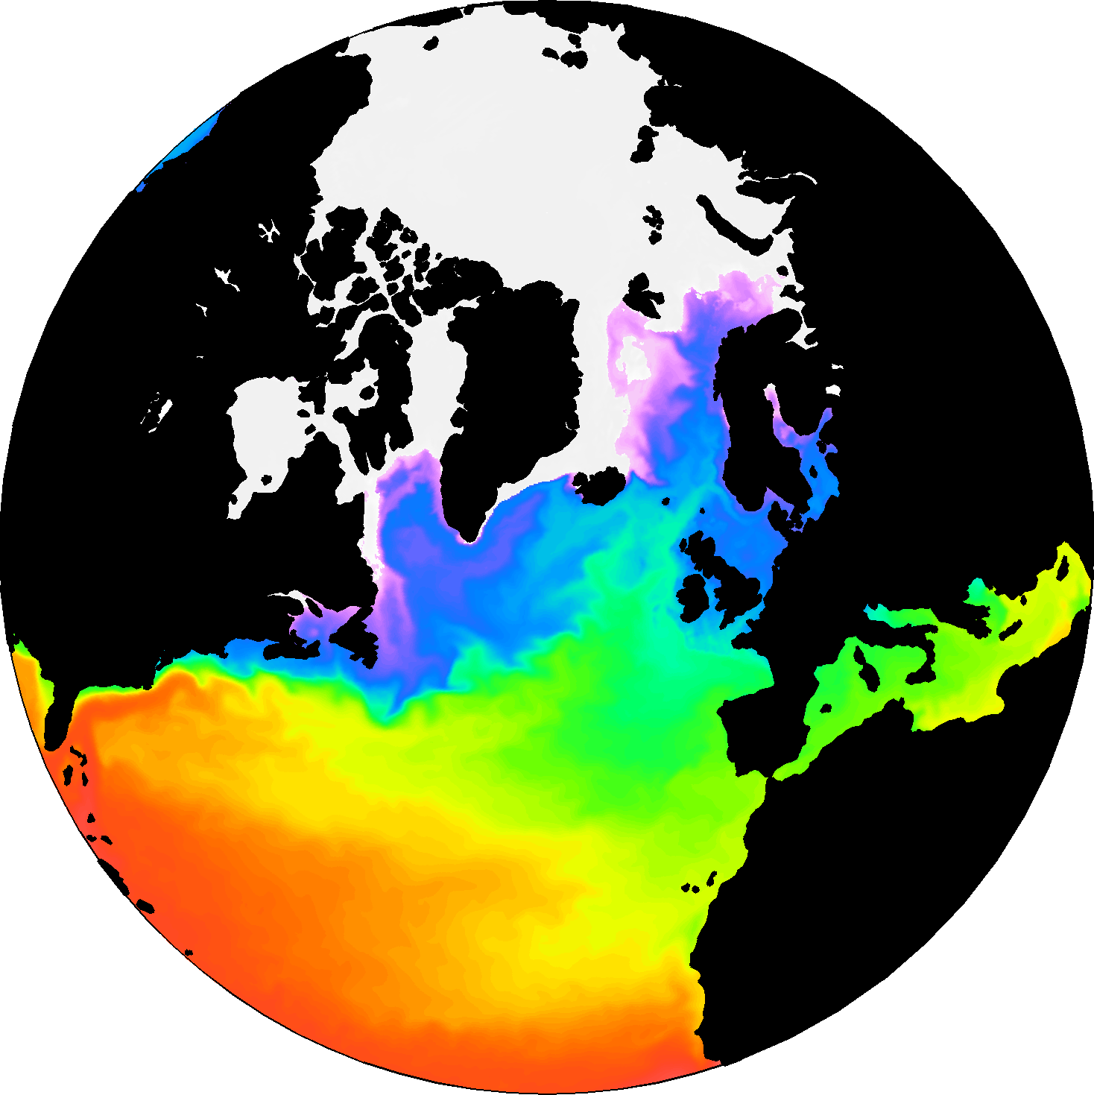
NorESM ocean component (NorESM-O)
Introduction What defines NorESM? NorESM2 plans for CMIP6
Horizontal resolution increased from 1° in NorESM1 to ¼° in NorESM2
new
indications of reduced SST biases in ¼° configuration
SST fronts sharper in ¼°; important for 1° atmospheric response?
more realistic exchange between North Atlantic and subpolar seas
Notes:
Caveat: parametrized eddy meso-scale mixing turned off;

Slide 17
HAMburg Ocean Carbon Cycle model (HAMOCC)
Introduction What defines NorESM? NorESM2 plans for CMIP6
What
biogeochemistry module coupled to physical ocean component of NorESM
Key features
formulation in isopycnic coordinate framework unique
advanced representation of sediment interactions
Research focus
uncertainties in future ocean carbon uptake
compatible GHG emission for atmospheric CO2 trajectories (Jones et al.2013, J. Clim.)
biogeochemical atmosphere–ocean interactions (DMS and N2O emissions, iron flux with dust)
constraining ocean ventilation/mixing with help of biogeochemical tracers

Slide 18
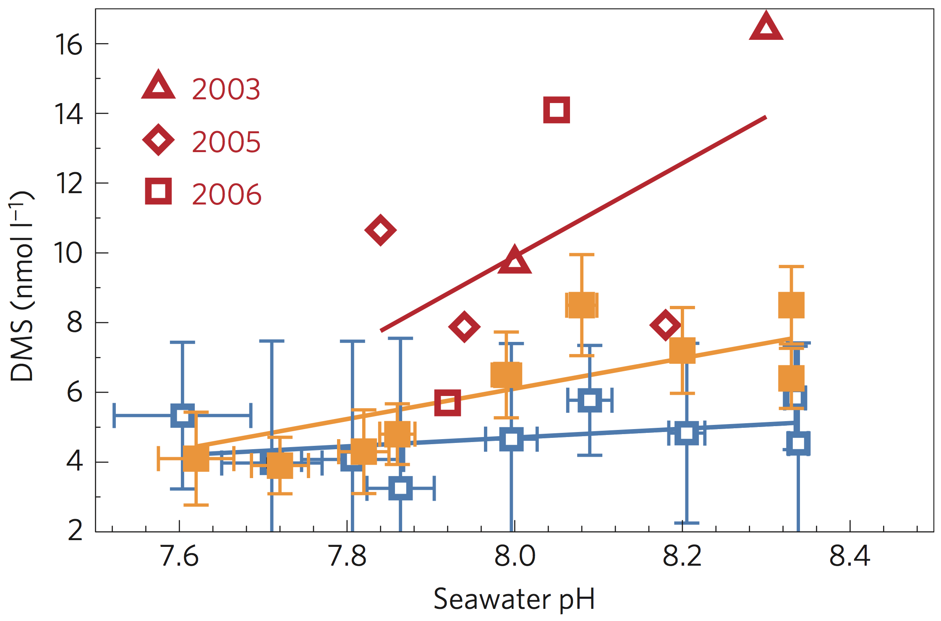
HAMburg Ocean Carbon Cycle model (HAMOCC)
Introduction What defines NorESM? NorESM2 plans for CMIP6
new
Marine DMS cycle included with PH dependency
Atmosphere
Emissions to atmosphere
Ocean surface (euphotic layer)
Photolysis
loss
DMS
Bacterial activity
Six et al. (2013)
Six and Maier-Reimer, 2006
Courtesy: Jerry Tjiputra
Acidification leads to future decrease in DMS production

Slide 19
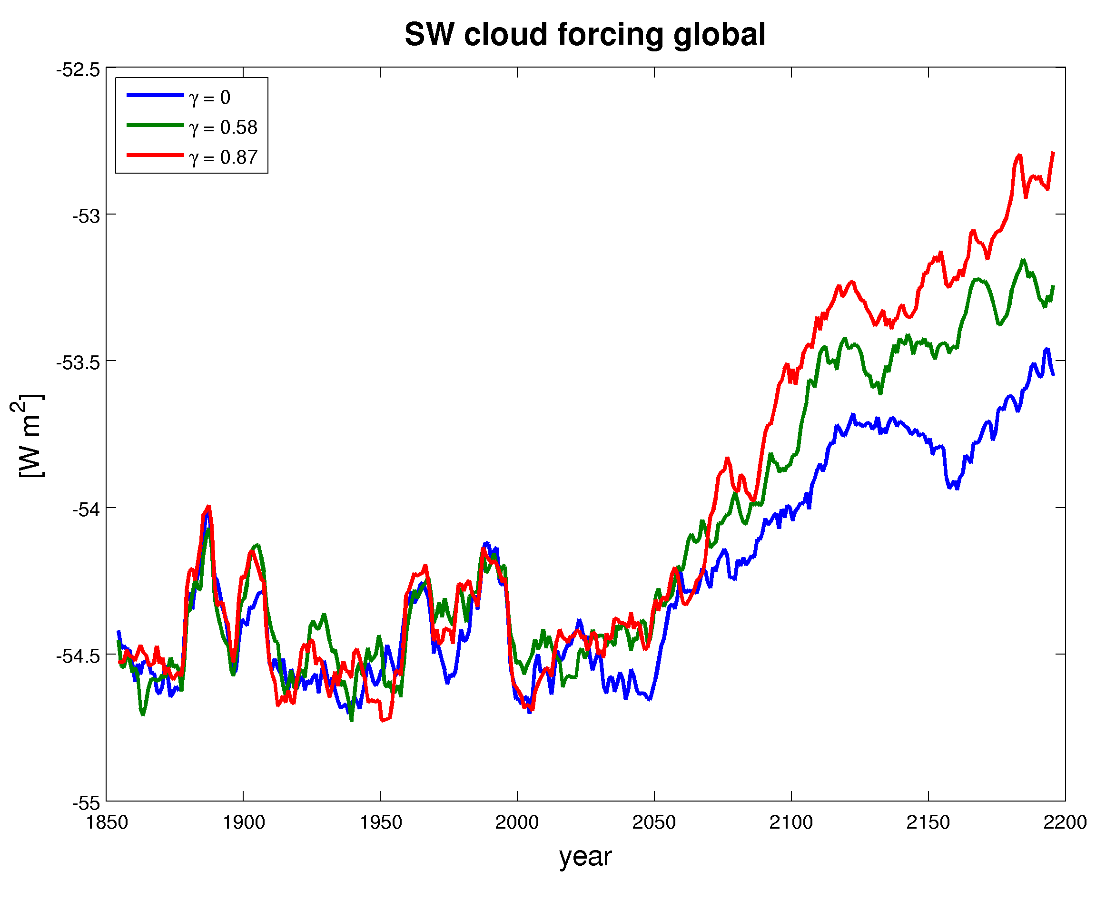
HAMburg Ocean Carbon Cycle model (HAMOCC)
Introduction What defines NorESM? NorESM2 plans for CMIP6
new
Marine DMS included in HAMOCC with PH dependency
Courtesy:
Jörg Schwinger
Up to 0.5 W global SW cloud forcing using RCP8.5 scenario

Slide 20
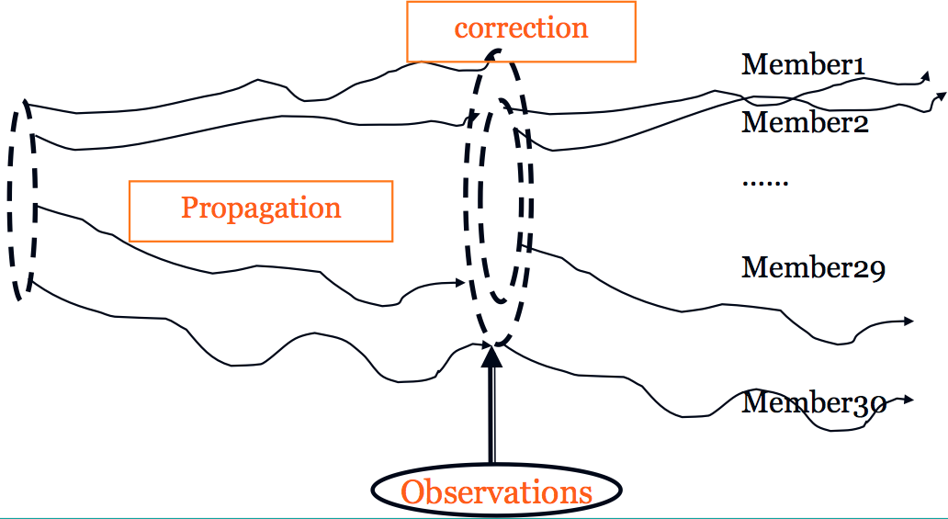
Ensemble Kalman filter assimilation in isopycnic coordinates
Introduction What defines NorESM? NorESM2 plans for CMIP6
1.
We use dynamical
covariance
Surface
OBS :SSTA
OBS
Courtesy: Francois Counillon
T1, S1, DP1
T2, S2, DP2
Propagate update via covariance
Covariance are constructed in isopycnal coordinate
2.
split into density compensated T/S update and layer thickness (density stratification) update-> efficient synchronisation of dynamics
Ocean bottom
Courtesy: Noel Keenlyside

Slide 21
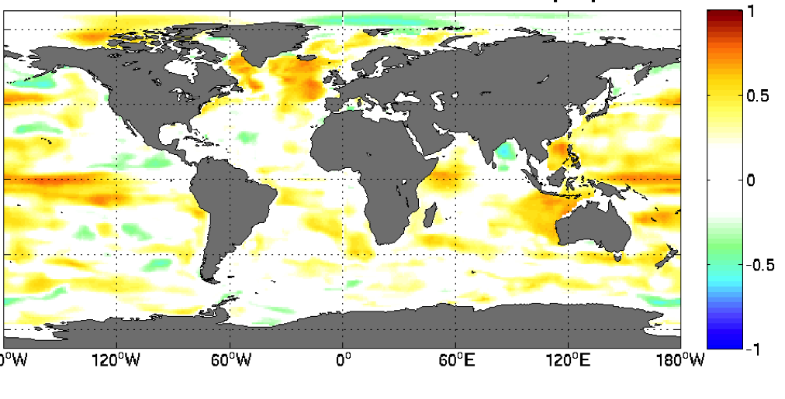
Ensemble Kalman filter assimilation in isopycnic coordinates
Introduction What defines NorESM? NorESM2 plans for CMIP6
Subpolar gyre index based on SSH
Assimilated observations: SST only
Weak SPG
new
Strong SPG
Correlation with 0-200m Salt Content, EN4 objective analysis, yearly
EnKF assimilation contraints variability of unobserved variables
Courtesy: Francois Counillon

Slide 22
Preparing for CMIP6

Slide 23
NorESM1 vs NorESM2
Introduction What defines NorESM? NorESM2 plans for CMIP6
 |  | NorESM1 (CMIP5) | NorESM2 (CMIP6)
CESM version |  | CCSM4/CESM1 | CESM2
ATMOSPHERE | CAM version | CAM4 | CAM5.5
 | Deep convection | Zhang-McFarlane (1995) | Zhang-McFarlane (1995)
 | Shallow convection | Hack (1994) | CLUBB?
 | PBL | Bretherton and Park (2009) | CLUBB?
 | Microphysics | Rasch and Kristjánsson (1998) | Gettelman and Morrison (MG2; 2015)
 | Aerosols | CAM4-Oslo | CAM5-Oslo
LAND | CLM version | CLM4 | CLM5
 | River routing | RTM | MOSART
OCEAN |  | NorESM1-O | NorESM2-O
SEA ICE |  | CICE4 | CICE5
we try to stay close to CESM2 to 1) help attribution of climate differences and 2) facilitate future upgrades

Slide 24
NorESM2 resolutions and CMIP6 contributions
Introduction What defines NorESM? NorESM2 plans for CMIP6
NorESM2- |  | HH | MH | MM | LM
RESOLUTION | Atmos. – Land | H: 0.23°x0.31° | M: 0.9°x1.25° | M: 0.9°x1.25° | L: 1.9°x2.5°
 | Ocean - Sea-Ice | H: 0.25° | H: 0.25° | M: 1° | M: 1°
PROCESSES | Atmos. Chem. | Simplified | Simplified | Simplified | Simplified + full
 | Ocean BGC. | TBD | TBD | ON | ON
CMIP-DECK + CMIP6 Hist |  | (from MH) | ALL | ALL | ALL
MIPs |  | HighResMIP | AerChemMIP CFMIP, RFMIP DAMIP, OMIP ScenarioMIP | AerChemMIP CFMIP, RFMIP DAMIP, OMIP ScenarioMIP | AerChemMIP CFMIP, DAMIP DCPP, LS3MIP LUMIP, OMIP PMIP, RFMIP ScenarioMIP VolMIP
Comment |  | experimental ver., depends on EU PRACE resources | flagship, cutting edge version | fallback version if MH not realisable | affordable version for ensemble and long runs
CAN WE DO IT?
Courtesy: Trond Iversen

Slide 25
CMIP6 simulation plan – two scenarios
Introduction What defines NorESM? NorESM2 plans for CMIP6
High (stretch goal) scenario
use medium-high resolution configuration (MH: 1° atm, 1/4° ocn), including ocean biogeochemistry
complete MH and ML production by end of 2017 and HH by fall 2018
Low (minimum) scenario
use medium-medium resolution (MM: 1° atm, 1° ocn) instead of MH
use 1° and 1/4° ocn for OMIP but without ocean biogeochemistry
no high-high (HH) configuration
otherwise same as high scenario
we are already 3-6 months behind schedule

Slide 26
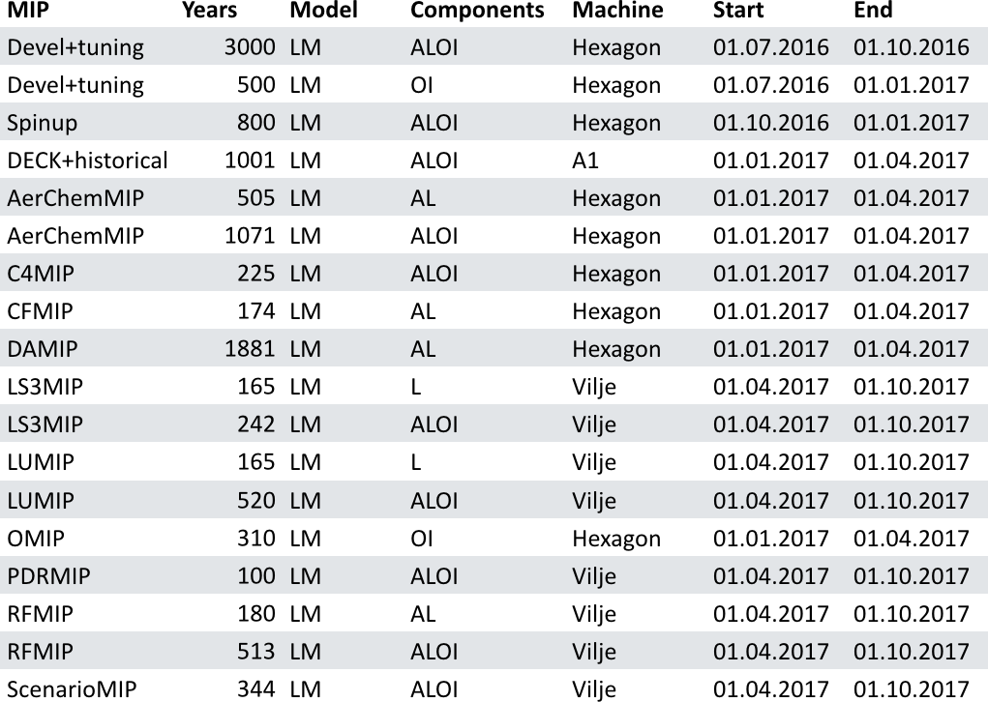
CMIP6 simulation plan – information gathered in xml-sheets
Introduction What defines NorESM? NorESM2 plans for CMIP6

Slide 27
CMIP6 simulation plan – plotted simulation time-line for ML
Introduction What defines NorESM? NorESM2 plans for CMIP6
Simulation phases:
development & tuning
spin-up
DECK+historical
MIPs

Slide 28
CMIP6 simulation plan – monthly cpu usage
Introduction What defines NorESM? NorESM2 plans for CMIP6
High scenario =
220 mill hours total
Low scenario =
110 mill hours total
100-200 mill hours excluding DCPP
~0.5 PB post-processed output

Slide 29
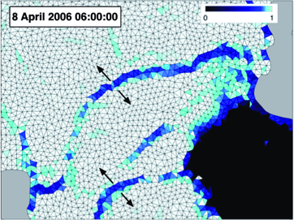
Plans beyond CMIP6 (NorESM3)
Introduction What defines NorESM? NorESM2 plans for CMIP6
Atmosphere
increased vertical resolution in stratosphere
coupled (atmosphere-land-ice-ocean) assimilation
Ocean
increased frequency of surface coupling
increased vertical resolution in mixed layer
replace virtual salt flux with mass fw flux
representation of ice shelf-ocean interactions
Lagrangian sea ice model (neXtSIM developed in Bergen)
elastic-viscous-plast (EVP) rheology replaced by elasto brittle (EB) rheology
ice mobility increased for thin ice (not captured by CMIP5 models)
ice flow – wave interaction
Courtesy: Pierre Rampal

