Slide 1
Cancer Survival Prediction
Norah Alibrahim

Slide 2



Problem
Alive
Deceased

Slide 3
Dataset Overview
Source: cBioPortal
Observations: 10,945 - Unique 10,336 patients
Columns: 26
Target: Patient's Vital Status (‘Deceased’, ‘Alive’)

Slide 4
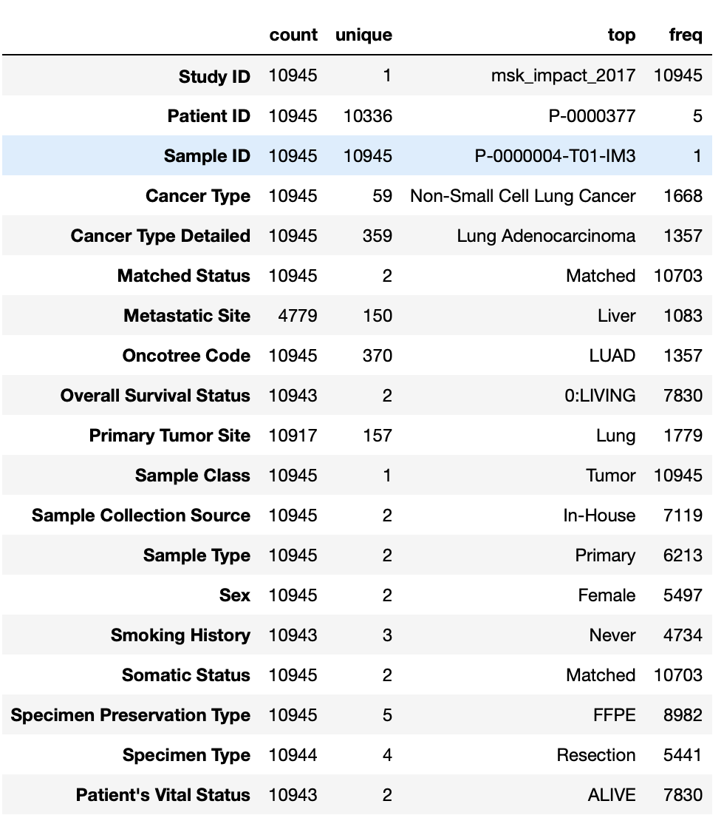
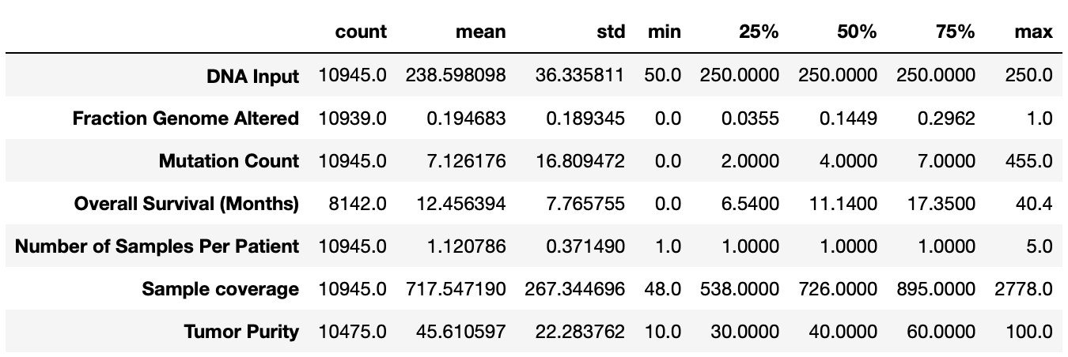
Dataset Overview

Slide 5
Data Cleansing
Dropped null values for numerical features
Replaced null with unknown for categorical features
Drop duplicated observations
Drop unnecessary features
Selected the top 7 cancer type observations

Slide 6
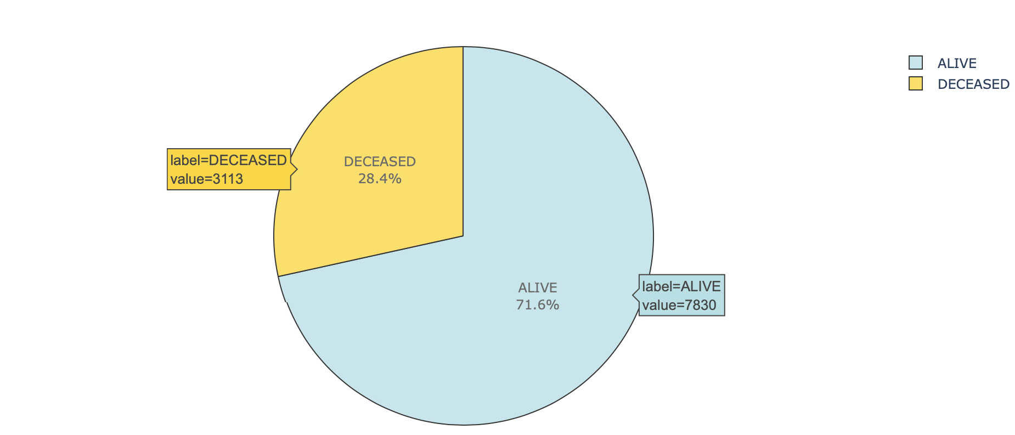
Cleansed Data
Observations: 5,897 - Unique 5,565 patients
Columns: 13
Target distribution:

Slide 7
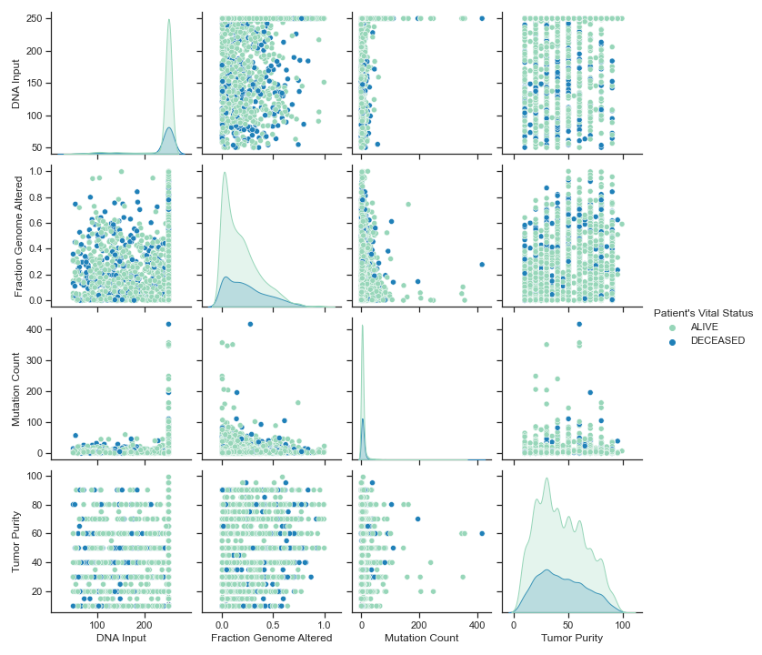
Exploratory Data Analysis
Numerical Features Pair Plot

Slide 8
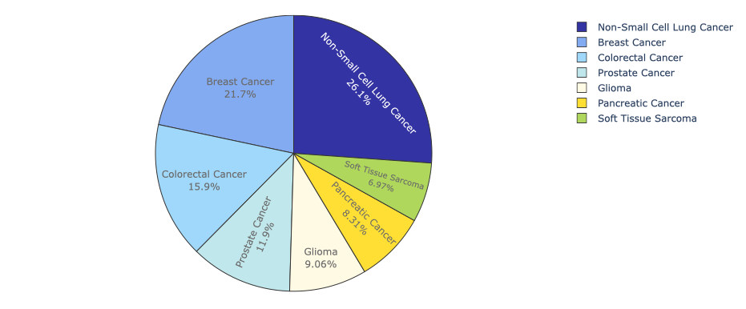
Exploratory Data Analysis
Cancer Types Percentage

Slide 9
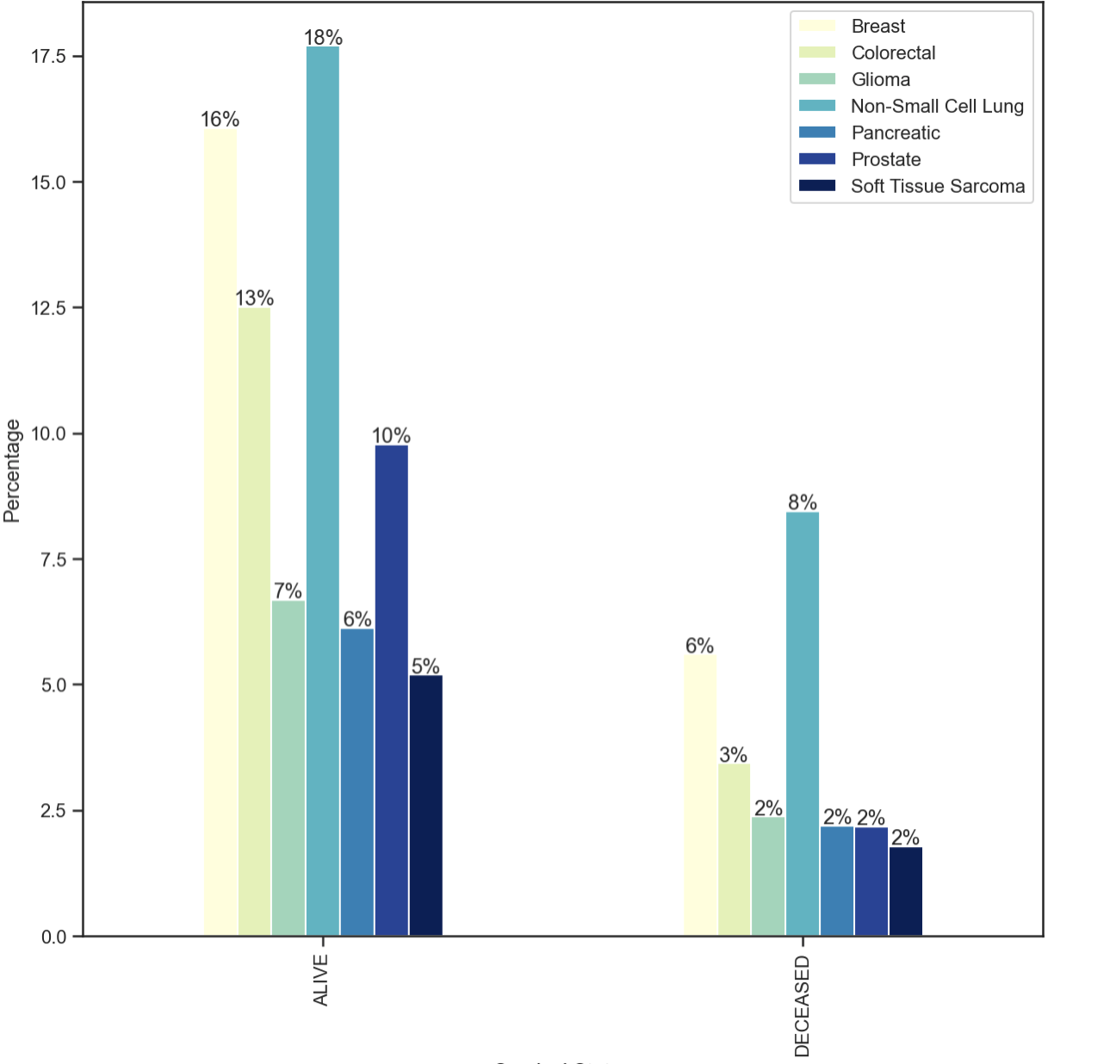
Exploratory Data Analysis
The effect of cancer type on the survival status

Slide 10
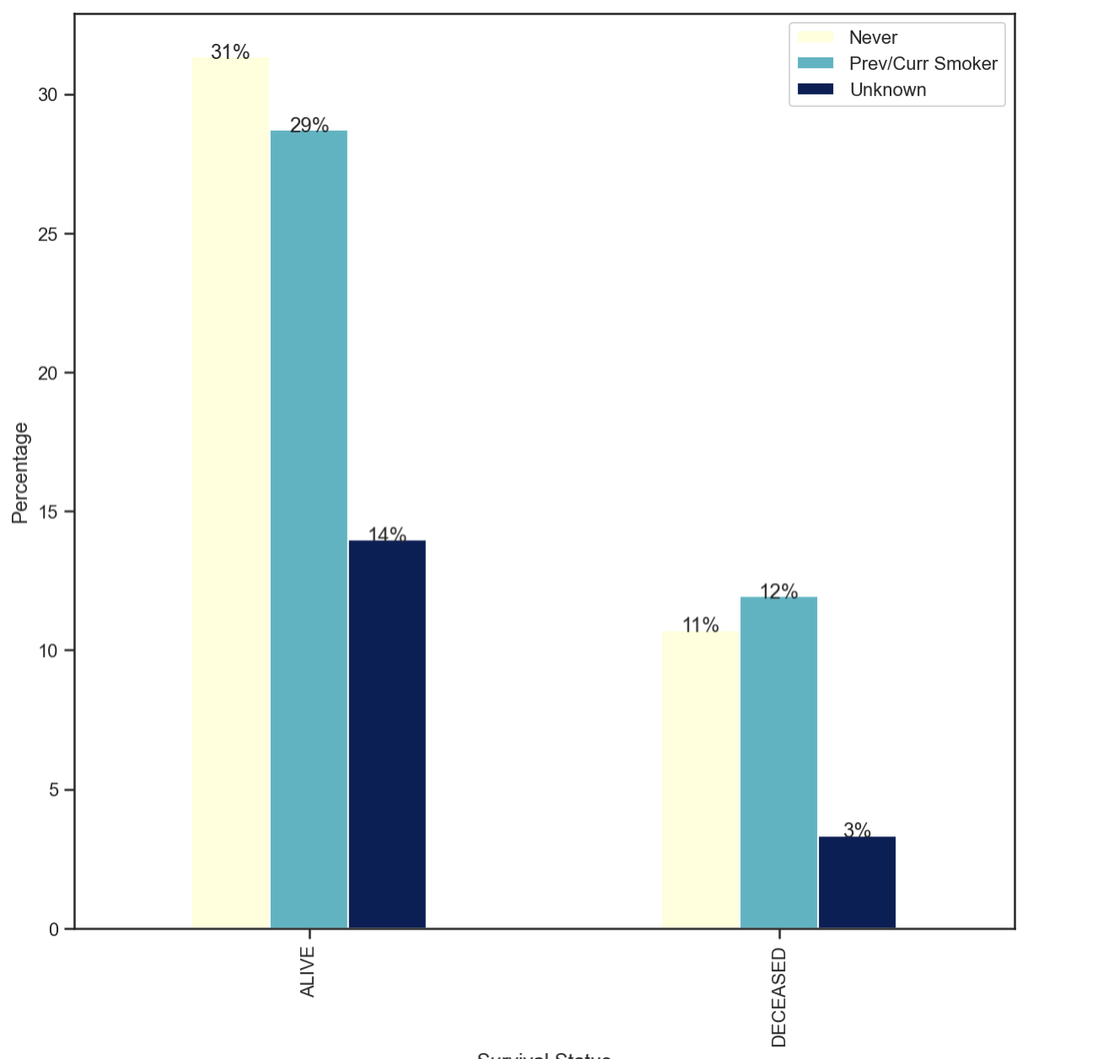
Exploratory Data Analysis
The effect of smoking on the survival status

Slide 11
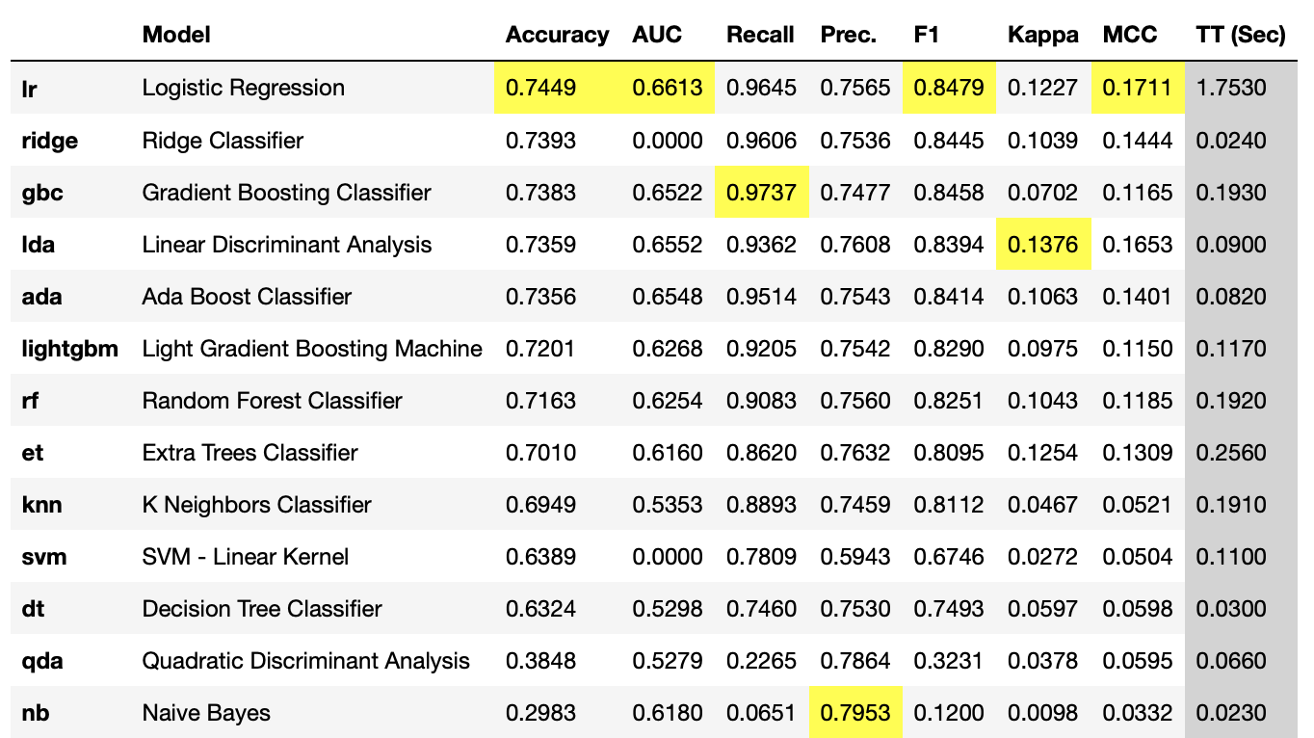
Model Selection
PyCaret models comparison:

Slide 12
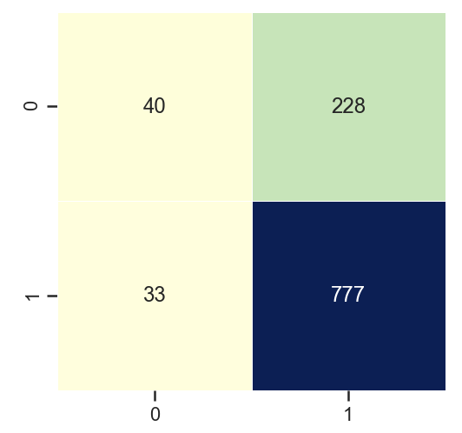
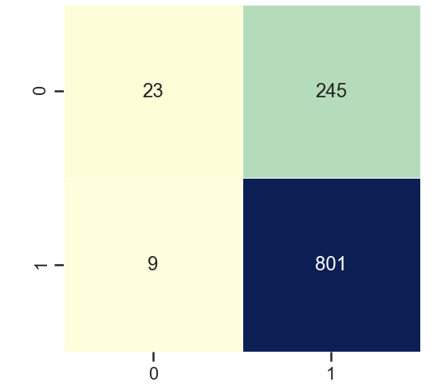
Models Performance
After hyperparameter optimization using PyCaret
Model | Score | Accuracy | F1 Score | Confusion Matrix
Logistic Regression |  | 0.758 | 0.856
Gradient Boosting | 0.76 | 0.764 | 0.863

Slide 13
Conclusion
Gradient boosting performed the best overall

Slide 14
Thank You

