Slide 1



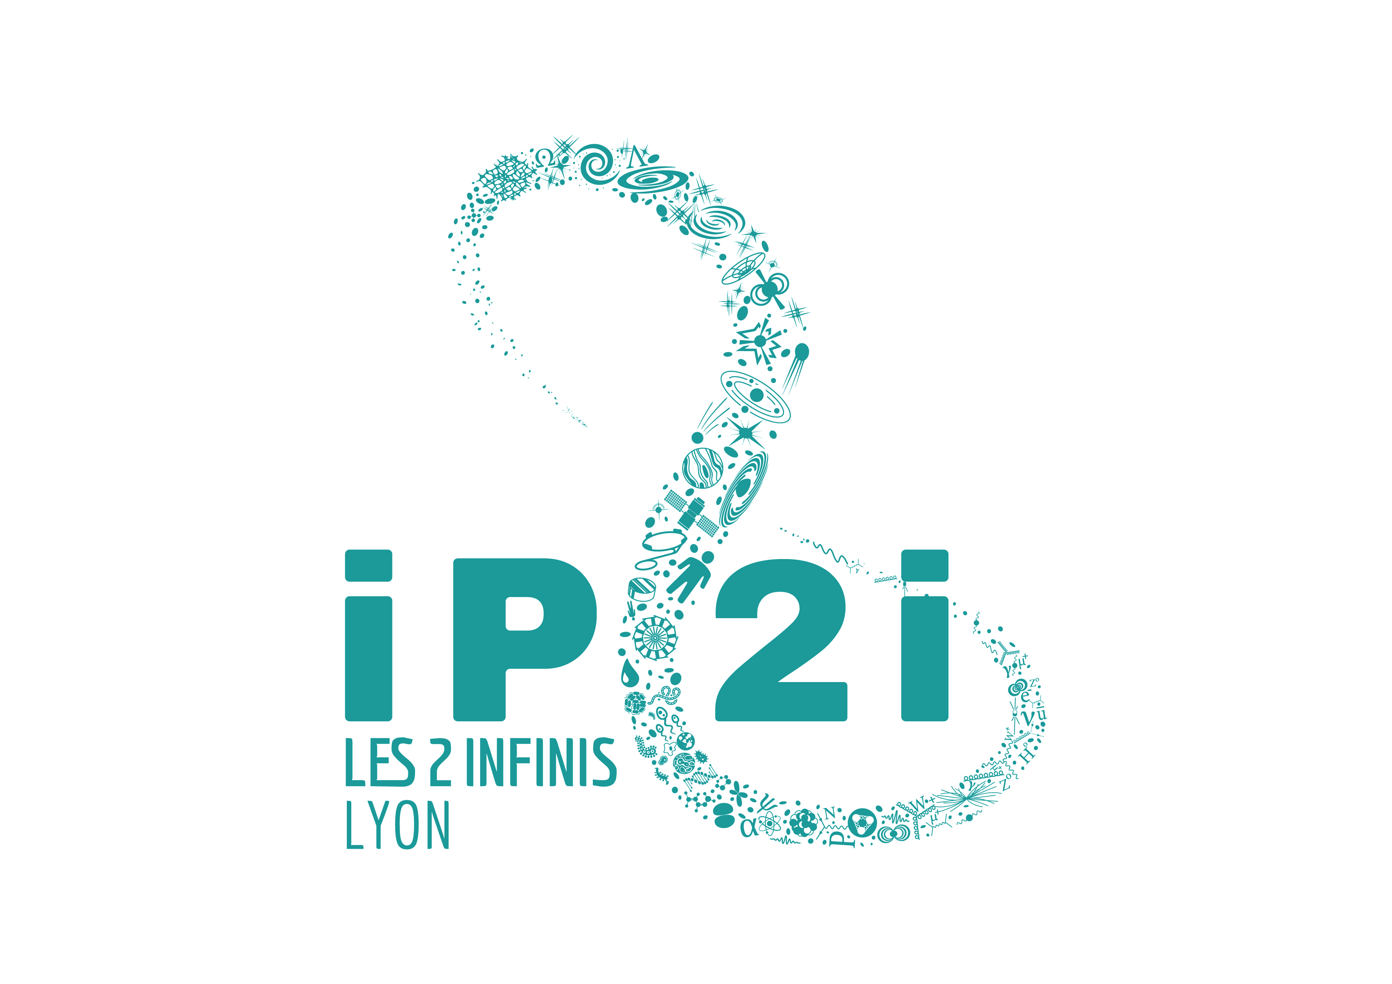

Intrinsic variabilities of type Ia supernovæ and their consequences on cosmological parameters https://doi.org/10.1051/0004-6361/202038447
PhD day
Nora NICOLAS
Cosmos Group IP2I
PhD student of M.Rigault
Tuesday, 02 november 2021
Notes:
Bonjour à touz, et merci d’assister à ma présentation ; moi c’est Nora NICOLAS et je travaille dans le groupe COSMOS au 4ème étage. Comme prévu aujourd’hui je vais vous parler de ma thèse dont le magnifique intitulé est « Variabilités intrinsèques des supernovae de type Ia et leurs conséquences sur les paramètres cosmologiques ». Avant d’entrer dans le cœur du sujet, je vais commencer par parler un peu de mon domaine d’étude, la cosmologie observationnelle, avec un rapide expérience de pensée : imaginez une bougie, placez-là à 10m de vous : vous observez une certaine luminosité. Si vous la reculez, vous pouvez savoir de combien elle l’est en mesurant sa nouvelle luminosité en sachant qu’elle diminue par dilution sur une sphère de rayon la distance entre elle et vous. Maintenant si vous avez une loi physique qui vous décrit la distance attendue en fonction de cette observation, vous pouvez les comparer.
Hello everyone, and thank you for being here! My name is Nora NICOLAS, working in the Cosmos group of the IP2I. Today I’m presenting my PhD work nicely called « Intrinsic variabilities of type Ia supernovæ and their consequences on cosmological parameters ». Before getting to the heart of the subject, I’ll say a few words on my domain of study, which is observational cosmology. Basically, I'm trying to contribute to better determination of cosmological parameters, such as the proportion of matter in the universe, doing direct observation of the sky.

Slide 2
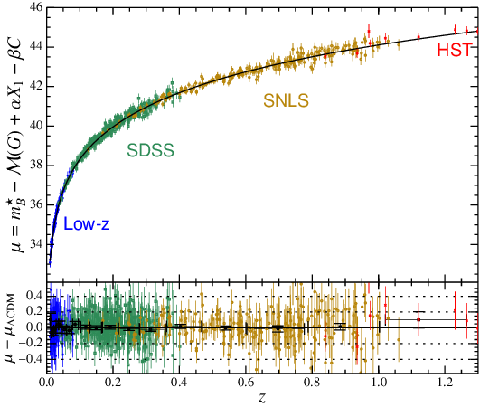
Observational Cosmology
Observed
Intrinsic
Distance modulus:
Distance:
Hubble const
Radiation
Matter
Dark Energy
Distance modulus µ
Betoule et al. (2014)
Notes:
Et bien la cosmologie observationnelle c’est exactement ça ! On a une quantité observée appelée mangitude apparente, petit m, dont on soustrait une quantité intrinsèque appelée magnitude absolue, grand M (c’est la magnitude qu’on a à une distance fixe, 10pc ici ou 10m dans mon exemple précédent), et qui nous donne ce qu’on appelle un module de distance. Ce module comprend une fonction qui dépend de paramètres cosmologiques comme la constante de Hubble, qui décrit le taux d’expansion de l’Univers, la proportion des 3 formes d’énergie composant l’Univers (et se sommant à 1) : la proportion d’énergie lumineuse, la proportion de matière (qui a un impact de contraction sur l’Univers), et la proportion d’énergie sombre (qui force l’expansion de l’Univers), et le fameux redshift, ou décalage vers le rouge, qui traduit la vitesse à laquelle un objet s’écarte de nous due à la dilatation de l’Univers mais qui est aussi un proxy pour le temps auquel a été emise la lumière. Pour reprendre la bougie, cette équation dit juste qu’après avoir posé ma bougie quelque part, sa distance actuelle et sa vitesse actuelle nous informe sur la compétition entre contraction et expansion due à la matière et à l’énergie noire, et un redshift de 1 correspond à une lumière émise quand l’Univers avait la moitié de son âge.
Vous voyez ici une réprésentation graphique de ce module de distance en fonction du redshift, qui suit une loi logarithmique comme attendu ; les points colorés correspondent à des valeurs mesurées par différents sondages cosmologiques, et ensemble ils donnent une valeur des paramètres cosmologiques.
De cette courbe on peut déduire qu’il nous faut observer de objets de faible redshifts mais aussi des objets de redshifts jusqu’à 1. Ça c’est facile, plein d’objets se trouvent à tous les redshifts, mais ce qui l’est moins c’est qu’il faudrait connaître leur luminosité à 10pc, la magnitude absolue, correctement pour chacun de ces objets. On ne peut pas déplacer les étoiles dans l’espace, et a priori la lumière que les corps célestes émettent est différente. Si vous prenez 100 bougies différentes vous ne pourrez pas déduire leur distance ni même savoir laquelle est la plus proche : vous pouvez avoir une très forte bougie beaucoup plus loin qu’une autre plus faible mais qui donnent la même magnitude apparente. C’est pour ça qu’on utilise les supernovae de type Ia : les supernovae ce sont des étoiles qui explosent, très très fort, jusqu’à émettre plus de lumière qu’une galaxie entière composée de centaines de millions de Soleil brillant en permanence pendant des milliards d’années mais qui n’explosent que pendant une dizaine de jours et sont donc visibles très proches et très loin, et les Ia ont un mécanisme d’explosion similaire qui leur donne une magnitude absolue très proches entre elles : on les appelle des chandelles standard. On peut donc les comparere entre elles, et tous les points que vous voyez sont en fait des SNe Ia.
Mais en réalité, leur magnitude absolue est dispersée (c’est donc une variabilité intrinsèque, ce qui doit éclaircir le titre), qui donne une incertitude sur la distance de 20%… et c’est clairement pas assez. On a besoin d’une astuce pour améliorer ça.
Here is a graphical representation of this distance modulus evolution with redshift, that follows a $log$ curve as expected. The colored points correspond to measured data from different surveys observing the sky, and together they give a fit of the cosmological parameters.
This plot shows us that we need data that are are close to us, and data as far as z=1, meaning objects that emitted their light when the Universe was half is age. We also see that we need both precise measurements of the apparent magnitude, of course, but also a good knowledge of each object’s absolute magnitude, with the least dispersion possible.
Not all celetial bodies can be used for that reason: we don’t know their absolute magnitude. If you take a 100 different candles and measure what you see, you won’t know which one is closest to you because it could be brigther than another but wy farther. That’s why this kind of study is done on supernovae, and mostly type Ia SNe.

Slide 3
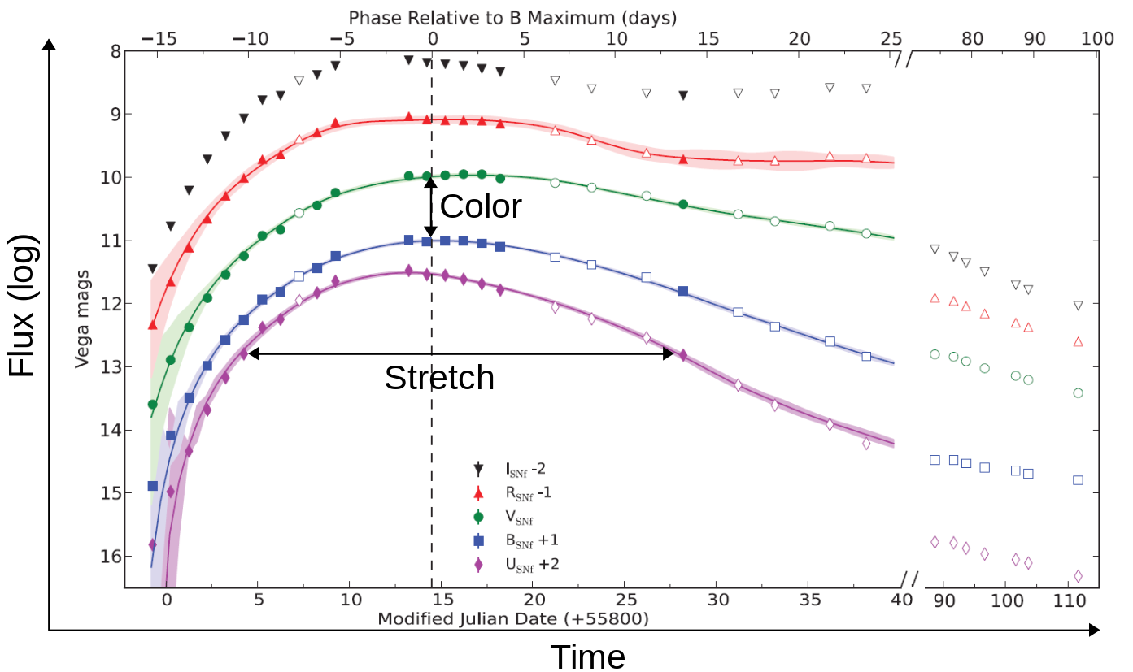
Light curve parameters
Peirera et al. 2013
Notes:
Cette astuce passe par l’utilisation d’autres paramètres de la supernova, et pas que sa magnitude apparente. En effet, quand on observe une SN, on observe le ciel avec différents filtres de couleur pendant une certaine durée pour la voir apparaître et disparaître. Ça donne une courbe de lumière, dont vous avez ici une représentation graphique, et à partir de laquelle on définit son « stretch », sa durée d’explosion, et sa couleur ; la magnitude apparente est prise au maximum de la luminosité.
However, we don’t only have a SN’s apparent magnitude to use. When observing the sky, we check for new SNe every night by acquiring one object's observed luminosity through time, for different wavelength, which is what we call a light curve. This plot represents the light curve of one SN, time being on the x-axis and the flux on the y-axis. From this curve, we define its $color$ and $stretch$ parameters, the stretch being a proxy for its explosion duration, and the apparent magnitude is taken at the peak.

Slide 4
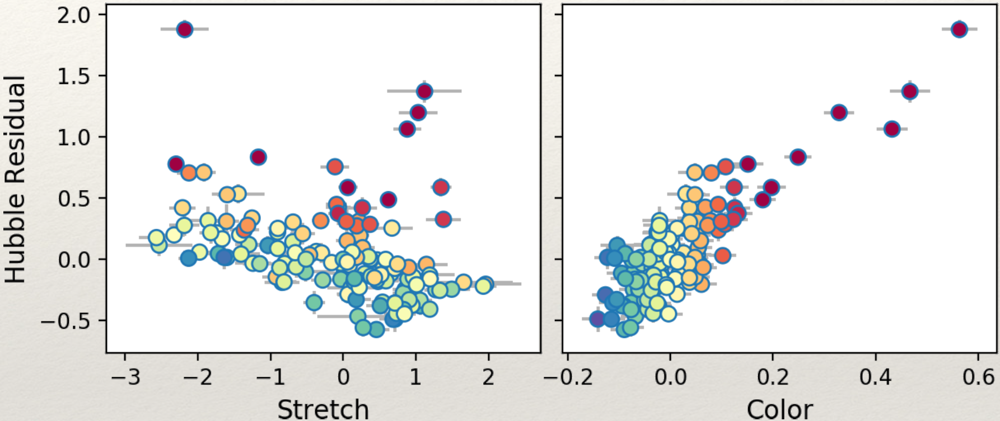
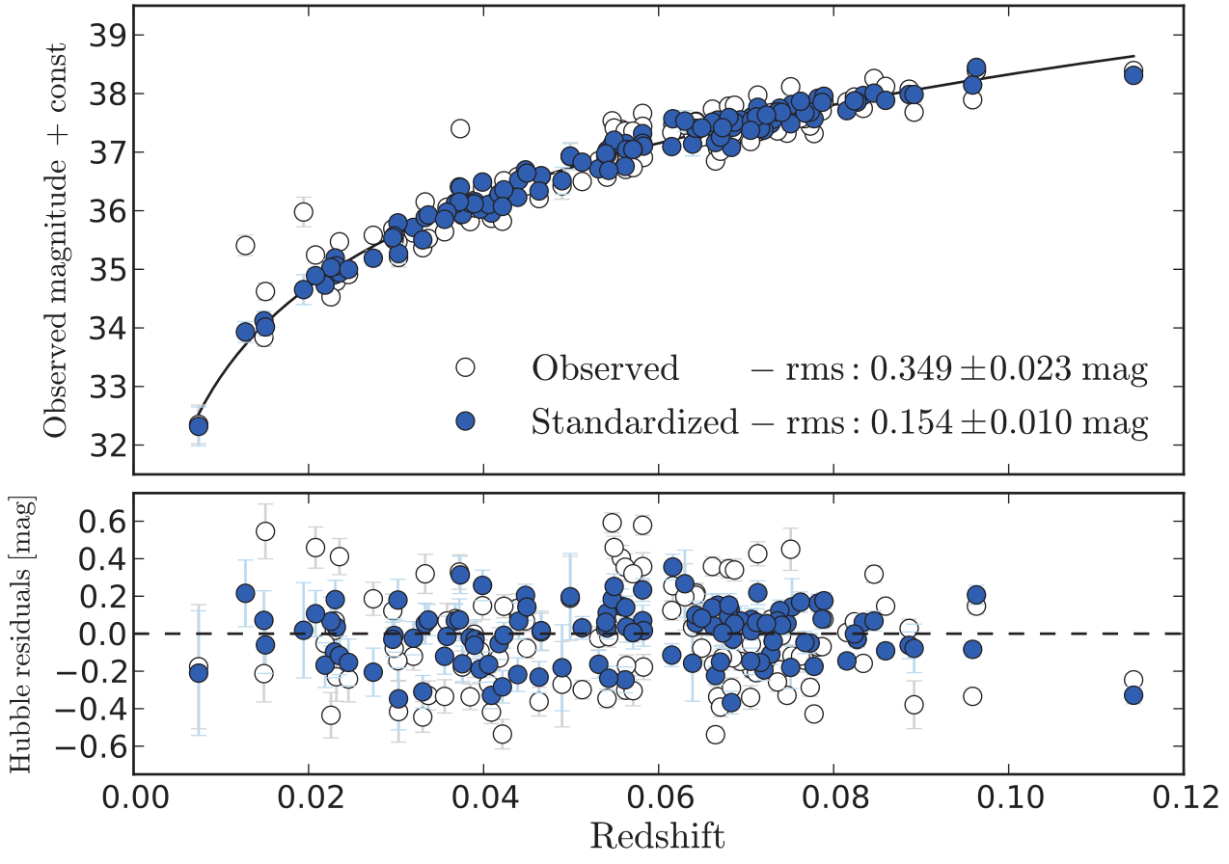
Brighter-slower relation
Fainter
Brighter
Faster
Slower
Standardized distance modulus:
For standardized Ia supernovae
Notes:
Using these parameters showed us that they are *linearly correlated* with an SN’s luminosity, described by the $brighter-slower$ and $brighter-bluer$ relations. It means that for instance, a SN Ia that is faint tends to have a lower stretch (so explodes faster) than a bright SN that will take its time.
That lead to the use of a $standardized magnitude$ that brought that distance dispersion to ~8%, enabling _Riess_ and _Perlmutter_ to have the 2011 $Nobel$ Prize for the measurement of the cosmological parameters that proved the accelerated expansion of the Universe by estimating the proportion of dark energy in the Universe to approximately 70 % while matter is only 30 %: the expanding force of dark energy surpasses the contracting force of matter.

Slide 5

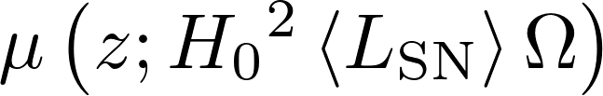
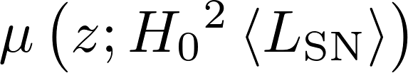
Systematic errors
Distance modulus µ
Betoule et al. (2014)
Can we see a redshift evolution of supernovae through the stretch?
Notes:
Well then, what's left to do? Well, increasing the statistic in a coherent way between telescopes of course, but also study the systematics better. In fact, when making these measurements, we suppose that the mean absolute magnitude is the same at all redshifts. That's fine for a first reading, but we actually have reasons to think it doesn't, and that farther SNe are intrinsically fainter. In fact there is a correlation between a SN's magnitude and its environment, which we'll present in a few slides, so if there is a link between environment and redshift, we could have an idea of how SNe's magnitudes evolves with redshift.
Right, so how do we test that? The parameter that has a lot of chance to help us in studying a potential redshift evolution is the $stretch$, the duration of the explosion, because it's mostly not affected by the interstellar medium, whereas the color does. So first, we need some data!

Slide 6
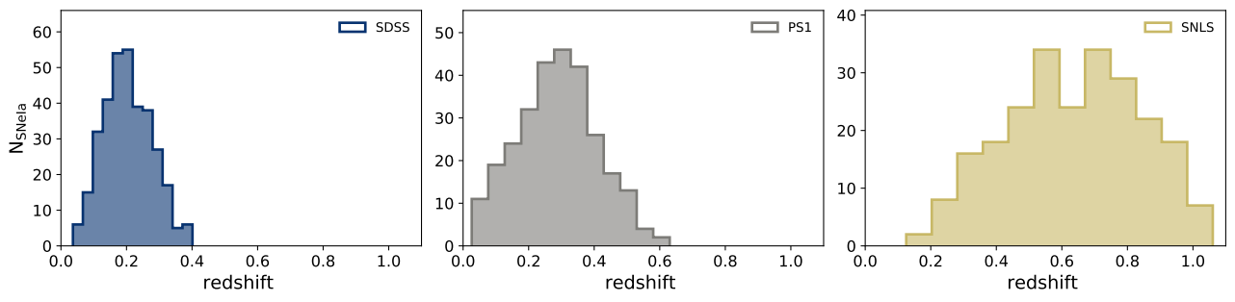
Complete sample free from selection effects
Nicolas et al. (2021)
Fainter
Brighter
Notes:
That would be totally fine, if not for the fact that, as we said earlier, the faintest SNe Ia are also the low-stretch ones. This has an impact on the stretch distribution of the SNe after that maximum redshift, and it's called the Malmquist bias, and comes from the selection effects of the instruments. Then, the only SNe that are not affected by this bias are the ones below this limit for such surveys; we call such samples "complete", meaning free from selection effects. We thus decided to cut the samples and combine them in one homogeneous sample.

Slide 7
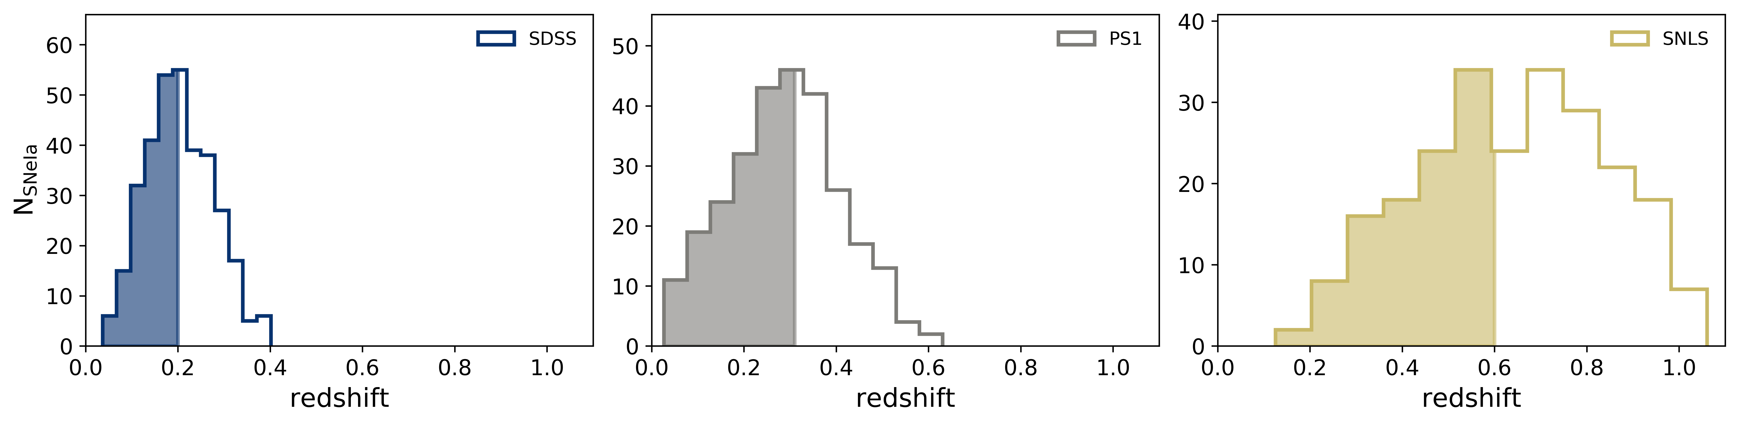
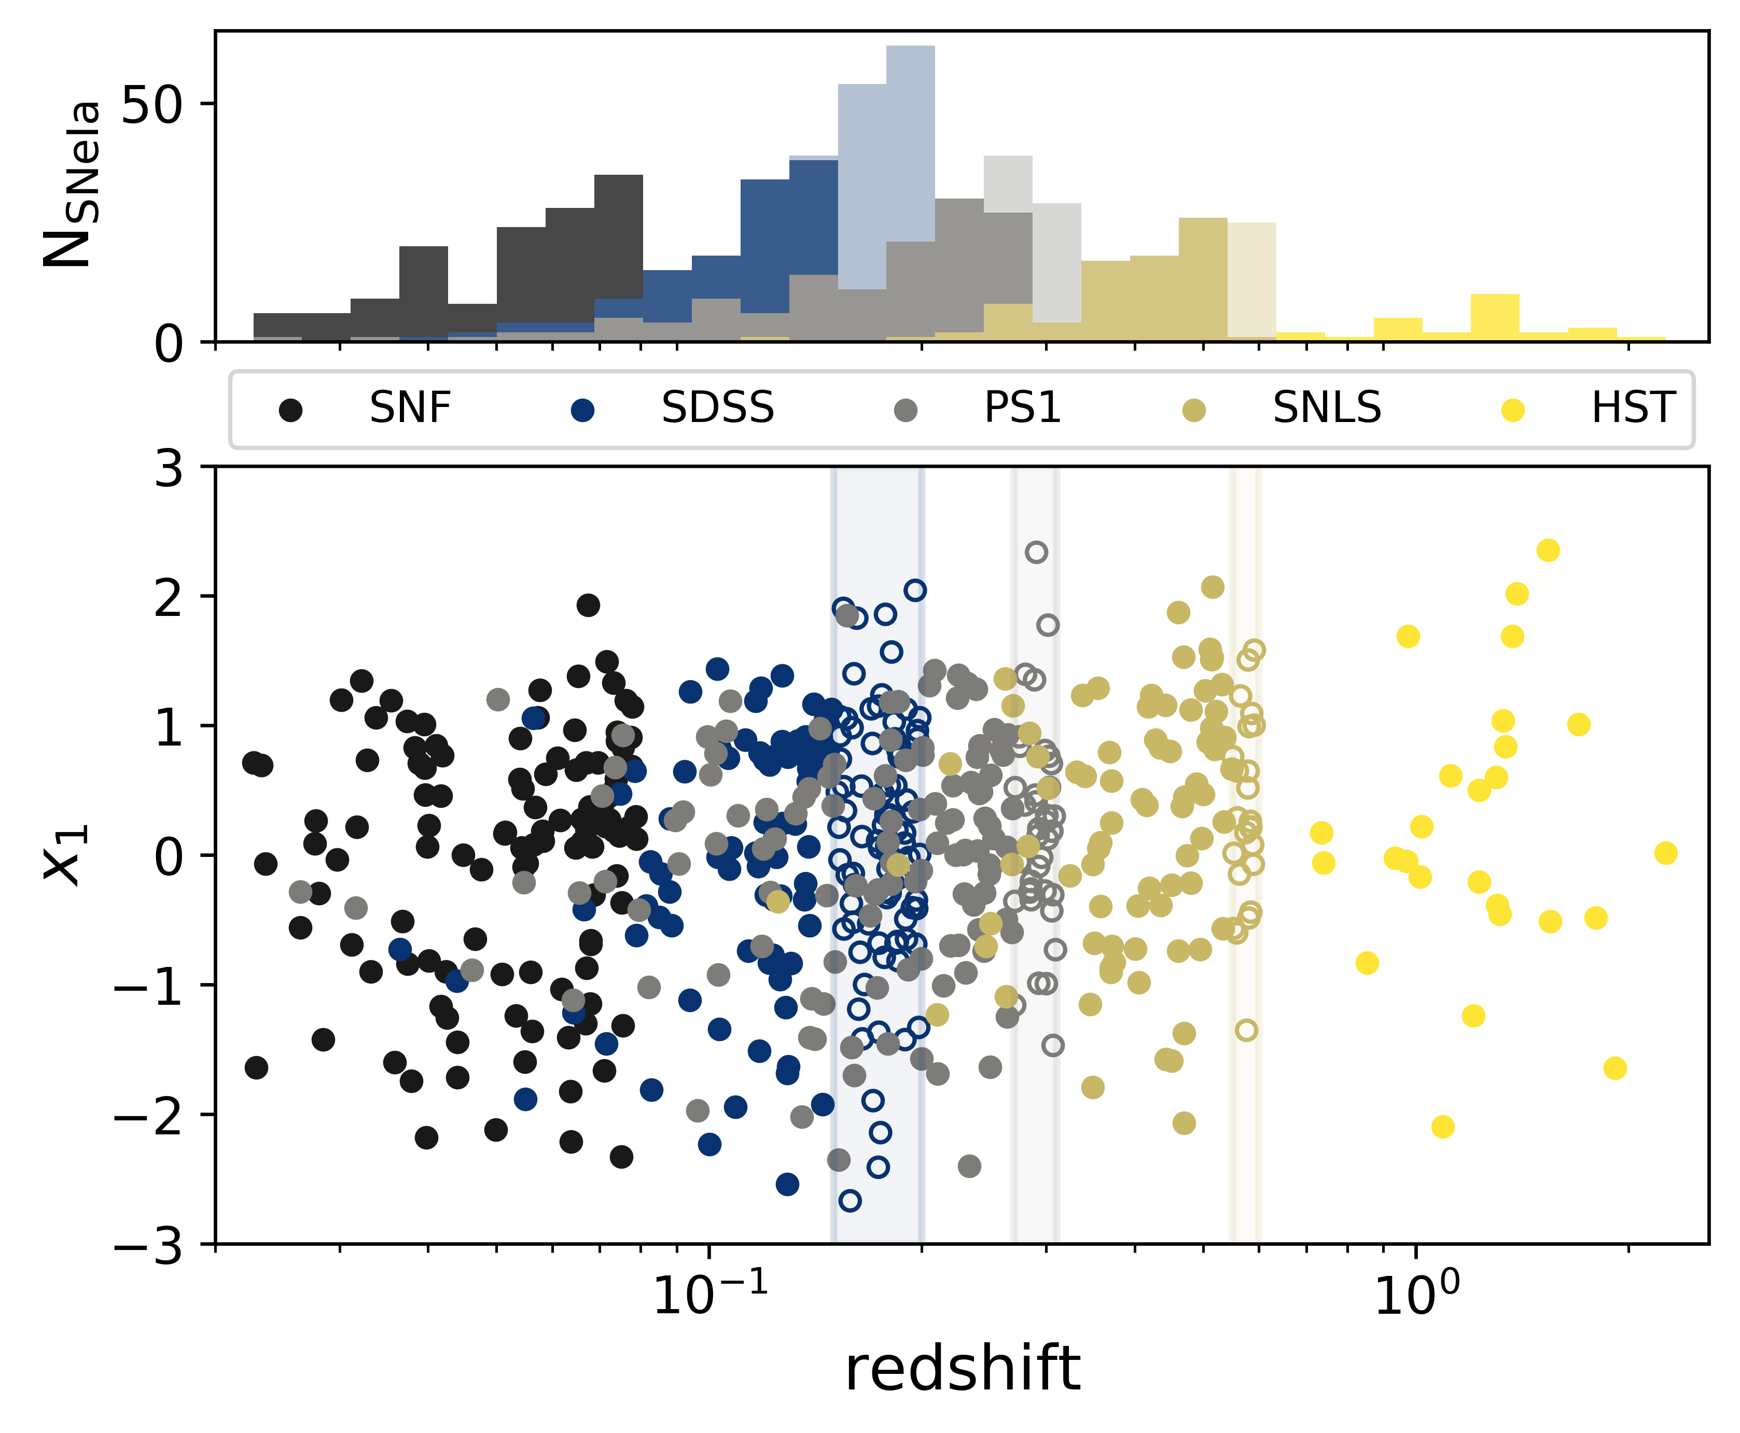
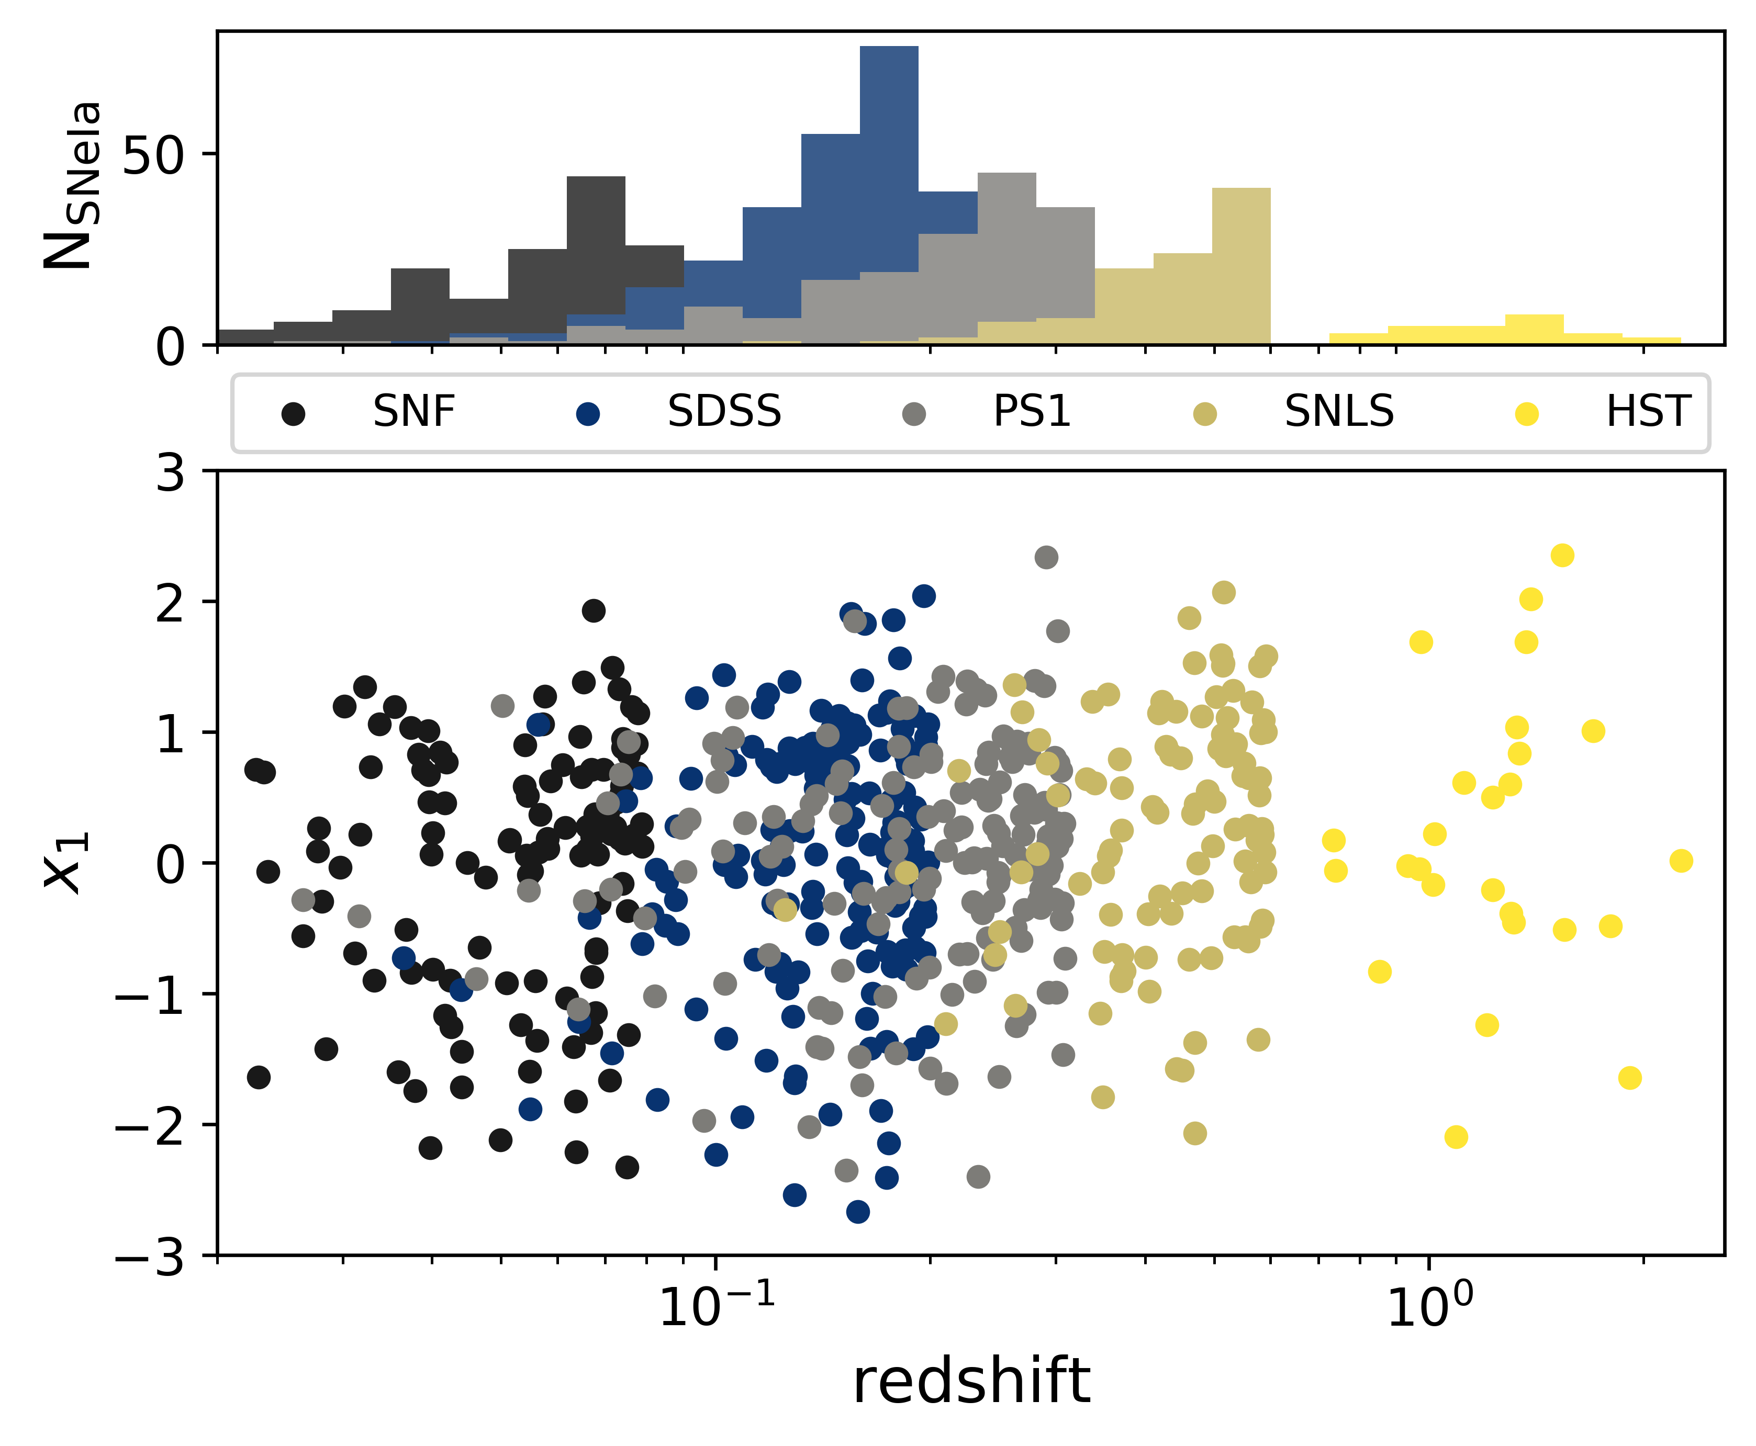
Complete sample free from selection effects
Nicolas et al. (2021)
Notes:
In addition to these now selection effects-free samples, we used SNf and HST data which were already complete, and made one big stretch sample from all these 5 individual surveys. Their stretch distributions are shown in this figure, with the redshift in logscale on the x-axis, and the cumulative histogram of the full sample shown above. In this figure, we can already see that the SNe whose stretch is over the -1 line seem to always be populated, while the Sne under it tend to become scarce with redshift. This is this disappearance we wanted to study.

Slide 8
Complete sample free from selection effects
Nicolas et al. (2021)
Notes:
In addition to these now selection effects-free samples, we used SNf and HST data which were already complete, and made one big stretch sample from all these 5 individual surveys. Their stretch distributions are shown in this figure, with the redshift in logscale on the x-axis, and the cumulative histogram of the full sample shown above. In this figure, we can already see that the SNe whose stretch is over the -1 line seem to always be populated, while the Sne under it tend to become scarce with redshift. This is this disappearance we wanted to study.

Slide 9




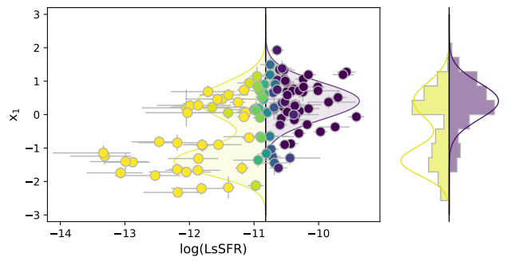
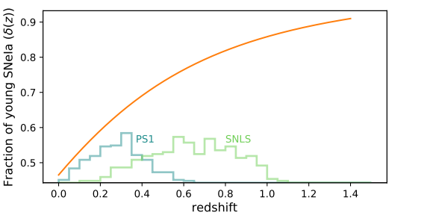
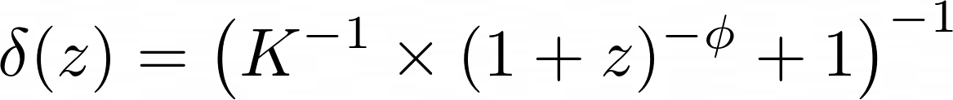
Why do we expect a stretch evolution?
Nicolas et al. (2021)
Older
Rigault et al. (2020)
Stretch
Younger
Probability for the progenitor to be young
Rigault et al. (2020), K=0.87, Φ=2.8
Notes:
In fact, this stretch evolution was already expected when looking at Rigault 20. Indeed, this paper presented these two elements.
On the left, we have the stretch vs. $LsSFR$ values of 114 SNe from the SNf sample. The $LsSFR$ is a tracer of the "age" of a supernova; it's called "young" if its progenitor was young, meaning that it exploded sooner than others, and is deduced by its environment properties. We see that their stretch distributions seem different. A single gaussian for the young ones, and a combination of that same Gaussian and another low-stretch mode for the old ones only.
On the right, we have an analytic expression of the fraction of young Sne Ia as a function of redshift. It shows that, as the redshift increases, we find an increasing ratio of young stars compared to old stars. For instance, the SNe Ia at the end of the $SNLS$ dataset exploded in an environment that was composed of ~85% of young stars, while the first ones of the $PS1$ sample exploded in an environment composed of ~50% young stars.
With the evolution of the fraction of young stars as a function of redshift from the image on the right, and the different distributions of young and old Sne from the one on the left, we see that we indeed expect the low-stretch mode to dispappear with redshift. Thanks to these two things, we have the link between stretch and environment, and the link between environment and redshift: we can analytically test the idea of low-stretch disappearance and intrinsic evolution of SNe Ia’s magnitudes!

Slide 10
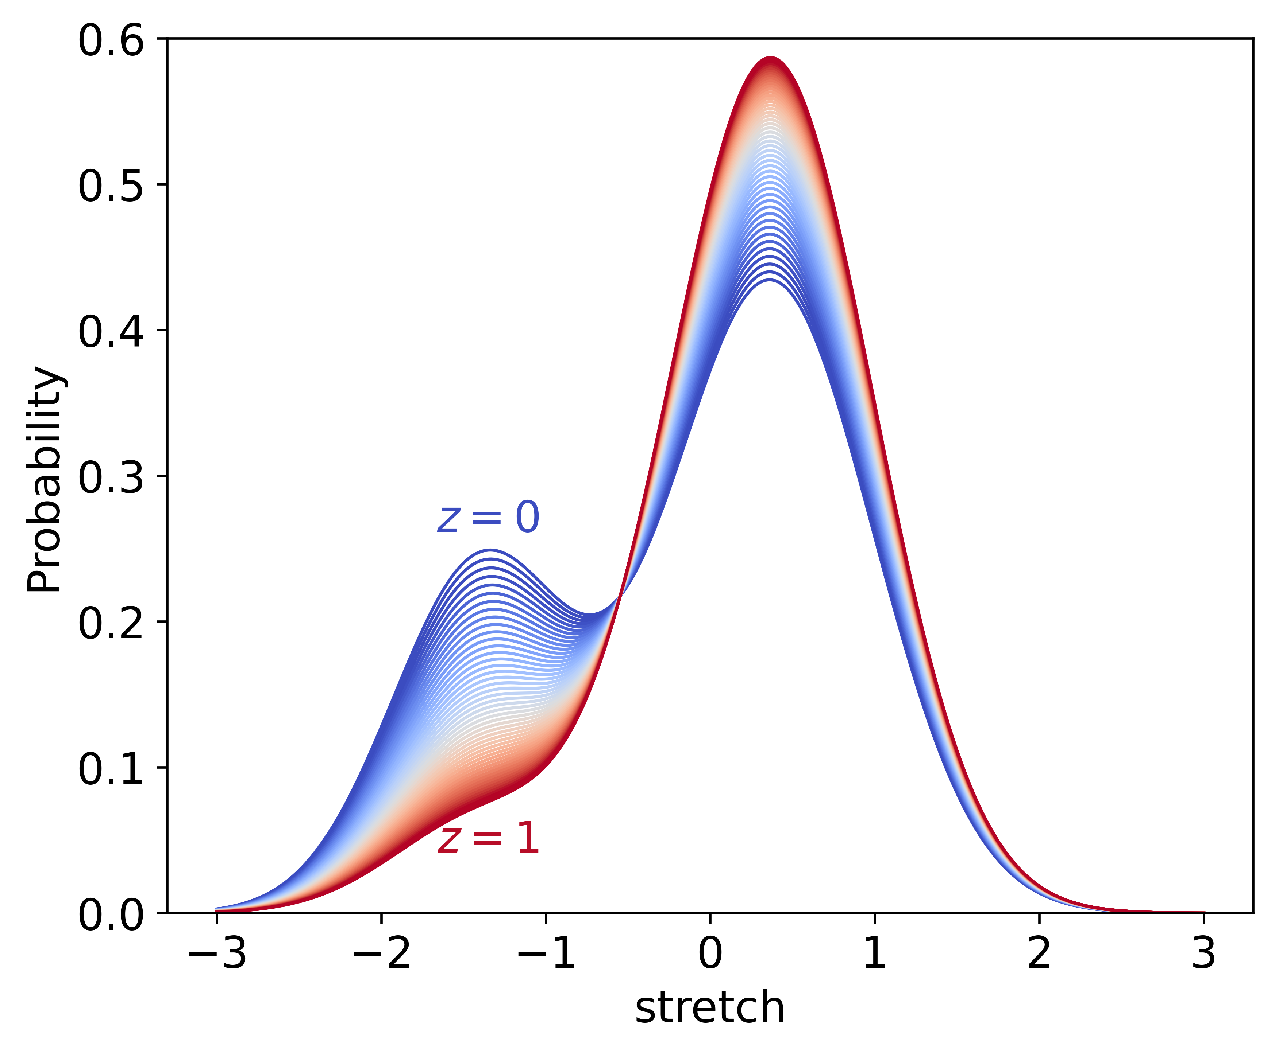
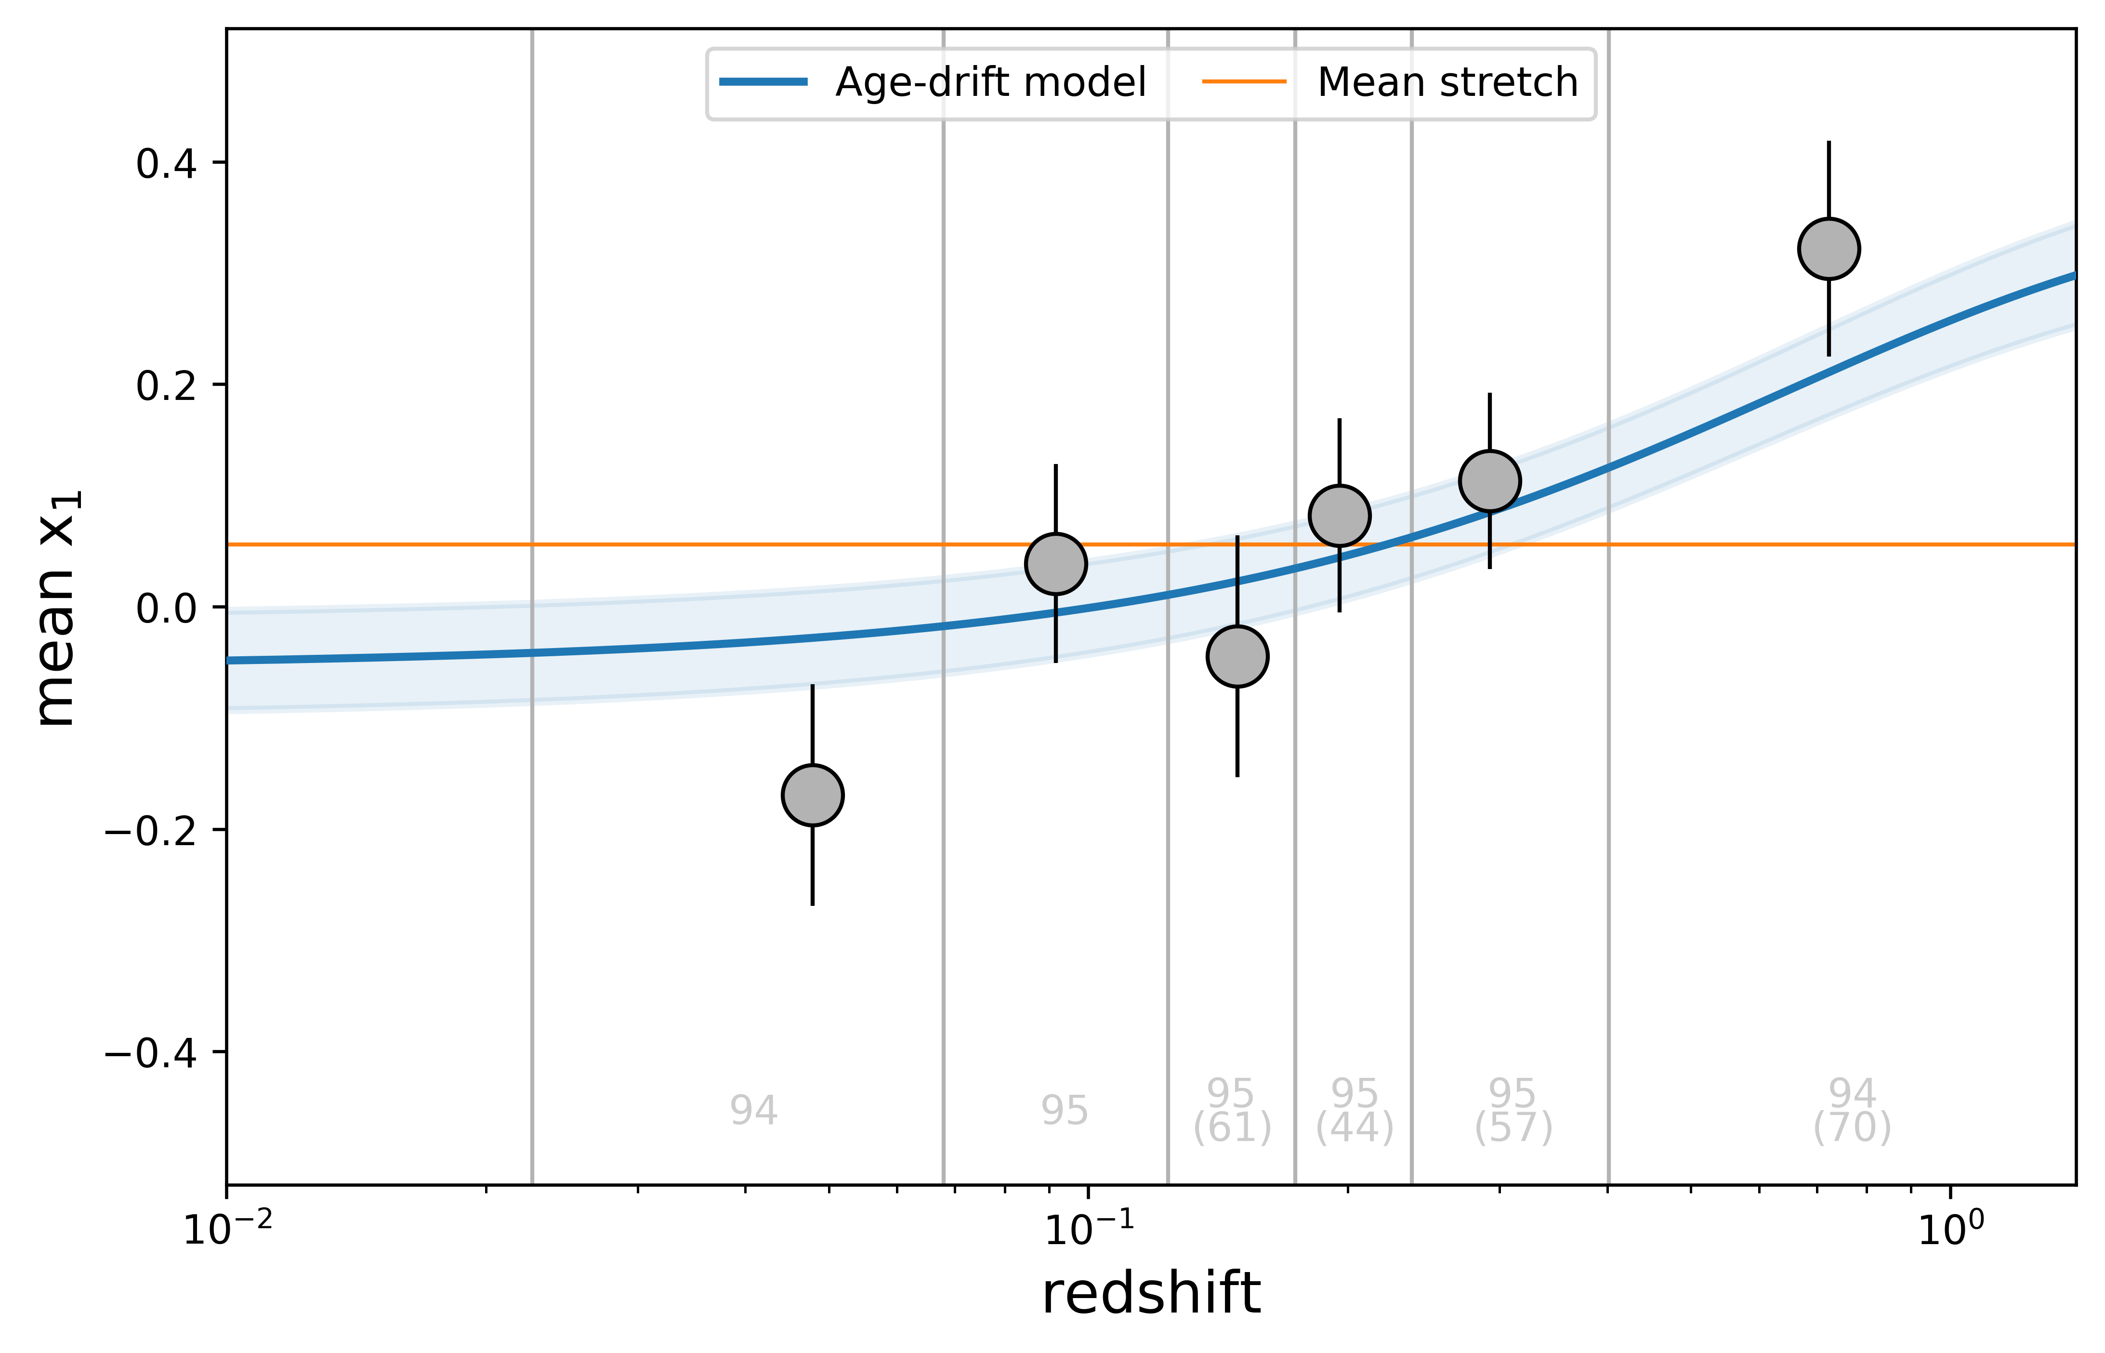

Implementation to dataset
Nicolas et al. (2021)
Notes:
Quand on minimise ces paramètres avec toutes nos données, on peut tracer le modèle de population du stretch à tout redshift, par exemple à gauche entre z=0 et z=1, mais aussi déterminer l’évolution moyenne du stretch comme on le voit à droite.
With the distributions we just talked about, it is easy to come up with the expected mean stretch at any redshift: \de(z) being the fraction of young stars at redshift (z), the expected mean stretch is simply \de(z) times the mean of the young distribution (and being a Gaussian that’s just µ₁) + (1-\de(z)), the fraction of old stars, times the mean of the old distribution (the linear combination of the two Gaussians from the previous slide). The parameters describing the distributions have been computed using the complete, 569 Sne of our complete sample, and a graphic representation is shown here. We cut the sample in 6 parts of equal sample size to plot their mean stretch and redshift, alongside to things : the mean of all the data, shown in orange, which is constant, and our analytic model and its error in blue line and band. When comparing the quality of fit of our age-drifting model vs this constant mean stretch model, we find a \De chi² of approximately 65, indicating that our model fits better to the data than the model shown in orange.

Slide 11
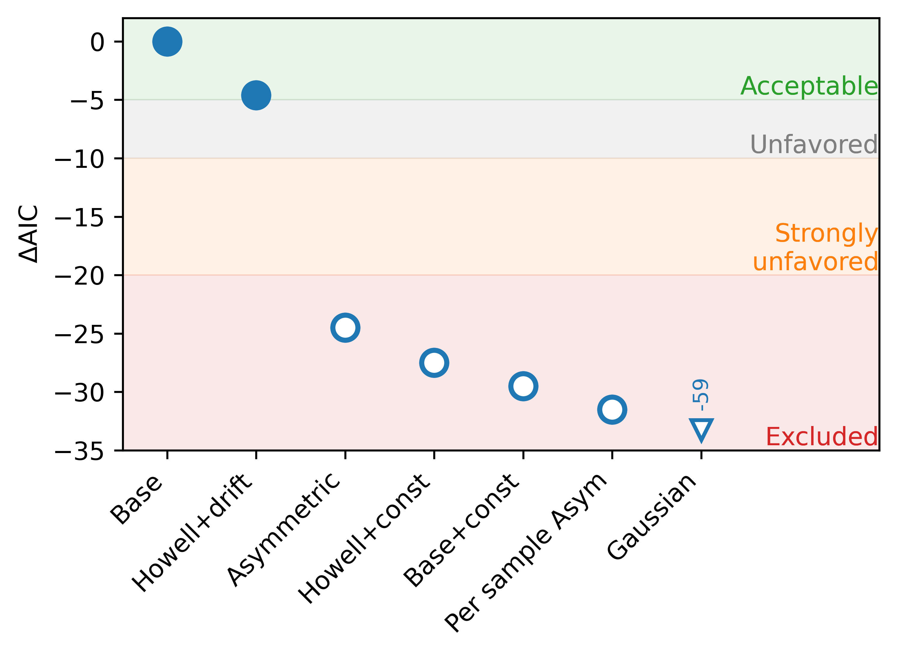
Comparison results
Nicolas et al. (2021)
Notes:
To test the viability of this model, we implemented a suite of different parametrizations that are shown on the x-axis here, and whose quality of fit from our Base model is shown on the y-axis using an estimator that penalizes the addition of free parameters (it prevents overfitting). The full markers represent the drifting models, with the \de(z) evolution, while the open markers represent constant models.
For example, the Howell+drift model is made of one Gaussian for each age distribution, the asymmetric one includes only one asymmetric Gaussian for the whole sample, and there are other constant models here, including our model but with a fixed ratio of young/old stars.
What we read on this figure is that any model that doesn’t include a redshift evolution of the stretch distribution – and now you’re supposed to have understood the title, I hope it’s the case –, is automatically excluded as suitable description of the data relative to our Base model; the asymmetric one has 10 to the minus 6 chance to describe the data as well as our Base model.

Slide 12
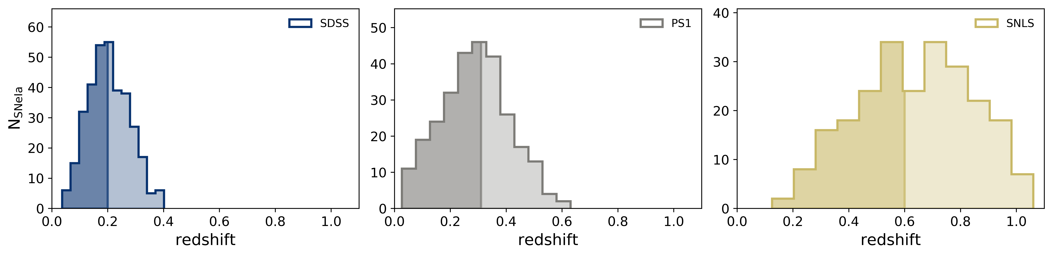
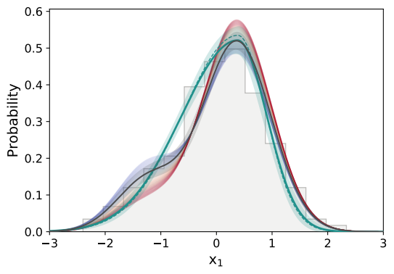
What’s the impact on cosmology?
An example with the BBC modeling
Nicolas et al. (2021)
PS1 stretch underlying distribution
BBC asymmetric
Base model
(fitted on PS1 data)
z_{min}
z_{max}
Notes:
C’est très bien mais en attendant, on a quand même retiré environ la MOITIÉ de notre échantillon au début. On n’a pas vraiment le luxe de faire ça en cosmologie. Ce qu’on veut vraiment, et ce qu’on fait vraiment, c’est d’utiliser ces données en les corrigeant pour ce qu’il manque, c’est-à-dire en simulant les effets de sélection des SNe dans les parties en peu en transparence. Mais selon la manière dont les modèle, et notamment leur stretch, le résultat cosmologique ne va pas être le même ! On a en bas la différence de modélisation de la population de stretch entre ce qui est fait de nos jours pour modéliser les supernovae d’un sondage (PS1), en vert, et notre modèle en couleurs comme précédemment.
Ainsi mon premier papier a été d’établir ce modèle de stretch, et le second en cours de rédaction vise à implémenter cette modélisation dans les outils en place et toutes les analyses qui supposent des distributions de stretch et étudier l’impact sur la cosmologie. Et finalement le titre de ma thèse se comprend.
The stretch’s underlying distribution is not something new. For instance, the Beams with Bias Correction modeling, or BBC modeling, is a technique that uses per-sample asymmetric Gaussians (it was also excluded on the previous slide) to correct data for selection effects, extrapolating what is missed after the redshift limit.
On this figure, we represented the normed stretch histogram of our complete PS1 sample, x1 being on the x-axis, and on top of that we have three things.
First is the BBC modeling’s asymmetric distribution in green. The full line and its band is our determination of the asymmetric Gaussian’s parameters; the dashed line shows the authors’ parameters. The are very close to each other, which indicates that we did get rid of selection effects with our cut (whereas BBC takes the selection effects to correct the sample).
Then, there is our bimodal model. Because the amplitude of each mode depends on \de(z), at low redshifts, in blue in the figure, the distribution favors the low-stretch mode more than at high redshifts, in red. The mean distribution on the redshift range of PS1 is shown in the black line and band.
What we see is that the asymmetric Gaussian goes through the middle of the bimodal distribution, over-estimating the number of SNe Ia at x1 = -0.7, and underestimating it at x1 = -1.7 in comparison to our Base drifting model. This means that the SN bias-corrected standardized magnitude estimated at a redshift affected by selection effects would be biased by an ill-modeling of the true underlying stretch distribution.

Slide 13
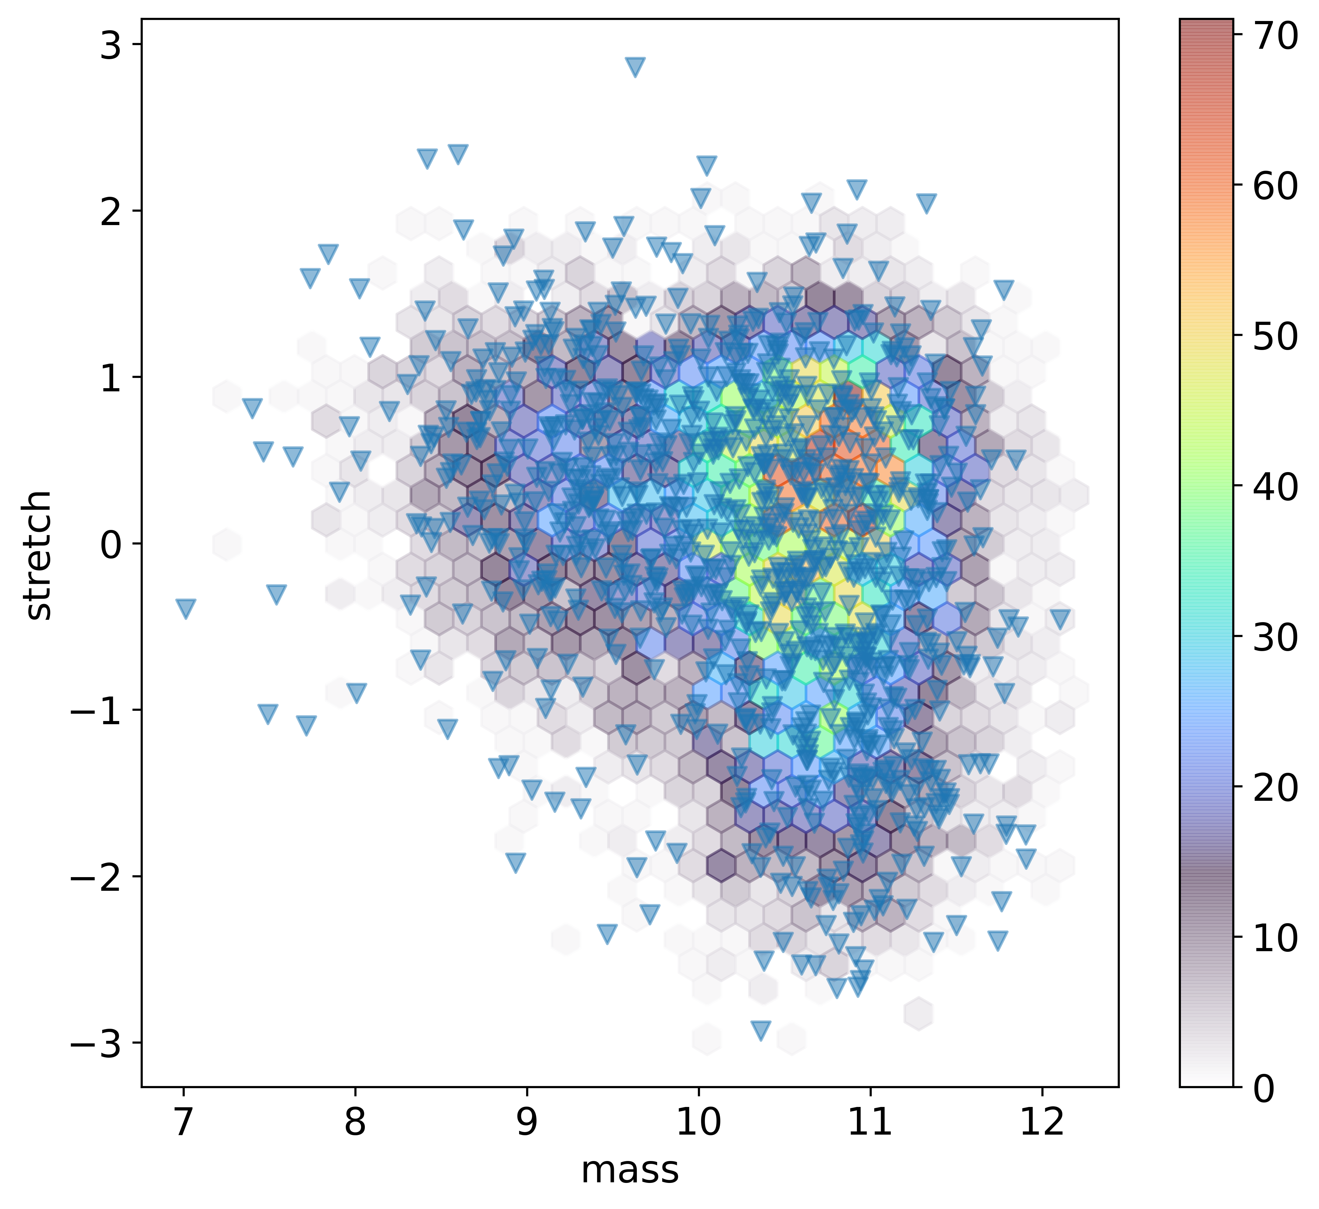
Actually using the model
Simulating SNe with SNANA
Notes:
J’en suis actuellement dans cette partie ; vous pouvez voir ici une réprésentation des données réelles de stretch et de masse en triangle et des données simulées avec notre modèle en hexagones de couleurs correspondant à la densité. On a une bonne représentation des données et l’injection dans les outils jusqu’à la détermination des paramètres cosmologiques est en cours.

Slide 14
Thank you!
PhD day
Nora NICOLAS
Cosmos Group IP2I
PhD student of M.Rigault
Tuesday, 02 november 2021
Notes:
Hello everyone, and thank you for being here! My name is Nora NICOLAS, working in the Cosmos group of the IP2I. Today I’m presenting my PhD work nicely called « Intrinsic variabilities of type Ia supernovæ and their consequences on cosmological parameters ». Before getting to the heart of the subject, I’ll say a few words on my domain of study, which is observational cosmology. Basically, I'm trying to contribute to better determination of cosmological parameters, such as the proportion of matter in the universe, doing direct observation of the sky.

Slide 15

Magnitude-limited surveys from the Pantheon dataset
(SNLS)
Notes:
We did that by considering the lowest apparent magnitude the surveys can acquire, for instance it’s 24.8 ag for SNLS. Indeed, a SN redshift is linked with its apparent magnitude and its absolute magnitude, which itself depends on its stretch and color.
So, at any given redshift, their is a minimum absolute magnitude. When we plot its evolution as a function of x₁ and c, we get this graph here. We get a minimum M_abs, days prior to its peak (so that we can acquire its lightcurve) of -18.00mag at x₁ = -1.66 and c=0.25.
We then have to compute the z_lim for which the apparent magnitude is lower that the m_lim.

Slide 16
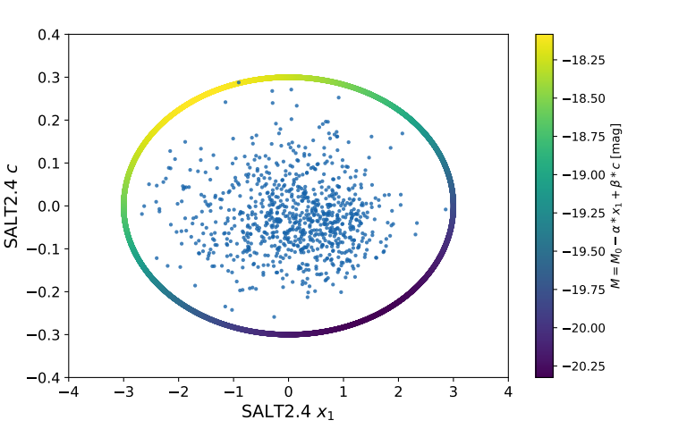
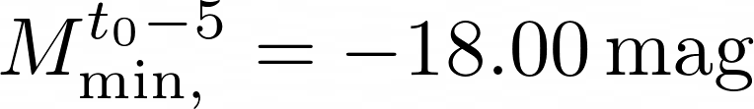


Magnitude-limited surveys from the Pantheon dataset
(SNLS)
Notes:
We did that by considering the lowest apparent magnitude the surveys can acquire, for instance it’s 24.8 ag for SNLS. Indeed, a SN redshift is linked with its apparent magnitude and its absolute magnitude, which itself depends on its stretch and color.
So, at any given redshift, their is a minimum absolute magnitude. When we plot its evolution as a function of x₁ and c, we get this graph here. We get a minimum M_abs, days prior to its peak (so that we can acquire its lightcurve) of -18.00mag at x₁ = -1.66 and c=0.25.
We then have to compute the z_lim for which the apparent magnitude is lower that the m_lim.

Slide 17

Magnitude-limited surveys from the Pantheon dataset
(SNLS)
Notes:
We did that by considering the lowest apparent magnitude the surveys can acquire, for instance it’s 24.8 ag for SNLS. Indeed, a SN redshift is linked with its apparent magnitude and its absolute magnitude, which itself depends on its stretch and color.
So, at any given redshift, their is a minimum absolute magnitude. When we plot its evolution as a function of x₁ and c, we get this graph here. We get a minimum M_abs, days prior to its peak (so that we can acquire its lightcurve) of -18.00mag at x₁ = -1.66 and c=0.25.
We then have to compute the z_lim for which the apparent magnitude is lower that the m_lim.

Slide 18

Base model
Nicolas et al. (2020)
Older
Stretch
Younger
Probability for the progenitor to be young
Notes:
That’s what we did with this first model: we described the stretch distribution of young Sne by a gaussian of mean µ₁ and standard deviation \s₁, and the stretch distribution of old Sne by a linear combination of that same gaussian and another one with mean µ₂ and std \s₂.
That way, our stretch distribution is given by the sum of these young and old distribution, weighted by their fraction.

Slide 19

Base model
Nicolas et al. (2020)
Older
Stretch
Younger
Probability for the progenitor to be young
Underlying stretch distribution
In SNf
Notes:
That’s what we did with this first model: we described the stretch distribution of young Sne by a gaussian of mean µ₁ and standard deviation \s₁, and the stretch distribution of old Sne by a linear combination of that same gaussian and another one with mean µ₂ and std \s₂.
That way, our stretch distribution is given by the sum of these young and old distribution, weighted by their fraction.

Slide 20
Base model
Nicolas et al. (2020)
Older
Stretch
Younger
Probability for the progenitor to be young
Underlying stretch distribution
Not in SNf
Notes:
That’s what we did with this first model: we described the stretch distribution of young Sne by a gaussian of mean µ₁ and standard deviation \s₁, and the stretch distribution of old Sne by a linear combination of that same gaussian and another one with mean µ₂ and std \s₂.
That way, our stretch distribution is given by the sum of these young and old distribution, weighted by their fraction.

Slide 21
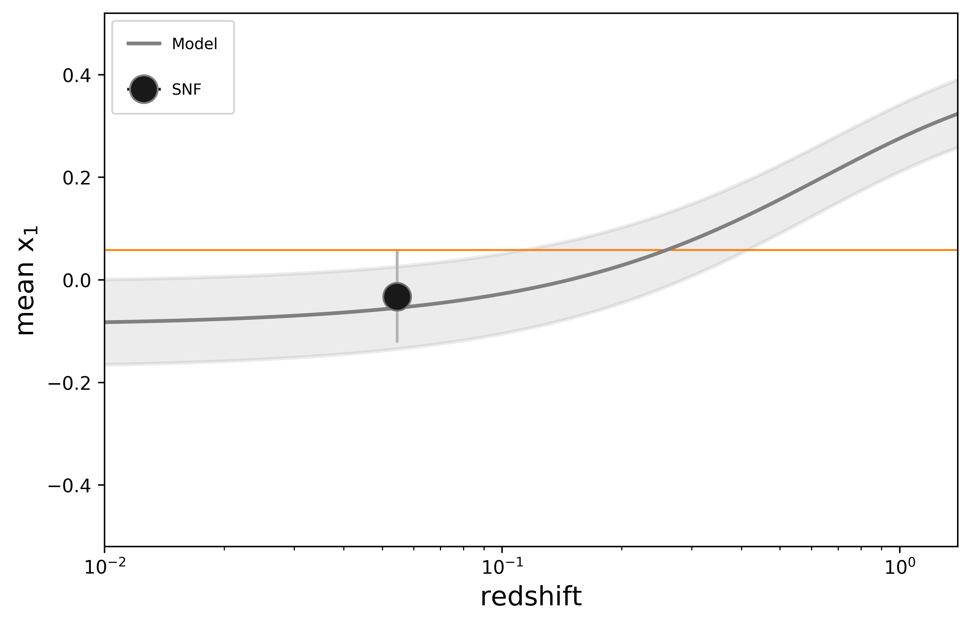
Implementation to dataset
Nicolas et al. (2020)
Comparison with other surveys
Model fitted on SNf data
Notes:
Here we have the mean stretch and redshift from 5 samples, 3 of them you already saw because we had to correct the selection effects, plus Snf and HST.
When we take the mean stretch from or model weighted by their evolving fraction, we get that evolution which fits the data. The current mean stretch evolution is showed by the dashed line, basically there is no evolution.
Doing the same work but with µ₁ and µ₂ fitted from all the data and not only on Snf data, we get that plot, where we divided the redshift data in bins with the same count of Sne in each and computed their mean stretch. It’s showing the change between fitting on Snf data and all the data, with the errors on the fitted parameters in filled gray.

Slide 22
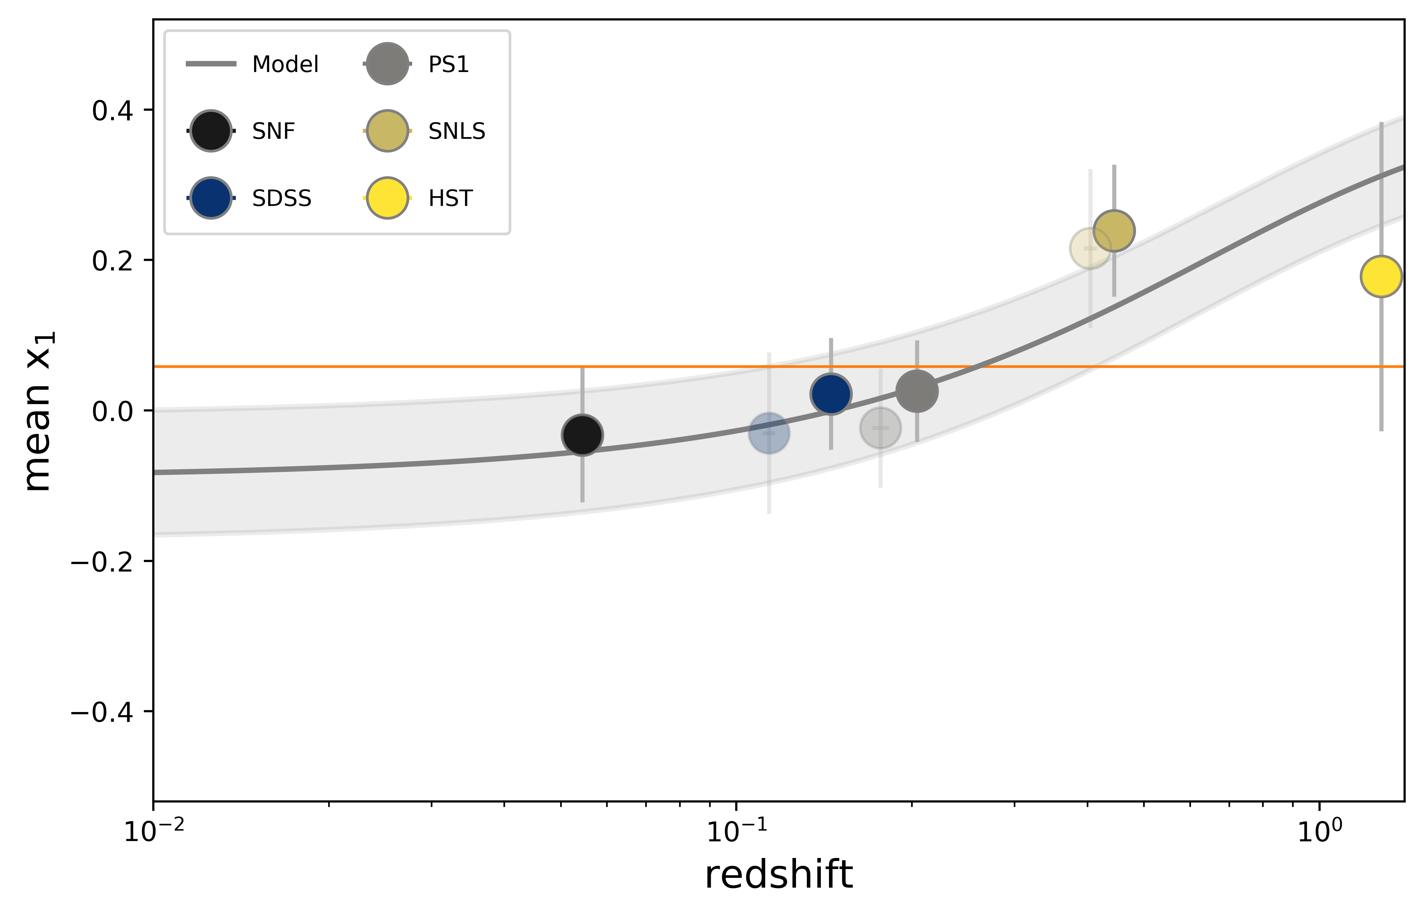
Implementation to dataset
Nicolas et al. (2020)
Comparison with other surveys
Model fitted on SNf data
Notes:
Here we have the mean stretch and redshift from 5 samples, 3 of them you already saw because we had to correct the selection effects, plus Snf and HST.
When we take the mean stretch from or model weighted by their evolving fraction, we get that evolution which fits the data. The current mean stretch evolution is showed by the dashed line, basically there is no evolution.
Doing the same work but with µ₁ and µ₂ fitted from all the data and not only on Snf data, we get that plot, where we divided the redshift data in bins with the same count of Sne in each and computed their mean stretch. It’s showing the change between fitting on Snf data and all the data, with the errors on the fitted parameters in filled gray.

Slide 23
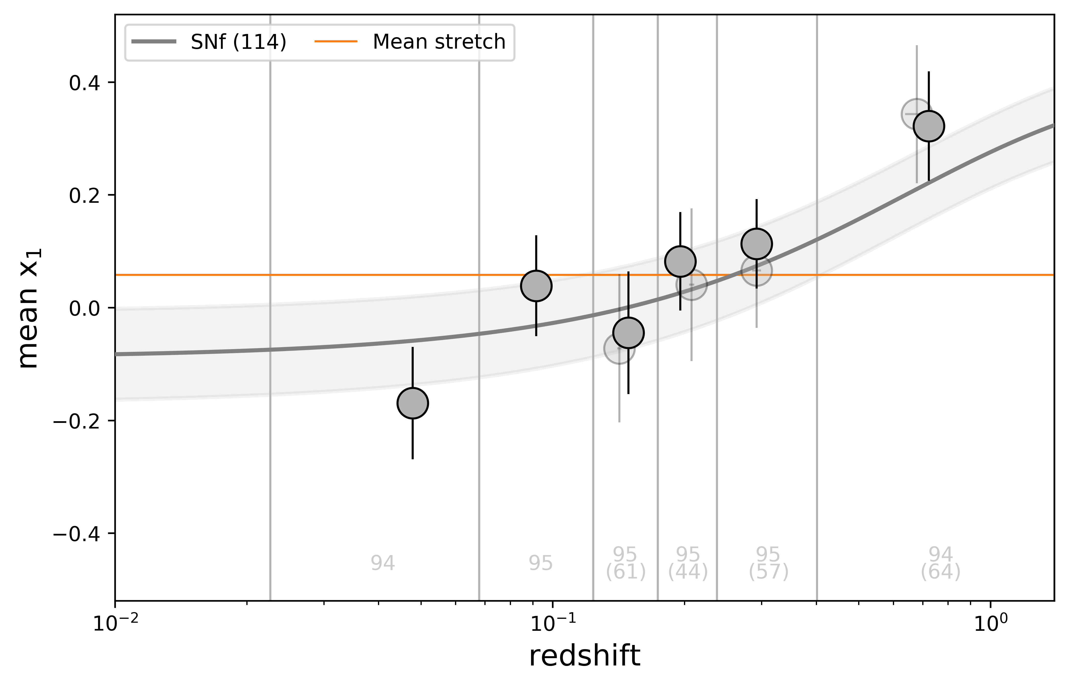
Implementation to dataset
Nicolas et al. (2020)
Comparison with all data combined
Model fitted on SNf data
Notes:
Here we have the mean stretch and redshift from 5 samples, 3 of them you already saw because we had to correct the selection effects, plus Snf and HST.
When we take the mean stretch from or model weighted by their evolving fraction, we get that evolution which fits the data. The current mean stretch evolution is showed by the dashed line, basically there is no evolution.
Doing the same work but with µ₁ and µ₂ fitted from all the data and not only on Snf data, we get that plot, where we divided the redshift data in bins with the same count of Sne in each and computed their mean stretch. It’s showing the change between fitting on Snf data and all the data, with the errors on the fitted parameters in filled gray.

Slide 24
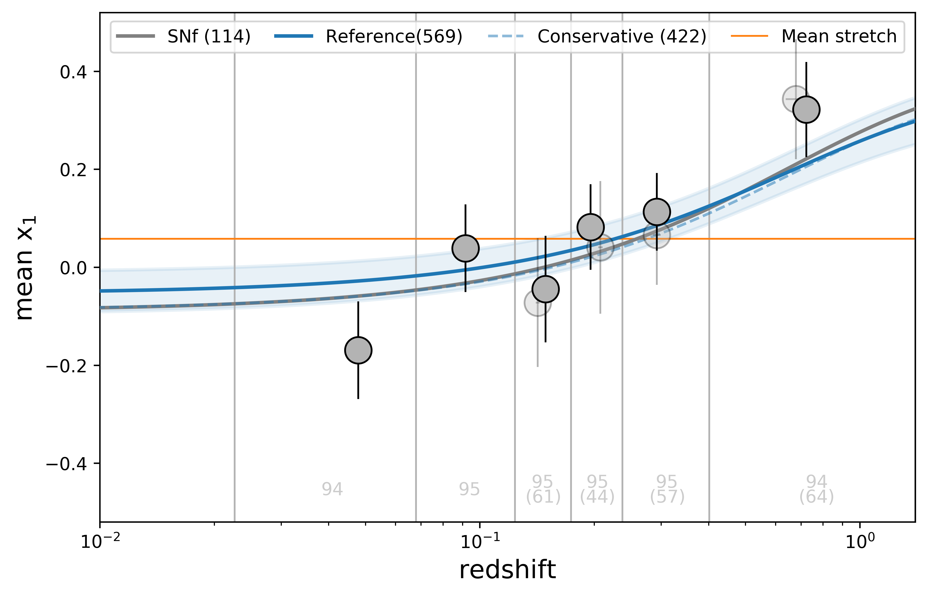

Implementation to dataset
Nicolas et al. (2020)
Comparison with all data combined
Model fitted on all data
Notes:
Here we have the mean stretch and redshift from 5 samples, 3 of them you already saw because we had to correct the selection effects, plus Snf and HST.
When we take the mean stretch from or model weighted by their evolving fraction, we get that evolution which fits the data. The current mean stretch evolution is showed by the dashed line, basically there is no evolution.
Doing the same work but with µ₁ and µ₂ fitted from all the data and not only on Snf data, we get that plot, where we divided the redshift data in bins with the same count of Sne in each and computed their mean stretch. It’s showing the change between fitting on Snf data and all the data, with the errors on the fitted parameters in filled gray.

Slide 25
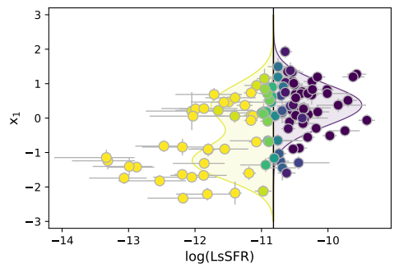
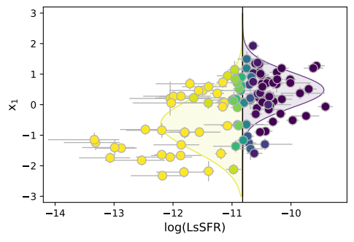

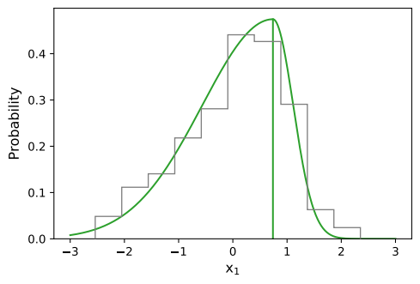
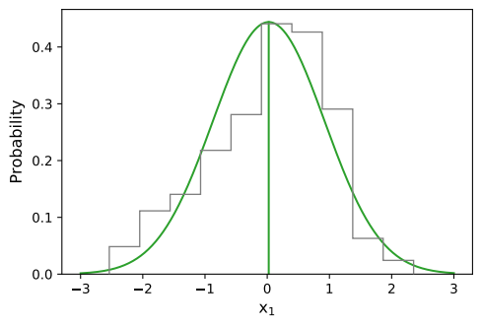
Other models
Nicolas et al. (2020)
Underlying stretch model per age population
Cf Howell et al. (2007)
N param = 5
N param = 4
Drift
+
Or no drift
Base
Howell
N param = 3
Asymmetric
N param = 2
Gaussian
Notes:
We could have chosen different models, and we did. Here’s a few of them, one with 3 independant gaussians, one with only two gaussians, one with only one gaussian and Kessler’s model which is asymetric. For each one we tested whether an evolving or constant weight was better.

Slide 26

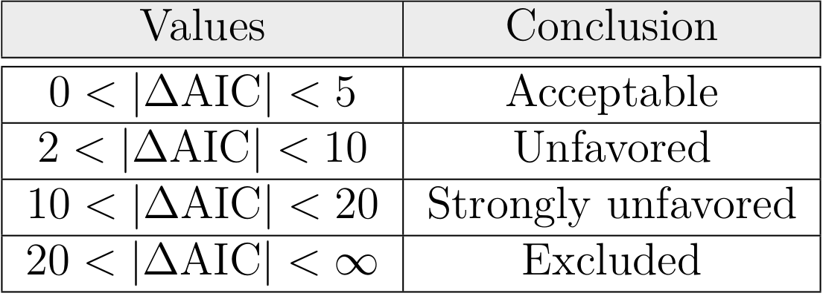
Comparison method
Notes:
To compare those models, we computed their AICc, which is an estimator of the relative quality of statistical models that includes a penalty for increasing the number of parameters: it’s easy to add parameters to fit data but we want to avoid overfitting.
Then, between two models to compare, the one with the lowest AICc will be the one minimising the loss of information; we can sort models between them via these values:

Slide 27
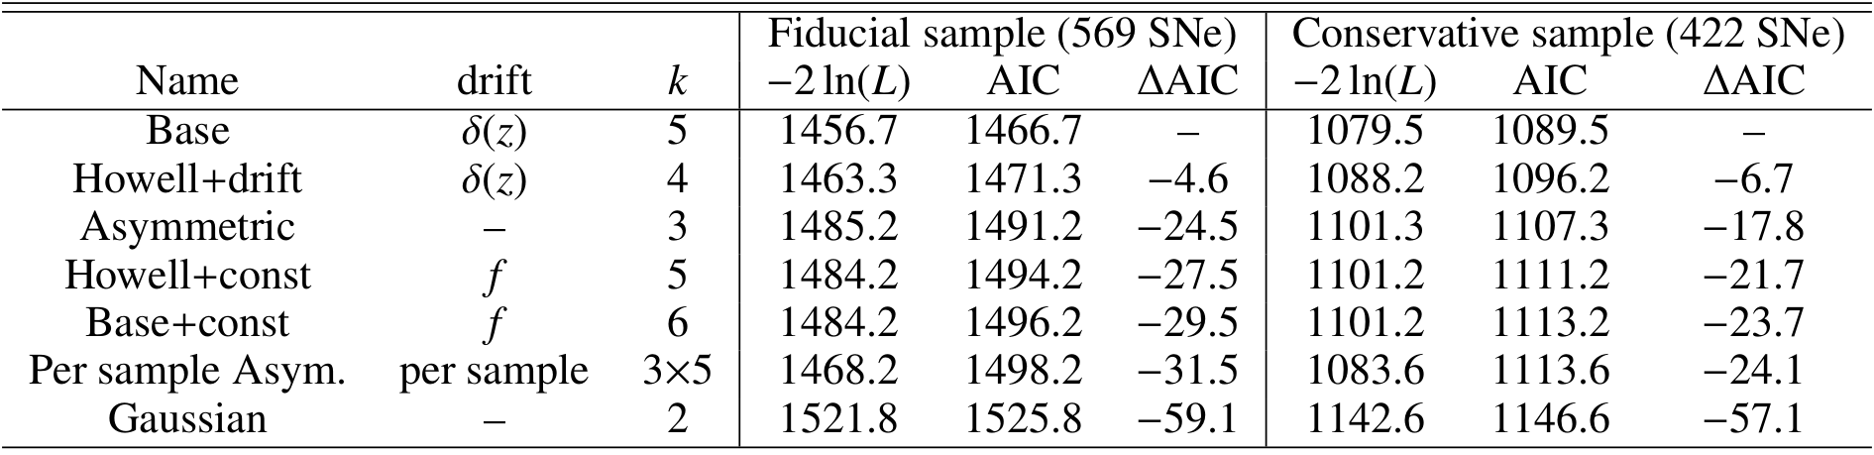
Comparison results
Notes:
To compare those models, we computed their AICc, which is an estimator of the relative quality of statistical models that includes a penalty for increasing the number of parameters: it’s easy to add parameters to fit data but we want to avoid overfitting.
Then, between two models to compare, the one with the lowest AICc will be the one minimising the loss of information; we can sort models between them via these values:

