Slide 1




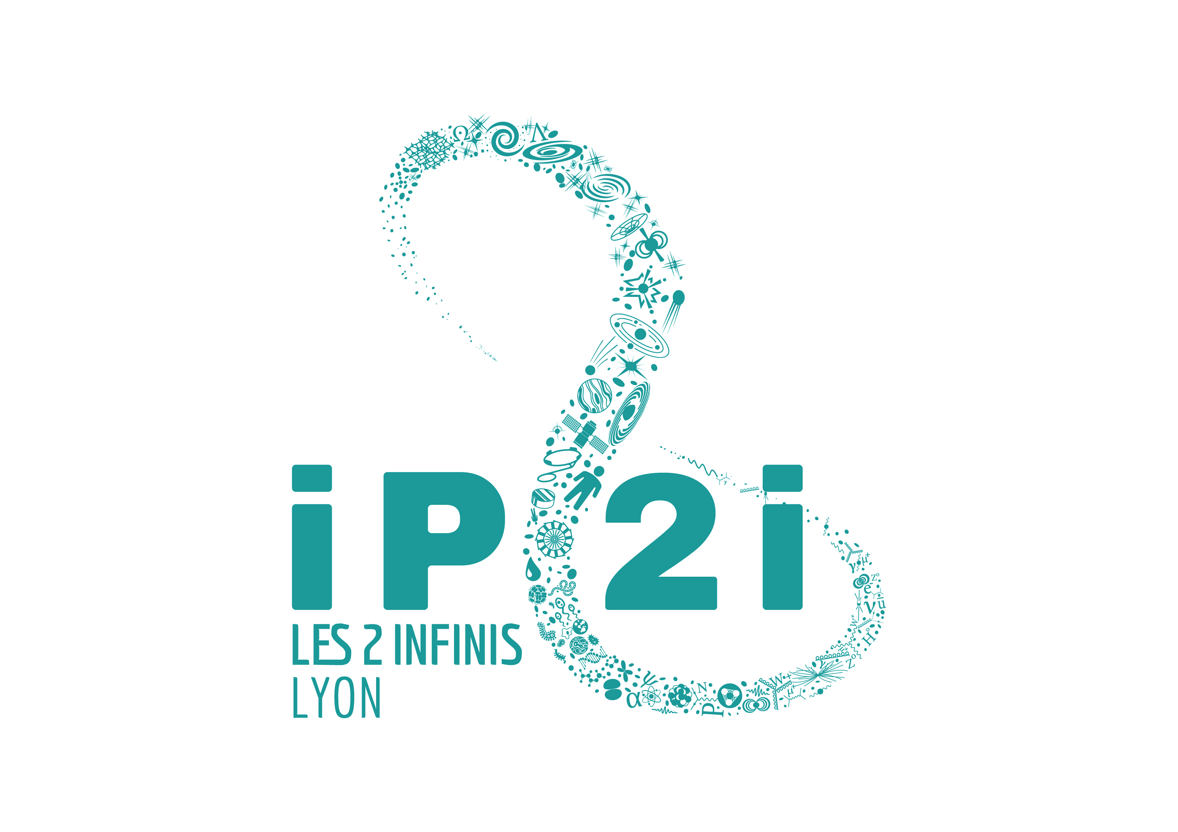
Redshift evolution of type Ia SN properties and consequences on cosmology
Nicolas et al. (2021)
Nora NICOLAS
Cosmos @ IP2I
PhD of M.Rigault
Rencontres de Moriond
Monday, 24 January 2022
Notes:
Hello everyone, and thank you for the invitation! My name is Nora NICOLAS, I’m a third year PhD student working in Lyon under the supervision of Mickaël RIGAULT in the Cosmos group of the IP2I. Today I'm glad to be presenting our work on the Redshift Evolution of the SN stretch distribution, which has been published this year on A&A with the following DOI.
Because there are lots of new students this year, let’s quickly talk about observational cosmology with SNe Ia first.

Slide 2
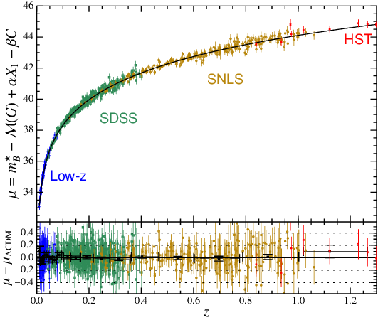
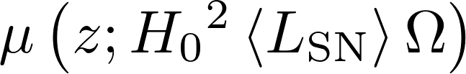
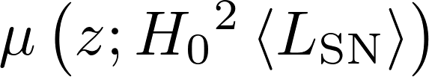
Assumptions in cosmology
Distance modulus µ
1999 → 100 SNe
2022 → 2000 SNe
Betoule et al. (2014)
Notes:
However, this absolute magnitude is also noisy, and it’s the use of the color and stretch of the lightcurves of SNe Ia that allowed a good measurment of these parameters by reducing the systematic errors on absolute magnitude, and gave the famous 70 % of the Universe’s energy as dark energy, meaning the Universe is in accelerated expansion.
Yet, when making these measurements, we suppose that the mean absolute magnitude is the same at all redshifts. That's fine for a first reading, but we actually have reasons to think it doesn't, and that farther SNe are intrinsically fainter. In fact we know that the environment is changing with redshift, the Universe of 7Gys ago was not the same as the one of today, and that there is a correlation between a SN's magnitude and its environment, so the goal is to find how environment changes and how SNe change with environment.
Right, so how do we test that? The parameter that has a lot of chance to help us in studying a potential redshift evolution is the $stretch$, the duration of the explosion, because it's mostly not affected by the interstellar medium, whereas the color does. So first, we need some data!

Slide 3
Assumptions in cosmology
Distance modulus µ
Betoule et al. (2014)
Constant with redshift?
Notes:
However, this absolute magnitude is also noisy, and it’s the use of the color and stretch of the lightcurves of SNe Ia that allowed a good measurment of these parameters by reducing the systematic errors on absolute magnitude, and gave the famous 70 % of the Universe’s energy as dark energy, meaning the Universe is in accelerated expansion.
Yet, when making these measurements, we suppose that the mean absolute magnitude is the same at all redshifts. That's fine for a first reading, but we actually have reasons to think it doesn't, and that farther SNe are intrinsically fainter. In fact we know that the environment is changing with redshift, the Universe of 7Gys ago was not the same as the one of today, and that there is a correlation between a SN's magnitude and its environment, so the goal is to find how environment changes and how SNe change with environment.
Right, so how do we test that? The parameter that has a lot of chance to help us in studying a potential redshift evolution is the $stretch$, the duration of the explosion, because it's mostly not affected by the interstellar medium, whereas the color does. So first, we need some data!

Slide 4
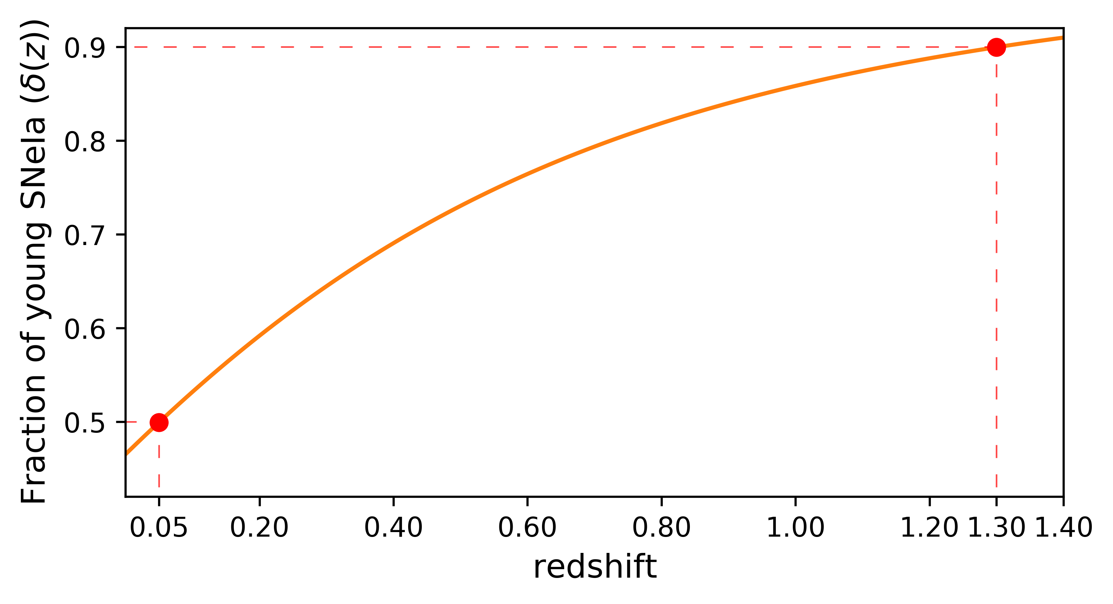
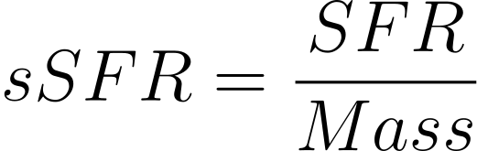


Prompt v. delayed drift model
50/50
90/10
Rigault et al. (2020)
Based on cosmic sSFR(z)

Slide 5
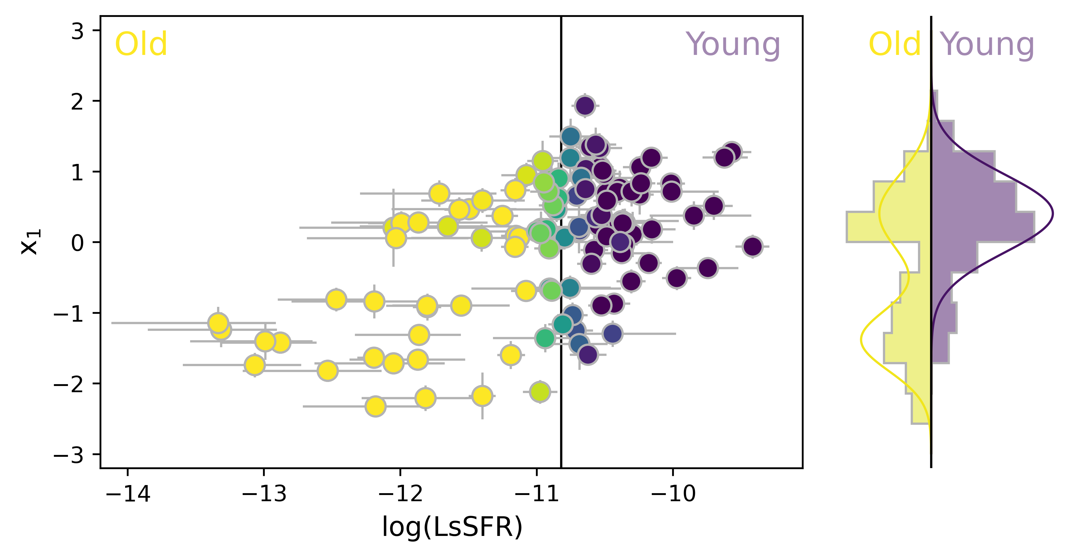
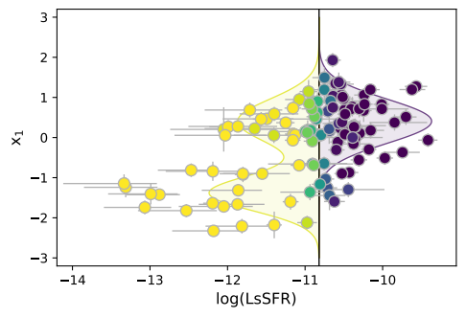




Prompt v. delayed population drift: stretch
Nicolas et al. (2021)
Delayed
Prompt
Older
Stretch
Nicolas et al. (2021)
Younger
Probability for the environment to be young

Slide 6
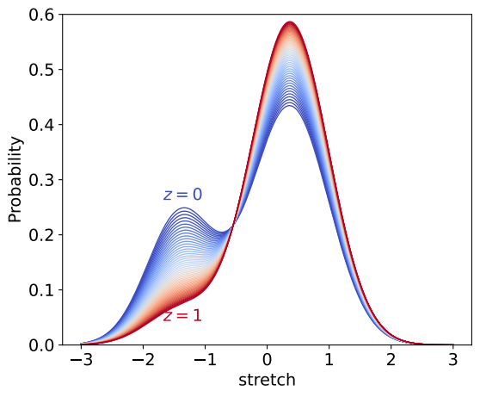


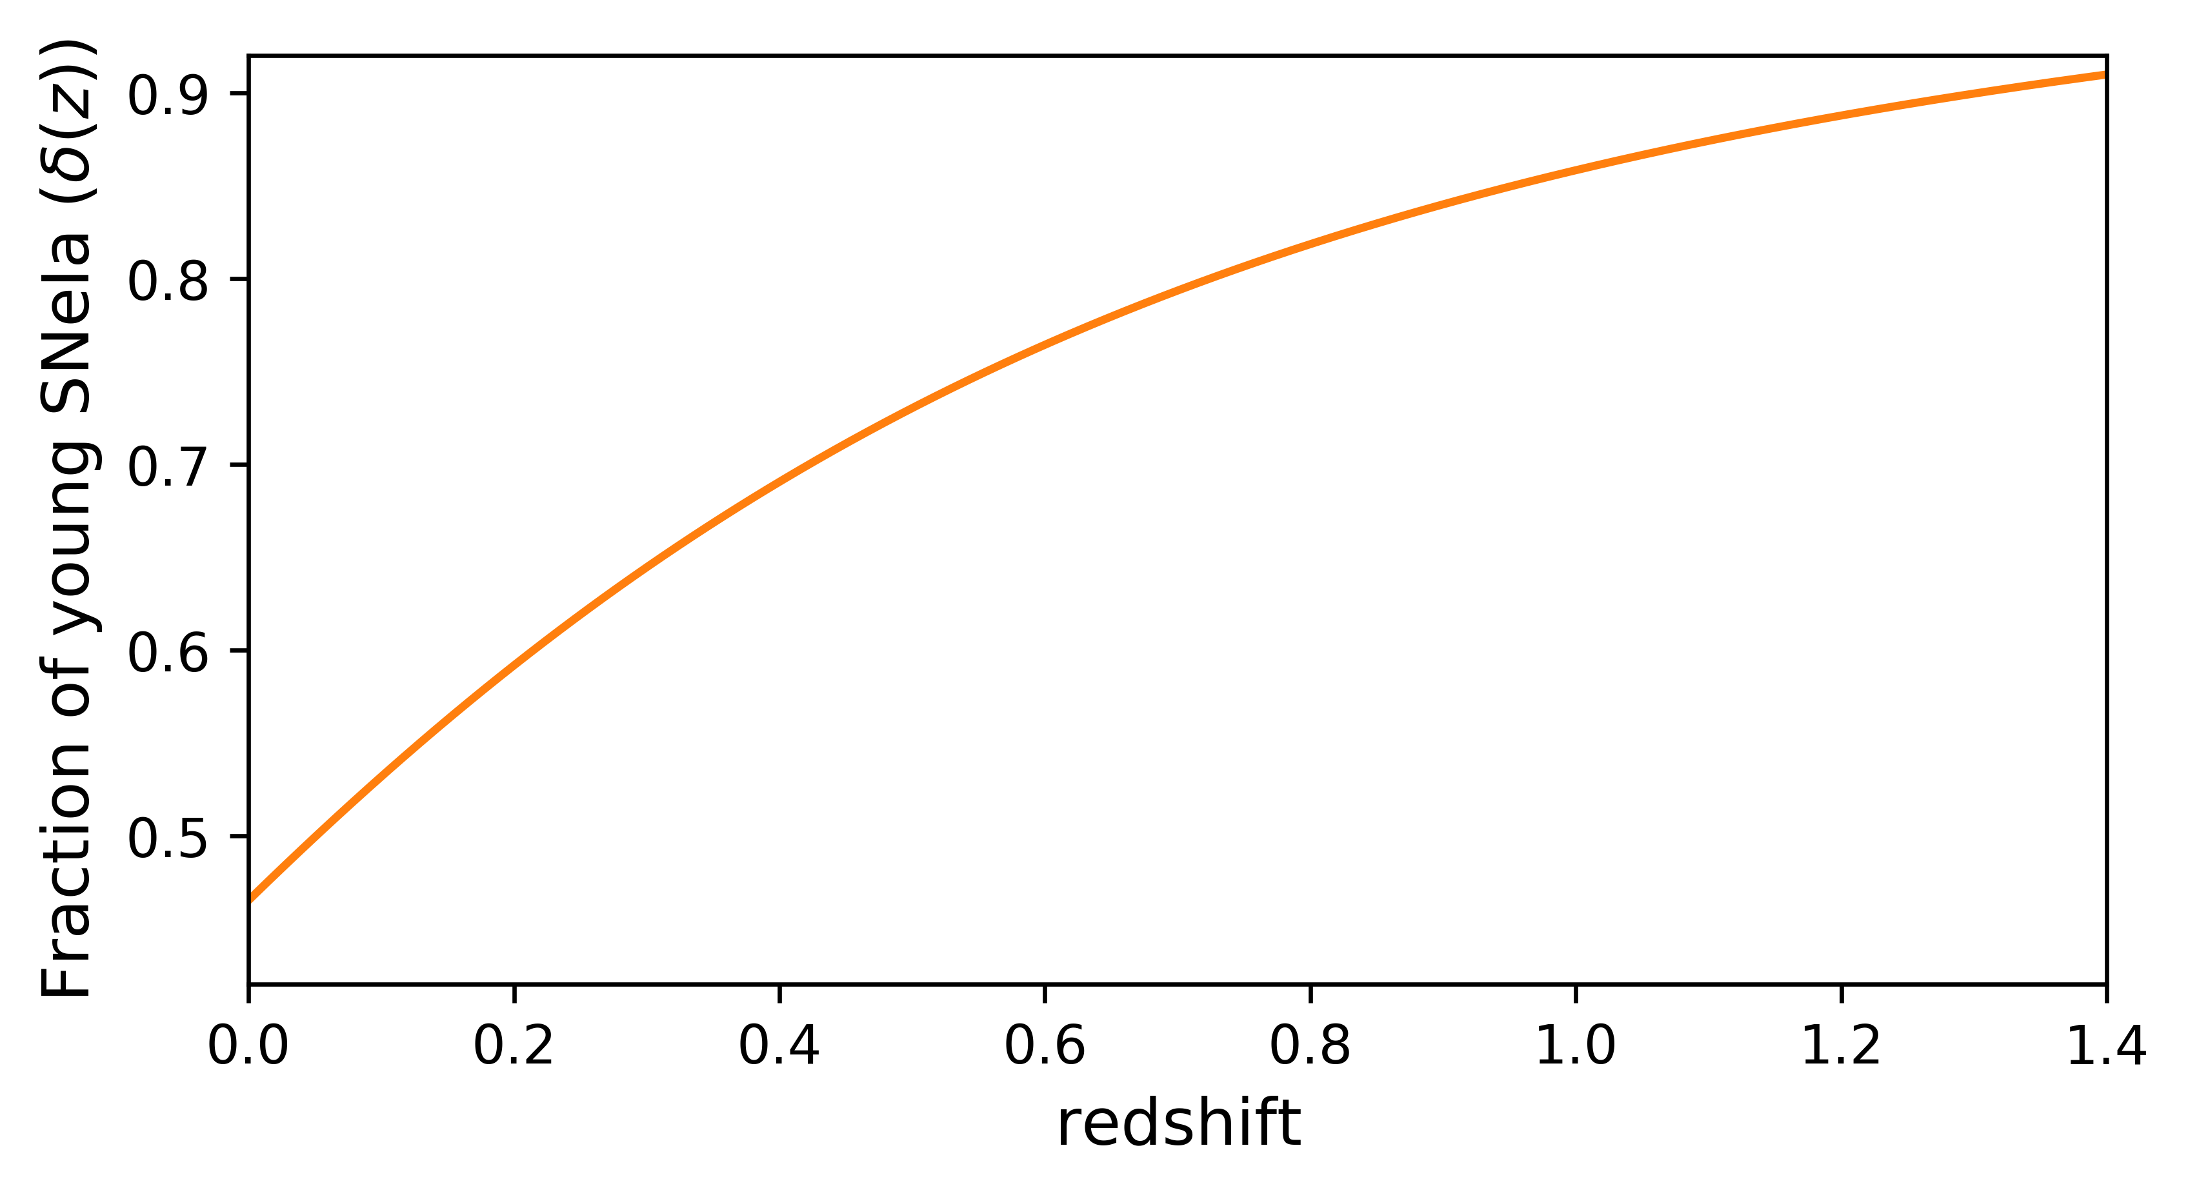
Prompt v. delayed population drift: stretch
Nicolas et al. (2021)
Distribution of SN Ia stretch as a function of redshift

Slide 7
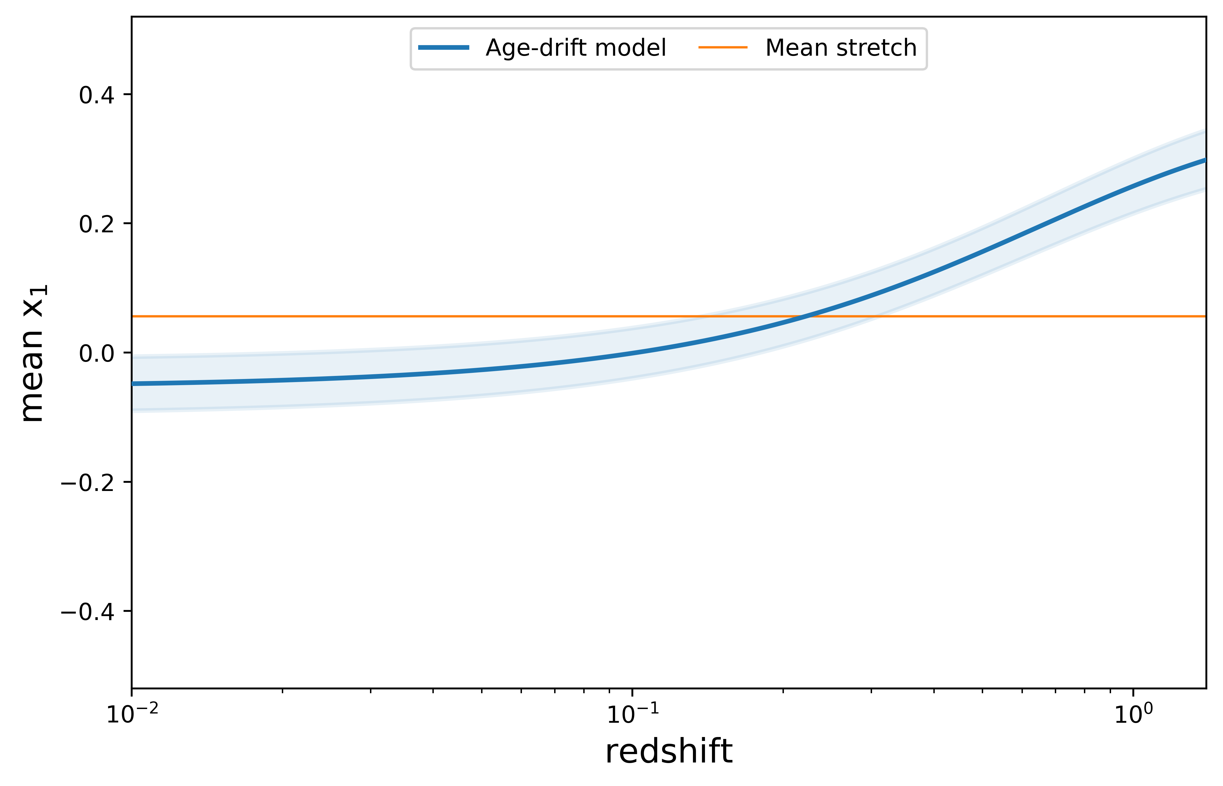
Prompt v. delayed population drift: stretch tested on data
Nicolas et al. (2021)

Slide 8
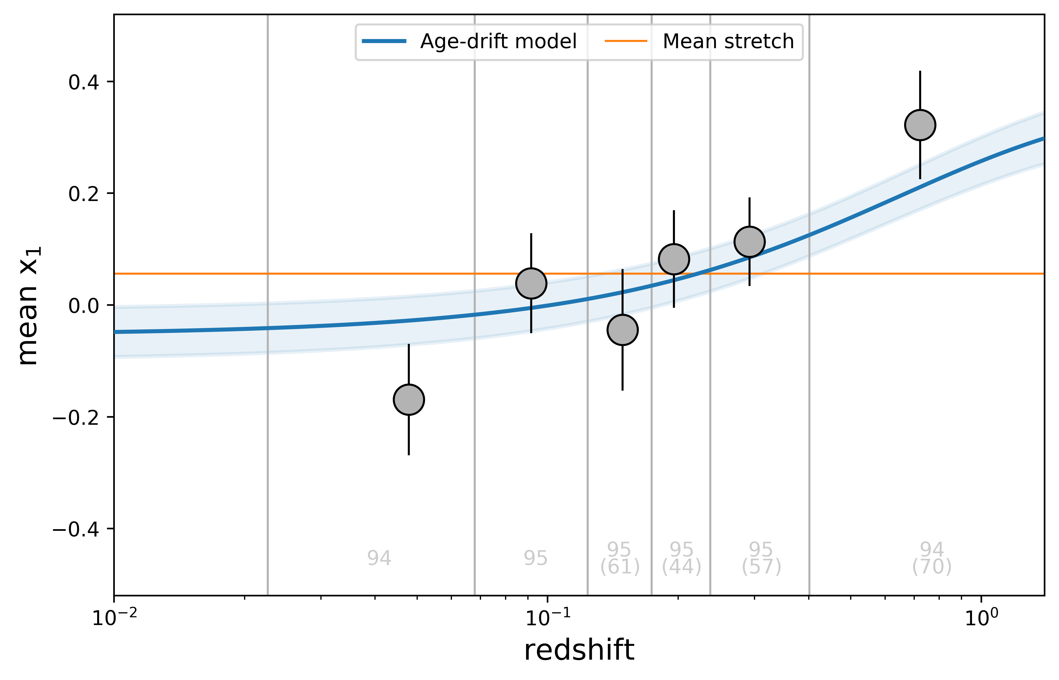

Prompt v. delayed population drift: stretch tested on data
Nicolas et al. (2021)
Literature data

Slide 9
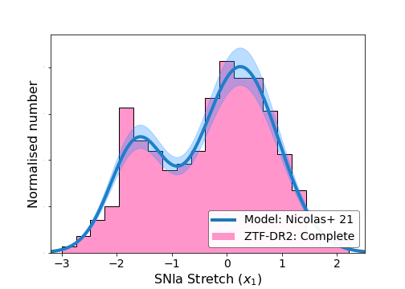
Prompt v. delayed population drift: prediction on other surveys
Smith et al. (in prep)
Preliminary

Slide 10
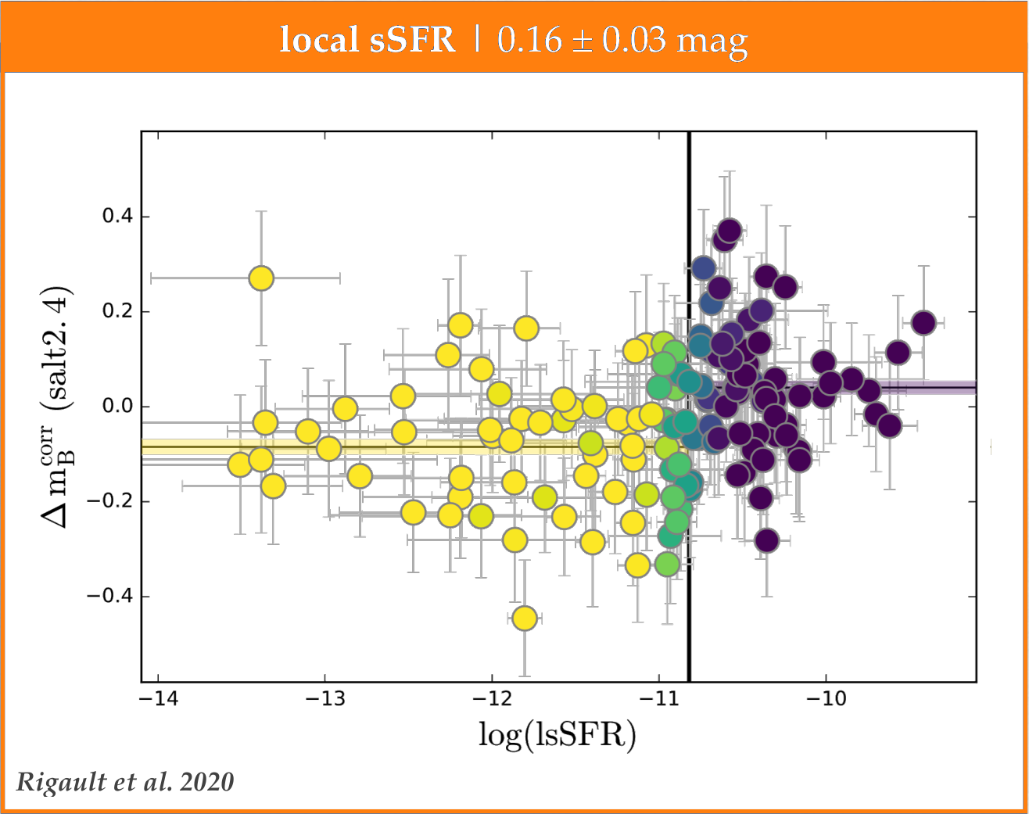
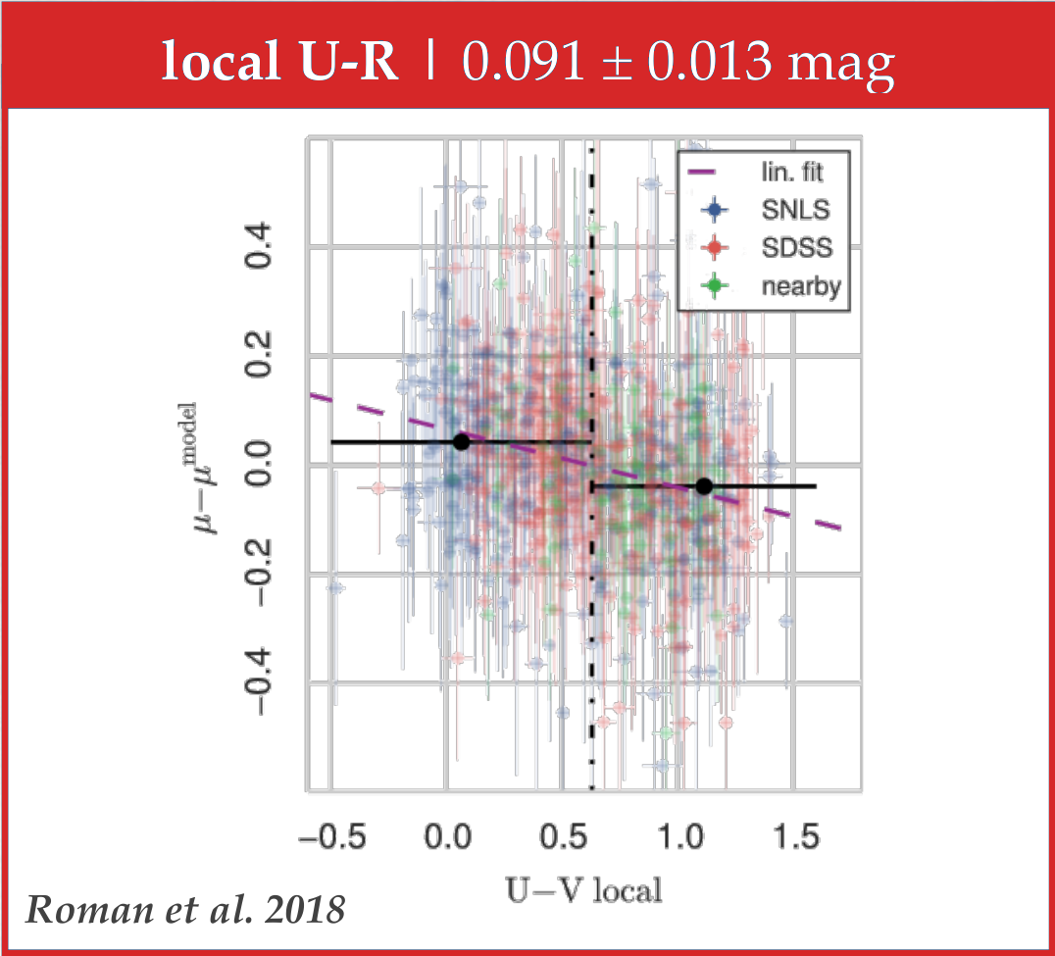
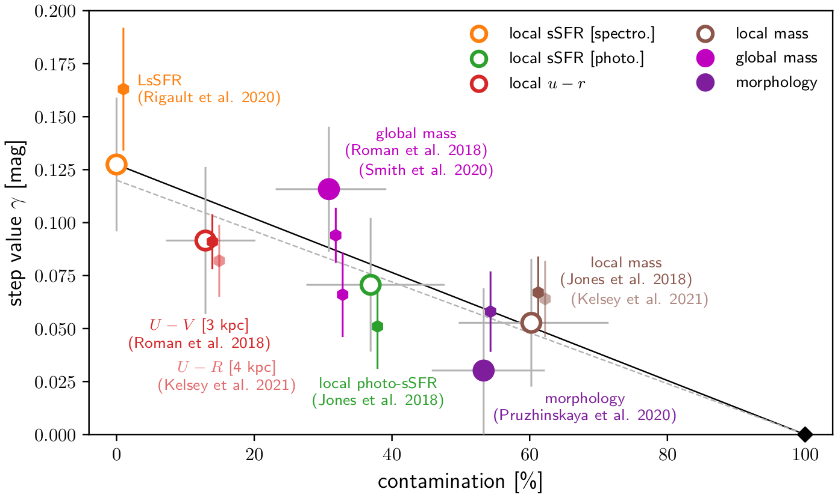
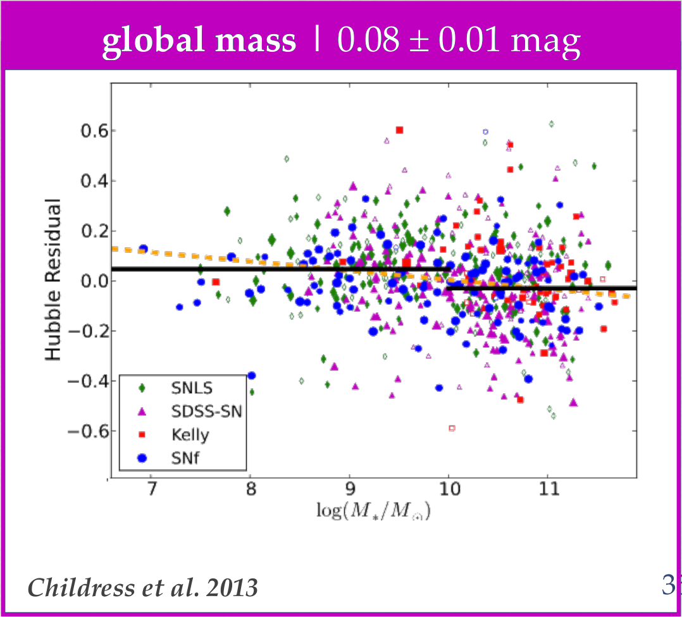
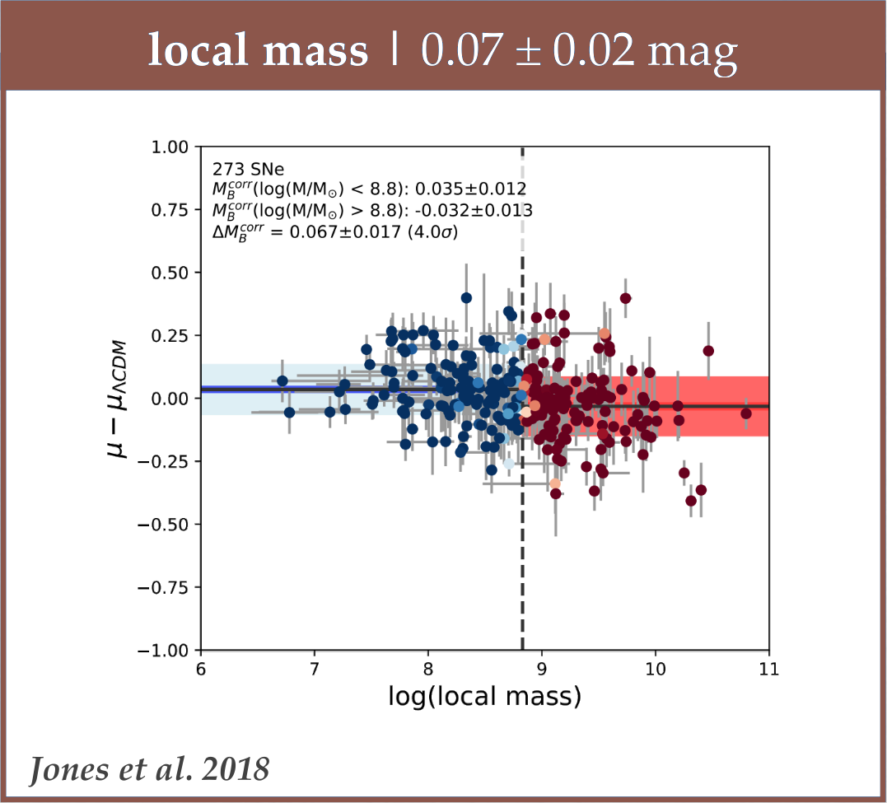
Different observed astrophysical bias: magnitude steps
Prompt v. delayed bias explains all observations in literature
Briday et al. (2021)
Prompt v. delayed model
Ability to discriminate SNe relative to LsSFR

Slide 11
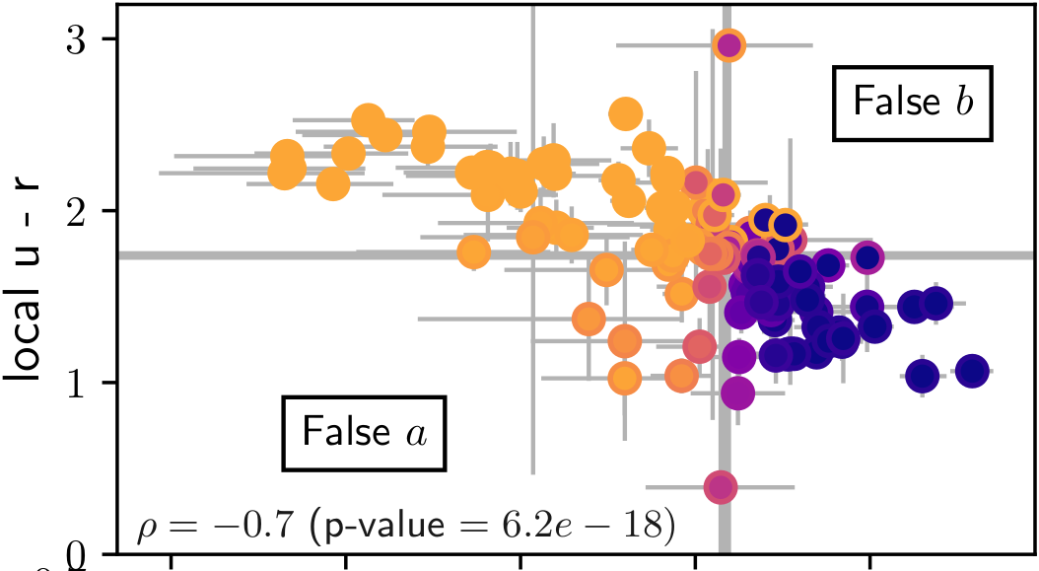
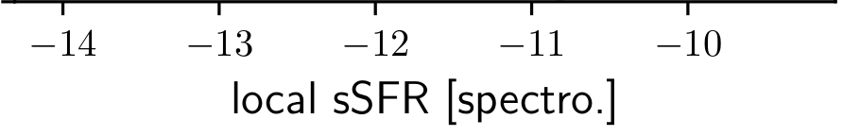
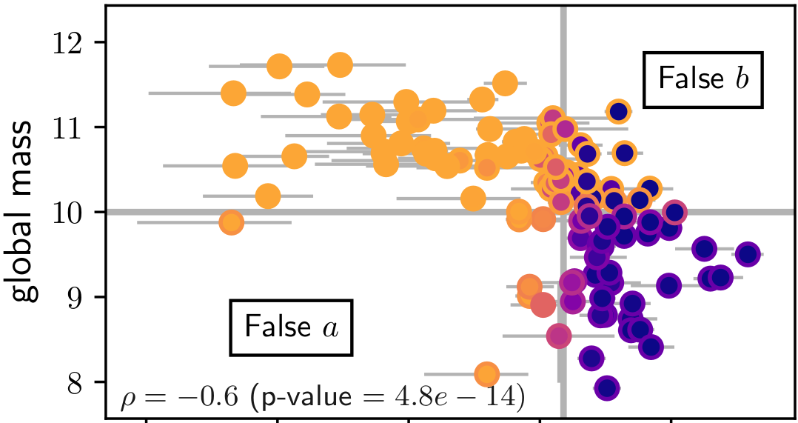
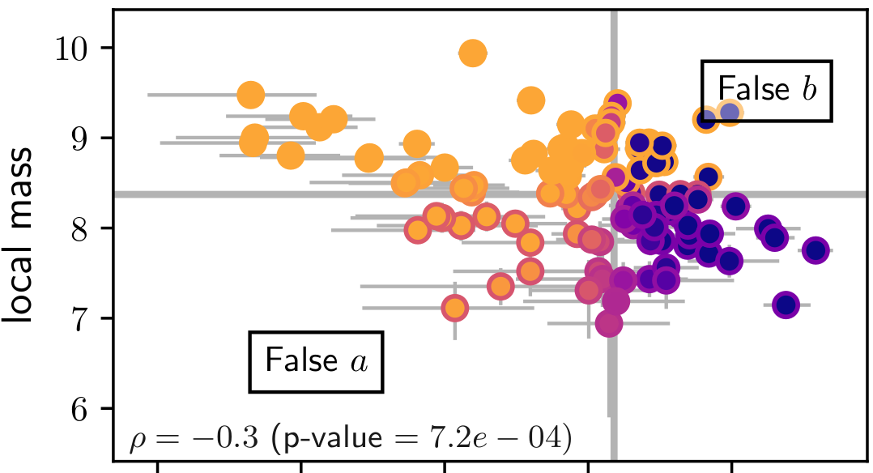
Different observed astrophysical bias: magnitude steps
Prompt v. delayed bias explains all observations in literature
Briday et al. (2021)
Prompt v. delayed model
Ability to discriminate SNe relative to LsSFR

Slide 12
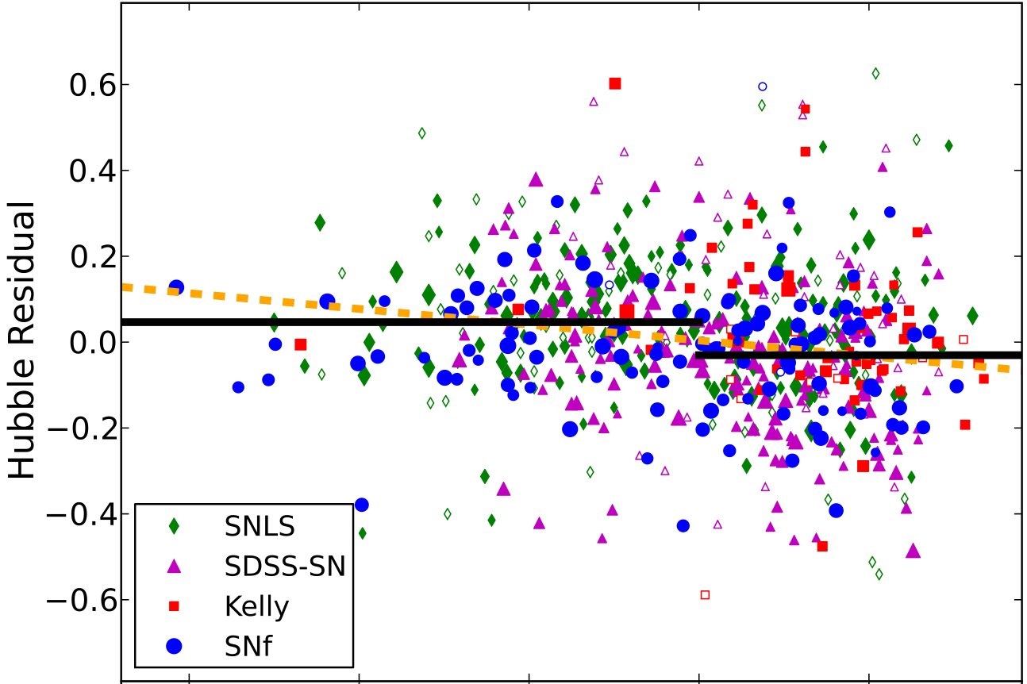
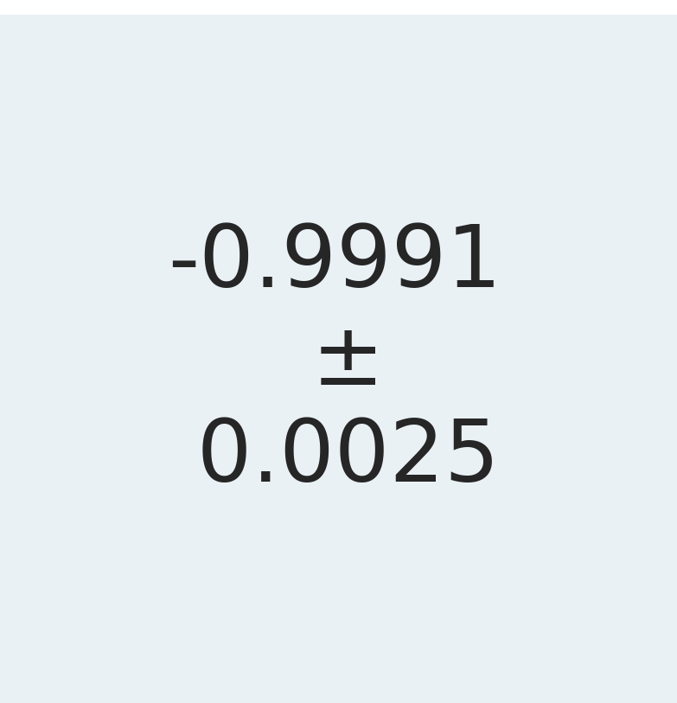
Prompt v. delayed: testing impact on w with simulations
Nicolas et al. (in prep)
Simulated world
Preliminary
Mass → m
Mass → m
age → x₁
age → m
age → x₁
Mass → m
Childress et al. (2013)
Fitted world
Mass → m
age → x₁
age → m
age → x₁
Recovered w
500 sims of 1000 SNe

Slide 13

Prompt v. delayed: testing impact on w with simulations
Nicolas et al. (in prep)
Simulated world
Preliminary
Mass → m
Mass → m
age → x₁
age → m
age → x₁
Mass → m
Childress et al. (2013)
Prompt v. delayed model:
Fitted world
Drift of stretch
Mass → m
age → x₁
Older
age → m
age → x₁
Nicolas et al. (2021)
Younger
Recovered Δw
500 sims of 1000 SNe

Slide 14
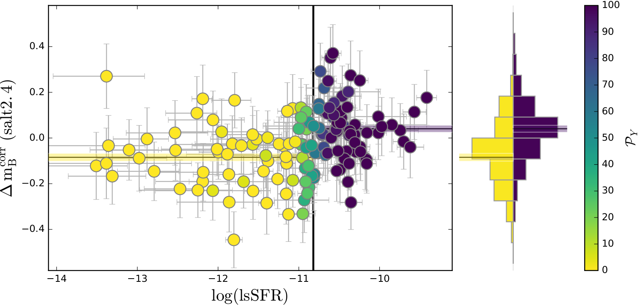
Prompt v. delayed: testing impact on w with simulations
Nicolas et al. (in prep)
Simulated world
Preliminary
Mass → m
Mass → m
age → x₁
age → m
age → x₁
Mass → m
Childress et al. (2013)
Assumed to be caused by age
Complete prompt v. delayed model:
Fitted world
Drift of stretch
Drift of SN mag
Mass → m
age → x₁
Older
Older
age → m
age → x₁
Nicolas et al. (2021)
Younger
Rigault et al. (2020)
Younger
Recovered Δw
500 sims of 1000 SNe

Slide 15
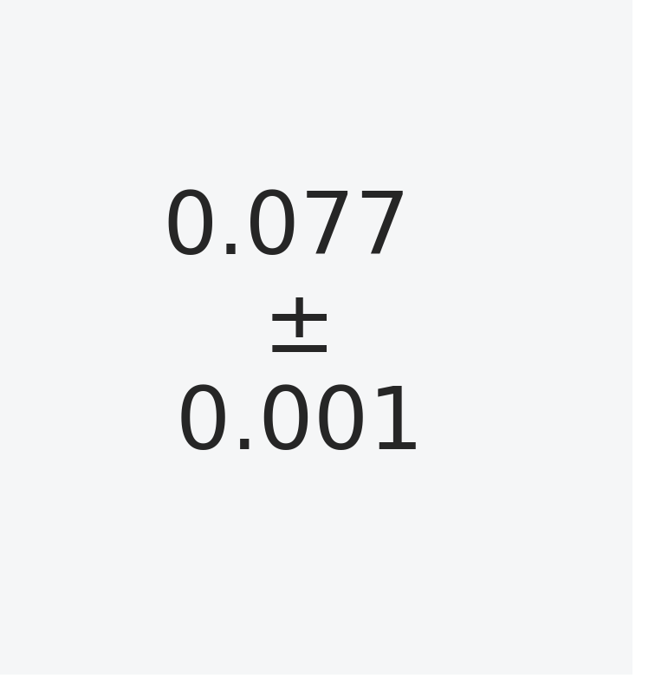
Prompt v. delayed: testing impact on w with simulations
Nicolas et al. (in prep)
Simulated world
Preliminary
Mass → m
Mass → m
age → x₁
age → m
age → x₁
Mass → m
Childress et al. (2013)
Assumed to be caused by age
Complete prompt v. delayed model:
Fitted world
Drift of stretch
Drift of SN mag
Mass → m
age → x₁
Input γ = 0.13
Older
Older
age → m
age → x₁
Nicolas et al. (2021)
Younger
Rigault et al. (2020)
Younger
Recovered γ
500 sims of 1000 SNe

Slide 16
Conclusion: prompt v. delayed model explains...
Redshift drift
Different magnitude steps
Bias up to 4%
Older
Rigault et al. (2020)
Nicolas et al. (in prep)
50 % young
Rigault et al. (2020)
Younger
Distance modulus µ
Nicolas et al. (2021)
Briday et al. (2021)
Betoule et al. (2014)
90 % young
This project has received funding from the European Research Council (ERC) under the European Union's Horizon 2020 Research and Innovation program (grant agreement no 759194 - USNAC)

Slide 18
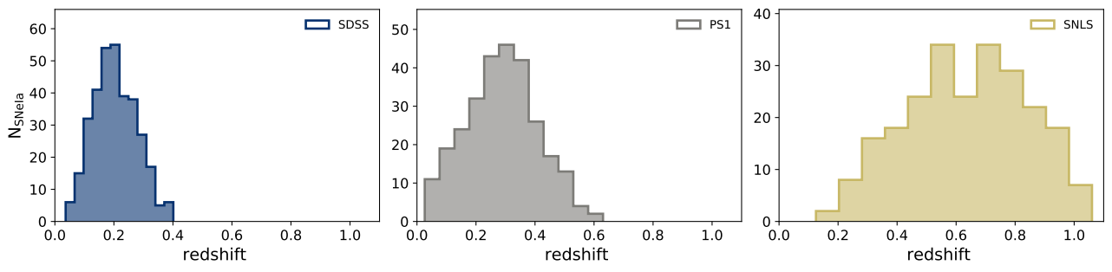
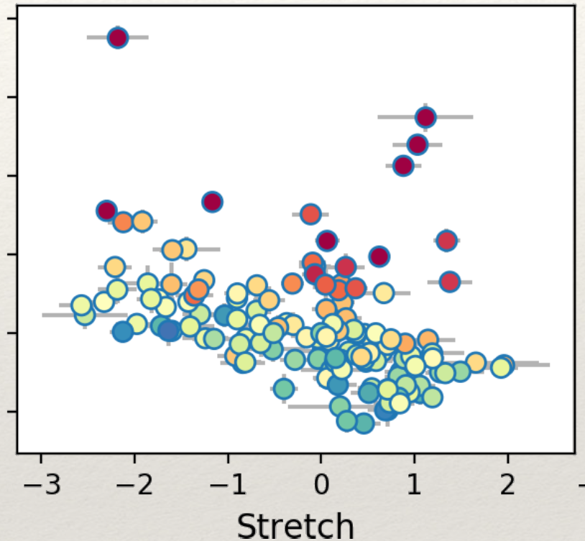
Complete sample – free from selection effects
Nicolas et al. (2021)
Fainter
Brighter

Slide 19
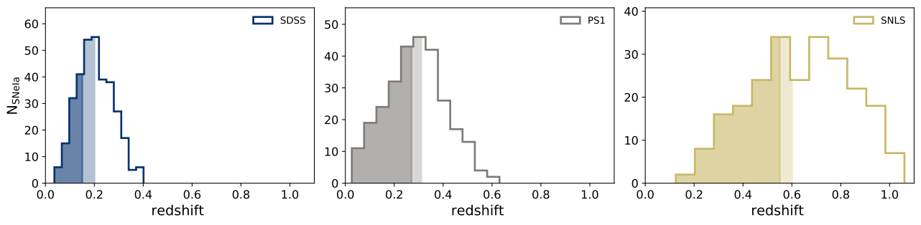
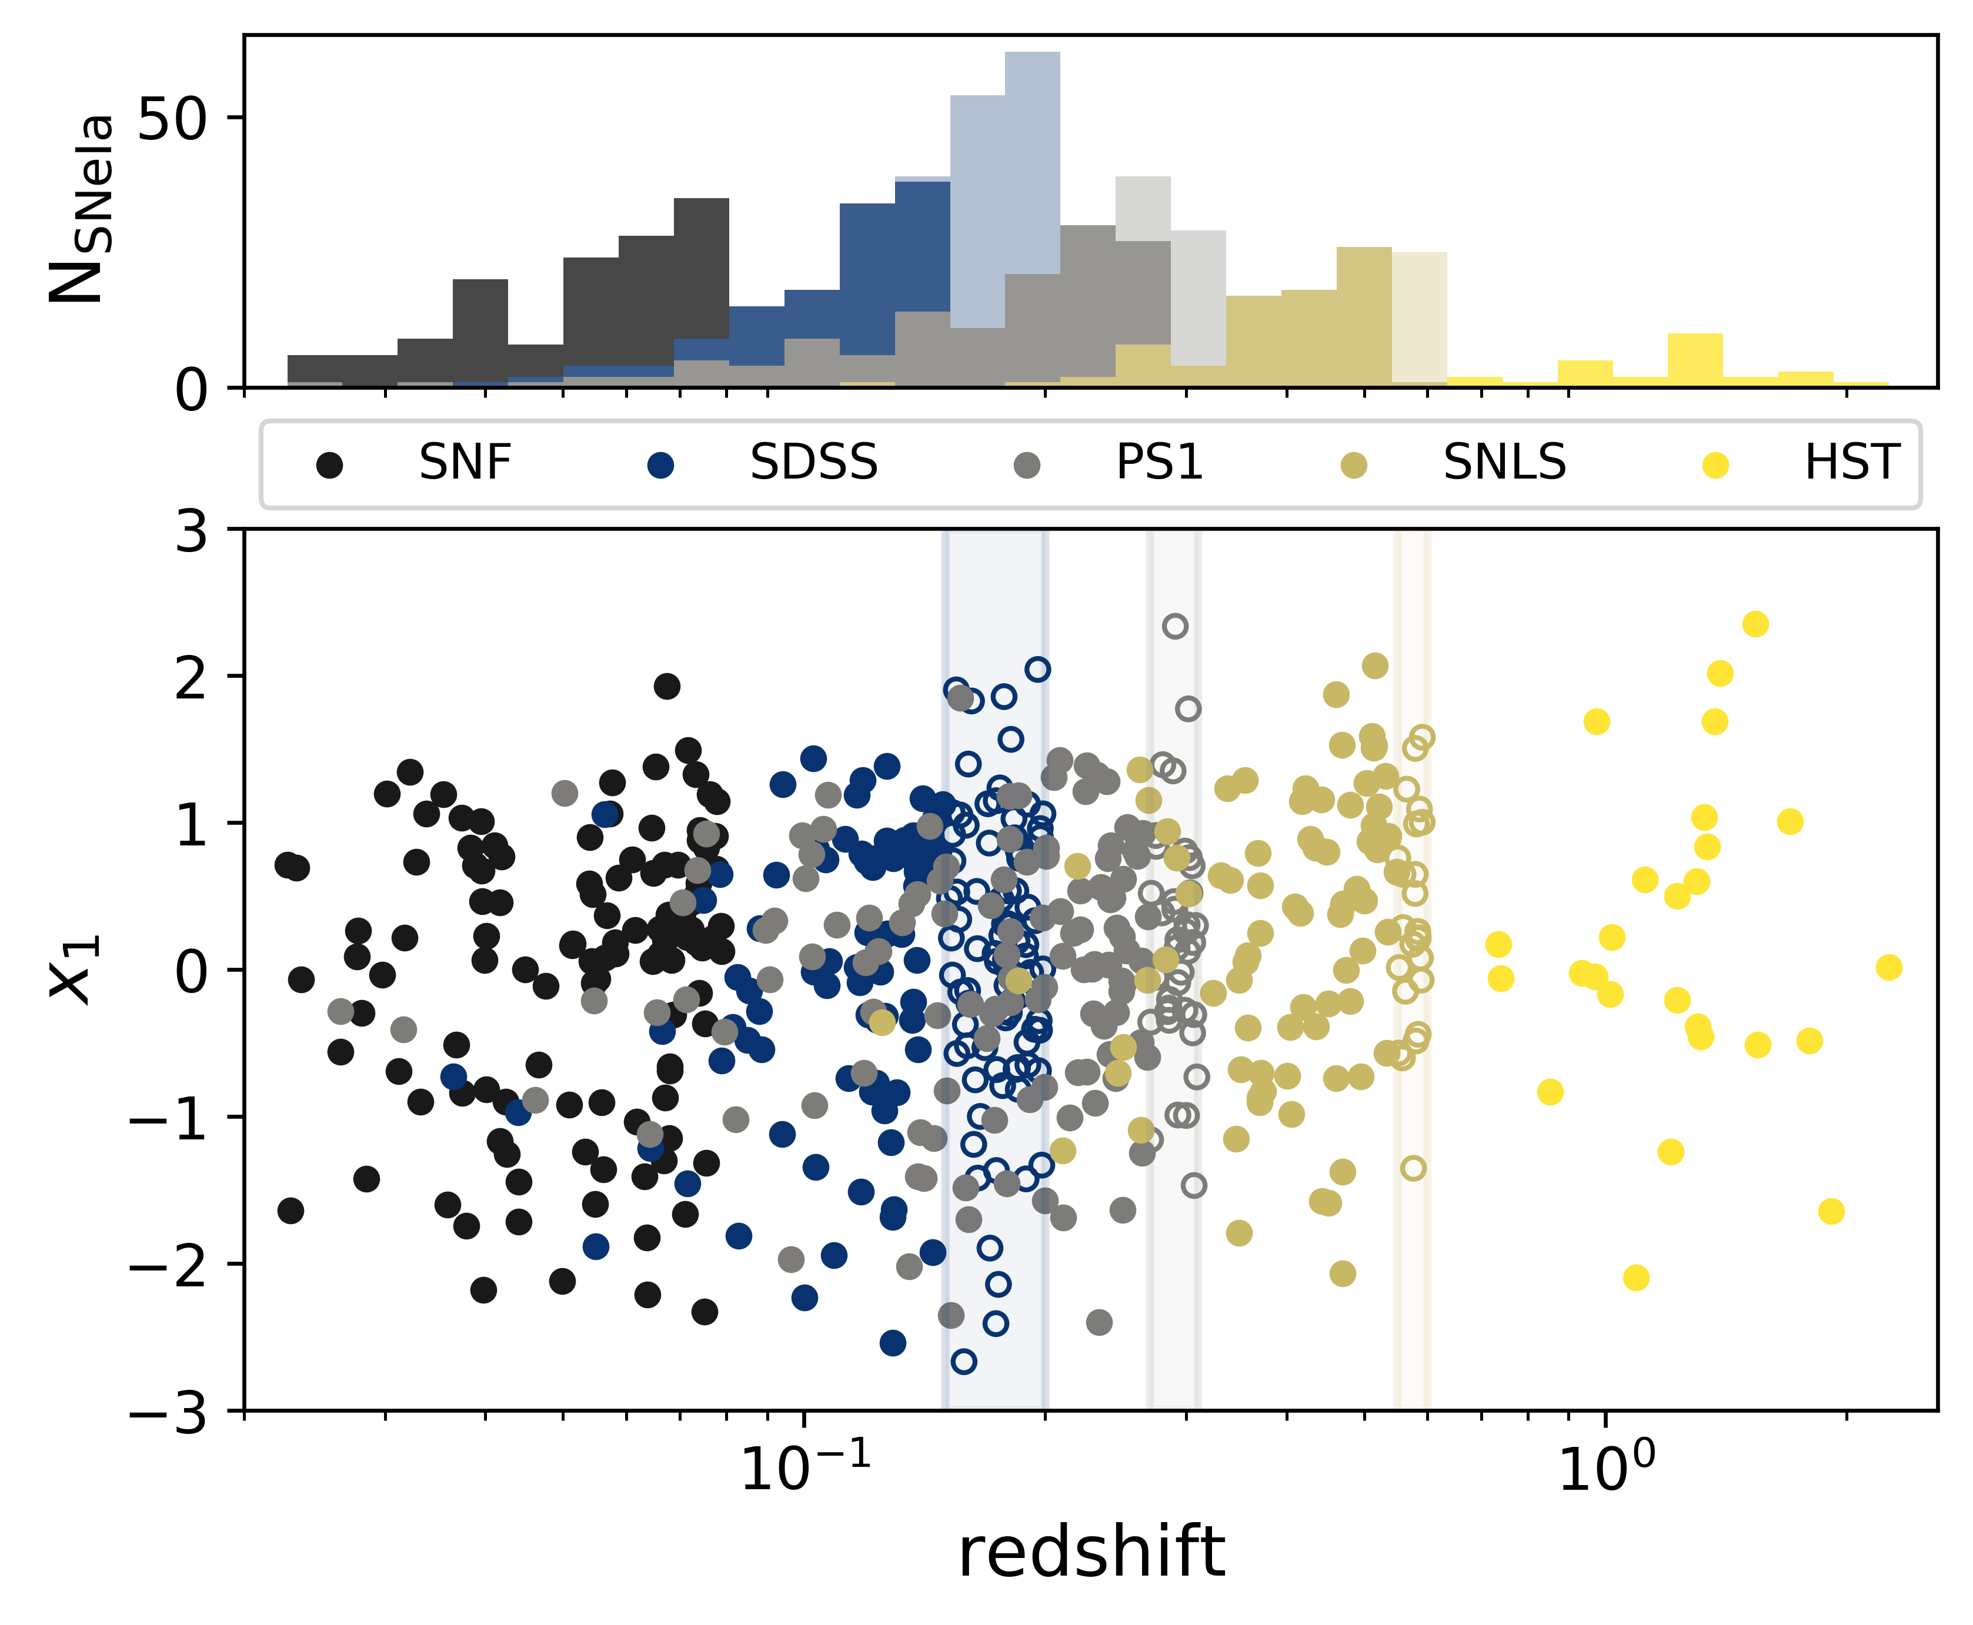
Complete sample – free from selection effects
Nicolas et al. (2021)

Slide 20
Complete sample – free from selection effects
Nicolas et al. (2021)

Slide 21
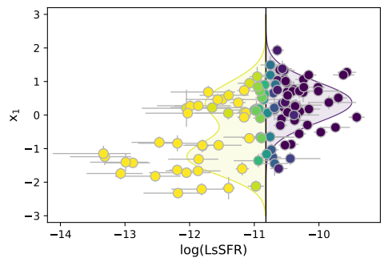
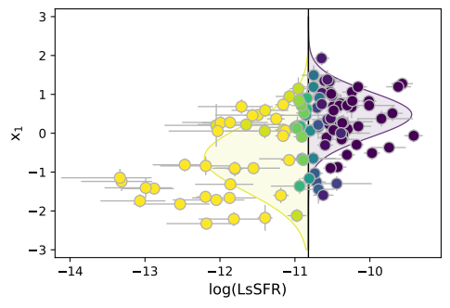
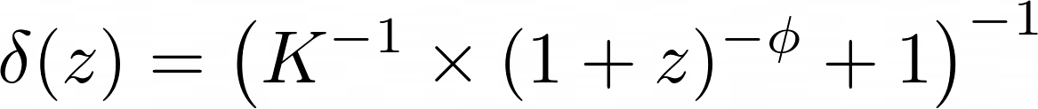

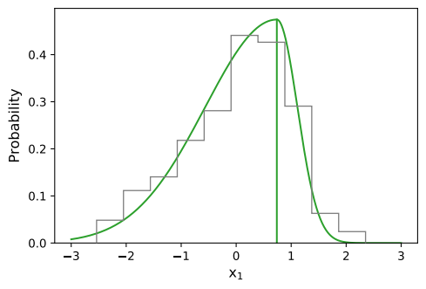
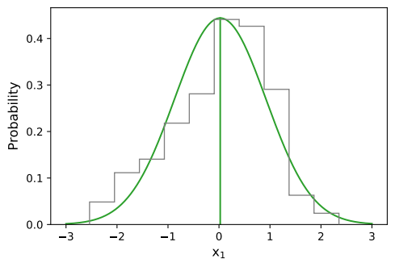
Other models
Nicolas et al. (2021)
Cf Howell et al. (2007)
Underlying stretch model per age population
Drift
N param = 5
N param = 4
+
Or no drift
Base
Howell
N param = 3
Asymmetric
N param = 2
Gaussian

Slide 22
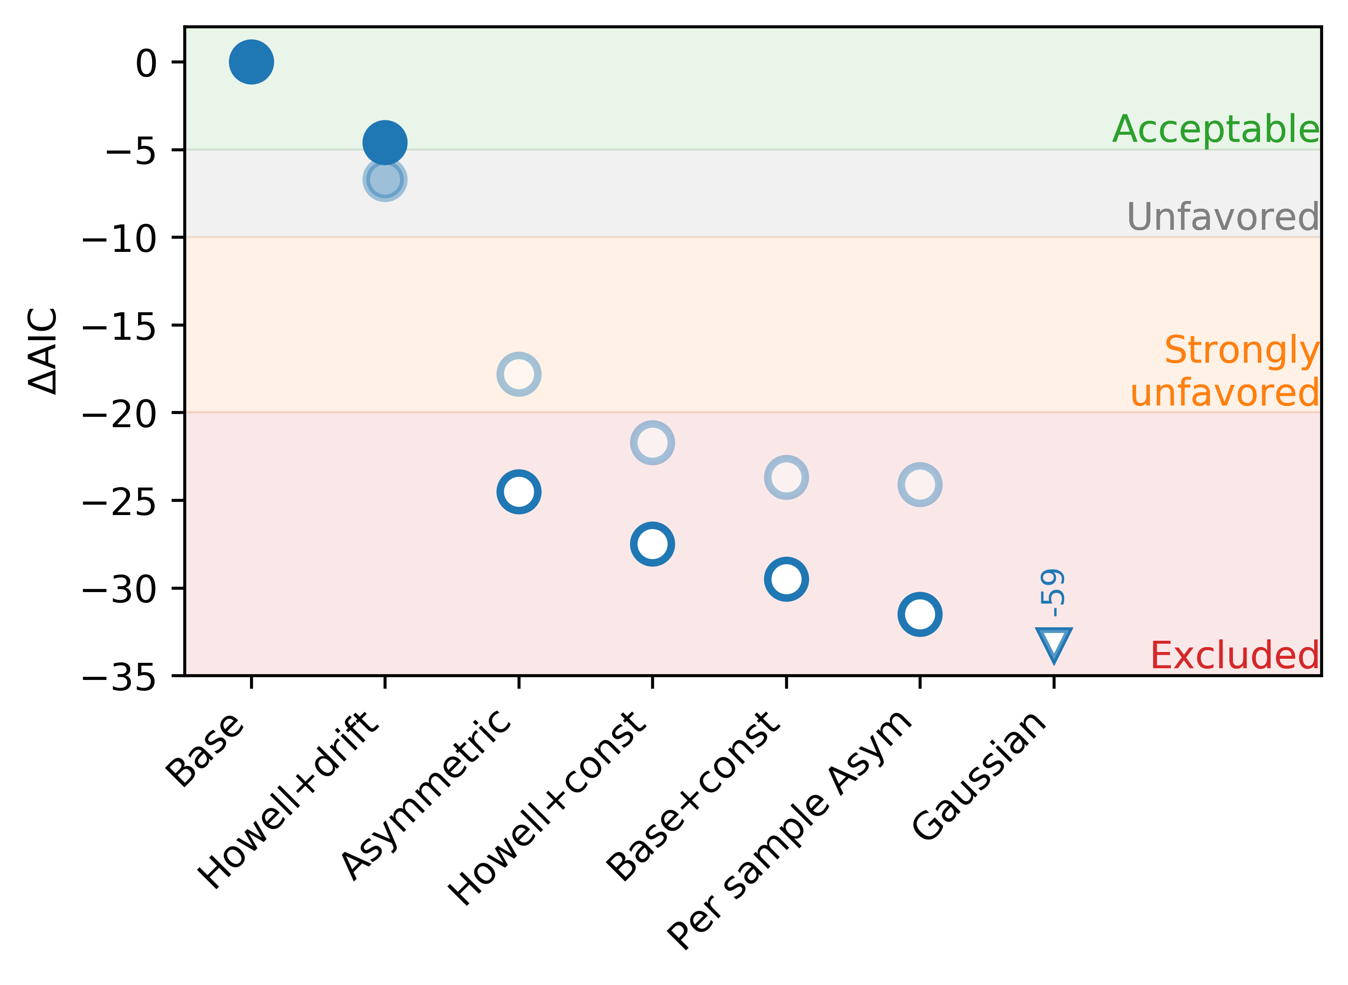
Comparison results
Nicolas et al. (2021)

