Slide 1

Bike Sharing Demand
Python project
Nora BOUKHATA
December 9th, 2020

Slide 2

Contex
Real time
Data/ bikes
Build a superior statistical model to
Predict the number of rental bikes
To learn how real time data is represented in datasets
Models :
- Ridge Regressor
- Random Forest Regressor
- Ada boost Regressor
- Bagging Regressor
- Kneighbors Reggressor

Slide 3
Agenda
Data Description
Data Analysis/Visualization
Machine learning Predictions
Optimal model

Slide 4
Agenda
Data Description
Data Analysis/Visualization
Machine learning Predictions
Optimal model

Slide 5
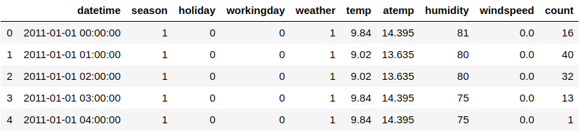
Data Description^{1/Original data}
Bike rentals
10 columns
10886 Rows
The data set is comprised of the first 19 days of each month
¹ : https://www.kaggle.com/c/bike-sharing-demand/data

Slide 6

Data Transformation
Understanding Data
Create time columns by splitting timestamp
Coerce holiday and season columns
Factorize training set and test set
New Data :
      10886 Rows X 17 columns
      Normalized data

Slide 7
Agenda
Data Description
Data Analysis/Visualization
Machine learning Predictions
Optimal model

Slide 8
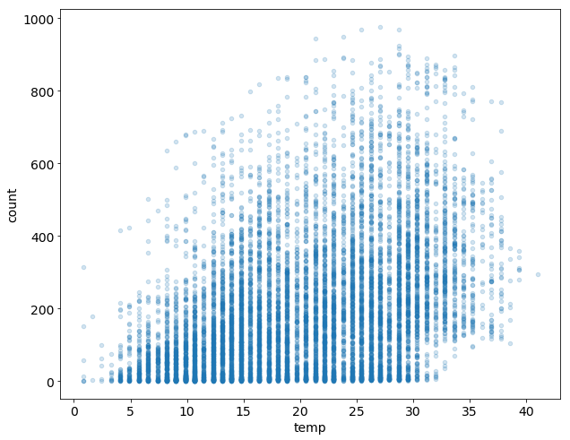
Bike rentals
throughout various
Temperatures
(Celsius)

Slide 9
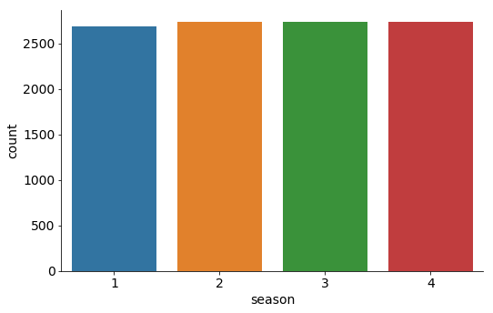
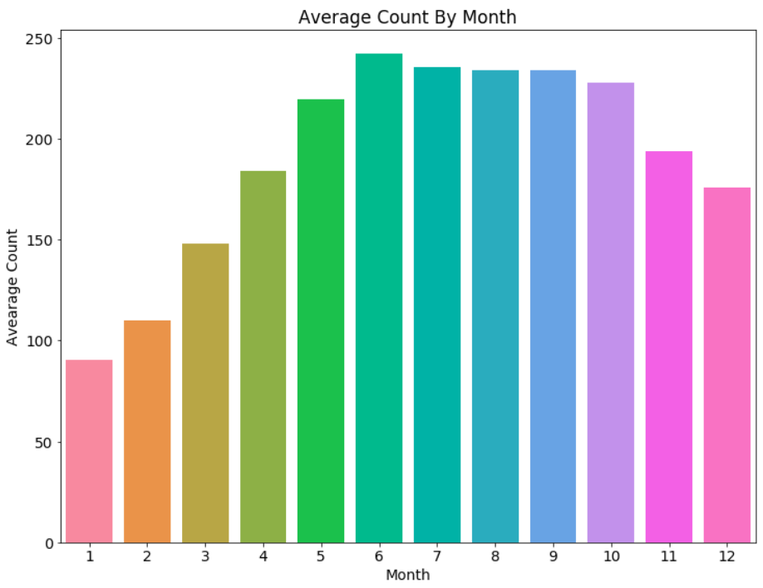
Season VS Month

Slide 10
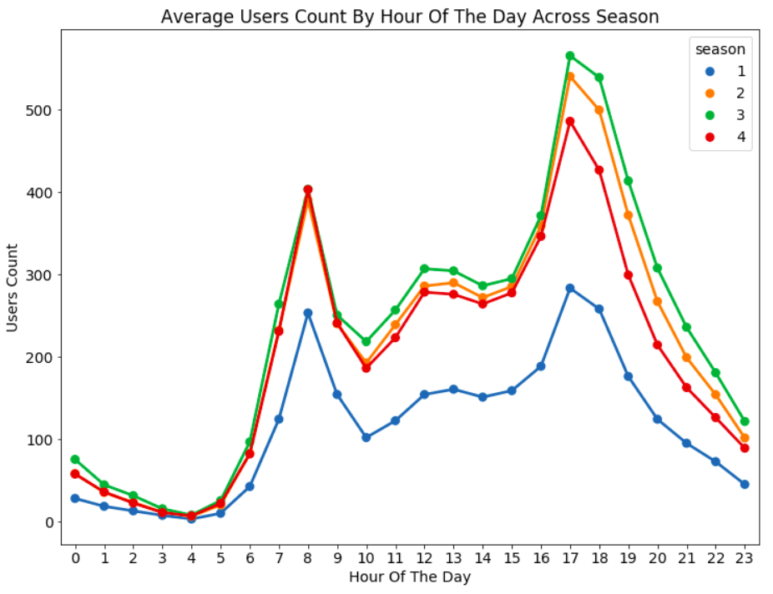
Bike rentals
By Hour of the
Day across
Season

Slide 11
Agenda
Data Description
Data Analysis/Visualization
Machine learning Predictions
Optimal model

Slide 12

Preprossed Methodology
Clean
Data
Analyze &
Visualize
Data
Removing
Null values
Building a
Regressor
model
Validate the
Model
Computing
Metrics
Coerce
columns
Data
partition
Pre-Processing

Slide 13
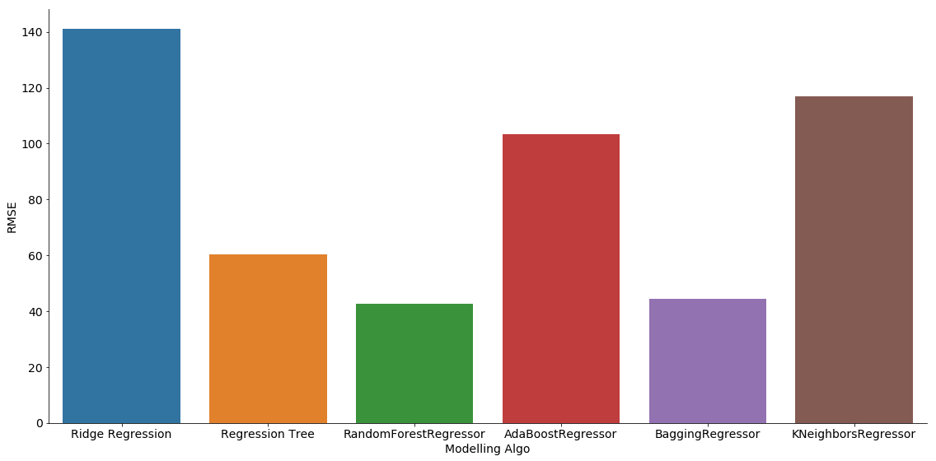
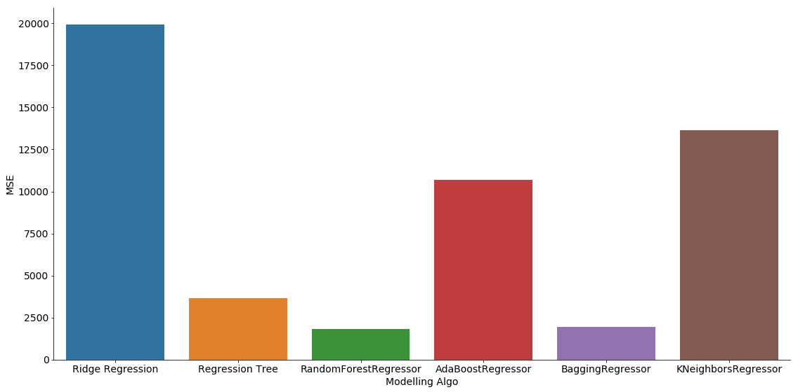
Results
² : https://scikit-learn.org/stable/modules/generated/sklearn.metrics.mean_squared_error.html
³ : https://scikit-learn.org/stable/modules/generated/sklearn.linear_model.Ridge.html
⁴ : https://scikit-learn.org/stable/modules/generated/sklearn.tree.DecisionTreeRegressor.html
⁵ : https://scikit-learn.org/stable/modules/generated/sklearn.ensemble.RandomForestRegressor.html
⁶ : https://scikit-learn.org/stable/modules/generated/sklearn.ensemble.AdaBoostRegressor.html
⁷ : https://scikit-learn.org/stable/modules/generated/sklearn.ensemble.BaggingRegressor.html
⁸ : https://scikit-learn.org/stable/modules/generated/sklearn.neighbors.KNeighborsRegressor.html
MSE ²
RMSE
Minimum of metrics
Random Forest Regressor

Slide 14
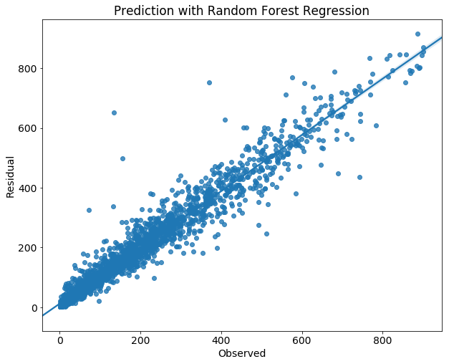
Random Forest Regressor
Predicted line
Training set : 8710
Test set : 2176
n_estimators : 400
RMSE = 42.7
MSE = 1822.6

Slide 15


