Slide 1
Using deep learning to track cells in single-cell biology
Nora Koe
Van Valen Lab
Mentors: David Van Valen, Erick Moen, Will Graf
Notes:
Interactions b/w cells

Slide 2
Tracking cells
Study dynamic cellular and sub-cellular interactions
Gain more information from single cell images
Observe changes within individual cells
Classify different cell types
Understanding viruses and diseases
Requires manual curation of data
Notes:
The ability to track cells allows researchers to

Slide 3
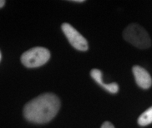
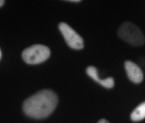

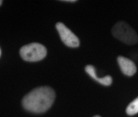
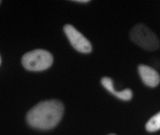
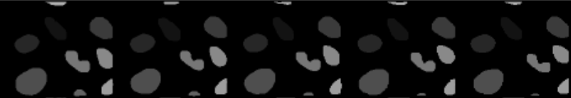
Tracking cells in microscope images
Raw
Frame 0
Frame 1
Frame 2
Frame 3
Frame 4
Annotated
Hard to teach due to dependency on information beyond two frames
Notes:
Tracking
What do we mean by producing tracks of cells. Image is array of numbers, labels. Deepcell
Daniel’s pipeline, scale of live cell experiments is limited by this ability to annotate data meaningfully.
Teach computer to do it for us

Slide 4
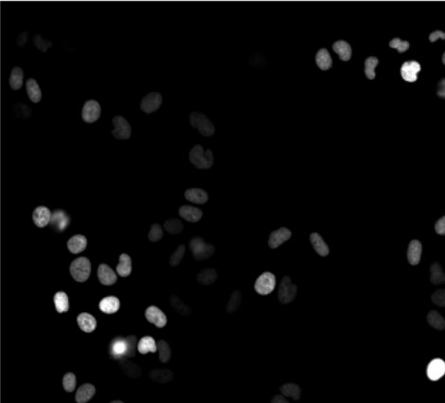
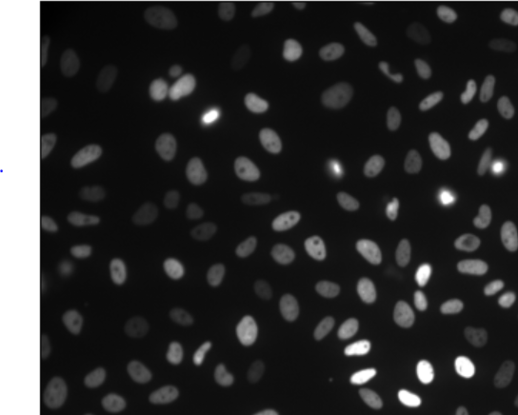
Classical approaches to tracking
Computation
Mass (area)
Intensity
Velocity
HeLa S3
NIH/3T3
Notes:
Parameters are case-specific,
Prof took these at Stanford, use neural networks to track

Slide 5
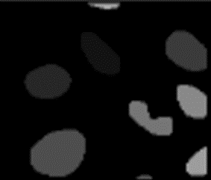
Track cells with model
Pairwise comparisons
Linear assignment of matching
label pairs
Tracked
Annotations
Raw image sequence
Frame i
Cost Matrix
Frame i+1
Annotations
(unique labels in each frame)

Slide 6
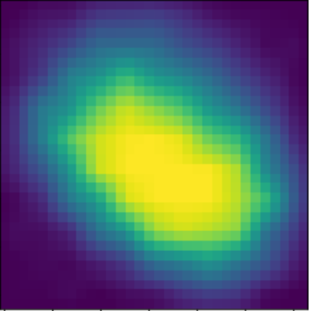
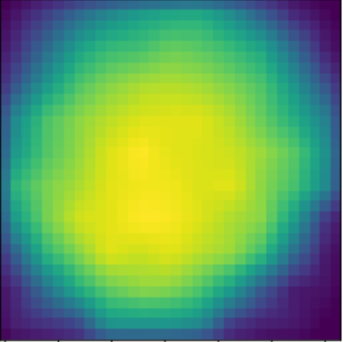
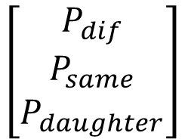
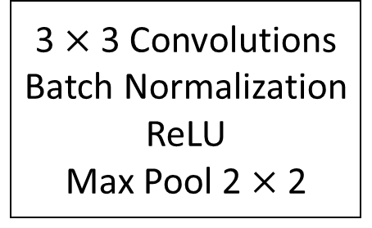
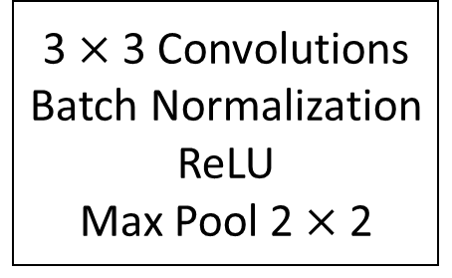
Neural Network Architecture
Centroid(s) 1
(Siamese Portion)
3 $×$ 3 Convolutions
Batch Normalization
ReLU
Max Pool 2 $×$ 2
3 $×$ 3 Convolutions
Batch Normalization
ReLU
Max Pool 2 $×$ 2
Output 1
LSTM
$$\left[\begin{matrix}P_{dif} \\ P_{same} \\ P_{daughter}\end{matrix}\right]$$
Image(s) 1
Dense
Output 2
Reshape
Centroid 2
Image 2
Notes:
DIFFERENTIATE CELLS. Tracking….Use deepcell for unique seg, division is rare
Flatten then dense, dense is fully connected…
Softmax optimization

Slide 7

Convolutional Siamese Network
3 $×$ 3 Convolutions
Batch Normalization
ReLU
Max Pool 2 $×$ 2
Notes:
ReLU (allows learning of nonlinear functions, interactions) – rectified linear unit (activation fn)
Convolutions are feature extractors (cell boundaries)
Batch Normalization keeps the distribution across output similar to input, keeps nn flexible as it grows
Max pool – downsampling

Slide 8
Long Short-Term Memory (LSTM)
Frames 0 to i Frame i + 1
Notes:
LSTM – long short-term memory – long term dependencies

Slide 9




Data generator
7
11
Frame 15/40
Frame 16/40
$$[ 70.1356 123.7804 ]$$
$$[ 54. 3921 248.6011 ]$$
Notes:
In training…., model input: Appearances, centroids

Slide 10
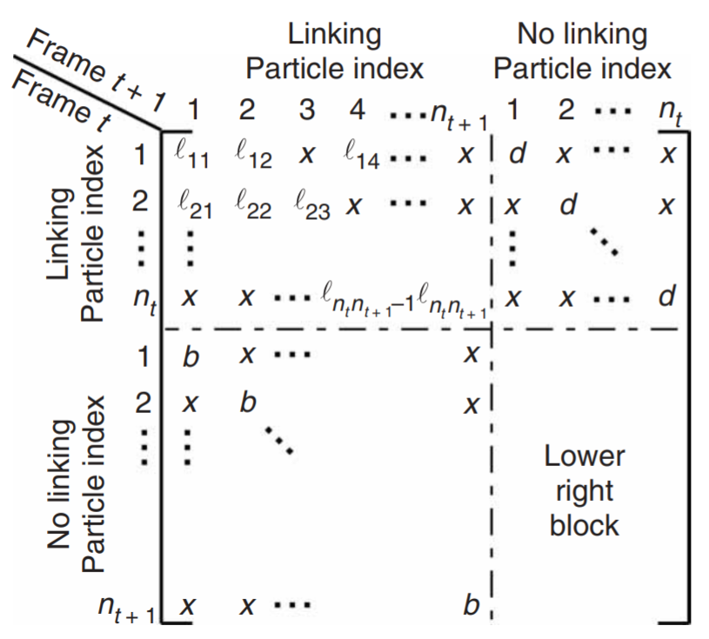
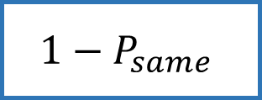
Cost Matrix
$$1−P_{same}$$
Threshold parameter d (deaths)
Threshold parameter b (births)
Jaqaman et al. (2008)
Notes:
How does the cost matrix work? Leverage the probability outputted from model.
Into linear assignment function – minimizes cost

Slide 11
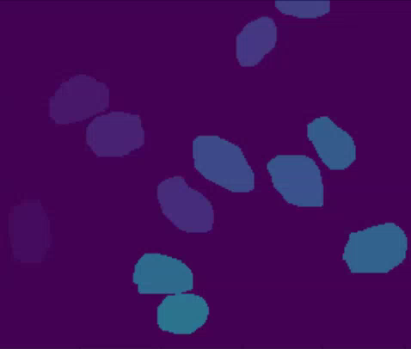
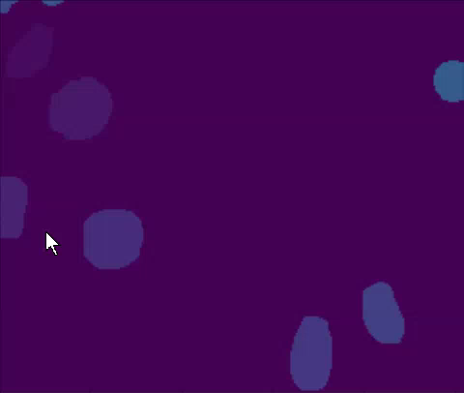
Results (8/2018)
Notes:
Left = pure tracking example
Right = two divisions, rare but interesting occurrences (difficult to teach)

Slide 12



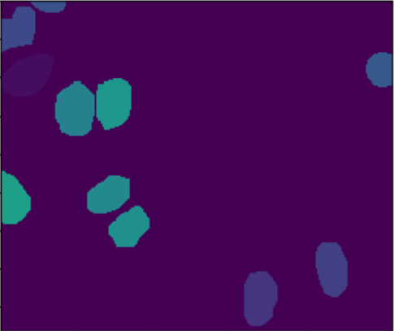
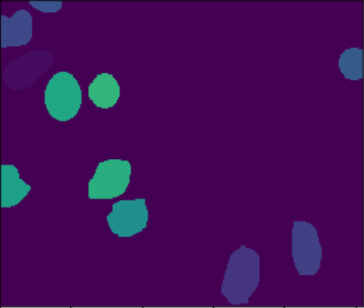
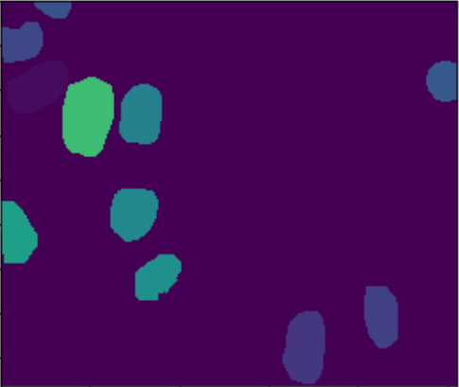
Notes:
Frames taken from second video. One of the daughter cells remains the same label while the rest oscillate.
…Data

Slide 13
Further work
Successive networks to determine same/different, then division classification
More accurate data to train on (divisions)
Other cells are not as homogeneous and move more
Notes:
Being able to track cells accurately, as well as follow cell lineages is important in studying single cells. These details allow for more insight and are the key to understanding viruses and diseases.

