Slide 1
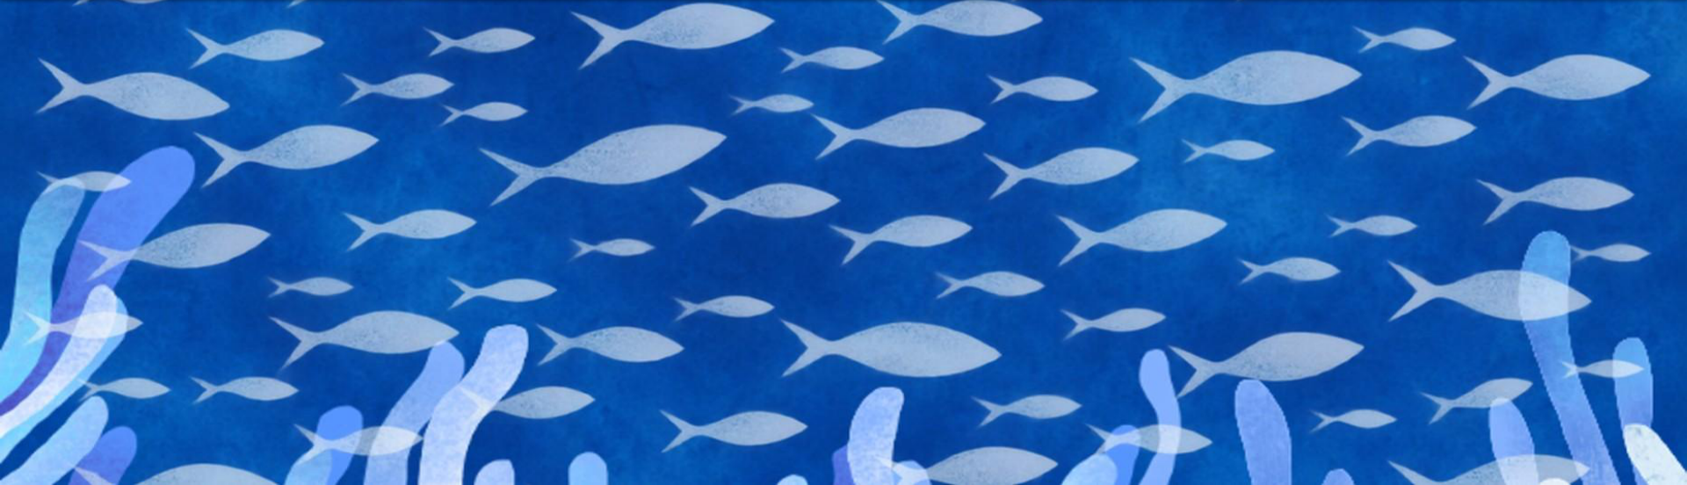
WEEK 07 · GROUP PROJECT
Ocean
Ocean life and tides projected onto everyday objects
Exploring how different surfaces change the image and the light around it.
Nora / Hanni / Yuki
Notes:
Our group project brings different parts of the ocean onto everyday objects. Hanni explores marine life and plastic pollution through hand-drawn artwork. Yuki connects fish, falling water and a fishbone image. My part uses a jellyfish on a vase and a changing tide on a reflective balloon. Together, we wanted the ocean to extend beyond the images into the surrounding space.
Sources: User explanation; Hanni PDF cover artwork reused for group cover.

Slide 2
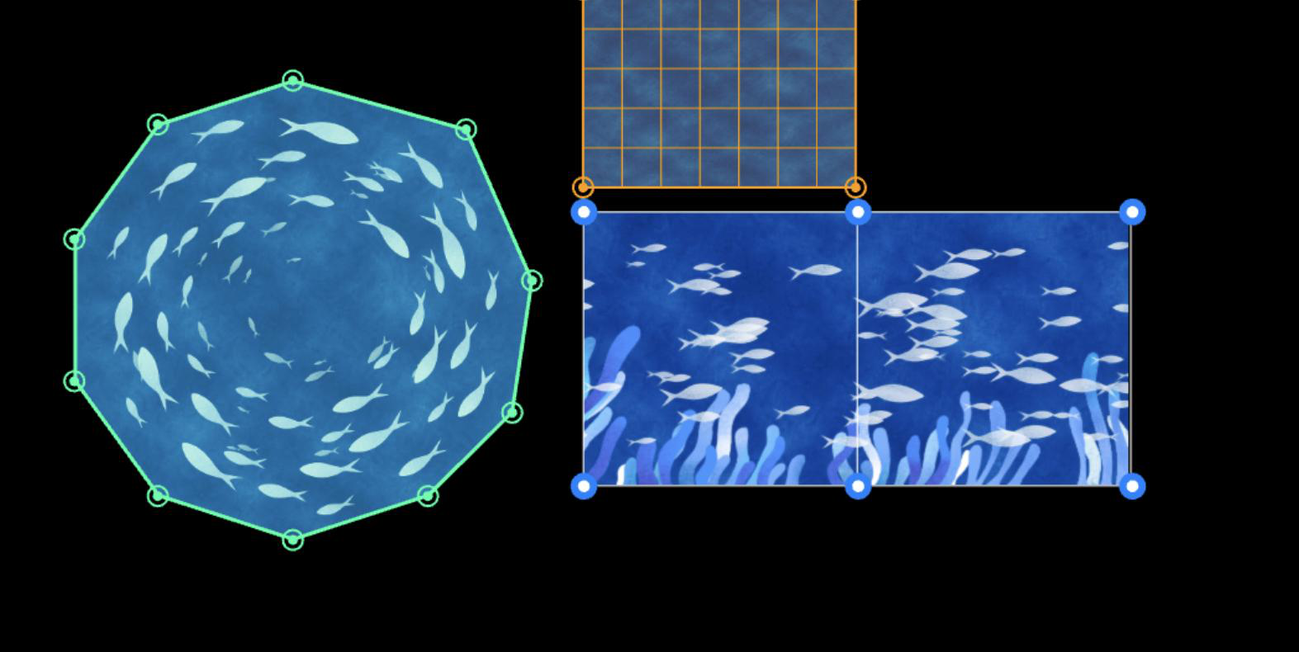
01 / CONCEPT
Underwater World
/ Hanni
My project explores the impact of ocean pollution on marine life through projection mapping. I created an underwater environment with swimming fish, swaying coral, and floating plastic waste. Through this contrast between beautiful marine life and plastic pollution, I hope to raise awareness of the threats facing our oceans.
WEEK 07 / CREATIVE CODING / PROJECTION MAPPING
02
Notes:
My project explores the impact of ocean pollution on marine life through projection mapping. I created an underwater environment with swimming fish, swaying coral, and floating plastic waste. Through this contrast between beautiful marine life and plastic pollution, I hope to raise awareness of the threats facing our oceans.
Sources: Week7_OceanNew.pdf, page 2. Text and layout rebuilt as editable PowerPoint objects; source artwork retained as separate images.

Slide 3
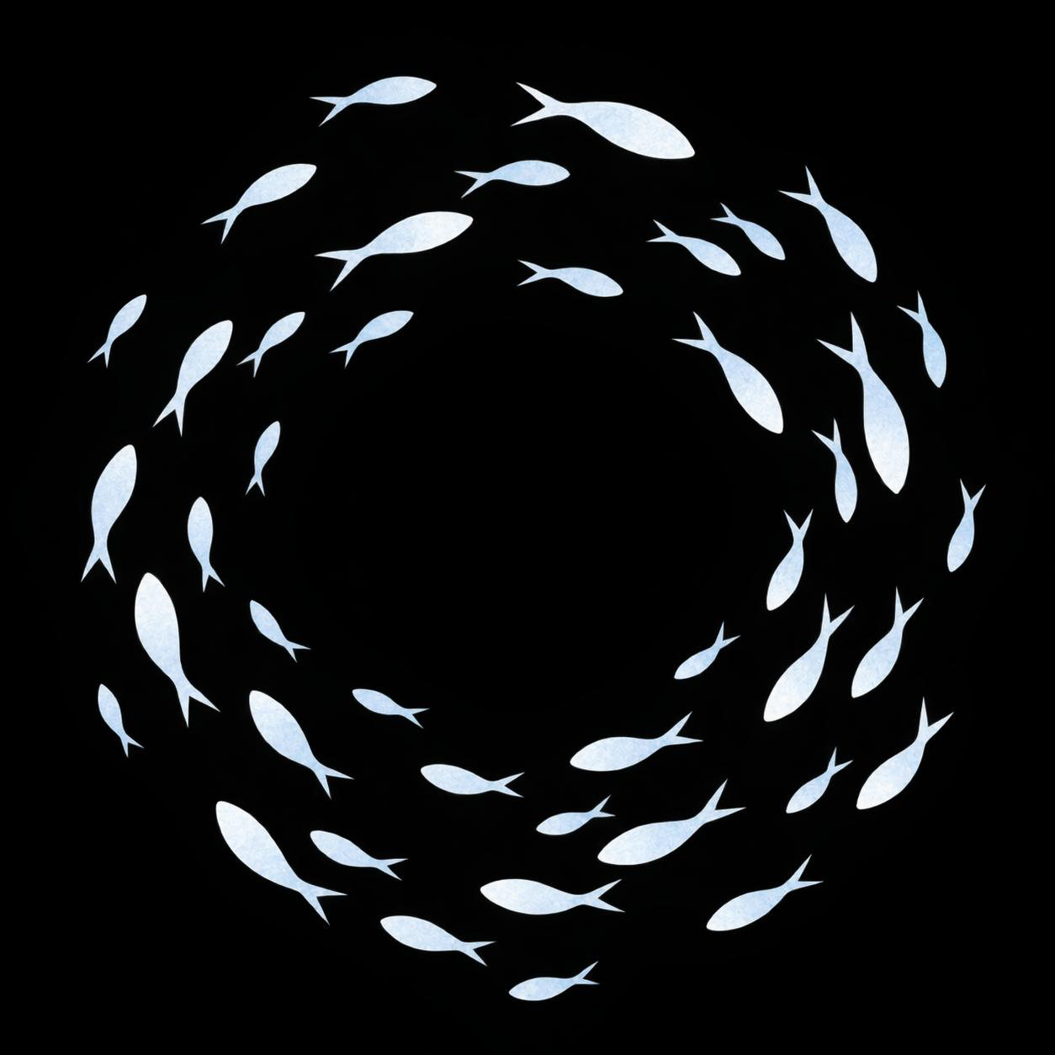
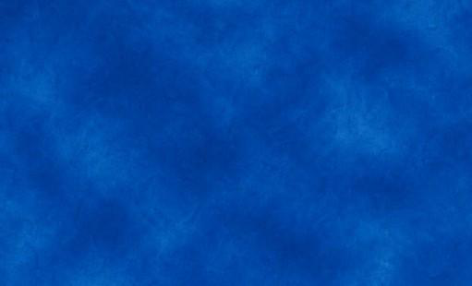
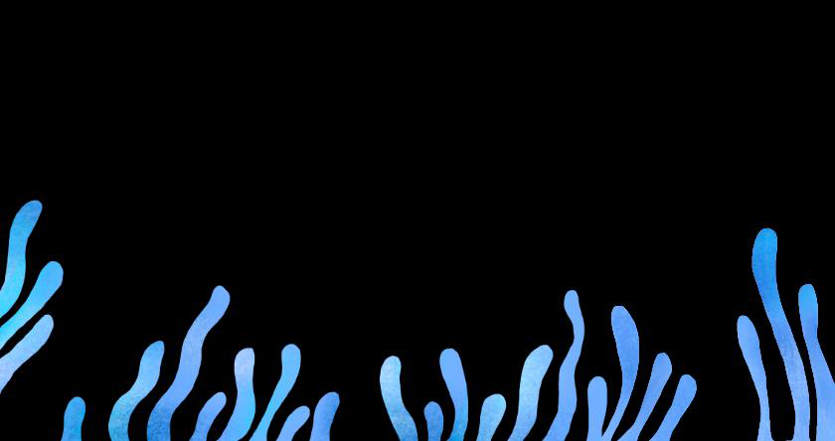
02 / VISUAL DIRECTION
From still images to layered animation
Watercolor textures and pale silhouettes establish a consistent visual language.
01 Watercolor base
02 Coral silhouettes
03 Fish + circular flow
I designed these elements as separate visual layers so I could control their movement independently.
WEEK 07 / CREATIVE CODING / PROJECTION MAPPING
03
Notes:
Watercolor textures and pale silhouettes establish a consistent visual language. I designed these elements as separate visual layers so I could control their movement independently.
Sources: Week7_OceanNew.pdf, page 3. Text and layout rebuilt as editable PowerPoint objects; source artwork retained as separate images.

Slide 4
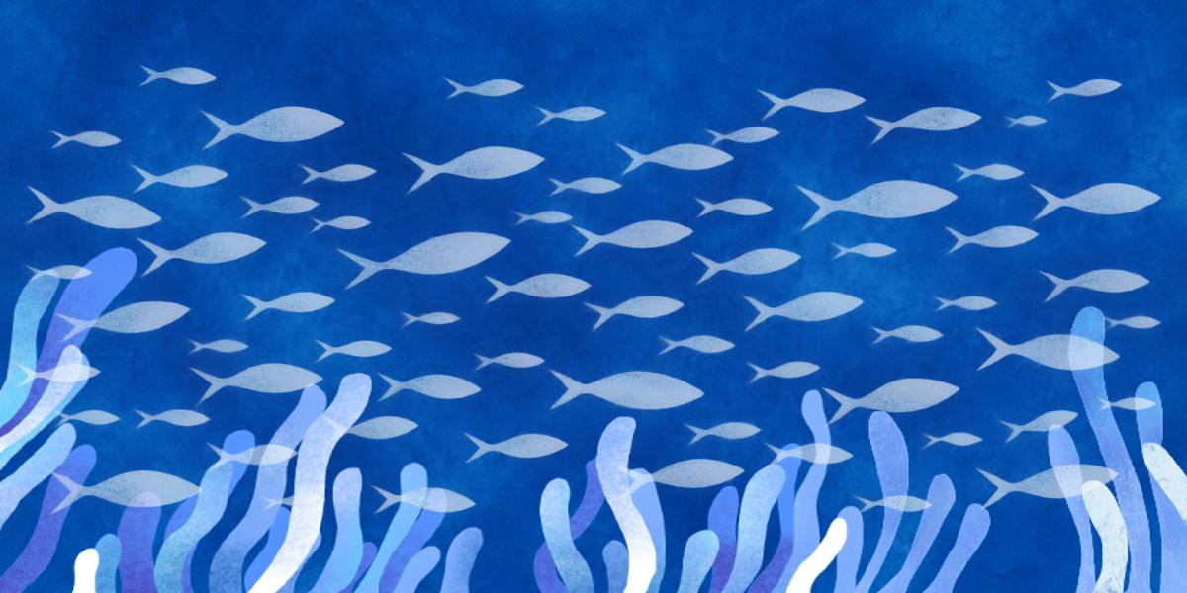
03 / CUBE ANIMATION
Three coral layers, one flowing ocean
The three coral layers sway at different speeds and rhythms.
BACKGROUND
CORAL 1 / 2 / 3
FISH
I used sine waves and a connected mesh to make the coral bend naturally.
The fish were later separated into individual sprites for more natural movement.
WEEK 07 / CREATIVE CODING / PROJECTION MAPPING
04
Notes:
The three coral layers sway at different speeds and rhythms. I used sine waves and a connected mesh to make the coral bend naturally. The fish were later separated into individual sprites for more natural movement.
Sources: Week7_OceanNew.pdf, page 4. Text and layout rebuilt as editable PowerPoint objects; source artwork retained as separate images.

Slide 5
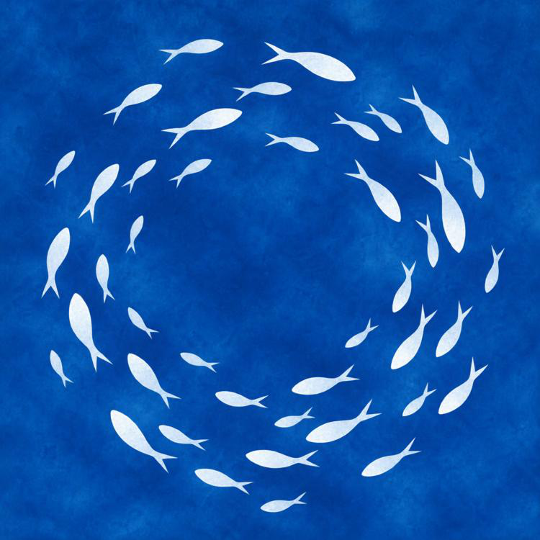
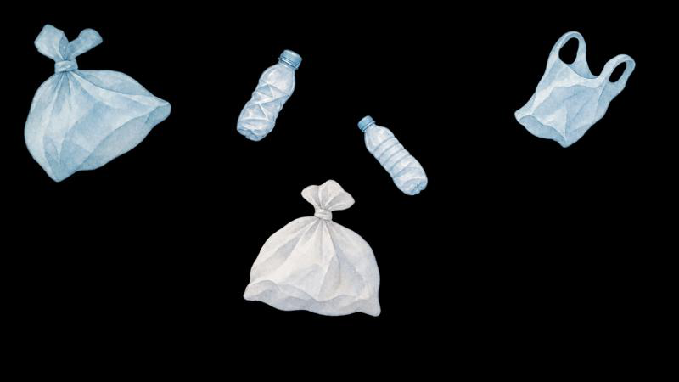
04 / UMBRELLA ANIMATION
Circular ocean currents
I drew the fish in Procreate and separated the visual elements into layers.
FISH
PLASTIC
WEEK 07 / CREATIVE CODING / PROJECTION MAPPING
05
Notes:
I drew the fish in Procreate and separated the visual elements into layers.
Sources: Week7_OceanNew.pdf, page 5. Text and layout rebuilt as editable PowerPoint objects; source artwork retained as separate images.

Slide 6
05 / REFLECTION
What I learned
Projection mapping changed how I think about animation and physical materials.
I had to consider the physical edges, the connection between surfaces, and how motion should respond to form.
WEEK 07 / CREATIVE CODING / PROJECTION MAPPING
06
Notes:
Projection mapping changed how I think about animation and physical materials. I had to consider the physical edges, the connection between surfaces, and how motion should respond to form.
Sources: Week7_OceanNew.pdf, page 6. Text and layout rebuilt as editable PowerPoint objects; source artwork retained as separate images.

Slide 7
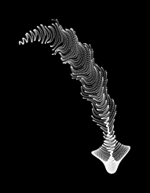
NORA / JELLYFISH
A small ocean inside a vase
/ Nora
A drifting creature built from a compact mathematical formula.
I wanted the jellyfish to feel as if it were swimming naturally inside the vase.
I adjusted the reference code while keeping its delicate, continuous movement.
Formula: @yuruyurau
MATLAB adaptation: Mike Croucher
p5.js modification and mapping: Nora
WEEK 07 / CREATIVE CODING / PROJECTION MAPPING
Notes:
For the vase, I wanted to create the feeling of a jellyfish swimming naturally in the sea. I was surprised that such an organic shape could come from a short mathematical formula. I used a MATLAB adaptation of work by the artist yuruyurau as a reference, then modified the animation for my p5.js projection. I experimented with the shape and proportions, but kept the delicate motion that attracted me to the original.
Sources: https://x.com/yuruyurau ; https://blogs.mathworks.com/matlab/2025/07/29/pair-programming-with-claude-to-produce-computational-art-in-matlab/ ; user explanation. Image is a cropped software preview.

Slide 8
NORA / MATERIAL TEST
The balloon changed the idea
A reflective surface suggested a different role for the animation.
Initial idea
What I noticed
I began with a more detailed ocean pattern. On the smooth foil balloon, the image was difficult to read.
The reflected light reminded me of soft, shimmering water. I decided to use that effect to create atmosphere around the installation.
WEEK 07 / CREATIVE CODING / PROJECTION MAPPING
Notes:
My first idea for the balloon was a more complicated ocean pattern. When I projected it onto the smooth, reflective surface, I could barely read the details. But the reflected light was interesting. It reminded me of gentle light shimmering on the sea. I decided to work with that material property and use the balloon to add moving ambient light to the whole installation.
Sources: User’s account of actual balloon projection test, supplied in voice transcript.

Slide 9

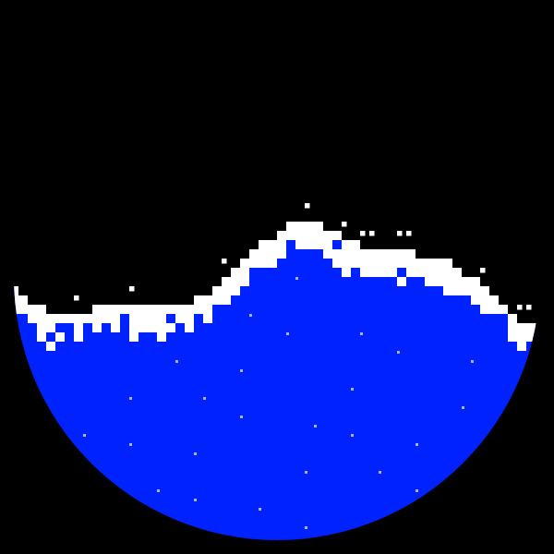
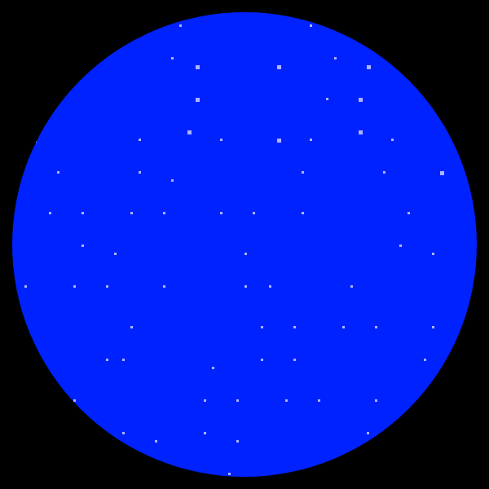
NORA / TIDE ANIMATION
A tide that fills and disappears
Large changes in brightness create a moving field of reflected light.
01 Empty
02 Rising water
03 Full
WEEK 07 / CREATIVE CODING / PROJECTION MAPPING
Notes:
I simplified the image into blue water and white foam. The balloon already has a square pattern, so I used pixels to connect the animation to its surface. The water rises until it fills the circle and falls until it disappears. That large change in the bright area is meant to make the reflected light move through the space. The sequence here is a software preview of the tide.
Sources: scenes/nora.js; user explanation. Images: software previews, not photographs.

Slide 10
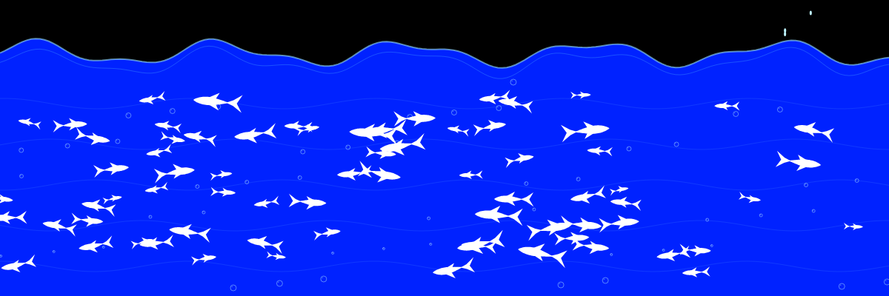
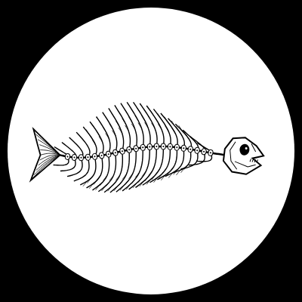
YUKI / CONNECTED SCENES
Living fish, falling water, a fishbone
The scenes connect the upper cube, lower cube and plate.
Fish move across the upper cube.
Water appears to fall toward Hanni’s lower cube.
The fishbone on a plate adds a contrast to the living ocean.
WEEK 07 / CREATIVE CODING / PROJECTION MAPPING
Notes:
The two cubes are intended to work together. The upper cube contains swimming fish, and the falling water visually connects it to the lower cube, where Hanni’s scene continues. We also use a plate with a fishbone animation. The fishbone creates a contrast with the living fish and connects to Hanni’s concern about plastic pollution. Yuki can explain the animation choices in more detail.
Sources: User description of installation arrangement; scenes/yuki-ocean-white.js and scenes/yuki-fishbone.js. Software previews.

Slide 11
GROUP / INSTALLATION
The objects form one environment
Different surfaces give each animation a different role.
Upper and lower cubes
Vase
Fish and falling water connect to the coral scene below.
The jellyfish creates the feeling of a small, contained ocean.
Plate and umbrella
Reflective balloon
A fishbone contrasts with living fish. Plastic waste interrupts the underwater scene.
The tide adds changing reflected light around the objects.
WEEK 07 / CREATIVE CODING / PROJECTION MAPPING
Notes:
The objects have different roles in the overall scene. The cubes carry the connected underwater images. The plate and umbrella bring in the contrast between marine life and harm. The vase contains a small drifting creature. The balloon extends the work through reflected light. What interested me most was how the material could change the direction of the design, as it did with the balloon.
Sources: User’s description of proposed arrangement and actual balloon test; Hanni PDF concept and reflection.

