Slide 1

Note: The data and information in this document is reflective of a hypothetical situation and client. This document is to be used for KPMG Virtual Internship purposes only.
Sprocket Central Pty Ltd
Data analytics approach
[Division Name] - [Engagement Manager], [Senior Consultant], [Junior Consultant]

Slide 2
Note: The data and information in this document is reflective of a hypothetical situation and client. This document is to be used for KPMG Virtual Internship purposes only.
Agenda
Introduction
Data Exploration
Model Development
Interpretation

Slide 3
Note: The data and information in this document is reflective of a hypothetical situation and client. This document is to be used for KPMG Virtual Internship purposes only.
Introduction
New customers analysis
Age distributions
Number of bike purchases in 3 years / percentages purchases
Job industry category.
Wealth segments
Number of cars own on each states

Slide 4
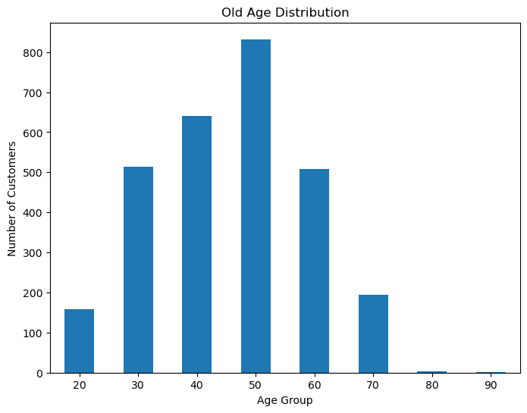
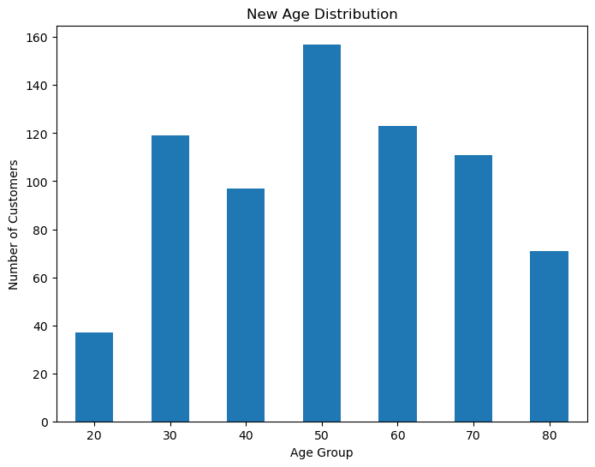
Note: The data and information in this document is reflective of a hypothetical situation and client. This document is to be used for KPMG Virtual Internship purposes only.
Data Exploration
Customers’ age distribution
As we can see, mostly our new customers are between 50 to 80 years old.
Number of customers of 40 and 60 years- old group has big drops on percentages.
There is a slightly increase in number of customers over 60 years old in term of percentages
It looks like the percentages of under 30 years old not really change.

Slide 5
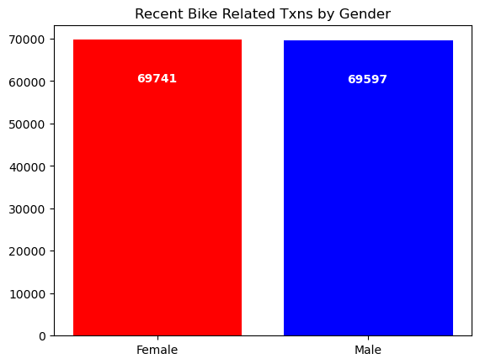
Note: The data and information in this document is reflective of a hypothetical situation and client. This document is to be used for KPMG Virtual Internship purposes only.
Model Development
Bike purchases last 3 years
As we can see, our new female customers purchase slightly more than male customers. So we should focus on advertises on Female customers than Male customers

Slide 6
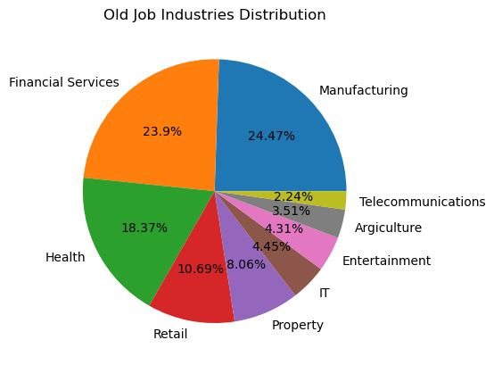
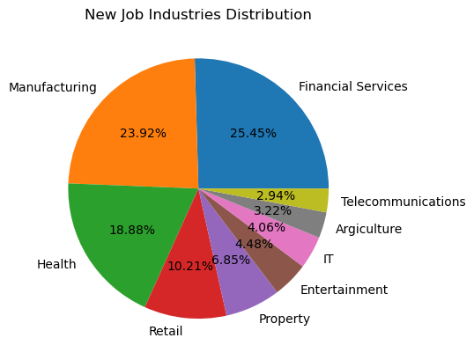
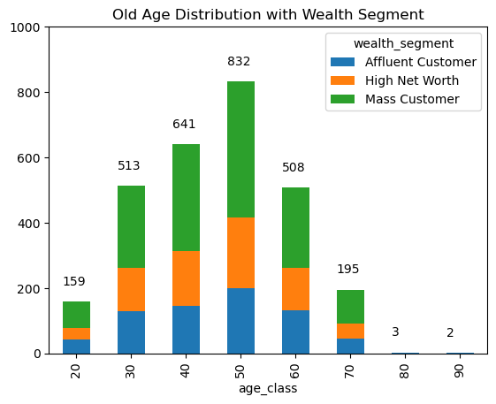
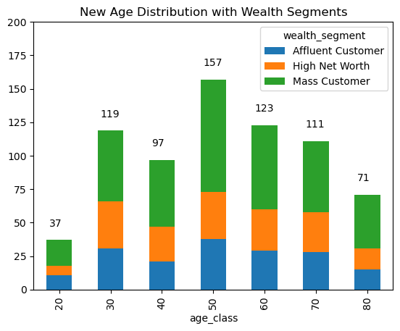
Note: The data and information in this document is reflective of a hypothetical situation and client. This document is to be used for KPMG Virtual Internship purposes only.
Interpretation
Job industry category
Mostly our new customers are on Finance industry and Manufacturing and Health customers are still on top 3.
The rest industries is still same, rarely changed
Wealth segments
Across all age groups, the number of Mass Customers is the highest so we should focus on this social class.
After that, we should focus on High Net Customer.

Slide 7
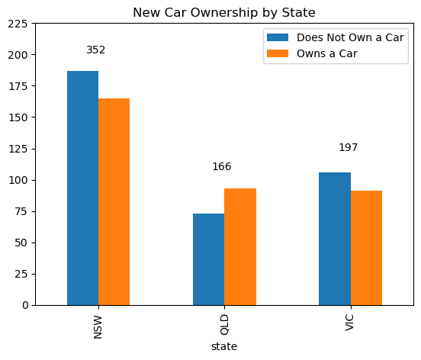
Note: The data and information in this document is reflective of a hypothetical situation and client. This document is to be used for KPMG Virtual Internship purposes only.
Interpretation
Numbers of cars owned
NSW should be considered the most since numbers of customers don’t own cars is significantly larger than that own.
VIC and QLD has more customers that own car that who don’t but we can try to have something so that those owns car will buy bikes.

Slide 8
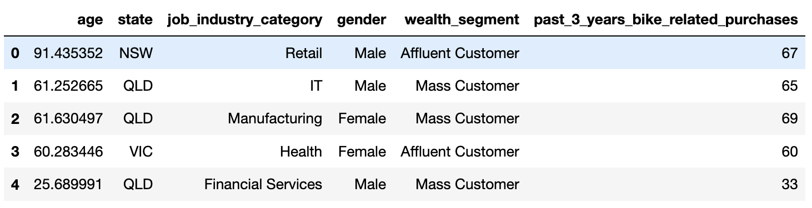
Note: The data and information in this document is reflective of a hypothetical situation and client. This document is to be used for KPMG Virtual Internship purposes only.
Example dataframe

Slide 9
Note: The data and information in this document is reflective of a hypothetical situation and client. This document is to be used for KPMG Virtual Internship purposes only.
Appendix

Slide 10
Note: The data and information in this document is reflective of a hypothetical situation and client. This document is to be used for KPMG Virtual Internship purposes only.
Appendix
https://github.com/NoraaaaaY/KPMG-data_analytical_project/blob/main/KPMG%202%20(1).ipynb

