Slide 1
COVID 19 – ARABIC TWEETS
NLP PROJECT
NORA AHSHLAWI - 2021

Slide 2
PROJECT GOAL
Displaying some of the Arabic tweets about vaccination.
Highlight the classification of opinions between agree and disagree with taking vaccination.

Slide 3
PROCESSING DATA
- Sample data from July Arabic tweets.
- The size of data : 497
- Data classified to : Neg- Neu and Pos
- Testing data size: 0.33

Slide 4
Building The Model
497
Tweets that’re belong to verified accounts or have links are excluded.
Tokenization is token and stop words are removed then lemma and stemmer is token but the model accuracy was low therefore the model is trained without taking these steps which result in increasing the accuracy more than 5%.
Linear support vector classification and logistic regression are applied and the accuracy is better in LSV.
The model is used to classified more than 70,000 Arabic tweets in June – 2021.
1
2
3
4

Slide 5
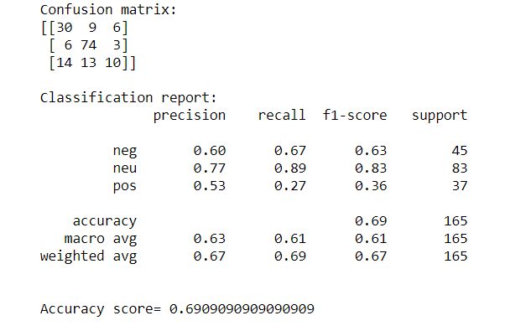
Model Output
Data size is 497.
Data split to train and test where the size of data = 0.33.
The accuracy with text processing is 0.6
The accuracy using the text without processing is 0.69

