Slide 1
Credit Card Churn🏦
Norah Fahad | Rahaf Alhazmi

Slide 2
Table of contents
01
04
Idea & Problem
Dataset visualization
02
05
Dataset description
Prediction: Random Forest
03
06
Dataset cleaning
Deployment: gradio

Slide 3
01
Idea & Problem
What is Credit card churning?
What is the Business Problem?

Slide 4
Idea & Problem
Credit card churning:
is the process of opening cards for the sole purpose of earning welcome bonuses or other benefits. Usually, it involves closing cards after the bonus posts to your account and before the next annual fee is charged. A pattern of opening and closing cards quickly is often a red flag for card issuers.🤑
Business Problem:
A business manager of a consumer credit card bank is facing the problem of customer attrition. They want to analyze the data to find out the reason behind this and leverage the same to predict customers who are likely to drop off.💳

Slide 5
02
Dataset description
What is the data shape?
Explenasion of columns

Slide 6

Dataset shape
Columns
23
Rows
10127

Slide 8
03
Dataset cleaning

Slide 9
Understanding the problem
Check for null and duplicates
Drop unnecessary columns
Change data types
From object to category Attrition_Flag, Gender Education_Level, Marital_Status Income_Category, Card_Category
There is no null nor duplicate values
CLIENTNUM
And the last two columns

Slide 10
04
Dataset visualization
Categorical Data
Numerical Data

Slide 11
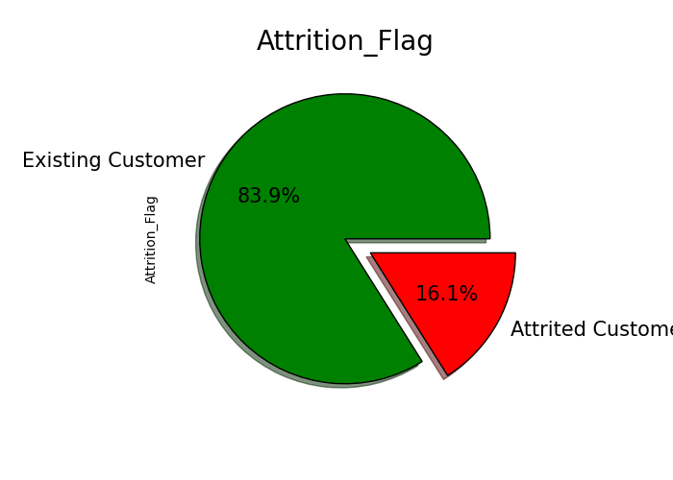
Categorical Data: Attrition Flag
Existing customer is about 83.9% of the total customer and we have 16.1% attired customer

Slide 12
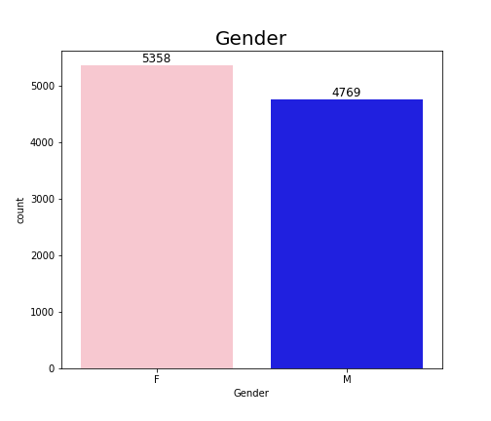
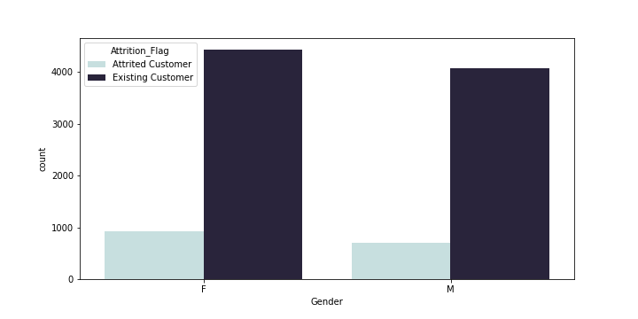
Categorical Data: Gender
The female customer more than male - Females existing more than male existing
Female attrited more than male attrited

Slide 13
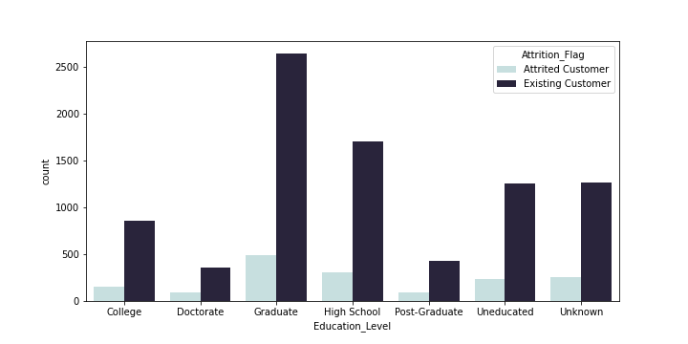
Categorical Data: Education Level
Most of the attrited customer are graduated

Slide 14
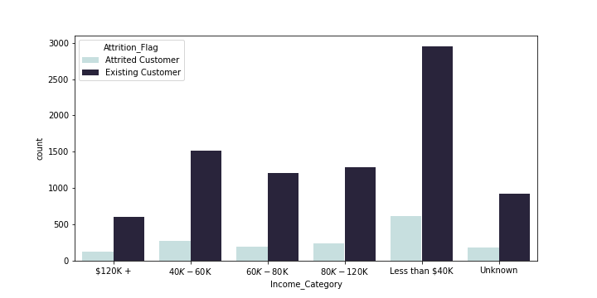
Categorical Data: Income Category
Most existing and attrited customer have a annual income of less than $40K

Slide 15
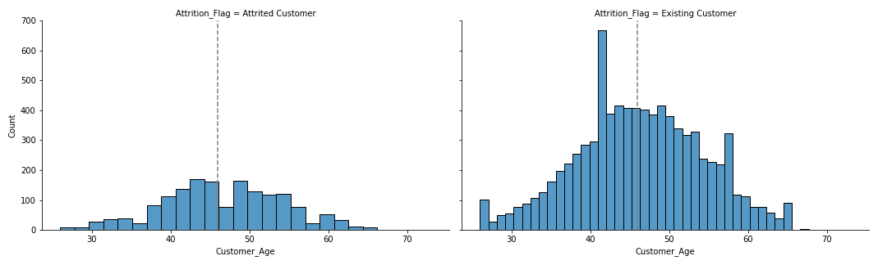
Numerical Data: Customer Age
The customer is between 26 and 73 years old - Most of the customer are between 42 and 55 - The mean is about 43 years old

Slide 16
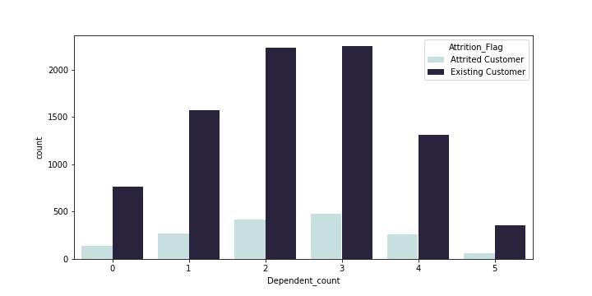
Numerical Data: Dependent count
Existing and attrited customer have 3 or 2 dependent

Slide 17
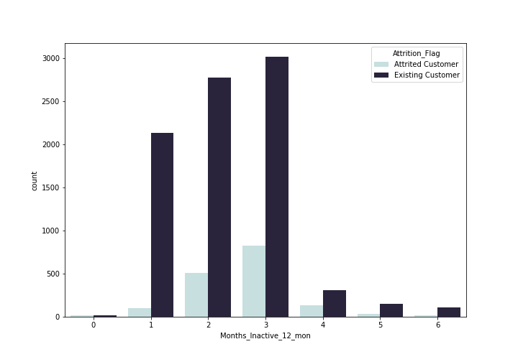
Numerical Data: # Months Inactive in last year
Customers who are inactive two or three times are the most existing

Slide 18
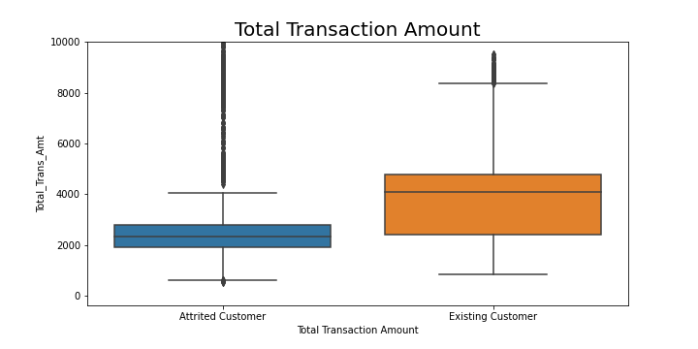
Numerical Data: Total Transaction Amount
Existing customer have more transaction amount than attrited customer

Slide 19
Conclusion
Attrited customer have less than 40k annual income
Attrited customer 2 or 3 dependent
Most of attrited customer between 40 and 50 years old, also they were inactive 3 or 2 month in the last year

Slide 20
05
Prediction: Random Forest

Slide 21

Random Forest
95.13%
96.87%
Accuracy Score
Before feature importances
Accuracy Score
After feature importances

Slide 22
06
Deployment
gradio

Slide 23

Gradio
Gradio is the fastest way to demo your machine learning model with a friendly web interface so that anyone can use it, anywhere!
Gradio is an open-source python library which allows you to quickly create easy to use, customizable UI components for your ML model, any API, or any arbitrary function in just a few lines of code. You can integrate the GUI directly into your Python notebook, or you can share the link to anyone.

Slide 26
Thanks
Do you have any questions?

