Slide 1
Introduction to Bioinformatics
Day 6 — Differential Expression Analysis
Higher Colleges of Technology Cohort | KAUST Academy
Instructor: Norah AlGhamdi
Saturday, May 9, 2026

Slide 2
Welcome Back to Day 6
Yesterday we loaded a real airway RNA-seq count matrix and saw the conditions clearly separate on PCA.
Yesterday's mystery
Yesterday we loaded a real airway RNA-seq count matrix (3 control + 3 dex-treated samples) and saw on PCA that the two conditions clearly separate, but we have not yet asked which specific genes drive that separation.
Today we'll learn the tool that lets us COMPARE conditions and find which genes actually change. Then next weekend, scRNA-seq adds another dimension: not just WHICH genes change, but in WHICH cell types.
Today: differential expression finding genes that DIFFER between conditions.
Introduction to Bioinformatics | Day 6 | HCT Cohort
2

Slide 3
What You'll Learn Today
01
What is differential expression?
02
Use PyDESeq2
How we find genes that change between two groups (e.g., healthy vs diseased).
The Python version of DESeq2 — the gold-standard DE tool.
03
Read DE results
04
Make a volcano plot
Log fold changes, p-values, and FDR — what each one means.
The most iconic chart in RNA-seq — see all your DE genes at once.
Introduction to Bioinformatics | Day 6 | HCT Cohort
3

Slide 4
Today's Agenda
3:00 – 3:15
Welcome back · Recap Day 5 · Today's plan
3:15 – 4:00
Theory: What is differential expression?
4:00 – 4:30
Theory: Statistics, fold changes, FDR
4:30 – 5:00
Theory: Volcano plots and how to read them
5:00 – 6:00
Browse: explore an RNA-seq study on GEO
6:00 – 7:00
Break
7:00 – 7:45
Code: PyDESeq2 on Control vs Dex airway
7:45 – 8:30
Code: build a volcano plot, find DE genes
8:30 – 9:00
Wrap-up · Preview of Weekend 4 (the scRNA reveal!)
Introduction to Bioinformatics | Day 6 | HCT Cohort
4

Slide 5
https://www.instagram.com/reel/DOxhQ5ZiMik/

Slide 6
Differential Expression
Finding genes that change between conditions.

Slide 7
What is Differential Expression?
Differential expression analysis asks one question:\n\n"Which genes are expressed at different levels between two groups of samples?"
Common comparisons:
Disease vs Healthy
Treated vs Untreated
Cell type A vs B
What genes go wrong in cancer? In diabetes? In Alzheimer's?
What genes does this drug actually change?
What makes a brain cell different from a muscle cell?
Today: Control airway cells vs Dexamethasone-treated airway cells — what genes change?
Introduction to Bioinformatics | Day 6 | HCT Cohort
6

Slide 8
The DE Question, Visualized
Imagine measuring one gene across many samples in two conditions:
Gene that is NOT differentially expressed:
Control
Dex
Gene that IS differentially expressed (UP in disease):
Dex (high)
Control (low)
DE analysis tells us: 'this gene is significantly UP in Dex'
Introduction to Bioinformatics | Day 6 | HCT Cohort
7

Slide 9
Why We Need Statistics
Just looking at means isn't enough. We need statistics to know if a difference is REAL or random noise.
Biological variation
Few samples vs many genes
Samples from different people naturally differ. We need to separate REAL differences from this noise.
We measure 20,000+ genes but typically have only 10-50 samples. We need stats to handle this.
Multiple testing problem
Effect size + significance
If you test 20,000 genes, you'll get hundreds 'significant' by pure chance. We need to correct for that.
A small change can be significant in lots of samples; a big change can be insignificant in few. We need both.
Introduction to Bioinformatics | Day 6 | HCT Cohort
8

Slide 10
Two Numbers Per Gene
DE analysis gives you two numbers for every gene. Together they tell the whole story.
Log Fold Change (log2FC)
Adjusted p-value (padj)
How MUCH did it change?
Are we CONFIDENT it changed?
Log2 of the ratio between groups.
• log2FC = +1 → gene is 2× higher in Dex
• log2FC = +2 → gene is 4× higher
• log2FC = -1 → gene is 2× lower in Dex
• log2FC = 0 → no change
Probability the difference is by chance, corrected for testing many genes.
• padj < 0.05 → significant ✓
• padj < 0.01 → strongly significant
• padj > 0.05 → not significant ✗
Introduction to Bioinformatics | Day 6 | HCT Cohort
9

Slide 11
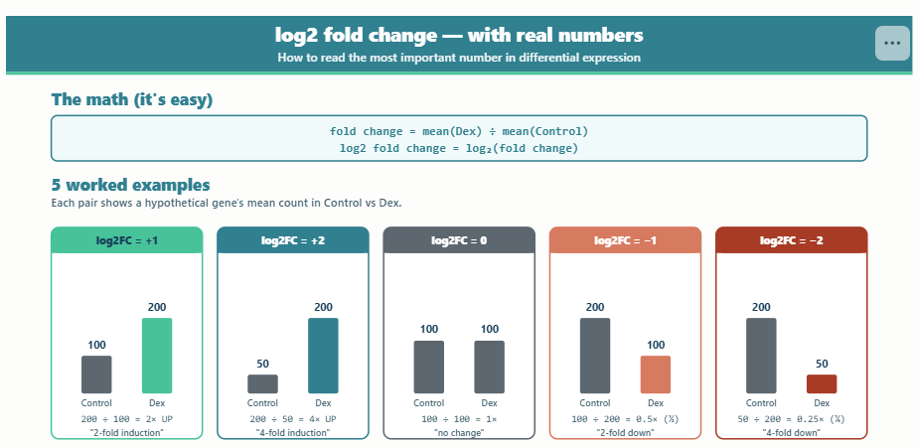

Slide 12
Why "Adjusted" P-value?
If you test 20,000 genes at p < 0.05, you'd expect about 1,000 false positives just by chance.
Test 20,000 genes × 5% chance of false positive = 1,000 false hits!
That's why we ADJUST p-values for multiple testing.
FDR (False Discovery Rate) = the fraction of your 'significant' results expected to be wrong. Standard cutoff: padj < 0.05 means at most 5% of your hits are false.
Introduction to Bioinformatics | Day 6 | HCT Cohort
10

Slide 13
PyDESeq2
The Python version of the most-used DE tool in biology.

Slide 14
DESeq2 — The Gold Standard
DESeq2 is the most-cited differential expression tool ever published. It came out in R, but PyDESeq2 brings the same algorithm to Python.
70K+
Standard
Python
Citations of the original DESeq2 paper
Used in nearly every RNA-seq study
PyDESeq2 — works in Colab
Introduction to Bioinformatics | Day 6 | HCT Cohort
12

Slide 15
What PyDESeq2 Does (Simply)
Three steps. Same as the R version.
1
Normalize counts
Account for differences in sequencing depth between samples.
2
Estimate variation
Figure out how much each gene normally varies — borrow strength across genes.
3
Test each gene
For each gene: is the difference between groups bigger than the noise?
In Python: 4 lines of code. PyDESeq2 does all the math for you.
Introduction to Bioinformatics | Day 6 | HCT Cohort
13

Slide 16
The Output — A Results Table
PyDESeq2 gives you a table with one row per gene. Here's what it looks like:
Gene baseMean log2FoldChange pvalue padj Verdict
FKBP5 9420.5 +3.85 3.2e-15 1.1e-12 UP ↑
DUSP1 2542.1 +2.91 4.7e-10 8.3e-08 UP ↑
KLF15 182.3 +3.12 1.5e-08 2.3e-06 UP ↑
PER1 854.6 +2.43 4.7e-07 8.2e-05 UP ↑
ACTB 18234.0 +0.05 0.92 0.99 — (housekeeping)
FKBP5, DUSP1, KLF15, PER1 go UP in dex (classic glucocorticoid response). ACTB stays flat (housekeeping).
Each row has the two key numbers — log2FoldChange and padj — plus context columns.
Introduction to Bioinformatics | Day 6 | HCT Cohort
14

Slide 17
Towards Biological Meaning: Visualization & Reporting
Good analysis without good visualization is invisible science.

Slide 18
Volcano Plots
The most iconic chart in RNA-seq analysis.

Slide 19
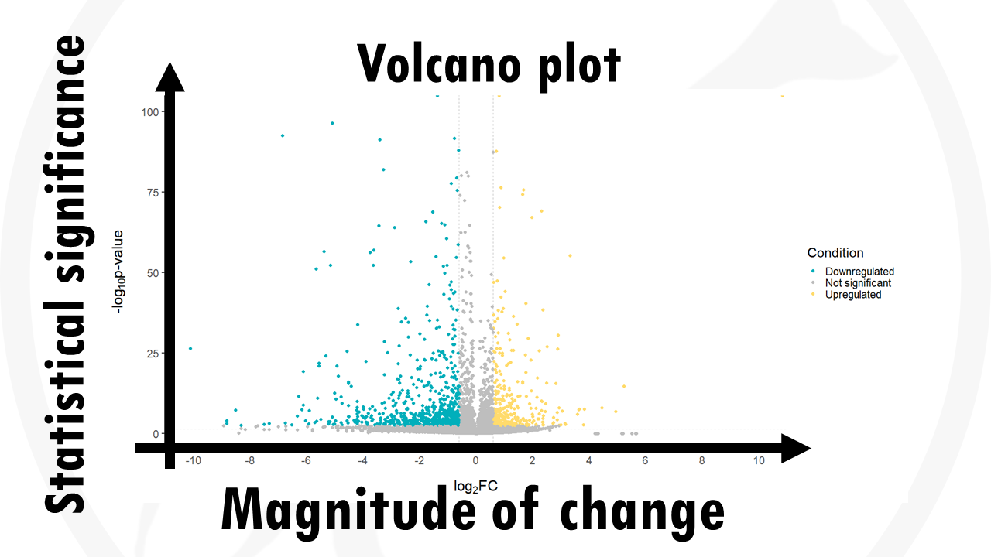

Slide 20
What is a Volcano Plot?
A volcano plot puts every gene on one chart. You see all your DE results in one glance.
Significant
← -log10(padj)
Not significant
← DOWN
UP →
log2 Fold Change →
Each dot = one gene. Look in the top-left (DOWN) and top-right (UP) corners — those are your significant DE genes.
Introduction to Bioinformatics | Day 6 | HCT Cohort
16

Slide 21
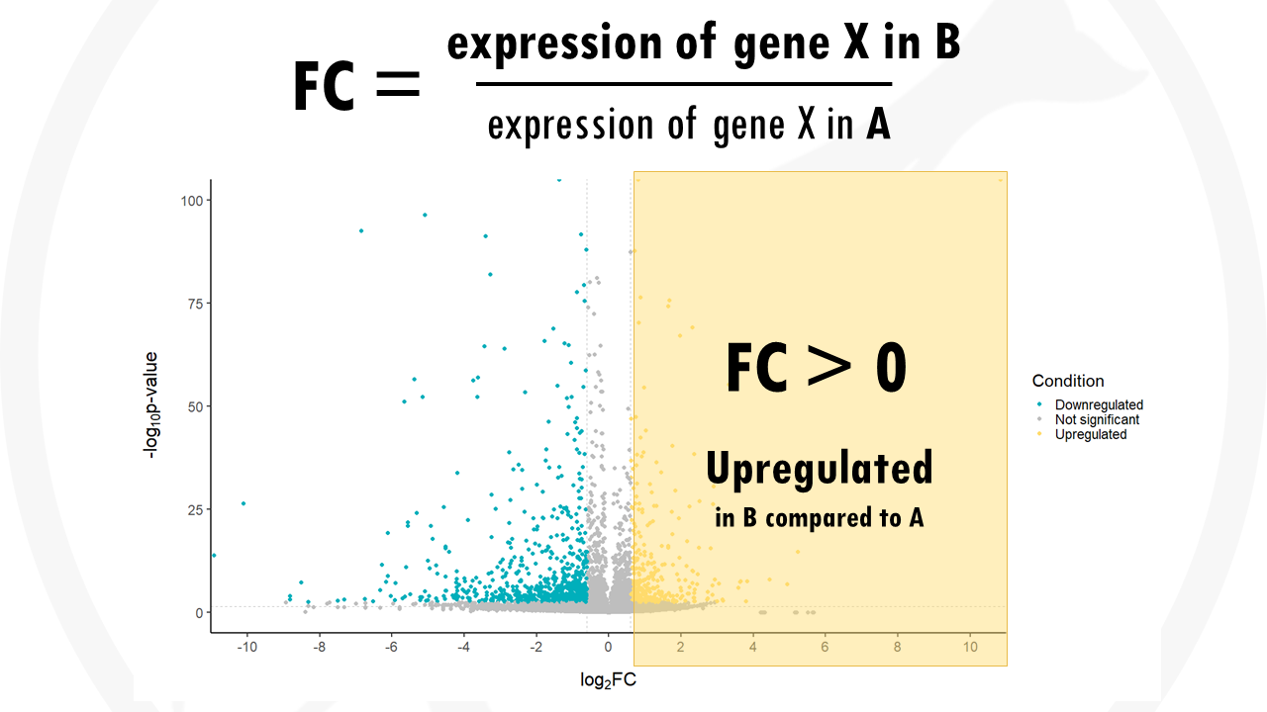

Slide 22
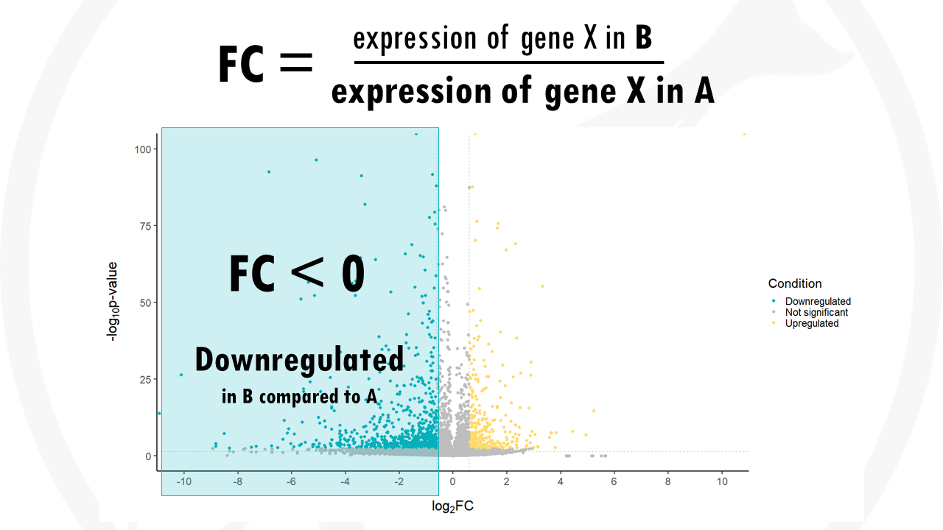

Slide 23
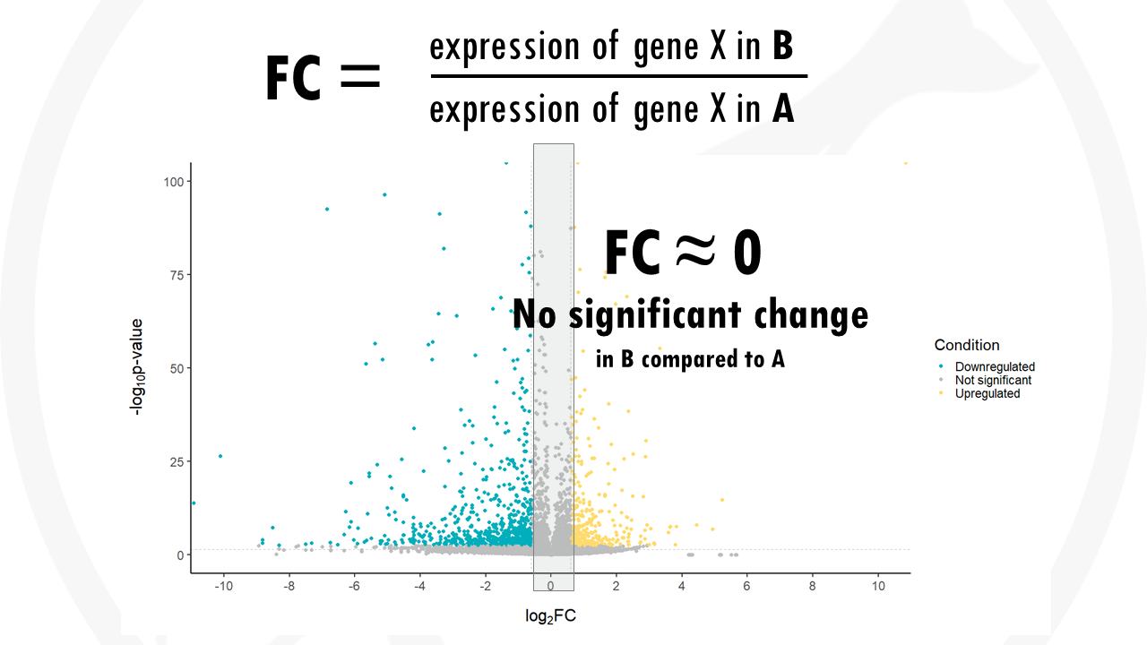

Slide 24
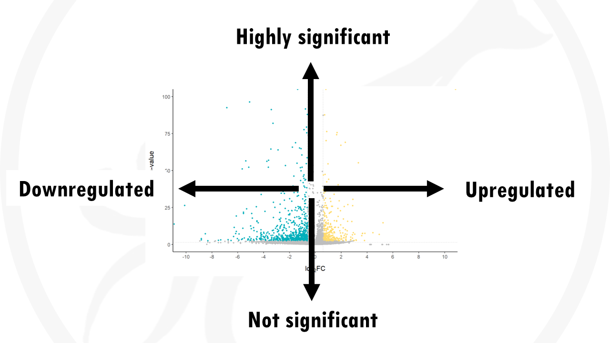
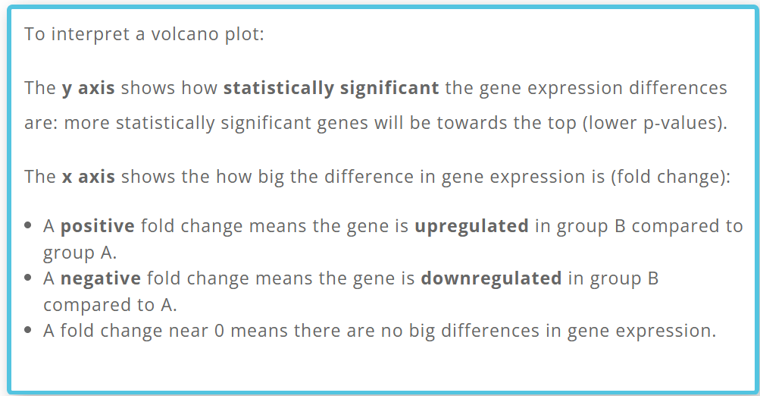

Slide 25
How to Read a Volcano Plot
Top-left corner
Top-right corner
Genes that are SIGNIFICANTLY DOWN in your test condition. Highly negative log2FC + low padj.
Genes that are SIGNIFICANTLY UP in your test condition. Highly positive log2FC + low padj.
Bottom area
Center top
Genes that are NOT significant — high p-values, ignore these.
Significant but small effect — not very interesting biologically.
In real papers, the most interesting DE genes are usually labeled by name on the volcano plot.
Introduction to Bioinformatics | Day 6 | HCT Cohort
17

Slide 26
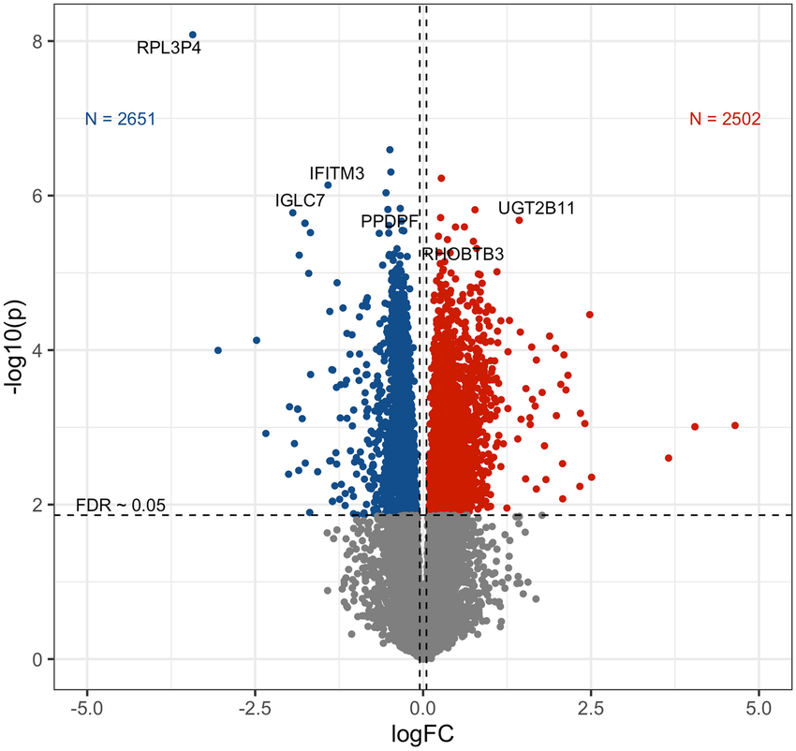
Volcano Plot
Which genes changed between two conditions? (Biologically)
How confident are we about that change? (Statistically)
------- Threshold
Most common DE visualization: statistical significance vs. magnitude of change for every gene.
Axes & Interpretation
X-axis: log2 Fold Change
Positive = up in treatment
Negative = down in treatment
Y-axis: –log10(adjusted p-value)
Higher = more significant
Cutoff at –log10(0.05) ≈ 1.3
How confident we are in the change.
Log fold change: how much a gene changed.

Slide 27
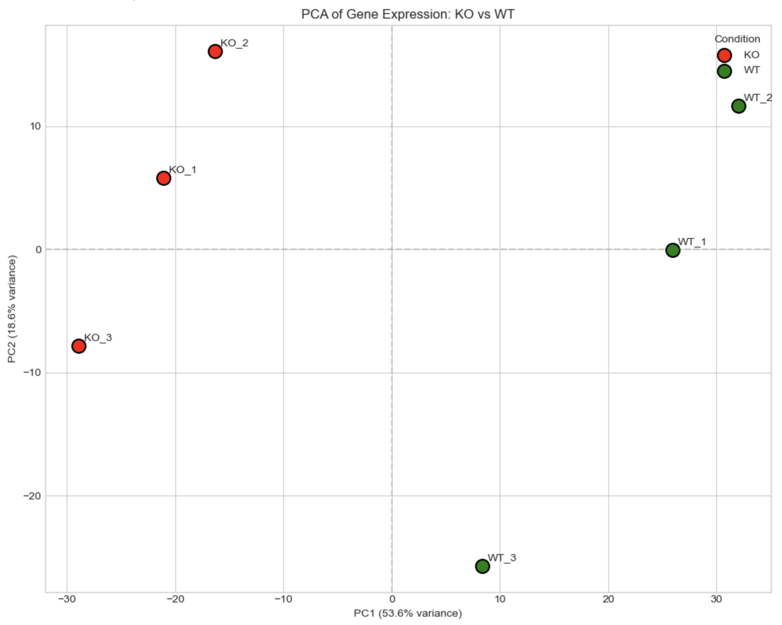
Sample-Level QC: PCA & Clustering
Assess data quality before DE. Identify outliers, batch effects, sample swaps.
PCA Plot
Reduces gene dimensions to 2D.
Look for:
• Separation by condition
• Tight replicate clustering
• Outliers far from group
• Batch effects
Use plotPCA() on vst/rlog data.
PC1 captures most variance.
Always transform data first

Slide 28
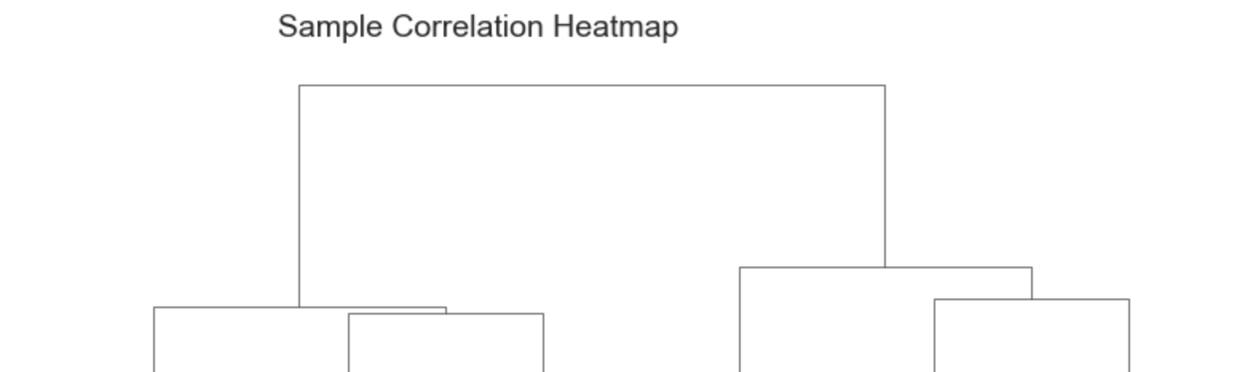
Sample-Level QC: PCA & Clustering
Assess data quality before DE. Identify outliers, batch effects, sample swaps.
Hierarchical Clustering
Sample-to-sample distance heatmap.
Look for:
• Samples cluster by condition
• Dark diagonal = similar replicates
• Unexpected patterns = problems
Use Euclidean distance on
variance-stabilized data.
pheatmap or ComplexHeatmap.
Always transform data first

Slide 29
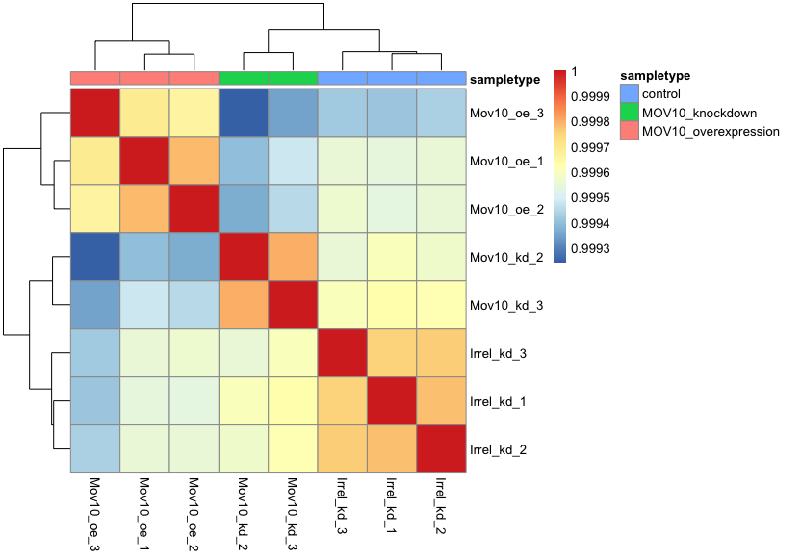
Heatmaps for Gene Expression
Display expression patterns across samples for selected genes, revealing clusters and co-expression patterns.
Best Practices
Input: transformed values, NOT raw counts
Scaling: Z-score by row (gene) to
focus on relative patterns
Gene selection: Top 20–50 DE genes
by padj, or genes of interest.
Annotations: Column annotations for
condition, batch, etc.
Clustering: Hierarchical clustering of
rows + columns reveals modules

Slide 30
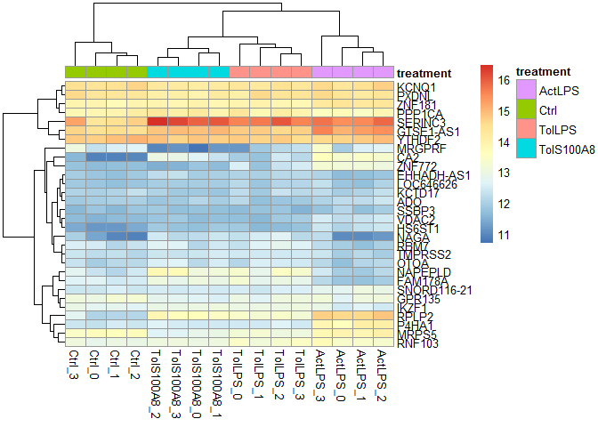
Heatmaps and Clustering
Condition
Heatmap of top genes with clear clustering by condition
Which genes behave similarly across samples
Do top DE genes show a clear pattern?
Genes (rows)
Samples (columns)

Slide 31
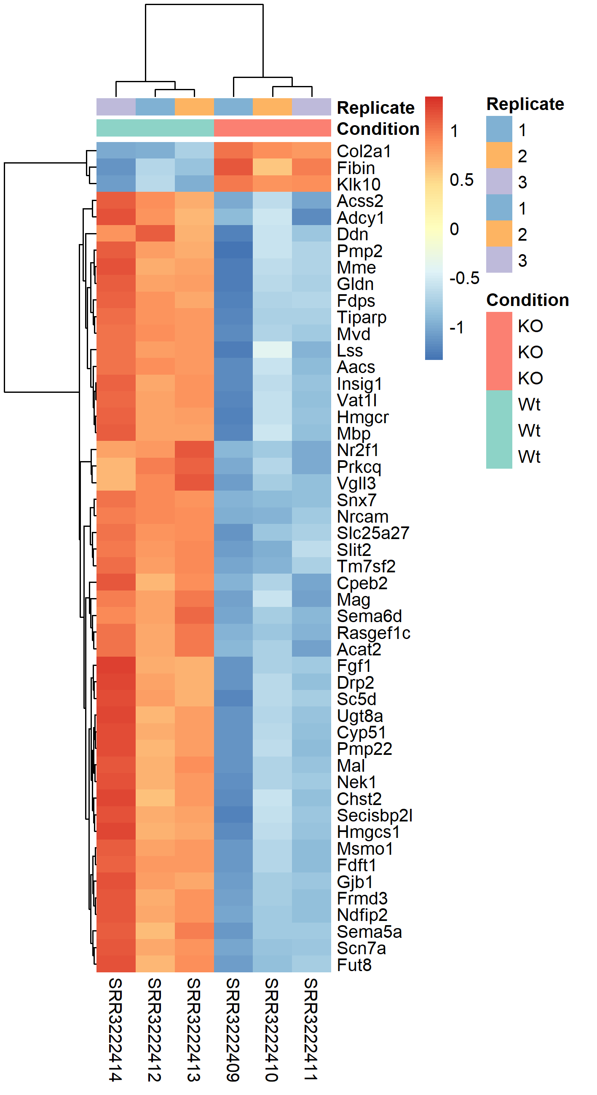
Heatmaps and Clustering
Do samples cluster by condition?
heatmap where the top annotation bars clearly label Condition and Replicate.
how to read the annotation bars and how clustering supports the experimental design.

Slide 32
Heatmaps and Clustering
Sample-to-sample correlation heatmap
Correlation matrix heatmap showing samples clustering nicely by group.
Usually uses for “QC check: do replicates look similar?”

Slide 33
Pathway & Enrichment Analysis

Slide 34

From Gene Lists to Biological Meaning
DE gives a gene list. Enrichment analysis connects it to known biology: pathways, processes, functions.
The Problem
The Solution
500 DE genes. Looking at individuals is overwhelming. A pathway effect may be distributed across many genes with small changes.
Enrichment asks: "Are genes from a biological pathway over-represented in my results more than by chance?" Provides higher-level interpretation.
2nd: FCS / GSEA
(Functional Class Soring)
3rd: Topology-Based
(Network context)

Slide 35
Knowledge Bases for Enrichment
Enrichment relies on curated databases defining gene sets.
Gene Ontology (GO)
BP, MF, CC ontologies. Hierarchical DAG. ~45,000 terms.
KEGG Pathways
Curated metabolic/signaling/disease pathways. ~350 human pathways.
Reactome
Open-source, peer-reviewed. Hierarchical. ~2,600 human pathways.
MSigDB (Broad)
8 collections: Hallmark (50 sets), curated, motif, GO, oncogenic, immunologic, cell type.
WikiPathways
Community-curated open pathway database with visual diagrams.
Use multiple databases for comprehensive analysis.

Slide 36
Gene Ontology: Structure & Three Domains
GO is a DAG: child terms are more specific. A gene annotated to a child inherits all parent annotations.
Biological Process (BP)
Molecular Function (MF)
Cellular Component (CC)
What the gene does biologically.
Ex: apoptosis, immune response,
cell cycle, DNA repair
Biochemical activity.
Ex: kinase activity, DNA binding,
receptor activity
Where in the cell.
Ex: nucleus, mitochondrion,
plasma membrane

Slide 37
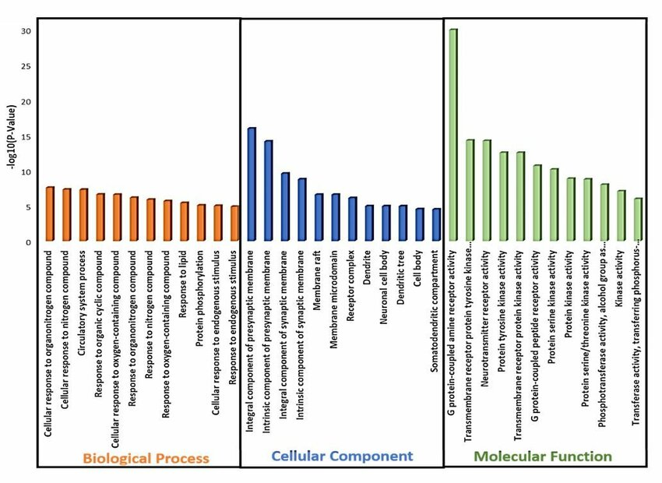
Gene Ontology (GO)
What does this gene do?
Biological Process → what is happening (e.g. cell division, neuron signaling)
Molecular Function → what the gene does (e.g. enzyme, receptor)
Cellular Component → where it works (e.g. nucleus, synapse)
Think of GO as labels describing gene functions.

Slide 38
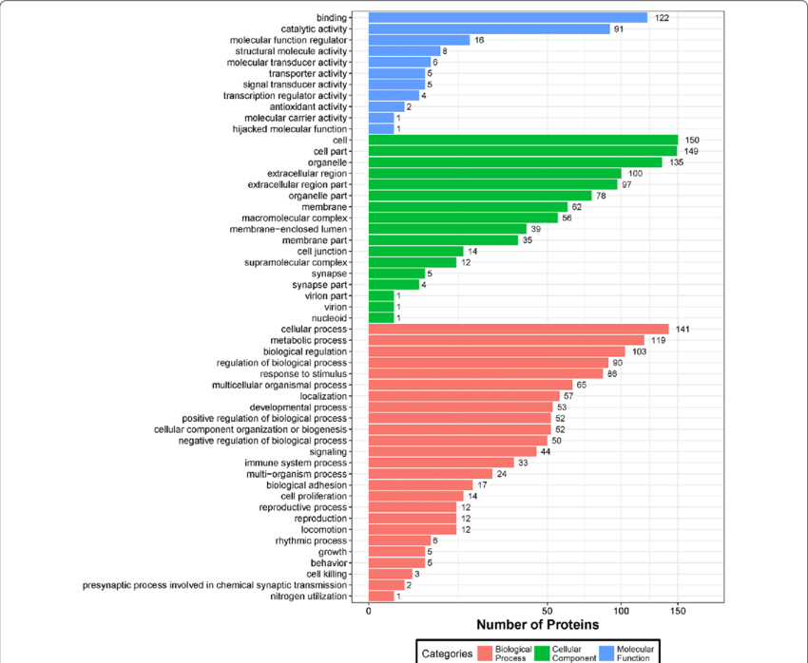
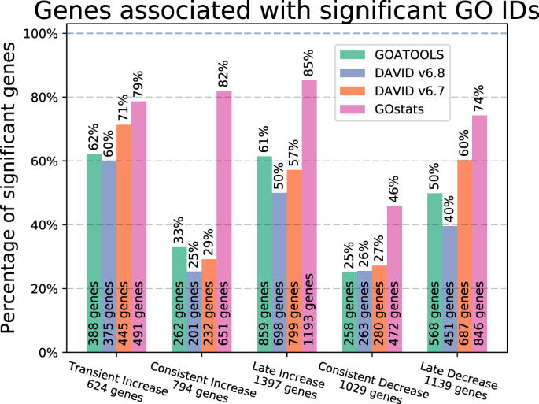
Example of Dot Plot for Enrichment

Slide 39
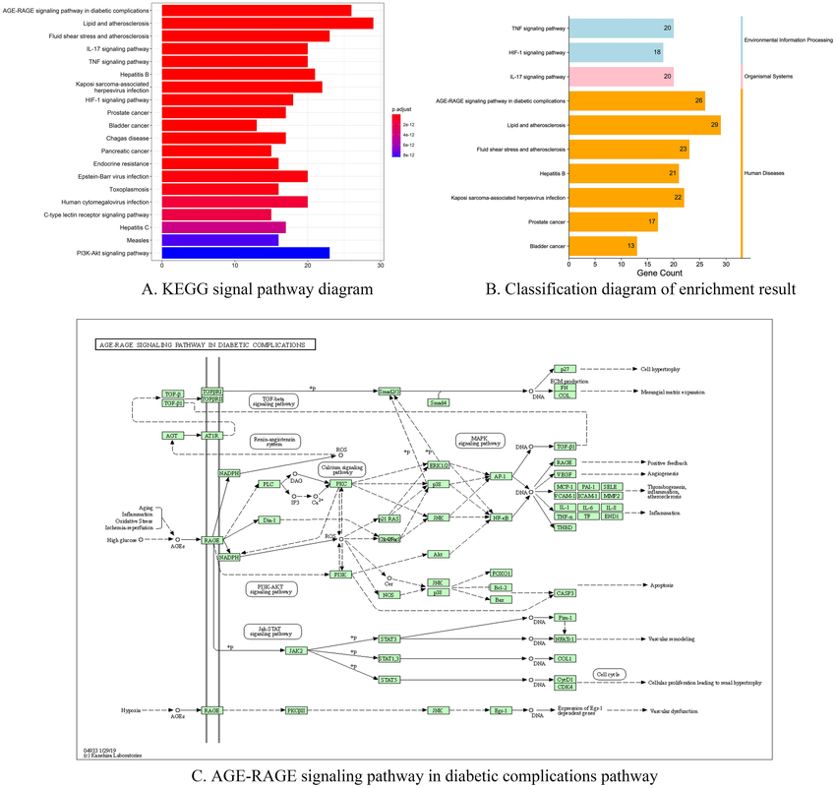
KEGG
How do genes work together?
Shows pathways (step-by-step biological processes)
Genes are connected by arrows and interactions
Examples: signaling pathways, metabolism pathways
Think of KEGG as a map of biological pathways.

Slide 40
Gene Set Enrichment Analysis (GSEA)
Uses the ENTIRE ranked gene list (no threshold). Tests whether pathway genes cluster at the top or bottom.
1
Rank all genes
Order by metric (Wald stat, shrunken log2FC, signed –log10(p)×sign(log2FC), or t-statistic).
2
Walk down ranked list
Running-sum: +increment for gene set members (weighted by rank metric), –decrement otherwise.
3
Enrichment Score
Max deviation from zero. Positive ES = members at TOP (upregulated). Negative = at BOTTOM (downregulated).
4
Significance testing
Compare ES to null from gene label permutation. NES = ES / mean(null). FDR for multiple testing.
Subramanian et al. (2005) PNAS | Tools: fgsea, clusterProfiler::GSEA(), GSEA (Broad Institute)

Slide 41
Visualizing Enrichment Results
Dot Plot
enrichplot::dotplot()
Gene sets vs gene ratio. Size=count, color=padj.
Bar Plot
barplot(ego)
Horizontal bars for enriched terms. Clean for talks.
GSEA Plot
plotEnrichment()
Running sum + barcode + rank metric for one set.
Enrichment Map
enrichplot::emapplot()
Network of overlapping gene sets. Reveals themes.
Concept Network
enrichplot::cnetplot()
Genes shared across terms. Identifies hub genes.
Pathway Render
pathview::pathview()
KEGG diagram colored by DE. Shows gene interactions.
Use enrichplot and clusterProfiler for publication-quality figures. Combine multiple views for full picture.

Slide 42

Practical Tips for Interpretation
Look for themes, not individual terms
Are multiple immune terms enriched? That's more convincing than one. Cluster related results.
Check gene overlap across terms
Use cnetplot/UpSet plots. If one gene drives many terms, may be artifact.
Validate with orthogonal data
Cross-reference with protein data, literature, independent datasets. Enrichment is hypothesis-generating.
Consider biological context
Does the enrichment make biological sense given your experimental system? Unexpected results need careful scrutiny.
Report methods transparently
Database(s), method (ORA/GSEA), ranking metric, background, correction, software versions.

Slide 43
Browse First
Find a real RNA-seq study on GEO.

Slide 44
GEO — Where RNA-seq Studies Live
GEO (Gene Expression Omnibus) is NCBI's archive of every published gene expression study — including thousands of RNA-seq experiments with full data and metadata.
1
Open GEO
ncbi.nlm.nih.gov/geo
2
Search 'airway dexamethasone RNA-seq'
You'll get many hits — find Himes 2014 (GSE52778, our airway dataset)
3
Click any GSE entry
GSE = study identifier. You'll see the full study description
4
Look at the metadata table
Check what samples they used, what conditions they compared
Introduction to Bioinformatics | Day 6 | HCT Cohort
19

Slide 45
Now in Code
PyDESeq2 on control vs dex airway samples.

Slide 46
The Code Plan
Open the Day 6 Part 2 notebook. Today's analysis: 3 control vs 3 dex-treated airway samples (real Himes 2014 data).
1
Load the airway count matrix
Same airway data as yesterday, now with control vs dex condition labels.
2
Run PyDESeq2 in 4 lines
Set up, fit, get results — that's it.
3
Look at INS and other DE genes
Are FKBP5, DUSP1, KLF15 significantly UP in dex? (Spoiler: yes)
4
Make a volcano plot
See all your DE genes at once — the iconic chart.
5
Heatmap of top DE genes
Visualize Z-scored expression patterns across all 6 samples.
Introduction to Bioinformatics | Day 6 | HCT Cohort
21

Slide 47
Break
6:00 – 7:00 PM
After the break — PyDESeq2 in action.

Slide 48
What We Covered Today
✓
What differential expression is
Finding genes that change between two groups (e.g., control vs drug treatment).
✓
Two key numbers per gene
Log fold change (how MUCH) + adjusted p-value (how CONFIDENT).
✓
Why we adjust for multiple testing
Test 20,000 genes naively → 1,000 false hits. FDR fixes that.
✓
PyDESeq2 in 4 lines
The Python version of the gold-standard DE tool.
✓
Volcano plots and heatmaps
How to visualize your DE results — top-left + top-right corners are the gold.
Introduction to Bioinformatics | Day 6 | HCT Cohort
23

Slide 49
Questions & Next Weekend — The Reveal
Weekend 4 (May 15 & 16) — Single-cell RNA-seq
Today's analysis told us WHICH genes change in dex-treated airway cells — but bulk RNA-seq mixed all the cells together. We don't know whether dex affected EVERY cell, or only some cells. Next weekend we'll use single-cell RNA-seq to resolve individual cell types — and ask not just WHICH genes change, but IN WHICH CELLS the changes happen.
That's the moment scRNA-seq will earn its reputation as the most exciting tool in genomics.
Questions?
You finished Weekend 3 — bulk RNA-seq, end to end.
Thank you — see you next Friday.
Introduction to Bioinformatics | Day 6 | HCT Cohort
24

