Slide 1
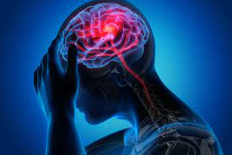
Stroke Predication

Slide 2
Abstract
According to the World Health Organization (WHO) stroke is the 2nd leading cause of death globally, this project use to predict whether a patient is likely to get stroke or not based on the input parameters.

Slide 3
Dataset
This dataset contains 5110 observations with 12 attributes from kaggle :
1. id : unique identifier
2. gender : "Male", "Female" or "Other"
3. age : age of the patient
4. hypertension : 0 if the patient doesn't have hypertension, 1 if the patient has hypertension
5. heart_disease : 0 if the patient doesn't have any heart diseases, 1 if the patient has a heart disease
6. ever_married : "No" or "Yes"
7. work_type : "children", "Govt_jov", "Never_worked", "Private" or "Self-employed"
8. Residence_type : "Rural" or "Urban"
9. avg_glucose_level : average glucose level in blood
10. bmi : body mass index
11. smoking_status : "formerly smoked", "never smoked", "smokes" or "Unknown"
12. stroke : 1 if the patient had a stroke, 0 the patient do not have a stroke

Slide 4
Project goal
Prediction people has a stroke or not using data machine learning model

Slide 5
Algorithms / Tools
Algorithms
I use ML (LogisticRegression)
Tools
Pandas
Nubay
seaborn and matplotlib for visualization data

Slide 6
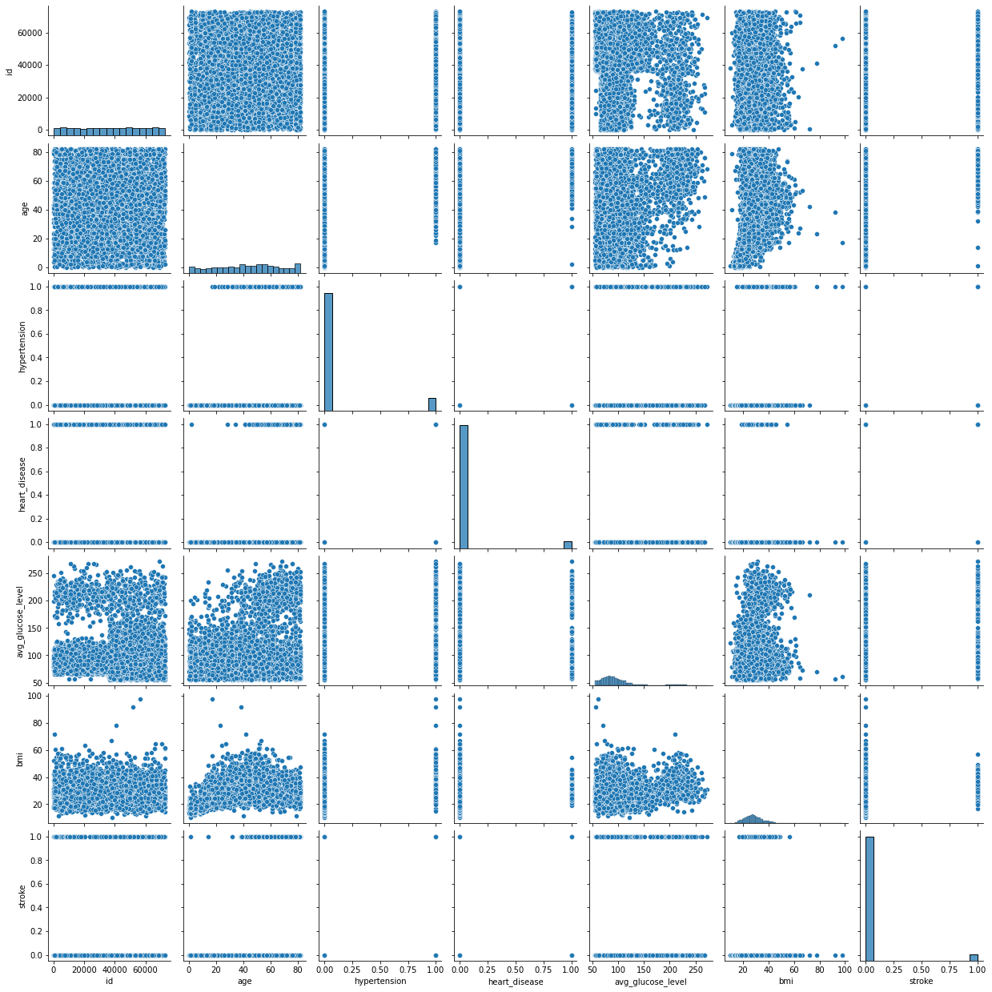

Slide 7
Communication/ observations
Percentage of pepole has a stroke: % 4.87 -->(249)
Percentage of pepole does not have a stroke: % 95.13 (4861)
Almost %95 of the instances of our target variable is 'No stroke'
4861 patient does not have a stroke
%5 of the instances of our target variable is 'Stroke'
249 patient have a stroke

Slide 8
Model accuracy
(LogisticRegression)
with 95.46165884194053% accuracy

