Slide 1



Learning recommendation system
Name: Sharon Gurung (23048933)
Module: Artificial Intelligence (CU6051NP)
Module Leader: Mr. Jeevan Prakash Panta
Date: 21st January 2026
Notes:
NOTE:
To change the image on this slide, select the picture and delete it. Then click the Pictures icon in the placeholder to insert your own image.

Slide 2
Content
Topic
Solution
Synthesis of information
Pseudo code for the solution
Diagrammatical representations of the solution (flowcharts/state transition diagrams)

Slide 3
Topic- Explanation of the AI concepts used
Artificial Intelligence is used to help computers make intelligent decisions.
This project uses Machine Learning to recommend suitable online courses.
Supervised learning algorithms predict whether a course should be recommended.
Logistic Regression -Simple and interpretable baseline model.
Decision Tree -Captures complex decision rules.
Random Forest - Improves accuracy by combining multiple trees.
Unsupervised learning groups similar courses using clustering techniques.
A hybrid recommendation system combines both methods with gradient stacking classifiers.
This improves accuracy, scalability, and recommendation quality.

Slide 4
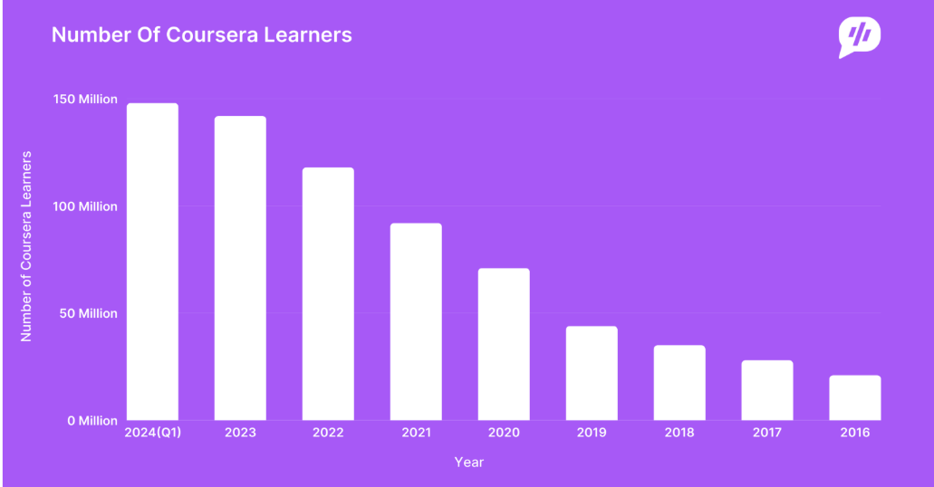
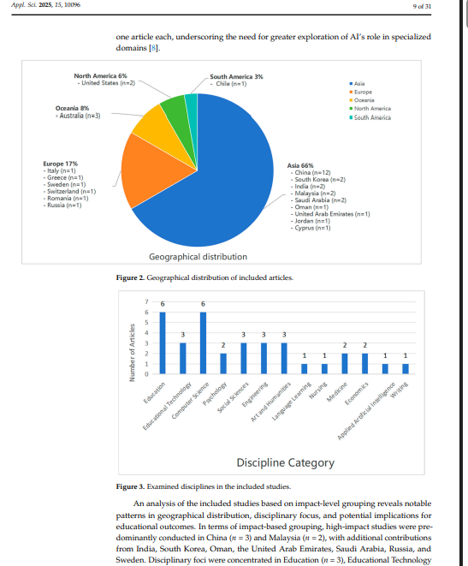
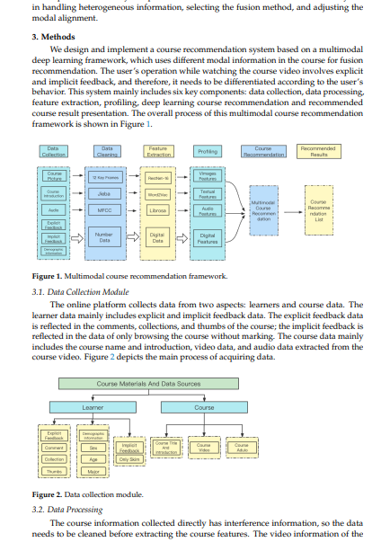
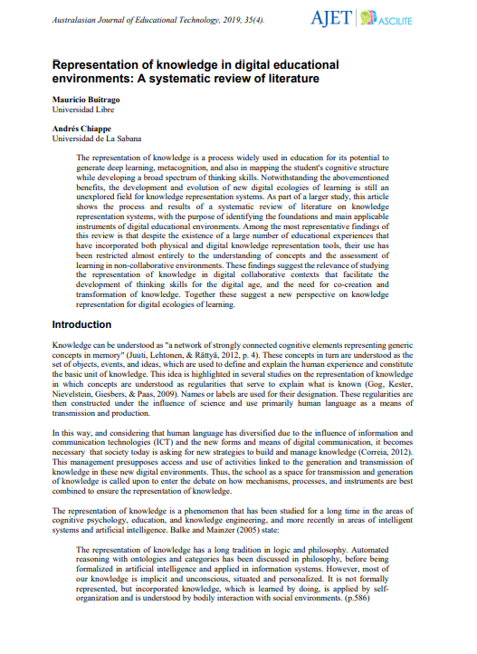
Research Evidence
Research 1 (Tilahun & Sekeroglu, 2020):
Developed an intelligent course advising system using AI.
Used rule-based and machine learning approaches for course selection.
Highlighted limitations of popularity-based recommendations.
Research 2 (Islam & Hosen, 2022):
Proposed a multi-model machine learning framework for course recommendation.
Found that hybrid models outperform single algorithms.
Emphasized scalability and accuracy in large educational datasets.
Research 3 (Ren et al., 2022):
Introduced a deep learning-based hybrid recommendation system.
Combined supervised and unsupervised learning techniques.
Improved recommendation accuracy and diversity.
Identified challenges of complexity and high computational cost.

Slide 5
Reason for Selection of the Topic
Online learning platforms offer thousands of courses, making selection difficult.
Learners often choose unsuitable courses, leading to low completion rates.
Existing recommendation system focuses on popularity.
Helps learners save time and choose relevant courses.

Slide 6
Solution-Explanation of the Solution and Developed Application
1. Data Preprocessing
Coursera course dataset is used as input.
Duplicate records and missing values are removed.
Categorical features are encoded.
Numerical features are normalized using StandardScaler.
2. Model Selection and Training
Dataset is split into 80% training and 20% testing.
Supervised models used:
  Logistic Regression, Decision Tree and Random Forest
Models predict whether a course should be recommended or not.
3. Unsupervised Learning
K-Means clustering is applied where similar courses are grouped based on features.
4. Hybrid Recommendation
Supervised predictions and clustering results are combined.

Slide 7
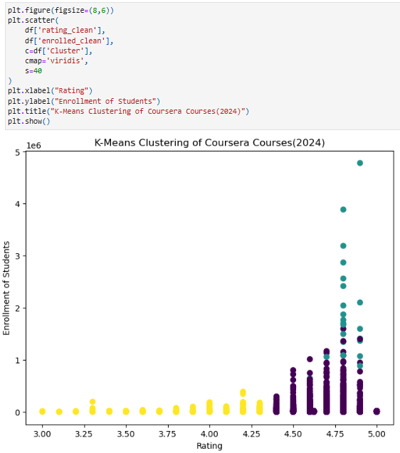
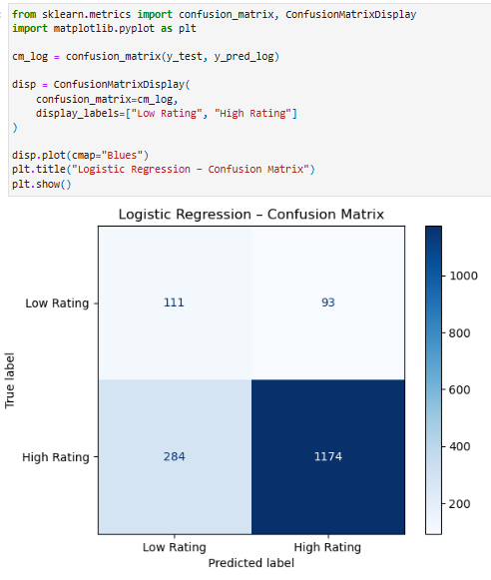
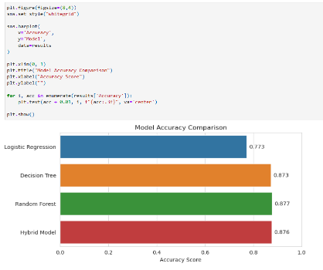
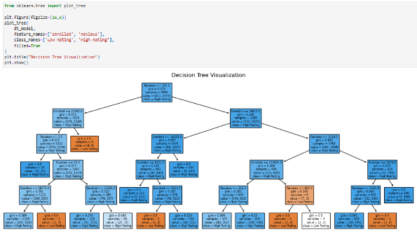
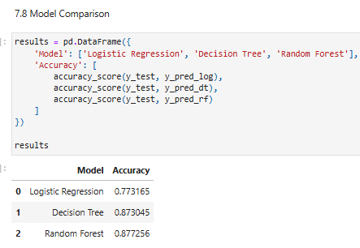
Achieved Results
Logistic Regression provides baseline performance.
Decision Tree handles complex data patterns better.
Random Forest achieves the highest accuracy.
The hybrid model gives stable and reliable predictions.
Course relevance is improved using multiple models.

Slide 8
How It Solves Real-World Problems?
It reduces information overload for learners.
Helps users select relevant courses quickly.
Improves learning satisfaction and engagement.
Works without detailed learner history.
Supports large online learning platforms.
Provides scalable and intelligent recommendations.

Slide 9
Synthesis of Information
PseudoCode of Solution
Load Coursera course dataset
Preprocess data: remove duplicates, handle missing values, encode categorical features,
Normalize numerical features
Split dataset into 80% training and 20% testing sets
Train supervised models: Logistic Regression, Decision Tree, Random Forest
Evaluate supervised models using accuracy and precision
Apply K-Means clustering to group similar courses
Combine supervised predictions and clustering results using hybrid approach
Match learner preferences with ranked courses
Generate Top-N recommended courses

Slide 10
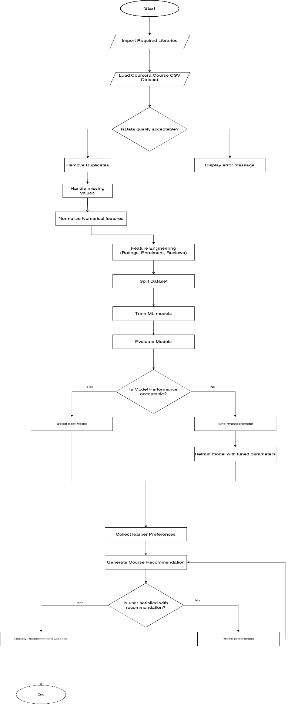
Diagrammatical representation of the solution (Flowchart)

Slide 11
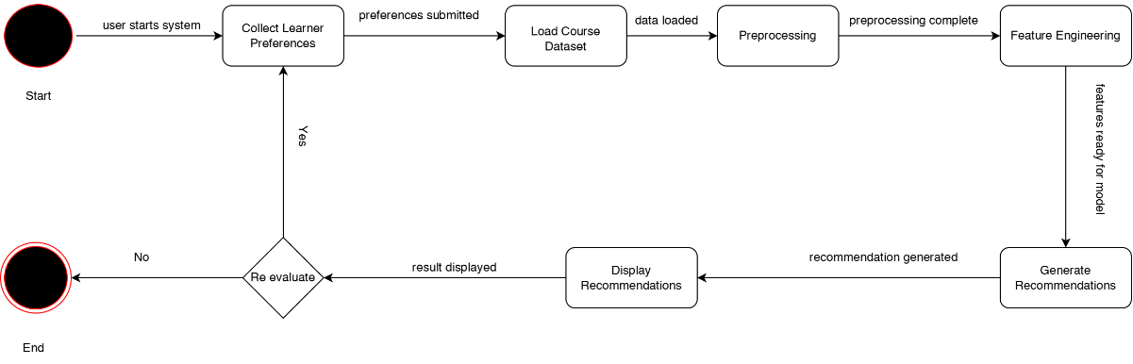
Diagrammatical representation of the solution (State Transition Diagram)

Slide 12
Thank you

