Slide 1
Prime factors using
Shor’s Algorithm
Final project

Slide 2

Team introduction
Nabin Baral
Charles Monie
Olajumoke Ajiniran

Slide 3
Running on simulator
Demo:

Slide 4
Running on quantum computer
Demo:

Slide 5
Idea behind Shor’s Algorithm

Slide 6
Why Shor Algorithm?
Shor's algorithm is a polynomial-time quantum computer algorithm for integer factorization. Informally, it solves the following problem: Given an integer N, find its prime factors. It was invented in 1994 by the American mathematician Peter Shor.

Slide 7
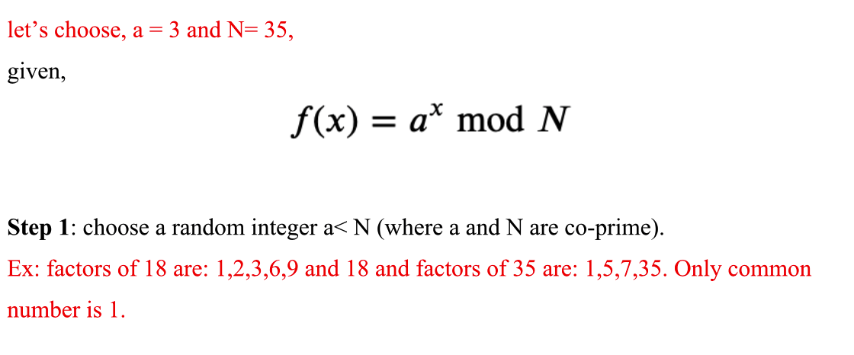
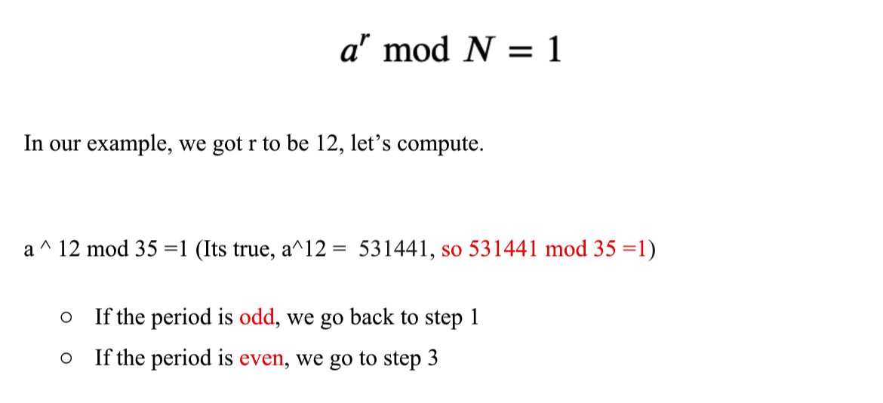
Steps here:
Step 1: Choose a co-prime number a and N
Step 2: Period Finding

Slide 8
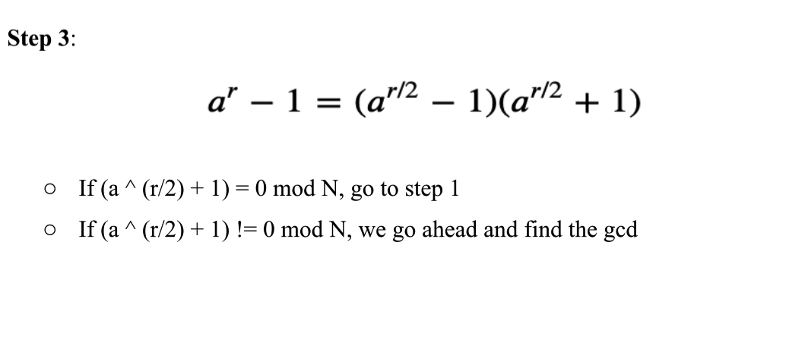
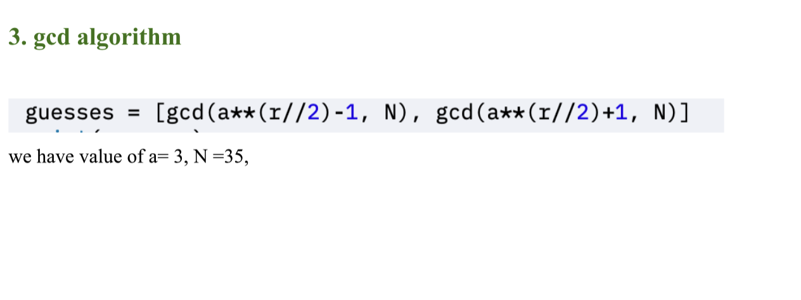
Continued:
Step 3:
Step 4:

Slide 9
Thank you!

