Slide 1
Image Classification Using Transfer Learning
Using Inception V3 for Enhanced Accuracy

Slide 2
Project Details
Objective: To build a web application for image classification using transfer learning.
Tech Stack: Python, Flask, TensorFlow, Keras, Jupyter Notebook.
Overview: Users upload an image and receive a predicted class label from a pre-trained model.

Slide 3
Data Used and Features
Dataset: CIFAR-10
Classes: 10 (airplane, automobile, bird, cat, deer, dog, frog, horse, ship, truck)
Training Samples: 50,000
Test Samples: 10,000
Features: 32x32 pixel color images

Slide 4
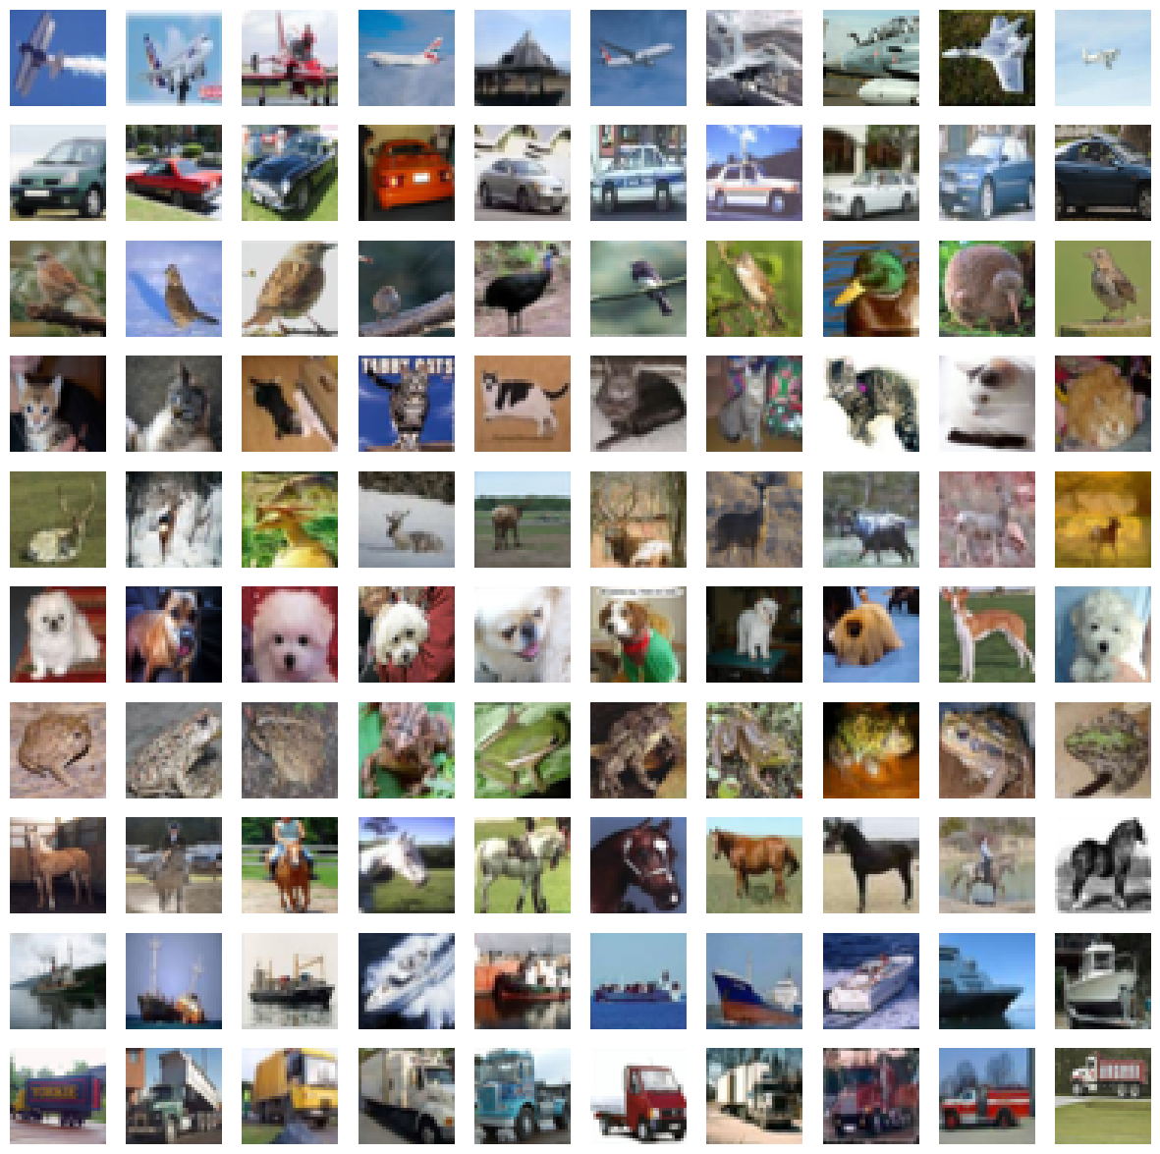
Exploratory Data Analysis (EDA)
Sample Images per Class

Slide 5
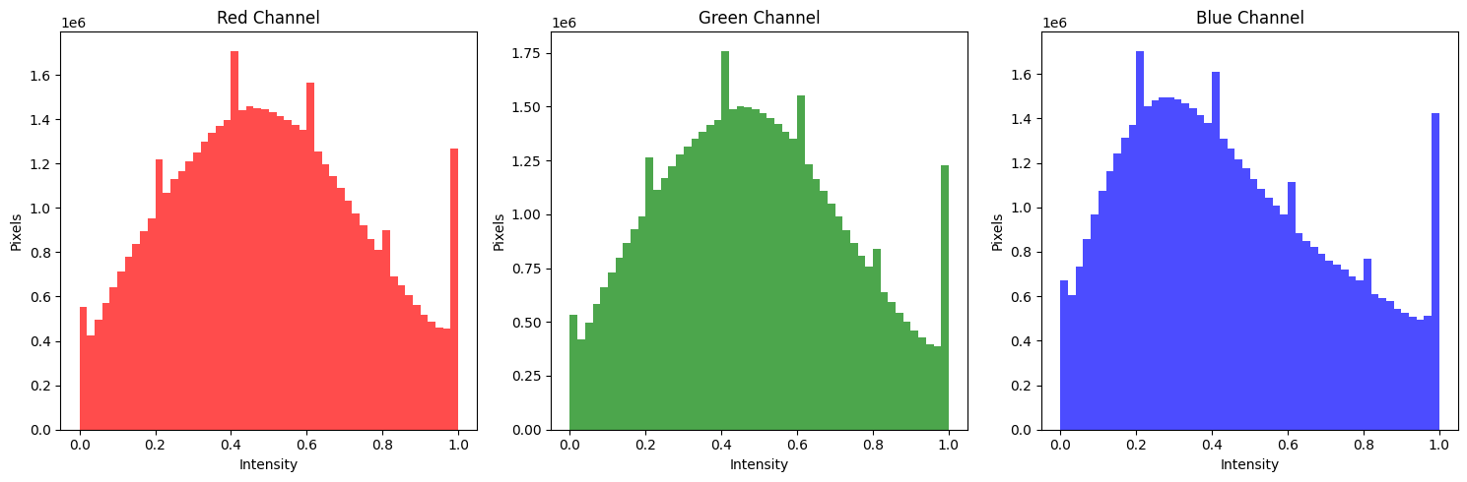
Color Channel Intensity Distribution

Slide 6
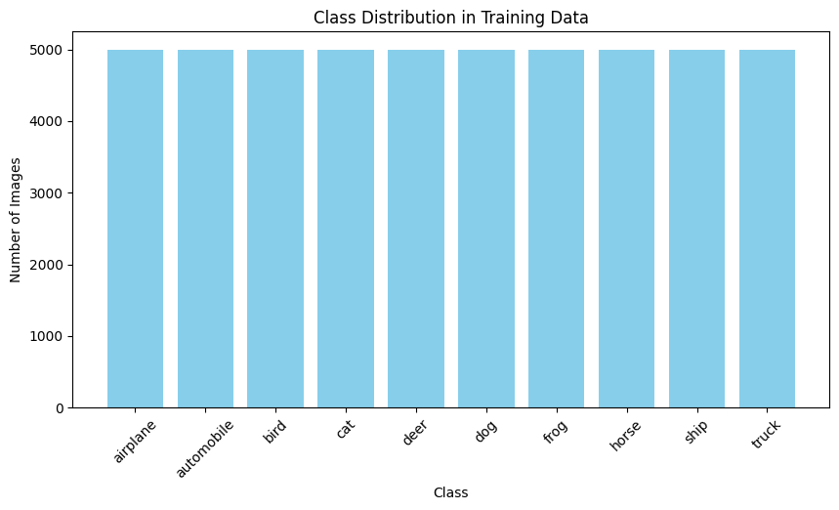
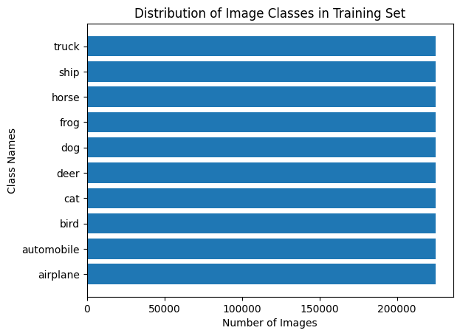
Distribution of Image Classes in Training Set
The distribution shows a state of balance
This balance in the distribution is important for model training-to minimize biases.

Slide 7
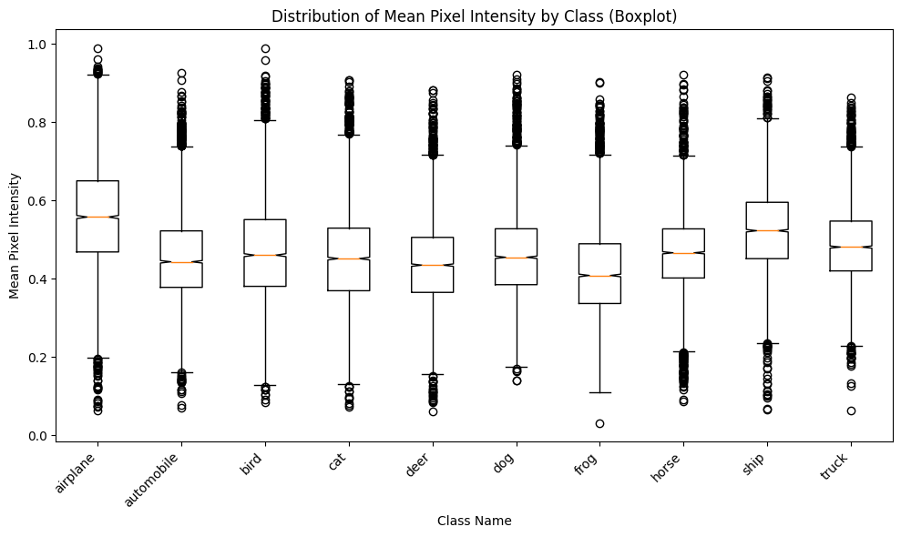
Image Quality per class

Slide 8
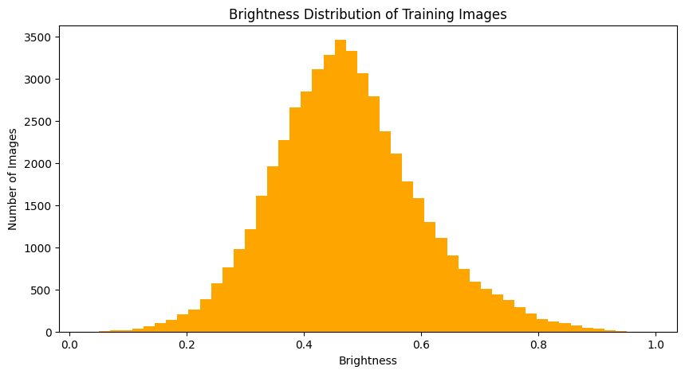
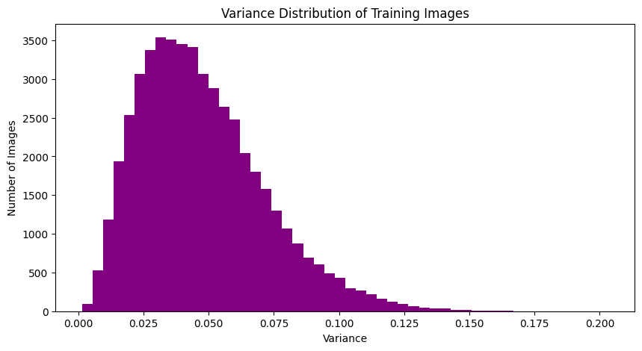
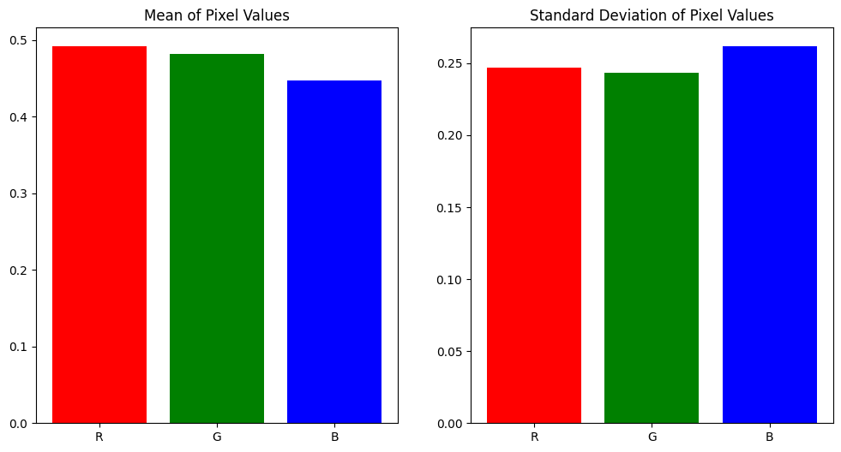
Image Properties
Brightness
Variance distribution: training set
Image Quality Pixels

Slide 9
Baseline Model
4- layer Convolution Neural Network

Slide 10
Architecture Summary:
Convolutional Neural Network (CNN)
Layers: Conv2D, MaxPooling2D, Flatten, Dense
Activation Functions: ReLU, Softmax
Performance Metrics:
Test Accuracy: 64.41%
Test Loss: 1.2282
Training Time: 2.5 hours

Slide 11
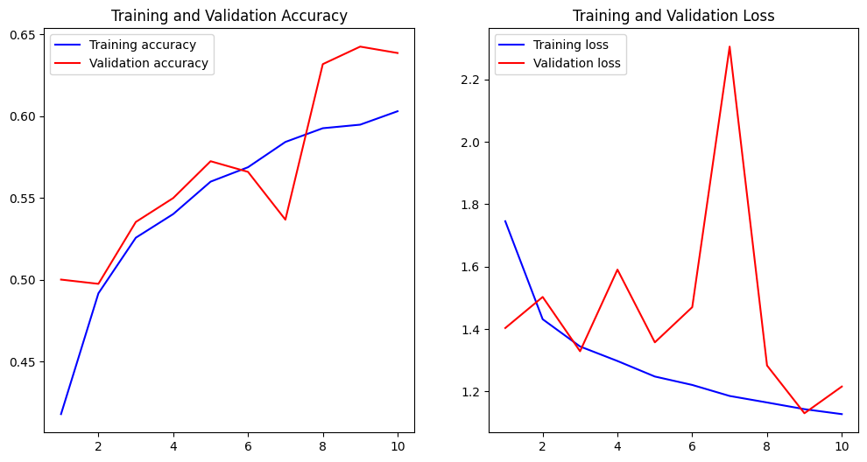

Slide 12
Transfer Learning
Inception V3

Slide 13
Inception V3 Model Summary
Architecture Summary:
Pre-trained on ImageNet
Fine-tuned on CIFAR-10 dataset
Key Features:
Deeper network with multiple convolutional layers
Better feature extraction capabilities

Slide 14
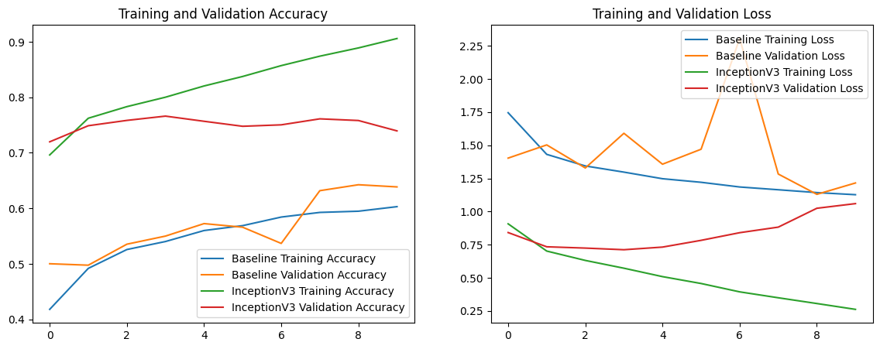
Model Comparison

Slide 15
Model Comparison
Metric | Baseline Model | Inception V3 Model
Accuracy | 64.41% | 90.59% (training), 73.95% (validation), 73.52% (test)
Loss | 1.2282 | 1.06 (training), 1.08 (test)
Training Time | 15mins 20.4 sec | 8.04 hours
Epochs | 10 | 10

Slide 16
Conclusion and Future Work
Conclusion:
Transfer learning using pre-trained models like Inception V3 can significantly improve performance.
Web application successfully classifies images with improved accuracy.
Future Work:
Further fine-tuning of the model.
Extending the application to support more datasets and classes.
Improving the web application's user interface and performance.

Slide 17
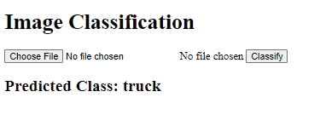

Application

