Slide 1
Data Analyst Certification Presentation
Presented by: Norbert Dzikowski

Slide 2
Project Overview and Business Goals
Objective: Analyse sales data to uncover actionable insights.
Problem Addressed:
Understanding which sales methods are most effective.
Identifying opportunities to increase revenue.
Business Goal: Optimize resource allocation to maximize revenue and improve sales efficiency.

Slide 3
Summary of Work Undertaken
Data Cleaning: Handled missing, duplicate, and inconsistent data to ensure accuracy.
Exploration: Investigated sales trends, revenue distributions, and method performance.
Metric Development: Established revenue per sales method as the key metric.

Slide 4

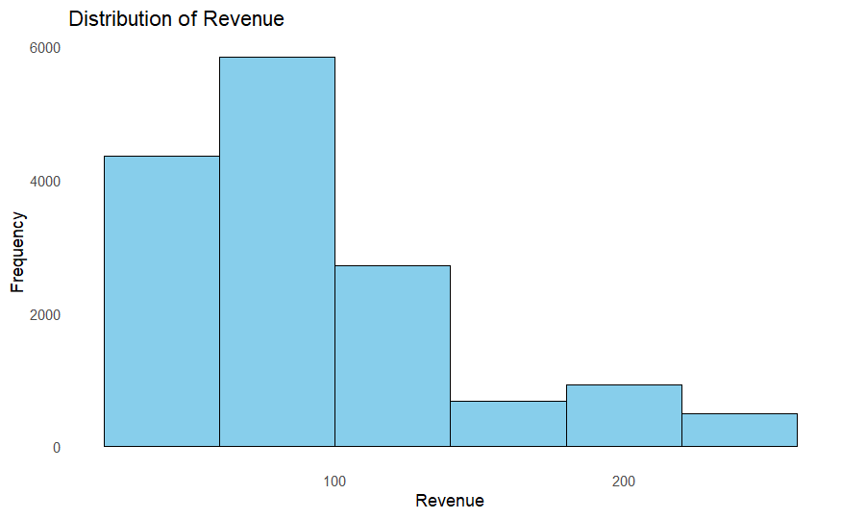
Revenue Distribution
The revenue distribution is right-skewed, with most transactions generating low revenue. This highlights an opportunity to focus on strategies, like upselling or targeting high-value customers, to increase average transaction value and overall revenue growth.

Slide 5
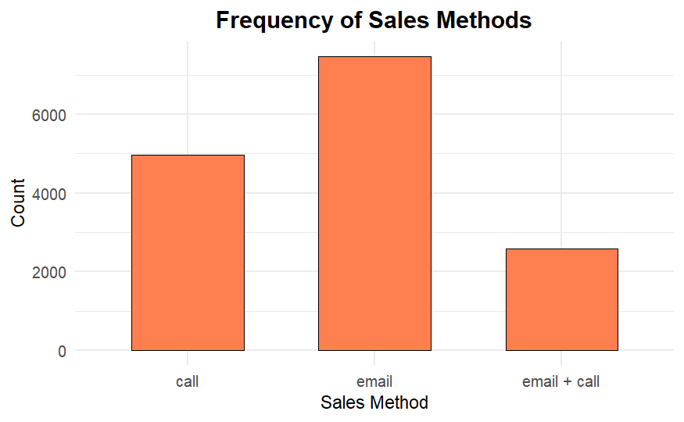
Frequency of Sales Methods
The bar plot shows the frequency of each sales method. The more frequent methods may indicate customer preference or team strategy. This analysis can guide decisions about resource allocation for different sales methods.

Slide 6
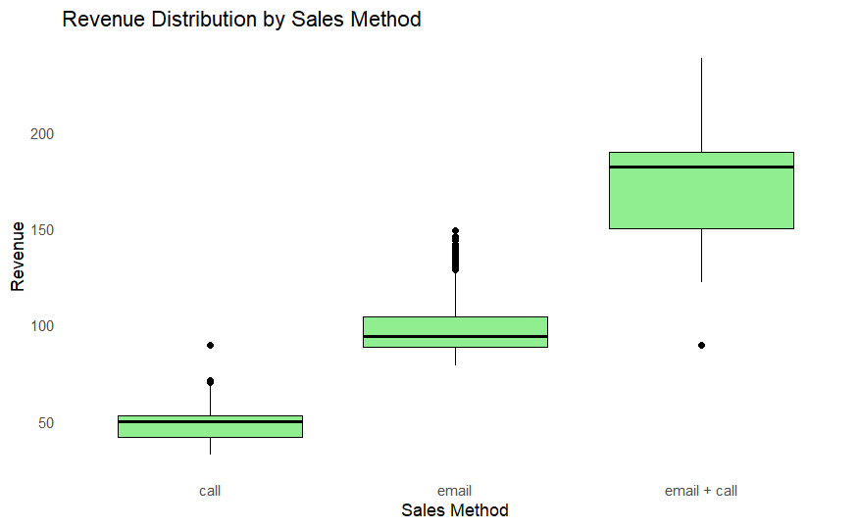
Revenue by Sales Method
Email + Call' generates the highest median revenue and widest range, making it ideal for high-value sales. 'Email' is cost-efficient for consistent, moderate revenue, while 'Call' is suited for targeted customer segments. These insights guide method-specific strategies to maximize revenue.

Slide 7
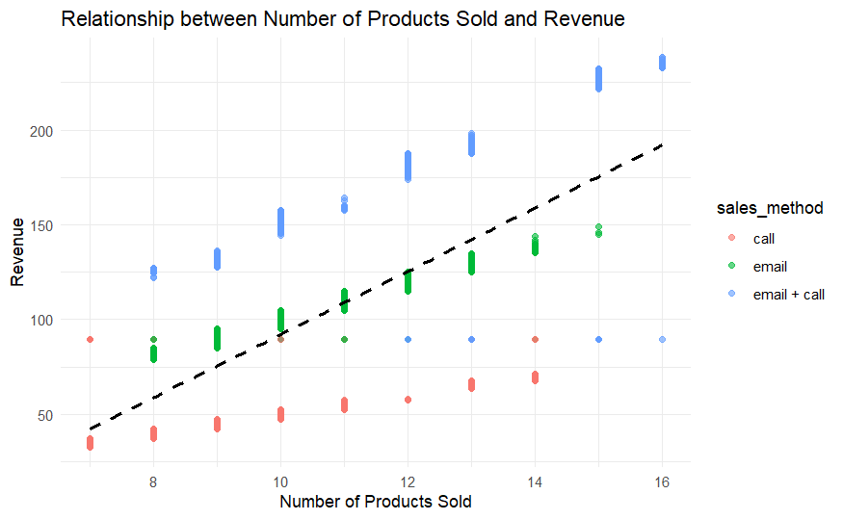
Relationship Between Products Sold and Revenue
The graph shows that revenue increases with products sold. "Email + Call" generates the highest revenue, "Email" is steady for moderate sales, and "Call" is less effective. Focus on "Email + Call" for maximizing revenue.

Slide 8
Key Metric: Revenue per Sales Method
Definition: Average revenue generated per method.
Importance: Helps identify which methods are most effective and deserve more resources.
Current Performance:
Call: 49,13
Email: 96,57
Email + Call: 170,88

Slide 9
Key Findings
Most transactions generate low revenue, with opportunities to increase average value.
'Email + Call' drives the highest revenue; 'Email' is cost-efficient; 'Call' suits targeted high-value clients.
Average revenue per method shows 'Email + Call' is most effective.
Higher units sold lead to greater revenue, highlighting bundling opportunities.

Slide 10
Recommendations to the Business
Scale Up Email and Email + Call methods:
Email for cost-effective customer engagement (e.g., newsletters, promotions).
Email + Call for high-value follow-ups and personalized communication.
Focus Call-Only on High-Potential Customers:
Prioritize key accounts and potential high-value clients.
Develop criteria for customer selection based on purchase history.
Impact: Maximizes revenue while optimizing resource allocation.

Slide 11
Conclusions
The analysis highlights key opportunities to optimize sales strategies. 'Email + Call' stands out as the most effective method for high-revenue transactions, while 'Email' offers a cost-efficient solution for consistent, moderate revenue. The 'Call' method, though less frequent, shows potential when targeted toward high-priority or high-value customers. By aligning sales efforts with these findings, the business can enhance resource allocation, improve efficiency, and drive overall revenue growth.

