Slide 1
eSchool
Web app for schools
Norbert Chmiel

Slide 2
Goals
The main goal of project is to develop an web app for middleschools with:
main page for visitors
school register
file uploads and sharing system

Slide 3
Main page
newsfeed
school history and contact
user authentication system for teachers, students and news writers, with profiles
Progress: 15%

Slide 4
School register
access for teachers and users
lessons management with presence lists
grades and notes management
management panels for classes supervisors
Progress: 35%

Slide 5
Files uploading and sharing system
access for teachers and users
system allowing sharing files for whole classes at one moment
grades and notes management
management panels for classes supervisors
Progress: 75%

Slide 6
Many more will come!

Slide 7
SHOWTIME

Slide 8
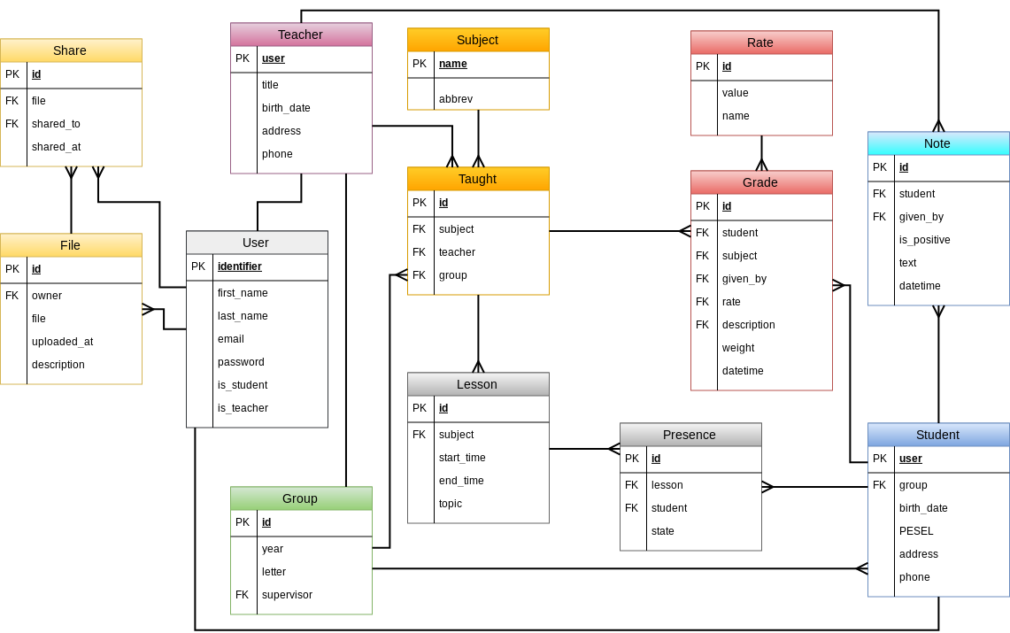

Slide 9
Q&A, suggestions?

