Slide 1
Accumulation mode number concentrations in the Arctic: Observations vs models Bjørn Gilje Lillegraven
Group 4, assistant: Olga Garmash

Slide 2
Introduction
Optical properties (AOD) are underestimated by models during Arctic winter/spring (Glantz et. al, 2014)
Hypothesis: This is related to the underestimation of accumulation mode aerosols in models during winter/spring (Arctic Haze) .
I have been looking at size distributions from three stations and compared them to models, with main focus on the accumulation mode.

Slide 3
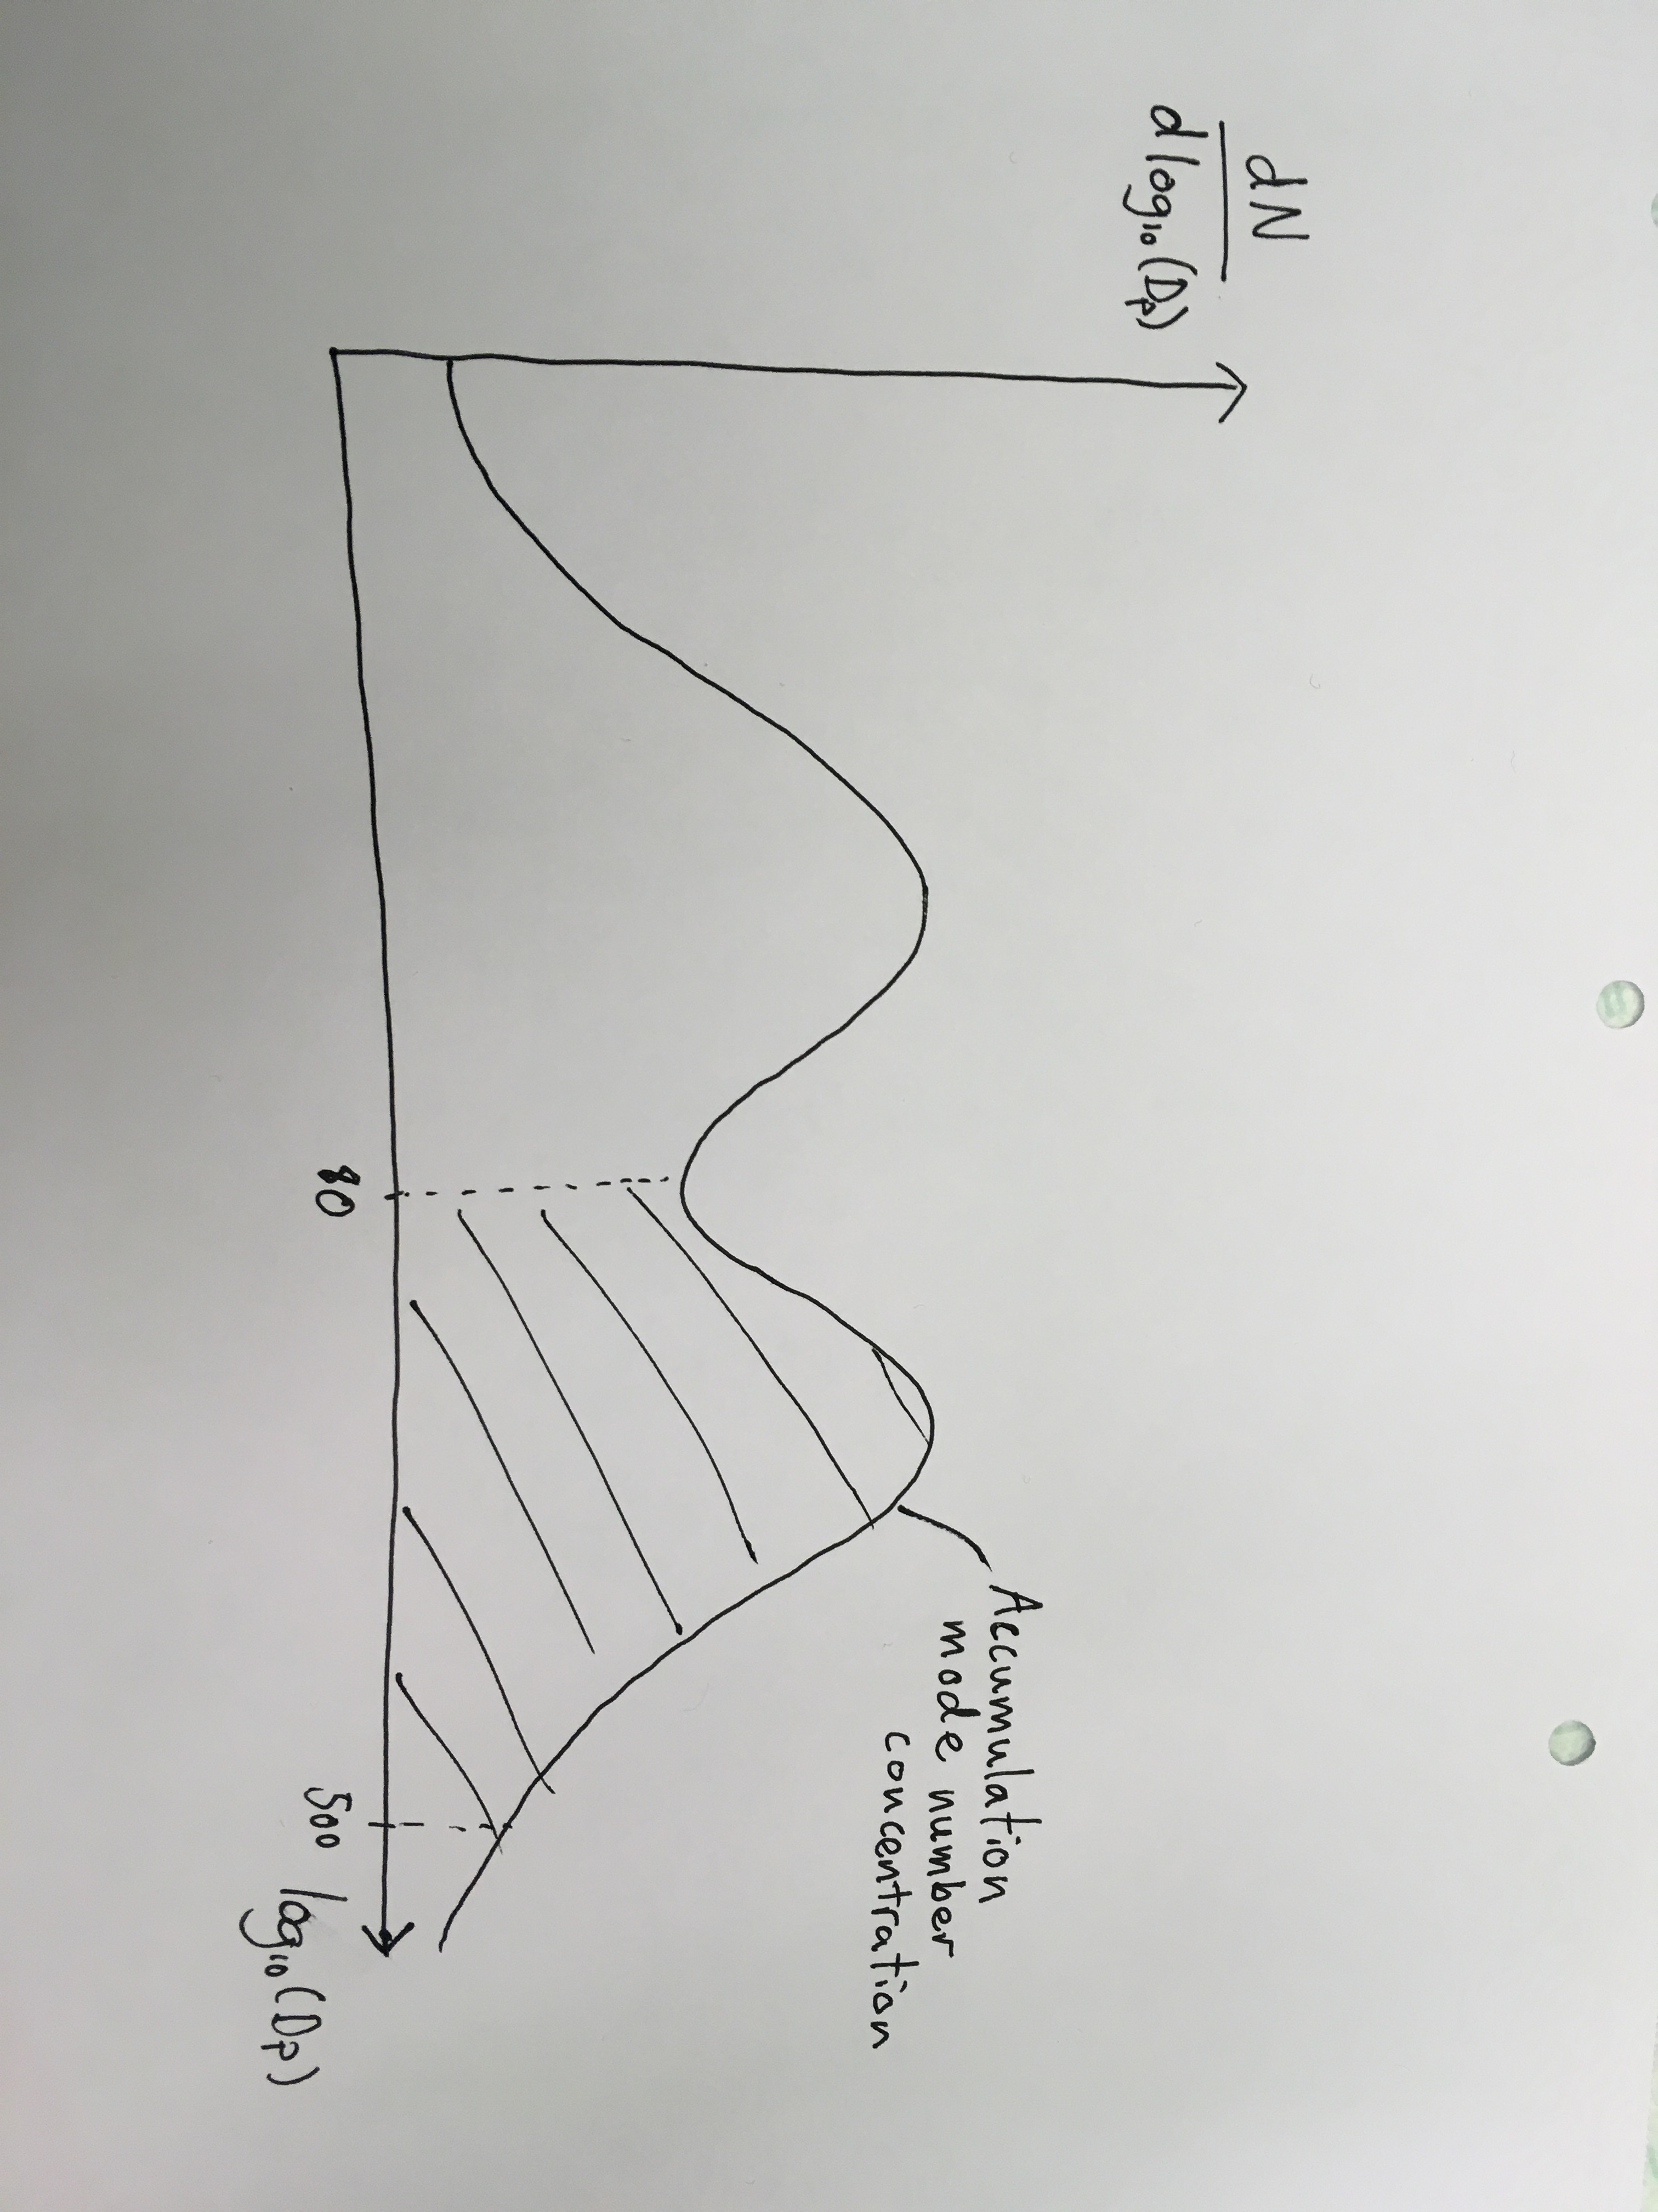
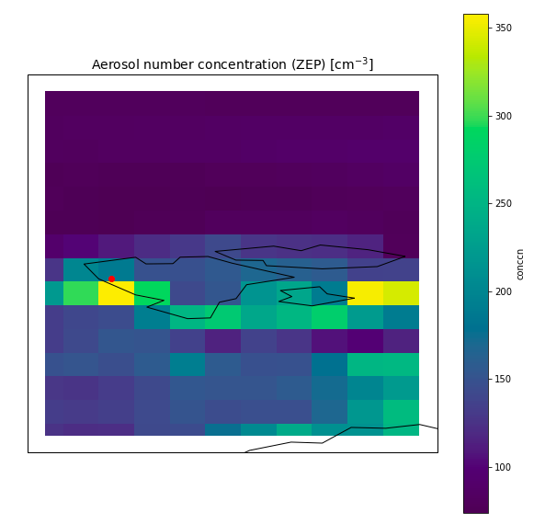
Methods
Data sets: NorESM2-LM data for size distribution, UKESM1-0-LL data for total number concentration
Observations of aerosol size distributions from Zeppelin (Svalbard), Alert (Canada) and Tiksi (Russia) using Differential/Scanning Mobility Particle Sizer
Number concentration from size distribution
Averaging over grids because of coarse model resolution
Concentration [cm⁻³]
May 2010, UKESM1-0-LL
Notes:
Differential mobility particle sizer (DMPS) or scanning mobility particle sizer (SMPS), dry aerosol measurements. Assume spherical geometry (error source, not big though).

Slide 4
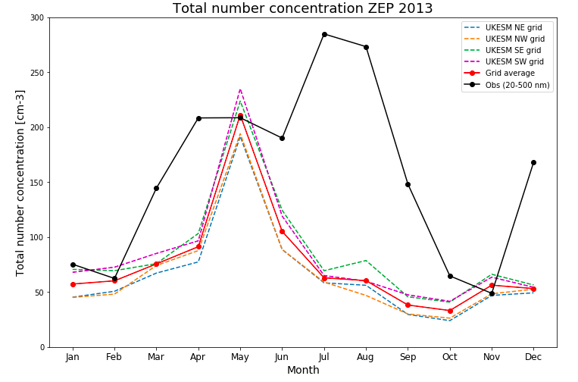
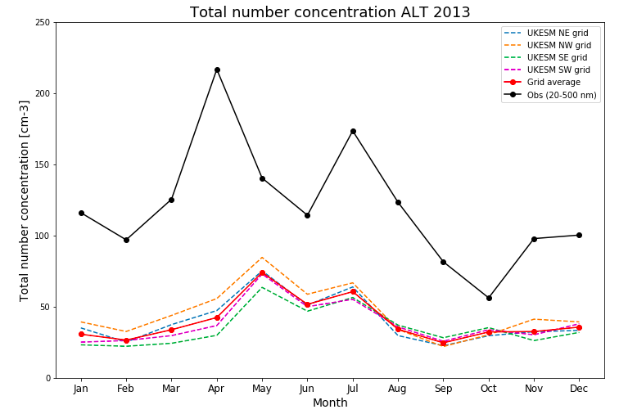
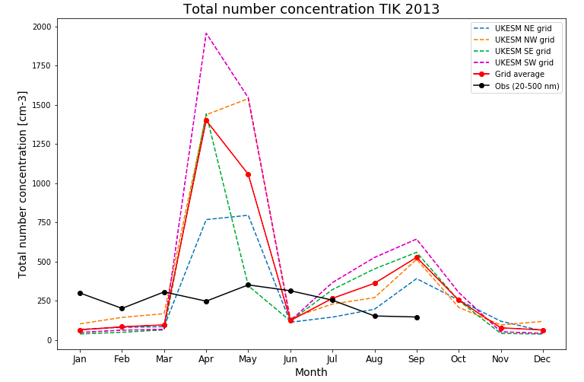
Results
Comparing total number concentration from UKESM to 20-500nm number concentration from observations
The model underestimates (and overestimates)
Notes:
We originally wanted to focus on tot num conc in spring because we know that the optical properties was underestimated in this season. Wanted to look at size distribution to see how acc mode aerosols were represented, arctic haze.

Slide 5
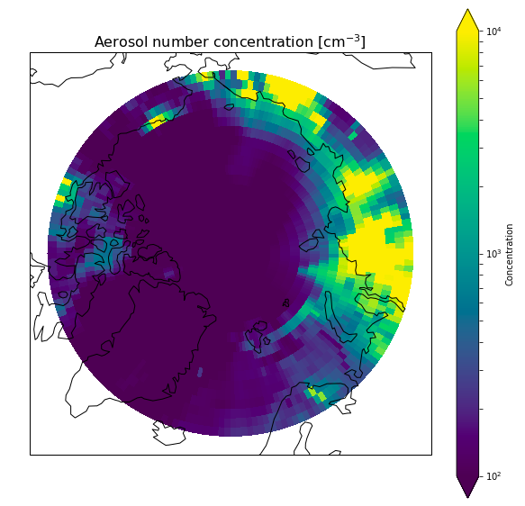
Results
Comparing total number concentration from UKESM to 20-500nm number concentration from observations
The model underestimates (and overestimates)
Concentration [cm⁻³]
May 2010, UKESM1-0-LL

Slide 6
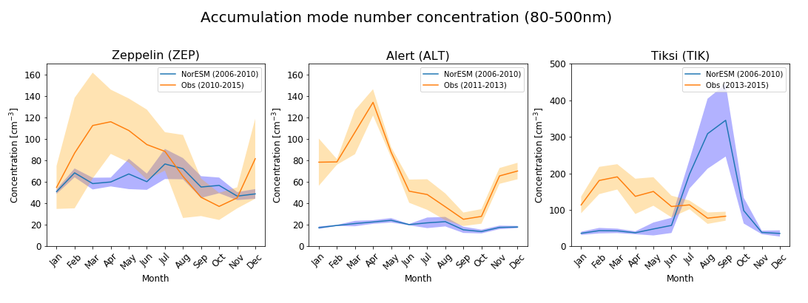
Results
Accumulation mode number concentration underestimated by NorESM during winter/spring for all stations
Notes:
Based on three NorESM control runs with nudged meteorology, meaning that it is not exactly as observed meteorology. Mean of these runs give the blue curves. Because of this nudged meteorology, it’s reasonable to compare the model to observations from a few years later, as it hasn’t changed much and would still be representative.

Slide 7
Conclusion and outlook
UKESM1-0-LL underestimates winter/spring concentration of aerosols at Zeppelin and Alert, while overestimating immensely for Tiksi in the same season.
NorESM2-LM underestimates winter/spring concentration of accumulation mode aerosols. This could explain the underestimation of AOD in spring (Glantz et. al, 2014).
Future work: Link to Dina’s work, chemical composition of the aerosols. Could also look at how smaller aerosols (20-80nm) are represented in NorESM2-LM.

