Slide 1
Aerosol Chemical Composition
Name: Dina Stabell
Group: 4
Assistant: Olga

Slide 2
Introduction
Motivation:
Aerosol chemical composition affects optical properties
Arctic AOD poorly represented in models during spring
Hypothesis:
The models does not get a representative chemical composition of aerosol during spring in the Arctic
I have studied:
The chemical composition of aerosols at Zeppelin
How well different aerosol species are represented in a model compared to the observations

Slide 3

Methods
Model data:
NordEsm2-LM (CMIP6 r1i1p1f1 run)
- The units were converted from mass mixing ratio to concentration
- Nearest point to Zeppelin reasearch station was found
Observations:
EBAS (concentrations of; sulfate, nitrate, ammonium and sea salt)
- Measured with filter 3pack
Radovan Krejci and Ulla Widequist (concentrations of organic aerosols and elemental carbon)
- Measured with OC/EC instrument
Time frame:
May 2006-May 2009
IT tools:
Sigrid and pandas

Slide 4
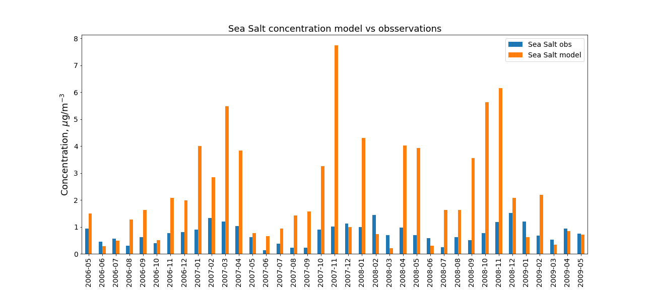
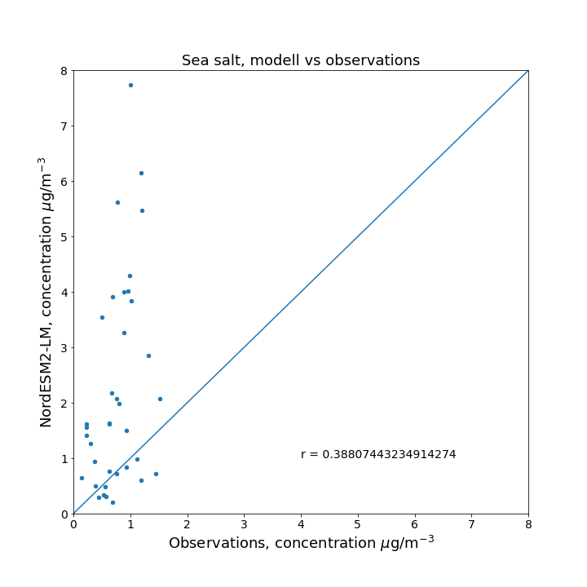
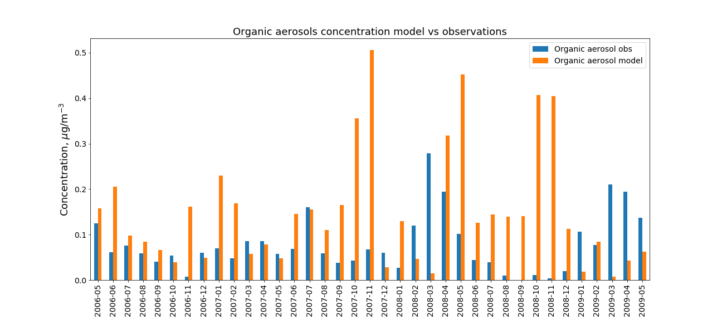
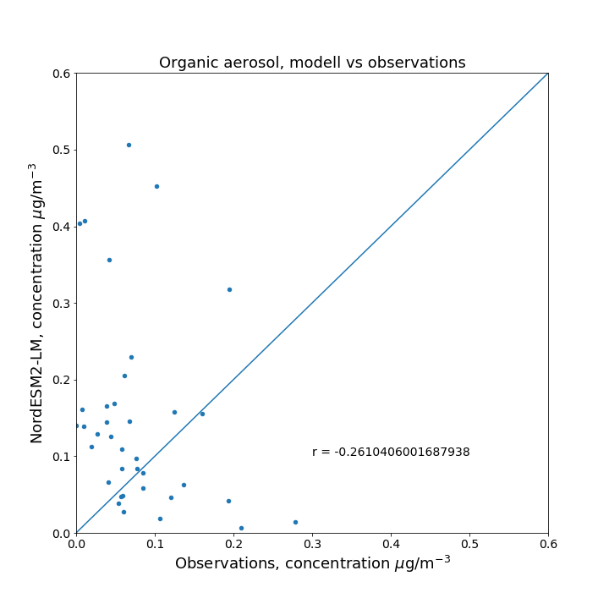
Results

Slide 5
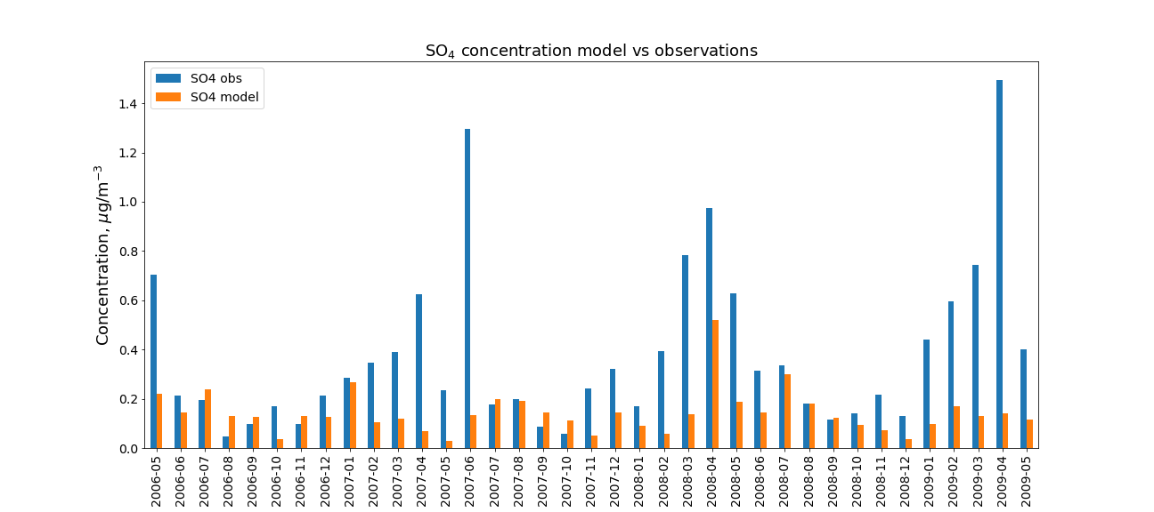
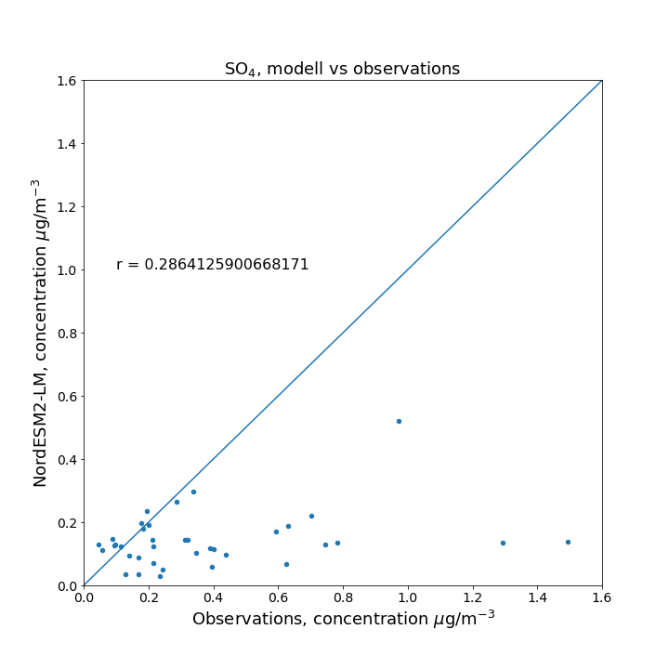
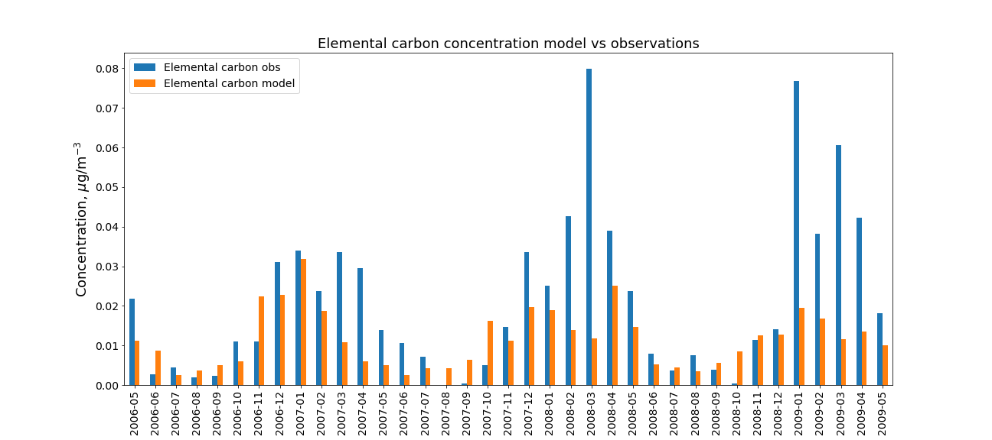
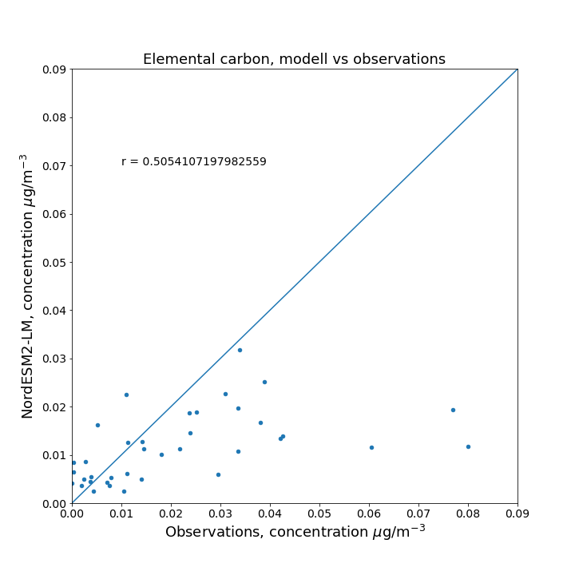
Results

Slide 6
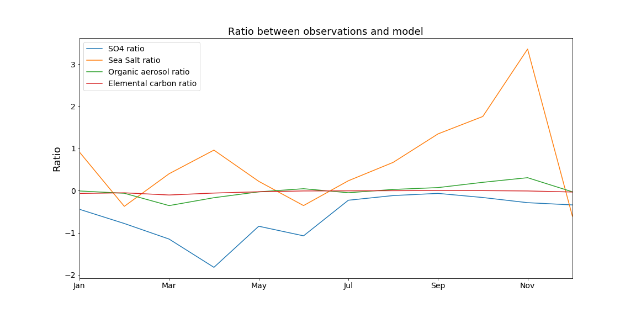
Results

Slide 7
Conclusions
Main findings:
Underestimation of sulfate and elemental carbon during arctic haze season
Overestimation of sea salt
Learning outcomes:
Better understanding of data analysis
Outlook:
Include more models
Look at other stations
Look at trends (if models can reproduce the long term trends)

Slide 8
Thank you!

