Slide 1
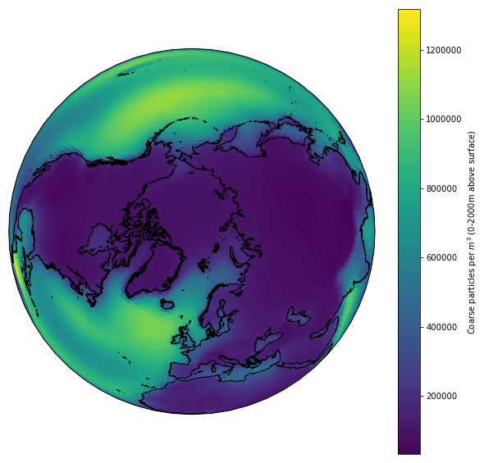
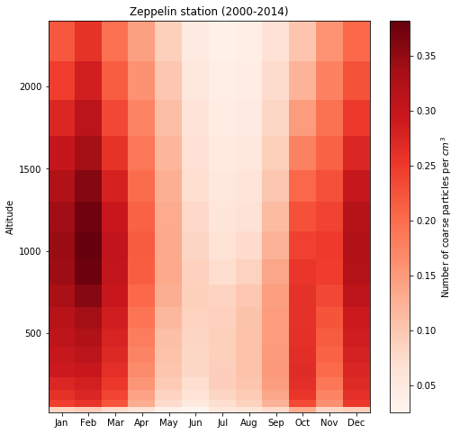
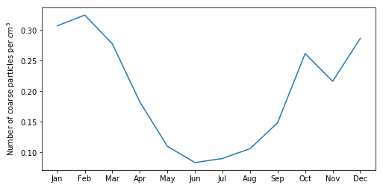
Gabriel Pereira Freitas
Stockholm University
Coarse
Particles
In Polar regions
Group 1
with Johaness
Ass.: Paul Z.
23 – October – 2019 Abisko, Sweden

Slide 2
Introduction
Motivation
Coarse particles are the ones bigger than 1 μm
Coarse particles are important for radiative effects and cloud formation (i.e. giant cloud condensation nuclei)
My own current measurement at Zeppelin with a MBS to study coarse particles (e.g. biological particles) and their importance for cloud formation
Coarse mode in the Arctic in models:
Year trends?
Are they relevant for radiative forcing?
Representation in models:
Only few models generate their concentration as a variable
Mostly, only sea-salt and dust particles are considered

Slide 3
Introduction
Objectives
Compare observations and historical model data
Yearly trends of coarse particles in the Arctic (and Antarctica)
Which model better represents the observations?
What are the parameters that drive coarse mode concentration?
Spatial and temporal variability
What will be the evolution of coarse particles in the Arctic for different climate scenarios?

Slide 4
Methods and Data
Observational data:
OPSS(FIDAS) at Zeppelin Observatory (2018-2019)
Arctic
APS at Neumayer (2011-2013)
Antarctica
Model data:
UKESM:
esm-hist, ssp126, ssp585
CESM2 and CESM-WACCAM:
historical, ssp126, ssp686

Slide 5
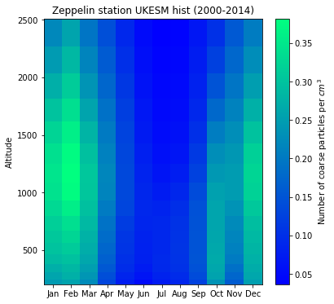
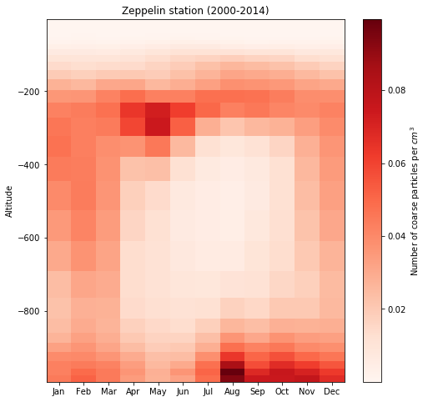
Results
Yearly and vertical variations
Zeppelin 2000-2014
UKESM
CESM2

Slide 6
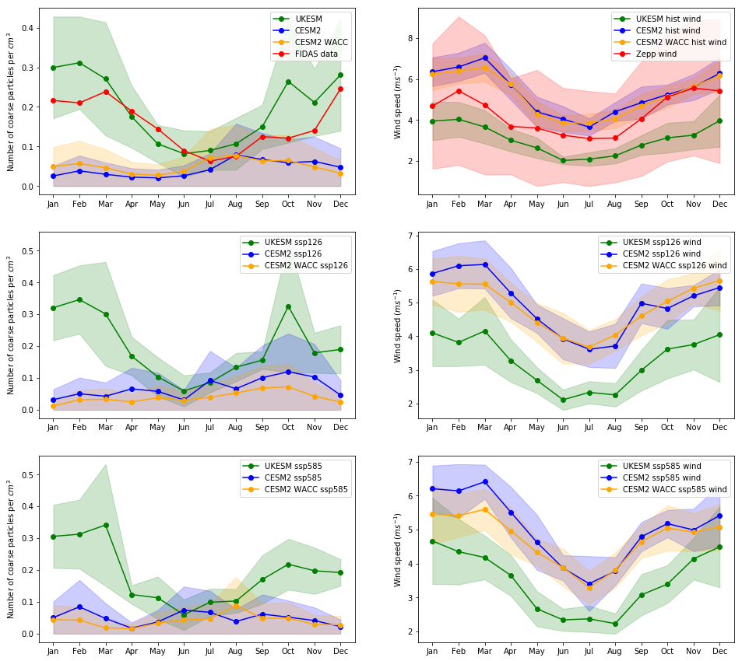
Results
H:2000-2014
S:2015-2020
OPSS 2018-2019

Slide 7
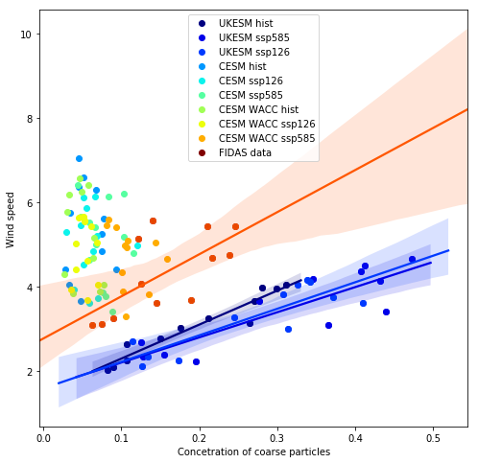
Results
Coarse mode vs Wind speed

Slide 8
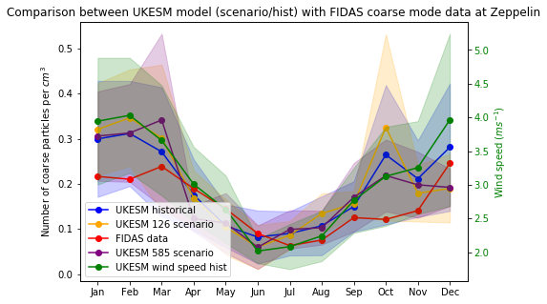
Results
Close-up for UKESM model

Slide 9
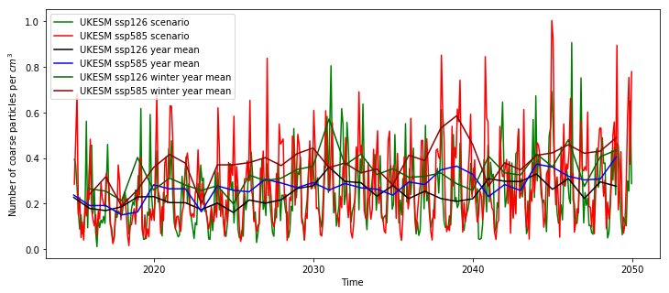
Results
Future trends for UKESM
2014-2050
50 - 100% increase in Coarse mode concentration in 30 years

Slide 10
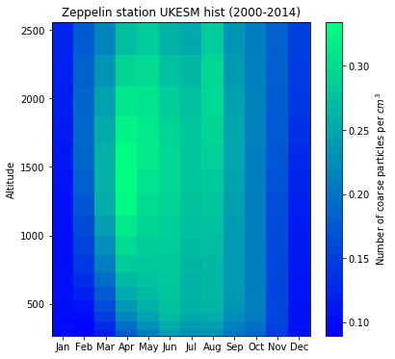
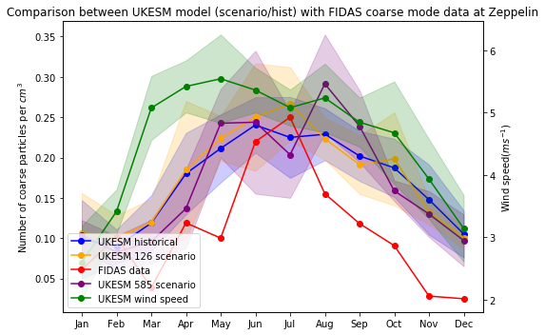
Results
A look to the other pole: Antarctica
Normalized (No instruction on the data files)

Slide 11
Conclusions
Coarse particles are prevalent in the winter
UKESM better represents observations
Although wind speeds do not clearly match
Dependence on wind is not straightforward
Both 126 and 585 scenarios represents almost the same increase in coarse mode concentration
CESM2 and CESM2-WACC don’t have good parameterization for coarse particles

Slide 12
Outlook
Report
Future
Retrieve coarse mode data from other sites (Barrow, Alert…) and compare to models
Learn how coarse mode particles are parametrized in the models. What are the main variables that drive these concentrations?
What is the UKESM model taking into account that CESM2 and WACC doesn’t?
Correct data from Neumayer for better comparability between modelling in north and south pole
Effect on radiative forcing
Continue monitoring our OPSS at Zeppelin
How can we enhance coarse mode representation in models

