Slide 1
Johan Midtgard Raniseth AOD and trends of observational data and model data Group 3 Assistants: Michael & Diego(The Python Wizard)

Slide 2
Motivation and what I've been doing
Aerosols are a large uncertainty in models.
Evaluating model performance with observations.
Model evaluation of CANESM5 AOD by comparing model and observed.
Trend calculation for different regions based on AOD observations.
To be done: Model evaluation of CANESM AOD trends by looking at model and observed trends.

Slide 3
Model and observational data
Data sets: CANESM5(r1i1p1f1) - historical
Observation data: Aerosol optical depth('od550aer') from AERONET LEV 2._{[1][2]}
Software: Anaconda(JupyterHub)
Dependencies:
Python 3.7.3 Pyaerocom 0.8.1.dev4 Pandas 0.25.2 Numpy 1.17.2 matplotlib 3.1.1

Slide 4
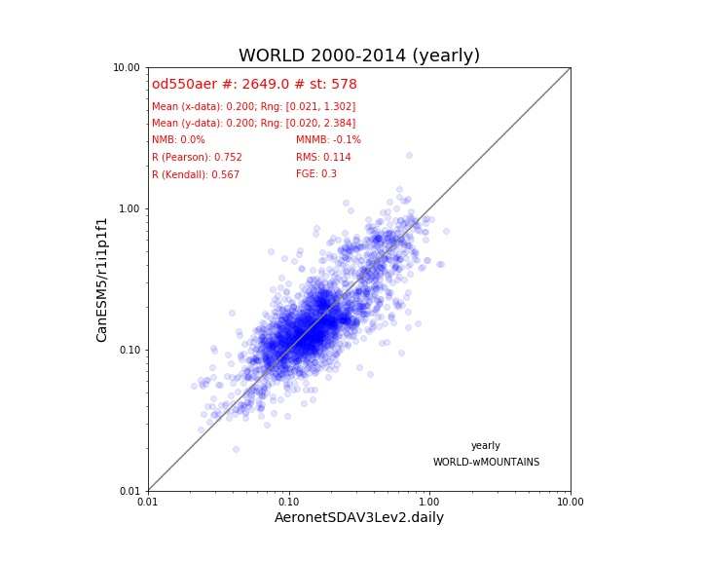
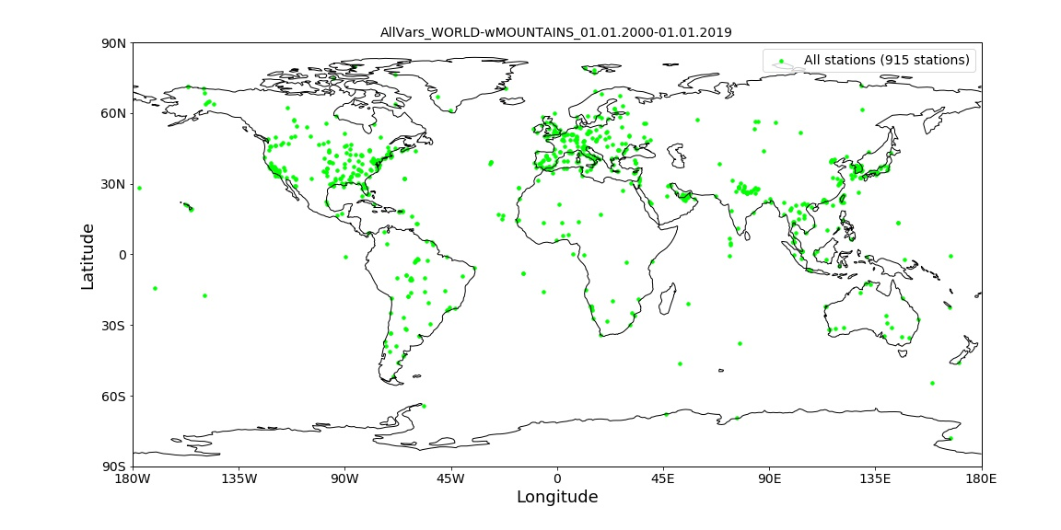
Results - Comparison between model and observations

Slide 5
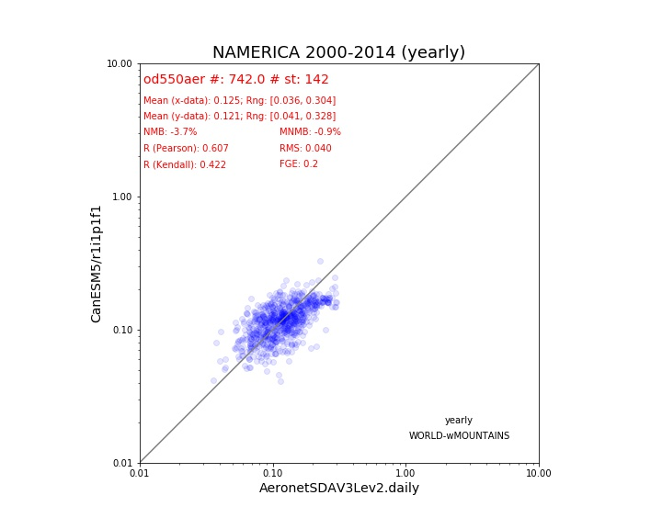
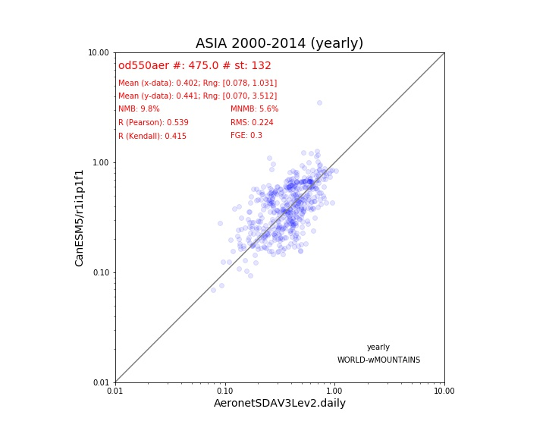
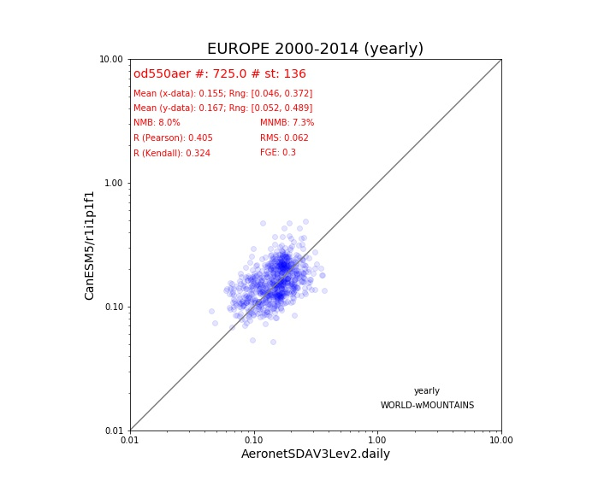
Results - Comparison between model and observations

Slide 6
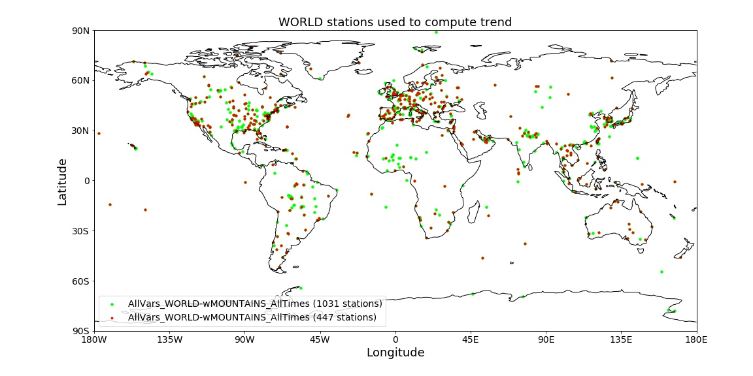
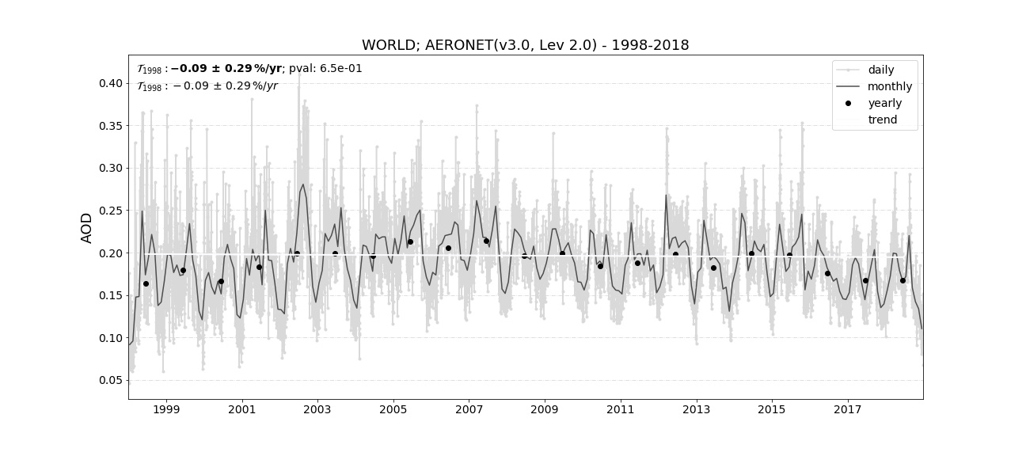
Results - Trend of AOD World

Slide 7
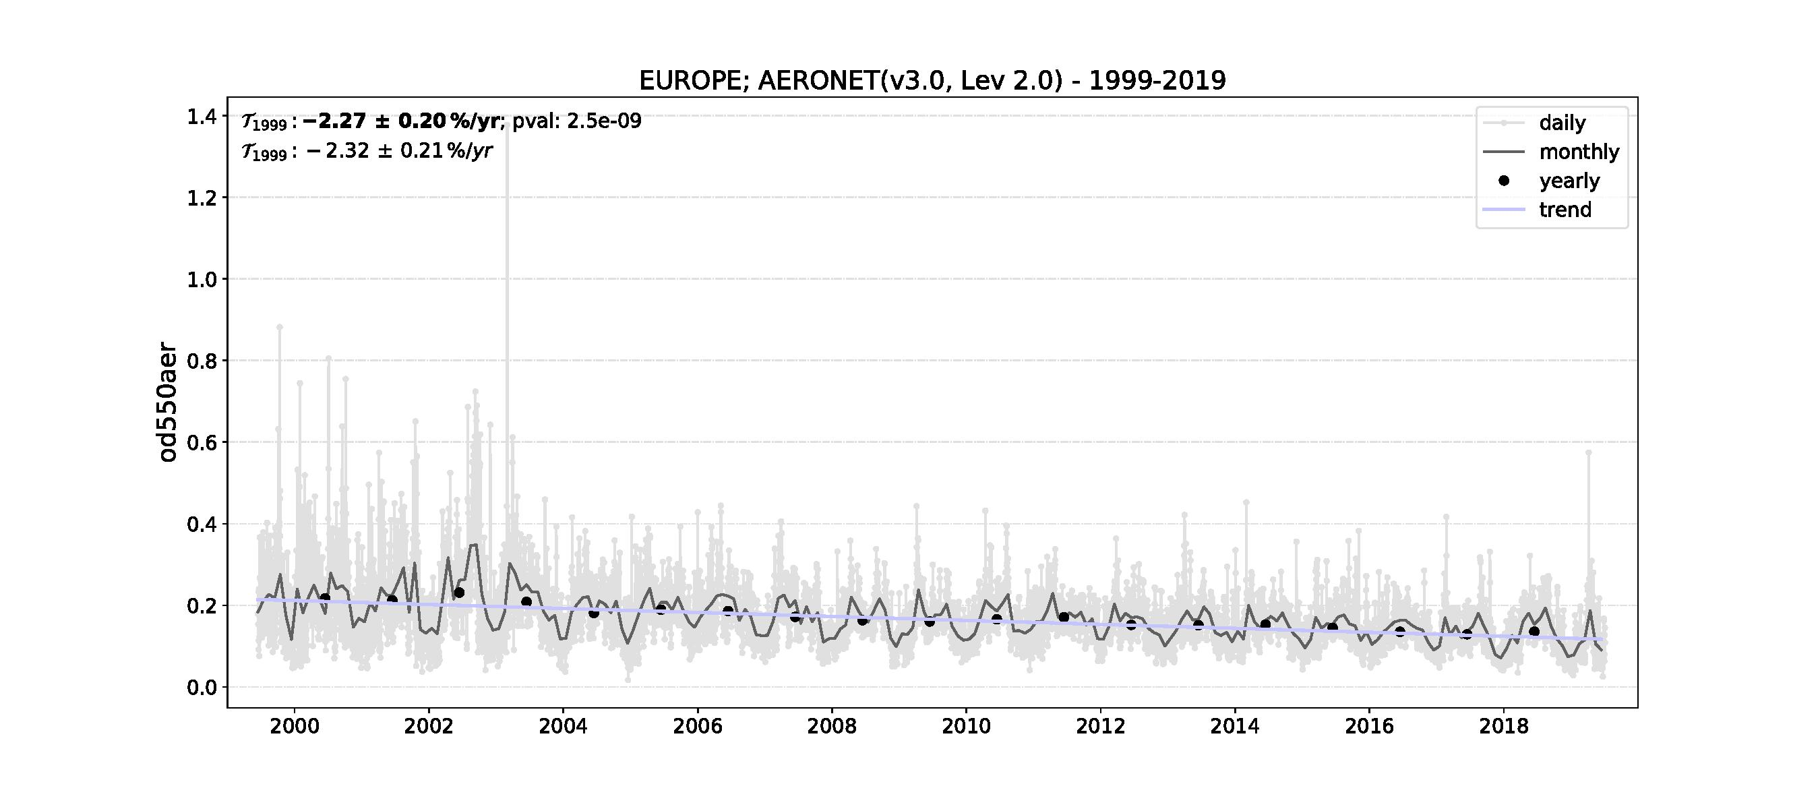
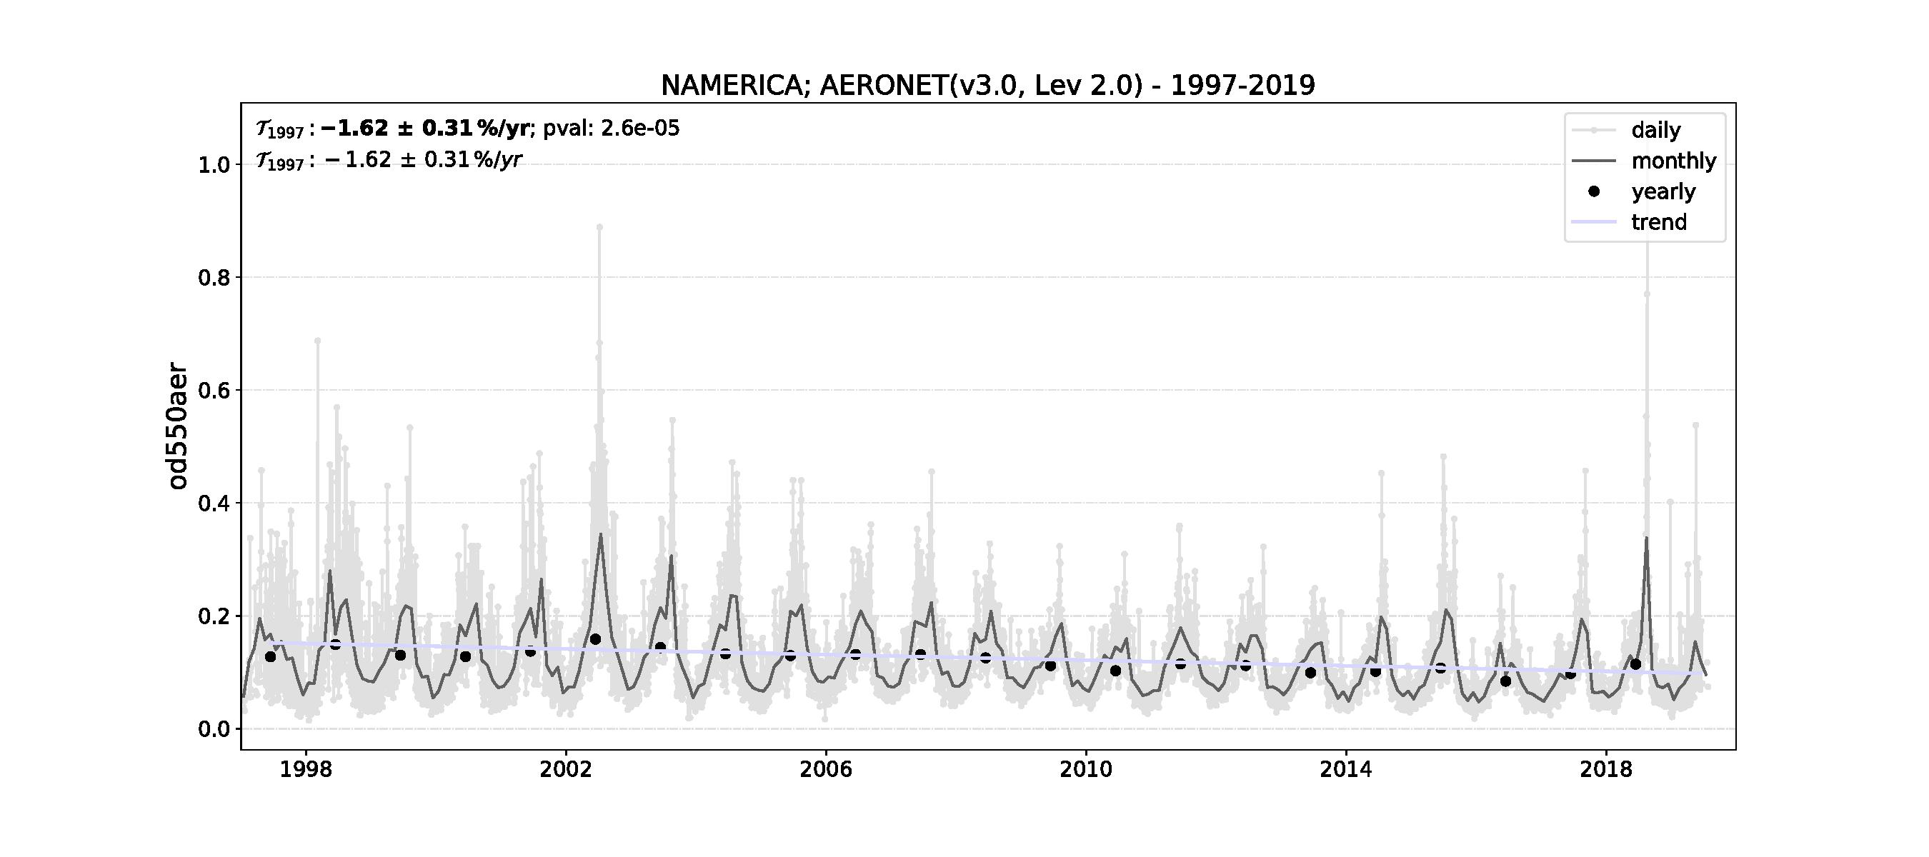
Results - Decreasing regional trends
Notes:
Here we have Europe and North America. Both decreasing trendss

Slide 8
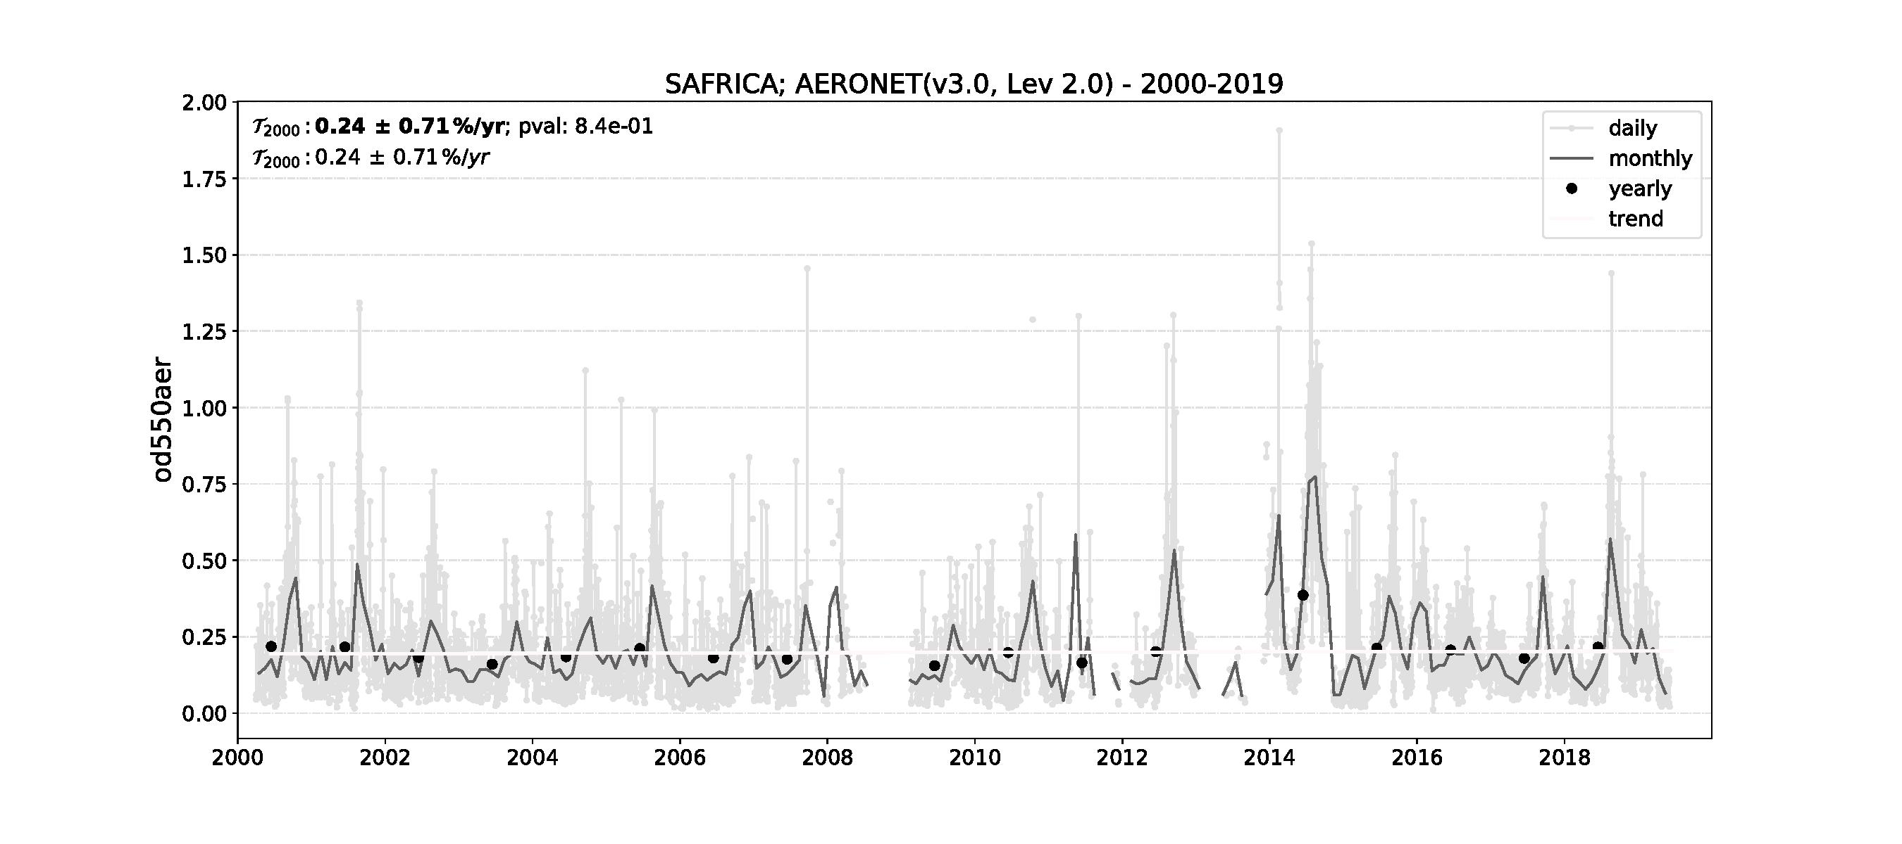
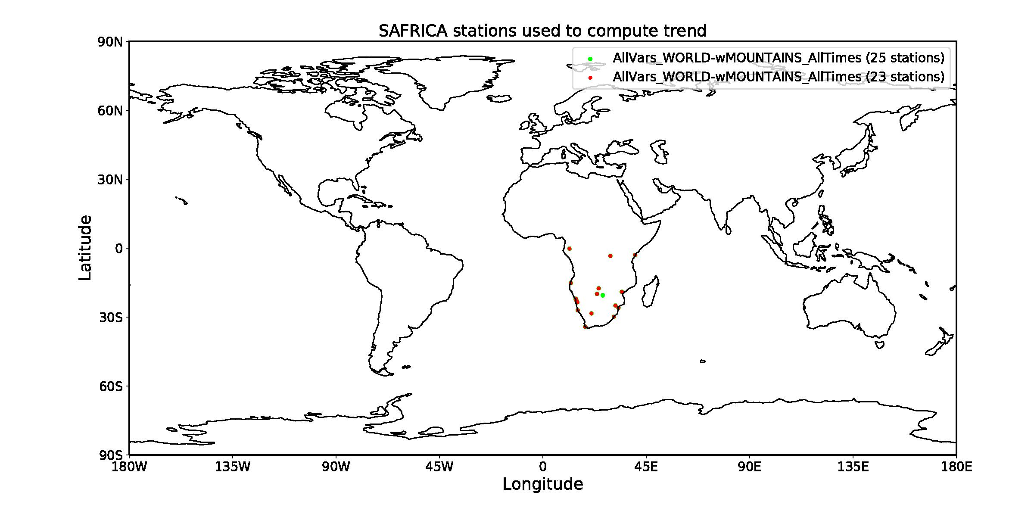
Results - Insignificant regional trend

Slide 9
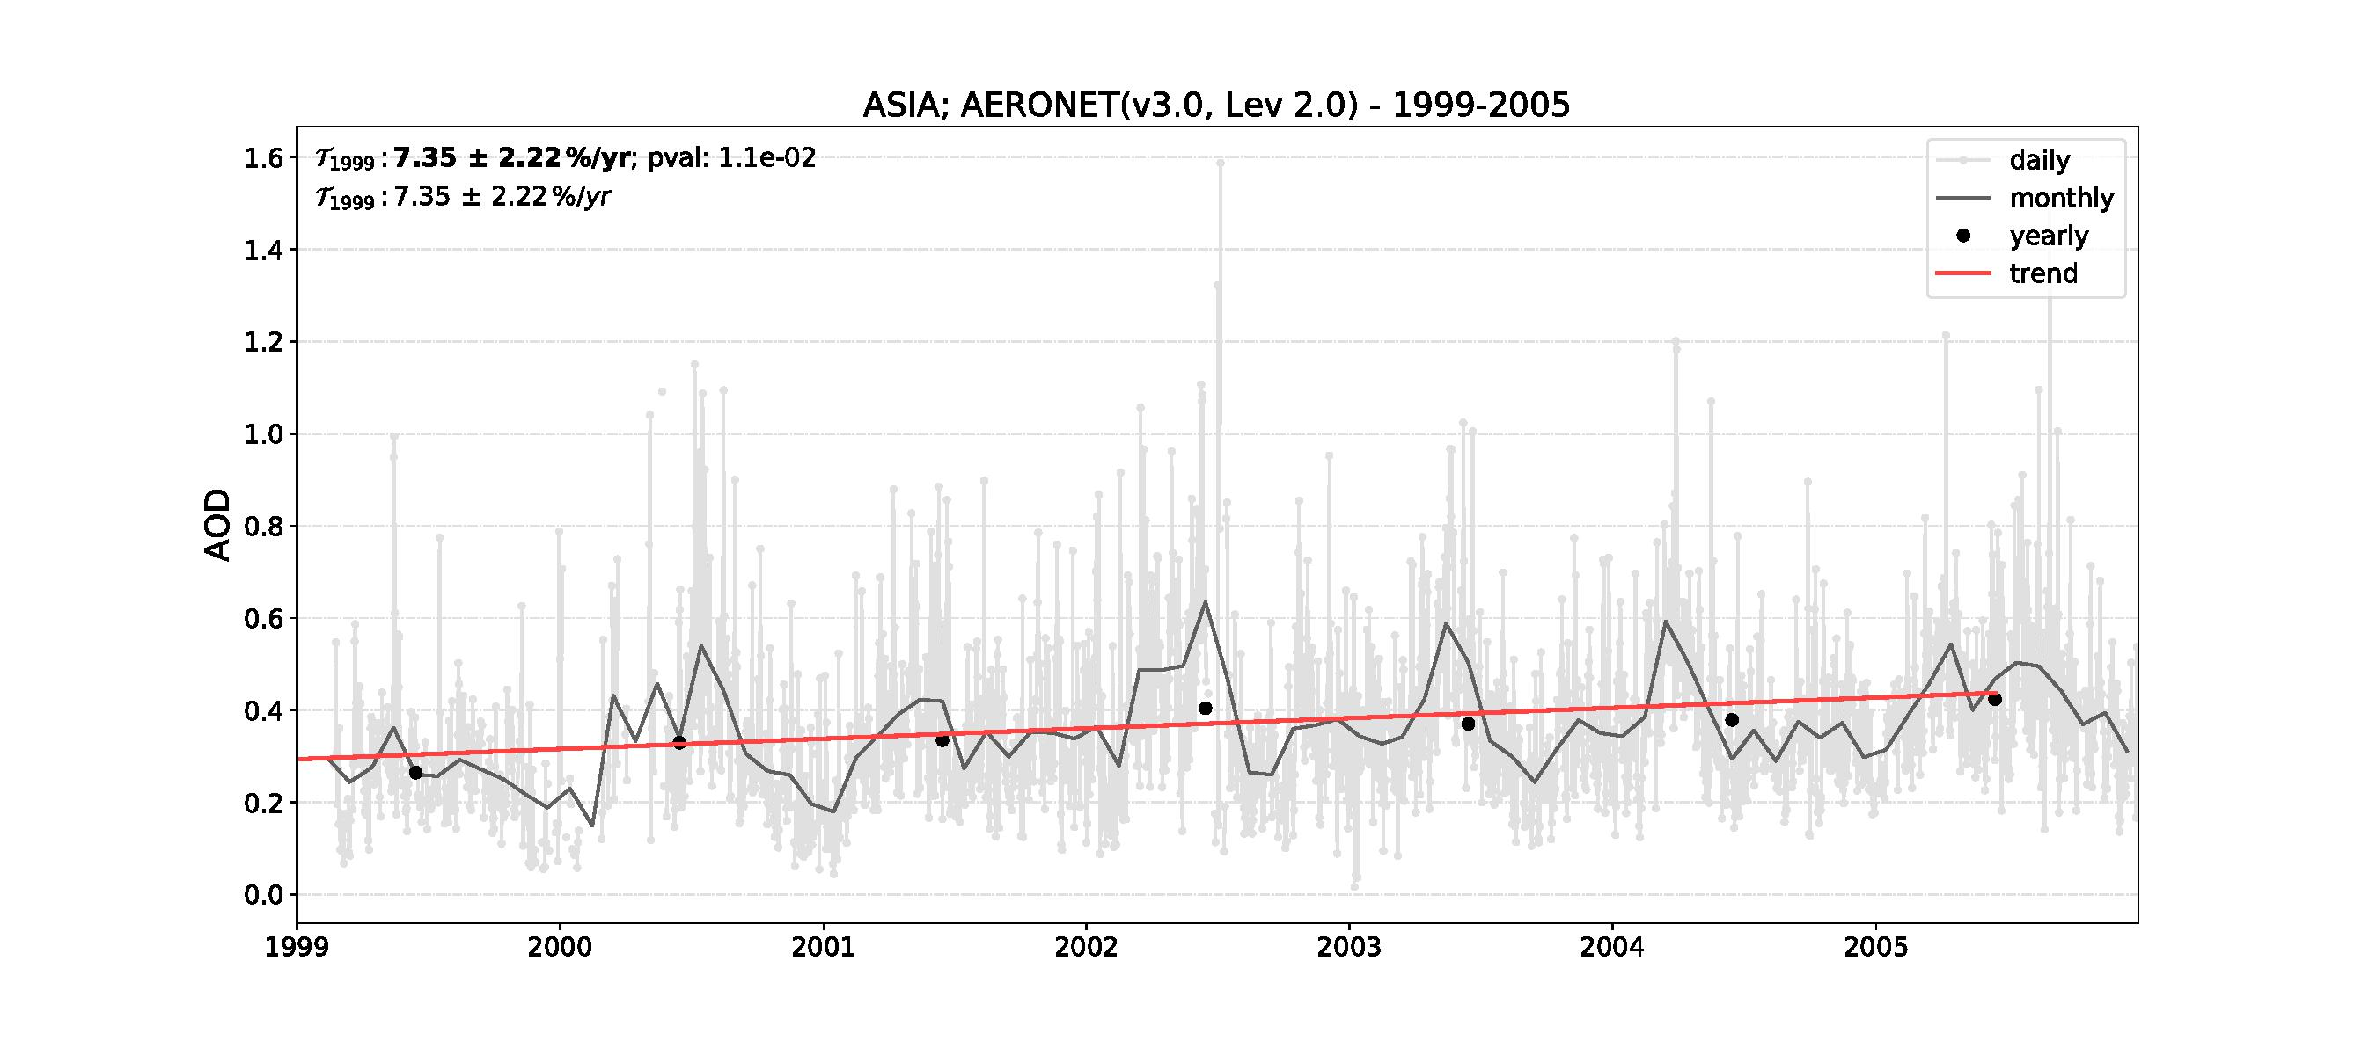
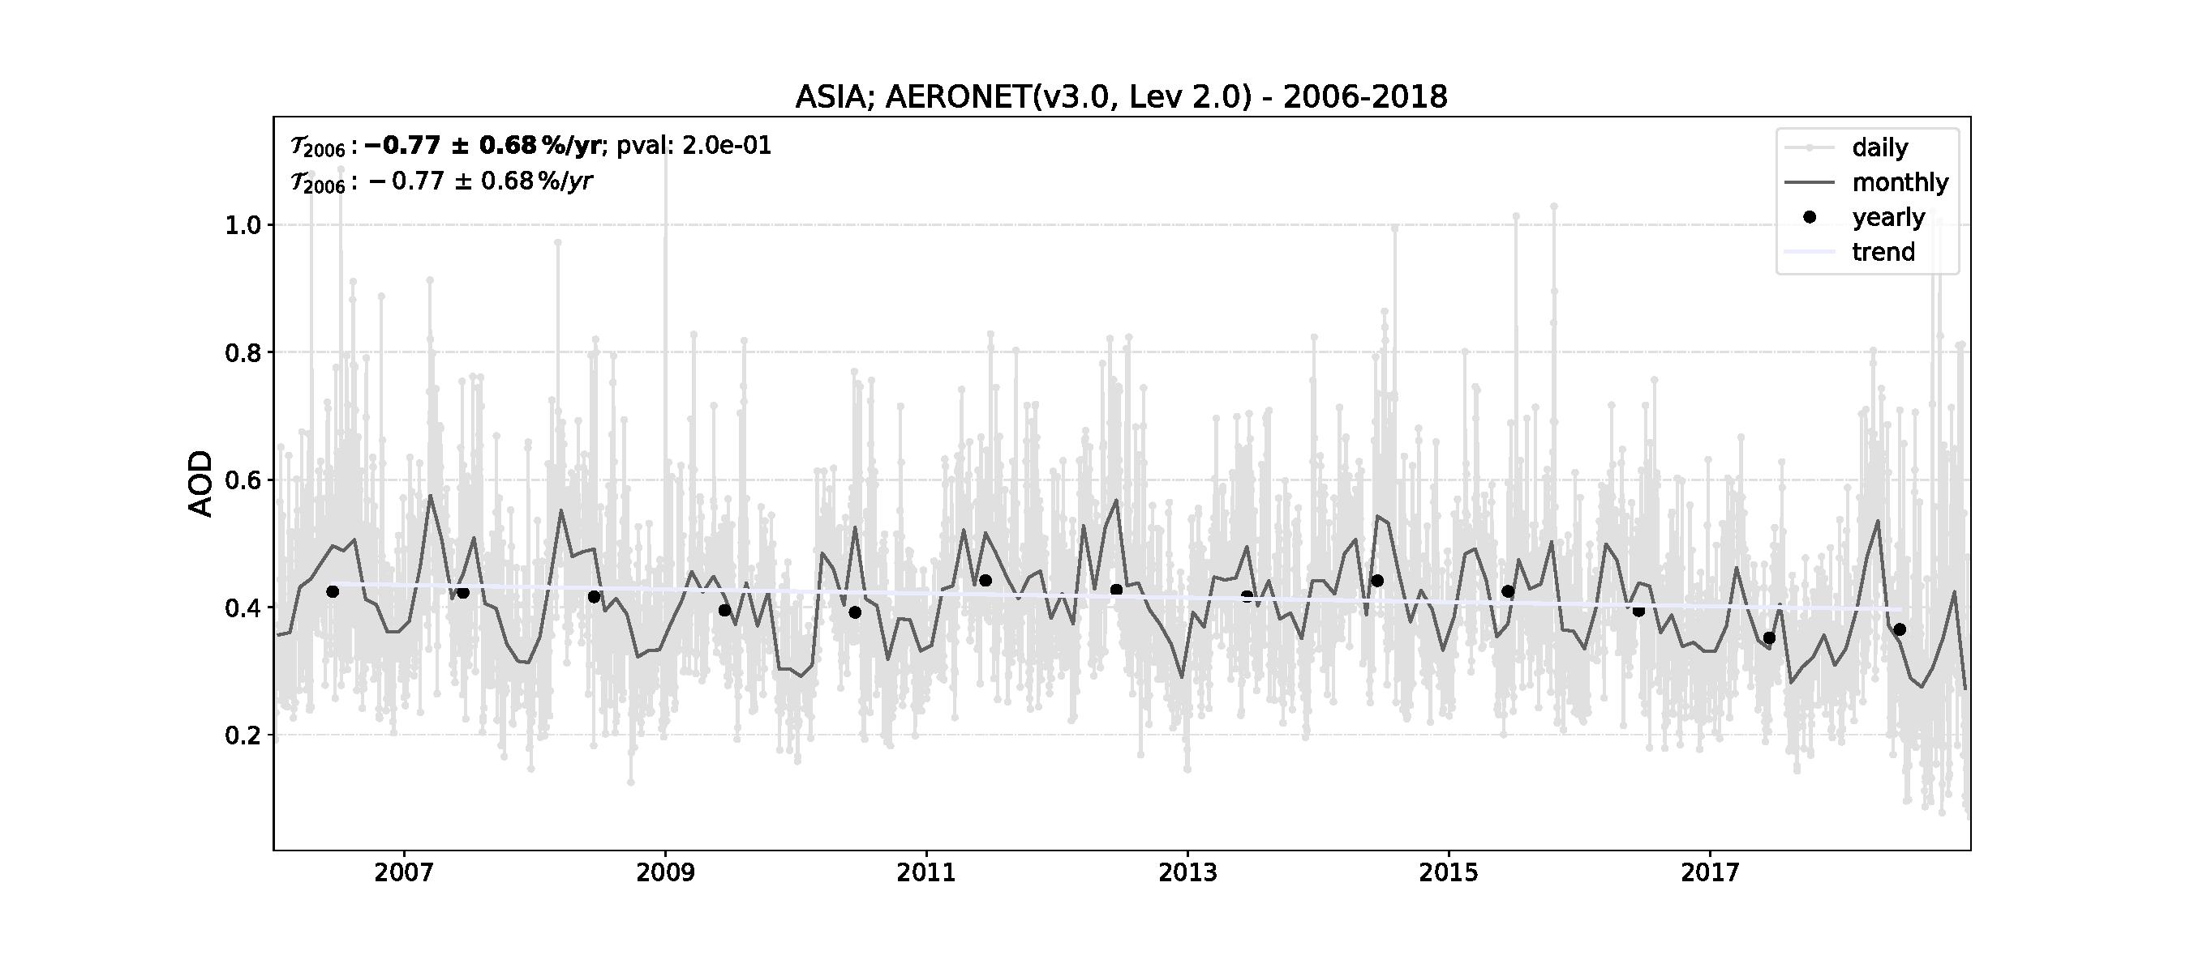
Results - Asia trends
Regulation of emissions in newer time?

Slide 10
Conclusions
CANESM5 seems to reproduce the AERONET observations fairly well. Few extreme outliers in the scatter plots.
Europe, America and in later time Asia all have decreasing trends.

Slide 11
Future work/on the train home
Create and compare trends from the model with observational data.
Questions to answer: - Is the trends equal for the same region in model and observations? - Are regions with better cover of ground based measurement stations gonna compare better with the model? - Could be a sign that the model might be doing well globally but that regions with bad station coverage are impacting the global comparison.

Slide 12
References
[1] https://aeronet.gsfc.nasa.gov/new_web/index.html
[2] https://aerocom-trends.met.no/-> datasets
“Aerosol Trends.” A. Mortier, J. Gliss, M. Schulz
“Historical aerosol forcing diagnosis and analysis in CMIP6, AerChemMIP and AeroCom models.” Michael Schulz, Dirk Olivie, Jan Griesfeller

