Slide 1

Open Research Demonstrator
NICEST – Climate Community
Anne Fouilloux
University of Oslo, Norway
Nordic Infrastructure Collaboration on Earth System Tools (NICEST)

Slide 2
What do we have to offer to EOSC-Nordic?
A community focused on understanding, quantifying and reducing uncertainty in projected northern latitude climate change and in particular rapid Artic warming.
Research objects for Climate Research:
Earth System Models
Source codes and all the necessary input data, grids, etc.
Workflows to run the model in a reproducible way
Conda package, docker/singularity containers for running the models
Bespoke tools for processing and visualization
Interactive plotting, 3D visualization, post-processing utility suites (diagnostics)
Well established Nordic collaborations and multi-disciplinary aspects
Earth System Grid Federation (ESGF) data node administration & use
Parameterization of subgrid processes based on machine learning techniques

Slide 3



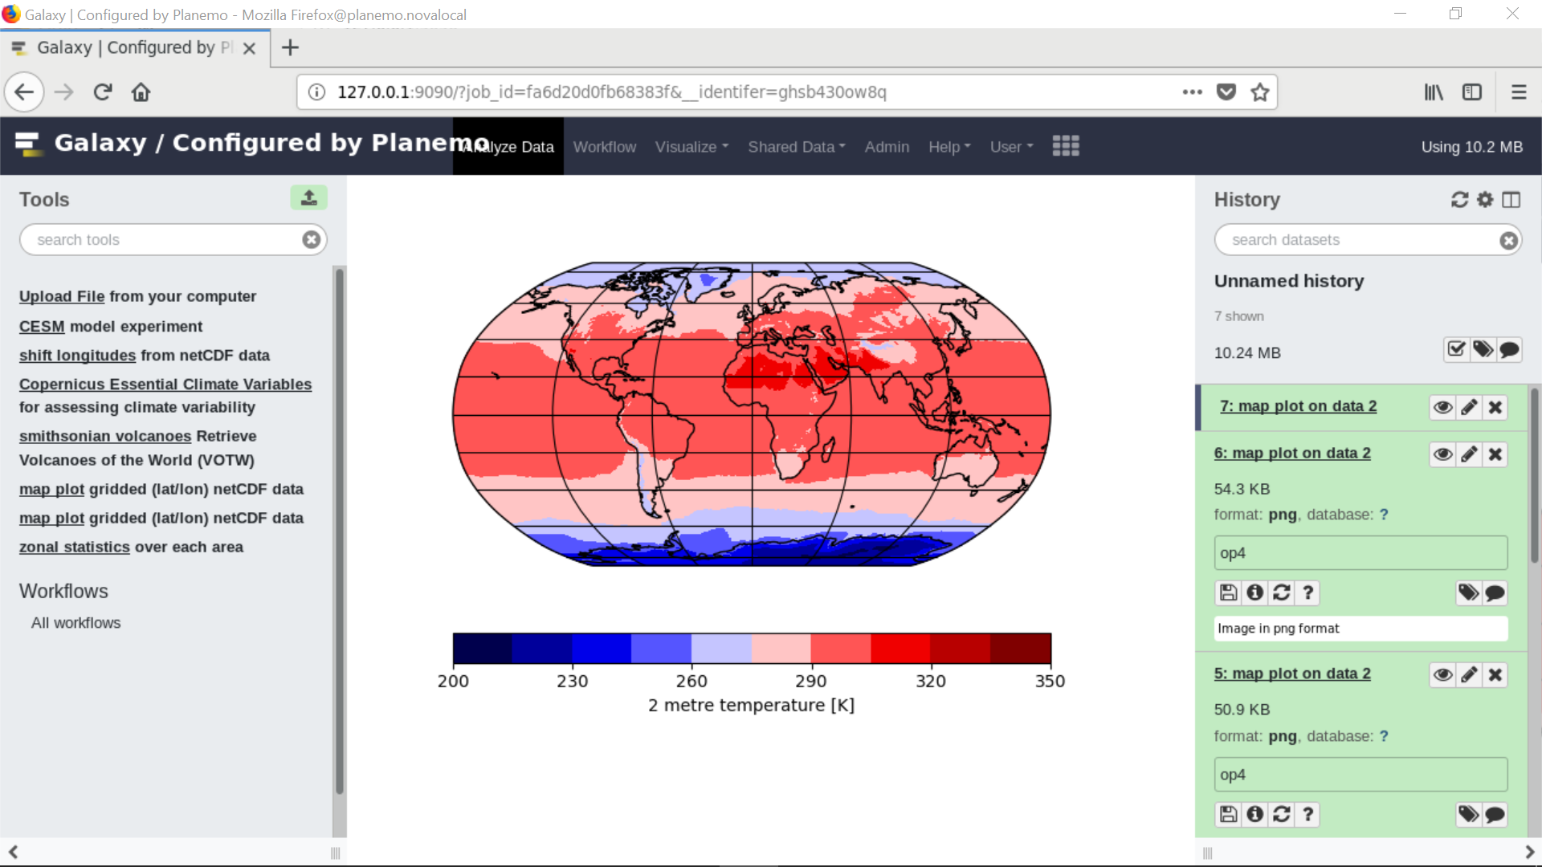

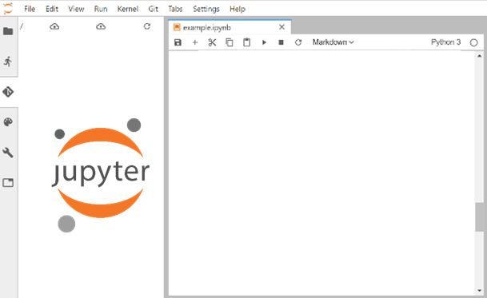

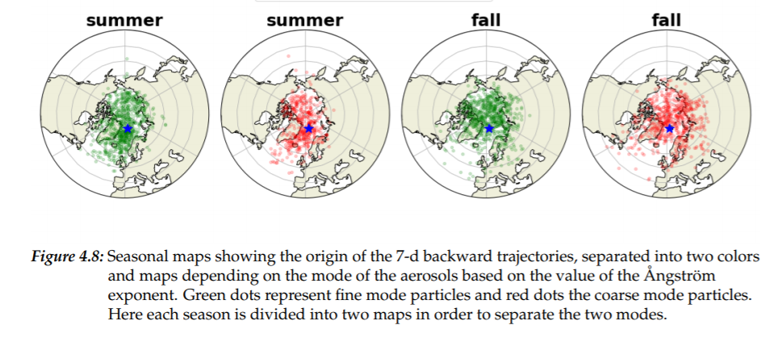


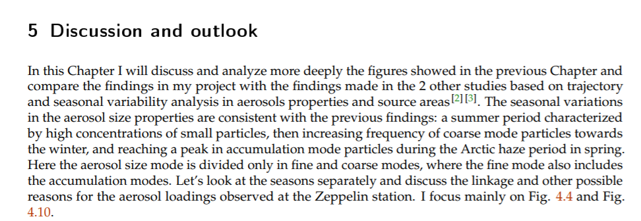

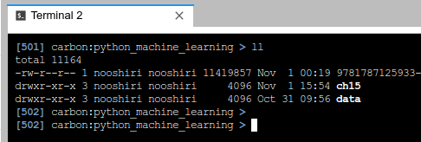









Our current approach
Publication
Packages
Tools & Workflows
DMP
ES-DOC¹
Codes
Data Management
Containers
Training
¹Earth System Documentation (ES-DOC)

Slide 4
Adopted strategy and technical challenges
Development of «individual» services rather than coordinated deployment
«Nomad» computing
Difficulty to get the needed «colocated» computing AND storage allocations
Lot of time wasted moving data (especially when collaborating) or waiting for available compute resources
Increasing user expectations for tools to visualize complex climate data
Our community is impatient and it is now becoming critical to capitalize our efforts towards the deployment of effective services

Slide 5
What do we expect from EOSC-Nordic?
Facilitate the sharing of data and compute across Nordic countries
Identify gaps for uptake of FAIR data practices across the climate community in the Nordic countries
Get the best all-in-one computer and storage solutions
Take over security, authentication and other administrative tasks
Support the deployment of ESM tools & workflows on EOSC for running ESM models, processing and visualizing model outputs
Get feedback on our current approach to adapt our practices
Get us out of «nomad» computing so that we can focus on Science

