Slide 1
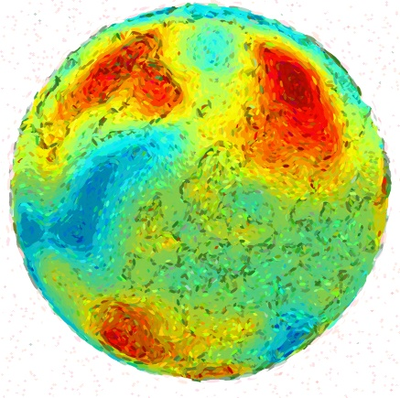
Repurposing Climate Data
Anne Fouilloux¹
Bérénice Batut², Björn Grüning², Jean Iaquinta¹, Yvan Le Bras³ and @galaxyproject
¹ University of Oslo, Norway
² University of Freiburg, Germany
³ Natural History Museum, France
Image generated with https://github.com/matteo-ronchetti/Pointillism

Slide 2
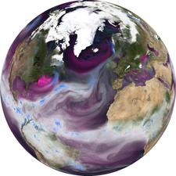
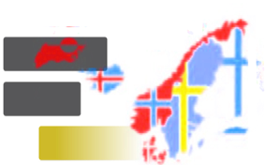


INES - Infrastructure for Norwegian Earth System modelling
(NRC grant 270061)
https://nordicesmhub.github.io/
Nordic Infrastructure Collaboration on Earth System Tools (NICEST)
Mozilla Open Leaders Program

Slide 3
Overview
Why and what for?
What have we done so far to make climate data and models more reusable?
What have we learned?
What is the way forward?

Slide 4
What for?
There is a wealth of data¹ and information available about the past, current and future climate.
Is this information easily accessible, discoverable or reusable?
Which information is authoritative and trustworthy and which information to use when and how?
What about local and regional impacts of global change?
Should we better support education and innovation?
¹ Climate models, model outputs, diagnostic tools, etc.

Slide 5
One constraint
Be inclusive
Cover needs from students, researchers, decision makers, businesses, media, artists, citizen, etc.
Cater for cross-disciplinary aspects
Cater for different expectations and different level of expertise in climate Science, data & visualization analysis, programming, etc.

Slide 6

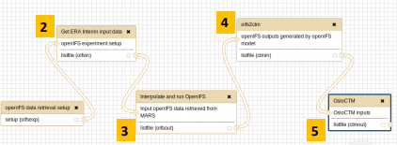
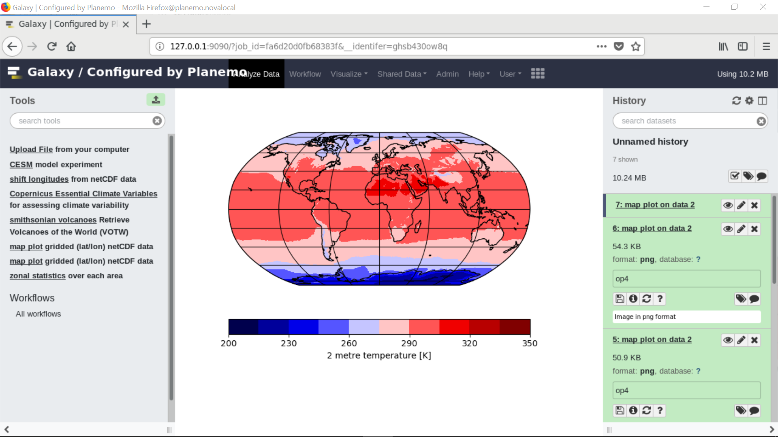

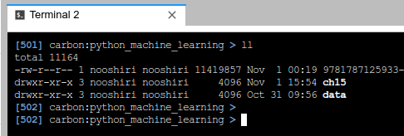
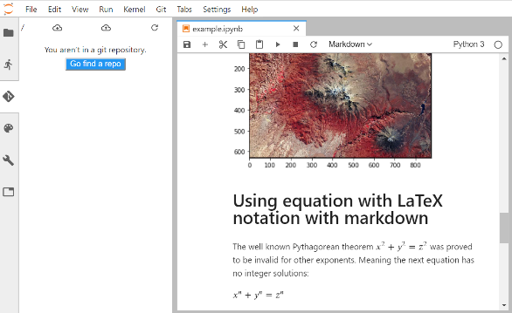

Our approach: the front end
web portal
Galaxy workflows
Galaxy Command Line Interface
Jupyter ecosystem

Slide 7














Our approach: behind the scene
Create containers for tools
Manage source codes
Compute & Storage
Share and publish tools & workflows
Manage packages

Slide 8






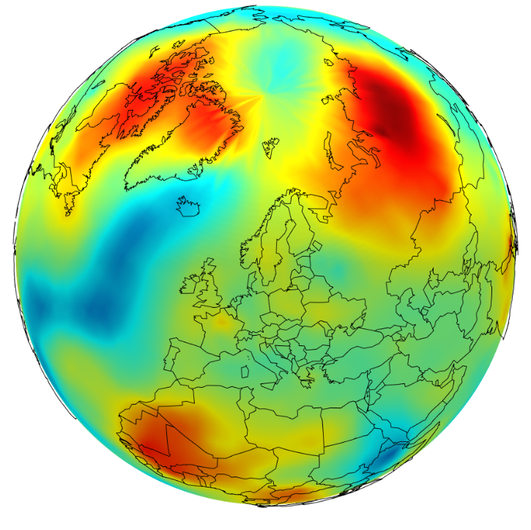












Example: climate and economic models
PhD Research Fellow working on climate modelling and economic impacts of climate change
Running
DIAM
Running NorESM¹/CESM² on HPC
¹ Norwegian Earth System Model
² UCAR/NCAR Community Earth System Model

Slide 9

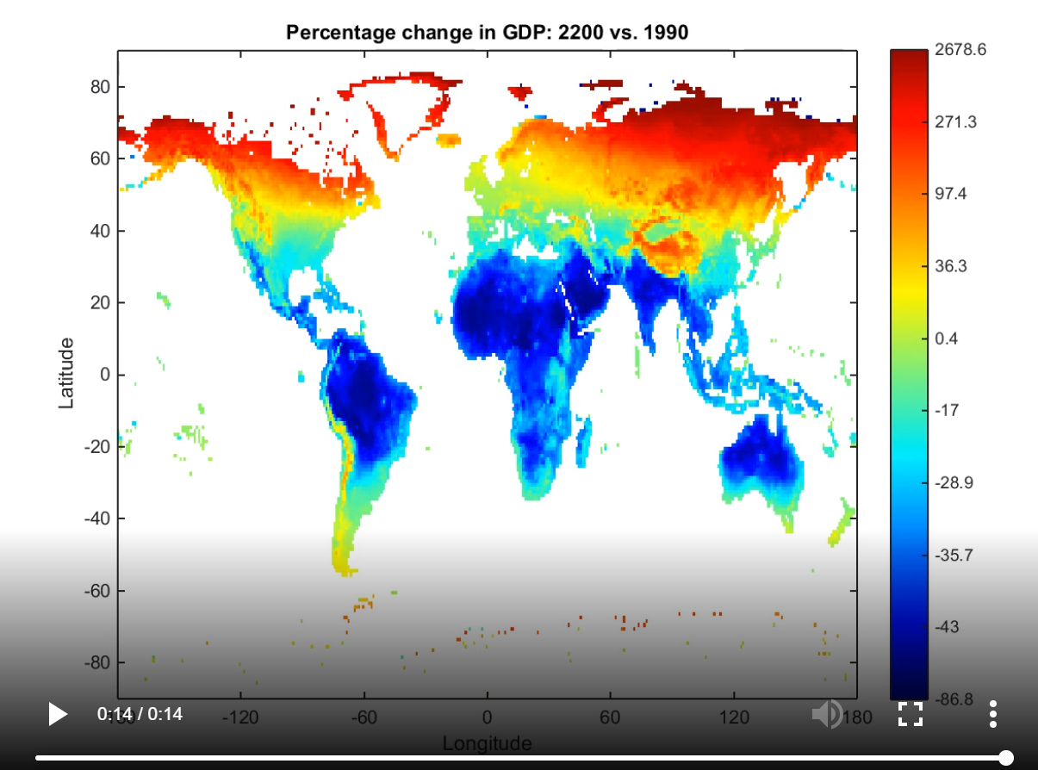
Example: NorESM/CESM & DIAM in Galaxy
A one-time effort
NorESM
DIAM
NorESM/CESM & DIAM package and containers for all

Slide 10
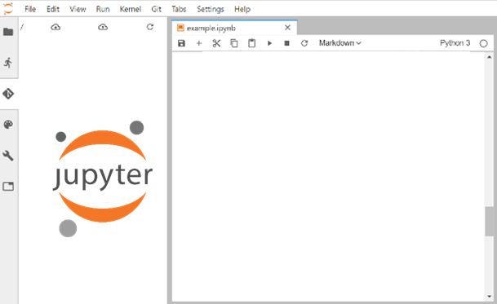
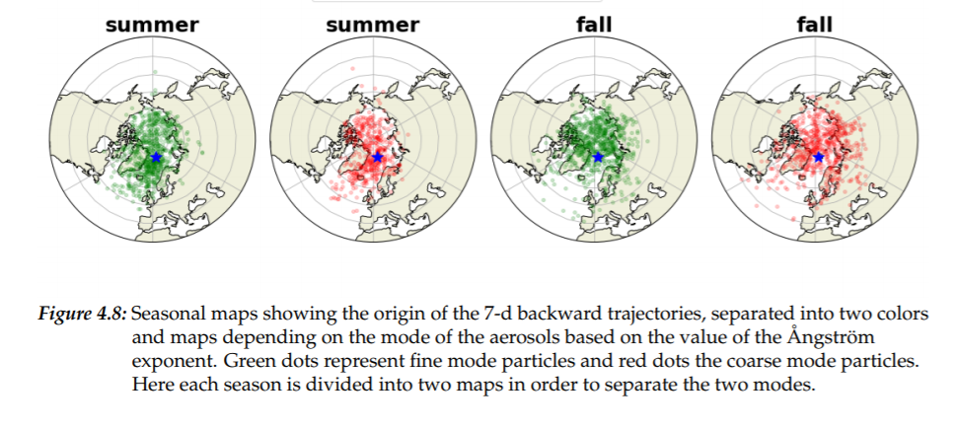
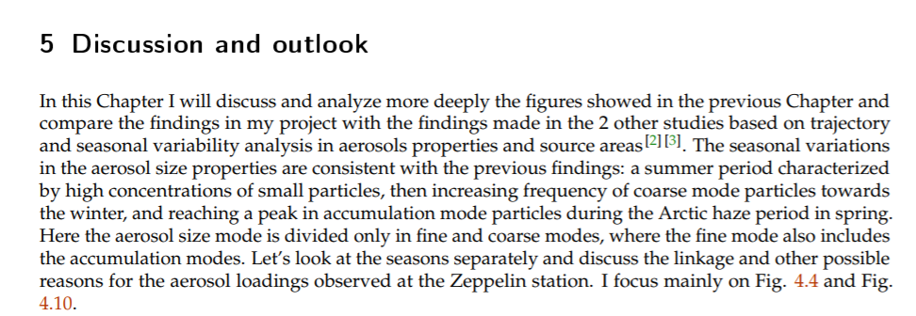




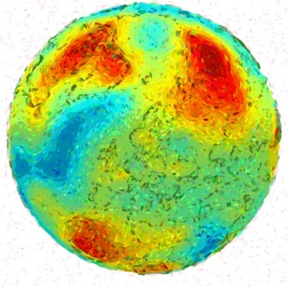

Example: Coupling climate and economic models
Research Object
workflow

Slide 11

Lessons learnt
First, be patient…

Slide 12





Second, training is paramount

Slide 13
What’s next?
EOSC-Nordic project
Compute & Storage

