Slide 1

NICEST – Nordic Climate community in a Nutshell
A community focused on understanding, quantifying and reducing uncertainty in projected northern latitude climate change and in particular rapid Artic warming.
Two main Earth System Models (EC-EARTH and NorESM)
International participation to World Climate Research Programme Coupled Model Intercomparison Project Phase 6
Aware of the importance of sharing, comparing and analyzing the outcomes of global climate models
Earth System Grid Federation (ESGF) to handle large-scale data management for worldwide distribution
Conda package, docker/singularity containers for running complex workflow in a reproducible way
Nordic Infrastructure Collaboration on Earth System Tools (NICEST)

Slide 2






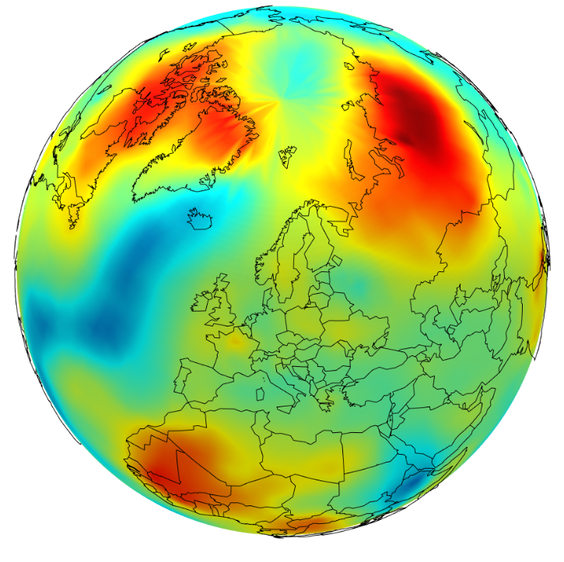








Our approach today
→ No «colocated» view of our computing AND storage allocations
→ Lot of time wasted moving data (especially when collaborating) or waiting for available compute resources
Various Computing resources
depending on the use case
Different
Storage solutions

Slide 3
Our needs
Support the deployment of ESM tools & workflows on EOSC for running ESM models, processing and visualizing model outputs
Facilitate the sharing of data and compute across Nordic countries
Identify gaps for uptake of FAIR data practices across the climate community in the Nordic countries
Orchestration of our workflows on available and best suited computing resources
Unified view of our data and workflows whatever the storage location
Take over security, authentication and other administrative tasks

